Slide 1


3D Integration activities at MPP
Update on the measurements of the FE-I3 modules interconnected with SLID
Anna Macchiolo
L. Andricek, H.G. Moser, R. Nisius, R.H. Richter, S. Terzo, P. Weigell
Max-Planck-Institut für Physik & MPI Semiconductor Laboratory, Munich
Anna Macchiolo
L. Andricek, M. Beimforde, H.G. Moser, R. Nisius, R.H. Richter, P. Weigell
Max-Planck-Institut für Physik & MPI Halbleiterlabor (HLL)
Munich
In collaboration with
© Fraunhofer EMFT / Bernd Mueller
In collaboration with
AIDA General Meeting 10 April 2013
Second TIPP Conference on ….

Slide 2


R&D towards a 3D integrated demonstrator module
R&D towards a fully 3D integrated demonstrator pixel assembly allowing for a minimized inactive area:
from the present ATLAS pixel module design ...
... to a 3D integrated assembly with thin sensors (75-150 μm range) interconnected with the Solid Liquid Interdiffusion technique, SLID, to thin chips (down to 60 μm thickness)
Inter Chip Vias (ICVs) etched in the read-out chip on the front-side on the positions of the original wire bonding pads to route signal and services to the ASIC backside
Production of active edge sensors to achieve a fully four-side buttable module, in collaboration with VTT (Finland)

Slide 3
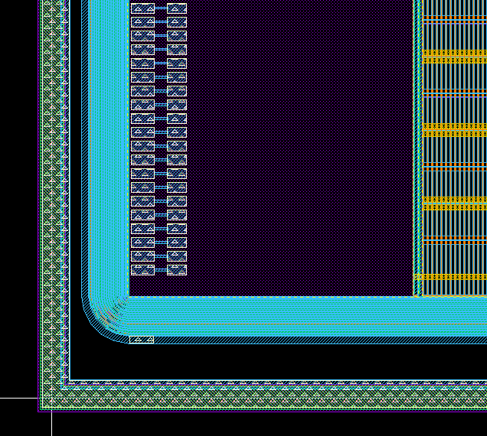
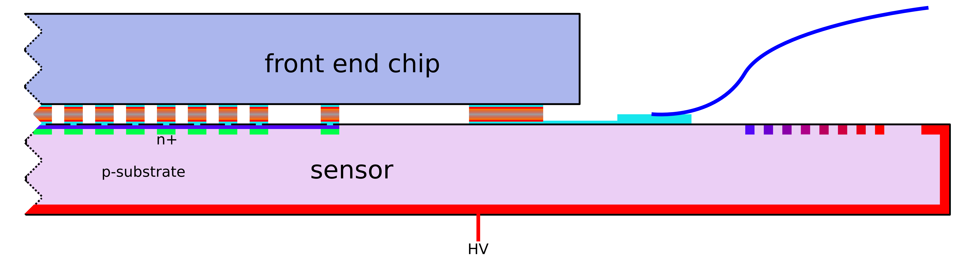
MPP 3D R&D Program: demonstrator module
Step I:
  ATLAS FE-I3 ASIC thinned to 200 µm
  n-in-p pixel sensors of 75 μm active thickness
  thin sensors / ASIC interconnection using SLID
  No ICV, integrated fan-out on sensor for service connection
Step II:
  ICV etched in the read-out chip on the front-side on every wire bonding pad to route signal and services to the ASIC backside
  ASIC thinned to 60 µm
  thin sensors /ASIC interconnection using SLID

Slide 4
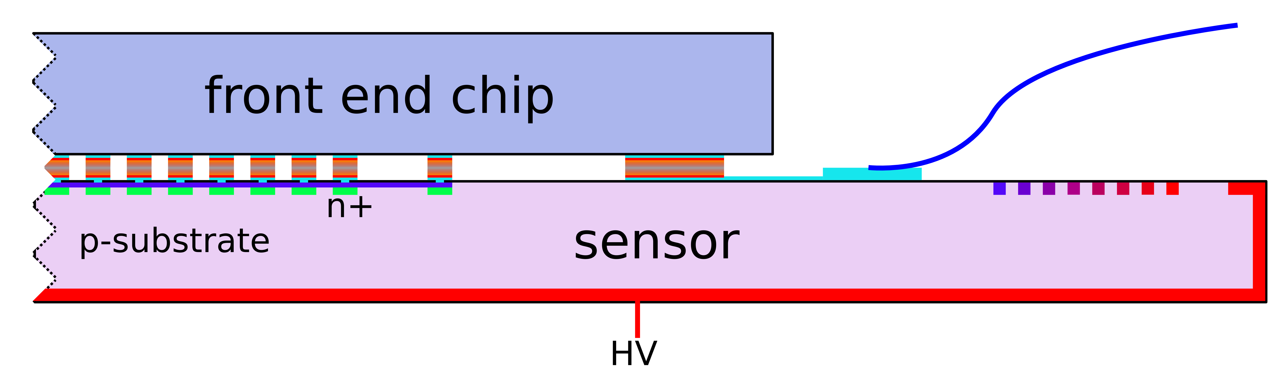
MPP 3D R&D Program: demonstrator module
Step I:
  ATLAS FE-I3 ASIC thinned to 200 µm
  n-in-p pixel sensors of 75 μm active thickness
  thin sensors / ASIC interconnection using SLID
  No ICV , integrated fan-out on sensor for service connection
Step II:
  ICV etched in the read-out chip on the front-side on every wire bonding pad to route signal and services to the ASIC backside
  ASIC thinned to 60 µm
  thin sensors /ASIC interconnection using SLID
ICV

Slide 5
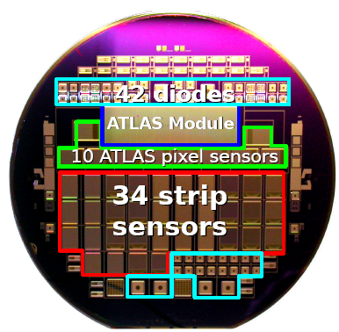
Thin pixel technology at MPP-HLL
75μm and 150μm active thickness
150μm active thickness
FE-I4 modules
n-in-p 6“ wafers with ATLAS FE-I3 compatible sensors
75 μm thick sensors interconnected with SLID to FE-I3 chips, thinned down to 200 μm, at EMFT
n-in-p 6“ wafers with ATLAS FE-I4 sensors (pitch 50 μm x250 μm)
IBL compatible GR → 450 μm dead edge
Interconnected to FE-I4 chips with bump-bonding at IZM

Slide 6
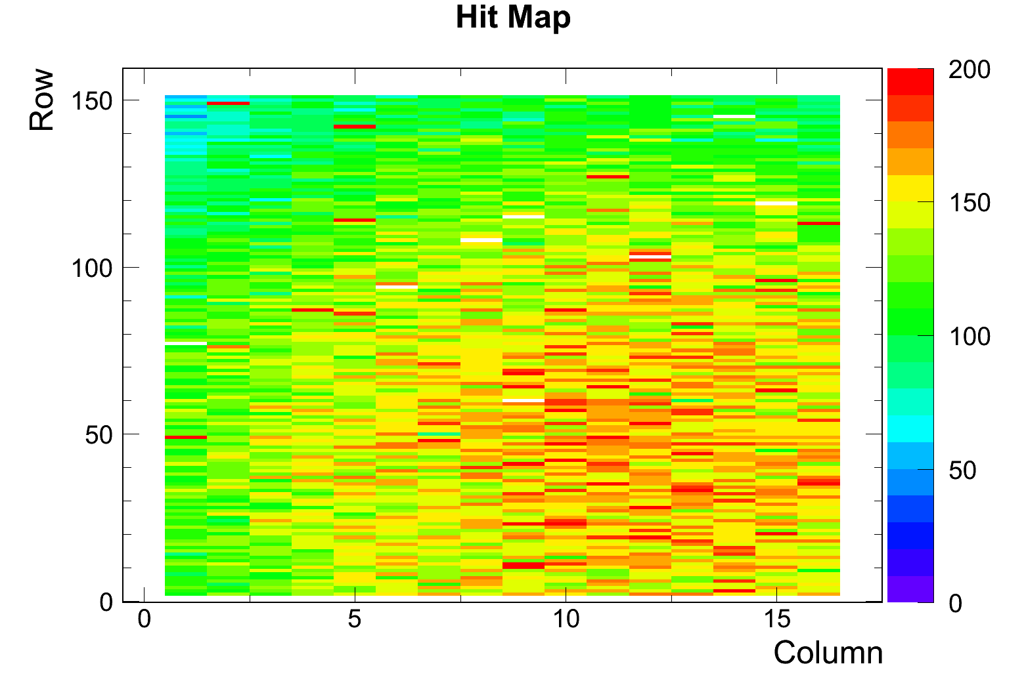
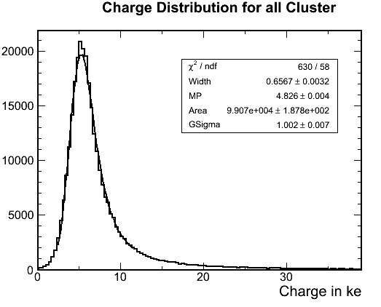
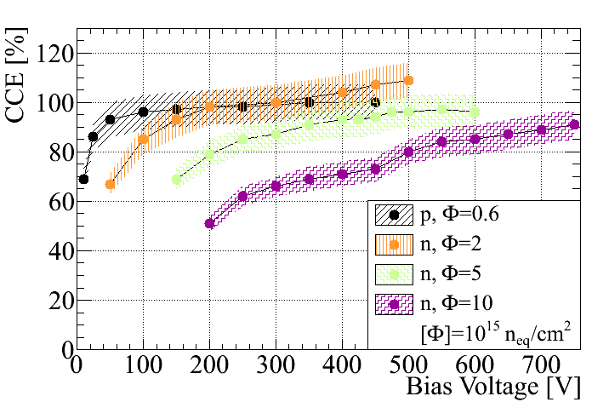
Post irradiation characterization of SLID FE-I3 modules
Good Charge Collection efficiency after irradiation up to 10¹⁶ n_{eq}/cm²
Number of unconnected channels stable after irradiation and multiple thermal cycles ( +20ºC → -50ºC)
2x10¹⁵ n_{eq}/cm²
All channels connected
Φ=2x10¹⁵ n_{eq}/cm²
SLID interconnection is radiation hard and withstands thermal cycling
5x10¹⁵ n_{eq}/cm²
MPV = 4.8 ke
V_{bias}=600V

Slide 7
Comparison of CC for n-in-p pixels of different thickness
Φ= 2 x10¹⁵ n_{eq} cm⁻²
Φ=(4-5) x10¹⁵ n_{eq} cm⁻²
Φ= 10¹⁶ n_{eq} cm⁻²
Higher charge with 150 μm thick sensors up to a fluence of Φ=(4-5)x10¹⁵ n_{eq} cm⁻² → next run of interconnection to FE-I3 chips with ICVs will be performed with wafer of 150 μm active thickness
At higher fluences the charge of thin and thicker sensors tends to equalize
150 μm data still missing

Slide 8
Inter Chip Vias on FE-I3 chips
ICV etched in the read-out chip on the front-side on every wire bonding pad of the FE-I3 chip to route signal and services to the ASIC backside
  ASIC thinned to 60 µm
  thin sensors /ASIC interconnection using SLID
Processing sequence:
Via- and trench etching in Bosch-process, TSV cross-section of 3x10 μm²
insulation with TEOS (low T)
filling of vias with Tungsten
attachment to handle-wafer on the top side and thinning to desired thickness of chip ~ 60 μm
redistribution layer on the backside
SLID-interconnection to sensor wafer.

Slide 9
Design concept of ICVs on the backside
Process steps:
Backside
Front-side

Slide 10
Design concept of ICVs on the backside
Process steps:
Thin with CMP until the opening of the trenches
Backside
Front-side

Slide 11
Design concept of ICVs on the backside
Process steps:
Thin with CMP until the opening of the trenches
Etch silicon down to the oxide of the ICV
Backside
Front-side

Slide 12
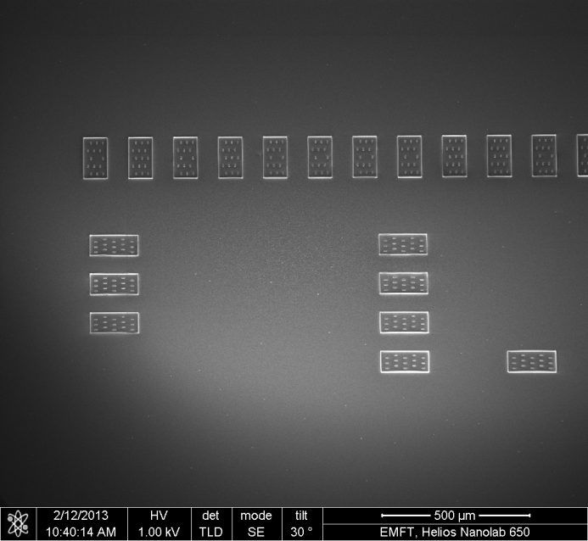
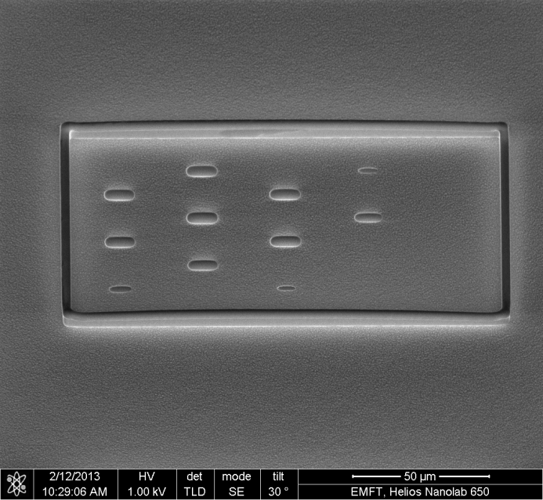
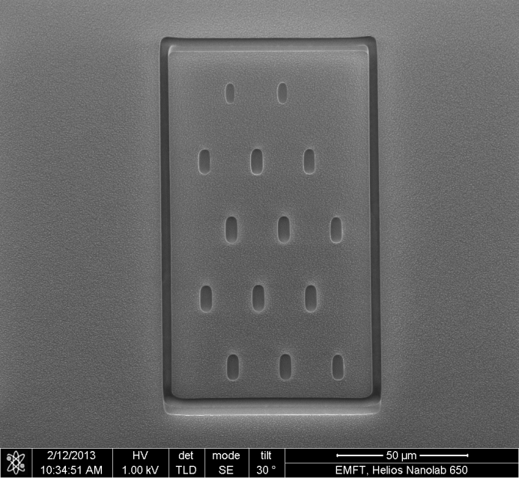
Status of ICVs on the backside
TSV preparation from back side
  High selectivity of silicon etch doesn’t touch isolation oxide of TSV
TSV preparation from back side shows different etch depths between TSVs and trench (due to bowed shape of trench). This results in specific topology:
Trench height is about 3 µm higher (deeper) than TSV height (TSV height: < 1.0 µm)
19.02.2013

Slide 13
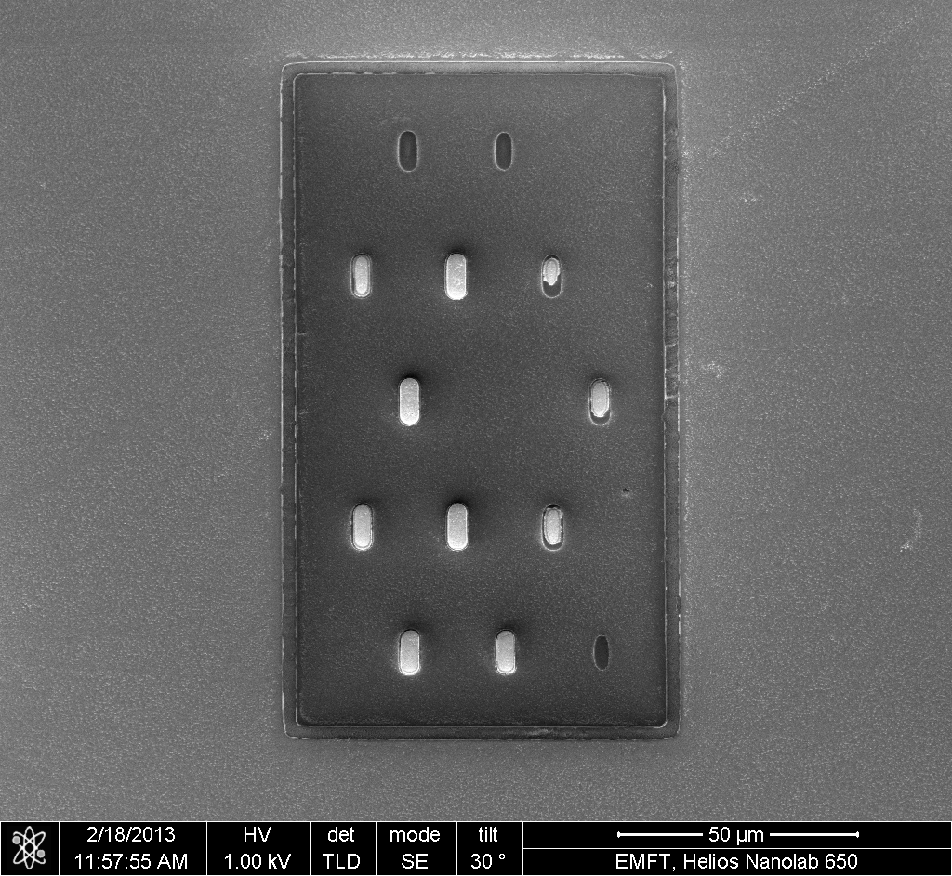
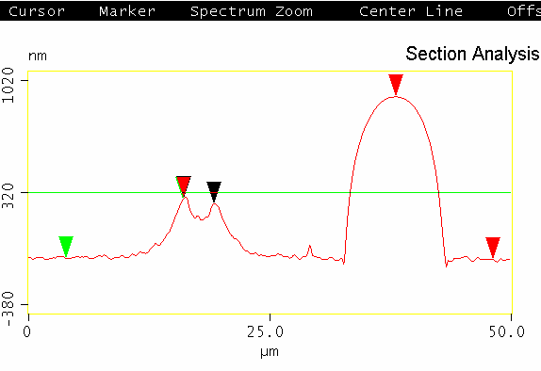
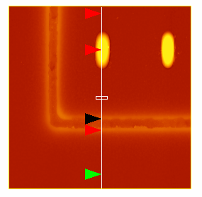
Status of ICVs on the backside
TSV preparation from back side
  → Additional CMP process necessary to cut down isolation trench
TSV preparation results in specific topology due to CMP selectivity:
trench height: 375 nm
TSV height: < 1.0 µm

Slide 14
Design concept of ICVs on the backside
Process steps:
Thin with CMP until the opening of the trenches
Etch silicon down to the oxide of the ICV
Additional layer of isolation oxide including opening within trenches
Backside
Front-side

Slide 15
Design concept of ICVs on the backside
Process steps:
Thin with CMP until the opening of the trenches
Etch silicon down to the oxide of the ICV
Additional layer of isolation oxide including opening within trenches
Access to metallic core of TSV by dry etching (if not already done by the dry etch of oxide before)
Metallization including lithography, aluminium etch and resist strip
Backside
Front-side
Steps 3-5 have still to be achieved

Slide 16
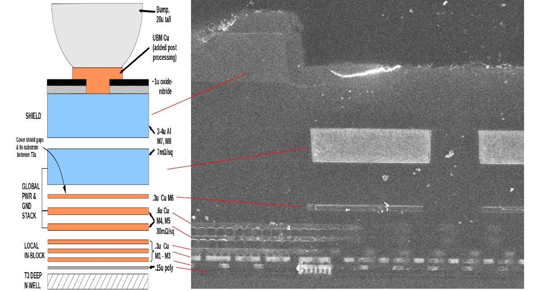
ICVs on the FE-I4 chip
Metal stack on the FE-I4 wire bonding pad
M1 has to be contacted through the ICV from the backside
  Difficult to apply the ICV process developed for the FE-I3 chip : in the FE-I4 chip a stack of different metal layers and filling structures for many metal layers are present all over the wire bonding pads
  EMFT is setting up a process to etch ICVs from the back-side, still with a reduced cross-section, around 10x30 μm². The total FE-I4 wafer thickness will be below 150 μm. An aggressive thinning will be performed only locally, below the wire bonding pad.

Slide 17
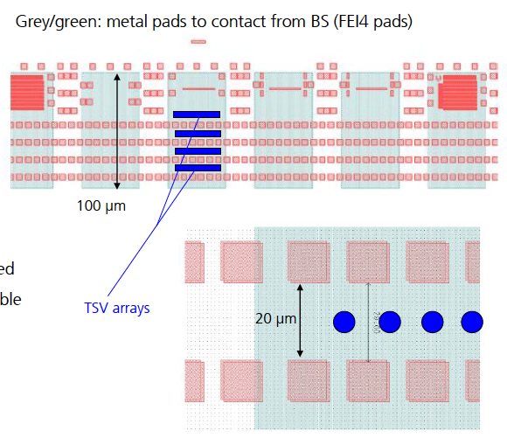
ICVs on the FE-I4 chip
Polysilicon layer
TSV have to be placed between the opening of the poly-silicon layer
Most difficoult step is the etching of the silicon oxide beneath M1 through the ICV

Slide 18
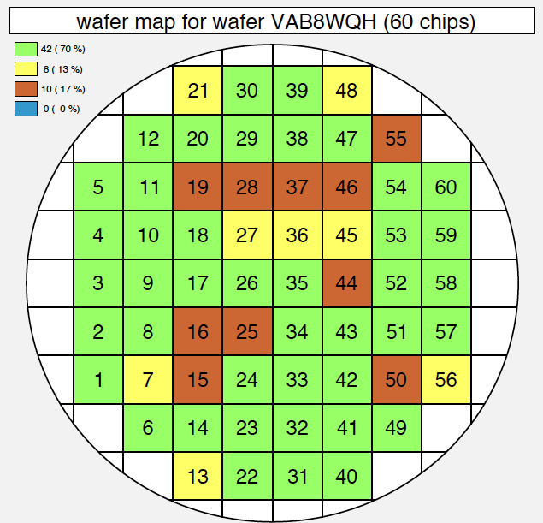
FE-I4 chip wafer availability
4 FE-I4B wafers ordered by MPP within the common IBL-ATLAS R&D order
  2 or 3 reserved for TSV trials at EMFT, shipment has already started after testing

Slide 19
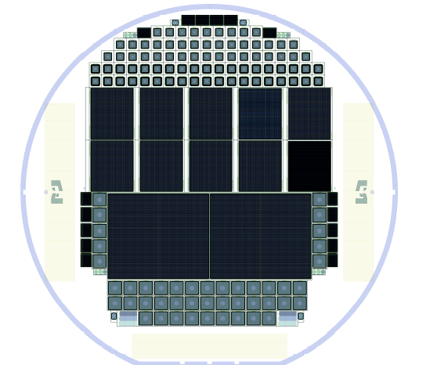
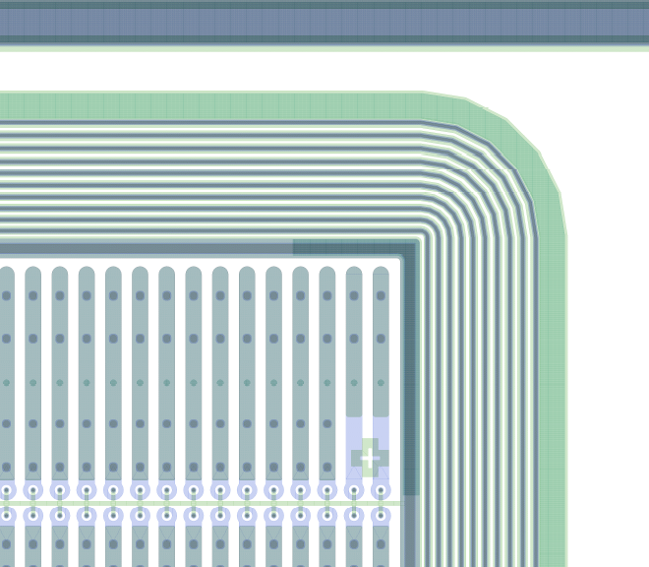
Sensors for FE-I4 modules with SLID and ICVs
  SLID interconnection of FE-I4 chips with n-in-p pixel sensors with standard thickness and reduced inactive edges (~450 μm)
450 μm
  Successive run to interconnect FE-I4 chips with ICV using SLID to active edge n-in-p sensors produced at ADVACAM (spin-off company of VTT)

Slide 20
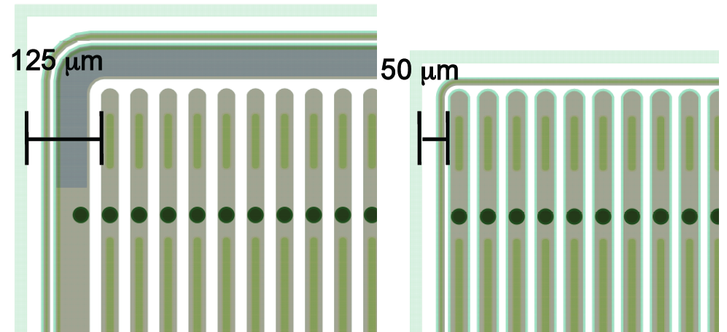
Active edges with planar n-in-p sensors
Active edge sensors produced at VTT and connected with bump-bonding to FE-I3 and FE-I4 chips
FE-I3
50 μm edge
V_{bias}=15 V
Measurements with radioactive sources: edge pixels show the same charge collection properties as the central ones

Slide 21
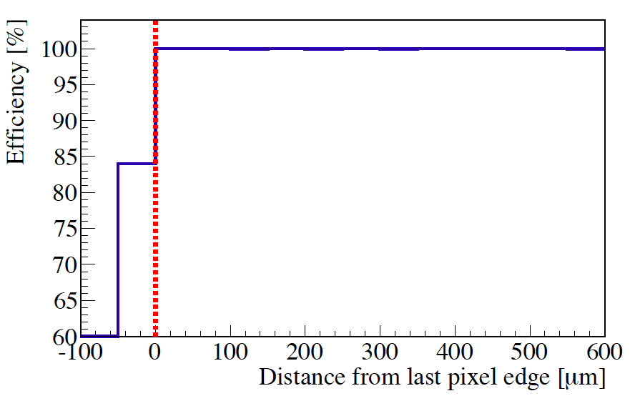
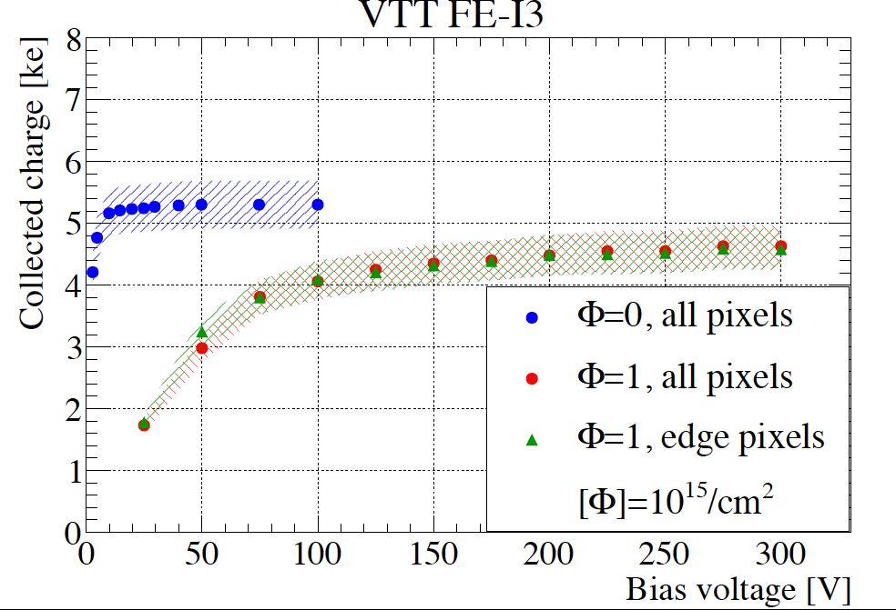
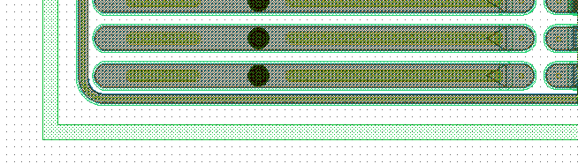
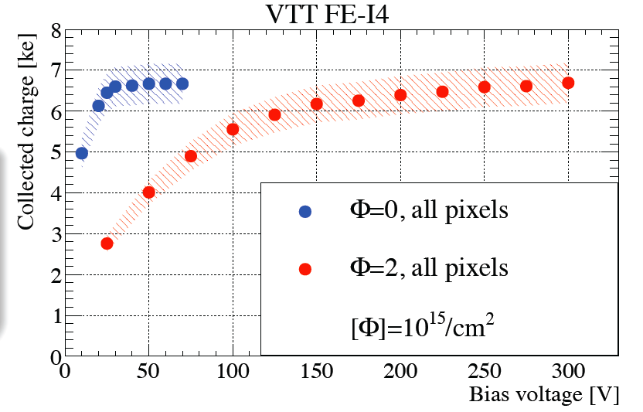
Active edges with planar n-in-p sensors
Edge Tracking Efficiency in Beam Tests
Charge Collection Efficiency after irradiation
Φ=1 e15
99-100% hit efficiency on the area of the pixel implant of the edge column
Φ=2 e15
84% efficiency in the last 50 μm of the sensor edge, beyond last pixel implant

Slide 22
Conclusions and Outlook
Development of hybrid pixel modules with reduced inactive edge is carried out in collaboration between MPI für Physik and Fraunhofer EMFT
SLID interconnected FE-I3 modules have been characterized before and after irradiation: good mechanical strength and radiation hardness of the SLID interconnection
Thin sensors have shown good charge collection properties after heavy level of radiation
ICVs on FE-I3 chips with very narrow cross-section and high aspect ratio are almost completed
Next step: develop ICVs for the FE-I4 chip etching from the back-side → process under development
Plan to interconnect FE-I4 with ICVs to active edge sensors as demonstrator towards a four-side buttable module

Slide 23
Back-up slides

Slide 24
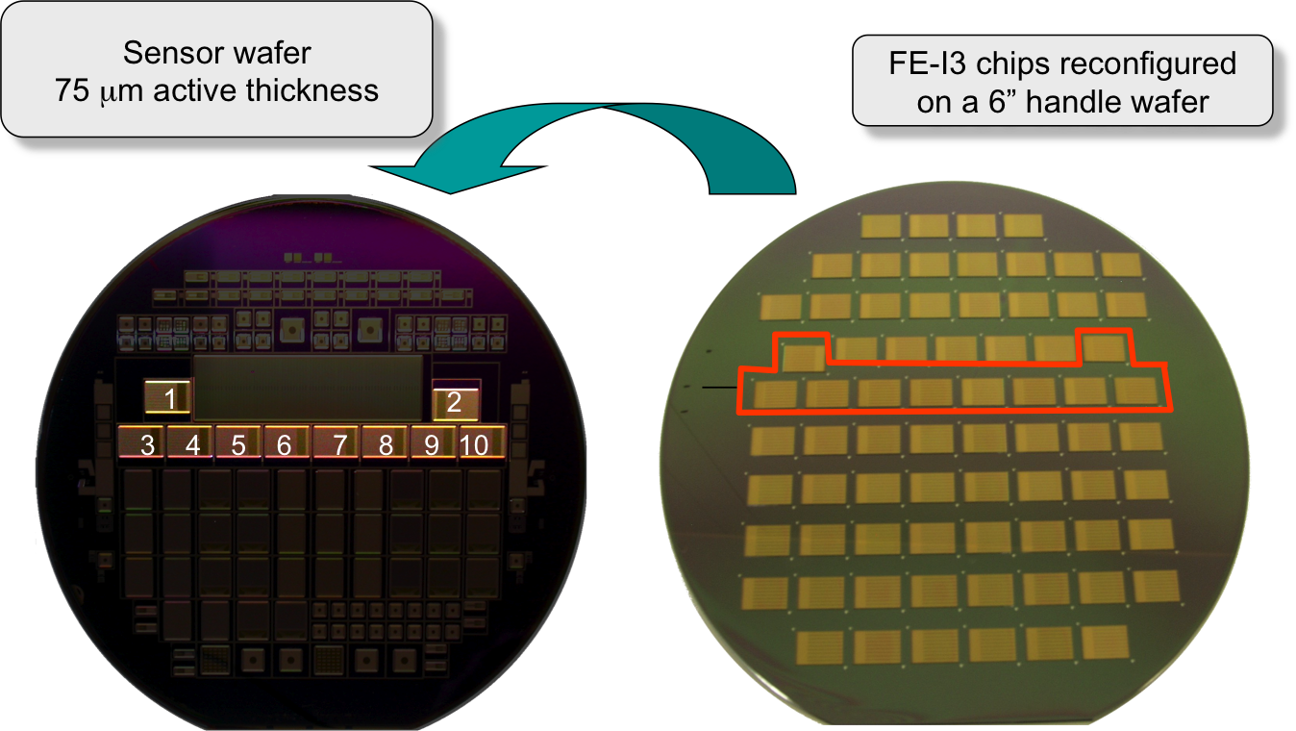
Chip to wafer SLID interconnection (with handle wafer)
For R&D purposes difficult to have same pattern on sensor and chip wafers → a chip to wafer approach is needed. Problems encountered due to the misalignment of chips in the handle wafer with respect to the nominal positions.
Change of pick and place machine (switching to Panasonic FCB3 ) should improve this step for the next interconnection runs

Slide 25
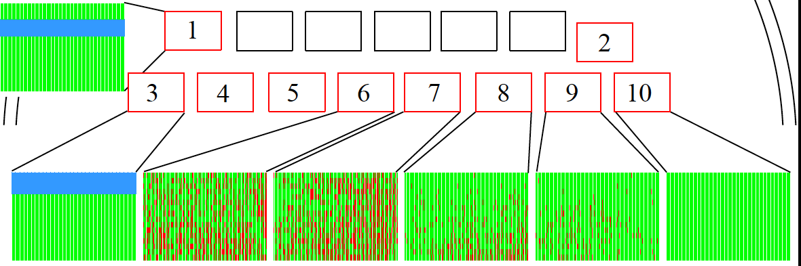
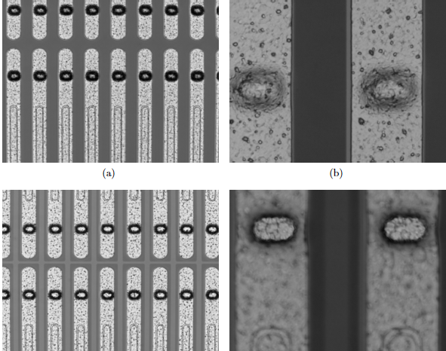
SLID Interconnection efficiency
connected
not connected
Electrically not functional
Low interconnection efficiency at the center of the wafer → not due to the SLID technology but to the missing opening in the BCB passivation layer used to isolate and planarize the surface of the sensor wafer
Solvable by descum process with SF₆ of the remaining wafers for next interconnection runs with ICVs
Insufficiently opened passivation layer
perfectly opened passivation layer

Slide 26
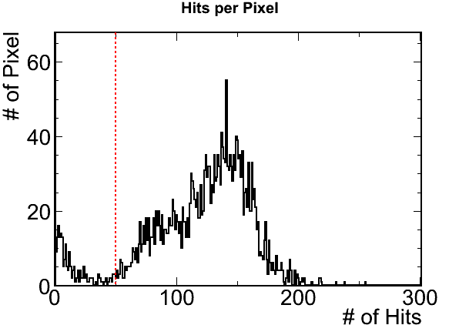
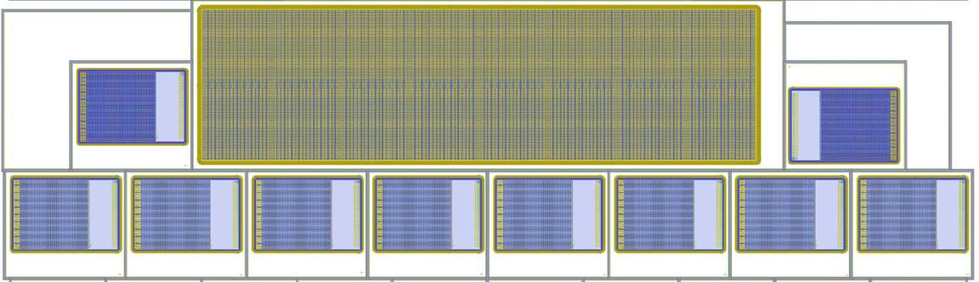

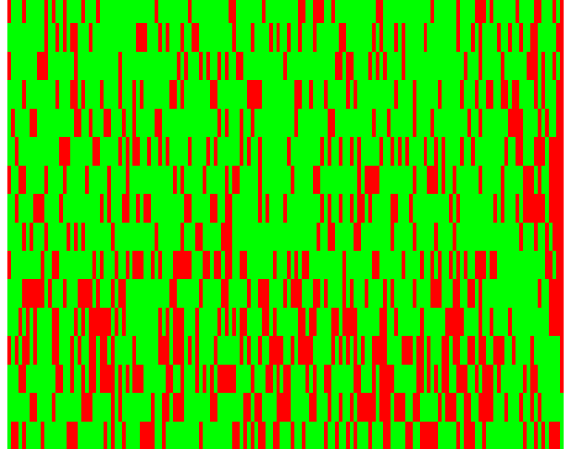
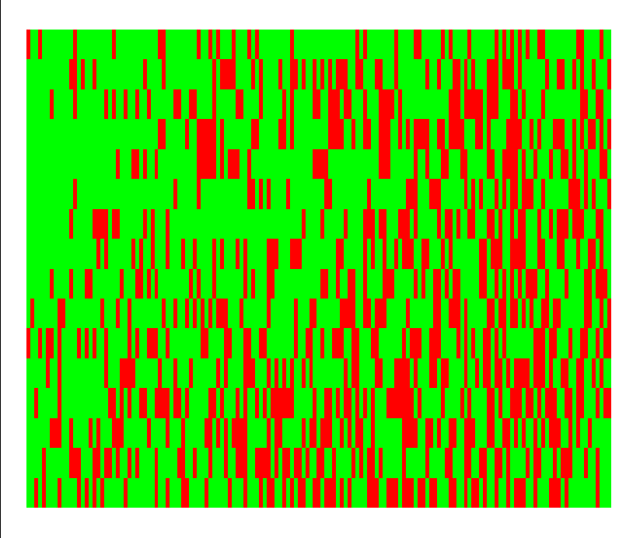
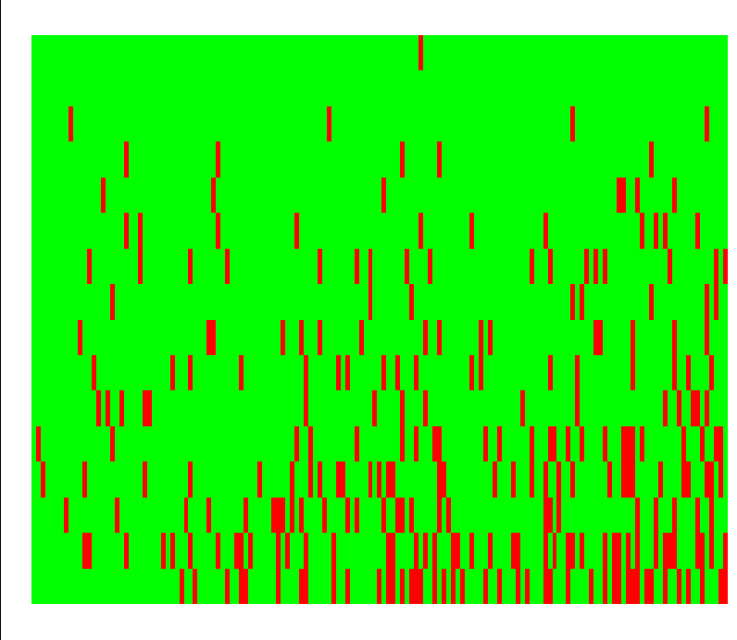
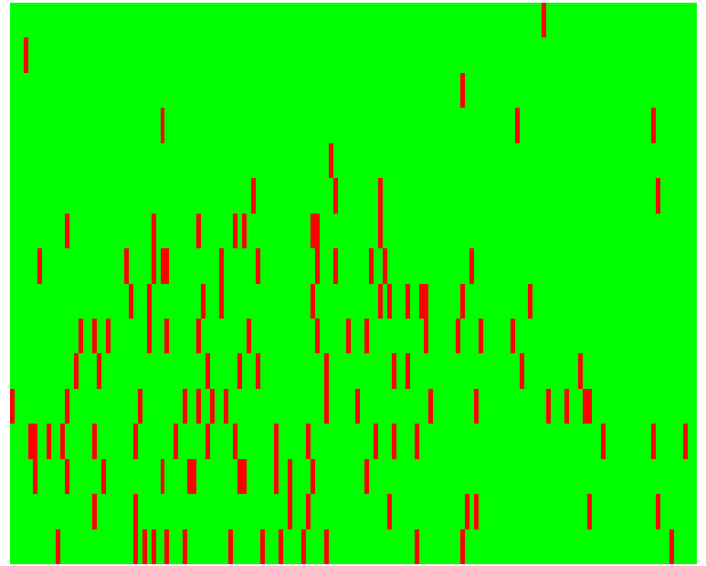
Overview of SLID interconnection efficiency
Chip | Unconn. Pixels | Efficiency [%]
3 | 0 | 100
6 | 731 | 70
7 | 713 | 71
8 | 274 | 89
9 | 134 | 94
10 | 0 | 100
⁹⁰Sr scan
Unconnected
03
06
07
08
09
10
Connected channel
Dead columns
A. Macchiolo et al, “SLID-ICV Vertical Integration Technology for the ATLAS Pixel Upgrades”, arXiv:1202.6497
Unconnected channel

Slide 27
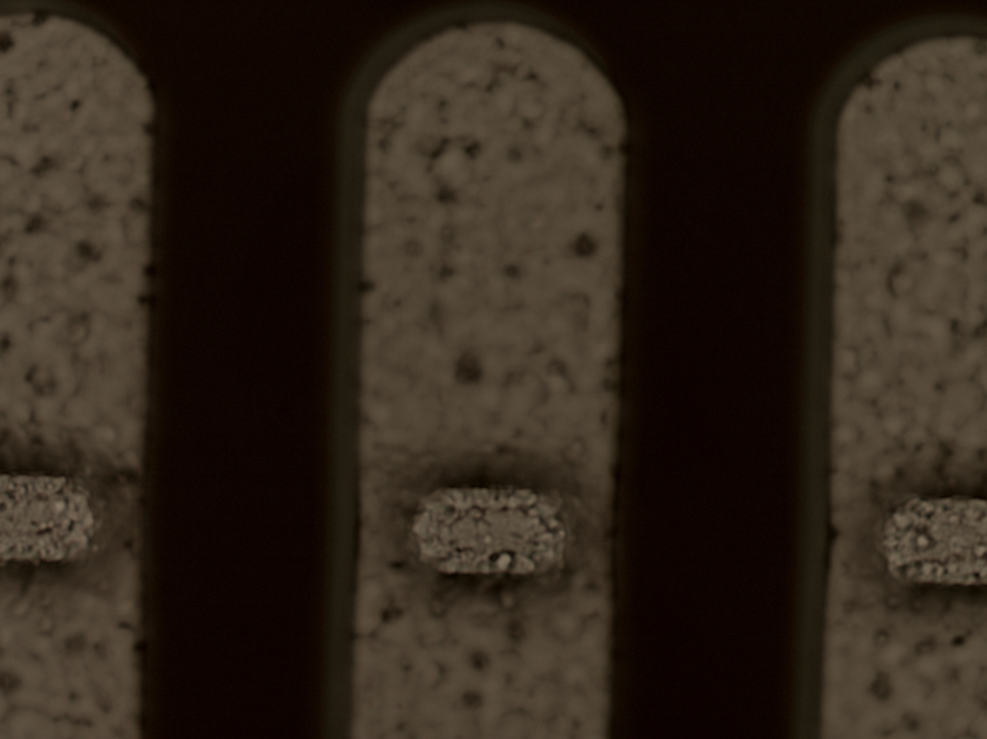
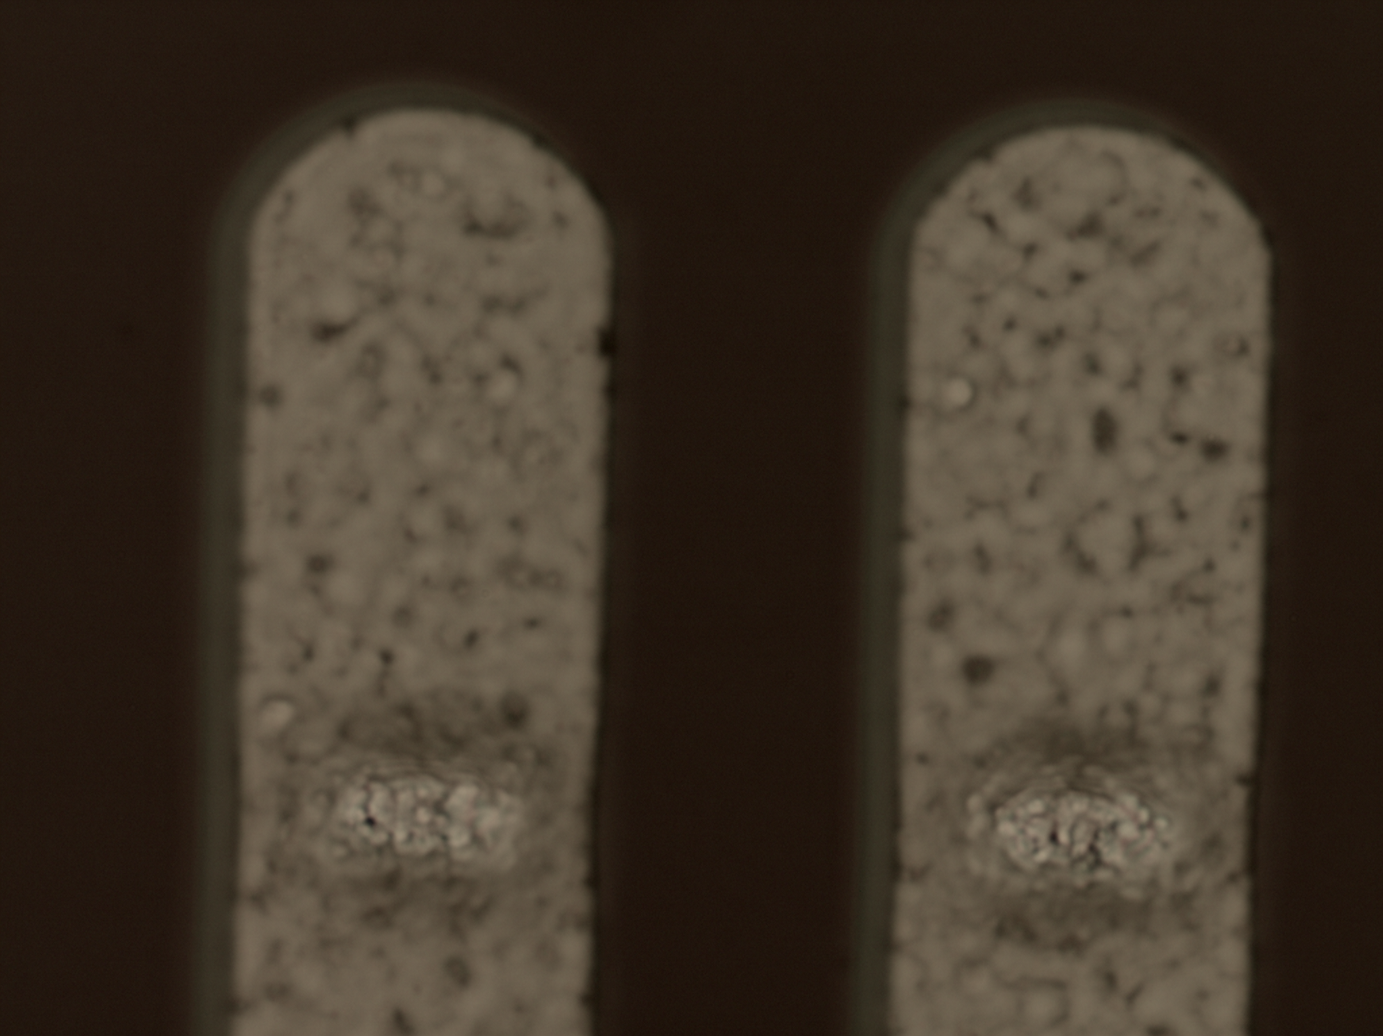
Problem with contact opening in BCB passivation
SLID 10
Good opening in BCB
SLID 6
Bad opening in BCB
BCB (BenzoCycloButhene) passivation deposited to planarize the sensor surface before Cu and Sn electroplating
Unconnected channels are not an intrinsic SLID problem!
Problem cured for the remaining wafers with a descum process of BCB using a SF₆ plasma at IZM
Badly defined BCB contact openings observed in 2 sensor wafers not yet electroplated → pattern fully compatible with the distribution of unconnected channels in the modules

Slide 28
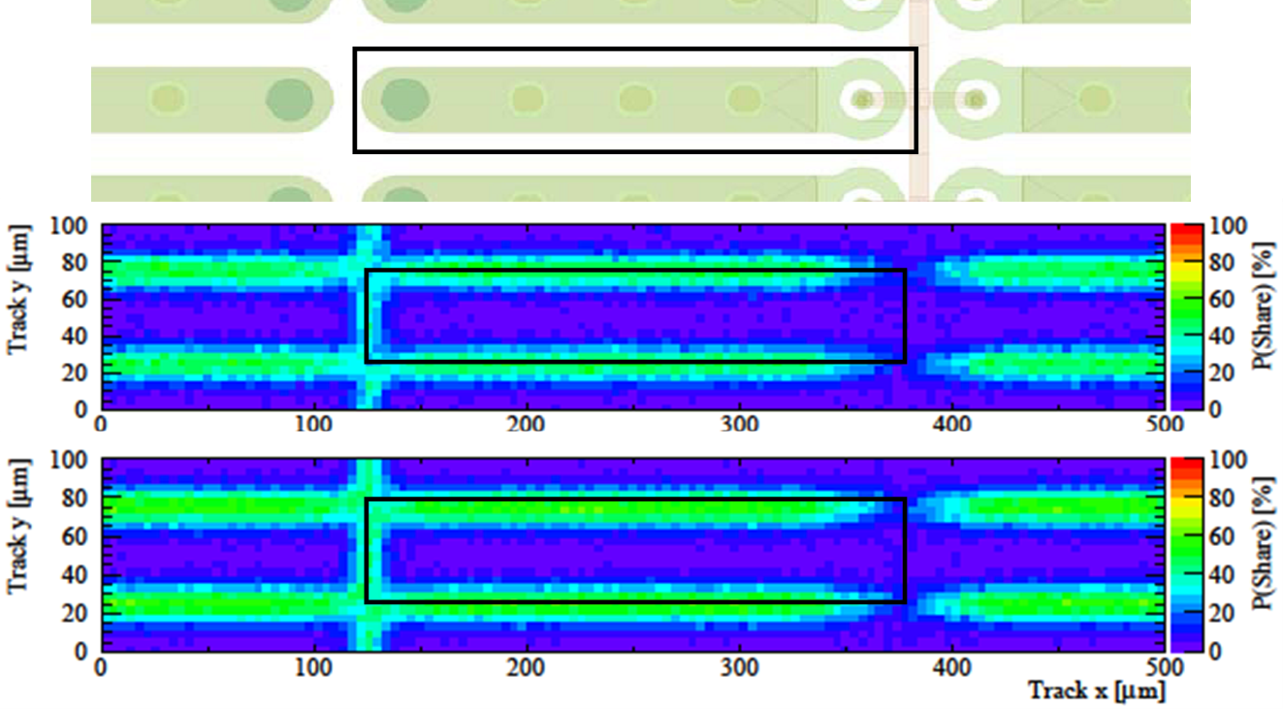
FE-I4 module charge-sharing
Φ=4x10¹⁵ n_{eq} cm⁻²
perpendicular tracks
400V
500V
Cluster size | Fraction @ 400V [%] | Fraction @ 500V [%]
1-hit | 81 | 78.6
2-hit | 16 | 19.7
3-hit | 1.1 | 1.1
average cluster size
1.17 hits @ 400V
1.2 hits @ 500V

Slide 29
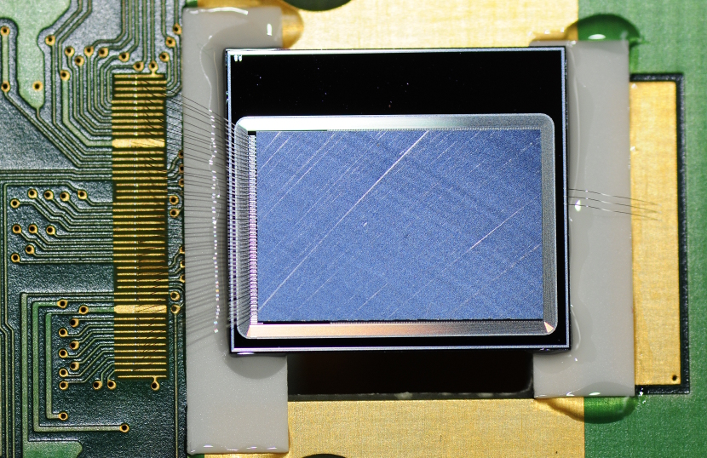
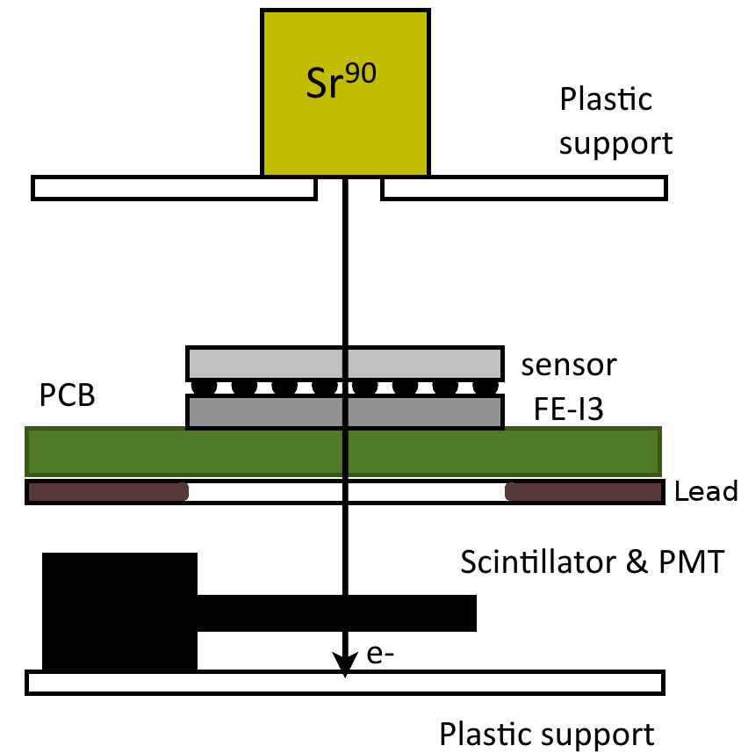
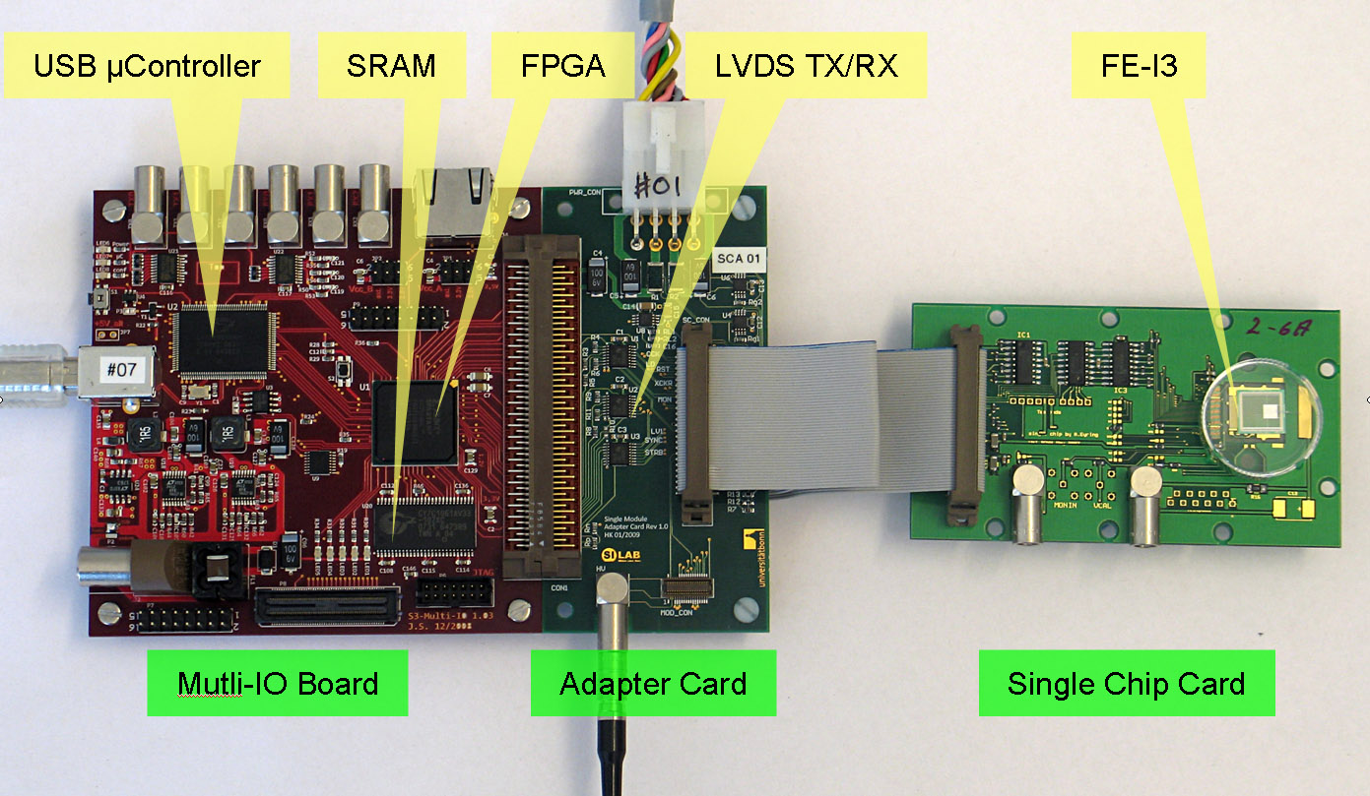
Set-up for the pixel module characterization
Pixel modules glued and wire-bonded to a detector board designed by the University of Bonn in two versions for FE-I3 and FE-I4
Measurements performed with the ATLAS USBPix read-out system

Slide 30
Process steps development
TSV preparation from back side
  Additional CMP process necessary to cut down isolation trench
TSV preparation results in specific topology due to CMP selectivity:
trench height: 375 nm
TSV height: < 1.0 µm
19.02.2013

Slide 31
Through Silicon Vias processing
SACVD Pad Planarization, TSV Litho, Etching with Bosch process, cross section ~4x10 μm^{2,} depth=60 μm
TSV Isolation with SACVD SiO₂ ~ 300 nm
TSV Filling with TiN seed + CVD W
Electroplating of Cu on the front side
handling substrate
Bonding to handling substrate, thinning to 50 μm
handling substrate
handling substrate
Exposure of W in TSV and Alu spattering for creation of pads on the back-side

Slide 32
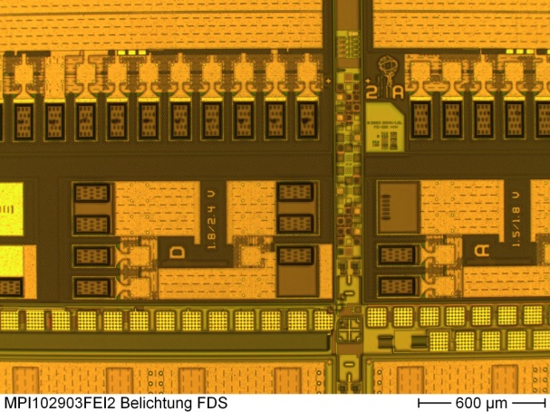
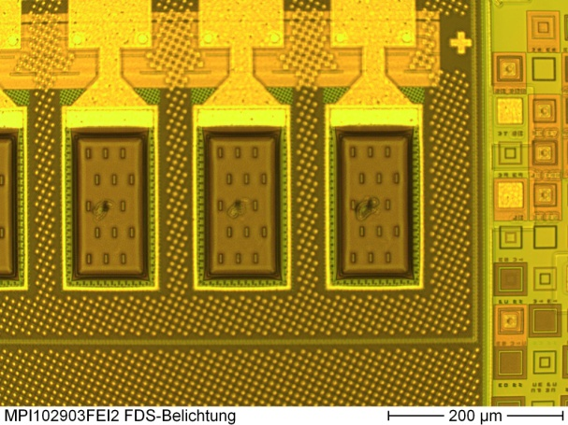
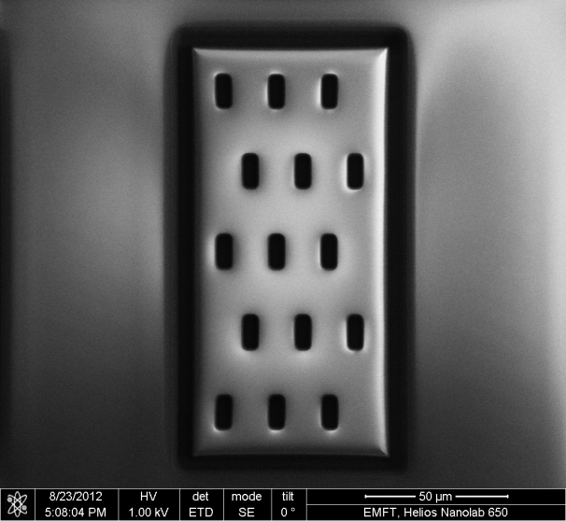
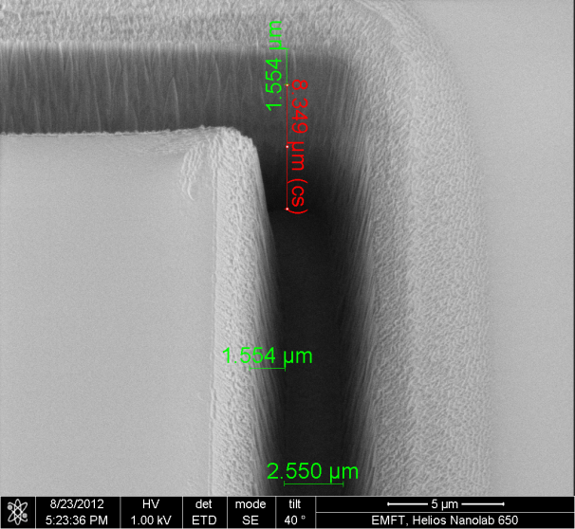
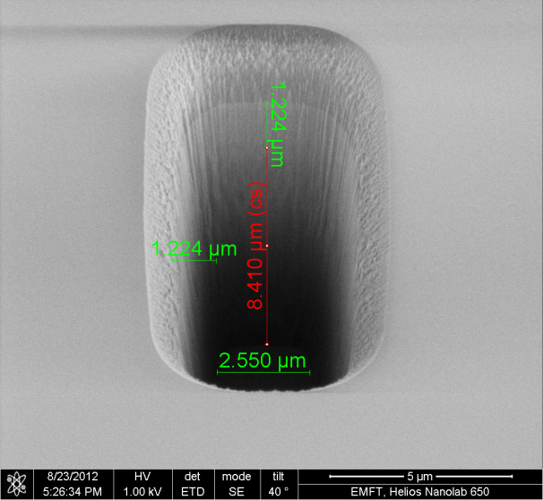
MPP 3D R&D Program: Through Silicon Vias
Processing status on the first hot wafer: etching of the dielectric layers accomplished
total view pad array & test field
total view pad array
total view pad
Very narrow TSV allows for their possible use to connect every single pixel
8.34 µm (resist on top)
8.4 µm (resist on top)

Slide 33
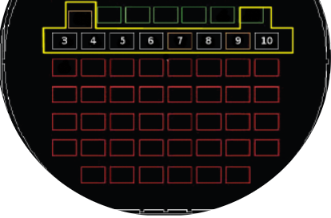
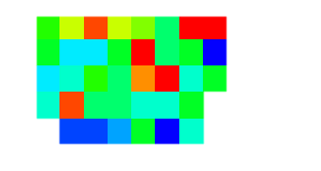
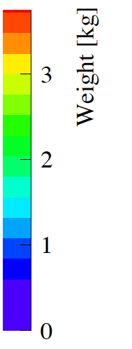
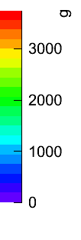
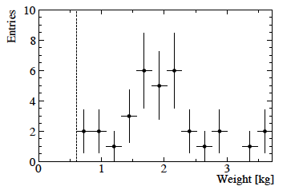
Connection strength – Pull out tests
Pull out test performed with “mechanical” chips placed below the hot chips
Connection strength of the order of 0.01N per pad → similar to bump-bonding and other pixel interconnection technology
y→
FE-I3 mechanical dummies used in the pull tests
X →

