Slide 1





CSIC WP9.4 Activities
Status report
AIDA 2nd Annual meeting WP9.4
Iván Vila Álvarez
Instituto de Física de Cantabria

Slide 2
Outline
Review of CSIC commitments
Smart mechanics
Microstrips sensors with resistive electrodes (charge division on microstrips)
Summary

Slide 3
Overall task´s deliverables
Baseline
Deliverable
Two orthogonal layers of u-strips
HPK SiLC sensors ?
AVP25 based hybrid
Provide precise entry point to calorimeter
Advanced Deliverable
Integration with CaloDAQ
Deliverable 2nd QT 2014
Ultra-light strip layer of thin sensors (230 um)
Conventional mechanics
Demonstrator of ILD silicon tracker
Integrated PA or 2D-Poly silicon or short strip sensors.
APV25 based hybrid
Light mechanics with embedded Fiber Optic Sensors
Integration with caloDAQ
Offline software
Offline Software
No deadline
ivan.vila@csic.es, AIDA 2nd Annual meeting

Slide 4
CSIC commitments for the BBL Deliverable
SMART CFRP supports: self-monitoring of deformations and temperature.
Implementation of the charge division method in microstrip sensors

Slide 5
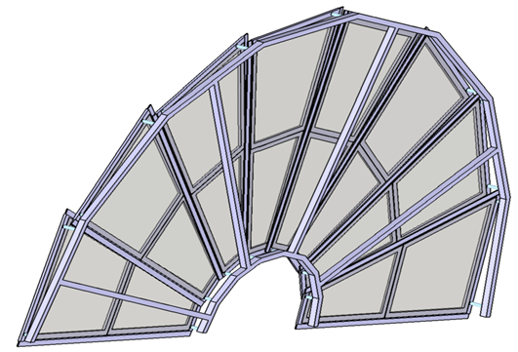
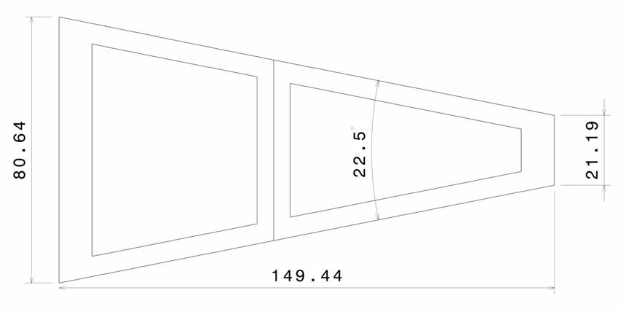
SMART Mechanics: Initial proposal
The aim is to manufacturea a few ILD FTD support petals, both for real sensor support and thermo- mechanical mock-up
Petals matching the geometry of the 3th FTD geometry has been chosen, being the biggest one
Equiped with CNM manufactured sensors (four inches Wafers) , the structure will be scaled 0.65 :1
Petals mechanical and thermal behavior will be tested
Embeding of FOS sensors for selfmonitoring.

Slide 6
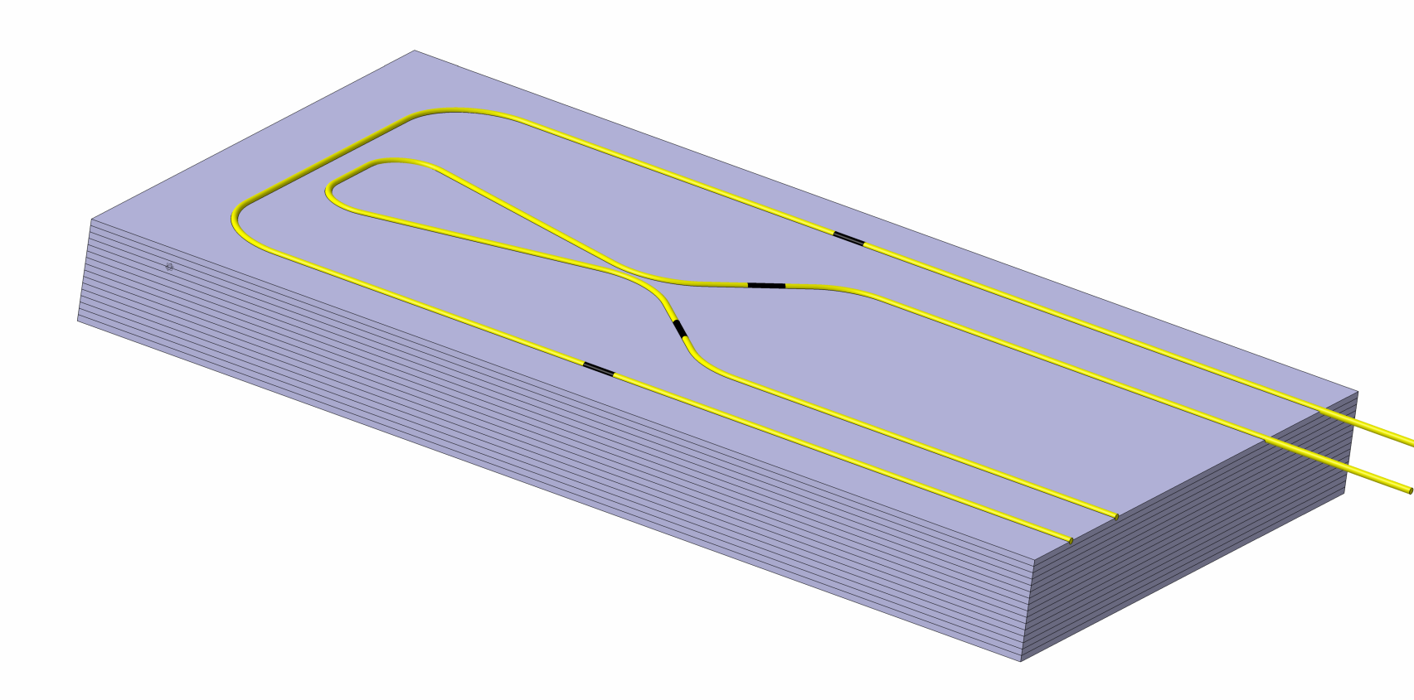
Demostrator plate demostrator @ DESY
,
The First step is to manufacture and test this self monitoring structures
This demonstrator is a CFRP plate with ten FBG sensors embedded at a define position, allowing us to measure deformations under Torsion and Flexion loads, and temperature
When a torsion or a flexion load is applied to the sheet, we know from simulations the expected measured value of each sensor.
Flexion sensors
Top layer
Torsion sensors
Botton layer

Slide 7
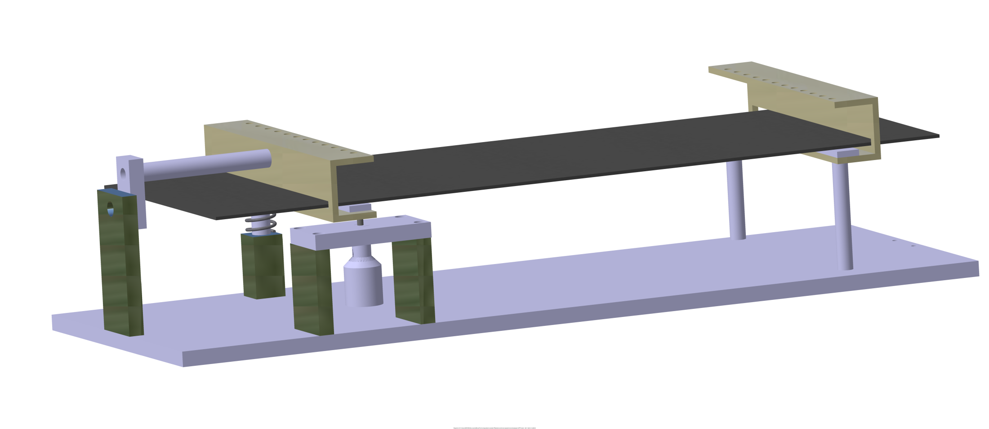
New approach for cross calibration
Next steps.
  Manufacture a first technological demonstrator .
  Design and manufacture torsion and flexion calibration systems
  Calibrate the technological demonstrator using profile meter (< 1 um accuracy) or/and 3D CMM ( < 10 μm accuracy).
Fixed Edge
Torsión apply edge
Demonstrator plate
Micrometric screw
spring

Slide 8
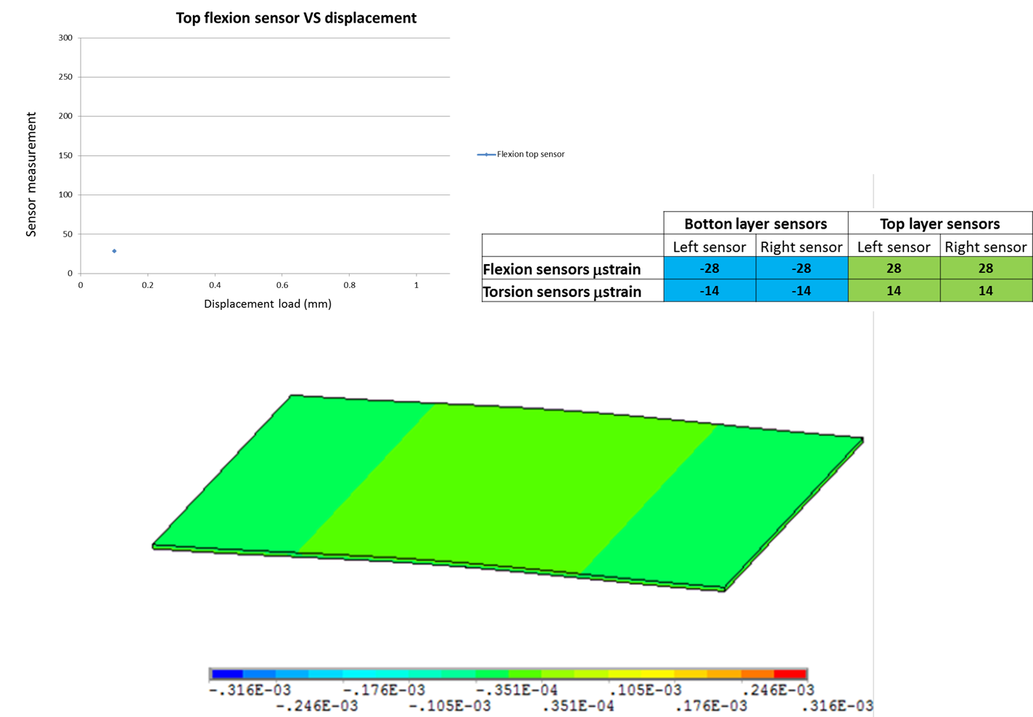
Demonstrator simulation under flexion loads
8

Slide 9

Demonstrator simulation under flexion loads
9

Slide 10
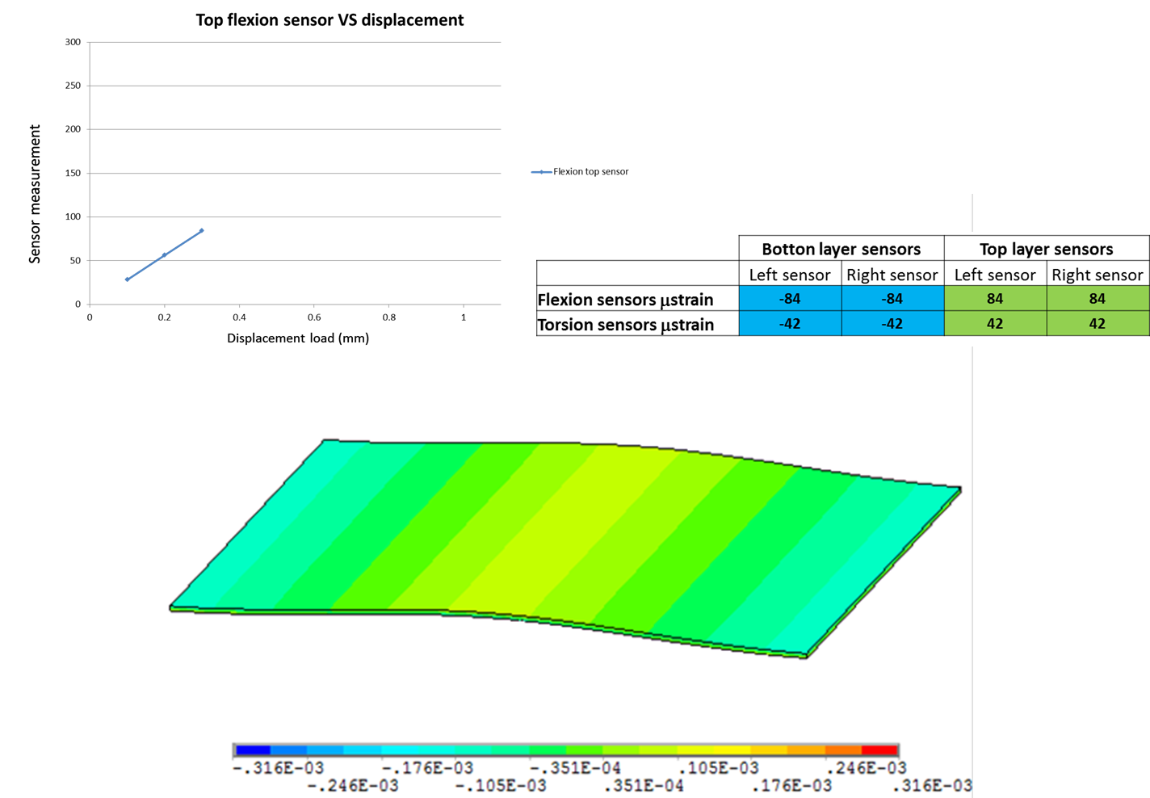
Demonstrator simulation under flexion loads
10

Slide 11

Demonstrator simulation under flexion loads
11

Slide 12
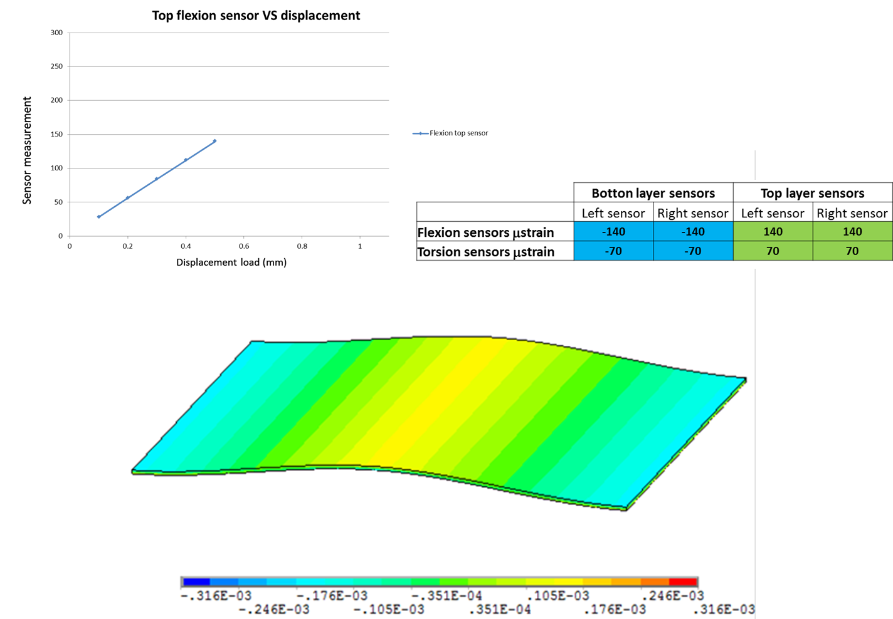
Demonstrator simulation under flexion loads
12

Slide 13
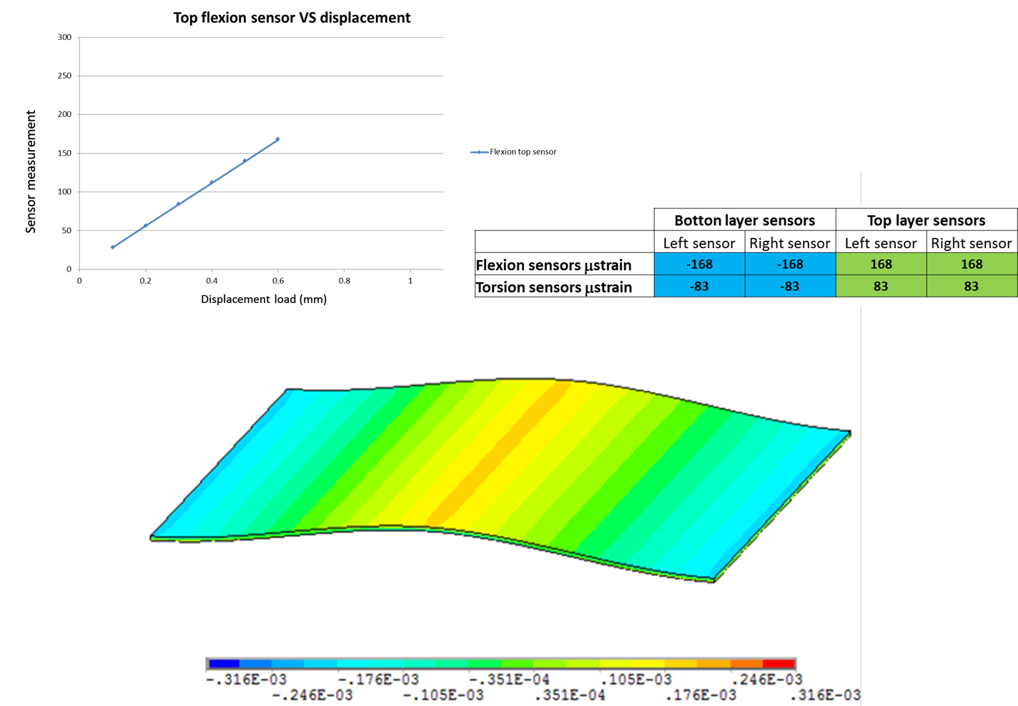
Demonstrator simulation under flexion loads
13

Slide 14
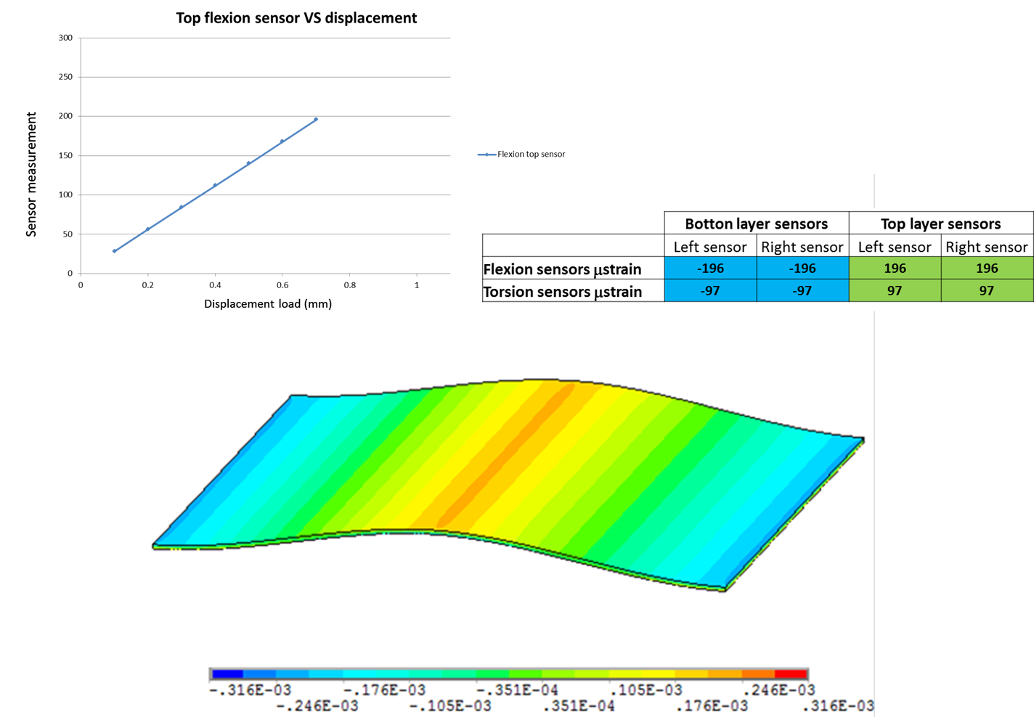
Demonstrator simulation under flexion loads
14

Slide 15
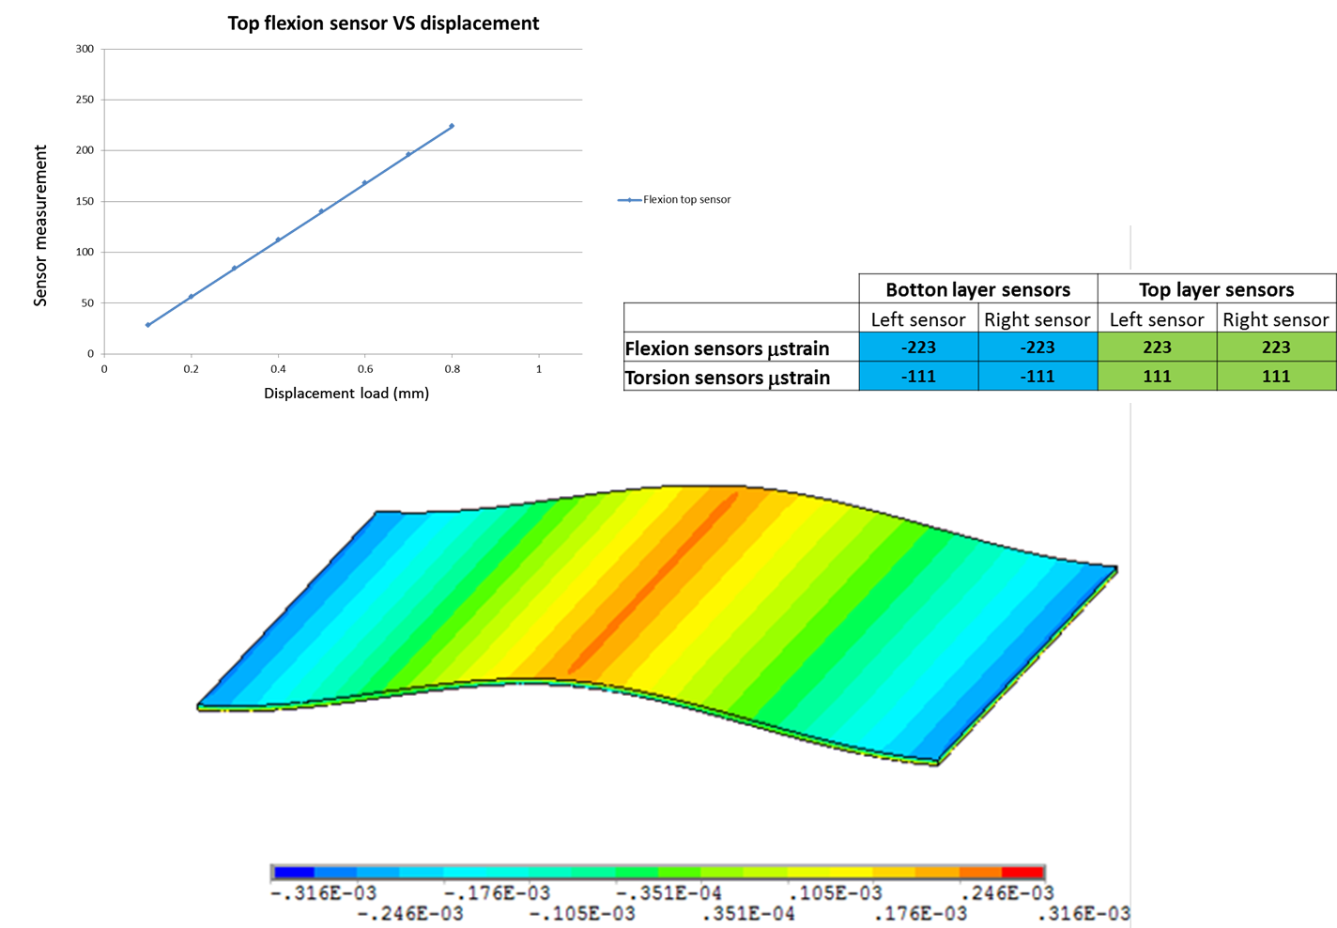
Demonstrator simulation under flexion loads
15

Slide 16
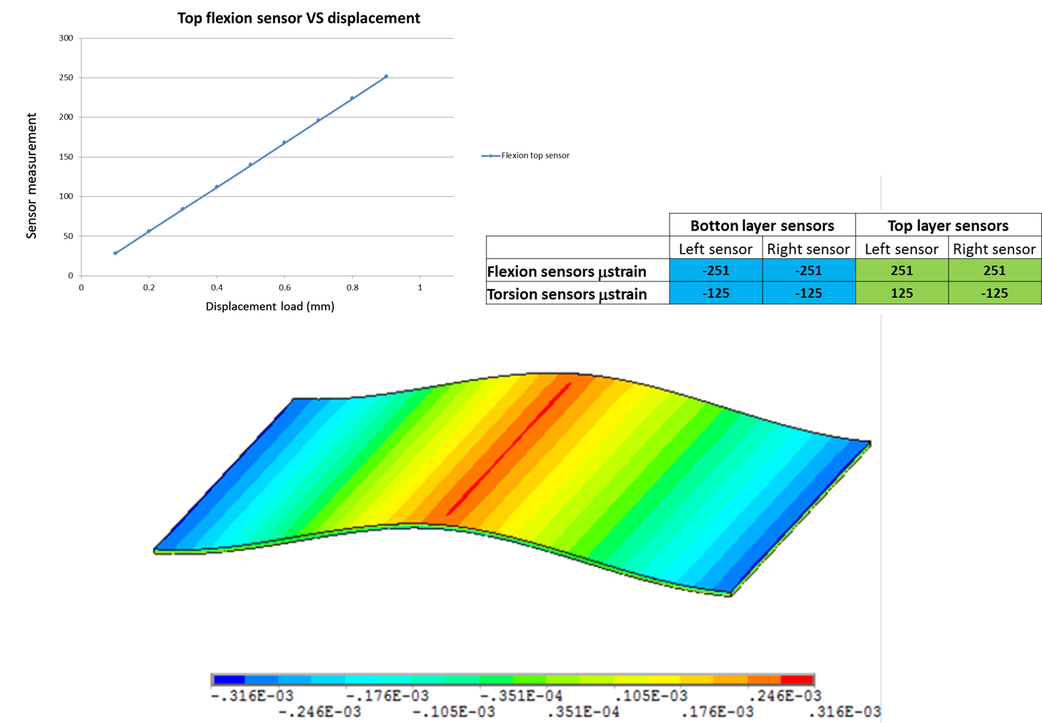
Demonstrator simulation under flexion loads
16

Slide 17
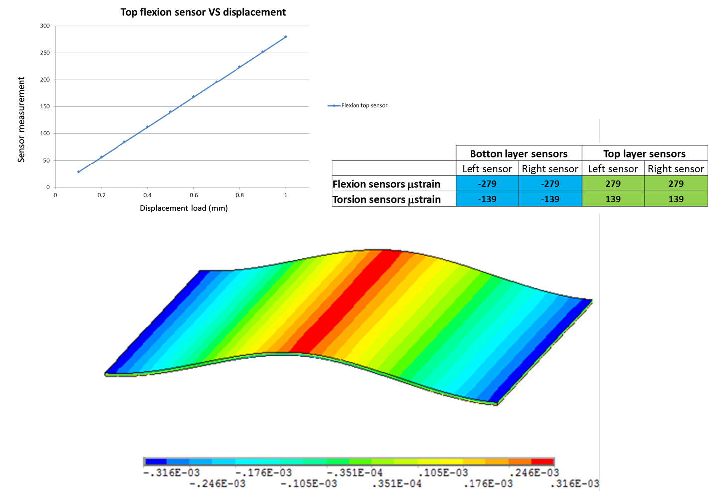
Demonstrator simulation under flexion loads
17

Slide 18
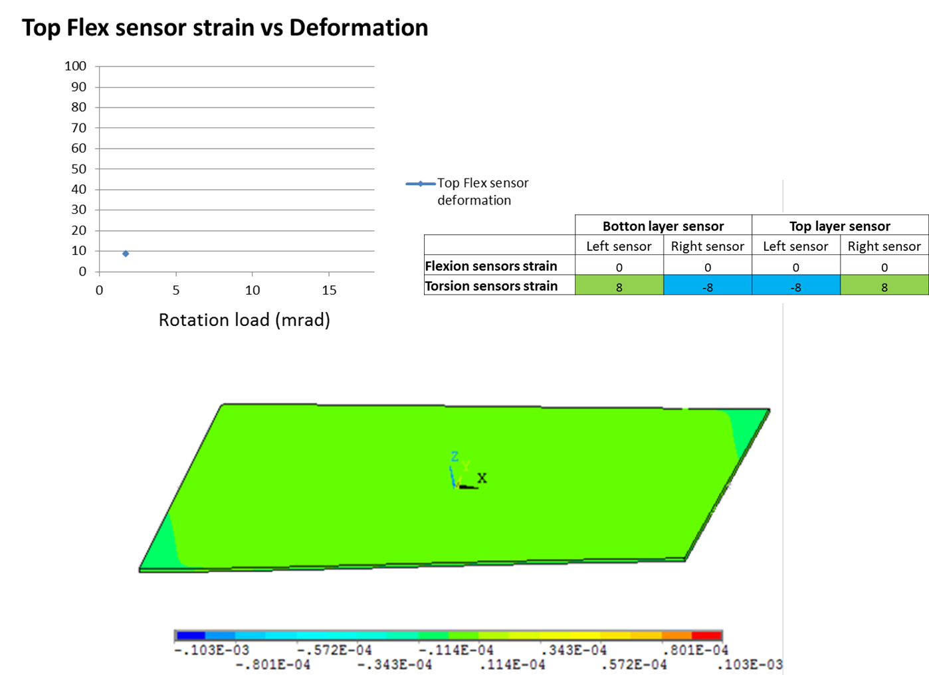
Demonstrator simulation under torsion loads
18

Slide 19
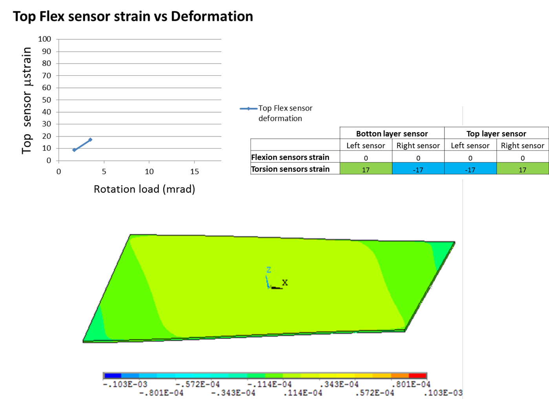
Demonstrator simulation under torsion loads
19

Slide 20
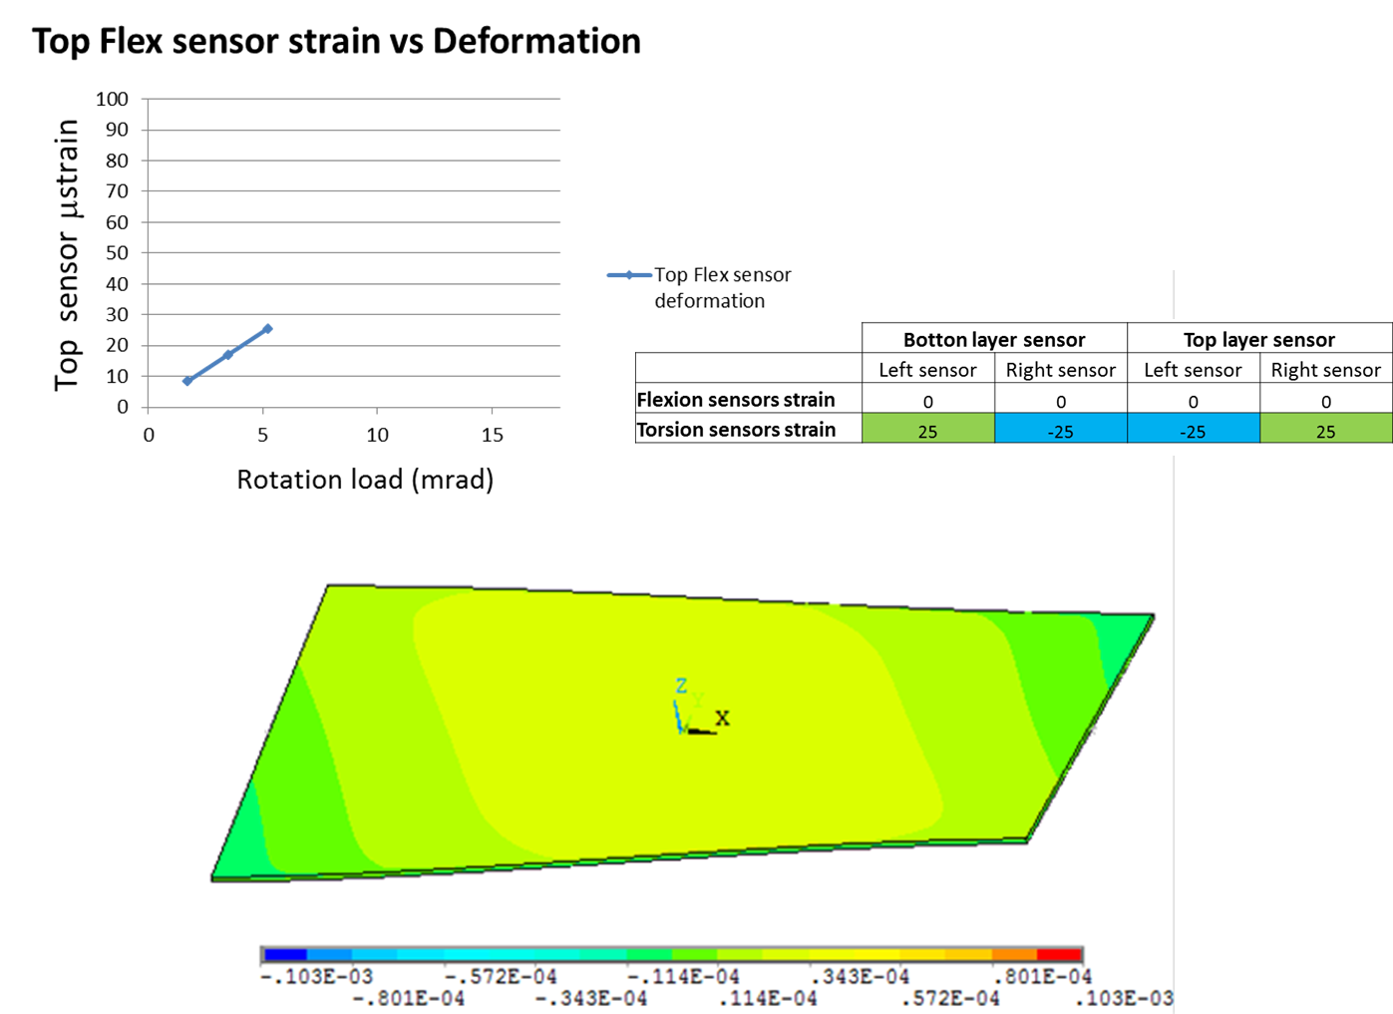
Demonstrator simulation under torsion loads
20

Slide 21
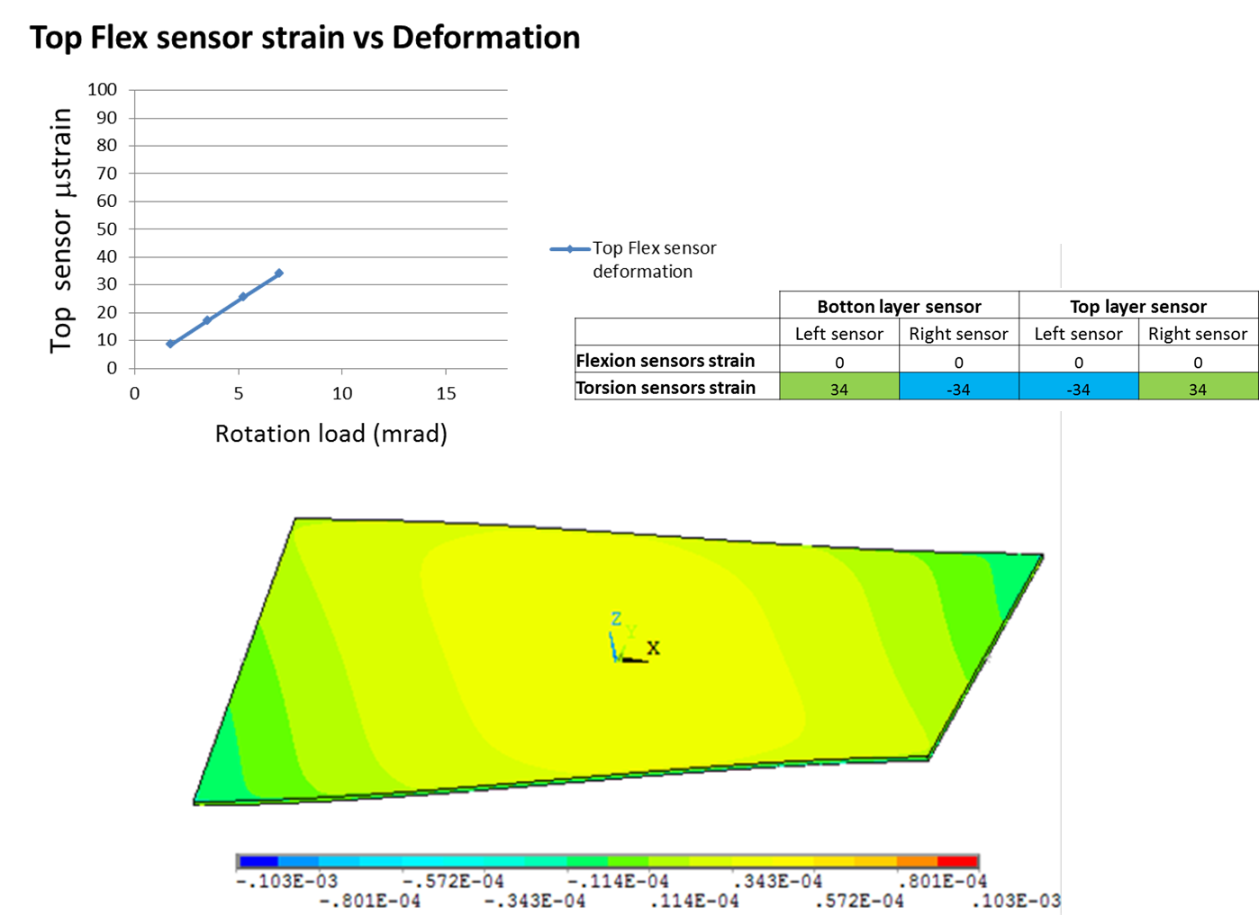
Demonstrator simulation under torsion loads
21

Slide 22
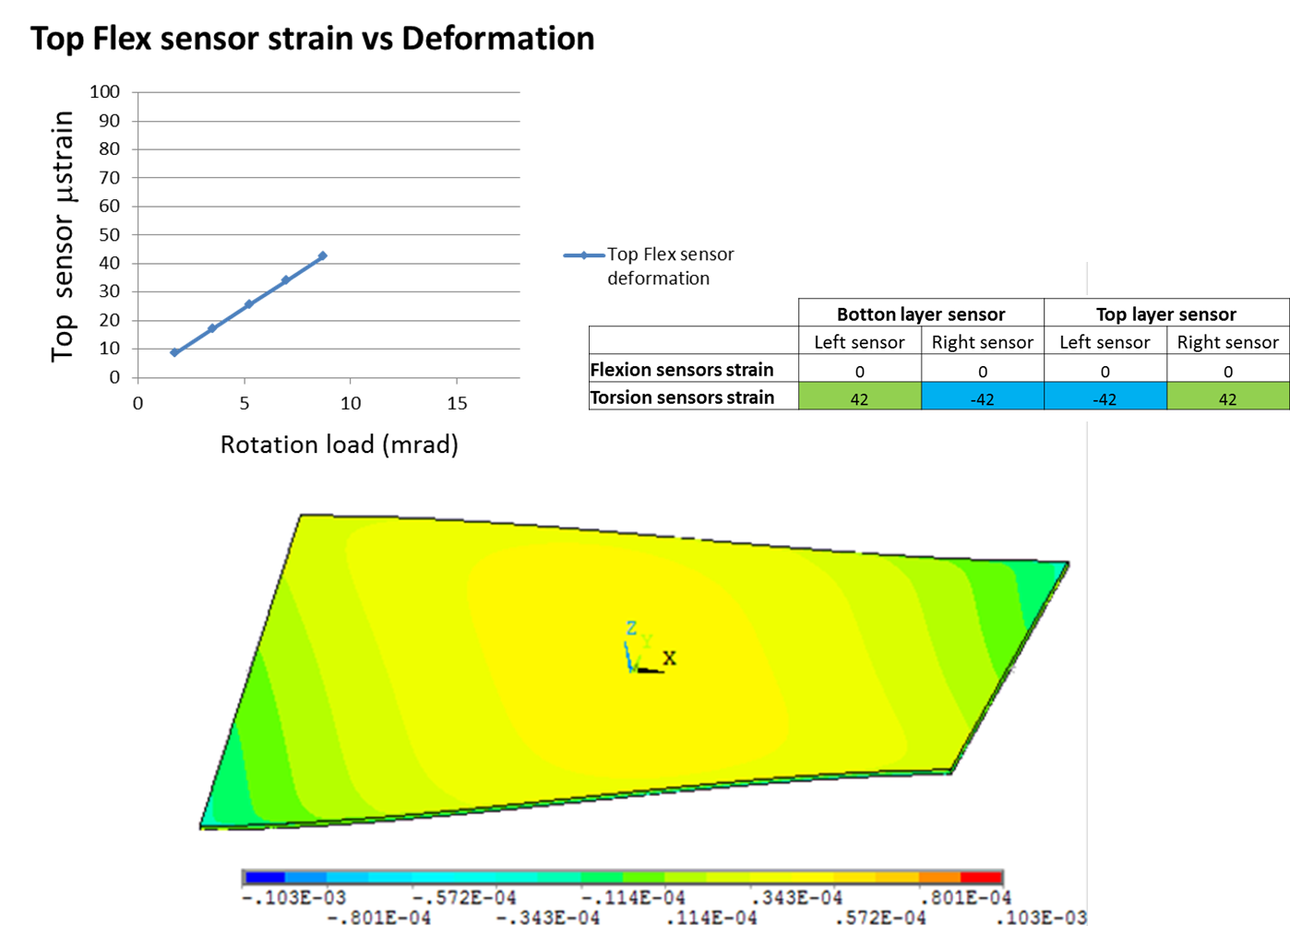
Demonstrator simulation under torsion loads
22

Slide 23
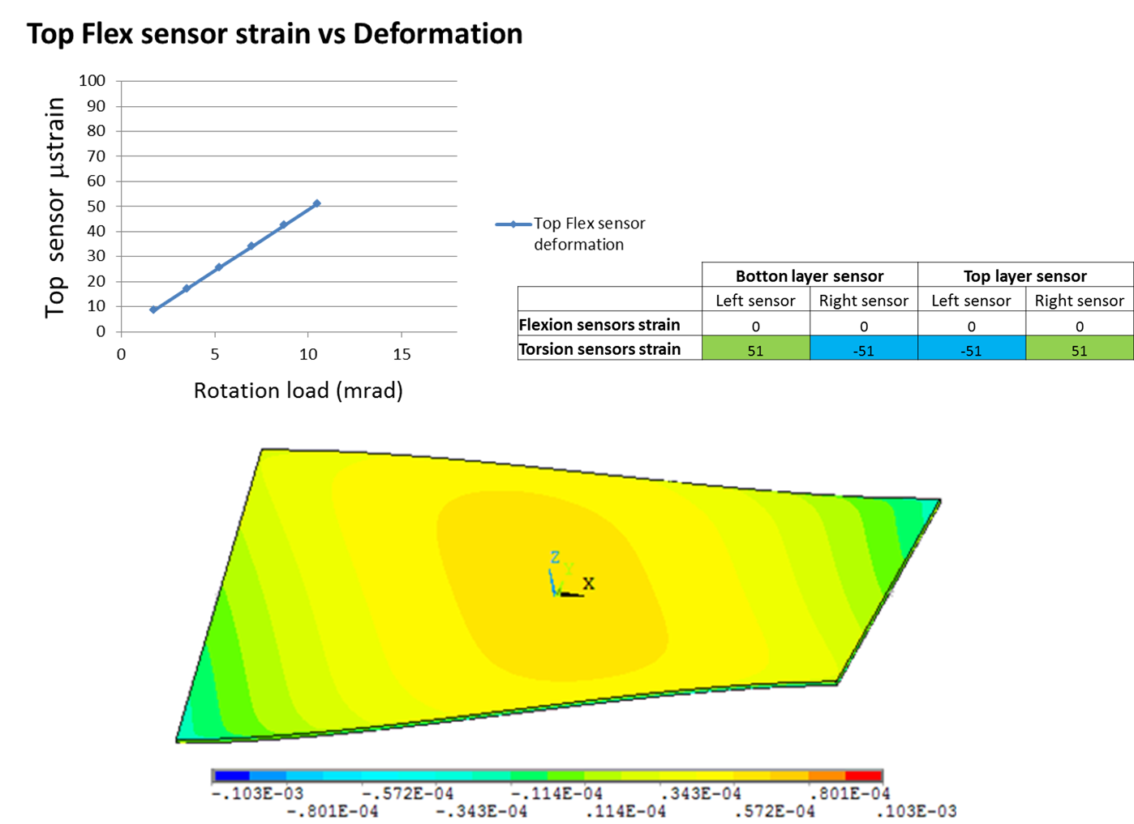
Demonstrator simulation under torsion loads
23

Slide 24
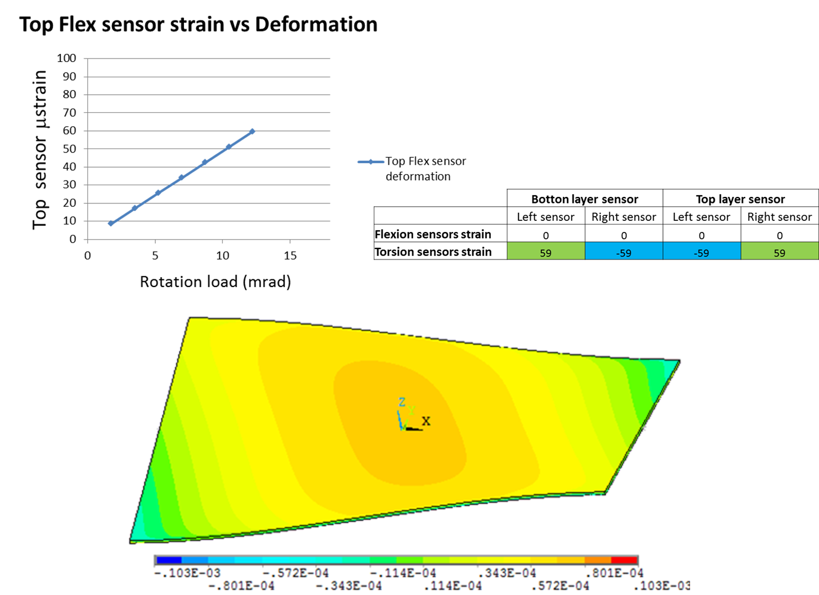
Demonstrator simulation under torsion loads
24

Slide 25
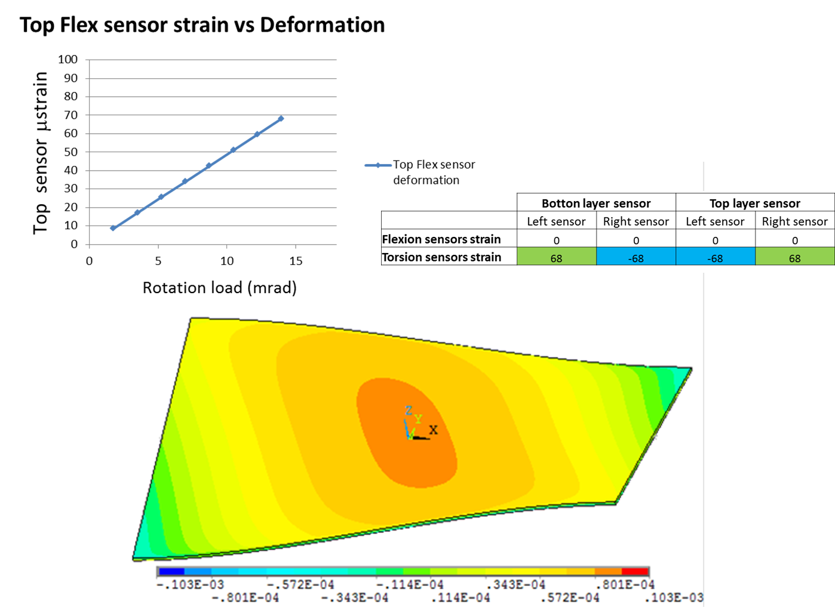
Demonstrator simulation under torsion loads
25

Slide 26
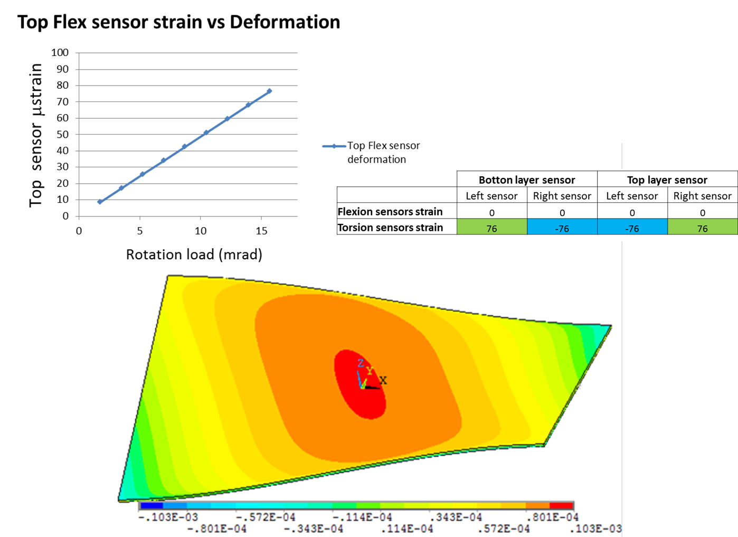
Demonstrator simulation under torsion loads
26

Slide 27
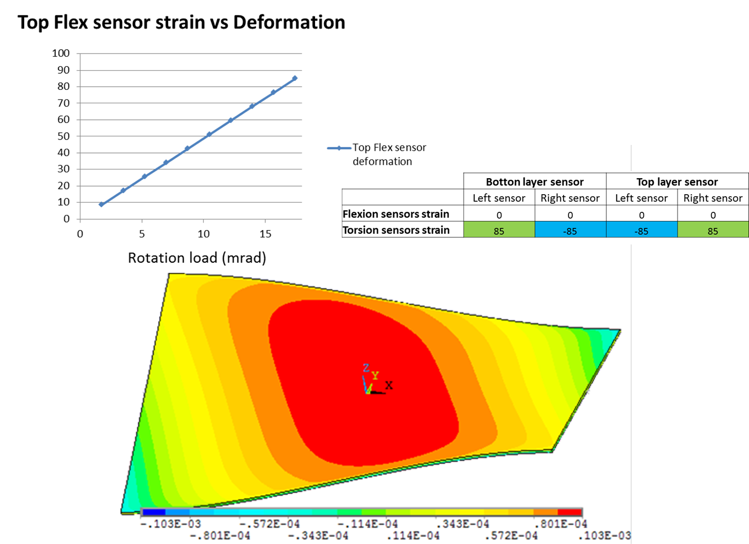
Demonstrator simulation under torsion loads
27

Slide 28
PART 2
CHARGE. DiVISION IN MICROSTRIPS SENSORS.

Slide 29
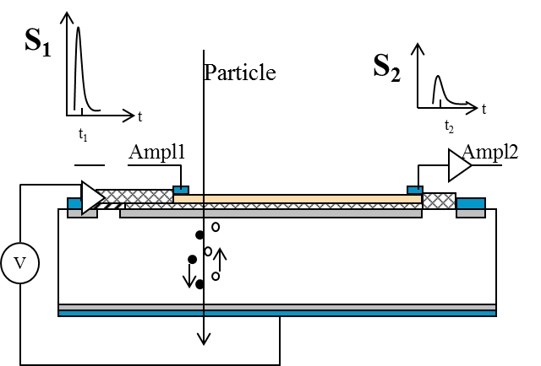
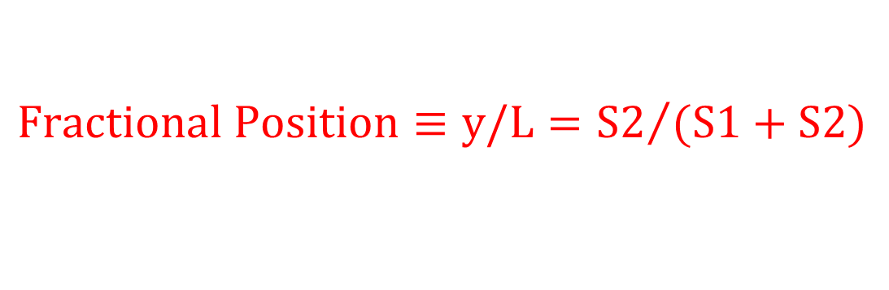


Charge-Division Concept in ustrip Sensors (1)
Charge division used in wire chambers to determine the coordinate along the sensing wire.
Same concept with conventional microstrips with slightly resistive electrodes (doped polysilicon)
$$y$$
$$L$$
$${Fractional Position≡y/L=S2}/{(S1+S2)}$$

Slide 30
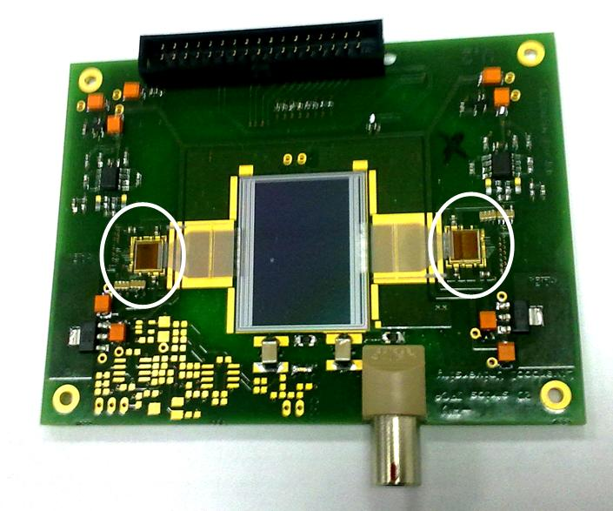
Prototypes from CNM
two new prototypes with double-end readout and different resistivity.
Beatle chip
Strip:
  length =20 mm
  width =20 um
Pitches:
  Implant=80 um
  readout= 80 um
Electrode:
  R/um = 2.8 Ohms/um
  R/um = 12.2 Ohms/um

Slide 31
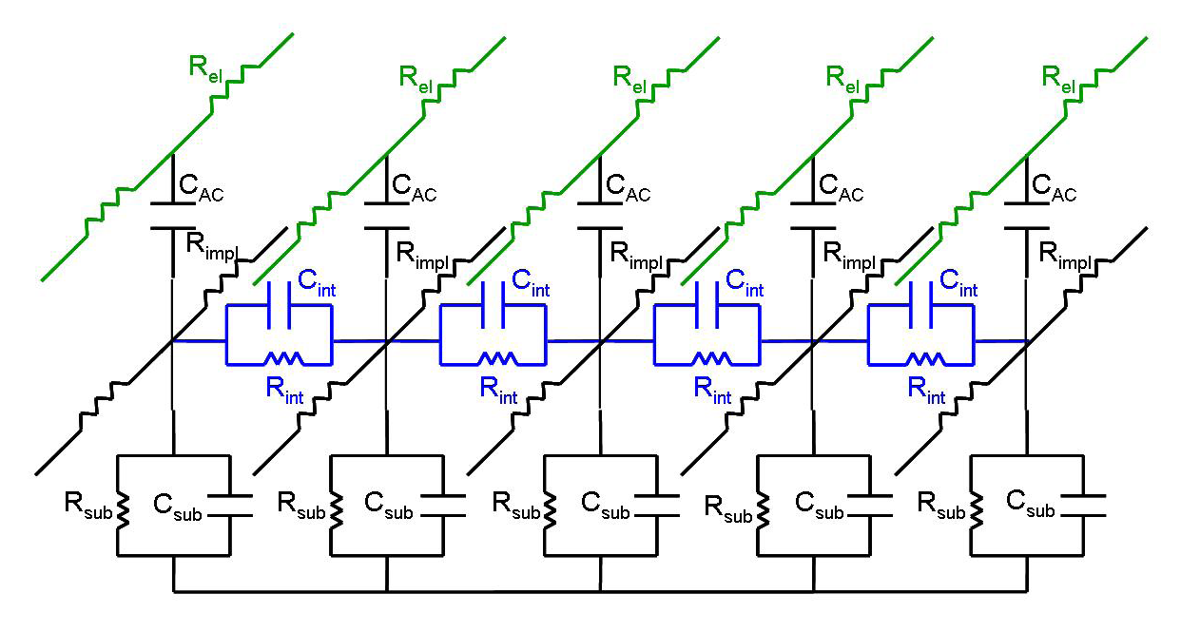
Spice simulation (1): Equivalent Circuit
Detector cell model including five consecutive strips.
Total sensor: periodic structure composed of 80 cells.
Realistic parameters (from sensor electrical characterization)
Already validated microstrip simulation.
charge sensitive preamplifier + CR-RC filter, which peaking time 25 ns.

Slide 32
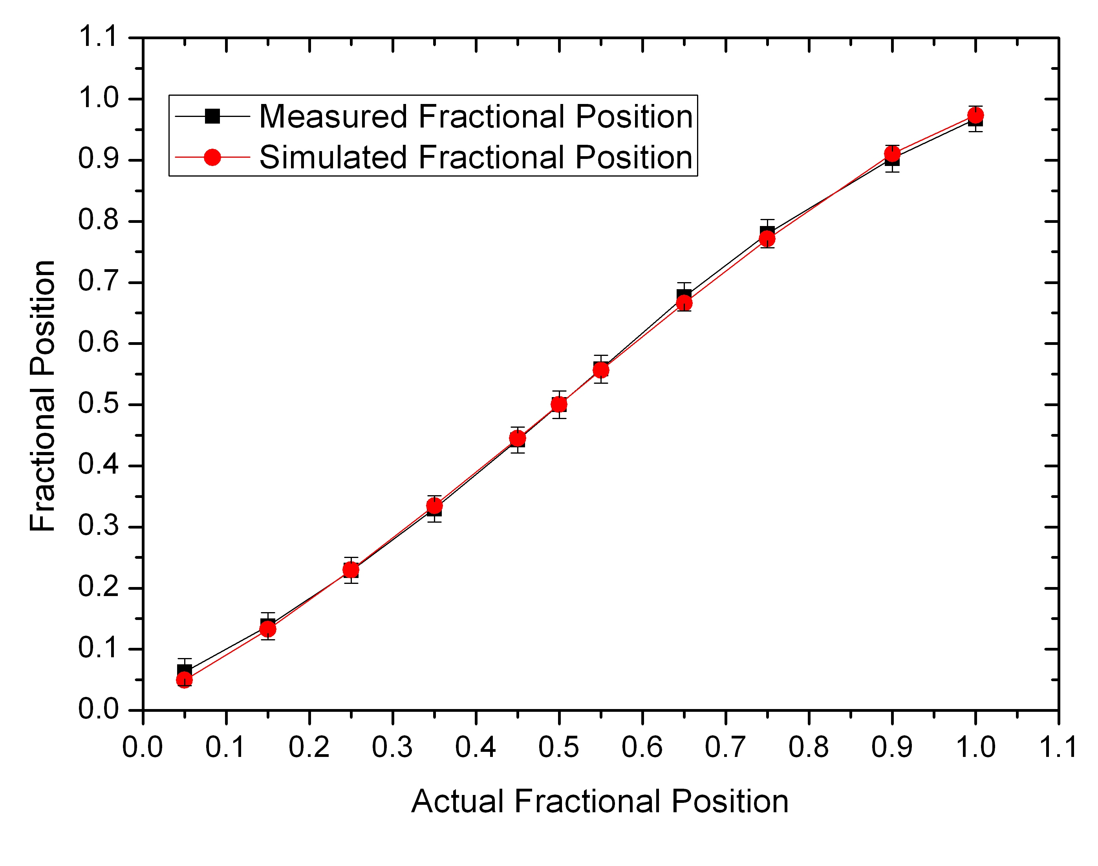
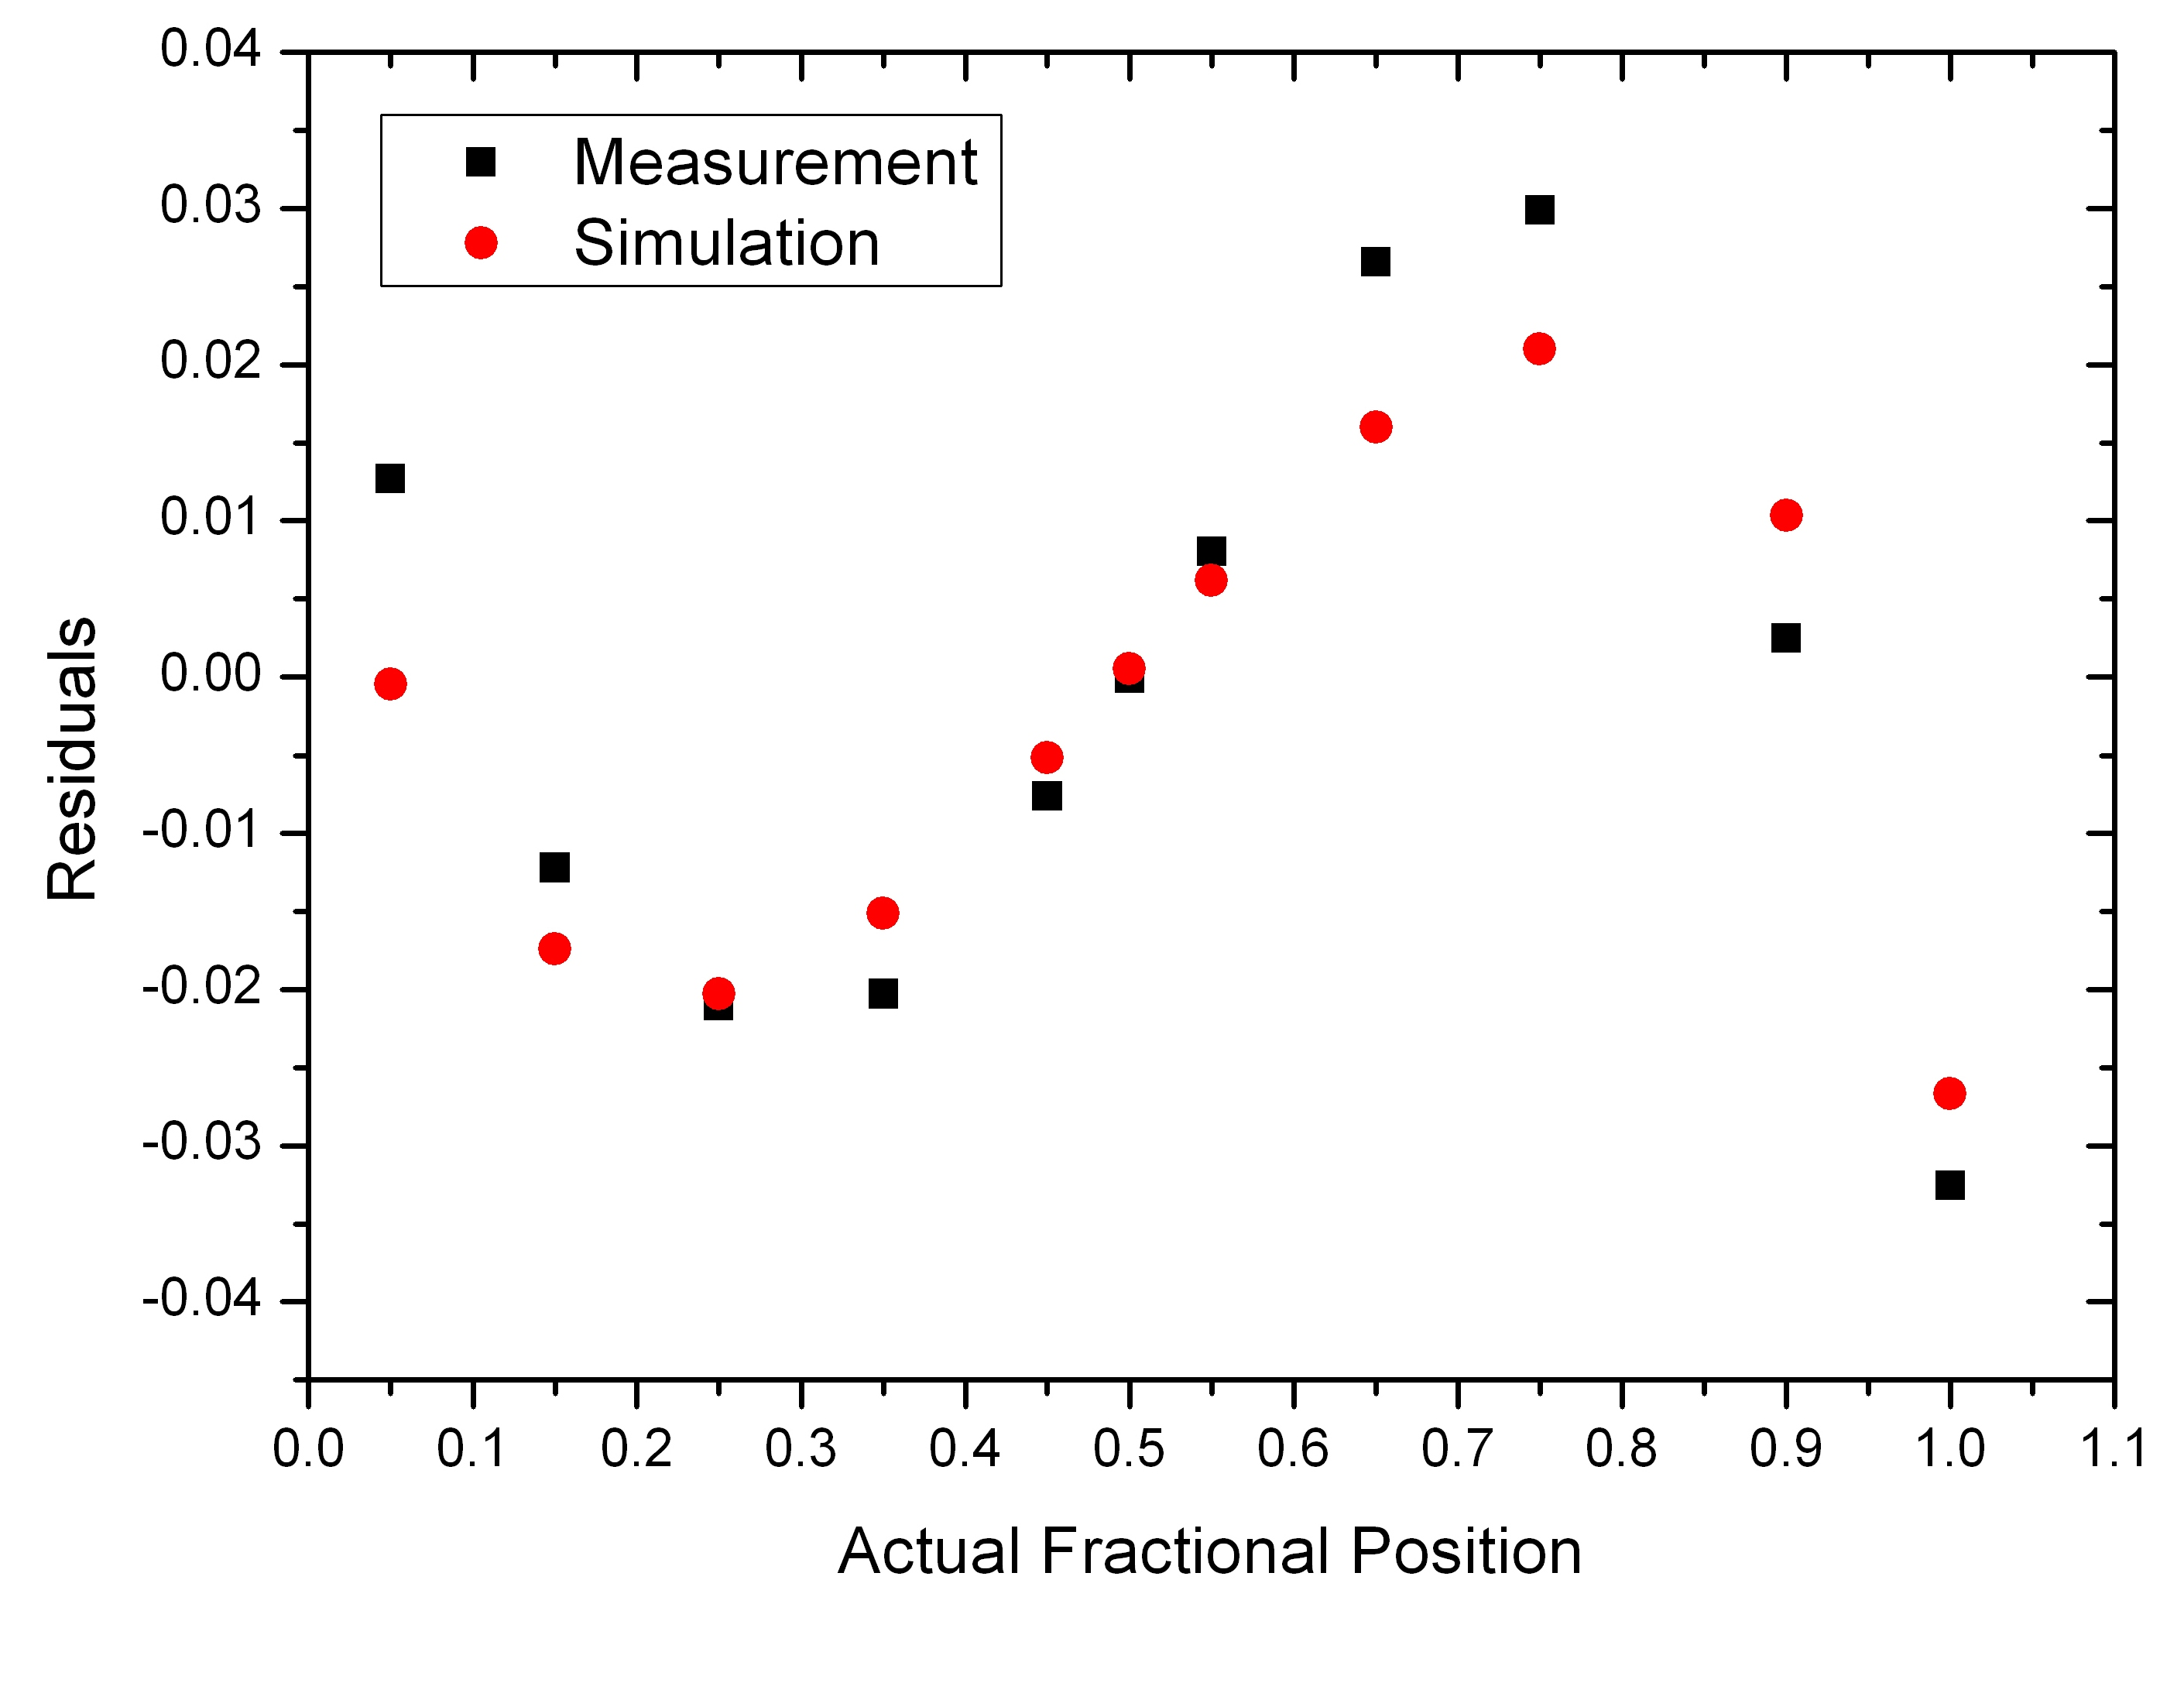
Data vs. Simulation: Fractional position (1)
High resistivity sensor: 12.2 Ω/μm, RC = 450ns

Slide 33
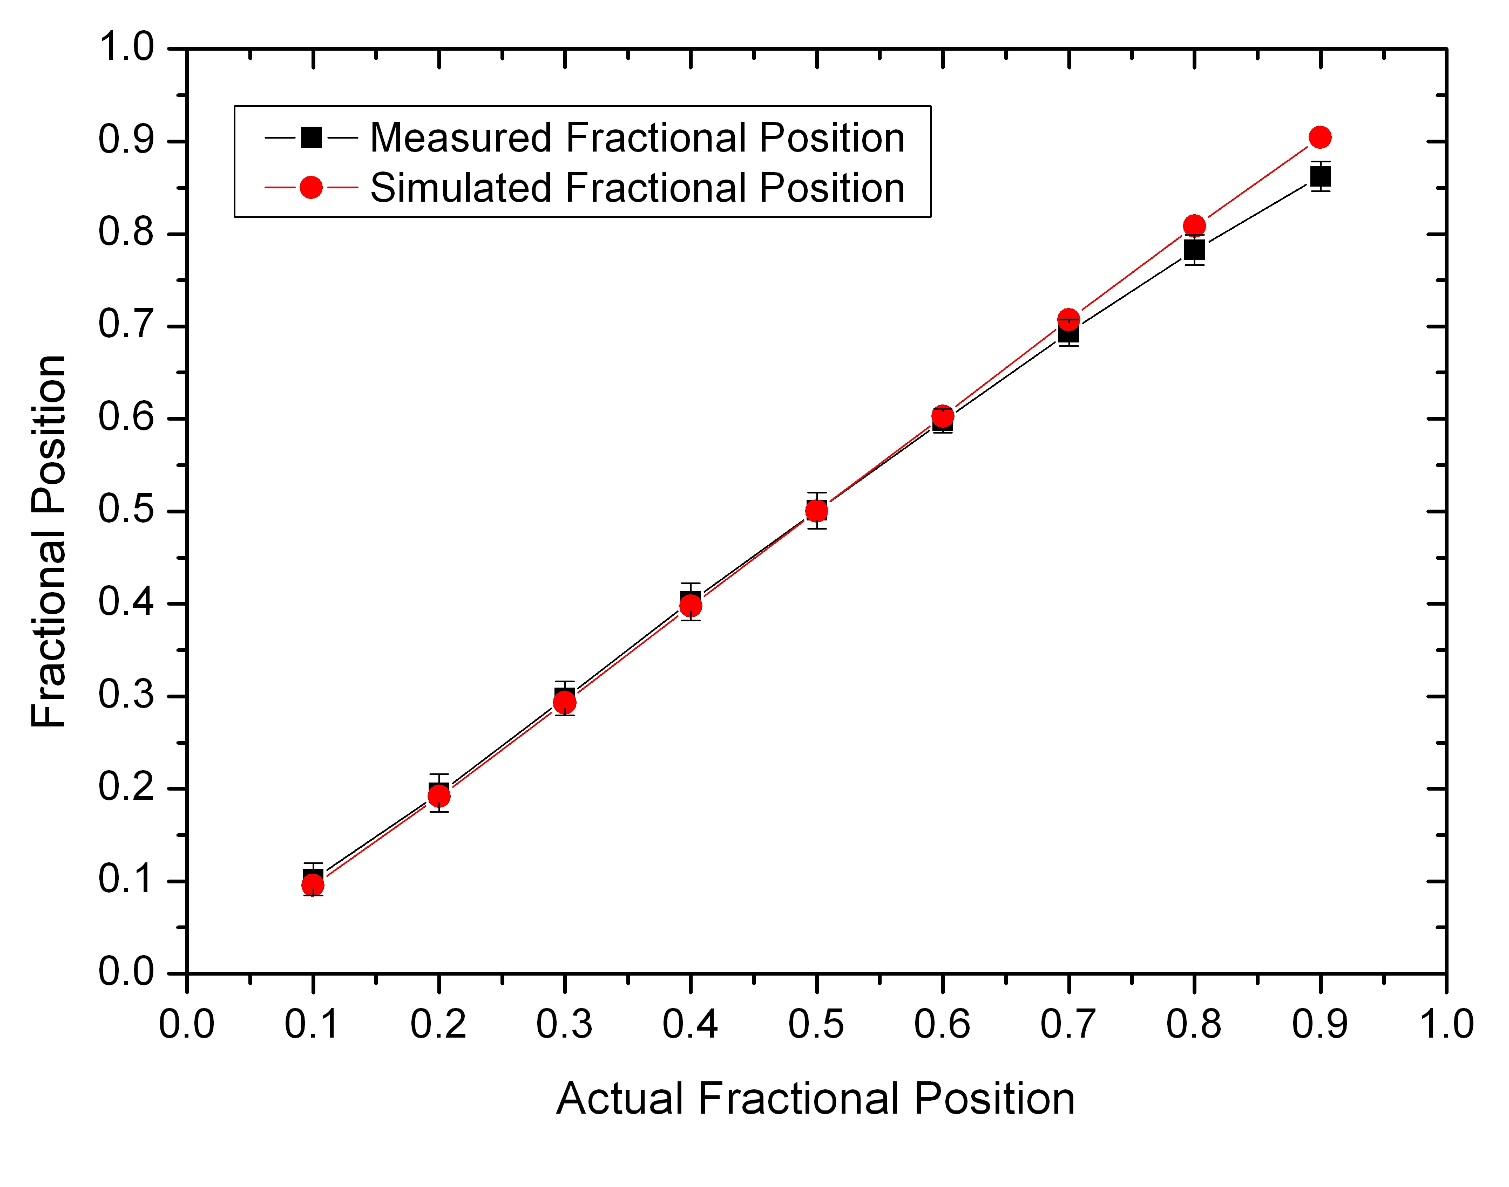
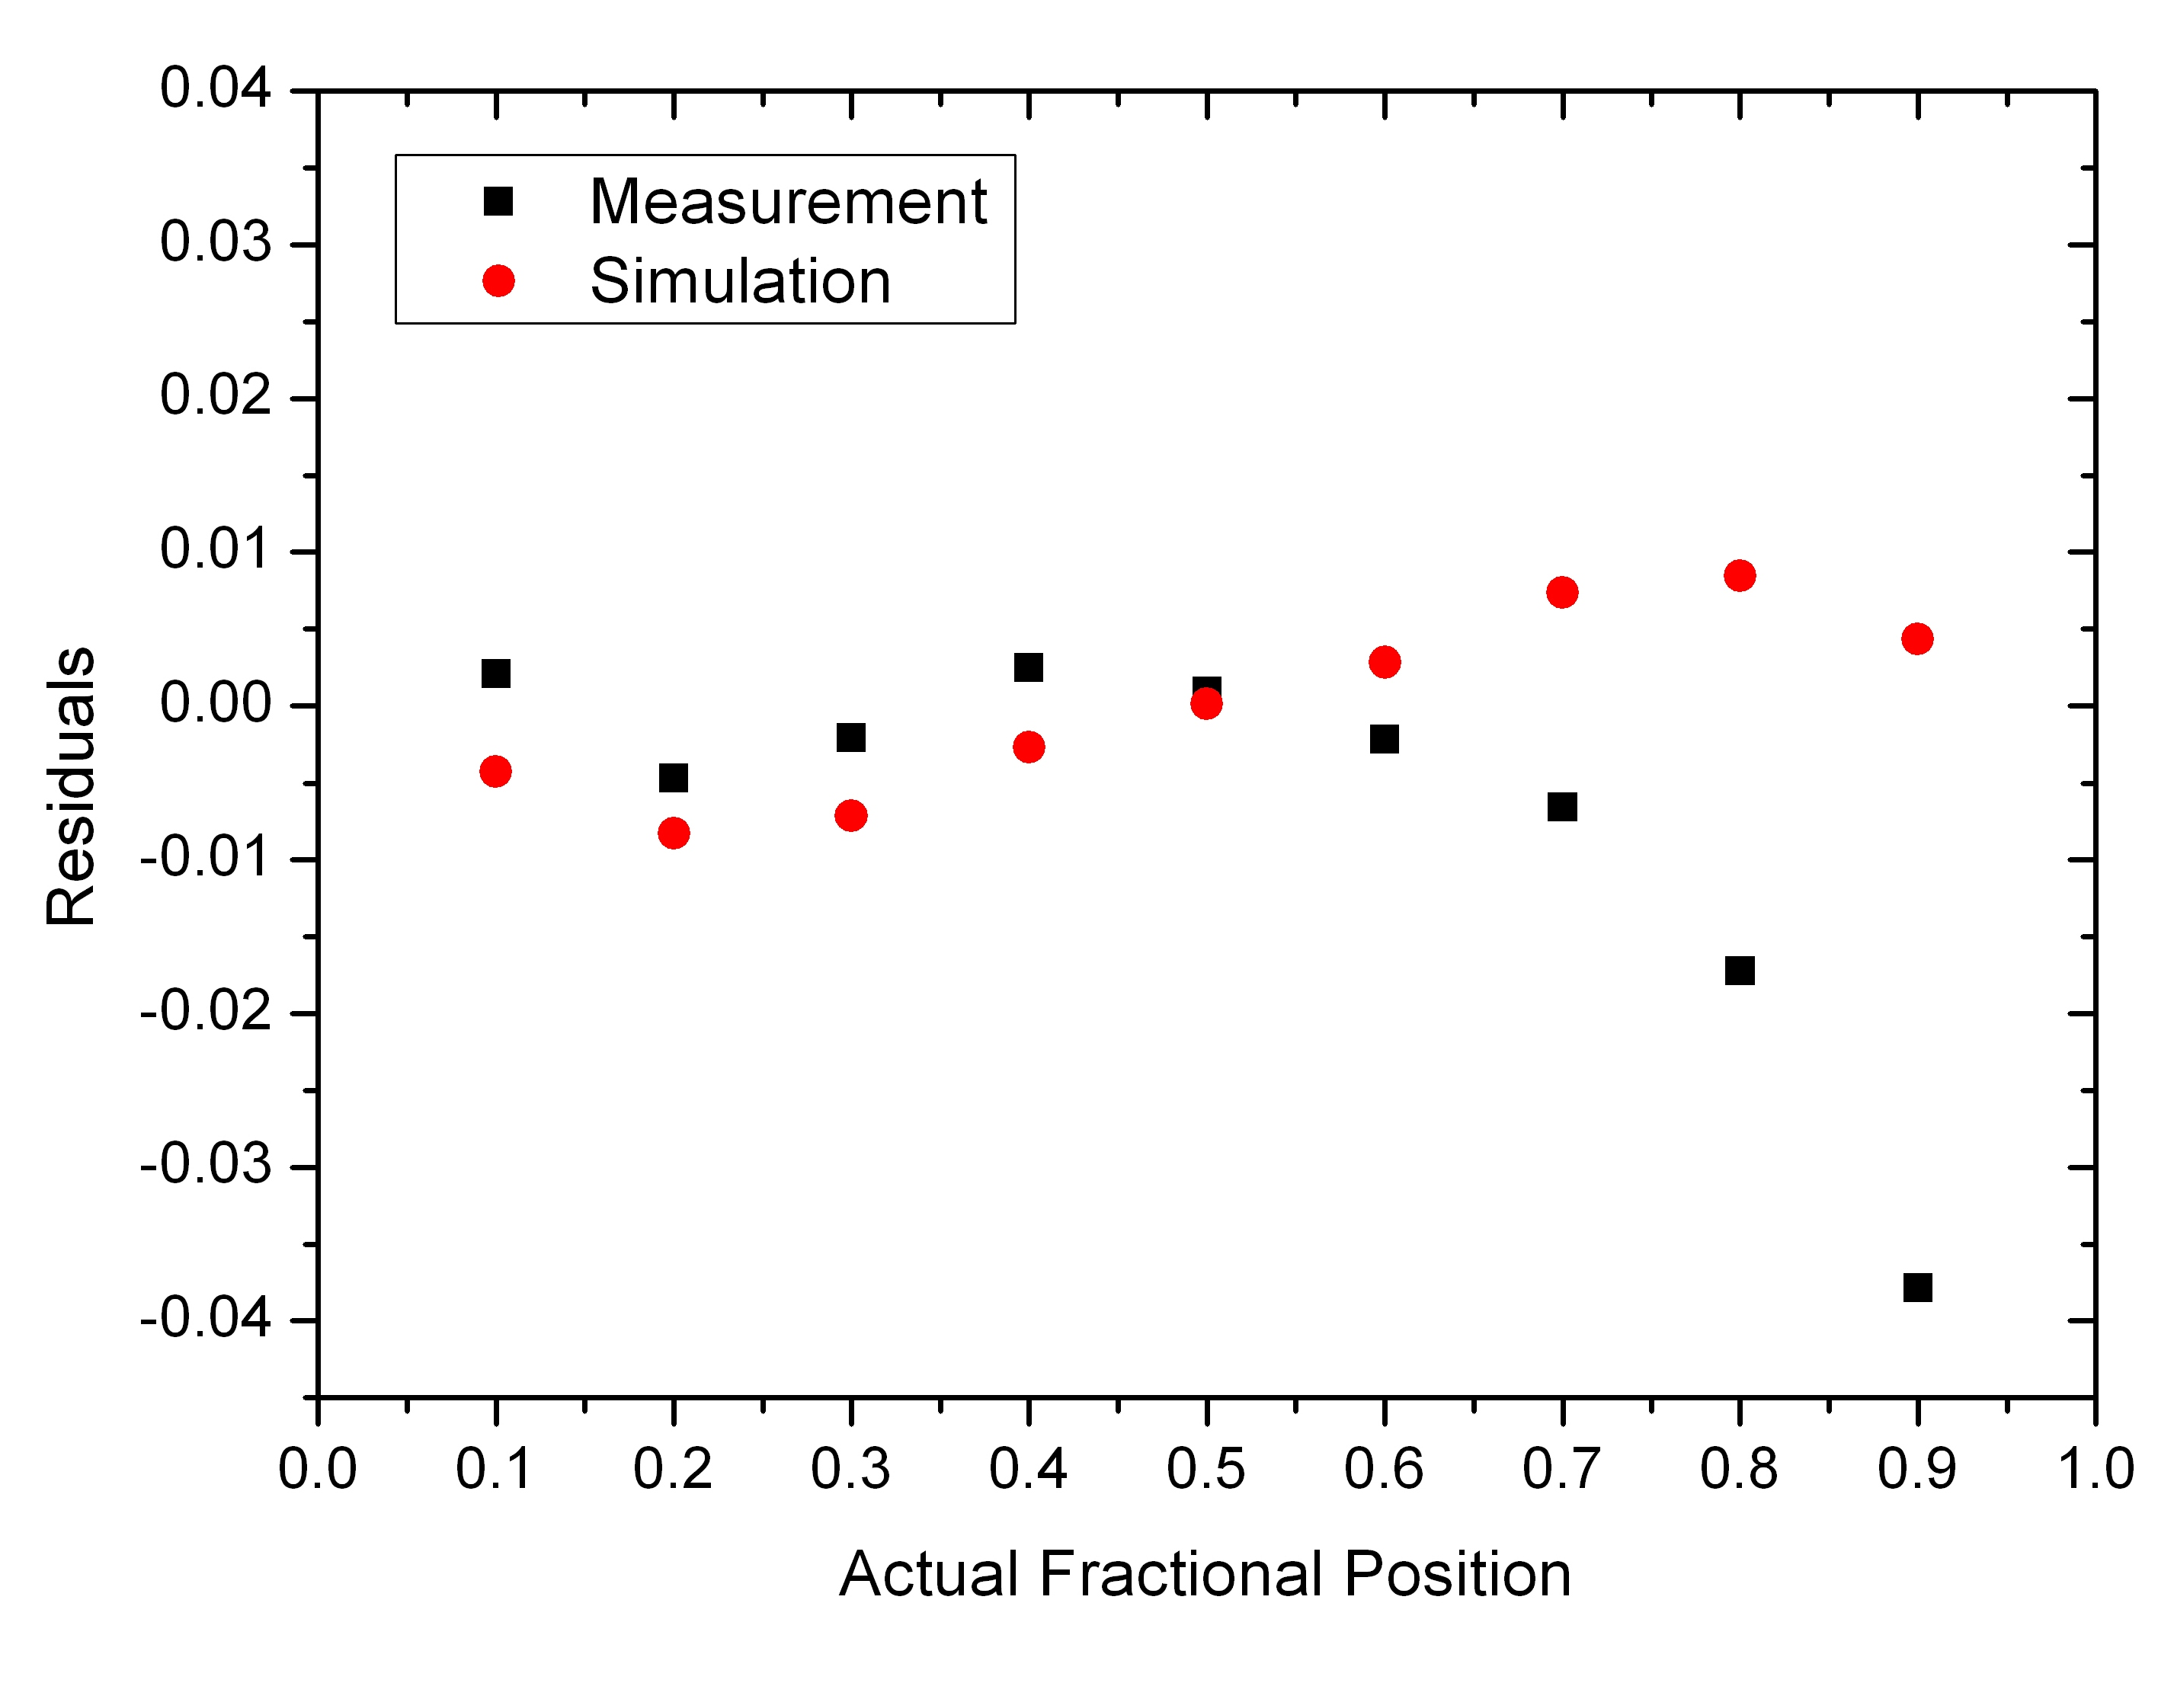
Data vs. Simulation: Fractional position (2)
Low resistivity prototype: 2.8 Ω/μm, RC = 100ns

Slide 34
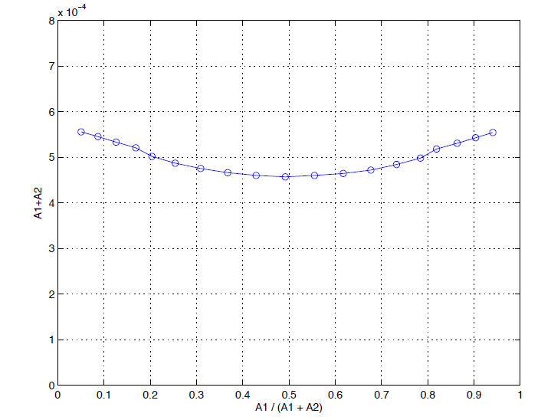
Simulation SNR vs longitudinal position
High resistivity
Low resistivity

Slide 35
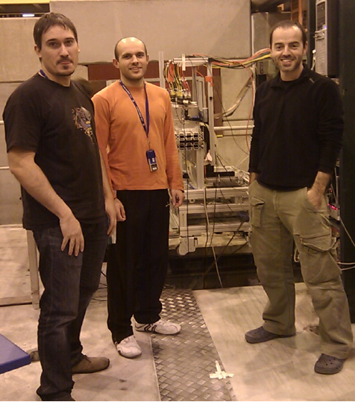
The Test Beams

Slide 36
Test beam (2)
SPS H6 test beam line
Standalone data taking (parasitic) Oct 2011 and inside the AIDA telescope (main users) Nov 2012

Slide 37
Synchronizing ALIBAVA r/o and AIDA telescope
TELESCOPE DAQ
DUT DAQ
NIM CRATE
TRIG
Alibava
TLU
Fan Out 1
TRIG IN
BUSY
Fan Out 2
Alibava
END MARKER
TRIG IN
Scaler
LOAD
Dual Timer 1
Dual Timer 2
BUSY sending data
BUSY getting data
OR

Slide 38
Synchronizing ALIBAVA r/o and AIDA telescope (2)
Sample Size triggers count
Triggers enabled
Trigger / Busy sequence
200ns
Triggers disabled
TRIG
TRIG IN
BUSY getting data
7 ms
END MARKER
50ns 1us
LOAD
BUSY sending data
200ms
BUSY
Getting data
Sending data

Slide 39
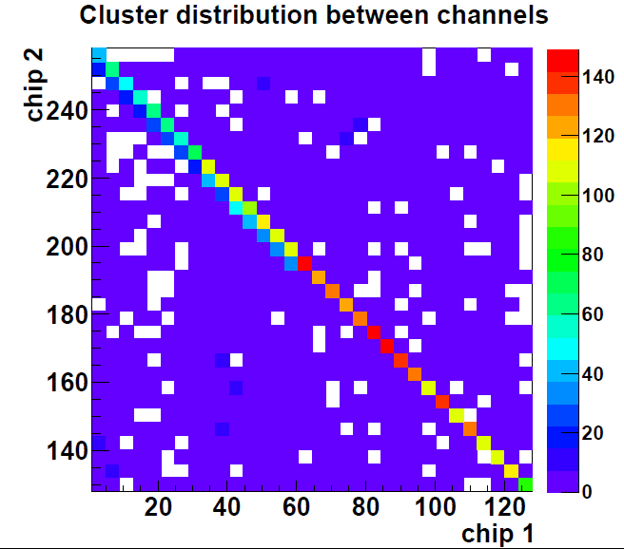
VERY Preliminary results (1)
Imaging of the SPS beam profile.
Cluster correlation between opposite ends

Slide 40
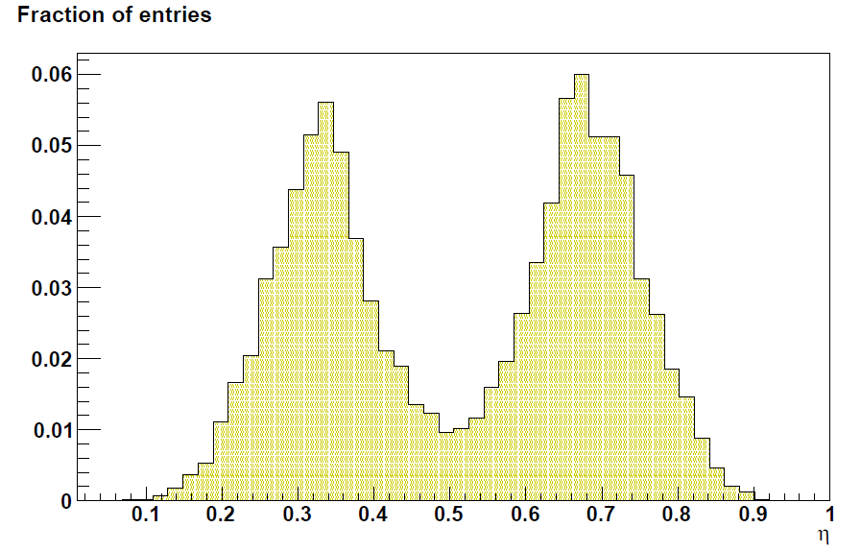
Very preliminary results (2)
Resistive sensor
Poor Signal/Noise for prototypes AND
Reference sensors
Resistive sensor
Reference sensor

Slide 41
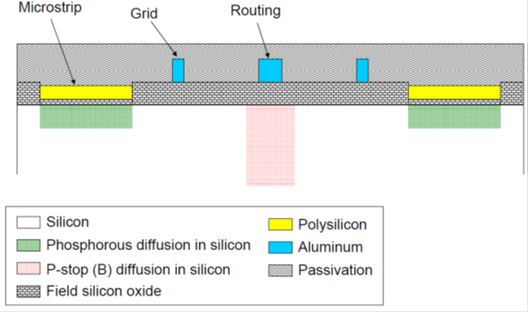
New prototype run (1)
Signal routing to one end of the sensor

Slide 42
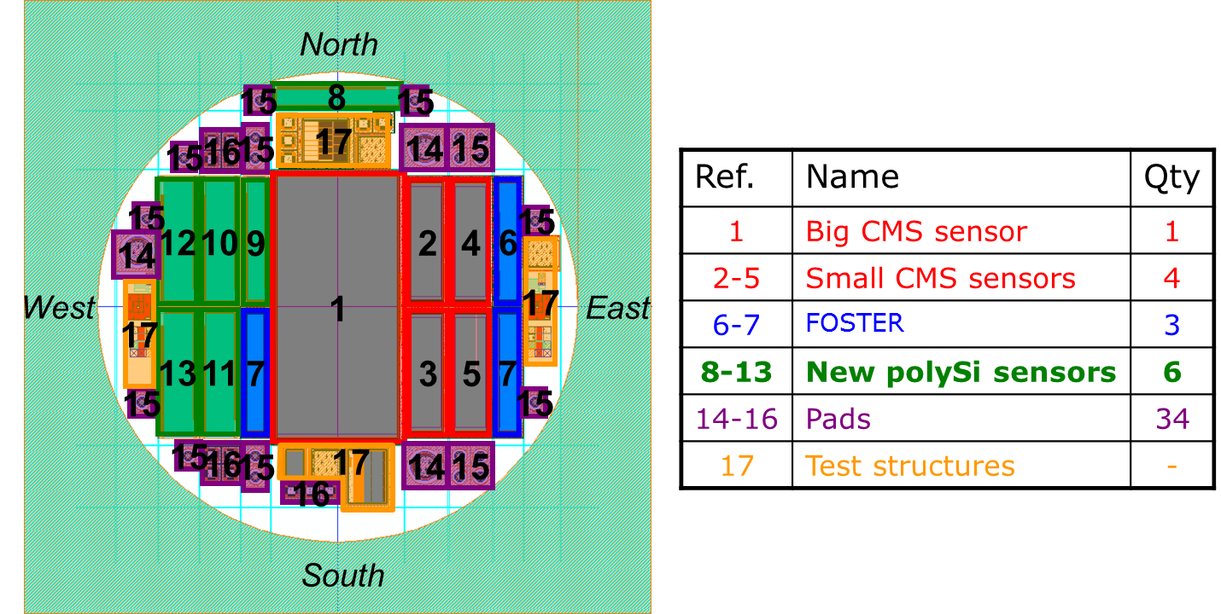
New prototype run (2)

Slide 43
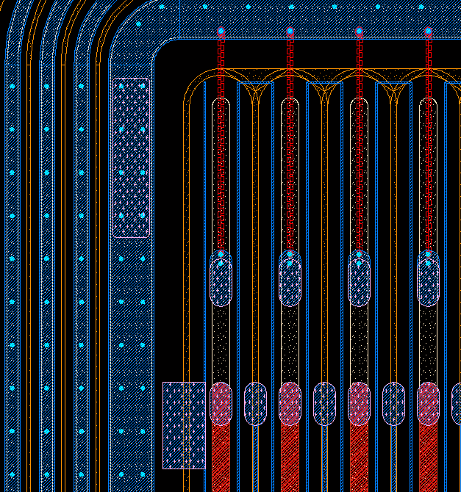
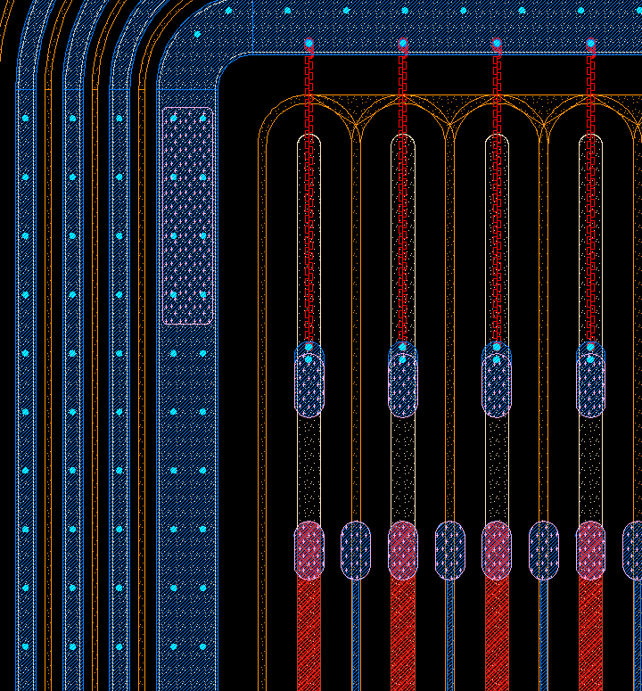
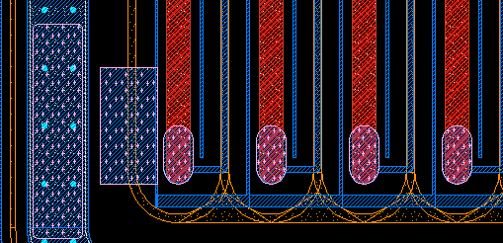
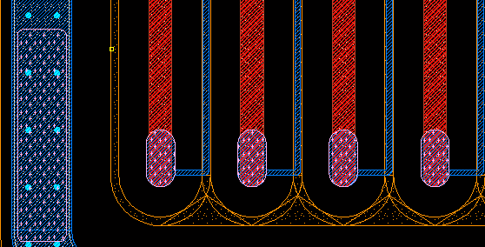
New prototype run (3)
    Dimensions: 25x8mm2
    34 strips with 160um pitch
    N-type contact width: 40um
    PolySi contact width: 40um
    R_bias 3um wide & 255 squares
(12-13)
(10-11)
Pad con/sin p-stop
Pad con/sin p-stop

Slide 44
Summary
“Smart Mechanics” demonstrator plate is being produced with embedded fiber optic sensors for shape and temperature monitoring.
Charge Division in microstrips (POLYSTRIPS):
  laser measurements very well reproduced by electrical simulation
  Poor SNR in test beam as well as reference sensor.
A new generation of POLYSTRIPS sensors in production with routing tracks and screening structures ready by JUNE

Slide 45
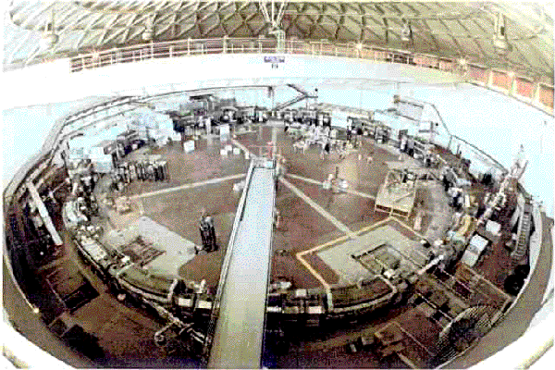
THANK YOU

