Slide 1
AIDA WP3 Annual Meeting
Status of milestones and deliverables
Progress report by sub-projects
AOB

Slide 2
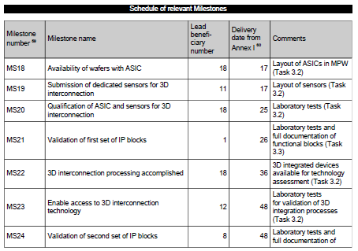
Milestones

Slide 3
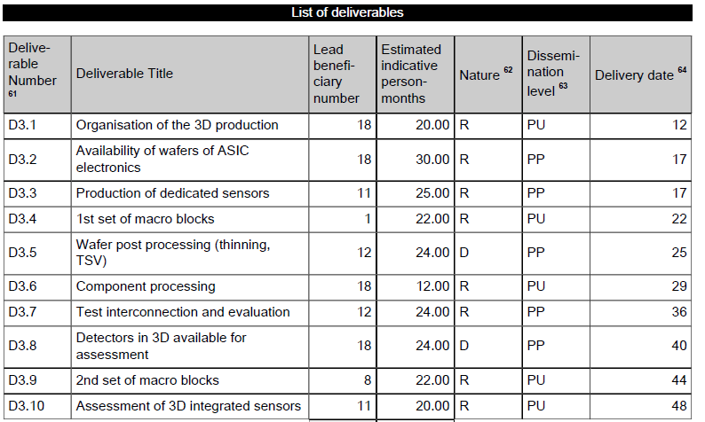
Deliverables

Slide 4
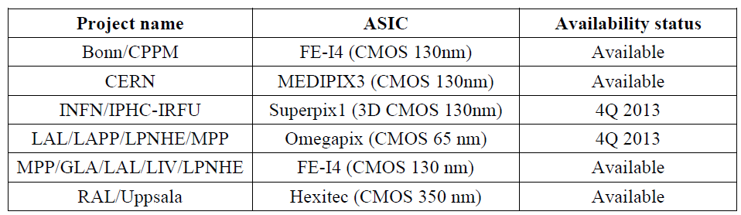
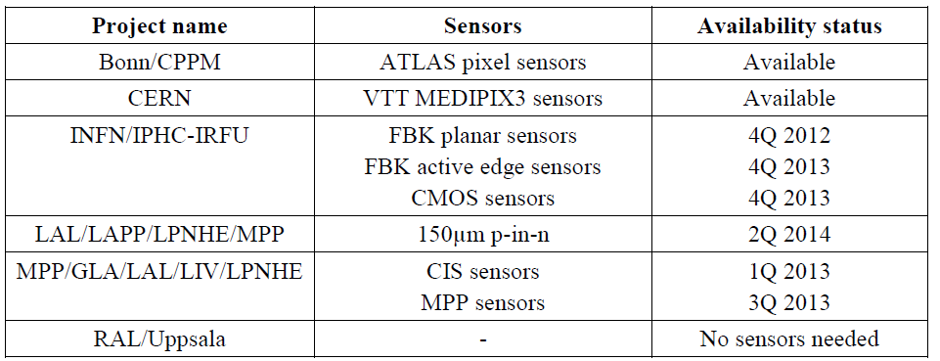
Delivered (partially)
D3.1 Organisation of 3D production (6 sub-projects defined)
  Bonn/CPPM:
  CERN:
  INFN/IPHC-IRFU
  LAL/LAPP/LPNHE/MPP
  MPP/GLA/LAL/LIV/LPNHE
  RAL/UPPSALA
:
D3.2 Availability of wafers of ASICs electronics
D3.3 Production of dedicated sensors

Slide 5
Milestones and Deliverables in 2013
Milestones:
1) MS20 Qualification of ASICs and Sensors M25 (Feb 2013)
for 3D interconnection
2) MS21 Validation of first set of IP blocks M26 (Mar 2013)
postponed till 65nm MPW available by CERN
Deliverables:
D3.4 First set of macro blocks M22 (Nov 2012)
postponed till 65nm MPW available by CERN
2) D3.5 Wafer post processing (thinning, TSV) M25 (Feb 2013)
3) D3.6 Component processing M29 (Jun 2013)

Slide 6
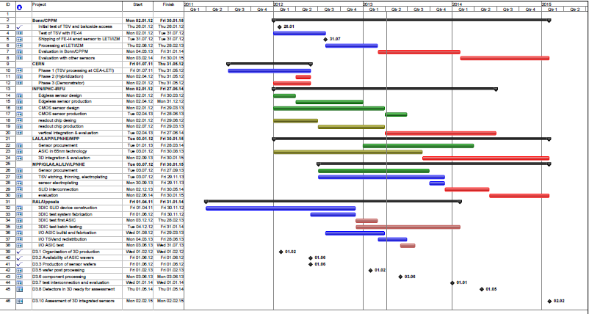
Schedule

Slide 7
Bonn/CPPM Project
Item | Start | Stop
Initial test of TSV process and backside access using “old” FE-I2 ICs (not part of AIDA WP3) |  | done
Test of TSV process with FE-I4A IC (not part of AIDA WP3) | In progress | Month 18
Shipping of FE-I4B and planar sensor wafers to LETI / IZM |  | Month 18
Processing at LETI / IZM | Month 19 | Month 25
Process evaluation in Bonn / CPPM | Month 26 | Month 36
possibly: Evaluation of prototypes with other sensors | Month 36 | Month 48
Wafers are at IZM for processing ? LETI?

Slide 8
CERN Project
Item | Start | Stop
Phase 1 (TSV processing of Medipix 3 wafers at CEA-LETI) | Month 6 | Month 16
Phase 2 (Hybridization of the TSV processed read out chips) | Month 15 | Month 17+
Phase 3 (Demonstrator module) | Month 12 | Month 17+
Since Medipix chips with TSVs are available and have been tested. Phase 2 should be completed?
Next: interconnection to sensor

Slide 9
INFN/IPHC-IRFU Project
Item |  | delivery
Edgeless sensor design |  | Month 14
Edgeless sensor production |  | Month 23
CMOS sensor design |  | Month 26
CMOS sensor production |  | Month 29
Readout chip design |  | Month 17
Readout chip production |  | Month 26
Readout chip-to-sensor vertical integration |  | Month 41
Planar sensors under test
Edgeless sensors designed and fabrication at FBK scheduled
Interconnection tests with T-MICRO (to be evaluated)
3D MAPS from Tezzaron under test

Slide 10
LAL/LAPP/LPNHE/MPP Project
Project | Start | Finish
Sensor procurement | Tue 01.01.13 | Fri 28.03.14
ASIC in 65nm technology | Tue 03.01.12 | Fri 30.08.13
3D integration & evaluation | Mon 02.09.13 | Fri 30.01.15
CIS and VTT sensors delivered?
Status of 65nm ASIC: ready for submission? Wait for CERN MPW?

Slide 11
MPP/GLA/LAL/LIV/LPNHE
Project
Item | Start | Stop
Sensor procurement | Month 18 | Month 32
TSV etching, ASIC wafer thinning and electroplating | Month 18 | Month 34
Sensor wafer electroplating | Month 32 | Month 34
SLID interconnection | Month 34 | Month 40
Evaluation | Month 40 | Month 48
CIS sensors expected in June 2013?
ASIC wafer processing: needs change of TSV etching,
In discussion with EMFT. Status?

Slide 12
RAL/Uppsala
Item | Start | Stop
3DIC SLID Device construction | Apr 11 | Nov 12
3DIC test system fabrication | June 12 | Nov 12
3DIC test first ASIC | Dec 12 | Feb 12
3DIC test batch testing | Dec 12 | Jan 14
I/O ASIC build and fabrication | Aug 12 | Mar 13
I/O TSV and redistribution | Mar 13 | June 13
I/O ASIC test | June 13 | July 13
Now news !

