Slide 1

3D Integration activities
Abdenour LOUNIS, G. Martin Chassard, Damien Thienpont, Jeanne Tong-Bong
Laboratoire de L’Accelerateur Linéaire, Orsay, Pôle OMEGA
Giovanni Calderini, J.Francois Genat, Francesco Cressoli,
LPNHE, Paris
AIDA WP3
Frascati 2013

Slide 2
Actions and prospects
The project aims to exploit and combine two major technology advances and evaluate potential beneficts of 3D interconnections
Participation to 130 nm CMOS MPW, Technology Tezzaron Chartered : Corrected version of Readout Chip Omegapix expected May 1st, 2013
65 nm : work in coordination with CERN-Mic : waiting CERN decision for Company or foundry provider, process of building a 65 nm « club » or task force
Effort to develop collaborative work with « open » TSV providers in Europe to demonstrate the feasability of TSVs on functional detector chips.

Slide 3
OMEGAPIX2 project : CHIP for pixel readout
(IBM 130 nm) chartered-Tezzaron
Targets :
Low threshold (1000 e)
Low noise ~300 fF
Cope with high leakage current (up to 100 nA per channel)
8 bits local threshold adjustment
Time-Over-Threshold measurement
  3 bits
  Clock multiplier (40Mhz to 160 Mhz) possible
  Optimized readout for maximum charge measurement accuracy and event pile-up
On pixel memory of up to 3 event between each Lv1 clear
Ambitious goal is to couple this chip to a sensor and bring it in test-beam for performance study, radiation damage studies
Entangled with Slim Edge sensor R&D to produce 4 side buttable device
Size 5x5 mm²
3 bits
Range = ~ 10,000 e-
Step = ~ 1250 e-

Slide 4
Tezzaron-Chartered
3-D technology
Main characteristics :
2 wafers (tier 1 and tier 2) are stacked face to face with Cu-Cu thermo-compression bonding
Via Middle technology :
Super-Contacts (Through Silicon contacts) are formed before the BEOL of Chartered technology.
Wafer is thinned to access Super-Contacts
Chartered 130nm technology limited to 5 metal levels
Back-side metal for bonding (after thinning)
Wafer to wafer bonding
Bond interface layout
One tier

Slide 5
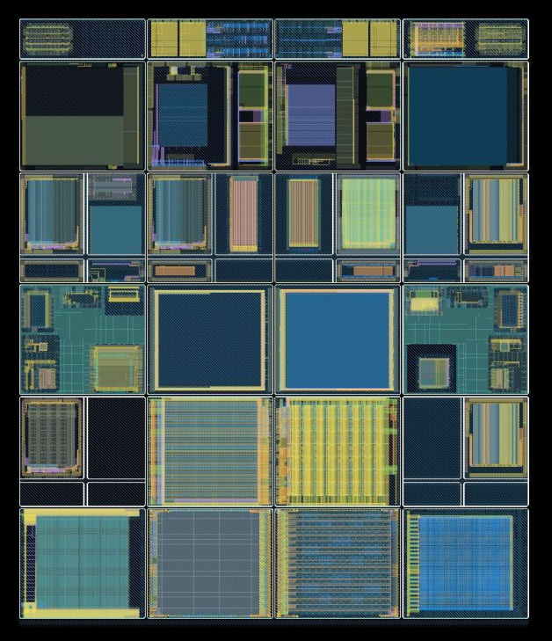
3-D Multi-Project Run
Fermilab has planned a dedicated 3-D multi project run using Tezzaron for HEP during 2009
There are 2 layers of electronics fabricated in the Global Foundries 0.13 um process, using only one set of masks. (Useful reticule size 15.5 x 26 mm)
The wafers are bonded face to face.
ATLAS/HL-LHC
Sub-part
    During 2011, the Omegapix2 was submitted via CMP, october 2011

Slide 6
2 sensor designs for a 3D Omegapix2 readout ASIC (Tezzaron Chartered)
Cis pixel Matrix
VTT pixel Matrix
Pixel Size( um): X : 200 microns
Pixel Size (um) Y : 35 microns
Matrice : 24 x 96 pixels : 2304 channels
  Active Sensor Area: 4800 x 3360 µm²
Omegapix2 : 5 x 5 mm²
Efficient Active zone : 64% because of Guard ring structure
Long Pixels on the Borders
Pixel Size( um): X : 200 microns
Pixel Size (um) Y : 35 microns
Matrice : 24 x 96 pixels : 2304 channels
  Active Sensor Area: 4800 x 3360 µm²
Omgapix2: 5x5 mm²
Efficient Active zone Bigger depending of the number of GR (0,1, 12) + (0 or 1 BR)

Slide 7

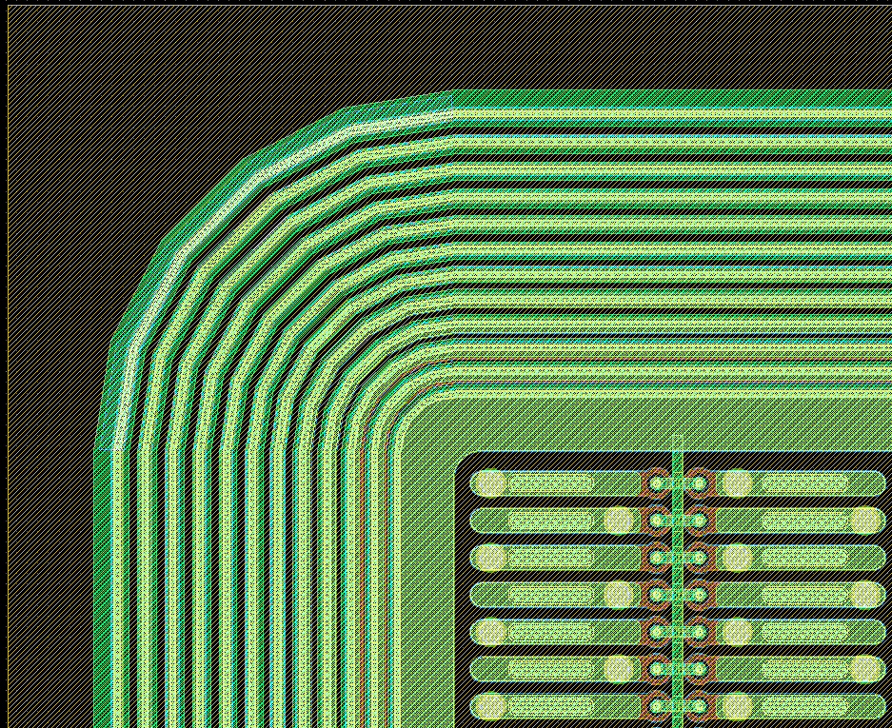
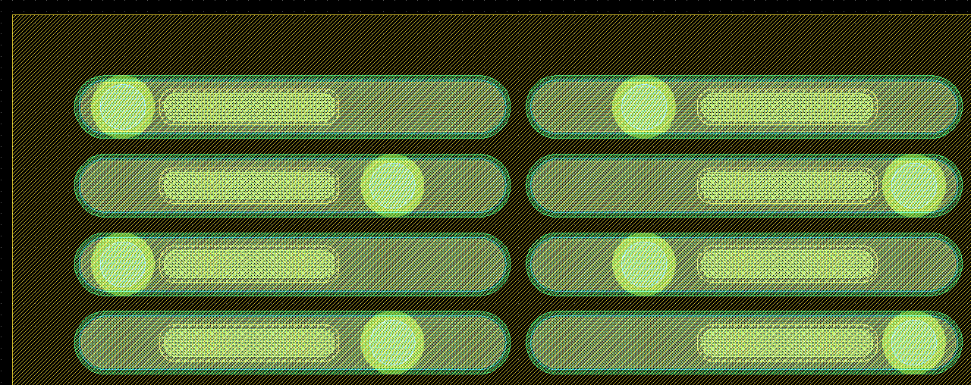
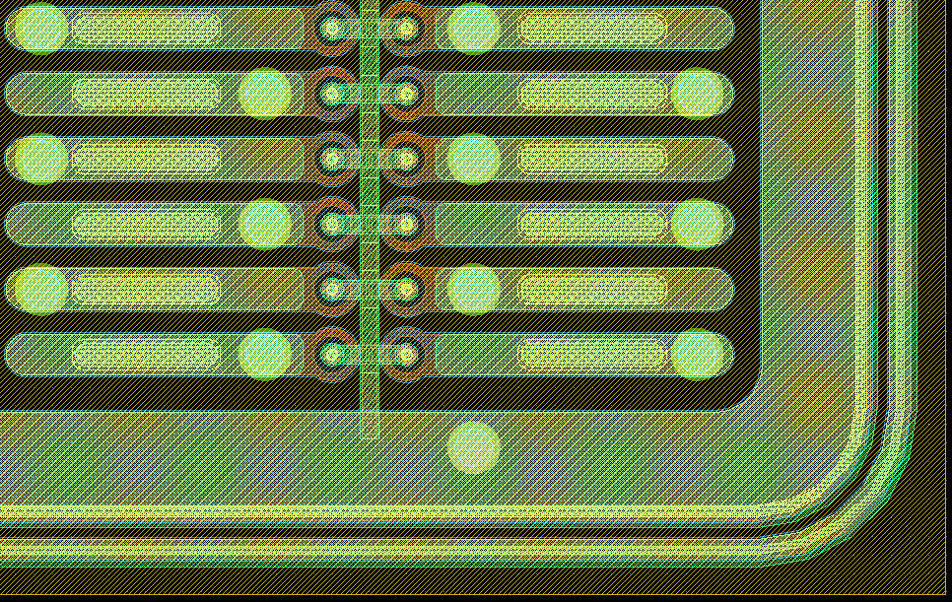
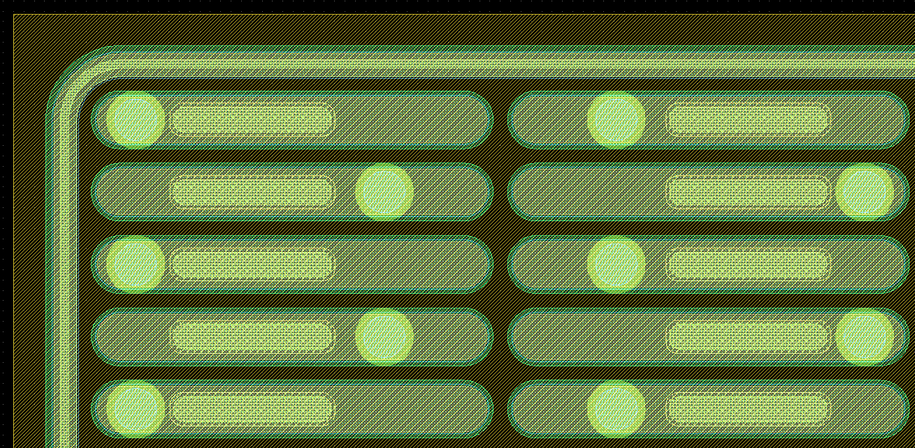
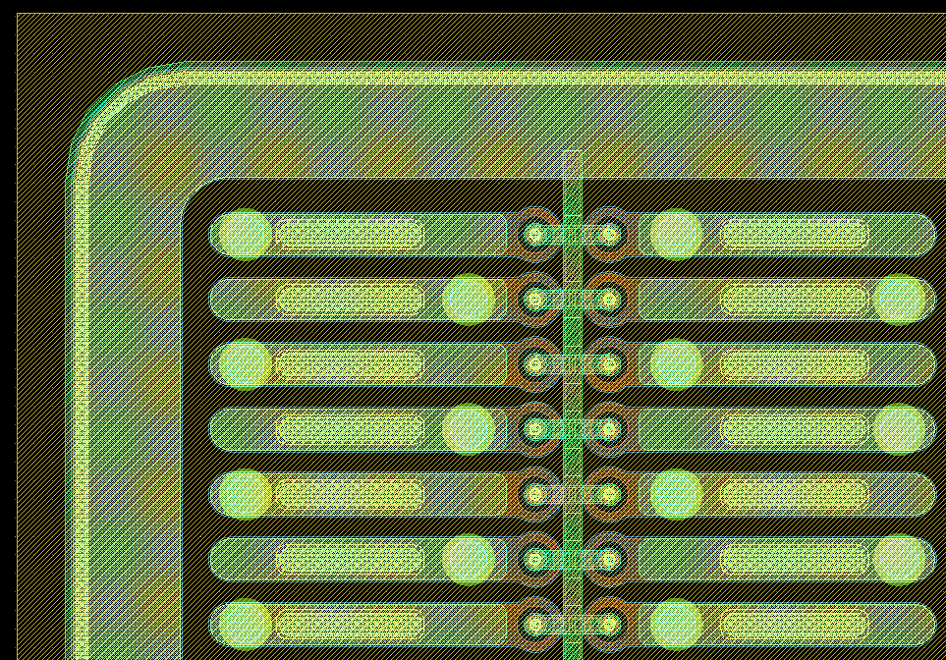
VTT OMEGAPIX
~400µm
VTT OMEGAPIX (SlimEdge & Edgeless) designs:
  12 GR +BR
  1GR + BR
  0 GR + BR
  0 GR & 0 BR
  1GR & no BR
All designs:
  Active Area: 4800 x 3360 µm2
  Array: 96 x 24 (ϕ,z)
  Pixel Size : 35 x 200 µm2
  Thickness: 100 & 200 µm
z
ϕ
~25µm
12GR+BR
0GR + 0BiasRing
~125µm
~35µm
1GR +BiasRing
~100µm
0BiasRing+1GR
oGR+ BiasRing

Slide 8
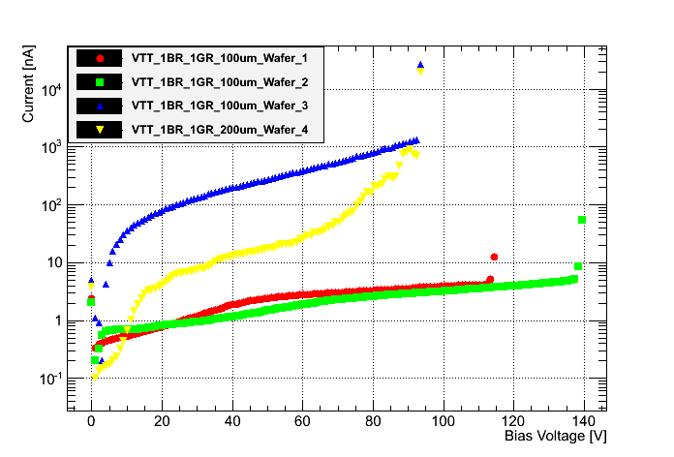
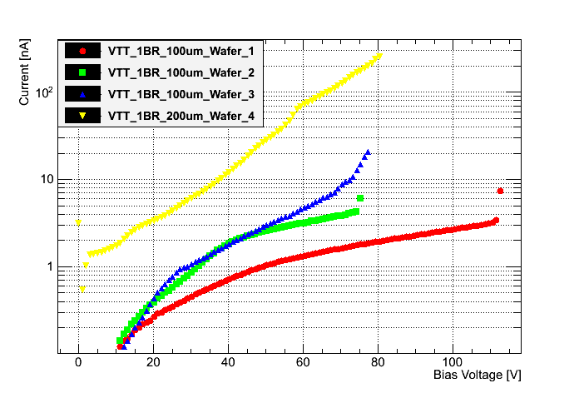
VTT SlimEdge:
~100µm
~125µm
1GR + BiasRing
BiasRing + 0 GR
2ooum
2ooum
1ooum
VTT: BiasRing + 1GR
100-200µm thickness
Vbd ~ 100V to 140V
VTT: BiasRing
100-200µm thickness
Vbd ~ 75V to 120V

Slide 9

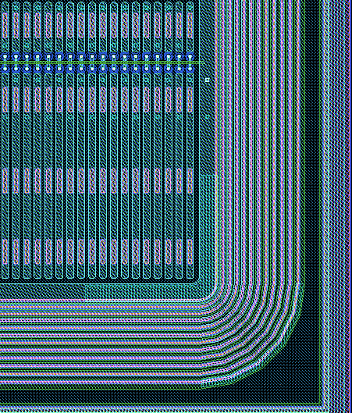
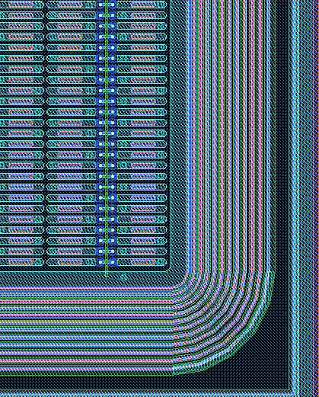
CiS OMEGAPIX
32 CiS OMEGAPIX detectors were received
  24 of new design (Ω1, Ω2 and Ω3)
  8 of old design (Ω)
  Ω1 & Ω2 were very close to the wafer edge
Both designs:
  12 GR ~400 µm inactive edge
  Active Area: 4800 x 3360 µm2
  Pixel Size : 35 x 200 µm2 (ϕ,z)
  300 µm thick
Different pixel arrays:
  Old: 16 x 142 (ϕ,z)
    With longer edge pixel
  New: 96 x 24 (ϕ,z)
    Compatible with the
    3D design electronics
Ω 1
Ω 2
Ω 3
Ω
z
ϕ
~400 µm
~400 µm
Old design (LAL)
New design (LAL)

Slide 10
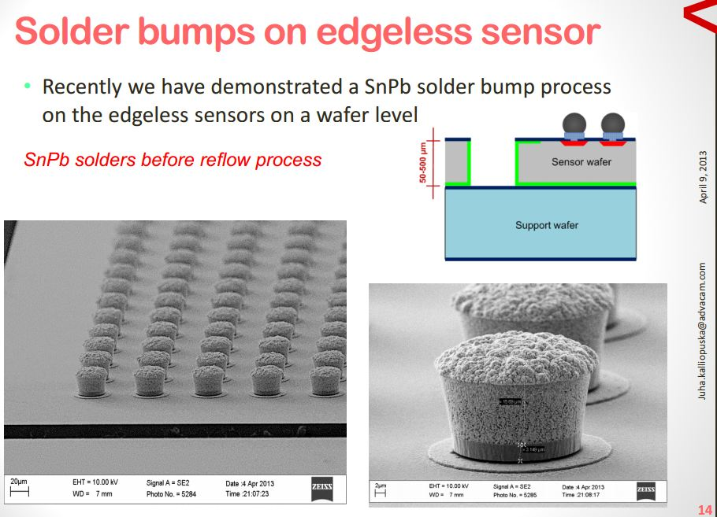
New challenges on interconnections for Edgless pixel sensor
Shown by Juha Kaliopuska, VTT AIDA 2013, Frascati

Slide 11
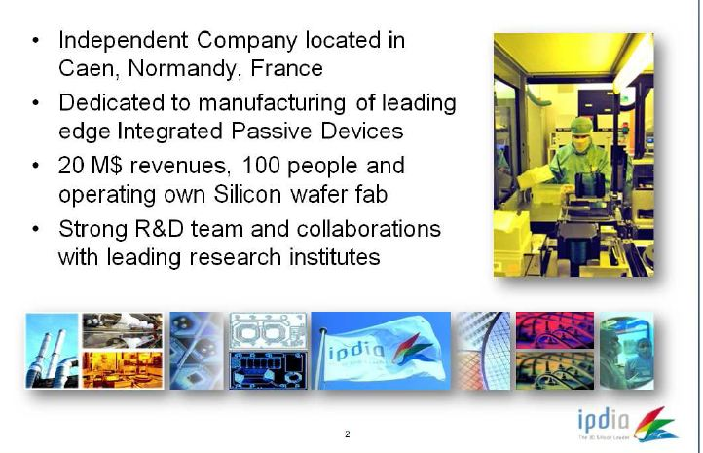
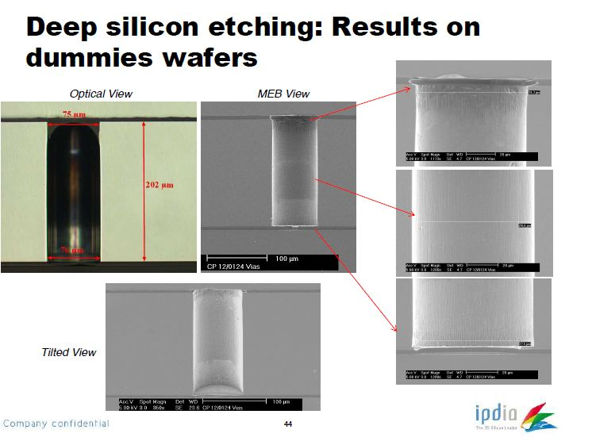
News on Industrial contacts : IPIDIA
IPIDIA, Normandie
First contacts taken on
March 18th, 2013
Our first conclusions:
Open and cooperative
State of the Art in Interconnections
Attractive in terms of cost
Ongoing Work with CERN (CMS) fast and Positive feedback

Slide 12
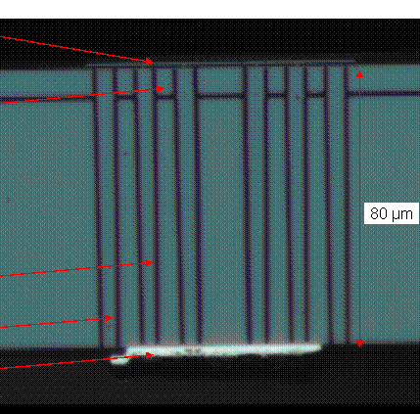
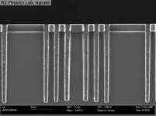
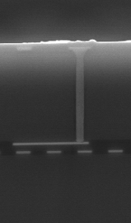
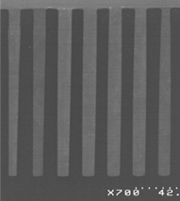
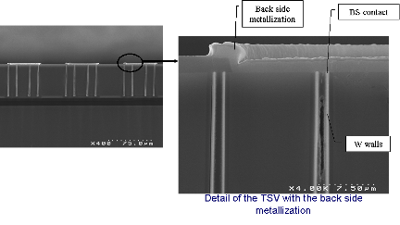
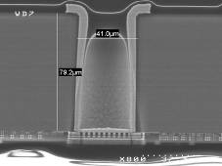
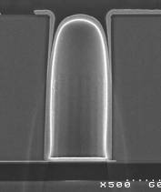
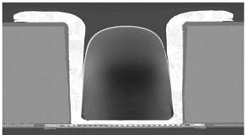
TSV Toolbox at CEA/LETI Grenoble: Open 3D Initiative
Through Silicon Via (TSV)
Technological Offer
Via First TSV (Polysilicon filled)
Trench AR 20, 5x100µm
Via Middle TSV (Copper or W filled)
AR 7 , 2 x 15µm
AR 10, 10x100µm
W filled
Via Last TSV (Copper liner)
métal RDL
BCB
SiO2 flanc
bulle air sous BCB
60µm
AR 1 80x80µm
AR 2, 60x120µm
AR 3, 40x120µm

Slide 13
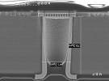






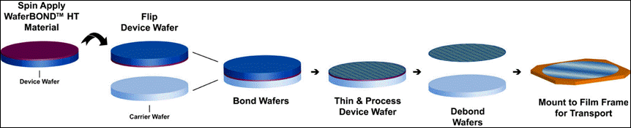
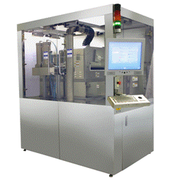
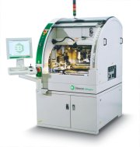
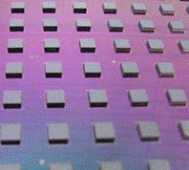
LETI Technological Offer
Six elementary bricks
  TSV Last (AR 1:1 & 2:1)
  Interconnections C2C : Cu pillars
  Interconnections C2C Cu post
  Interconnections C2S : Cu pillars
  Temporary bonding / Thinning / Debonding
  Stacking & underfilling
Frequent Contacts In 2013: First impression : Positive ,
Medipix First Project : Positive and encouraging
Cost ~ hundred K€ (to be discussed)

Slide 14
Via Last AIDA project: LAL + LPNHE
Bump bonding
TSVs module
back side
front side
front end chip (65 nm)
100 μm
First proposal
Bonding …
150 μm or less
sensor
HV
100 μm
front side
back side
front end chip (65 nm)
TSV
Interconnexions
150 μm or less
sensor
second proposal
HV

Slide 15
Project forecast & Time scale
Omegapix 2 3D 130 nm CMOS ASIC (Tezzaron Chartered) expected in May 1st, 2013 ---All test infrastructure ready in our laboratories for testing
(Wafer procurement from tezzaron ?)
Pixel Sensors matrices from Cis and VTT (egless) received and are functionnal
65 nm ASIC design has started, Green light from CERN for Company provider expected this summer
Interconnections : Now better view of potential candidates
Middle size « open 3D » companies identified, wafer procurement is an issue to be adressed.
Thank you

