Slide 1

CAD Tools for 3D-IC and TSV-based designs
Kholdoun TORKI
Kholdoun.Torki@imag.fr
CMP
46, Avenue Félix Viallet,
38031 Grenoble, France
http://cmp.imag.fr

Slide 2
Agenda
Introduction
Process overview
3D-IC Design Platform
3D-IC industrial CAD tools
Conclusion

Slide 3
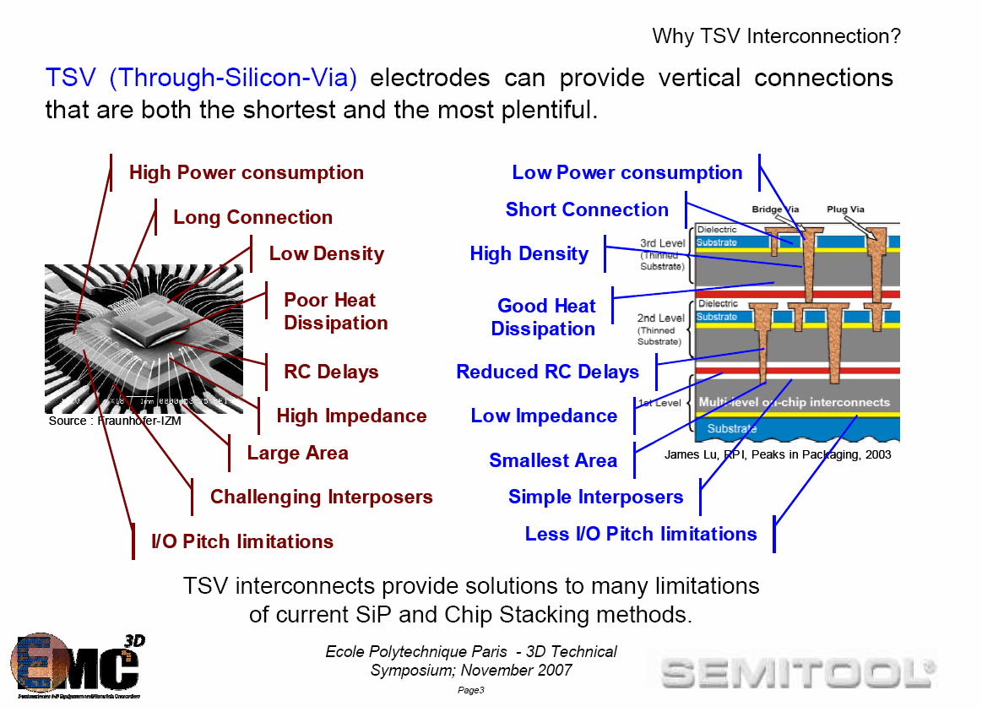
SiP versus 3D-IC

Slide 4
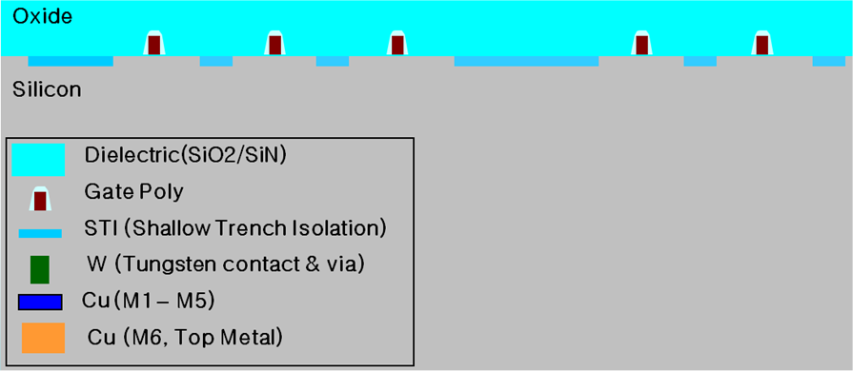
Tezzaron Process Flow for TSV and DBI (using Via Middle process)
Starting wafer in 130nm (5 Cu metal layers + 6th Cu metal as DBI)
Source Tezzaron

Slide 5
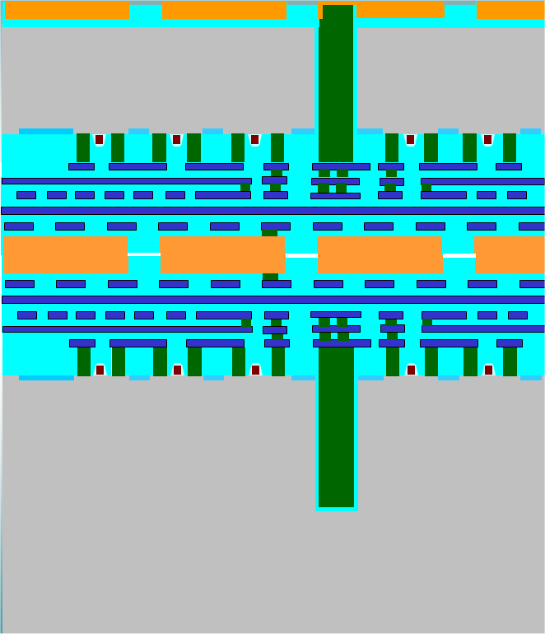
Resulting 2-tier 3D-IC integration TSV and DBI (Via Middle Process)
Bond pad for wire bonding or bump, flip-chip …
Top Tier
(10um thickness)
Bottom Tier
(Handle wafer)
Source Tezzaron

Slide 6
Interconnections
Interconnection Type | Line Width (µm) | Line Thickness (µm) | Line Resistance (Ohm/cm) | Max Length (cm)
Direct Bond Interface (DBI) | 2-100 | 2-100 | 0 | 0
Through Si Via (TSV) | 1-100 | 1-100 | 500-1000 | 5-100
On-Chip | 0.1-2 | 0.1-2 | 100-1000 | 0.1-1.5
Thin-film | 10-25 | 5-8 | 1.25-4 | 20-45
Ceramic | 75-100 | 16-25 | 0.4-0.7 | 20-50
PCB | 60-100 | 30-50 | 0.06-0.08 | 40-70
Shielded Cables | 100-450 | 35-450 | 0.0013-0.033 | 150-500
Interconnections in the 3rd dimension at Tezzaron/GF 130nm
 | Size | Capacitance | Series Resistance
DBI | 2µ | << | <
TSV | 1. 2µ | 2-3 fF | <1.5 Ω

Slide 7

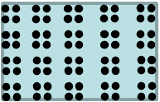
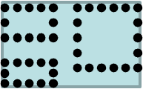

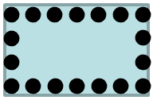
Design Methodology
The more is the Design Automation on the 3rd dimension, the more is the 3D-IC Integration.
3 D
Processor + DRAM + RF + MEMS + Optical communication
NoC
2.5 D
Multi-Processors + Memory
Pixel Sensor (HEP)
Simple Imaging Sensor
Memory Stack
2 D
System Complexity

Slide 8
3D-IC Design Platform

Slide 9
Tezzaron / GlobalFoundries Design Platform
Modular Design Platform. It has all features for full-custom design or semi-custom automatic design.
  PDK : Original PDK from GF + (TSV / DBI) definition from Tezzaron
  Libraries : CORE and IO standard libraries from ARM
  Memory compilers : SPRAM, DPRAM and ROM from ARM
  3D-IC Utilities : Contributions developments embedded in the platform
  Tutorials, User’s setup.
All modules inside the platform refer to a unique variable, making it portable to any site. The installation procedure is straightforward.
Support of CDB and OpenAccess databases.

Slide 10
PDK Tezzaron / GlobalFoundries
chrt13lprf_DK009_Rev_1D (Version issued in Q1 2011)
assura:
FILLDRC
LVS
QRC
assura
calibre
cds_cdb
cds_oa
doc
eldo
hercules
hspice
prep3DLVS
skill
spectre
strmMaptables_ARM
strmMaptables_Encounter
calibre:
3DDRC
3DLVS
DRC
FILLDRC
calibreSwitchDef
hercules:
DRC
LVS
STAR_RCXT

Slide 11
Collaborative Work on the Design Platform
HEP labs contributing with Programs, Libraries, and Utilities. All included in the Design Platform
DBI (direct bonding interface) cells library. (FermiLab)
3D Pad template compatible with the ARM IO lib. (IPHC)
Preprocessor for 3D LVS / Calibre (NCSU)
Skill program to generate an array of labels (IPHC)
Calibre 3D DRC (Univ. of Bonn)
Dummies filling generator under Assura (CMP)
Basic logic cells and IO pads (FermiLab)
Floor-planning / automatic Place & Route using DBIs, and TSVs (CMP)
Skill program generating automatically sealrings and scribes (FermiLab)
MicroMagic PDK (Tezzaron/NCSU)

Slide 12
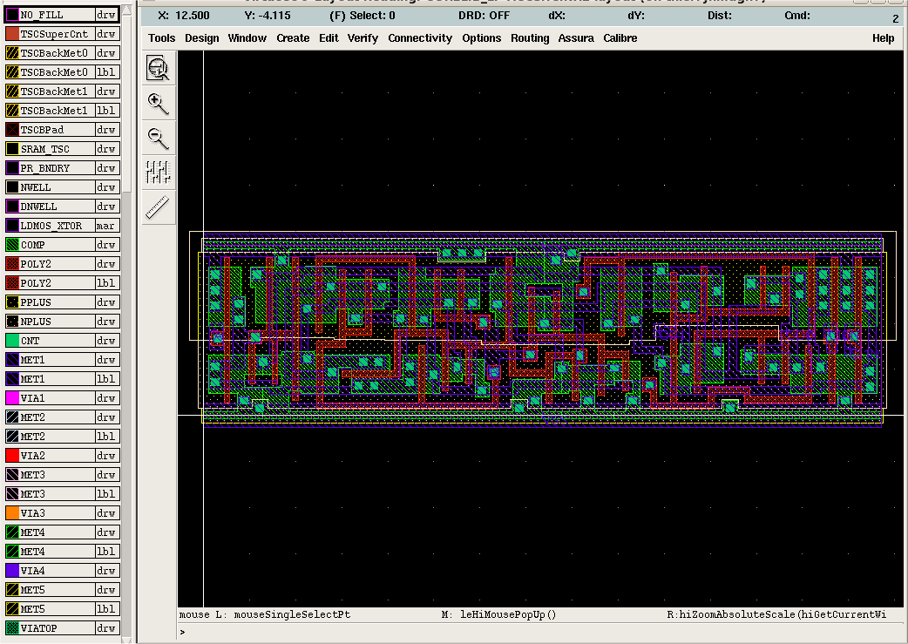

Virtuoso Layout Editor with 3D layers and verification
Virtuoso from Cadence IC 5.1.41
TSV
Back Metal
Calibre
Back Pad
Assura
DBI

Slide 13
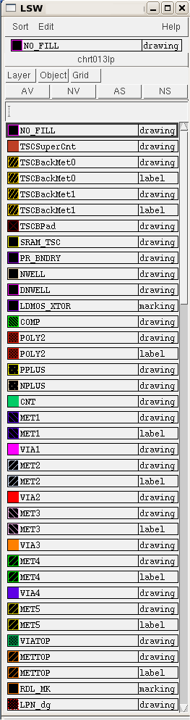
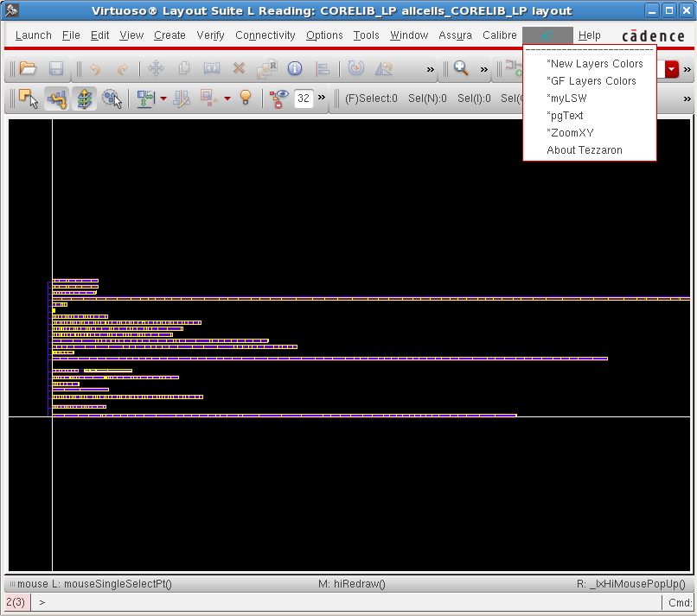
Customized Menu with some utilities
Virtuoso from Cadence IC 6.1.4

Slide 14
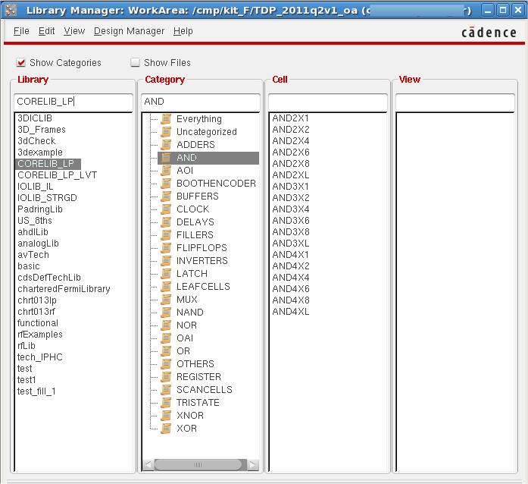
Libraries from Providers and Users
Univ. Bonn
NCSU
ARM
IPHC
FermiLab
GF/TSC

Slide 15
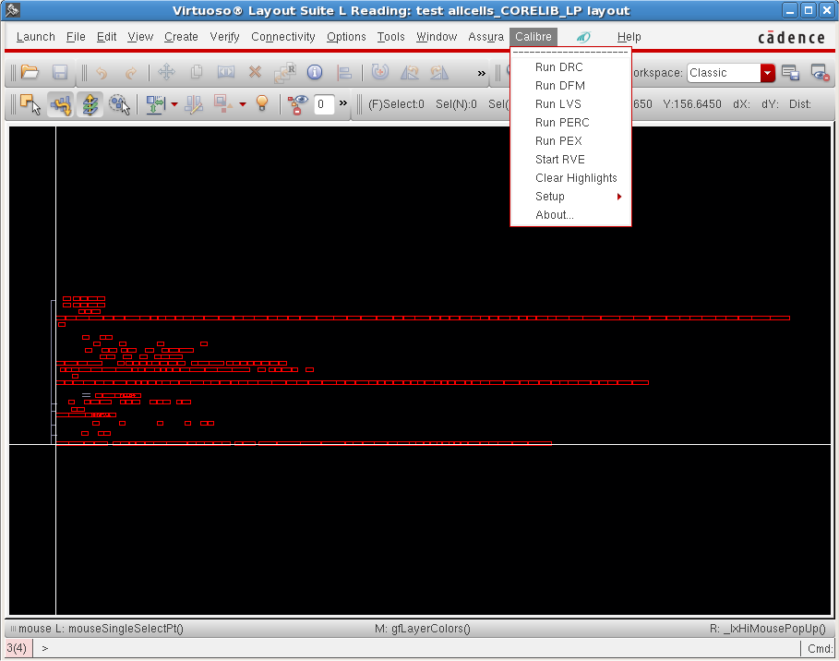
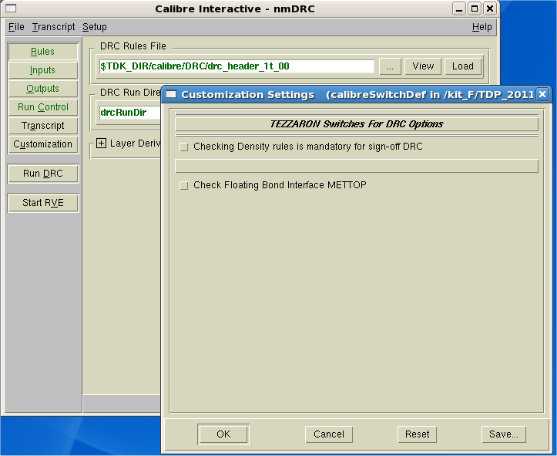
Virtuoso / Calibre DRC Interactive Menu
Setting switches
graphically

Slide 16
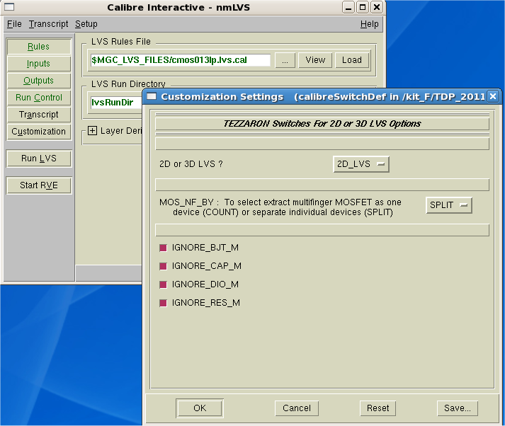
Virtuoso / Calibre LVS Interactive Menu
Choosing 2D
or 3D LVS

Slide 17
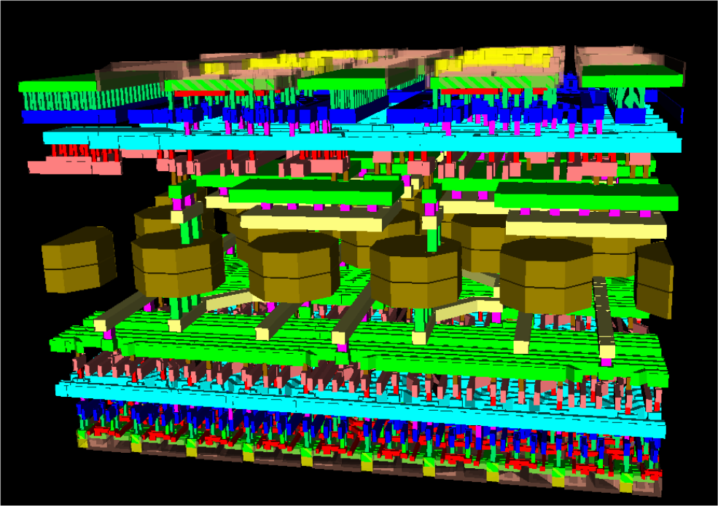
3D viewer in Virtuoso Layout
- Graphically Interfaced into Virtuoso.
- Works for both CDB and OA.
- Use a free and open-source VRML viewer.

Slide 18
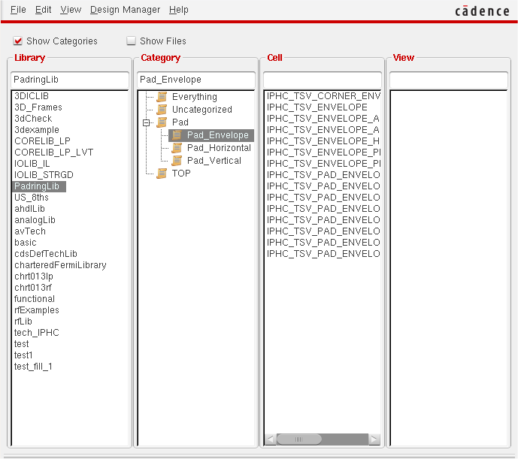
IPHC Contribution for 3D-IC IO Libraries
Pad shell containing TSV and DBI allowing the use of the ARM IO libraries in 3D-IC designs

Slide 19
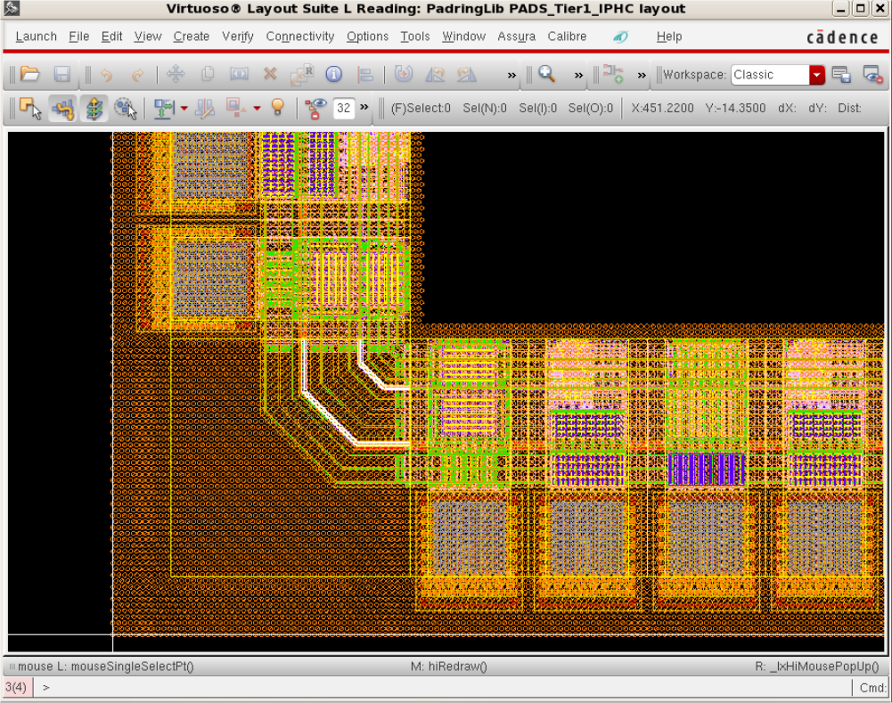
IPHC Contribution for 3D-IC IO Libraries
Pad shell containing TSV and DBI allowing using the ARM IO libraries in 3D-IC designs

Slide 20
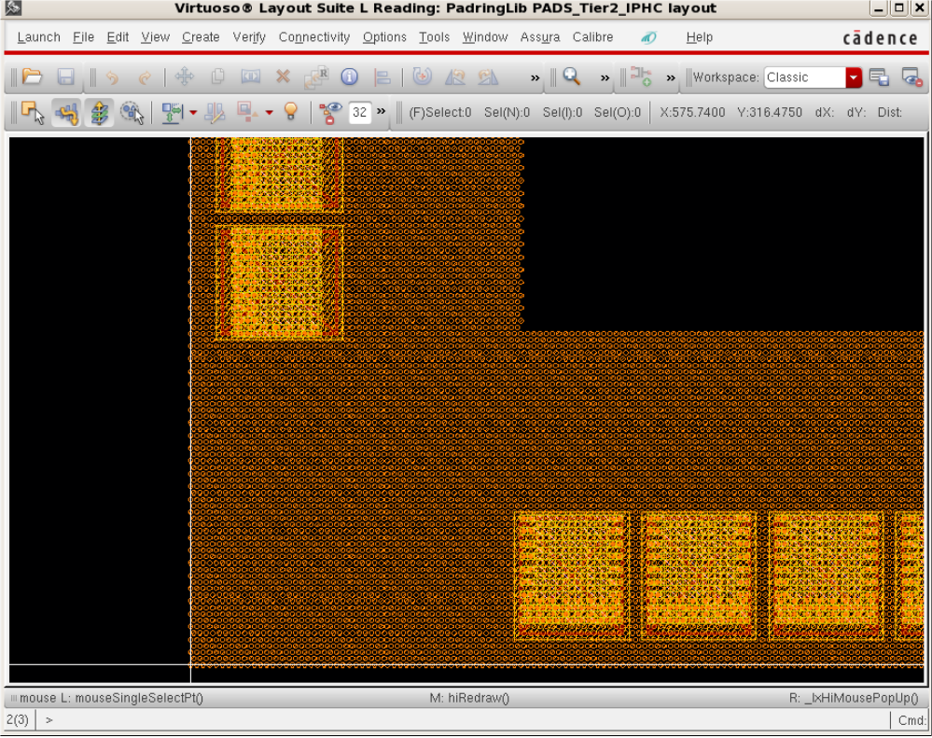
IPHC Contribution for 3D-IC IO Libraries
Pad shell containing DBI and TSV connecting the pad to the backside bonding pad

Slide 21
3D-IC Automatic P&R using DBI and TSV
System Level Partitioning
Design exploration at system level
3D Floor-Planning
DBI, TSV, IO placement
Design exploration at the physical level
DBI, TSV, and IO placement & optimization
Automatic Place & Route
Cells and blocks place & route can be done tier by tier
Extraction, Timing Analysis
To be done for each tier, then combined for back-annotation to the 3D top level system
Physical verification
3D DRC, 3D LVS
Similar to the full-custom design flow
Dummies Filling
Final 3D DRC

Slide 22
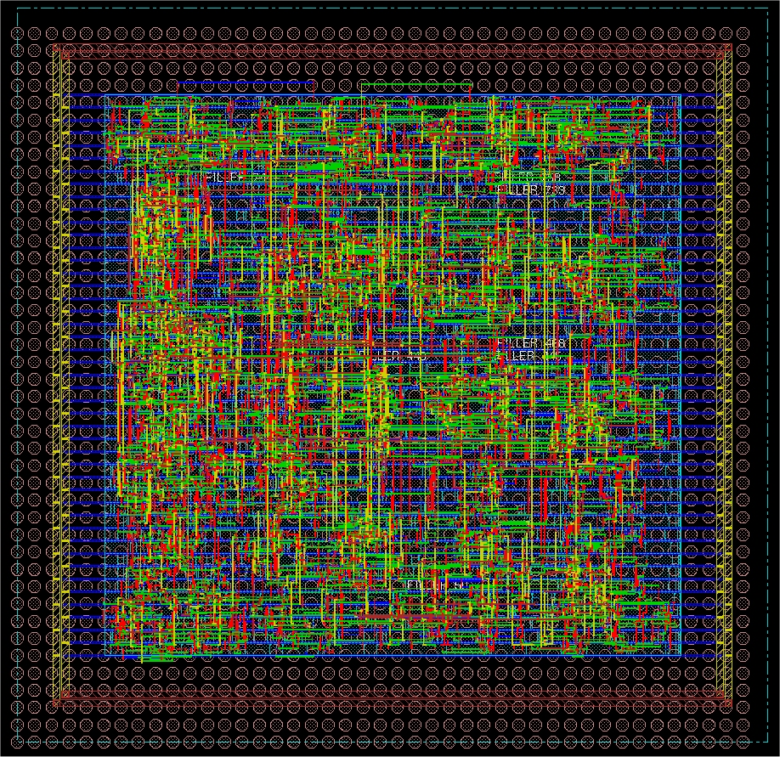
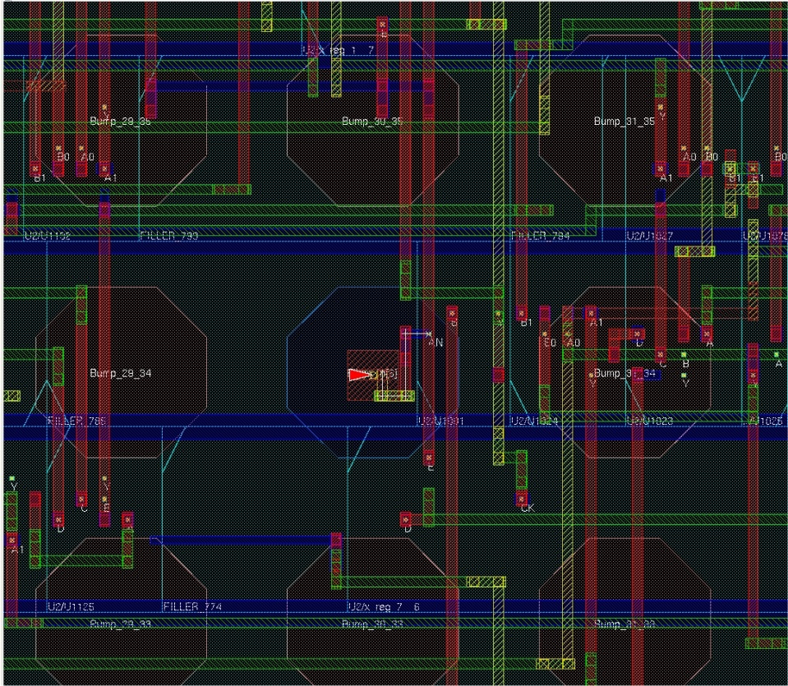
Automatic Place & Route with Direct Bond Interface
- Custom scripts allowing routing pins on DBIs.
- The resulting layout is compliant to the Tezzaron DRC, LVS etc …
DBI array generation + P&R
DBI completely routed down to the
lower metal layer

Slide 23
Automatic P&R with Direct Bond Interface
Saving the floor plan for the bottom tier, and apply it for top tier.
Place & Route taking into account the locations of the DBIs.
The place & route for both tiers is optimal for timing, buffer sizing and power performance.
This results in a “correct-by-construction” design.

Slide 24
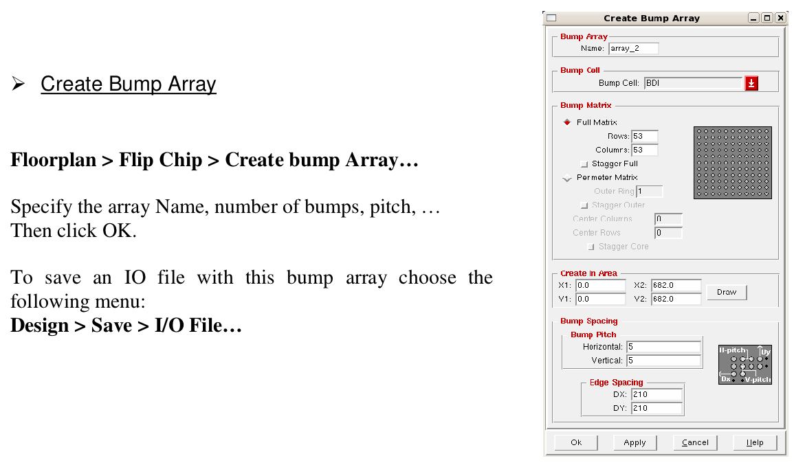
Cadence / Encounter Bump Array Generator

Slide 25
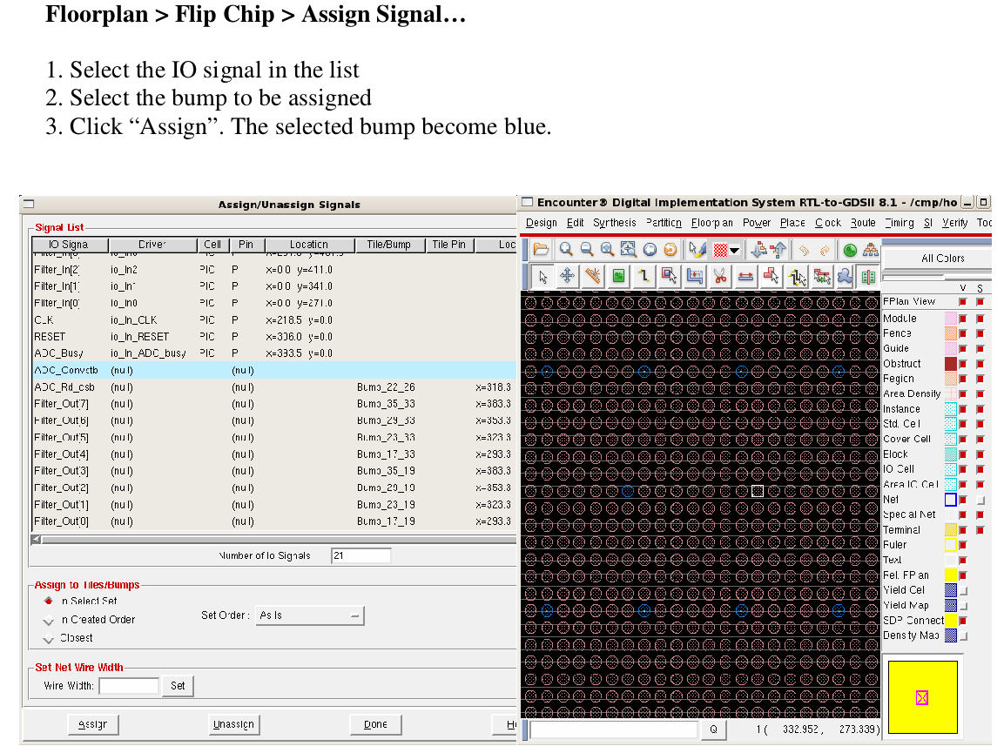
Cadence / Encounter Signal Bumps Assignment

Slide 26
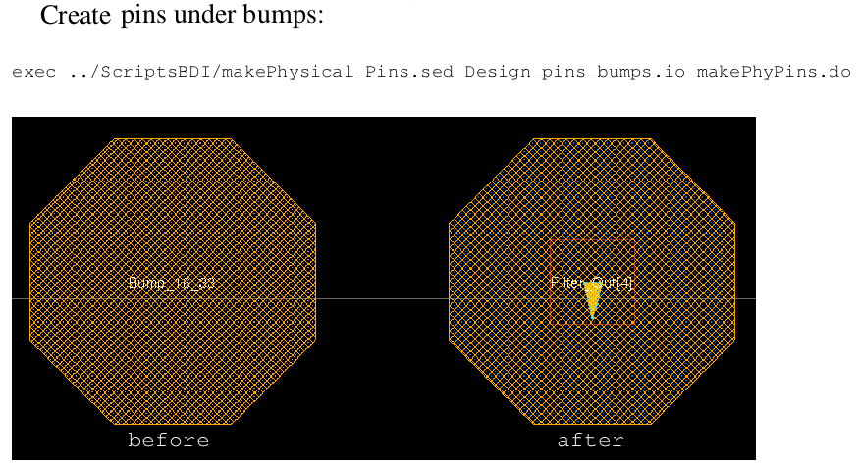
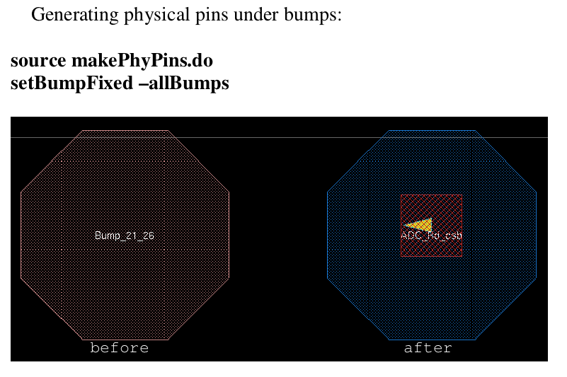
Custom Scripts Enabling Routing on DBIs
Placing logical pins on bumps (DBIs), and extract their location.
Before
After
Generating Physical pins from these locations.
They can now be used as terminals for routing.
Before
After

Slide 27
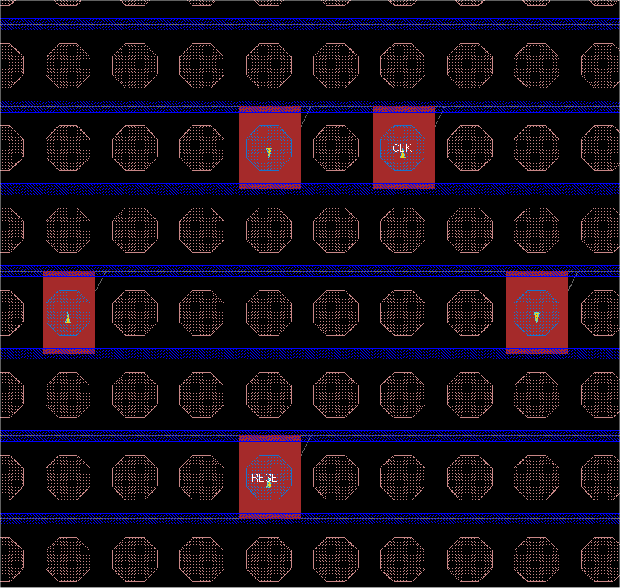
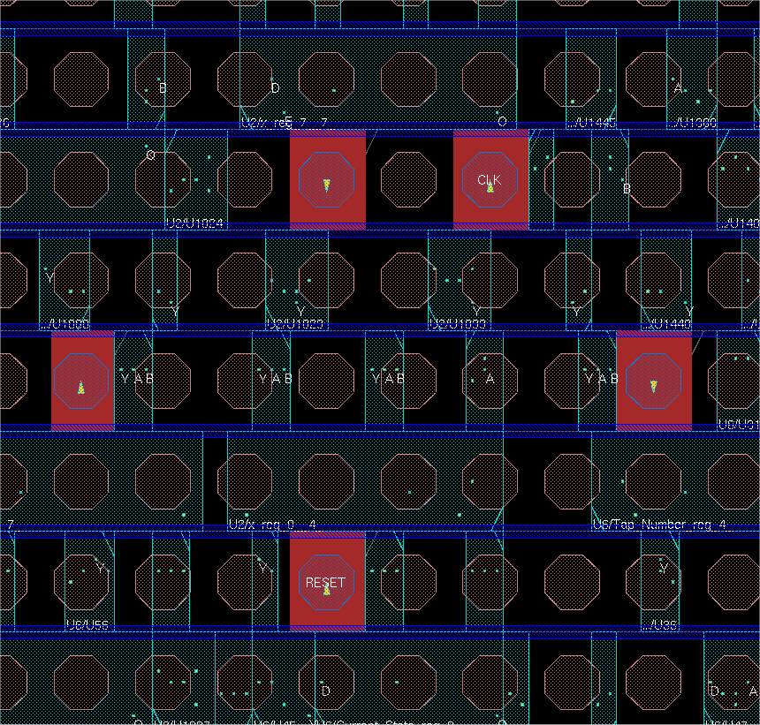
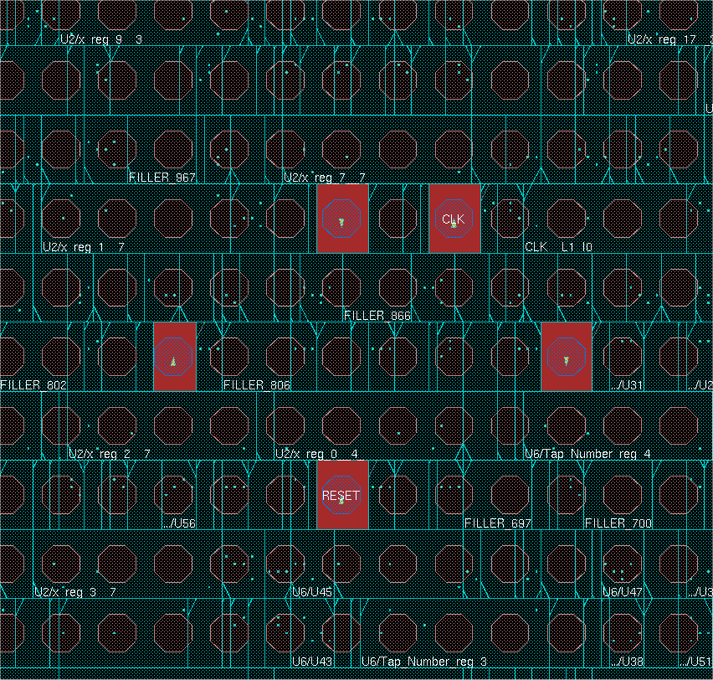
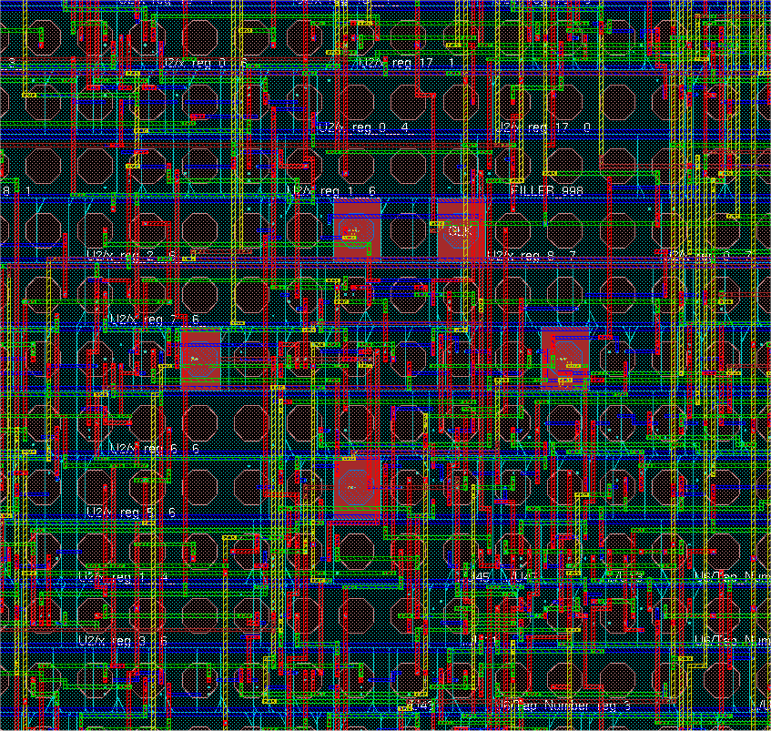
Automatic P & R Design Flow (From Floor-Plan to Routed Design)
- Std cells Placement
- Clock Tree Synthesis
Filler Cells Placement
- DBIs Placement
- TSVs Placement
- Obstructions on TSVs
- Clock routing
- Final routing

Slide 28
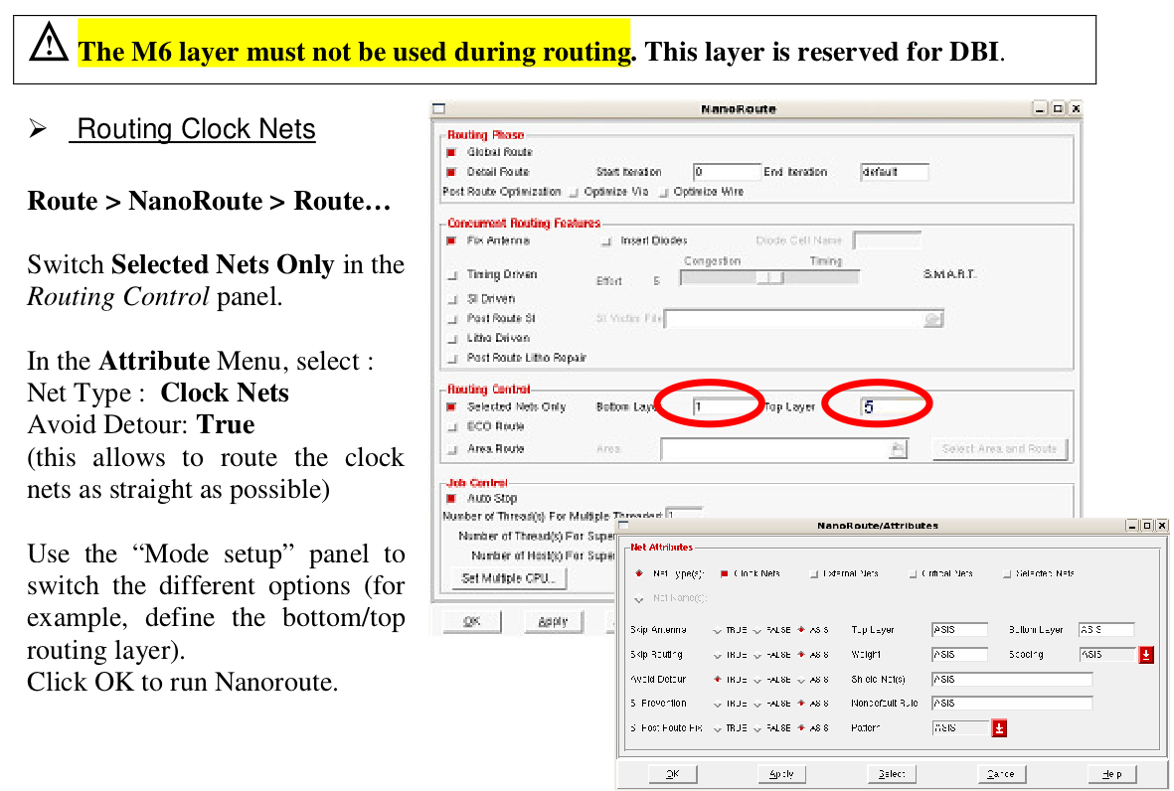
Clock and all nets routing is enabled on M1-M5

Slide 29


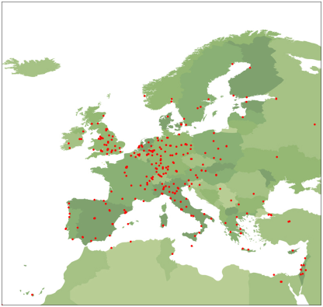

Cadence is making its 3D-IC design tools available to selected European academic institutions in partnership with the Europractice scheme operated by the UK Science and Technology Facilities Council Rutherford Appleton Laboratory
Proposals are being invited from the existing Europractice/Cadence user base of 378 European academic institutions
These selected early adopters will then be able to more efficiently design 3D-IC systems for their research projects, e.g. in new computer architectures, with the possibility of fabrication via existing broker services offered by CMP (Circuits Multi-Project) in France
Source John McLean
Rutherford Appleton Laboratory

Slide 30
True 3D Mask Layout Editor
Technology Files fully supported by Tezzaron
MicroMagic MAX-3D

Slide 31
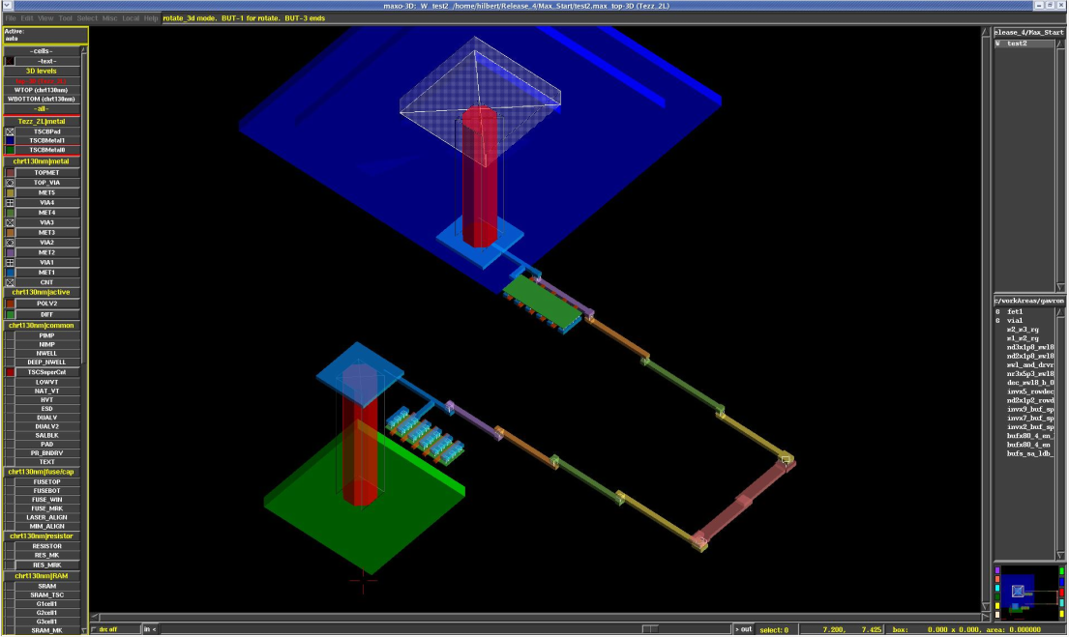
MicroMagic 3D viewer

Slide 32
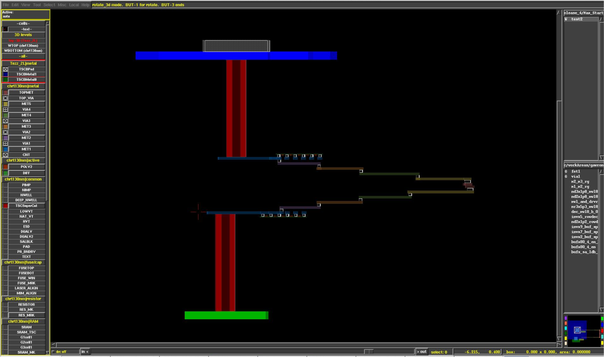
MicroMagic 3D crossection

Slide 33
Conclusion
A Design Platform resulted from the collaboration.
CMC, CMP, MOSIS, FermiLab, Tezzaron, HEP Labs, NCSU
Industrial CAD vendors just starting addressing the features.
Still awaiting for new CAD tools dedicated to 3D-IC Integration :
+ 3D-IC Partitioning : both at the system level and the floor-planning level.
+ Standard 3D layout editor (i.e. Virtuoso 3D)
+ Sign-off tools for 3D-IC Integration : (3D-DRC, 3D-LVS, 3D-Extration)

