Slide 1
Methods for architectural design methods of 3D-integrated systems
Andy Heinig, Uwe Knöchel
Fraunhofer IIS, Design Automation Division
Zeunerstraße 38, 01069 Dresden
andy.heinig@eas.iis.fraunhofer.de
Phone: +49 351 4640 783

Slide 2
Agenda
  Introduction
  Case study: interposer for Wide I/O memory – processor integration
  Chip-Package-Board-Co-design
  3D-Floorplanner and Flow
  Conclusion

Slide 3
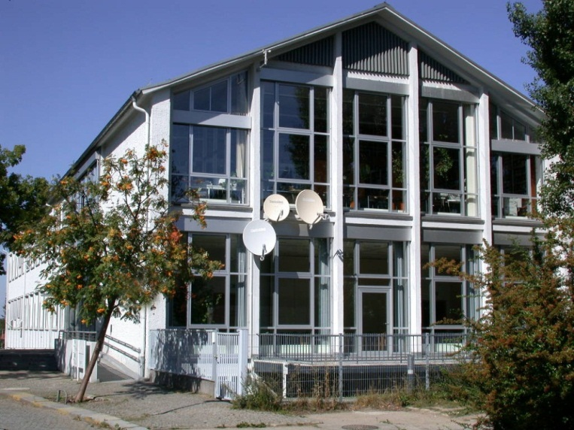
Fraunhofer IIS
Design Automation Division EAS
Profile
One of the largest research institutions in the field of design automation in Europe
Microelectronics and heterogeneous systems
Focus on all aspects of functional design
Challenges
Mastering the growing complexity of electronic systems
Closing the gap between manufacturing and system design
Comprehensive consideration of different physical domains

Slide 4
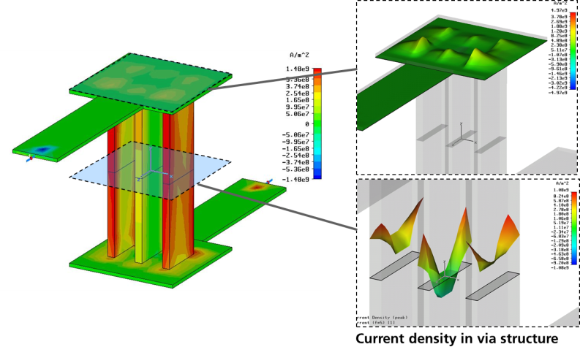
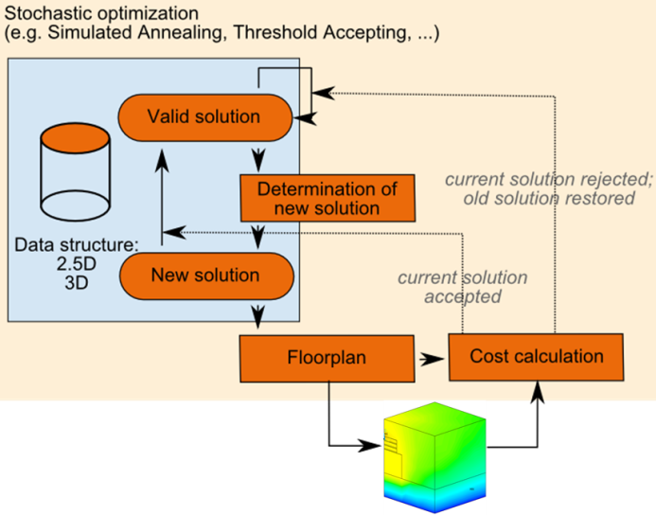
3D @ Fraunhofer IIS/EAS
History
Involved in 3D projects for over 10 years
Starting with electrical characterization of
TSVs and thermal simulation
Focused on technology improvement
Today
Multi physics analysis for library development and design rules
Integration into Design tools and flows
Development of methods for design space exploration (aca path finding, scouting) and floorplanning
Support of system design

Slide 5
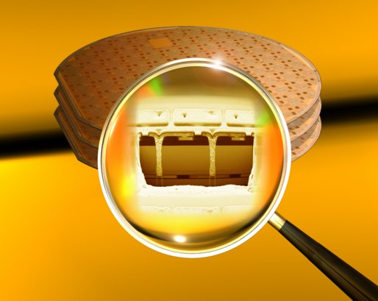
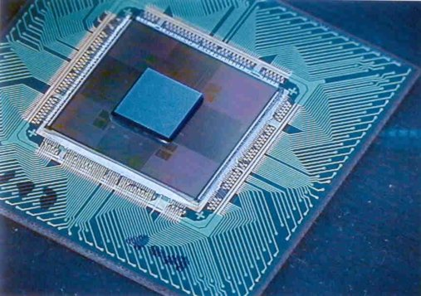
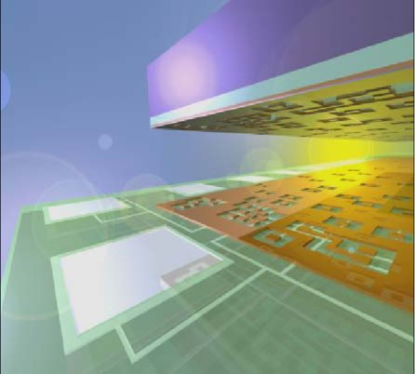
Why should the designer move from
SoC to 3D Integration?
Integration of mixed technologies
Performance
  Reduced interconnect length
  Lower delay, higher speed
  Reduced power consumption
Form Factor
  Reduced volume and weight
  Reduced footprint
Reduced Costs
  Cost per transistor start to grow below 22-nm
  Integration of heterogeneous technologies
  Integration of dies from high volume production
  Higher re-use rate (IP cores)
Notes:
If we compare the well known SoC integration with 3D integration then 3D integrated system has
Some advantages. 3D integration allows the integration of different technologies. 3D integration
Gives a better performance …

Slide 6
What designers ask:
What is the diameter of TSV? How big is the keep-out zone?
How many TSV can I use?
Who manufactures prototypes?
      Who provides the interposer?
      Who makes stacking and packaging?
      How much costs this?
Who manufactures products?
  Production time?
  Prizes?
  Testability?
How can I design this?
  EDA-tool environment
  Design Guidelines / Design-Kits
Notes:
So now the 3D integration technology is read but for the designers the technology is new. So they have
A lot of questions. For example technology questions like … They has also question about the supply chain for example …

Slide 7
Evolution of advanced packaging
2.5D-integration with interposer
Multiple IC are integrated at substrate or interposer
Supports integration of existing IP
Commercial application has been started
Reduced signal delay
3D-integration
System and individual dies are optimized for 3D
Provides highest performance and integration level
Co-design needed
Still in development only few products on market (memory stacks, processor with memory)
Side-by-side
Direct stacking
Top-bottom

Slide 8
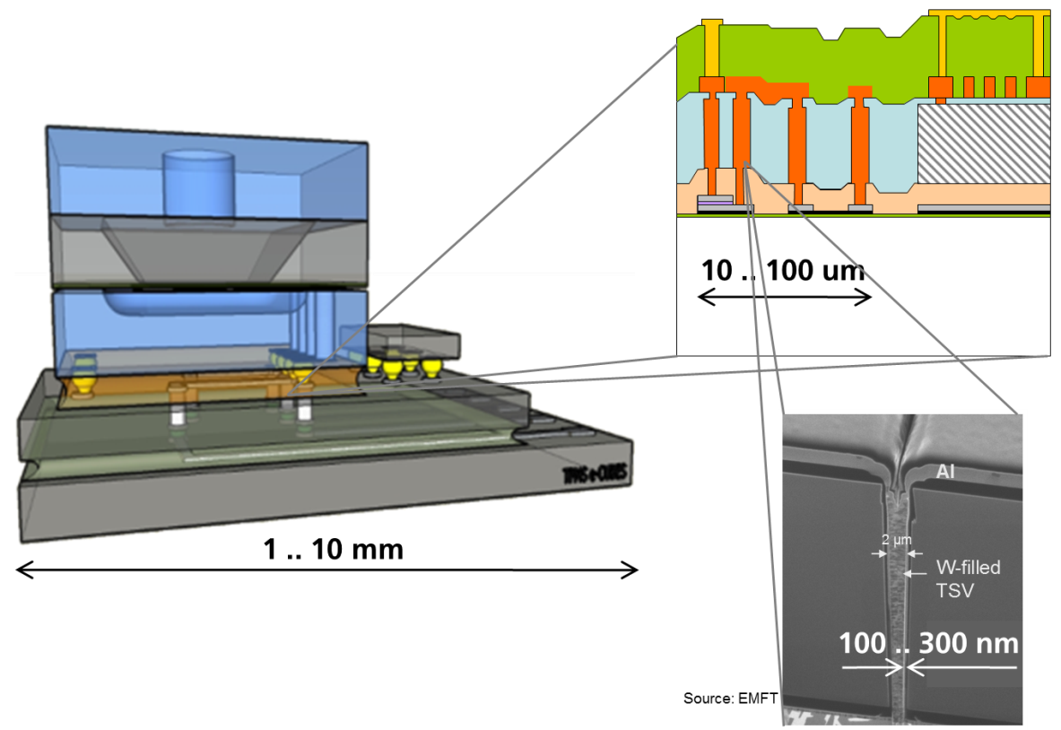
Challenges for 2.5D and 3D design
Top challenge for system design
Early estimation of performance, cost, reliability and risks
Why is this so difficult?
Design space complexity
Structural complexity
  Multi scale, multi physics
  Exceeds capacity of
  current simulators
Process complexity
Collaboration complexity
  System architect
  Component Designers
  IC manufactures
  OSATs

Slide 9
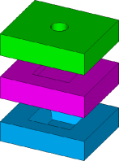


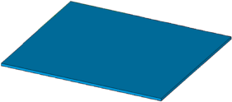
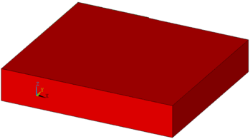

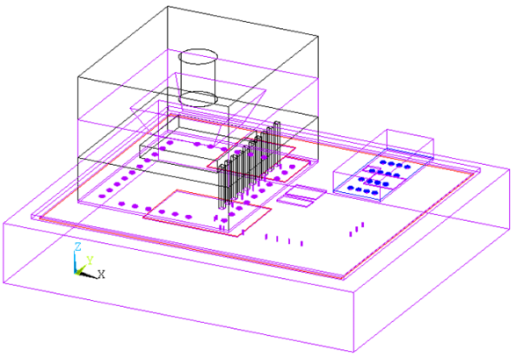
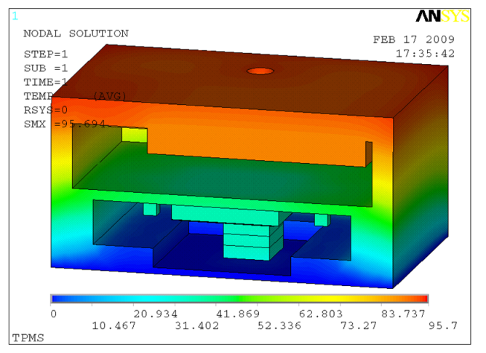
Modeling Concepts for Multi-Physics- Analysis
+
Model order
reduction
Thermal behavioral model
(Electro-)Thermal system simulation
Modular building blocks
FE model (ANSYS)
Detailed analysis of individual or critical parts with 3D-FEM analysis
Development of models at higher abstraction levels to handle system complexity
Interfaces between different tools
Thermal simulation of
entire 3D stack

Slide 10
Agenda
  Introduction
  Case study: interposer for Wide I/O memory – processor integration
  Chip-Package-Board-Co-design
  3D-Floorplanner and Flow
  Conclusion

Slide 11

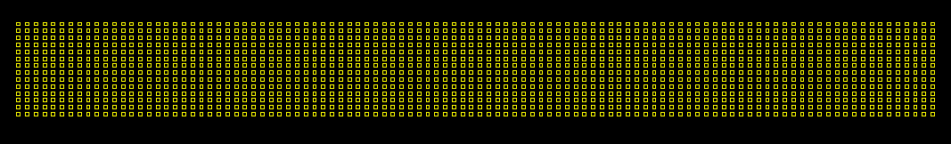
First Standard: JEDEC Wide I/O memory
  Application: memory on memory, memory on processor stacking
  JEDEC wide I/O memory standard for 3D integration: JESD229
Wide I/O RAM
10*9
    Very small size of pad area
    100 * 12 field of pads
    With 50 * 40um Pitch
Pads are located in
the center of memory die
Notes:
11

Slide 12
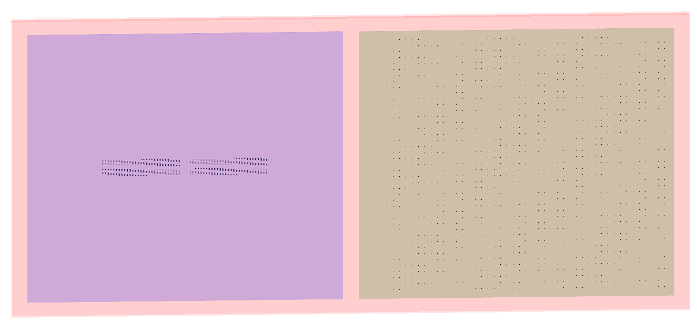
Case study: Side by side integration of
JEDEC Wide I/O memory and processor
CPU
10*10
Wide I/O RAM
10*9 mm²
Pads are located in
the center of memory die
    Requirements
    2200 pins processor, 1200 pins memory, 1000 pins external
    Side by side integration to avoid thermal and other problems
    Optimized for mass production
Notes:
12

Slide 13
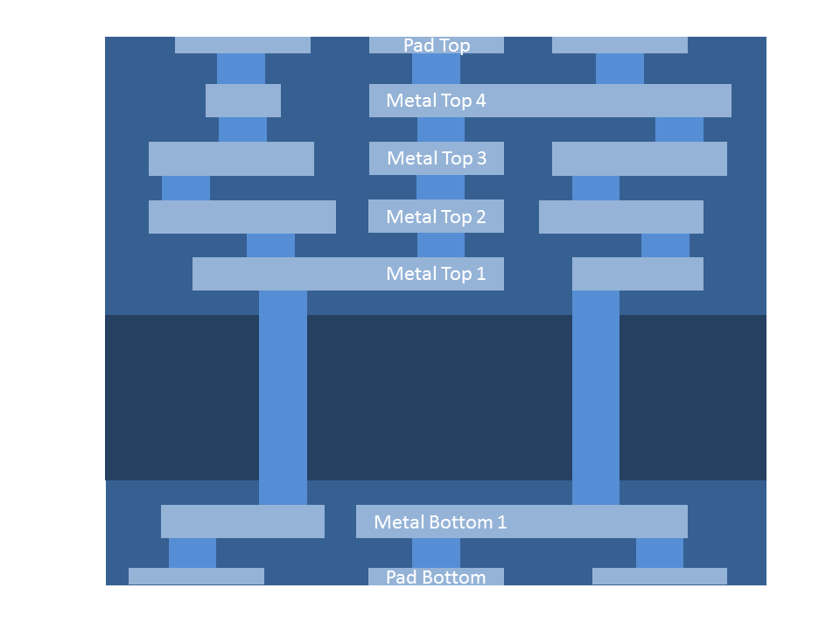
2.5D interposer for JEDEC Wide I/O memory
Initial Configuration
    Top of interposer
      4 metal layers for signal routing
      1 additional metal layer for pads
    Bottom of interposer
      1 metal layer for signal routing
      1 additional metal layer for pads
    As both active IC placed on top, signals will be mainly routed on top of interposer -> less TSV needed
Technology Parameters:
10um metal width
10um metal space
10um TSV
But 5 metal on top and only 2 at bottom
is not a good choice …

Slide 14
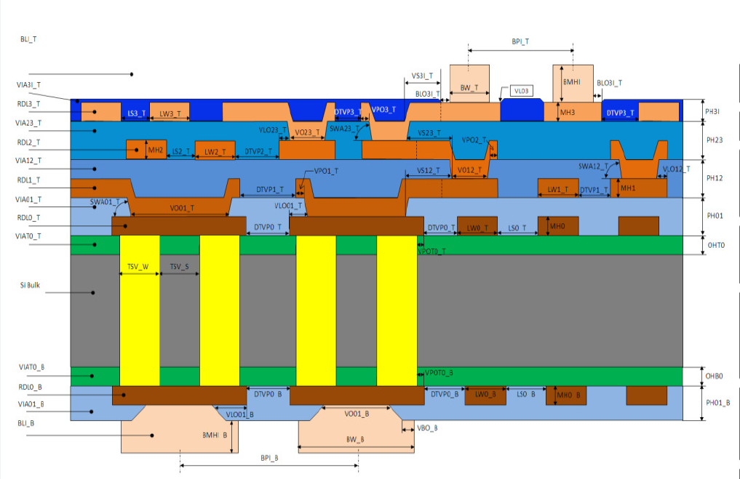
Technology Design Guide Lines
Metal:
Space 8µm
Width 8µm
Height 3µm
Dielectric:
Polymer e_{r} 2.9
Thickness 5µm
TSV:
Diameter 10µm
Depth 120µm
Warping is critical!

Slide 15
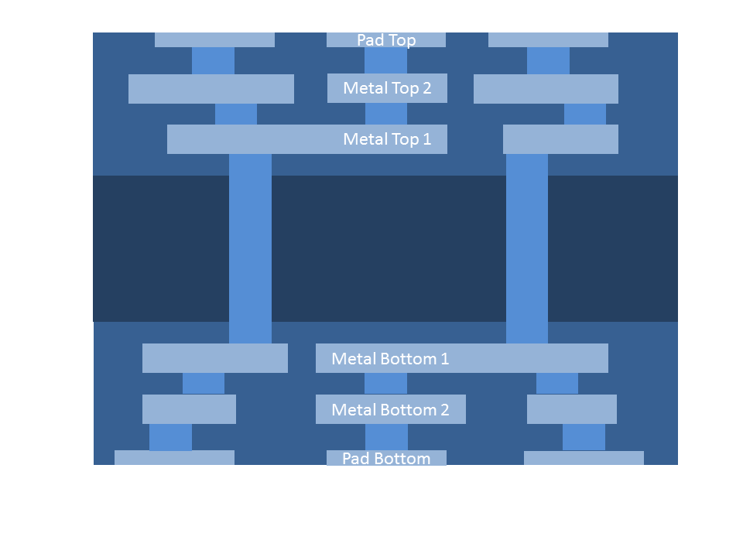
2.5D interposer for JEDEC Wide I/O memory
Second configuration
    Top of interposer
      2 metal layers for signal routing
      1 additional metal layer for pads
    Bottom of interposer
      2 metal layer for signal routing
      1 additional metal layer for pads
    Number of metal layers balanced between top and bottom
    More TSV needed (also for connections between processor and memory)
    Simultions shows that timing constraints can be achieved with routing via TSV
Technology Parameters:
10um metal width
10um metal space
10um TSV
The warping can be avoided,
but we can additionally save costs …

Slide 16
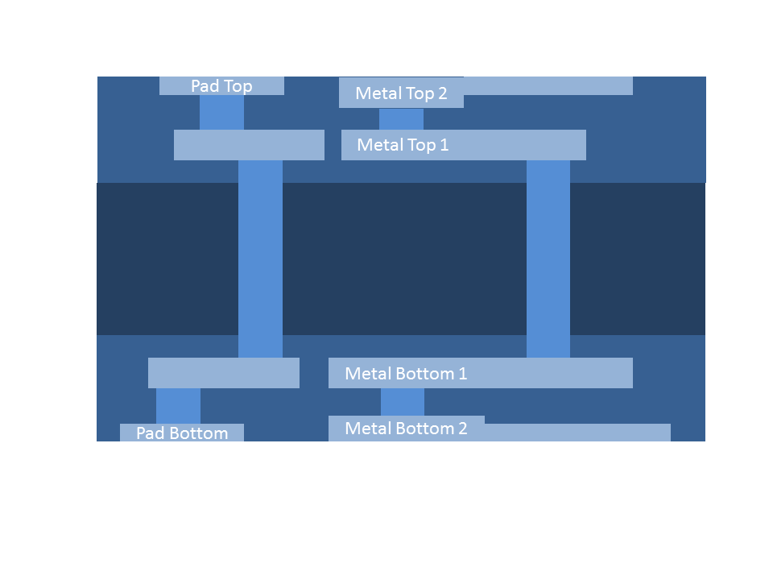
2.5D interposer for JEDEC Wide I/O memory
Cost optimized configuration
    Top of interposer
      1 metal layer for signal routing
      1 metal layer for routing and pads
    Bottom of interposer
      1 metal layer for signal routing
      1 metal layer for routing and pads
    Number of metal layers balanced
    Only two metal layers on each side!
Technology Parameters:
10um metal width
10um metal space
10um TSV
Challenge:
Very high density of wires at interposer
Standard routing algorithms need more metal layers
Optimized interposer was routed by our inhouse algorithms

Slide 17
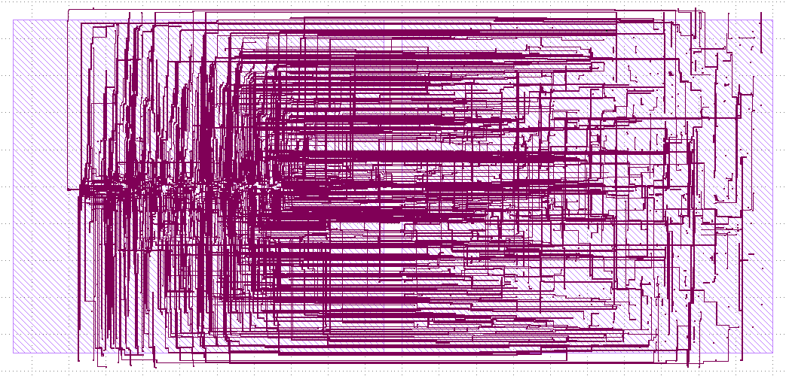
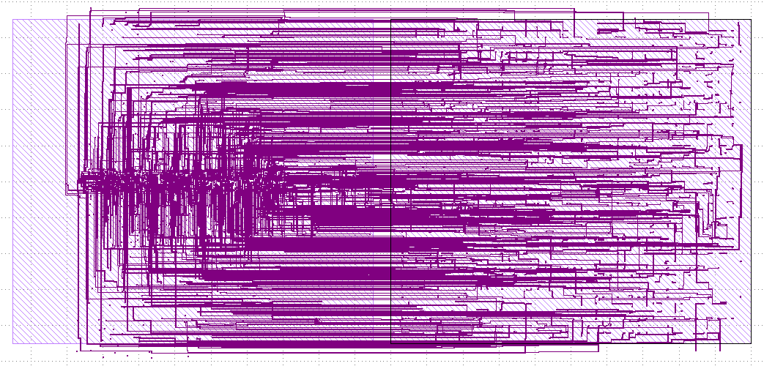
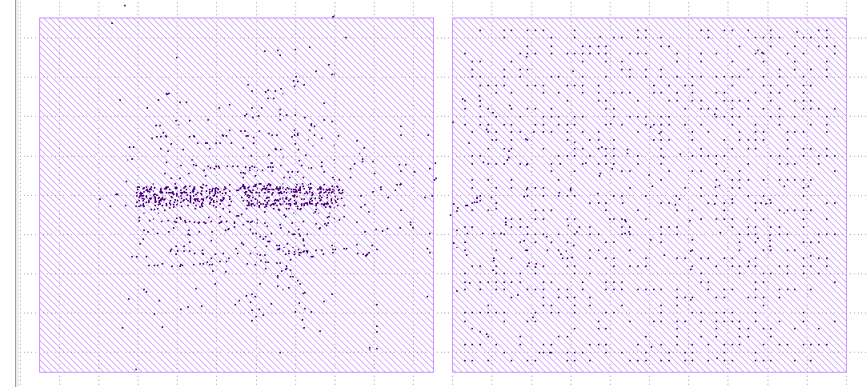
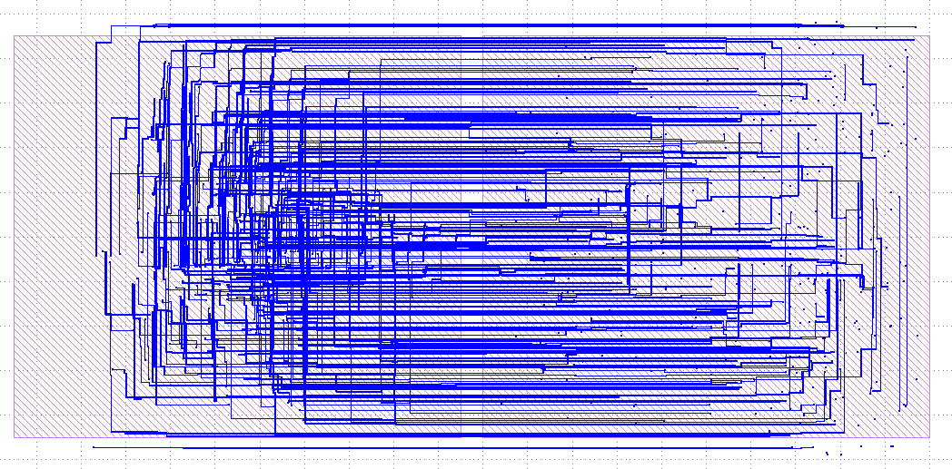
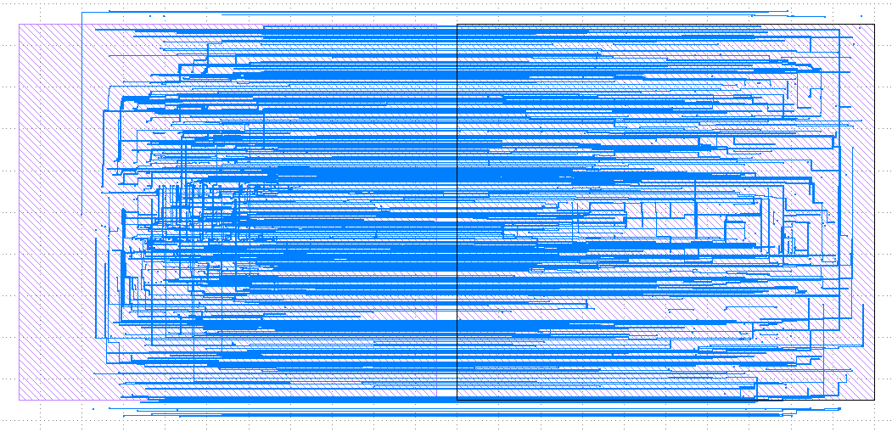
Interposer for Processor and JEDEC Wide IO Memory
Cost optimized configuration – Interposer layers and TSV
Manufacturing of wide-I/O demonstrator is ongoing at our colleagues from Fraunhofer IZM/ASSID.

Slide 18
Agenda
  Introduction
  Case study: interposer for Wide I/O memory – processor integration
  Chip-Package-Board-Co-design
  3D-Floorplanner and Flow
  Conclusion

Slide 19
Chip-Package-Board-Co-design (1)
Requirements
Evaluation of different packages
Evaluation of different stacking technologies
  Side-by-side in package (e.g. SiP, eWLB)
  Side-by-side at interposer
  3D stacking
Evaluation of different assembly technologies
  Ball, bumps, bonding
  Die to wafer, wafer to wafer
Embedding of passives
Evaluation of PCB technology (routability around device)
Considering performances
  e.g. timing, temperature
Consideration of production cost demands

Slide 20
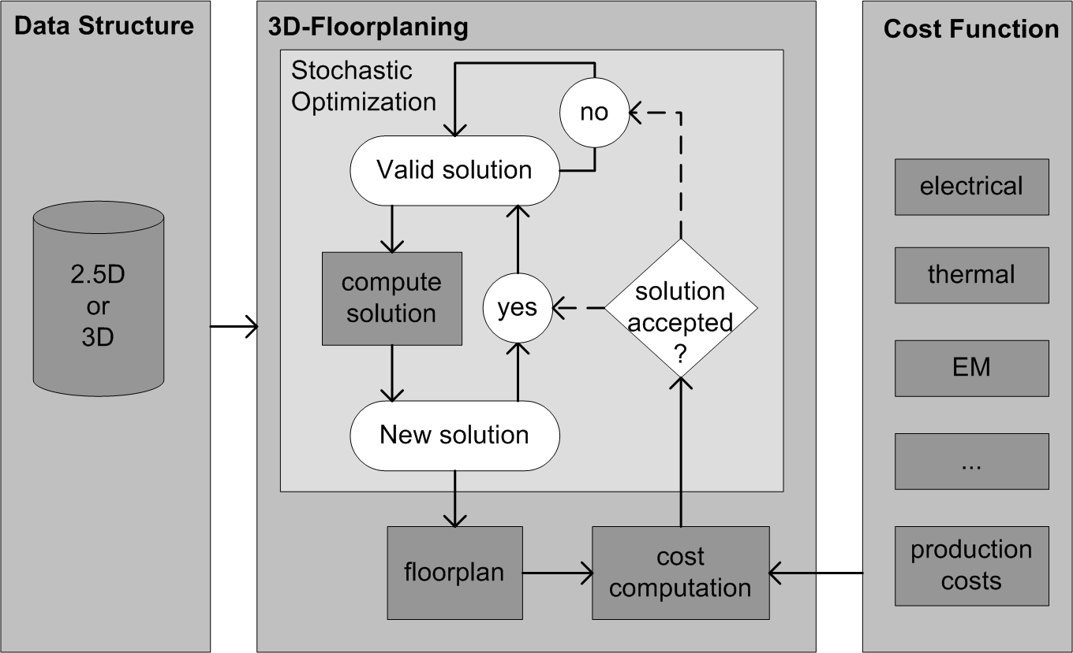
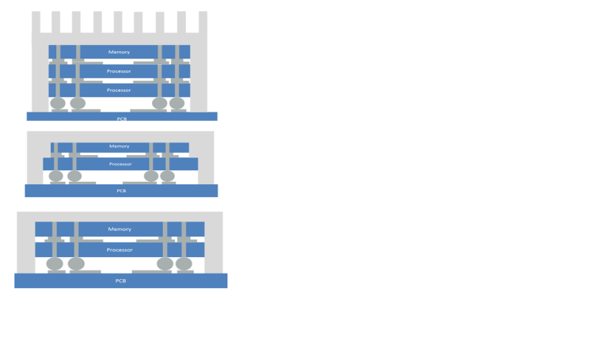
Chip-Package-Board-Co-design (2)
Goal: Guide the system designer to find the best suited solution.
Optimization goal is production cost under consideration of performance requirements
First generic cost function available, extension to company specific
functions is ongoing

Slide 21
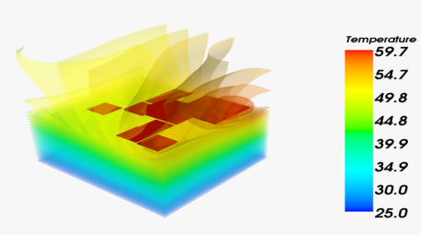
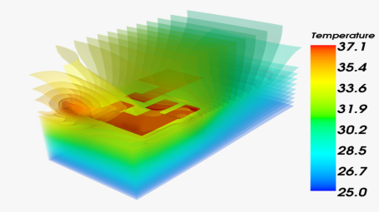
Thermal aware design space exploration
Estimation of heat distribution in a stack
evaluation of thermal constraints during design space exploration
further research on package modeling ongoing
Thermal behavioral model
Initial floor plan
After thermal optimization
Final result (heat transfer and die size optimized)
Notes:
21

Slide 22
Agenda
  Introduction
  Case study: interposer for Wide I/O memory – processor integration
  Chip-Package-Board-Co-design
  3D-Floorplanner and Flow
  Conclusion

Slide 23
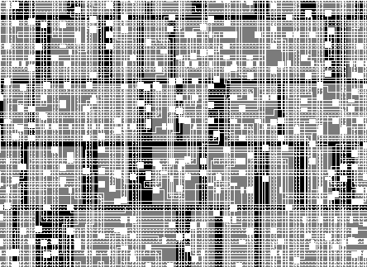
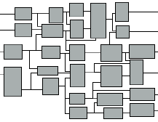

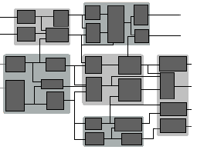
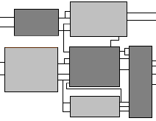

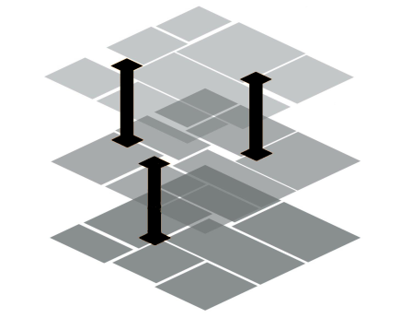
3D- chip-stack co-design flow @ Fraunhofer EAS
Result evaluation
Gate level netlist
Place and route of individual dies with 2D tools
solution
start
adjust
parameters
netlist
parameters
P&R die by die
coarsening
refinement
Grouping into super cells
3D-Floorplaning
insert TSVs
Detailed floorplanof layer
3D placement of supercells and TSV positions
Notes:
23

Slide 24
Agenda
  Introduction
  Case study: interposer for Wide I/O memory – processor integration
  Chip-Package-Board-Co-design
  3D-Floorplanner and Flow
  Conclusion

Slide 25
3D Integration – Summary
3D-integration technologies offer
  A wide design space for system realization
  Increased system performance and higher integration level
3D-integration is still a new technology
  Only few reference projects exist
  Commercial products starts with 2.5D at interposer
  Yield of 3D-manufacturing is increasing continuously
Broader application of TSV-based products needs better ecosystem
  EDA tools need to be enhanced or developed
  Design-kits, design-rules and cost models are required
  Standardization of design and manufacturing processes is ongoing, (IEEE, JEDEC, Semi Si2)

Slide 26
References
Limansyah, I., Wolf, M. J., Klumpp, A., Zoschke, K., Wieland, R., Klein, M., Oppermann, H., Nebrich, L., Heinig, A., Pechlaner, A., Reichl, H., Weber, W.: 3d image sensor sip with tsv silicon interposer, ECTC 2009, San Diego (2009)
Karnik, T.: 3d architectures and cad tools, D43D Workshop, Lausanne (2010)
Schneider, P., Elst, G.: Modeling approaches and design methods for 3D system design. In: Garrou, P.: Handbook of 3D integration. Vol.2: Technology and applications of 3D integrated circuits, Weinheim: Wiley-VCH, 2008, pp.529-574
Elst, G., Schneider, P., Ramm, P.: Modeling and Simulation of Parasitic Effects in Stacked Silicon. Proc. 2006 MRS Fall Meeting, November 27-December 1, 2006, Boston
Karypis, G., Aggarwal, R., Kumar, V., Shekhar, S.: Multilevel hypergraph partitioning: Applications in vlsi domain, 34th Design and Automation Conference, pp. 526 – 529, 1997.
Schneider, P., Heinig, A., Fischbach, R., Lienig, J., Reitz, S., Stolle, J., Wilde, A.: Integration of multi physics modeling of 3D stacks into modern 3D data structures. 2nd IEEE International 3D System Integration Conference, 3DIC 2010
Heinig, A., Schuster, T.: A 3d stack cost optimization floorplanning and routing approach, DATE Workshop for 3D Integration, Grenoble 2011.
Knöchel, U., Heinig, A., Stolle, J.,; Reitz, S., Wilde, A.: Electronic design automation for implementation of 3D integrated systems. In: Heuberger, A.: Microelectronic systems. Circuits, systems and applications : Circuits, Systems and Applications, Berlin: Springer, 2011, pp.19-27
Reitz, S., Heinig, A. , Martin, R.,; Stolle, J., Wilde, A.,: Thermal modeling of 3D stacks for floorplanning.
17th International Workshop on Thermal investigations of ICs and Systems, THERMINIC 2011 : 27-29 September 2011, Paris, France, Grenoble: EDA Publishing, 2011, pp.153-158
Wolf S., Knoechel U., Heinig A., XML-Based Hierarchical Description of 3D Systems and SIP, IEEE Design & Test, Special Issue on EDA Industry Standards, August 2012

Slide 27
Our Offerings
Support of 3D-integration projects from concept to prototype implementation
Case studies
  Cost and performance estimation
  Consideration of individual demands (e.g. reuse of existing dies)
Design support from concept level down to implementation
  Interposer design
  Design Space Exploration and 3D-floorplanning
  modeling of multi-physical effects (e.g. heat distribution)
Planning of prototype production with cooperation partners
Development of modeling- and design- methodology
Detailed multi-physical analyses of package- and TSV-structures
Model development and implementation in design tools
Notes:
Zentrale/P2/Juli 2009

Slide 28
2.5 and 3D Design and Technology @ Dresden
  Strong dependency between design and technology (manufacturability, reliability, and yield)
  Fraunhofer offers technology/manufacturing and design support at their institutes in Dresden
Design
Fraunhofer IIS/EAS
Requirements
Technology
Fraunhofer ASSID
Product
Reliability
Characterization
Fraunhofer IZFP

