Slide 1

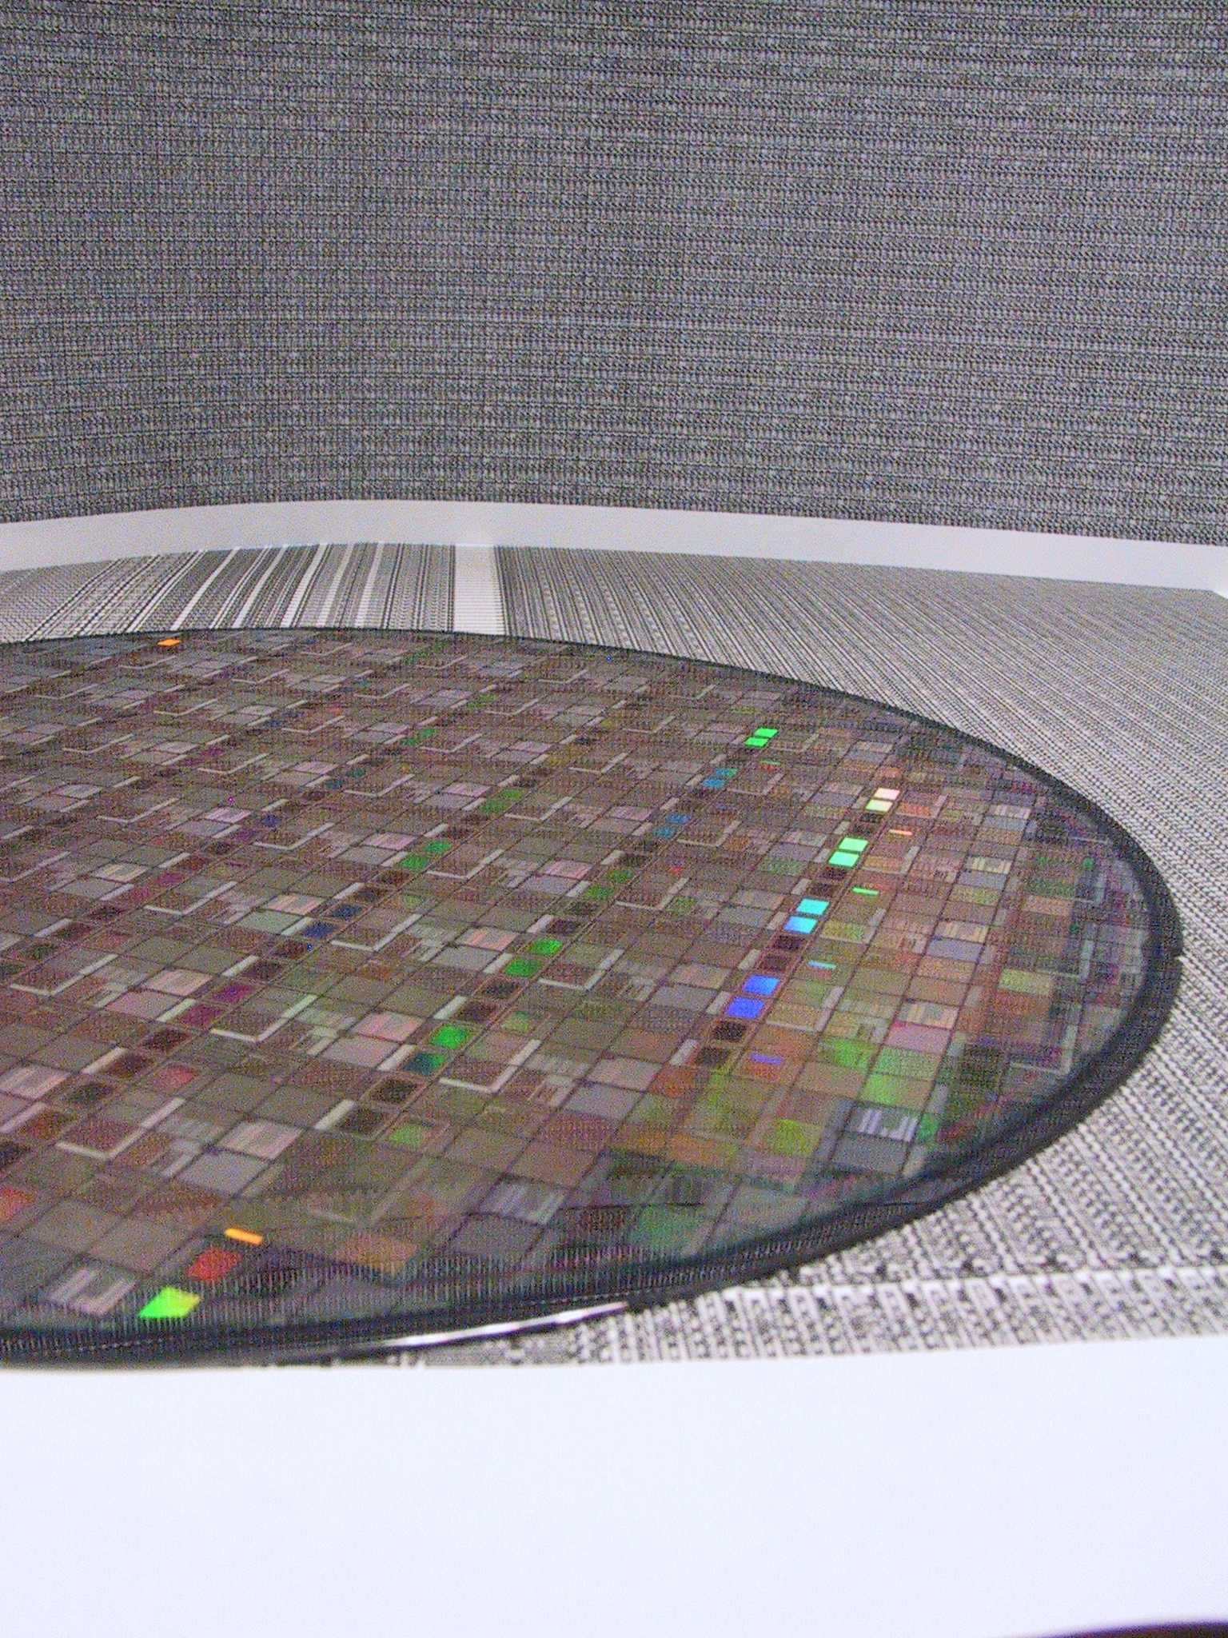
Implementing 2.5D and 3D Devices
Bob Patti, CTO
rpatti@tezzaron.com
Notes:
Sorry I couldn’t be with you today, but a pressing matter forced me to change my plans. Kholdoun has graciously agree to be my voice.
Tezzaron has 3 basic product lines. First, we are a memory company. We design and build DRAMs for high performance applications. A key to producing our memories is 3D integration. As we sought out users for our memories it became obvious that someone needed to integrate our memories with other devices, and there was no one to do this. Hence we extended our original business to include 2.5 and 3D assembly. Lastly, the production requirements led us to acquire a full fab late last year. With that, we added a third area to our business capabilities: contract foundry and custom process development.

Slide 2
The Effect of 2.5/3D on Devices
Notes:
2.5 and 3D integration are permitting a tremendous increase in the number of transistors that can be integrated. As you can see in this chart, we will see a 3 order of magnitude increase in integrated transistor counts over a period of a few years. In fact Tezzaron is already working on a 2.5/3D integrated assembly that has over 1 trillion transistors. We will also see a modest boost in absolute system speeds with 3D integration, which comes from the reduced wire lengths.

Slide 3
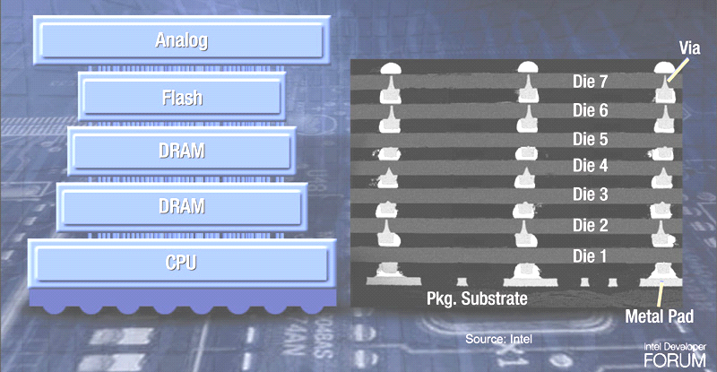

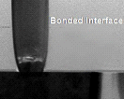
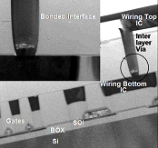
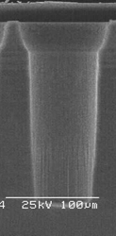

Span of 3D Integration
Packaging
Wafer Fab
Analog
Analog
Flash
Flash
Tezzaron
3D-ICs
100-1,000,000/sqmm
1000-10M Interconnects/device
DRAM
DRAM
DRAM
DRAM
CPU
CPU
CMOS 3D
3D Through Via Chip Stack
CMOS 3D
IBM/Samsung
IBM
1s/sqmm
Peripheral I/O
Flash, DRAM
CMOS Sensors
100,000,000s/sqmm
Transistor to Transistor
Ultimate goal
Notes:
If you look at 3D integration, it spans an enormous range. Today virtually every cell phone has some integration like that shown to the left. These devices have only 20 or 30 total connections at their periphery. At the opposite extreme is “true” 3D integration where transistors and interconnect are mixed as necessary within a structure. Today this “true” 3D, which is being pioneered by universities like Stanford, is still at least years away. Tezzaron focuses on the space between these extremes; devices with thousands to small 10’s of millions of vertical connections.
Also of note is the wide range in sizes of vertical interconnect that are available. The TSV on the lower left is about 100um in diameter and this is what one might have in the backside of a cell phone camera. At the same scale, in the lower right within the tiny black circle, is the latest generation of Tezzaron’s TSVs. The size of the TSV is one of the most important factors in the utility of the 3D integration.

Slide 4
TSV Pitch ≠ Area ÷ Number of TSVs
TSV pitch issue example
  1024 bit busses require a lot of space with larger TSVs
  They connect to the heart and most dense area of processing elements
  The 45nm bus pitch is ~100nm; TSV pitch is >100x greater
  The big TSV pitch means TOF errors and at least 3 repeater stages
1024 bit bus
Single layer interconnect
10um TSV
20um Pitch
1um TSV
2um Pitch
FPU
Notes:
Here is an example of why the TSV size is so important. The first identified “killer” app for 3D seems to be stacking memory with logic. So lets assume we want to 3D integrate our wide bus DRAM with our processor here. With the 10um TSV on a 20um pitch, the array of interconnects dwarfs a 45nm floating point processor. Even worse is that there would need to be 3 repeaters required to get the signal from the upper left corner of the TSV array to the FPU. Remember, the reason we are doing this 3D integration is to improve speed and reduce power. This seems to defeat any purpose in doing 3D integration, not to mention, as a designer, I have a hard time punching a hole this big in the middle of my logic. I want the interconnect to my memory to be as close as possible to the center of my logic specifically to reduce power and latency.
CLICK
However if the TSVs are smaller like the 1um ones shown here, this becomes a viable solution. It allows the 3D integration to deliver the promised reduction in power and latency. The size of the TSVs is important. As a designer, it is not only important to have the TSVs, but they must be small enough to put them where they are necessary to yield benefit.

Slide 5
3D Interconnect Characteristics
 | SuperContactTM I 200mm Via First, FEOL | SuperContactTM III 200mm Via First, FEOL | SuperContactTM IV 200mm Via First, FEOL | Interposer TSV | Bond Points | Die to Wafer
Size L X W X D Material | 1.2 μ X 1.2 μ X 6.0μ W in Bulk | 0.85 μ X 0.85 μ X 10μ W in Bulk | 0.60 μ X 0.60 μ X 2μ W in SOI | 10 μ X 10 μ X 100 μ Cu | 1.7 μ X 1.7 μ Cu | 3 μ X 3 μ Cu
Minimum Pitch | <2.5 μ | 1.75 μ | 1.2 μ | 30/120 μ | 2.4 μ | 5 μ
Feedthrough Capacitance | 2-3fF | 3fF | 0.2fF | 250fF | << | <25fF
Series Resistance | <1.5 Ω | <3 Ω | <1.75 Ω | <0.5 Ω | < | <
Small fine grain TSVs are fundamental to 3D enablement
Notes:
From this table you can see a cross section of the Tezzaron 3D interconnects. The first generation shown in the column at the far left is our workhorse process. This process, which is run and GlobalFoundries, is a 130nm mixed signal CMOS process. The 1.2um TSVs are made with tungsten. All of our small TSVs are made with tungsten. The TCE of tungsten being very close to that of silicon alleviates many of the issues related to TSVs that are widely reported. Tungsten does not electromigate, which further helps the reliability as voids in the TSVs are not killer defects. Tezzaron permits up to 25% of the TSV diameter to be voided. A vertical void in the TSV does actually help in reducing the overall wafer stress. Note the small capacitance and resistances. These low values make 3D interconnect competitive from a designer’s viewpoint.
Our interposers do use copper TSVs. For TSVs deeper than ~20um, Tezzaron, like everyone else today, must use copper. The deposition process of tungsten limits the diameter of the hole, whereas the copper plating process has no such limitation.
Tezzaron is a member of the IME interposer consortium and is working to transfer that technology into the Tezzaron fab in Texas. We hope to be producing the first full interposers in our line by the end of the year.
At the right you can see the bondpoints, which refers to our face to face capability. This is specifically for Cu-Cu diffusion bonding. We also now support the Ziptronix copper DBI process. With this process, we believe we will ultimately get to a 1um pitch capability.
Lastly, the die to wafer at the far right does not permit as fine of a pitch 3D interconnect. This is due to speed of alignment and the resultant accuracy. While the alignment could be better, it becomes cost prohibitive. It is not fundamentally a technology issue.

Slide 6
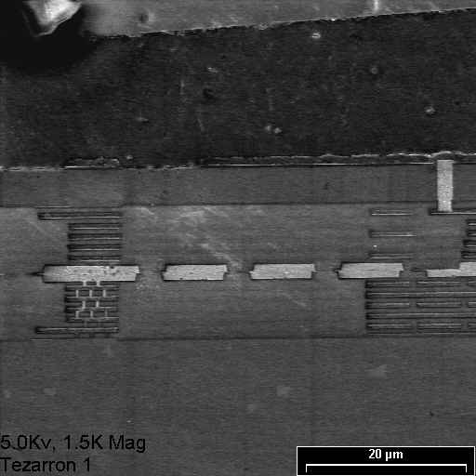
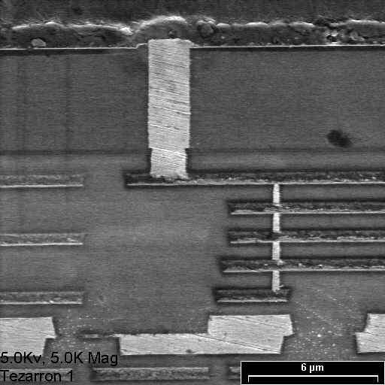
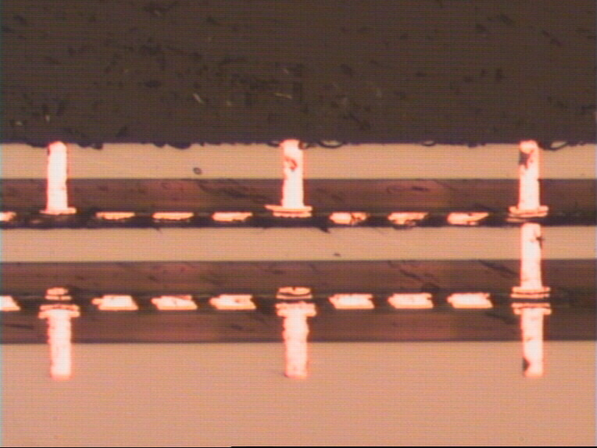
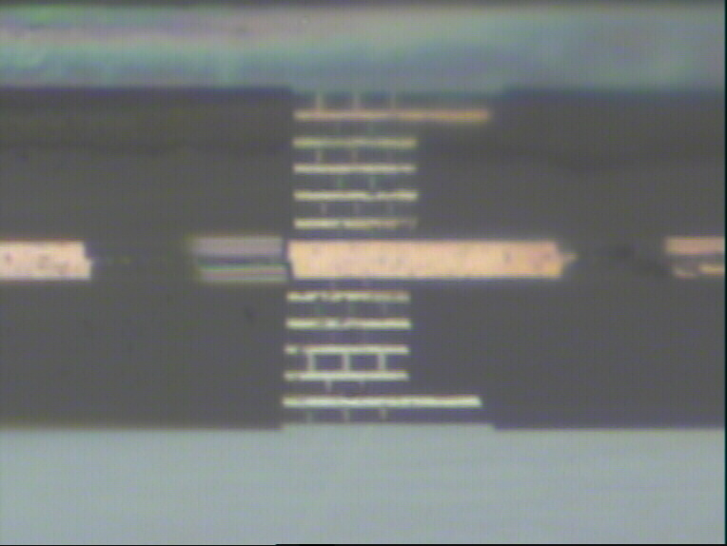
3rd Si thinned to 5.5um
2nd Si thinned to 5.5um
SiO₂
1st Si bottom supporting wafer
Notes:
Here you can see some of the Tezzaron 3D stacked devices. The TSV in the upper left corner is one of the latest 0.6um TSVs. These are built at Honeywell in their SOI process. The TSV protrudes about 2um into the substrate, which is completely removed during 3D assembly.

Slide 7
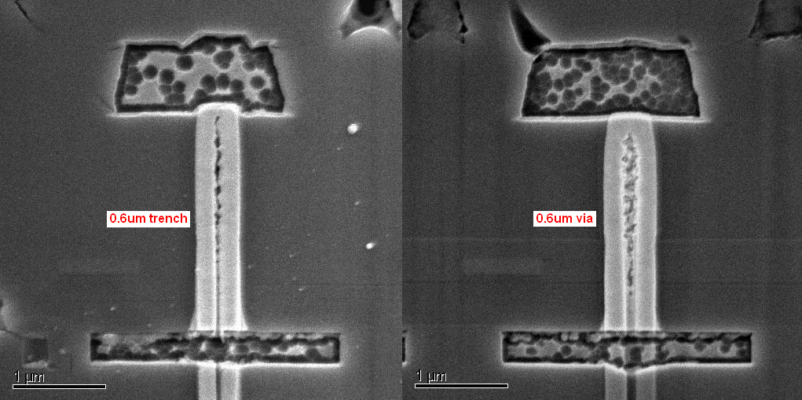
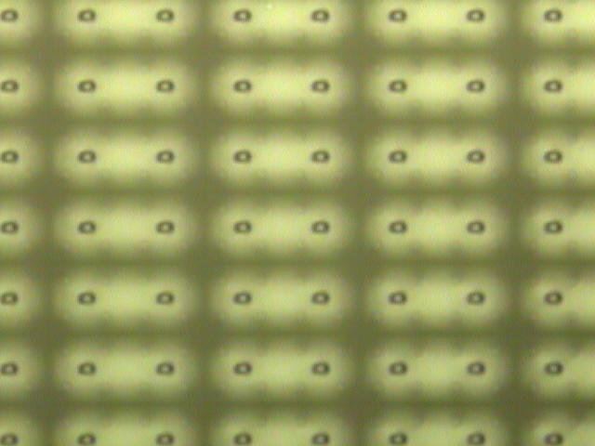
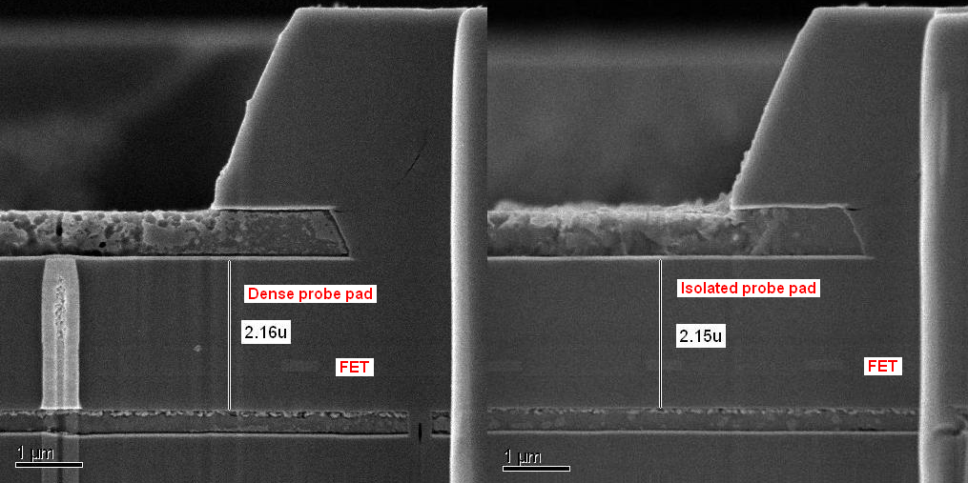
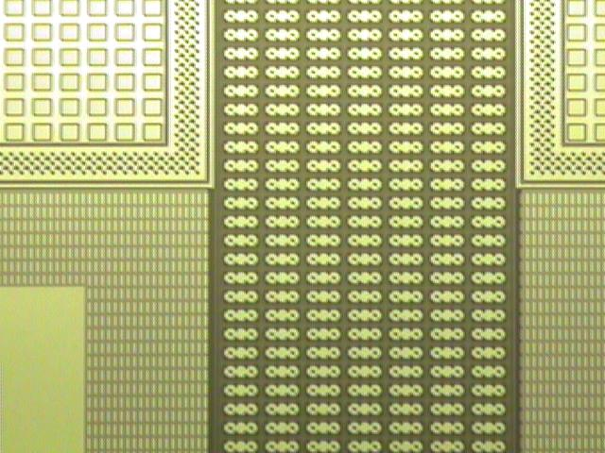
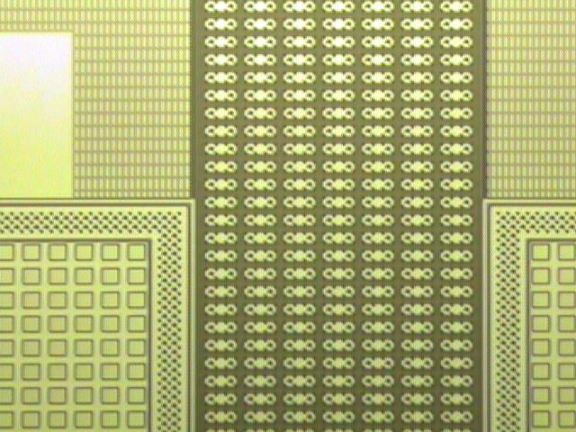
Honeywell 0.6um SOI TSV
120K TSVs
Notes:
Here are some additional views of the first 0.6um TSV test wafers. Of note, the first wafer to come off the line had 100% yield in the 120,000 TSV via chains. Note the tungsten void cores in these first wafers. As mentioned earlier, these don’t represent any reliability issues.

Slide 8
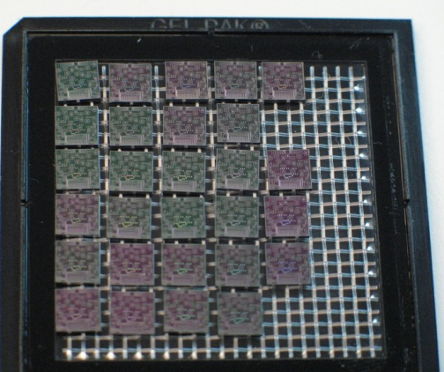
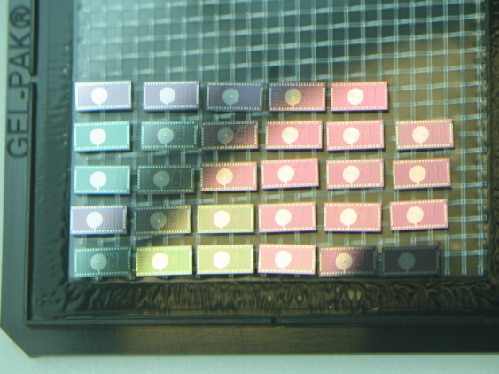
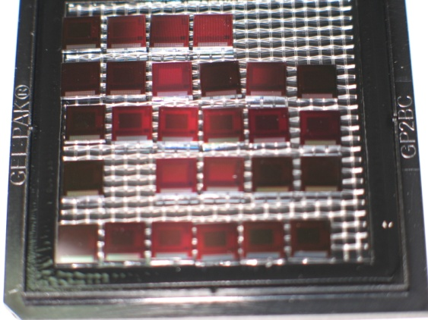
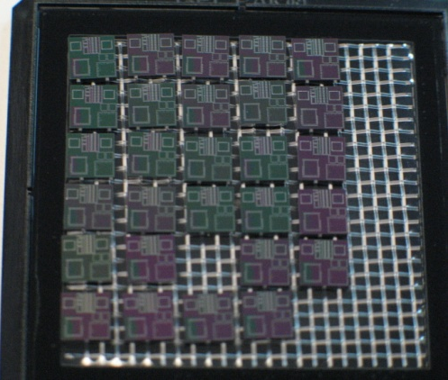
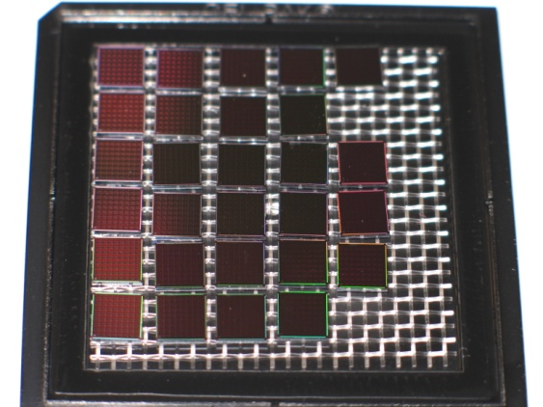
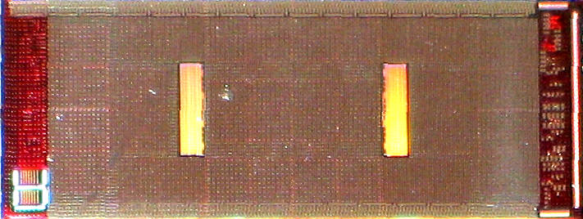
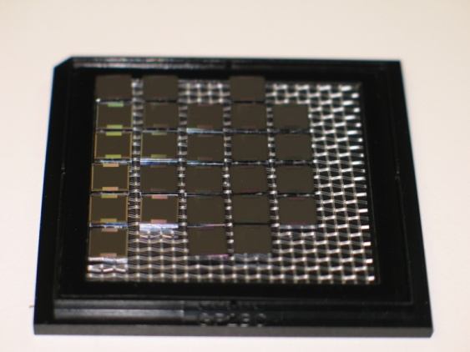
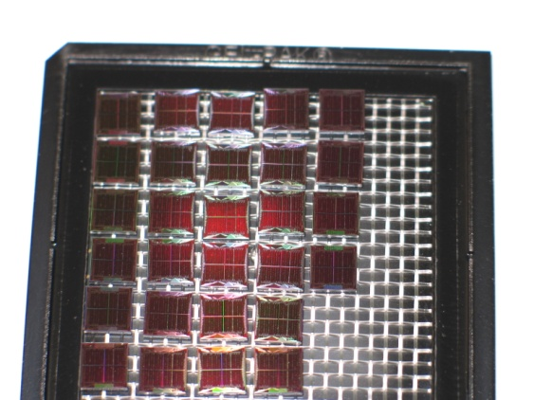
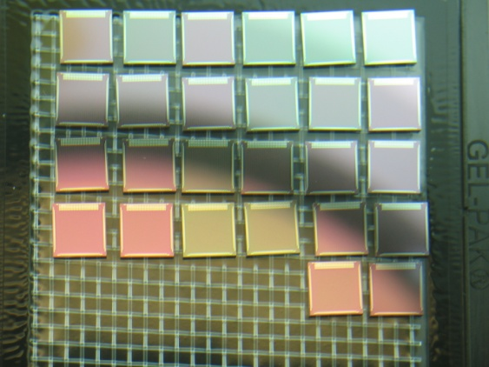
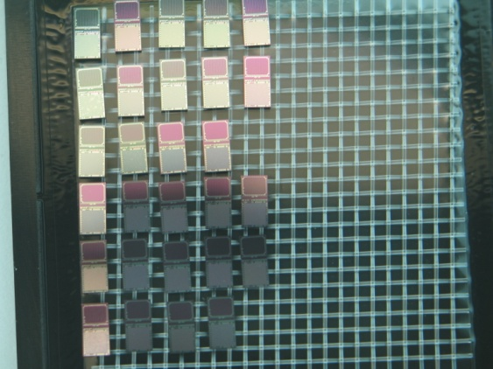
RF, Imaging, Processing, Analog
Notes:
Here are a variety of different types of parts that have been 3D assembled for customers. Of note, in the center is a 64 core ARM CPU with 32 cores per layer. The vertical rectangular bars that are visible are in fact fields of interconnect for attaching the CPU to a memory device.

Slide 9
“Dis-Integrated” 3D Memory
Memory Layers from DRAM fab
Memory Cells
Power,Ground, VBB,VDH
Bitlines
Wordlines
Controller Layer from high speed logic fab
Wordline Drivers
Senseamps
BiSTAR
I/O Drivers
2 million vertical connections per lay per die
Notes:
As was mentioned in the beginning, Tezzaron is a memory company. We employ 3D to allows us to “dis-integrate” our memory devices. We build the memory cells and very little else in a DRAM process and the rest of the circuitry in a high performance logic process. This gives us the best of both worlds. The DRAM memory is low leakage and very high density, which would not be possible in a logic process, and the balance of the circuitry will operate much faster and with lower power in high performance logic process. In order to do this however, one needs millions of vertical interconnects. In the case of the Tezzaron memory, about 2 million of the vertical interconnects are required.

Slide 10
Gen4 “Dis-Integrated” 3D Memory
DRAM layers
42nm node
2 million vertical connections per lay per die
Controller layer contains: senseamps, CAMs, row/column decodes and test engines. 40nm node
I/O layer contains: I/O, interface logic and R&R control CPU. 65nm node
Better yielding than 2D equivalent!
Notes:
Here is a depiction of our next generation memory device. The device can have up to 16 layers of memory cells. The control circuitry has been further split into 2 layers, one for most of the actual memory operation and a second I/O layer that primarily addresses the user interface. This was done to allow easier customization of the user interface with lower development cost. This is the first product that Tezzaron is undertaking that will employ 300mm wafers. The fab in Texas already has a full 300mm backend of line, but additional equipment is being added to handle 300mm assembly. The new 300mm capability should be on-line by the 4th quarter of this year.

Slide 11







Novati Heritage
SEMATECH
Austin site opens for business
SEMATECH spins off the R&D wafer fab and associated labs as Advanced Technology Development Facility (ATDF)
Tezzaron Semiconductor acquires the former SVTC facility.
2013
1987
1988
1995
2004
2007
2012
14 U.S.-based semiconductor manufacturers & U.S. government form consortium, called SEMATECH
The International 300 mm Initiative (I300I) was formed as a subsidiary of SEMATECH.
ATDF merges with former Cypress Semiconductor facility, SVTC Technologies.
Notes:
On Sept 28th last year, Tezzaron entered into an agreement to purchase the former SVTC fab in Texas. The fab has a long history stretching back to the forming of SEMATECH.

Slide 12
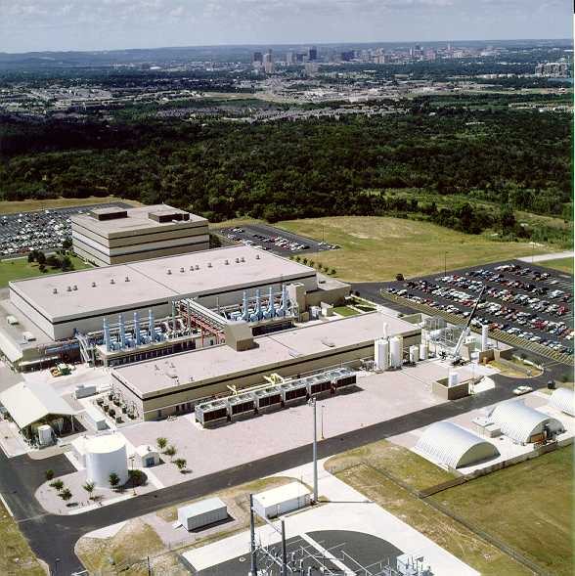
Tezzaron/Novati 3D Technologies
“Volume” 2.5D and 3D Manufacturing in 2013
Interposers
Future interposers with
  High K Caps
  Photonics
  Passives
  Power transistors
Wholly owned Tezzaron subsidiary
Cu-Cu, DBI®, Oxide, IM 3D assembly
Notes:
The Tezzaron new fab operates as a wholly owned subsidiary called Novati. The fab pictured here is targeting application in 2.5 and 3D assembly as well as continuing with its previous business of customized processing. The facility has 68,000 sqft of class 10 clean room in addition to office and facility space. Tezzaron offers open platform 2.5 and 3D services utilizing both copper-copper and DBI bonding. Bring up of the silicon interposers this year will be followed by enhancing them with capacitors, power transistors, and additional passive devices.

Slide 13

Facility Overview
Capabilities
Over 150 production grade tools
68000 sq ft Class 10 clean room
24/7 operations & maintenance
Manufacturing Execution Systems (MES)
IP secure environments, robust quality systems
ITAR registered
Full-flow 200mm silicon processing, 300mm back-end (Copper/Low-k)
Process library with > 25000 recipes
Novel materials (ALD, PZT, III-V, CNT, etc)
Copper & Aluminum BEOL
Contact through 193nm lithography
Silicon, SOI and Transparent MEMS substrates
Electrical Characterization and Bench Test Lab
Onsite analytical tools and labs: SIMS, SEM, TEM, Auger, VPD, ICP-MS, etc
ISO 9001:2008 13485:2013
TRUST 2013
Notes:
The facility is capable of 3,000 wafer starts per week with both 200mm and 300mm wafers. The 200mm line is a full CMOS line and can produce transistors down to ~65nm. The specialized operations include carbon nanotubes and 3-5 materials. The Novati facility is playing a key role in the DARPA Diverse Accessible Heterogenesis Integration (DAHI) program. This program includes the 3D integration of CMOS with InP, and GaN among other exotic materials.

Slide 14
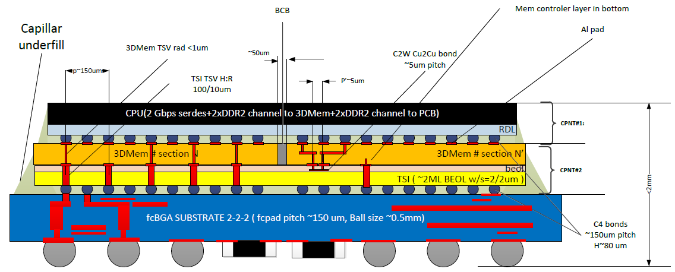
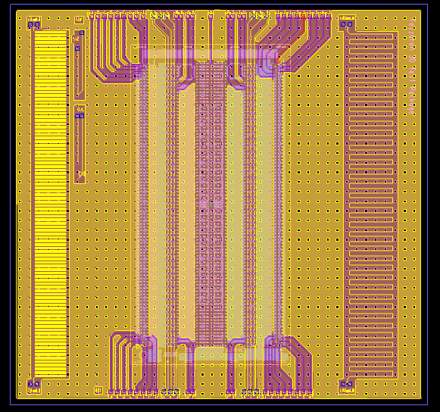
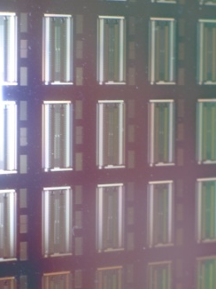
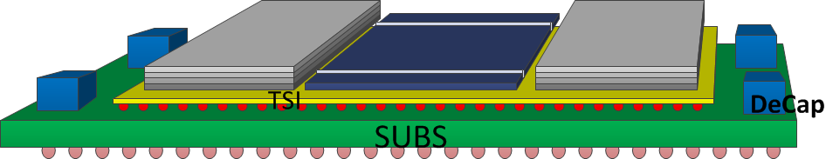
2.5/3D in Combination
IME A-Star / Tezzaron Collaboration
IME A-Star / Tezzaron Collaboration
Notes:
While full 3D integration does offer the best performance, it is unrealistic to assume that everyone will accept the risks and difficulties of doing a full 3D design. 2.5D with silicon interposers offers a significant bump in performance with a more standard lower risk flow. Tezzaron sees the real future use of silicon interposers as platforms for I/O interfacing and power regulation. The market for silicon interposers that are limited to just wiring is limited. The organic interposer manufactures are not about to simply let the advanced high margin, high performance interposer market go to silicon fabs. They have already demonstrated line and space capability down to 10um wire pitch and their cost model is half that of silicon. To compete in the long term, silicon interposers must bring more value.

Slide 15
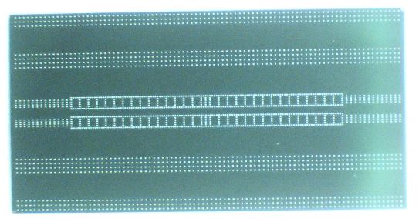
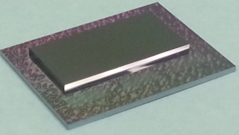
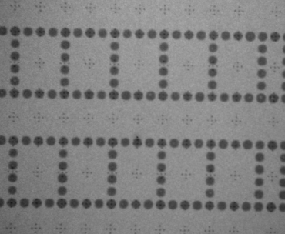
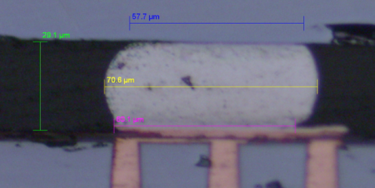
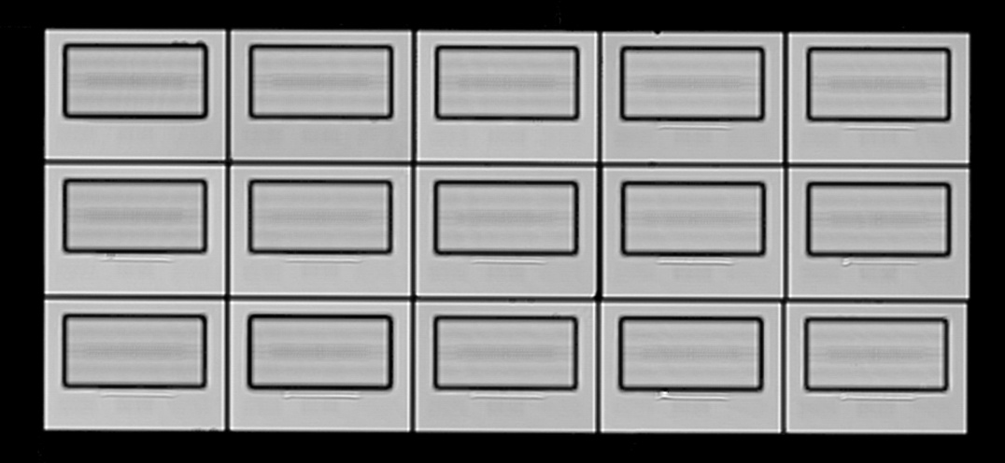
Tezzaron Dummy Chip C2C Assembly
Memory die
C2C sample
X-section of good micro bump
CSCAN showed no underfill voids (UF: Namics 8443-14)
X-ray inspection indicated no significant solder voids
Notes:
Here is an example of a Tezzaron memory device that is attached to a silicon interposer that was jointly developed with IME in Singapore. This interposer was manufactured on the IME A*STAR 300mm development line. Full production of interposers will be ready in the Tezzaron facility later this year.

Slide 16



Near End-of-Line TSV Insertion
M8
TM
M7
M6
2x,4x,8x Wiring level
~.2/.2um S/W
M5
M5
M4
M4
M3
W
M2
SIN
M1
poly
STI
TSV is 1.2µ
Wide and ~10µ deep
5.6µ
Notes:
Tezzaron has also found it necessary to insert TSVs in wafers. Very few fabs are ready to build wafers with TSVs today and many of them will not be ready for some time. As a result Tezzaron has been working on late stage insertion of TSVs into production wafers. This approach forces only some of the metal layers to have keep-outs for the TSV. New added metal wiring layers can be put down after the TSV, providing uninterrupted global routing. Today up to 4 additional metal layers can be added.

Slide 17
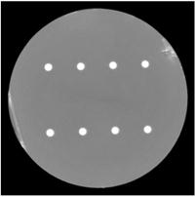
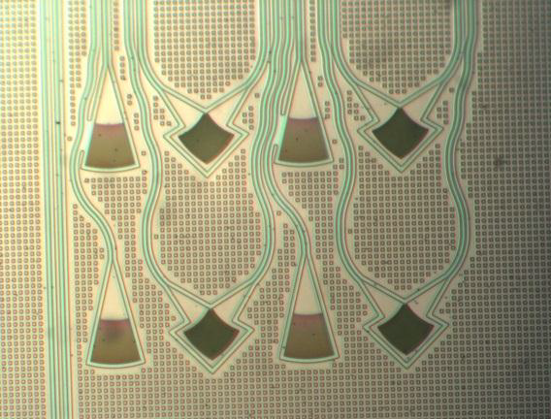
Advanced Photonic Interposers
2pJ/bit power target
WDM
Multicore fiber
25Gb channel interface
Self-calibrating self-tuning
Notes:
New Advanced Developments going on at Tezzaron…
Photonics is a developing trend and the incorporation of photonic elements into interposers is a technology that Tezzaron is pursing. Tezzaron has two joint development programs in this area. It appears that the 2pJ/bit transmission or reception energy is within reach. This enables the use of optical interconnect, not just for long connections, but even chip to chip optical connections can have lower power than conventional wired interconnect.

Slide 18
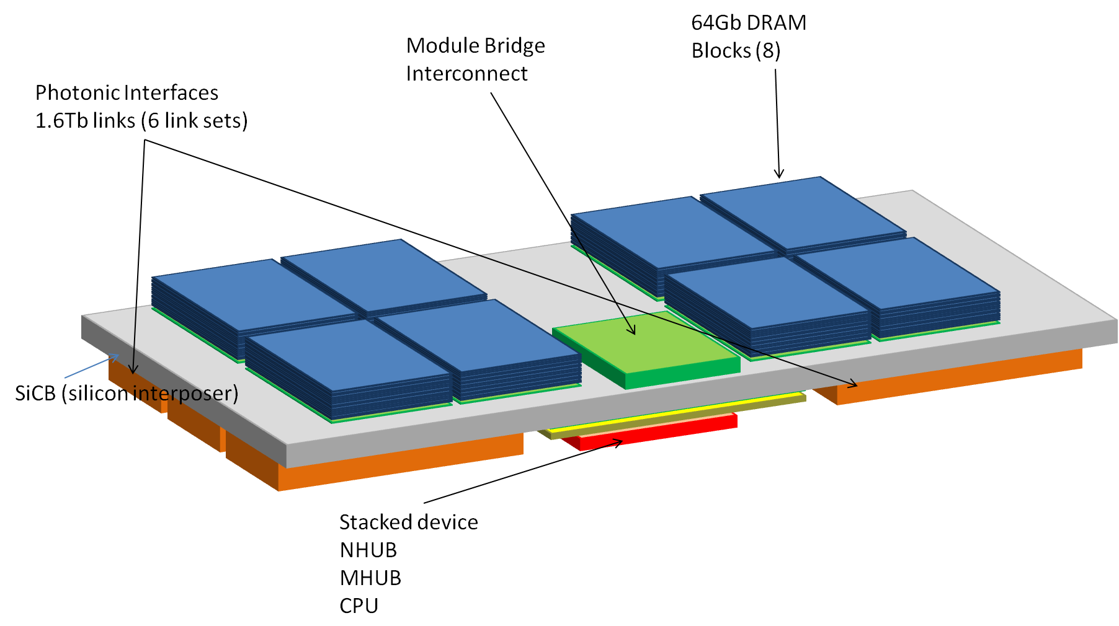
Double Sided Silicon Interposer
Notes:
Another effort also underway is combining interposer pairs to form double-sided interposers. This increases the device density and opens avenues for known good die assembly of larger silicon interposer devices.

Slide 19
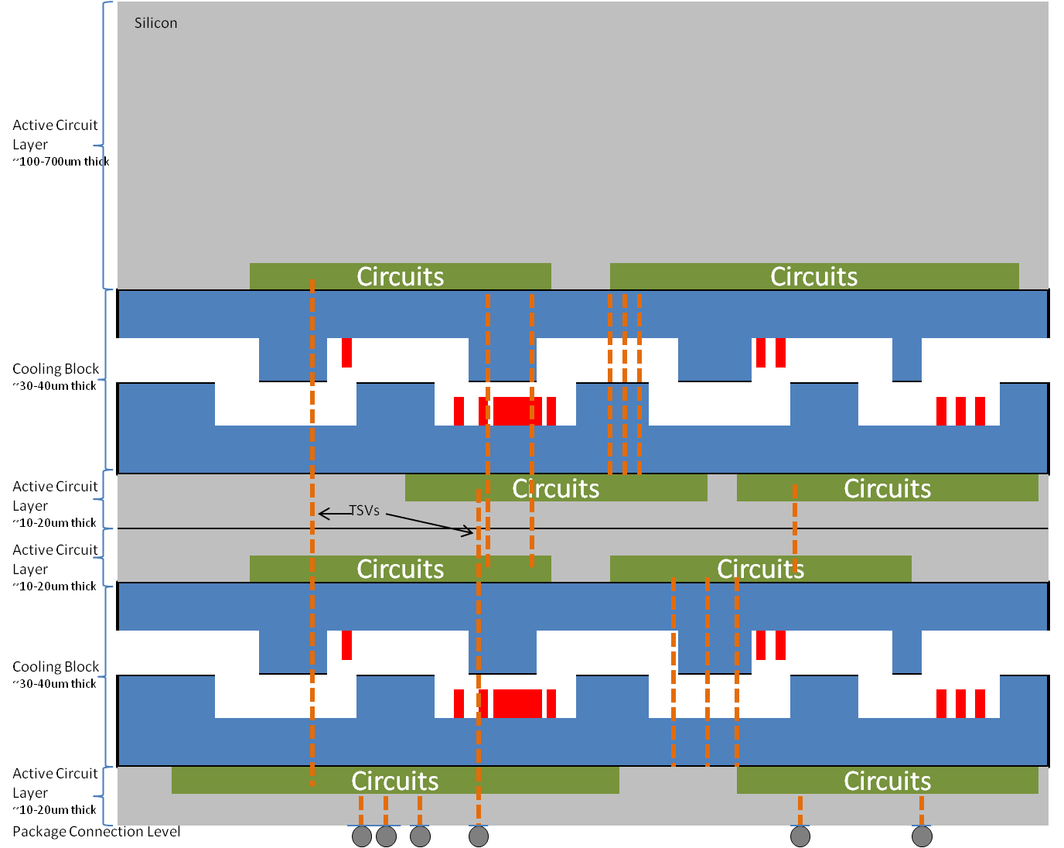
Integrating Fluidics into 3D:
Liquid Cooling
Notes:
Of course, as these 3D assemblies become more dense with more layers, ultimately power dissipation becomes a critical issue. A 2 phase liquid cooling solution is being prototyped already. The design goal is to remove up to 400 watts of heat per cooling block layer. With this option, large server processor and memory stack combinations are possible.

Slide 20
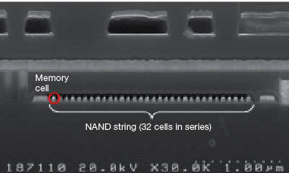
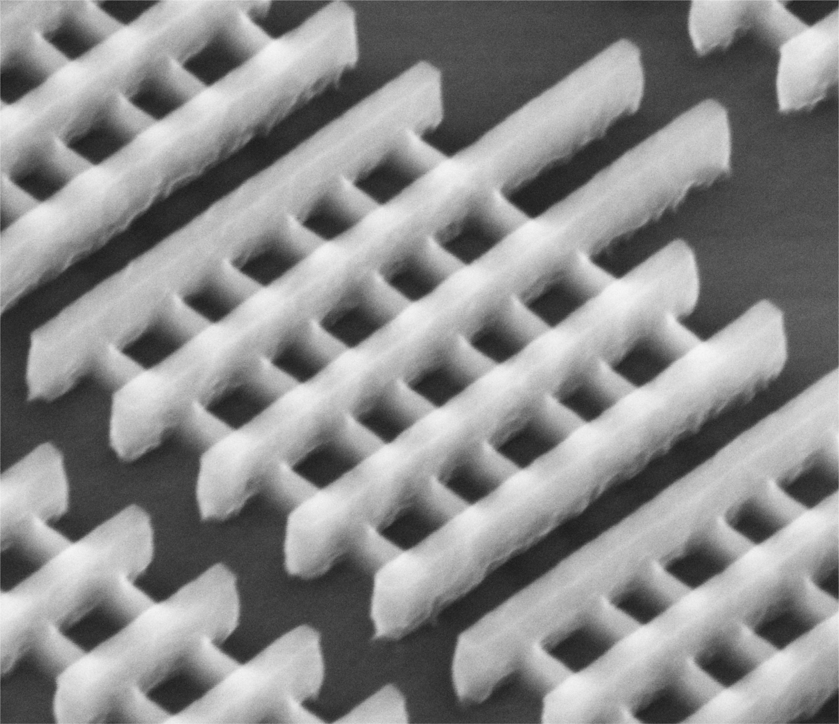
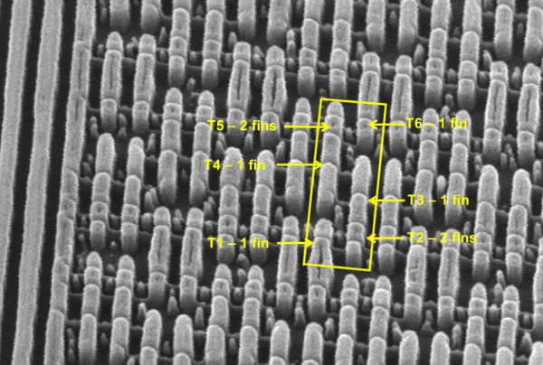
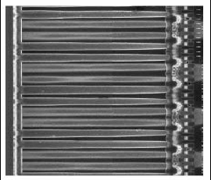
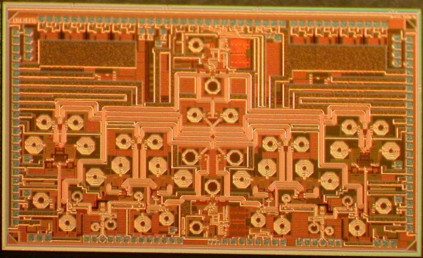
3D Key to Enable Next Gen
16nm Sea-of-Gates
14nm Sea-of-SRAM
65nm Analog and I/O
IP isolation Optimized Process Simplified Technology Real Reuse
Notes:
Tezzaron sees 2.5 and 3D as the best alternatives to enabling next generation technologies. The power of process separation permits much lower risk, easier technology development and deployment. Further, it offers true IP reuse. There is no continuing need to redesign all of the same blocks at each new node. It is well known in the industry that analog and I/Os really don’t scale and, in fact, scaled devices often perform worse than previous older versions in larger geometries. The tight integration afforded by 3D allows best of class solutions for every element in a chip design.

Slide 21
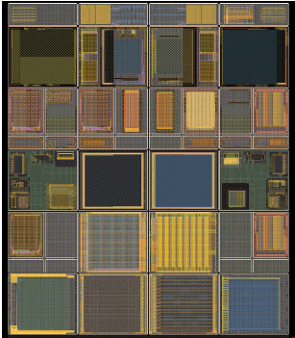
2.5/3D Design Enablement
Complete 3D PDK 8th Release
  GF 130nm
  Synopsys, Hspice, Cadence, MicroMagic 3D physical editor
  Calibre 3D DRC/LVS
  Artisan standard cell libraries
MOSIS, CMP, and CMC MPW support
  130nm, coming soon 65nm
  Silicon Workbench
Honeywell 150nm SOI
NEOL TSV insertion
40→28nm 3D logic
Silicon interposers, active, photonics
eSilicon 2.5/3D solutions, organic interposers
>100 devices in process
>500 users
Notes:
Tezzaron continues to provide a number of opportunities for developers. 3D MPWs will be extended to 65nm this year and will continue to other finer geometries in the few years. We will provide customers with best of class solutions for both 2.5 and 3D assembly. The new fab facility in Texas has already improved Tezzaron's capabilities and will significantly improve the delivery schedules and product quality as the fab comes up to full production.

Slide 22
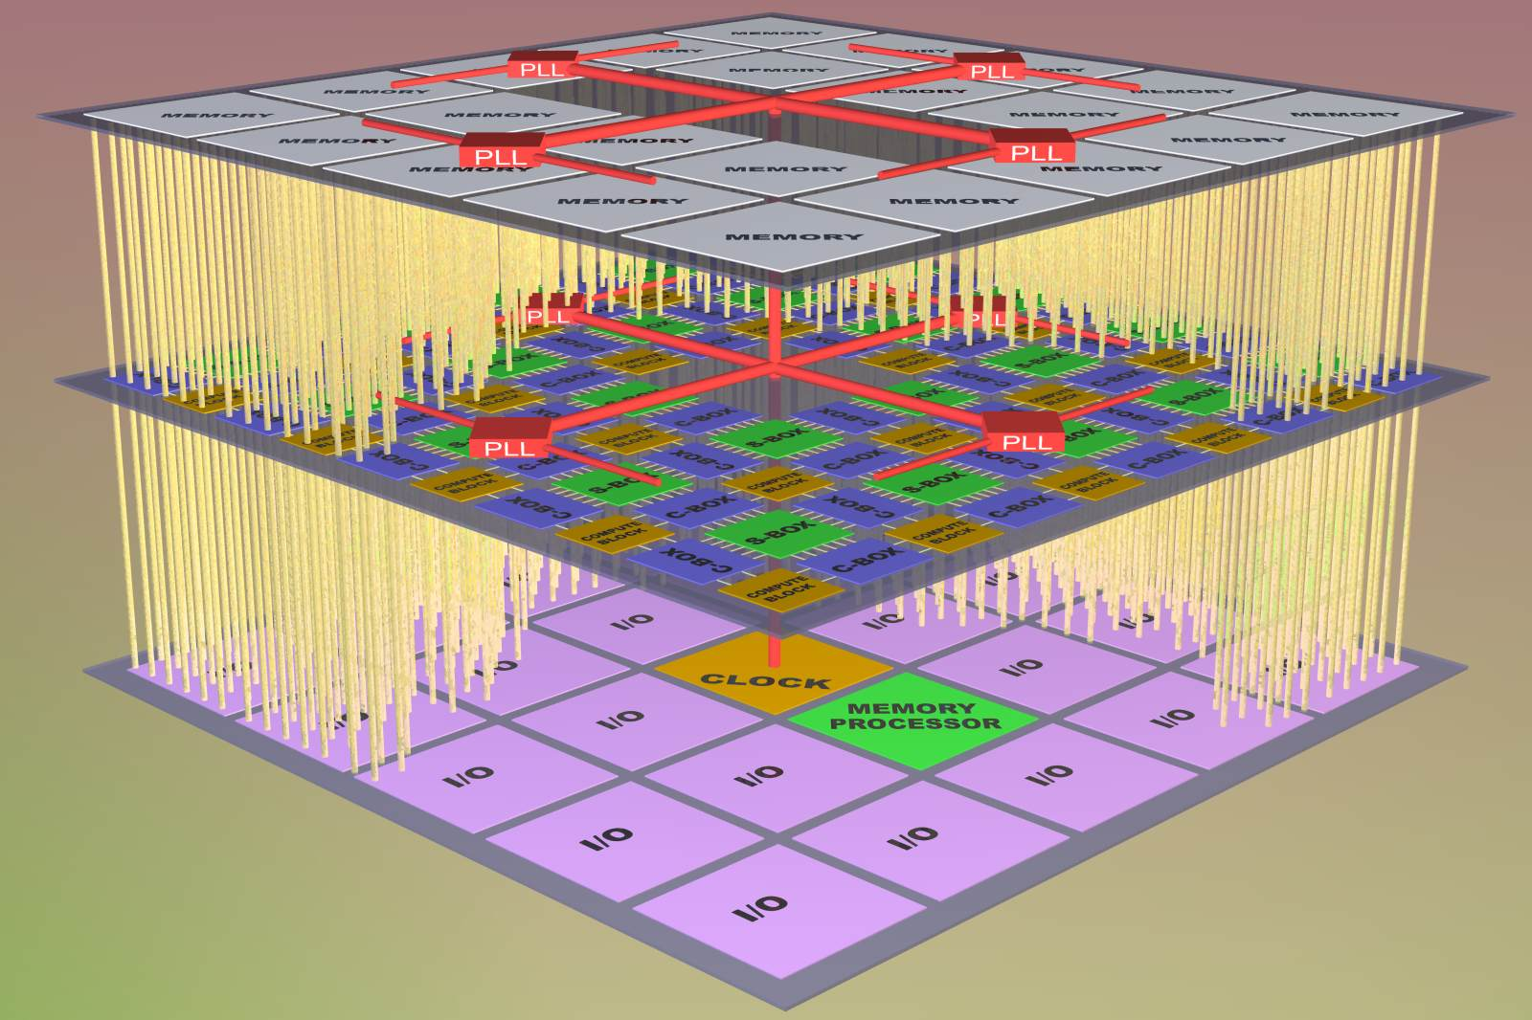
Summary
“One stop” 2.5/3D solution provider
Open technology platform
Volume 2.5D Si interposer production
Volume 3D assembly
High performance, ULP, extreme density memories
TSV Insertion
Silicon, 3/5 materials, carbon nanotubes
“Fully Engineered”
Sensors
Computing
MEMS
Communications
Notes:
In conclusion, it is Tezzaron’s goal to offer customers a “one stop” solution for advanced 2.5 and 3D packaging incorporating a wide variety of assembly options in an open platform environment.
Thank you for your attention!

