Slide 1
3D Needs and Opportunities
in X-ray Detection.
Heinz Graafsma
Head of FS-DS; DESY-Hamburg
and University of Mid-Sweden; Sundsvall

Slide 2
The Detector Challenge:
PETRA-3
ESRF (2000)
brilliance
ESRF (1994)
Synchrotron Sources
Second generation
First generation
X-ray
tubes
1900 1960 1980 2000

Slide 3
But is there hope ?
Europe has a long tradition in developing detectors for science; at least in part thanks to CERN
Europe has a large number of Storage Ring and FEL sources; which are centrally run ➔ this allows for centralized and larger scale instrumentation development
There is a surprisingly large number of Hybrid Pixel Array Detector systems; mostly photon-counting
PSI/SLS and CPPM-Marseille over 10 years ago started to use HEP HPAD detector technologies for dedicated photon science systems.

Slide 4
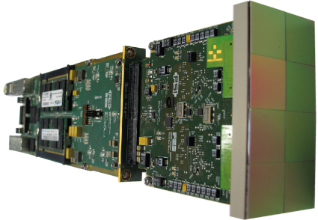
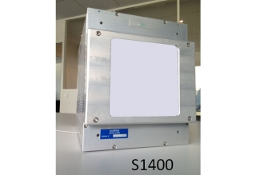
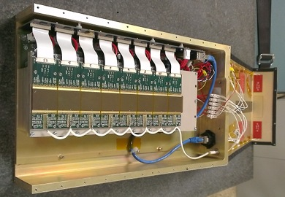
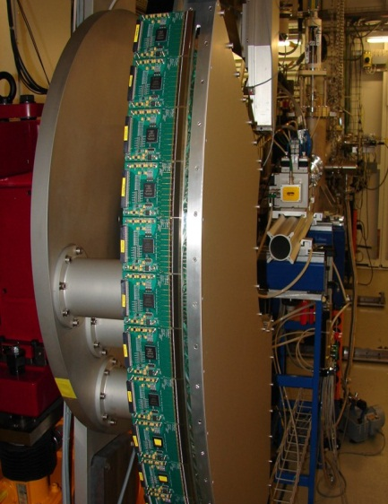
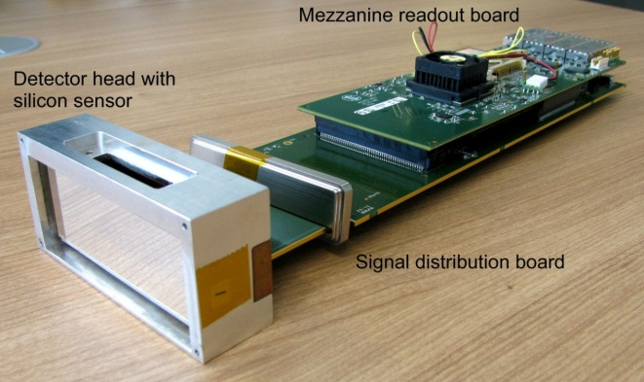
(some) major running systems:
PILATUS + EIGER
XPAD
MYTHEN + GOTTHARD
PIXIRAD
pnCCD
MEDIPIX
….

Slide 5
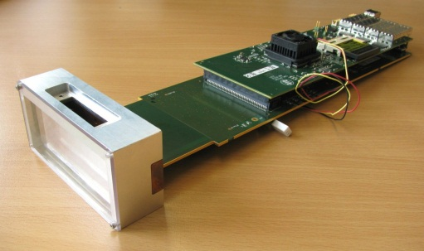
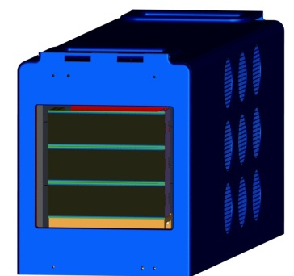
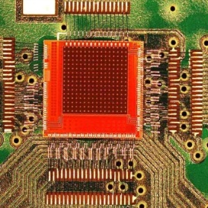
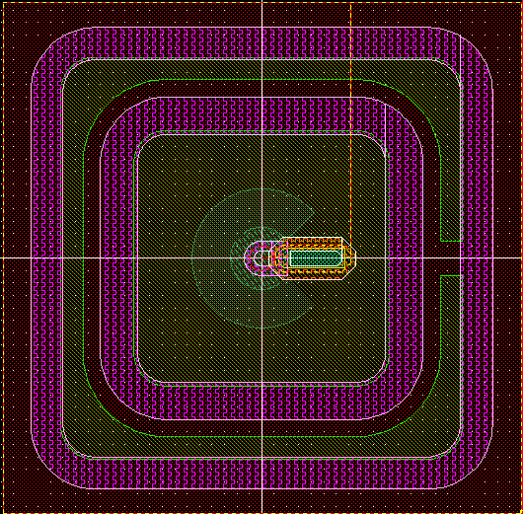
(some) major systems under development
MEDIPIX
  LAMBDA (DESY)
  EXCALIBUR (DIAMOND)
AGIPD (for EXFEL) (3 German + 1 Swiss partner)
LPD (for EXFEL) (2 British partners)
DSSC (for EXFEL) (7 German + Italian partners)
JUNGFRAU (for SWISSFEL) (PSI)
PERCIVAL (for low-E FEL applications) (DESY, STFC, Elettra, Diamond)
…

Slide 6
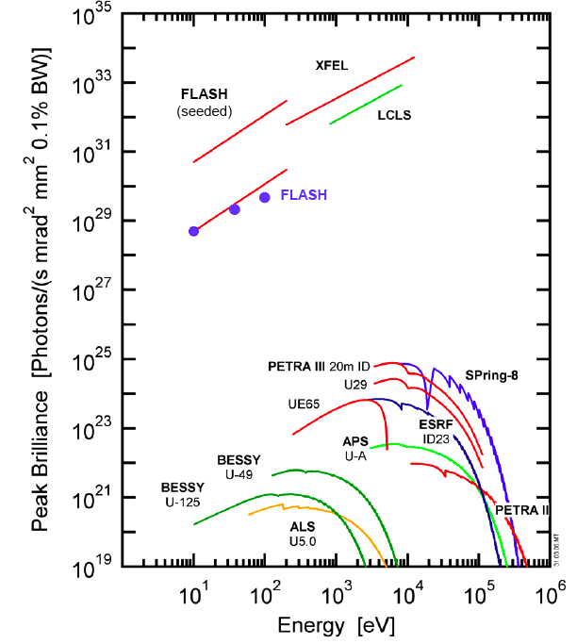
The FEL-Challenge: Different Science
Completely new science
Fast science 100 fsec
“Single shot” science
x10⁹

Slide 7
What is the Goal ?
K. J. Gaffney and H. N. Chapman, Science 8 June 2007

Slide 8
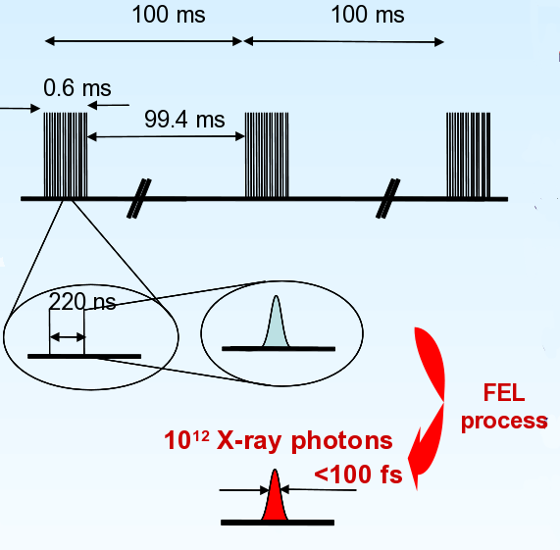
The European Free Electron Laser

Slide 9
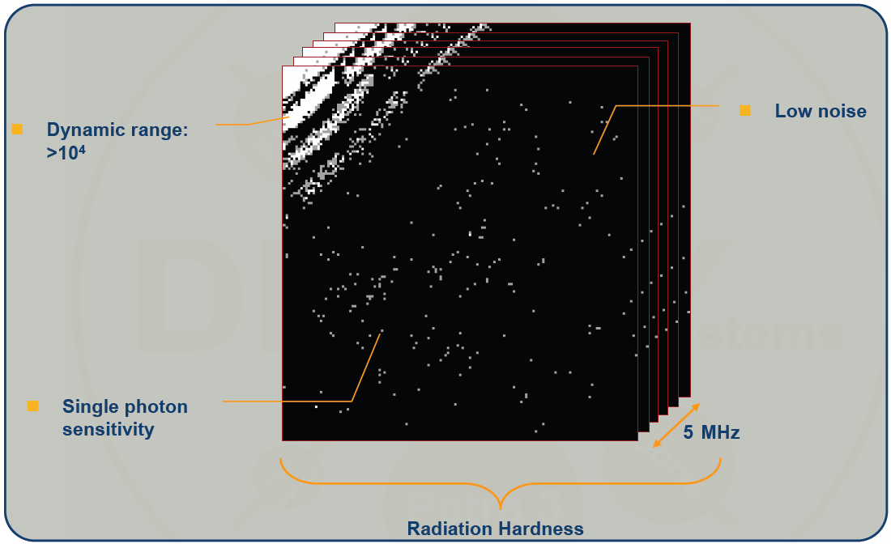
What are the Challenges ?
4.5 MHz

Slide 10
The Adaptive Gain Integrating Pixel Detector
High dynamic range:
Dynamically gain switching system
Extremely fast readout (200ns):
Analogue pipeline storage
C3
C2
Control logic
Analogue encoding
C1
Normal Charge sensitive amplifier
V_{thr} ≅ V_{ADCmax}
Discr.
Trim
DAC
Leakage comp.
08/04/2013

Slide 11
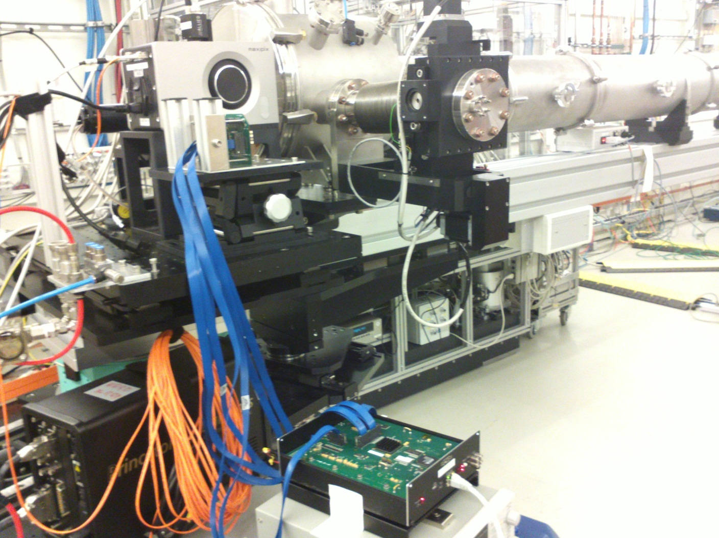
At the P10 beamline
Beam direction (coming from sample)
AGIPD sensor
It took about 1 ½ hours to set up, after about 2 hours we saw the first image
Chip tester box
Not in the picture: Sample, Alexanders PC, people, …

Slide 12
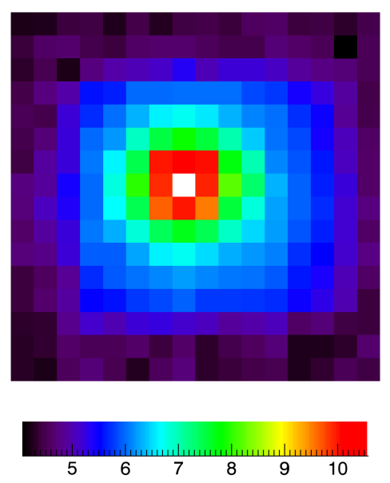
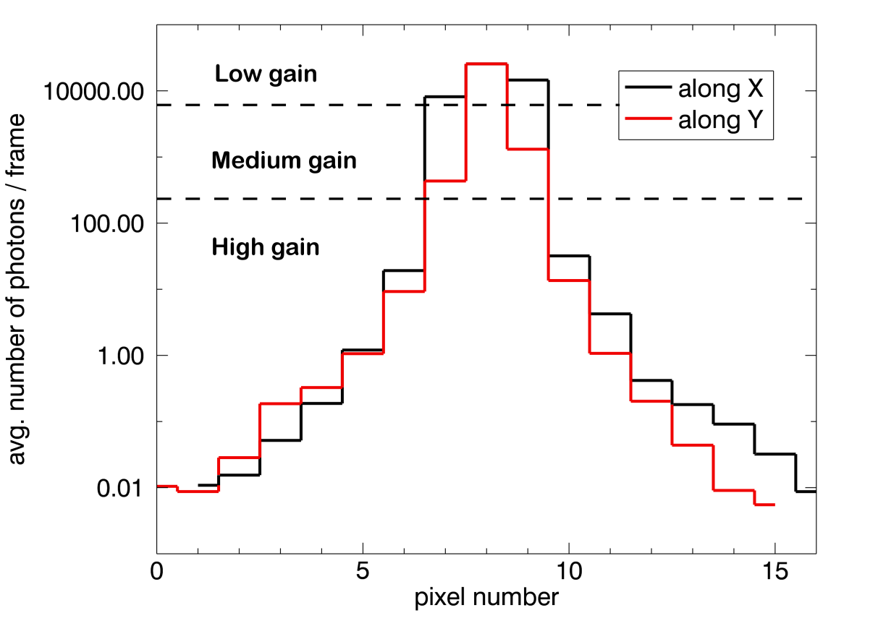
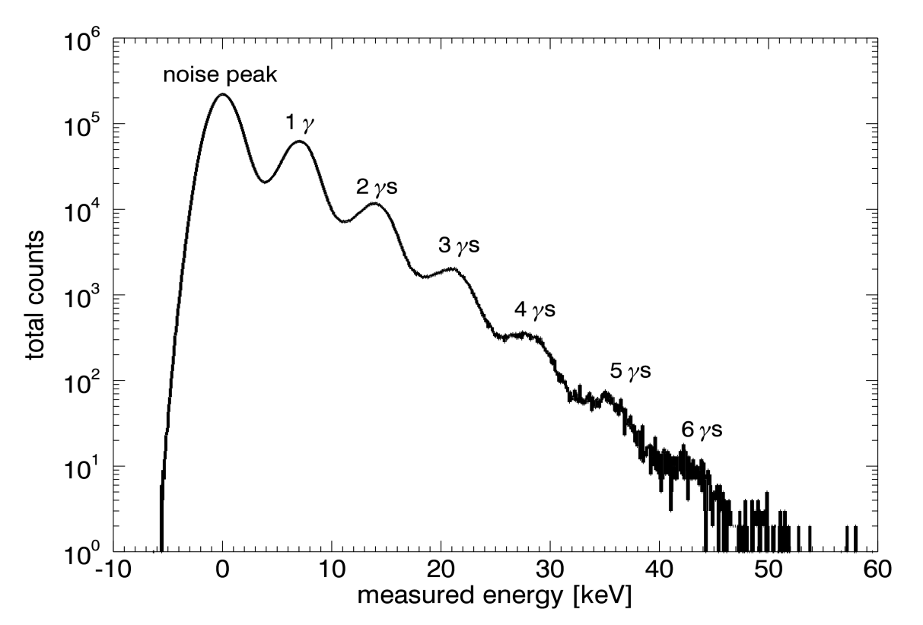
Looking at the direct beam
photons/second
Logarithmic color scale
Gain switching experimentally proven
10⁴ photons / pulse
Single photon sensitivity
4.5 MHz frame rate

Slide 13
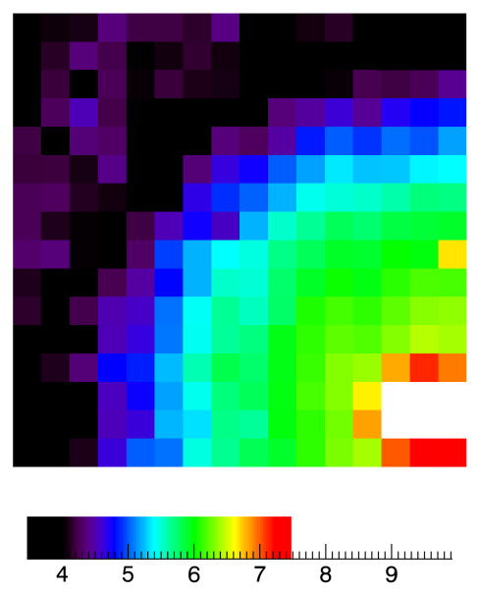
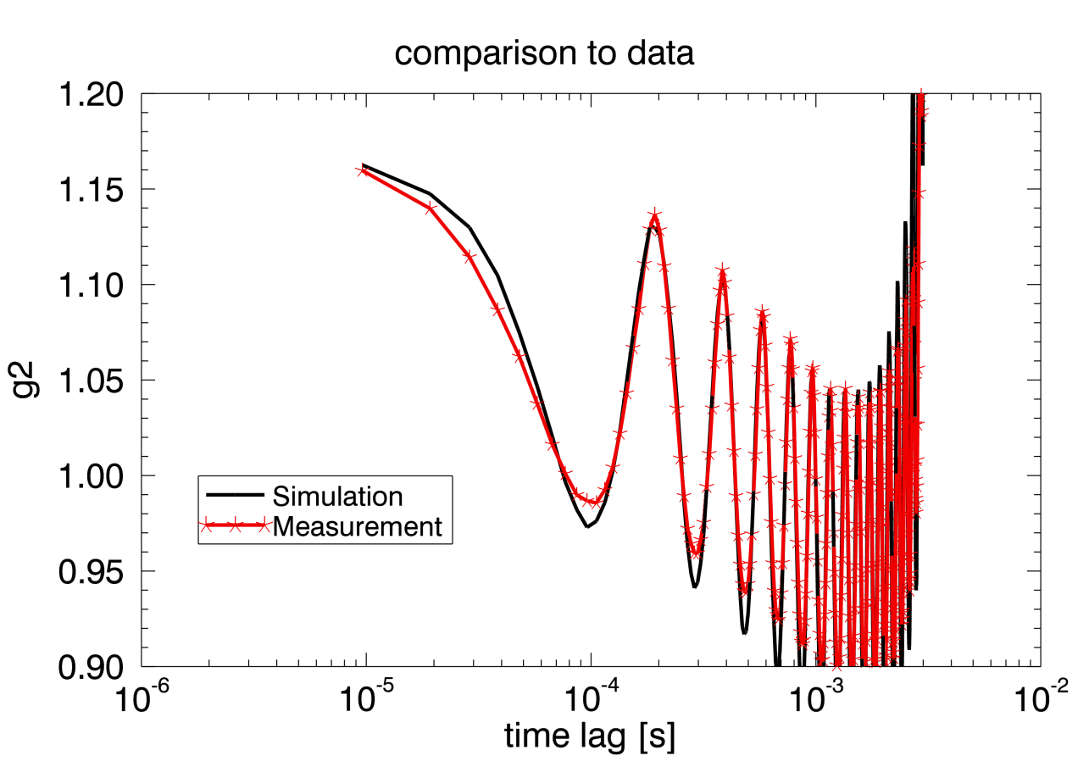
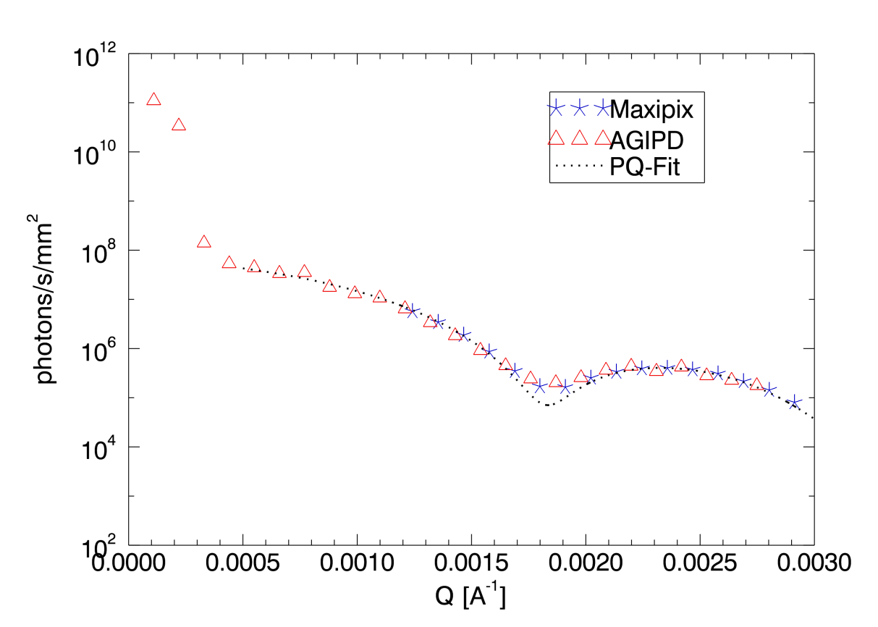
Some XPCS measurements
photons/second
Logarithmic color scale
Scientific quality data obtained
Complete system proven to work
Calibration proven to be adequate

Slide 14
The Analogue Storage
Sensor
ASIC per pixel
Pixel matrix
…
HV
Analog Mem
CDS
RO bus (per column)
+
SW
RO Amp
…
-
CTRL
DAC
Analog Mem
THR
Calibration circuitry
ASIC periphery
Chip output driver
Mux
Adaptive gain amplifier
352 analog memory cells
Notes:
Mention random vetoing possibility.

Slide 15
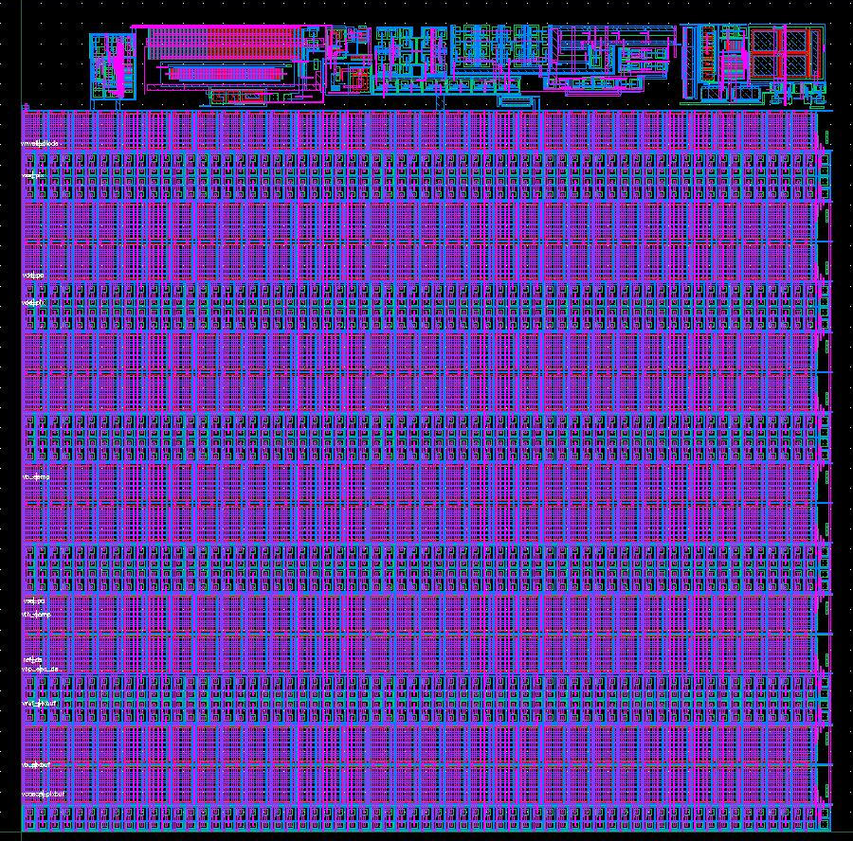
AGIPD 1.0 Pixel electronics
200 x 200 micron² pixels
352 storage cells + veto possibilities.
Minumum signal (noise) = 330 electrons = 0.1 photon of 12 keV
Maximum signal = 33 10⁶ electrons = 10⁴ photons of 12 keV
4.5 MHz frame rate
64 x 64 pixels per ASIC
2 x 8 ASICs per module (128x512 pixels, no dead area)
4 modules per quadrant

Slide 16
What could be next?
Smaller pixels with
  Reduced dynamic range (no gain switching);
  Reduced number of frames?
New Technologies including:
  3D CMOS: second layer (more functionality)

Slide 17
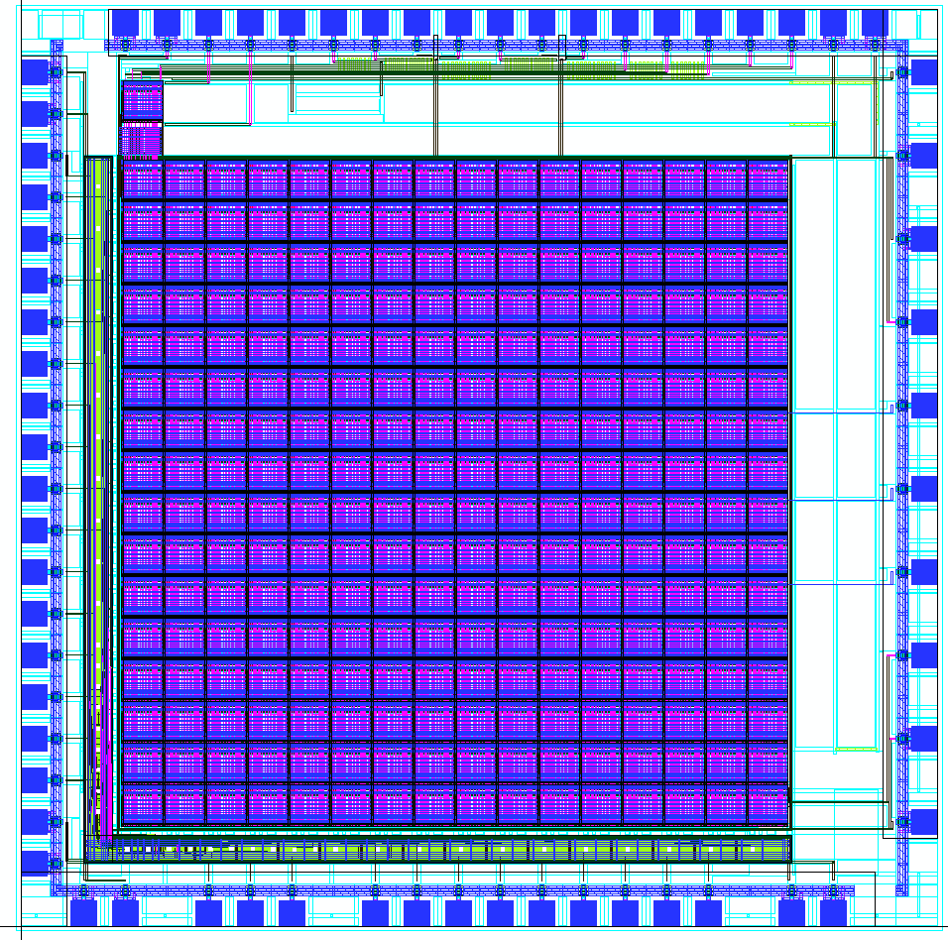
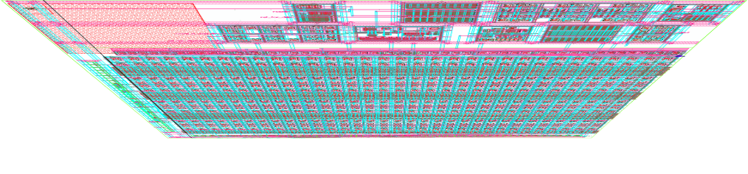
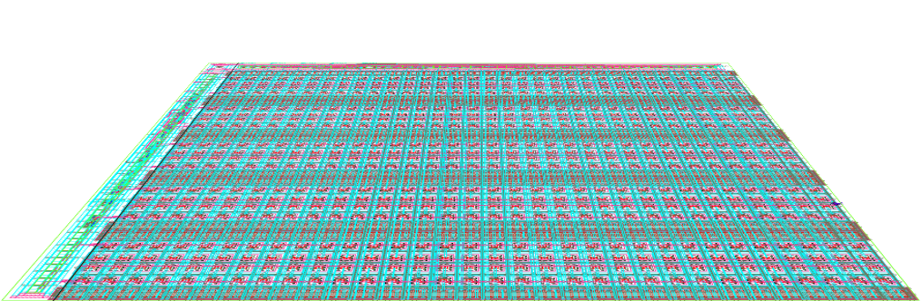
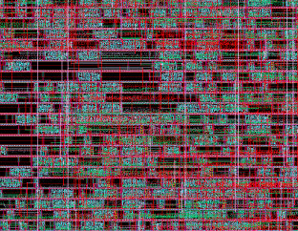
3D-CMOS
1) bump-bond to the detector (TSV)
2) amplification & double sampling
4) signal readout
3) store the analog signal in a memory cell in 1st/2nd layer
(544 memory depth)
5x5 mm2 double-tier dice
MPW, via CMP
submitted 2011
to be delivered early 2013
Standard Cells

Slide 18
What could be next?
Smaller pixels with
  Reduced dynamic range (no gain switching);
  Reduced number of frames?
New Technologies including:
  3D CMOS: second layer (more functionality)
  65 nm CMOS technology (more functionality)
  3D CMOS + 65 nm CMOS
Notes:
HGF Portfolio activity

Slide 19
HGF-Detector Program; Pillar-1 : The “Helmholtz-Cube”
What we have today
Replace standard sensor with: 3D and edgeless sensors, as well as High-Z
Replace standard bump-bonds with new interconnect techniques
Replace standard ASIC and wire bonds with thinned ASICs and TSV as well as ball-grid arrays
Replace standard ASIC with 3D-ASICs
Develop new high speed IO’s
Employ innovative materials

Slide 20
HGF-Detector Program; Pillar-1 : The “Helmholtz-Cube”
What we want tomorrow
new sensors
Thinned and 3D ASICs
Innovative materials
Advanced interconnect
High-speed I/O

