Slide 1
TSV vertical based interconnections, overview, state of the art
D. Henry / CEA-Leti-Minatec
Contibuting authors : A. Berthelot / R. Cuchet / G. Simon / Y. Lamy / P. Leduc / J. Charbonnier
AIDA Meeting / 08 & 09th of April 2013

Slide 2
Outline
Introduction
TSV definitions & process flows
TSV (brief & non-exhaustive) state of the art
Applications examples
Conclusions / prospects
Introduction
TSV definitions & process flows
TSV (brief & non-exhaustive) state of the art
Applications examples
Conclusions / prospects

Slide 3

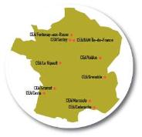


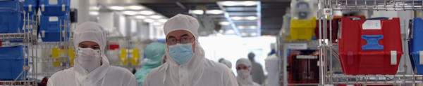
CEA - Leti at a Glance
Commissariat à l’Énergie Atomique
et aux Énergies Alternatives
is one of the largest research organizations in Europe, focused on energy, health, information technologies, and national defense
16,037
People (10% PhD and Post Doc)
Research centers
10
Founded in 1967 as part of CEA
CEO Dr. Laurent Malier
1,700 researchers
190 PhD students + 34 post PhD
with 70 foreign students (30%)
210 M€ budget
~ 40M€ CapEx
Over 1,700 patents
265 generated in 2010
40% under license
40 start-ups
& 265 industrial partners

Slide 4
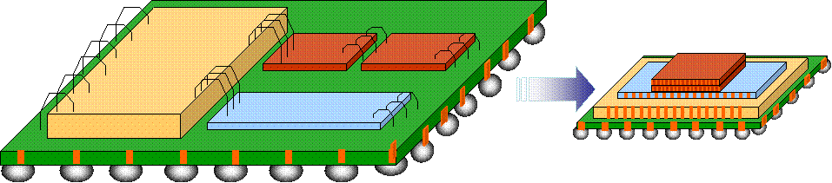
Introduction : What is 3D Integration ?
In electronics, a 3D integrated circuit is a chip in which two or more layers of active electronic components are integrated vertically into a single circuit, component or system.
3D Integration key drivers :
  Form factor decrease
  Performances improvement
  Heterogeneous integration
  Cost decrease
Interposer / substrate
passives
Memory
Logic

Slide 5
Introduction : Why do we need 3D Integration ?
To solve the following issues :
  Form factor decrease :
    X & Y axis
    Z axis
  Performances improvement
    Decrease R, C, signal delay
    Increase device bandwidth
    Decrease power consumption
  Heterogeneous integration
    Integration of heterogeneous components
    in the same system
  Cost decrese
    Si surface decrease
    Reuse of existing Packaging,
    BEOL & FEOL lines
The key technology of 3D integration is TSV

Slide 6
Outline
Introduction
TSV definitions & process flows
TSV (brief & non-exhaustive) state of the art
Applications examples
Conclusions / prospects

Slide 7
TSV definitions
Two main families :
  Vias first : vias done before bonding & thinning
  Vias last : vias done after bonding & thinning
Vias first
Vias last
Pre process
Middle process
Via formation
FEOL
FEOL
FEOL
Via formation
BEOL
BEOL
BEOL
Bonding perm. or Temporary
(C2W or W2W)
Bonding
Bonding
Via formation
BS process
Via Exposure
BS process
Via Exposure
BS process

Slide 8
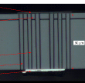


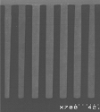
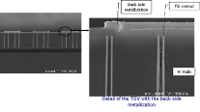



TSV families
TSV First (Polysilicon filled)
Trench AR 20, 5x100µm
TSV Middle (Copper or W filled)
AR 7 , 2 x 15µm
AR 10, 10x100µm
W filled
TSV Last (Copper liner or filled)
métal RDL
BCB
SiO2 flanc
bulle air sous BCB
60µm
AR 1 80x80µm
AR 2, 60x120µm
AR 3, 40x120µm
AR 7 , 2 x 15µm

Slide 9
TSV first / pre process – Detailled process flow
TSV etching
FEOL + BEOL
BS Insulation
TSV insulation
Bonding
BS RDL & Passivation
TSV filling
TSV planarization
BS Via Exposure
BS Bumping

Slide 10
TSV Middle – Detailled process flow
FEOL
TSV planarization
BS Insulation
TSV etching
BEOL
BS RDL & Passivation
TSV insulation
Bonding
TSV metalization
BS Via Exposure
BS Bumping

Slide 11
TSV last– Detailled process flow
FEOL + BEOL
TSV etching
BS passivation
Bonding
TSV Insulation
Under bump metallurgy
Device thinning
TSV metalization + RDL
BS Bumping

Slide 12
Outline
Introduction
TSV definitions & process flows
TSV (brief & non-exhaustive) state of the art
Applications examples
Conclusions / prospects

Slide 13
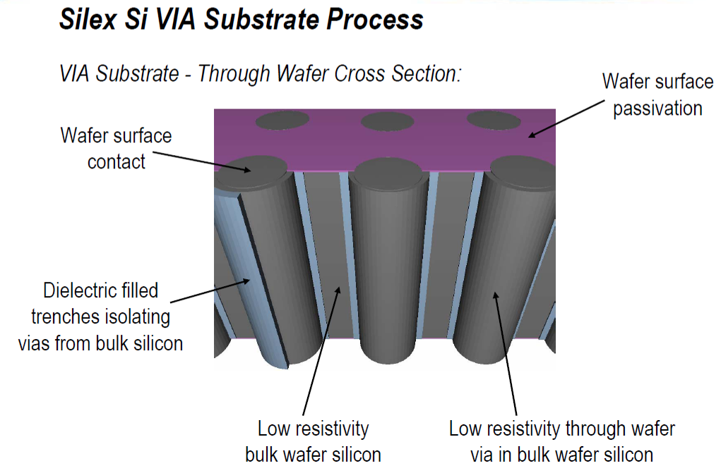
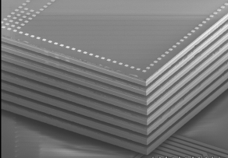
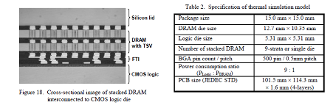
TSV first / pre process – State of the art
Silex
  MEMS applications
  Conductive substrate
  TSV Insulation / Si poly
NEC / ELPIDA
  DRAM on logic / 8 levels of memories
  Doped poly TSV
Source Silex
Source : Y. Kurita / NEC – OKI – ELPIDA / ECTC 2007

Slide 14
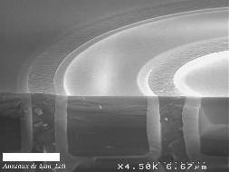
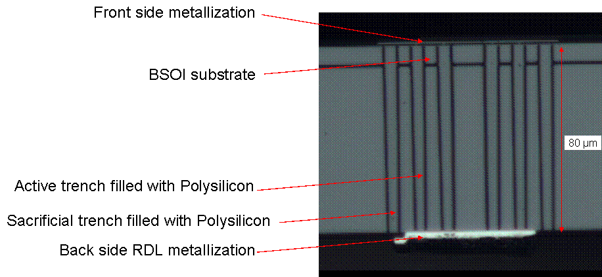
TSV first / pre process – State of the art
LETI
  TSV first for medical application
  SOI substrate
  High voltage
TSV after filling & CMP
Final cross section of TSV first + Backside RDL
Source : G. Pares / CEA-LETI

Slide 15
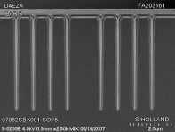
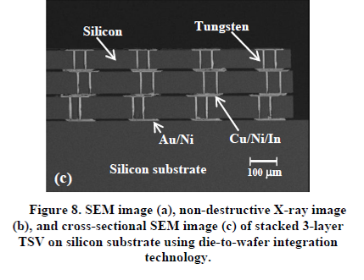
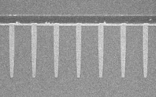
TSV Middle – State of the art
IBM / 2008
  IR detector
  W filling
TSMC / 2009
  Cu filling
Source : K. Sakuma / IBM / ECTC 2008
Source : F. Liu / IBM / IEDM 2008
M1 on TSV
TSV formation
Source : D.Y. Chen / TSMC / IEDM 2009

Slide 16
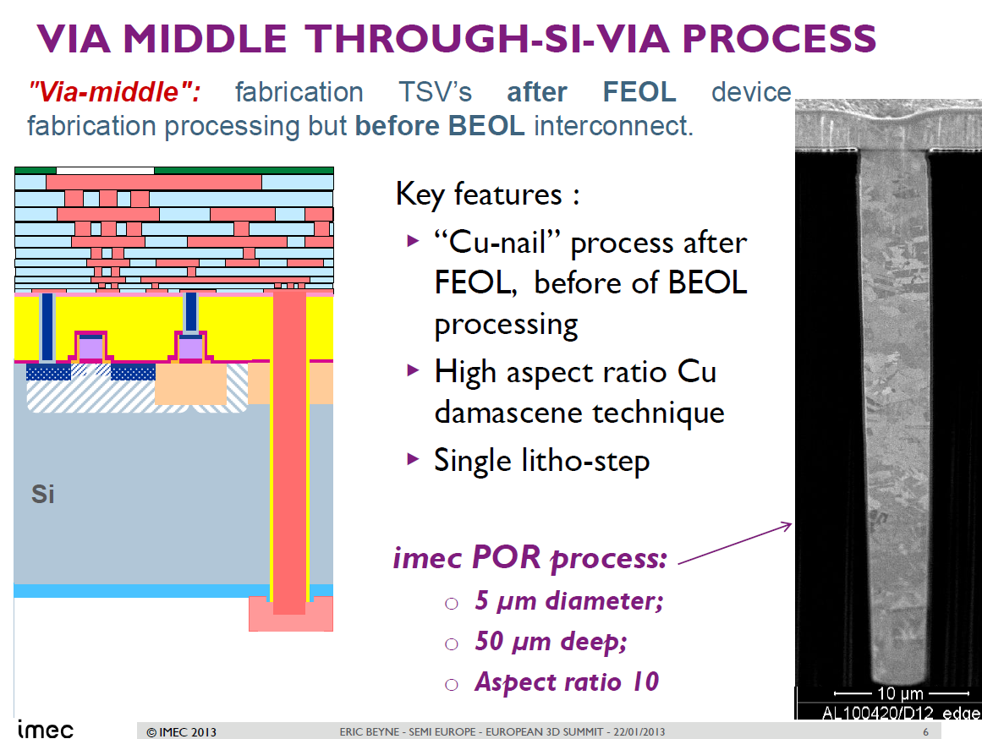
TSV Middle – State of the art
IMEC / 2013
  TSV formation after FEOL / before BEOL
  Cu filling
  AR 10 : 1
Source : E. Beyne / IMEC

Slide 17
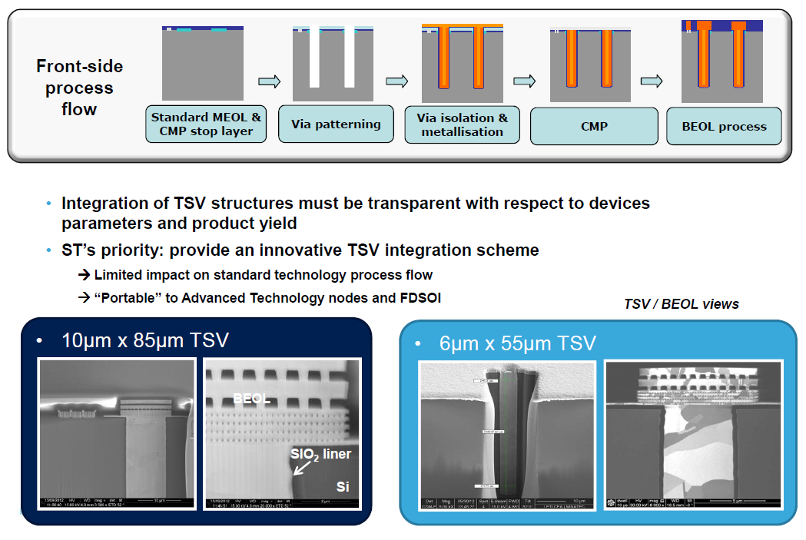
TSV Middle – State of the art
ST Micro - LETI / 2013
  TSV formation after FEOL / before BEOL
  Cu filling
  TSV diameters : 10 µm & 6 µm ➔ AR ~ 9 : 1
Source : J. Michailos / ST Micro

Slide 18
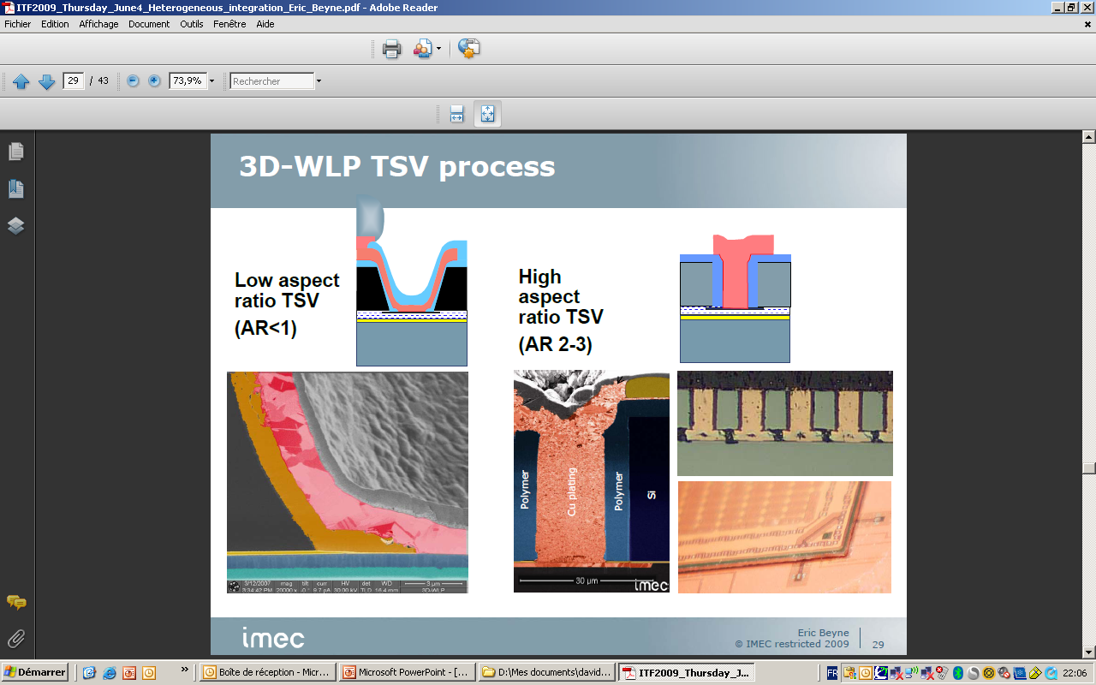
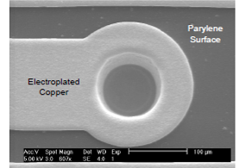
TSV last - state of the art
State of the art for TSV last / AR from 1:1 to 3:1
  TSV last approach with temporary bonding
  Low temperature process (< 260°C)
IMEC (Belgium - 2009)
  Tapered via / TSV AR from 2:1 to 3:1
  Cu liner + parylène insulation
  Donut structure
Source : D. Tezcan / IMEC / ECTC 2007
Source : E. Beyne / IMEC / ITF 2009

Slide 19
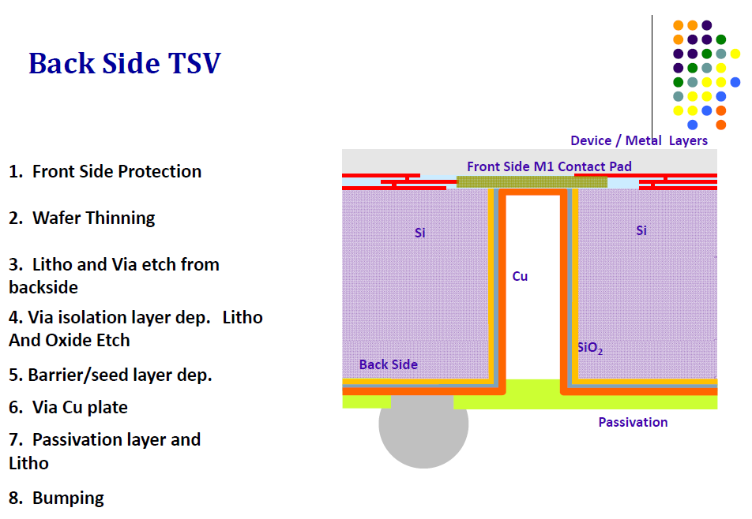
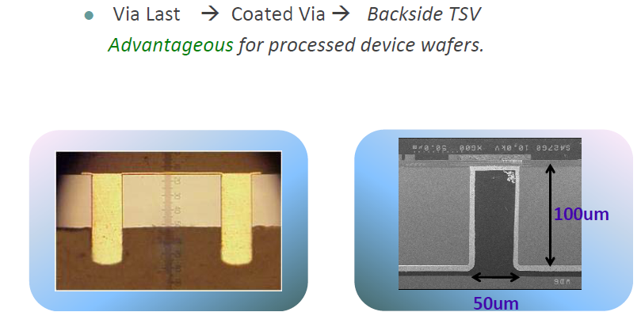
TSV last - state of the art
Allvia (USA - 2011)
  TSV diameter : 50µm / Thickness : 100 µm / AR 2:1
  Cu liner
Source : Allvia / 2011

Slide 20
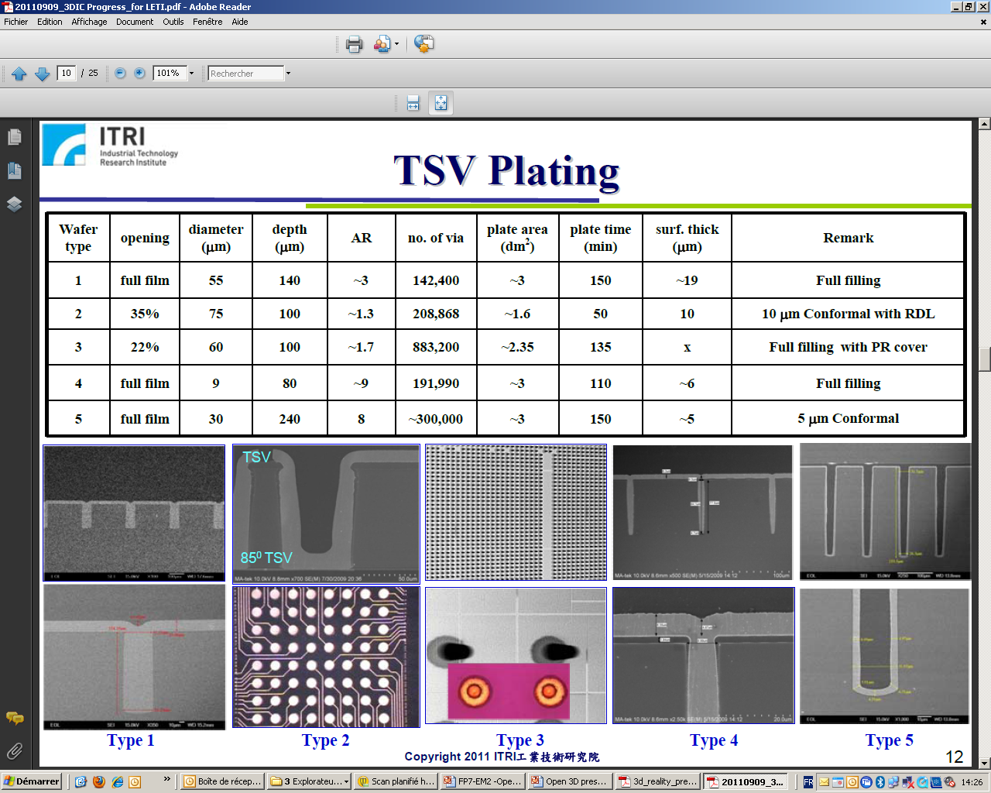
TSV last - state of the art
ITRI (Singapore - 2011)
  TSV diameter from 55 to 70 µm / AR from 1.3 to 3:1
  Cu liner
Source : ITRI / 2011

Slide 21
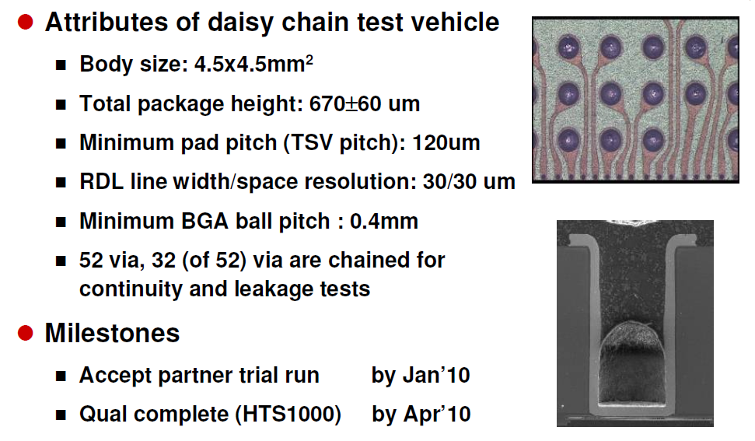
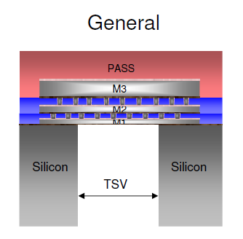
TSV last - state of the art
Xintec (Taiwan - 2011)
  TSV diameter 60 µm / AR 2:1
  Cu liner
  CIS applications
Source : Xintec / 2011

Slide 22
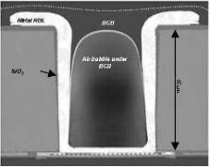
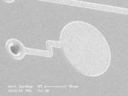
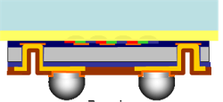
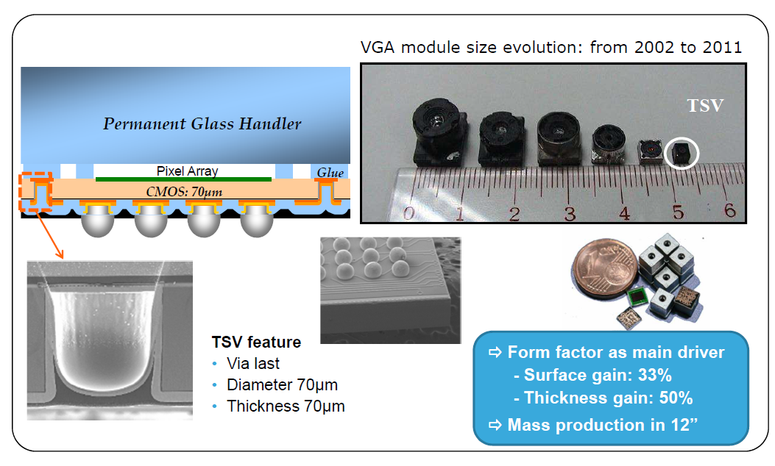
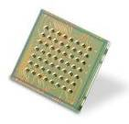
TSV last - state of the art
LETI / ST Micro (2008 ➔ 2013)
  CIS application
  Cu liner
  TSV AR 1 : 1
Production mode since 2009
300 mm production line @ STM Crolles
Source LETI / 2009 & J. Michailos 2013

Slide 23
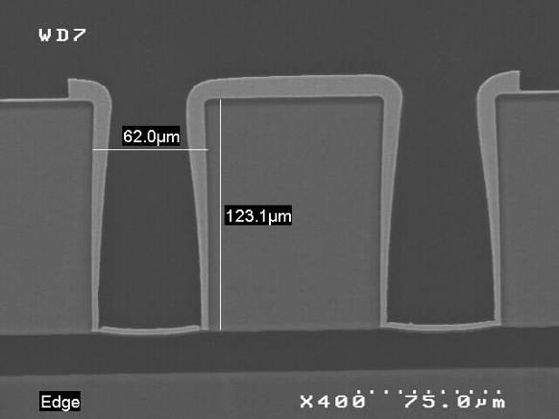
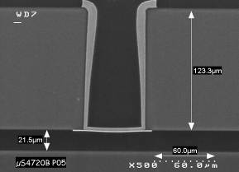
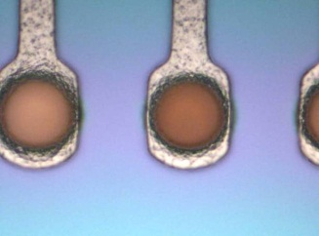
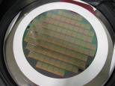
TSV last - state of the art
LETI RF & detectors Applications (2012-2013) :
  RF platform development & HEP applications
  AR 1.5 : 1 and 2:1
AR = 2
TSV AR 2:1
Redistibution layer
From: “A Silicon Platform With Through-Silicon Vias for
Heterogeneous RF 3D Modules”, EuMW2011 P. Bar et al.
AR = 1.5
Ni/Au finishing
Thin wafer on tape

Slide 24
Outline
Introduction
TSV definitions & process flows
TSV (brief & non-exhaustive) state of the art
Applications examples
Conclusions / prospects

Slide 25
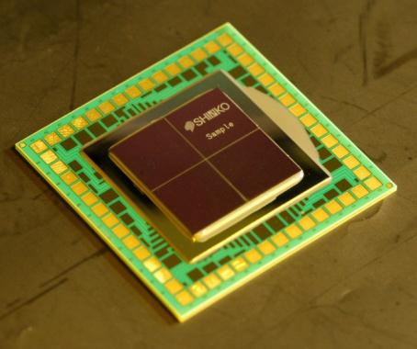
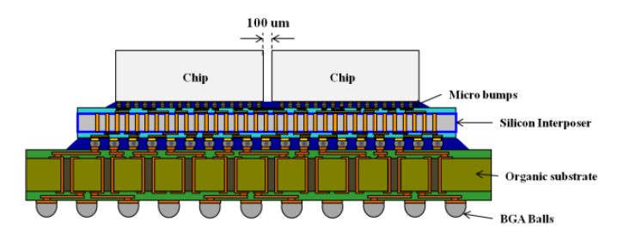
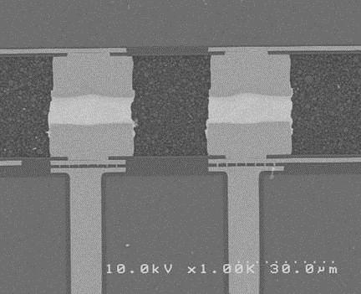



Product example : Passive interposer / TSV first
Features
  Cu TSV, AR10
  2 to 4 layers routing, Damascene thick copper, L/W 0.5/0.5 x 1.4μm
  Temporary bonding
  Thinning, Stress Monitoring, Warp Management
Chip
Cu Pillar
Under-fill
Chip A Chip B
Si-IP
TSV
Si-IP
Organic substrate
Ken Miyairi, Masahiro Sunohara, Jean Charbonnier et al, IMAPS, San Diego 09/2012
| 25

Slide 26
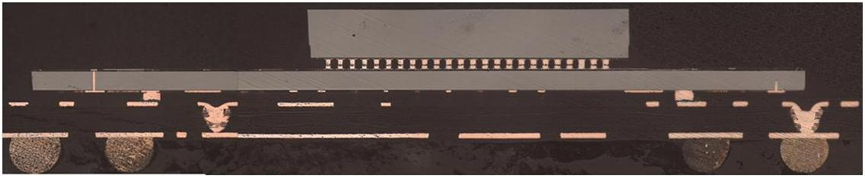
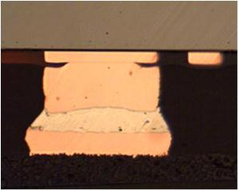
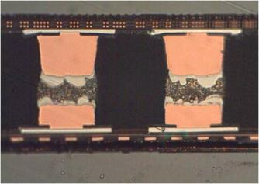
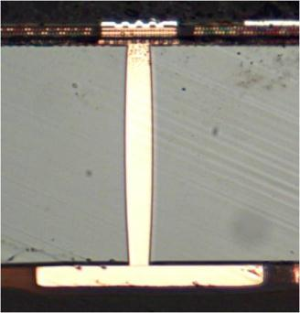
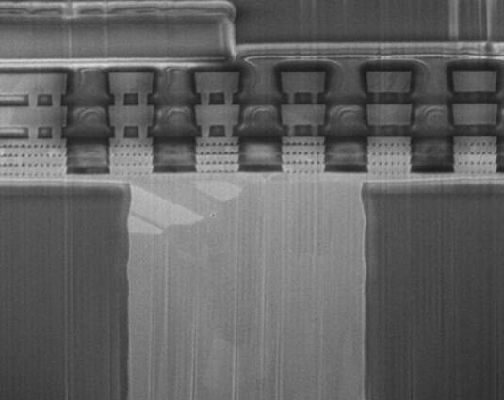
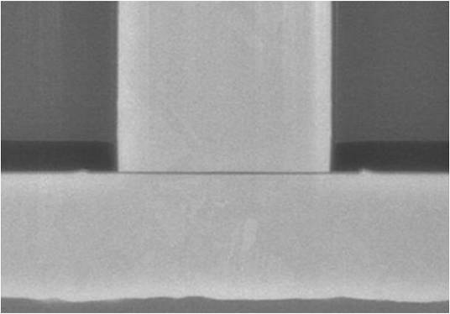

Product example : Active interposer – Partitioning / TSV middle
Top - Digital
②
①
③
Bottom - Analog
BGA
BEOL
③ Die - BGA connection
② Die - die connection
① TSV
Cu TSV
Wide I/O
  SDRAM JEDEC memory standard released Jan. 2012
TSV’s
  Ø 10 μm, AR 8, Pitch 40 μm, Number 1016
  Compatible with FD-SOI
Chip to Chip Cu Pillars
  Ø20 μm, Height 20 μm, Pitch 40 μm, Number 1016
SoC to Substrate Cu Pillars
  Ø55 μm, Height 40 μm, Pitch >200 μm, Number 933
FBGA Package
  Size 12x12mm, Ball Pitch 0.4mm,Ball Matrix 29x29, 1.2 mm thickness
Cu TSV
Cu RDL
3D Integration of a Wireless product with Design Partitioning
G. Druais et al., 3DIC 2012
| 26

Slide 27
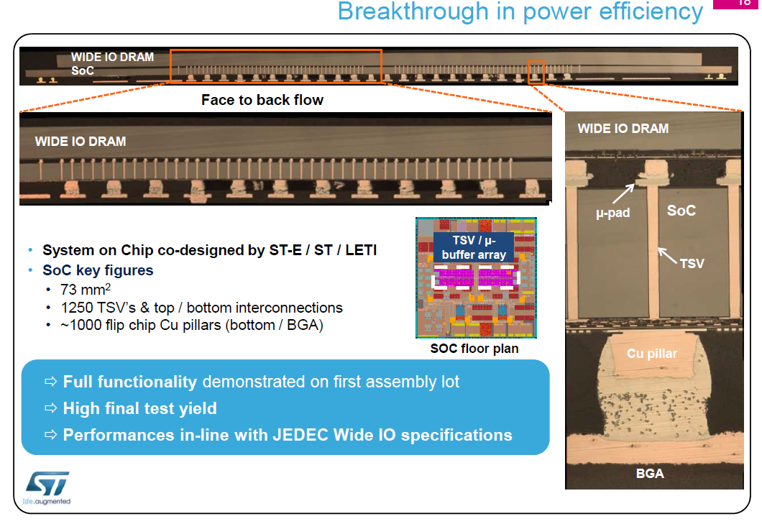
Product example : memory on application processor – TSV middle
Source : J. Michailos / ST Micro / 2013
| 27

Slide 28
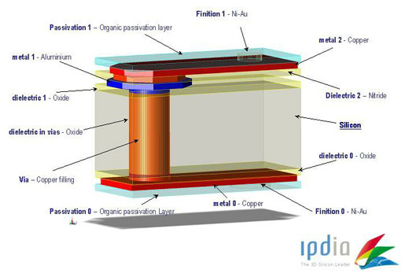
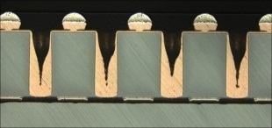
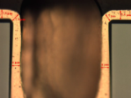
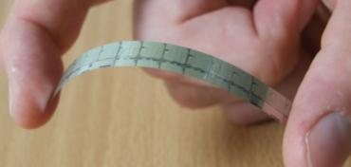
Product example : Ultra thin 3D capacitors stacking – TSV last
Courtesy of IPDIA
Stack target: 4µF/mm²
TSV
solder
<100µm
Sample of IPD of 250nF/mm2 thinned at 60µm
Thinned 3D capacitors interposer
Low profile 3D-IPD for Advanced Wafer Level Packaging
S. Bellenger,et al.IMAPS Minapad 2011
PCB or Si wafer
| 28

Slide 29
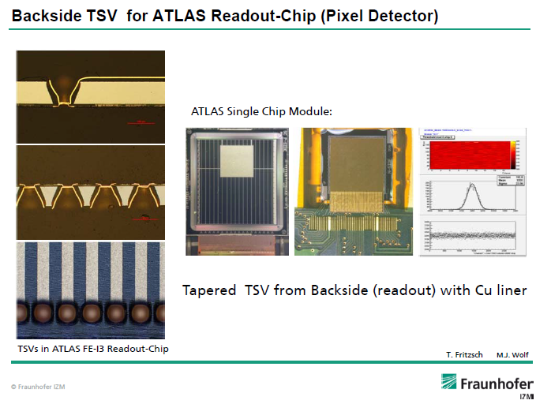
Product example : TSV for ATLAS Readout chip – TSV last
Tapered TSV with Cu liner
Source : J. Wolf / TSV summit / January 2013
| 29

Slide 30
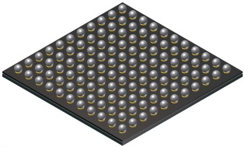
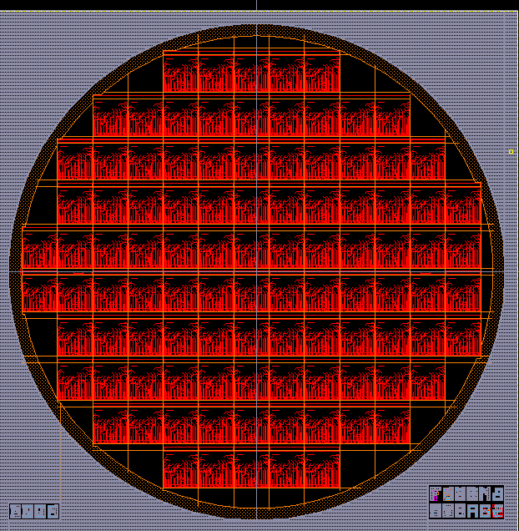
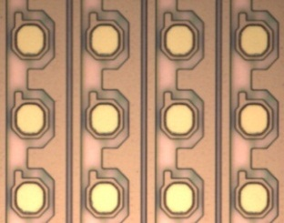



Product example : TSV for Medipix project – TSV last
Product : XRay detector for medical applications
Project started On June 2011
First wafers delivered on January 2012
Design
Technology
Electrical Tests
TSV
Medipix wafer after front side UBM
Wafer view
Back side UBM
TSV
Single chip
| 30

Slide 31
Outline
Introduction
TSV definitions & process flows
TSV (brief & non-exhaustive) state of the art
Applications examples
Conclusions / prospects

Slide 32
Conclusions / Prospects
Conclusions :
  There are 3 TSV families with differents properties, applications and maturity levels :
    TSV pre-process : R&D level
    TSV Middle : consumer / High end - pre-industrialization level
    TSV last : CIS / Imaging – Mass production
  Lot of companies & R&D centres are working on TSV developments and industrialization
  The 3D & TSV supply chain is starting to be available
  Some industrial products have been already achieved with TSV
Prospects
  For TSV community : to find the “killer application” for TSV adoption in the consumer market
  To disseminate the TSV technologies on other markets :
    Medical
    Spatial / aerospace
    HEP
    …

Slide 33



Thank you for your attention

