Slide 1
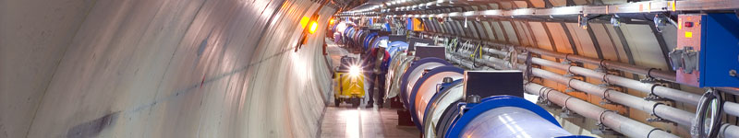
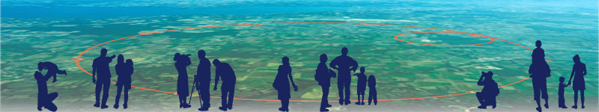
Introduction to Experiments
How do you detect particles?

Slide 2

Content
Particle interaction with matter
Principles of detection
How does it work
  Some detector examples

Slide 3
Particle interaction with matter

Slide 4
Interaction of Particles with Matter
In order to detect a particle it must interact with matter!
The most important interaction processes are electromagnetic:
Charged Particles:
Energy loss due to ionization (e.g. charged track in straw detector)
heavy particles (not electrons/positrons!)
Energy loss due to photon emission (electrons, positrons)
bremsstrahlung
Photons:
Interaction of photons with matter (e.g. EM calorimetry)
Photoelectric effect
Compton effect
Pair production
Other important electromagnetic processes:
Multiple Scattering (Coulomb scattering)
scintillation light (e.g. TOF systems)
Cherenkov radiation
Transition Radiation (e.g. particle id normally electrons)
Can calculate the above effects with a combo of classical E&M and QED.
In most cases calculate approximate results, exact calculations very difficult.

Slide 5
Bethe-Bloch Formula for Energy Loss
Average energy loss for heavy charged particles
Energy loss due to ionization and excitation
Valid for energies <100’s GeV and β >>zα (≈z/137)
heavy= m_{incident}>>m_{e}
proton, k, π, μ
Fundamental constants
r_{e}=classical radius of electron
m_{e}=mass of electron
N_{a}=Avogadro’s number
c=speed of light
=0.1535MeV-cm²/g
Absorber medium
I=mean ionization potential
Z= atomic number of absorber
A=atomic weight of absorber
ρ=density of absorber
δ=density correction
C=shell correction
Incident particle
z=charge of incident particle
β=v/c of incident particle
γ=(1-β²)^{-1/2}
W_{max}=max. energy transfer
in one collision
Note: the classical dE/dx formula contains
many of the same features as the QM version: (z/β)², & ln[]

Slide 6
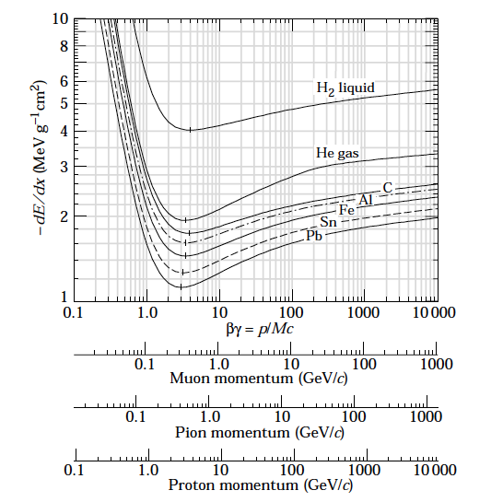
Bethe-Bloch Energy Loss
PDG plots:
http://pdg.lbl.gov/index.html
Calculated

Slide 7
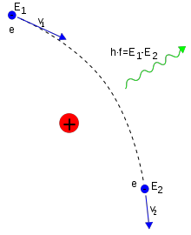
Bremsstrahlung
(braking radiation)
A fast moving particle is decelerated in the electrical field of the nuclei.
Above a few tens MeV, bremsstrahlung is the most dominated process for electrons and positrons
It becomes important to muons (and pions) at a few hundred GeV
What about the atomic electrons? Yes, the electron cloud gives and additional contribution to the bremsstrahlung
Let’s see how this is used in the detector layout later
e⁻
e⁻
e⁻
e⁻
e⁻

Slide 8
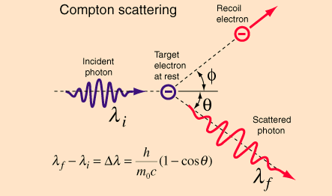
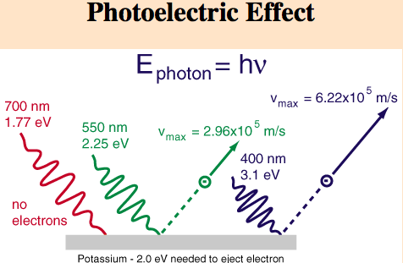
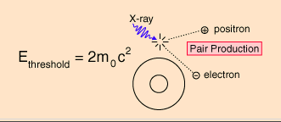
Photons - 3 interactions

Slide 9
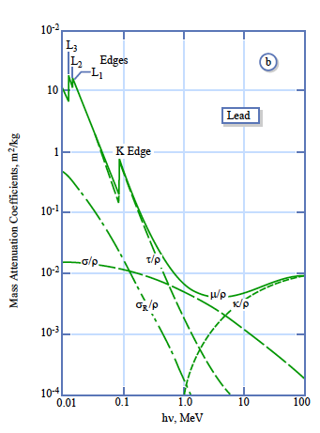
Photons interacting with matter
Photoelectric effect
Compton scattering
Pair production
Mass Attenuation Coefficient = Interaction probability/density

Slide 10

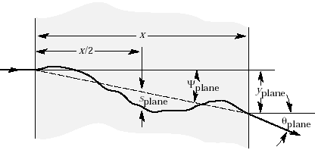
Multiple Scattering
A charged particle traversing a medium is deflected by many small angle scatterings.
These scattering are due to the coulomb field of atoms and are assumed to be elastic.
In each scattering the energy of the particle is constant but the particle direction changes.
In the simplest model of multiple scattering we ignore large angle scatters.
In this approximation, the distribution of scattering angle θ_{plane} after traveling a distance x
through a material with radiation length =L_{r} is approximately gaussian:
with
In the above equation β=v/c, and p=momentum of incident particle
This is not good for tracking!

Slide 11
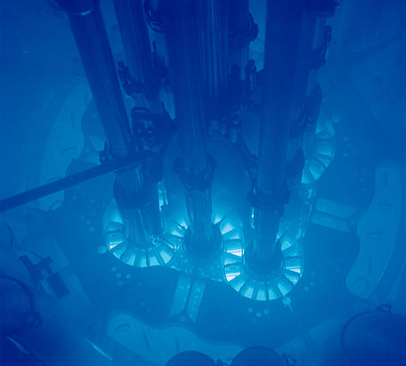
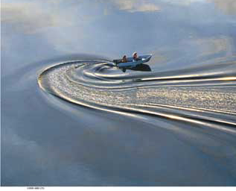
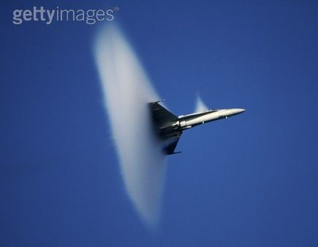
Cherenkov light
Named after the Russian scientist P. Cherenkov who was the first to study the effect in depth (he won the Nobel Prize for it in 1958)
From Relativity, nothing can go faster than the speed of light c (in vacuum)
However, due to the refractive index n of a material, a particle can go faster than the local speed of light in the medium c_{p} = c/n
Fast electrons in a reactor emitting blue light (Cherenkov radiation)
This is analogous to an aeroplane travelling faster than the speed of sound

Slide 12
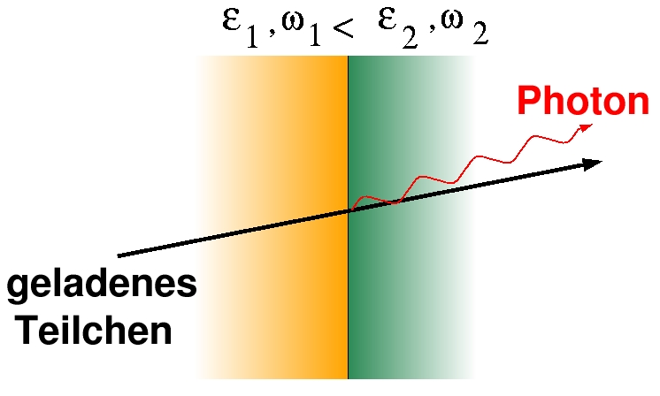
Transition Radiation (Particle ID)
Transition Radiation: photon emitted by a charged particle when traversing the boundary between materials with different dielectrical constants (ε1ε2)
γ > 1000
Intensity: I ~ γ = E/m, θ ~ 1/ γ
  Identification of transition radiation
  photons used for
  particle identification (mostly electrons)
  of particles with momenta between
  1 and few 100 GeV
θ
charged
particle

Slide 13
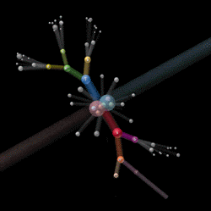

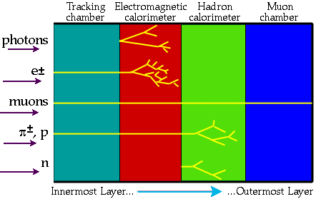
Principles of Detection
The collision energy condenses into particles (e⁻, p, π…)
Detectors surrounding the collision point (or after in case of fixed target) are sensitive to the passage of energetic particles.

Slide 14
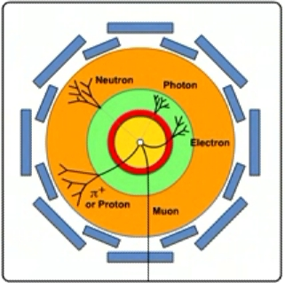
How to detect particles in a detector
Tracking detector
Measure charge and momentum of charged particles in magnetic field
Electro-magnetic calorimeter
Measure energy of electrons, positrons and photons
Hadronic calorimeter
Measure energy of hadrons (particles containing quarks), such as protons, neutrons, pions, etc.
Neutrinos are only detected indirectly via ‘missing energy’ not recorded in the calorimeters
Muon detector
Measure charge and momentum of muons

Slide 15
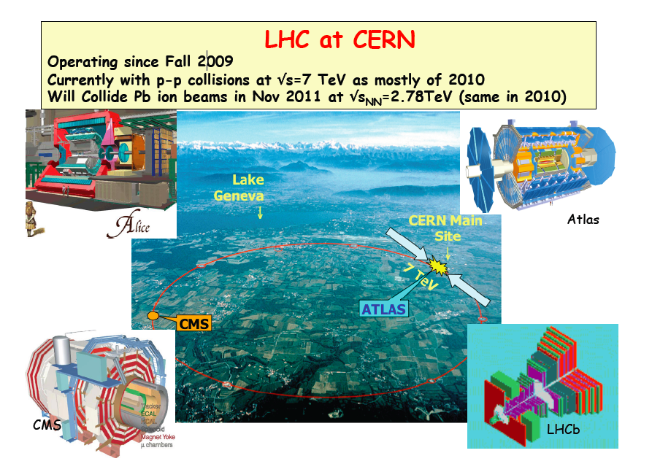

Slide 16

Example: ATLAS

Slide 17
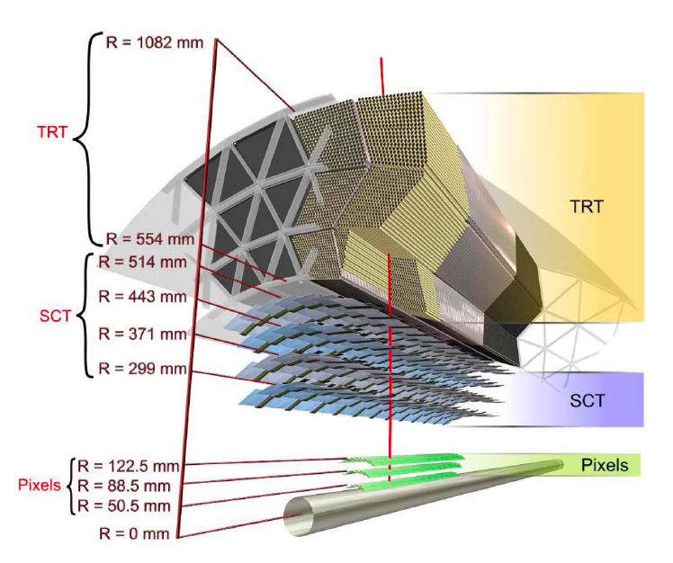
The ATLAS Inner Detector (ID)
2 physicists
Provides charged particle tracking for particles above 0.5GeV, |η| < 2.5
Electron identification for particles with |η|<2 and 0.5 < p_{T} < 150 GeV
Surrounded by solenoid B = 2T
Consists of Pixel detectors, Semiconductor Tracker and Transition Radiation Detector (TRT)

Slide 18
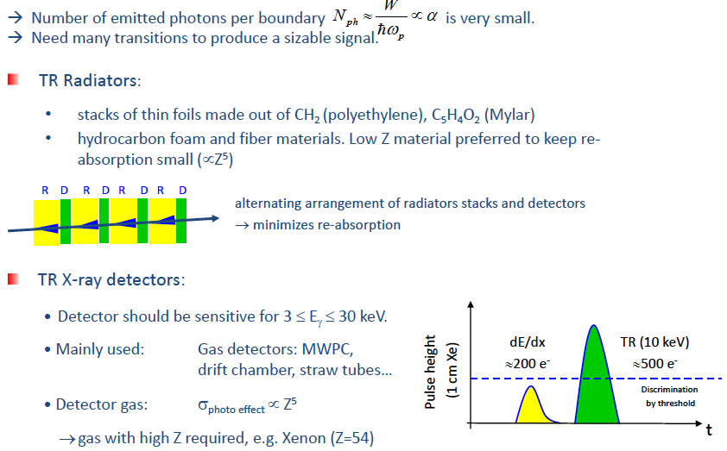
Transition radiation
(particle identification)

Slide 19
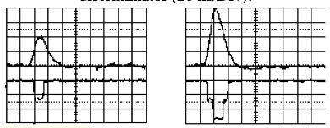
TRT (ATLAS): 3 straws and radiators
Cross section view
TR photon
electrons
High threshold
Low threshold

Slide 20
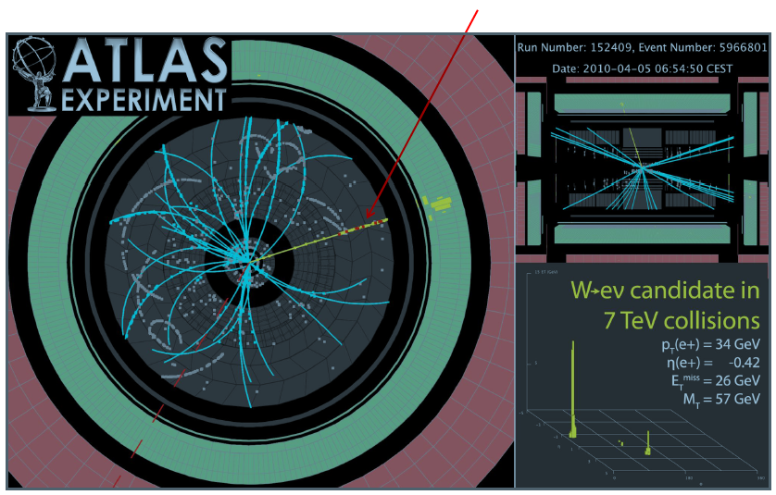
Red dots indicates High threshold hits
W mass: 80.398±0.023 GeV/c

Slide 21
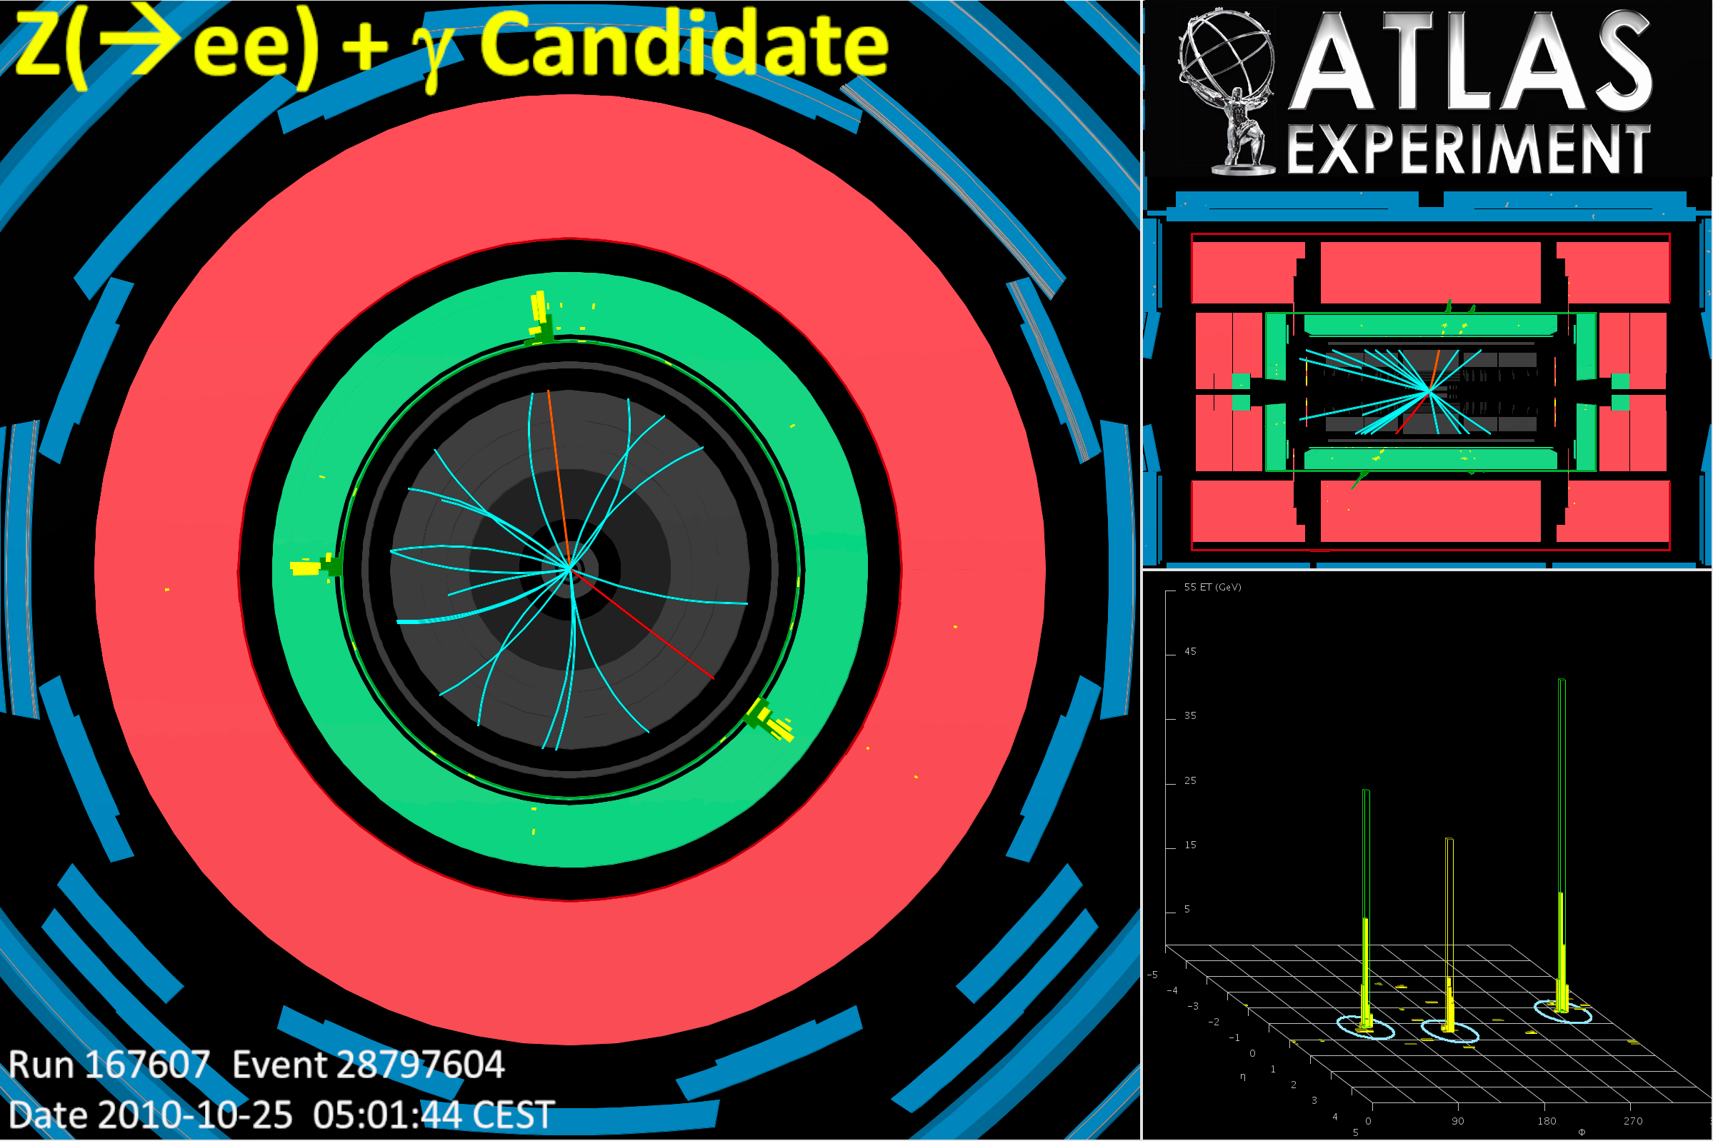
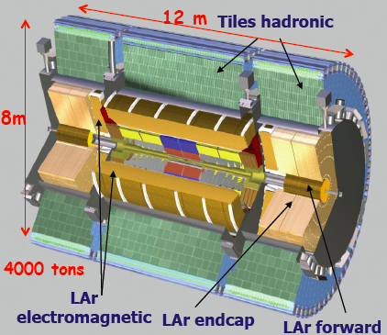
ATLAS Calorimeter
Electromagnetic calorimeter measures the energy of e and γ)
Hadron calorimeter measures the energies of hadrons
The calorimeters are important for the trigger (selecting 100 interesting events per second out of 1000 million others !)

Slide 22
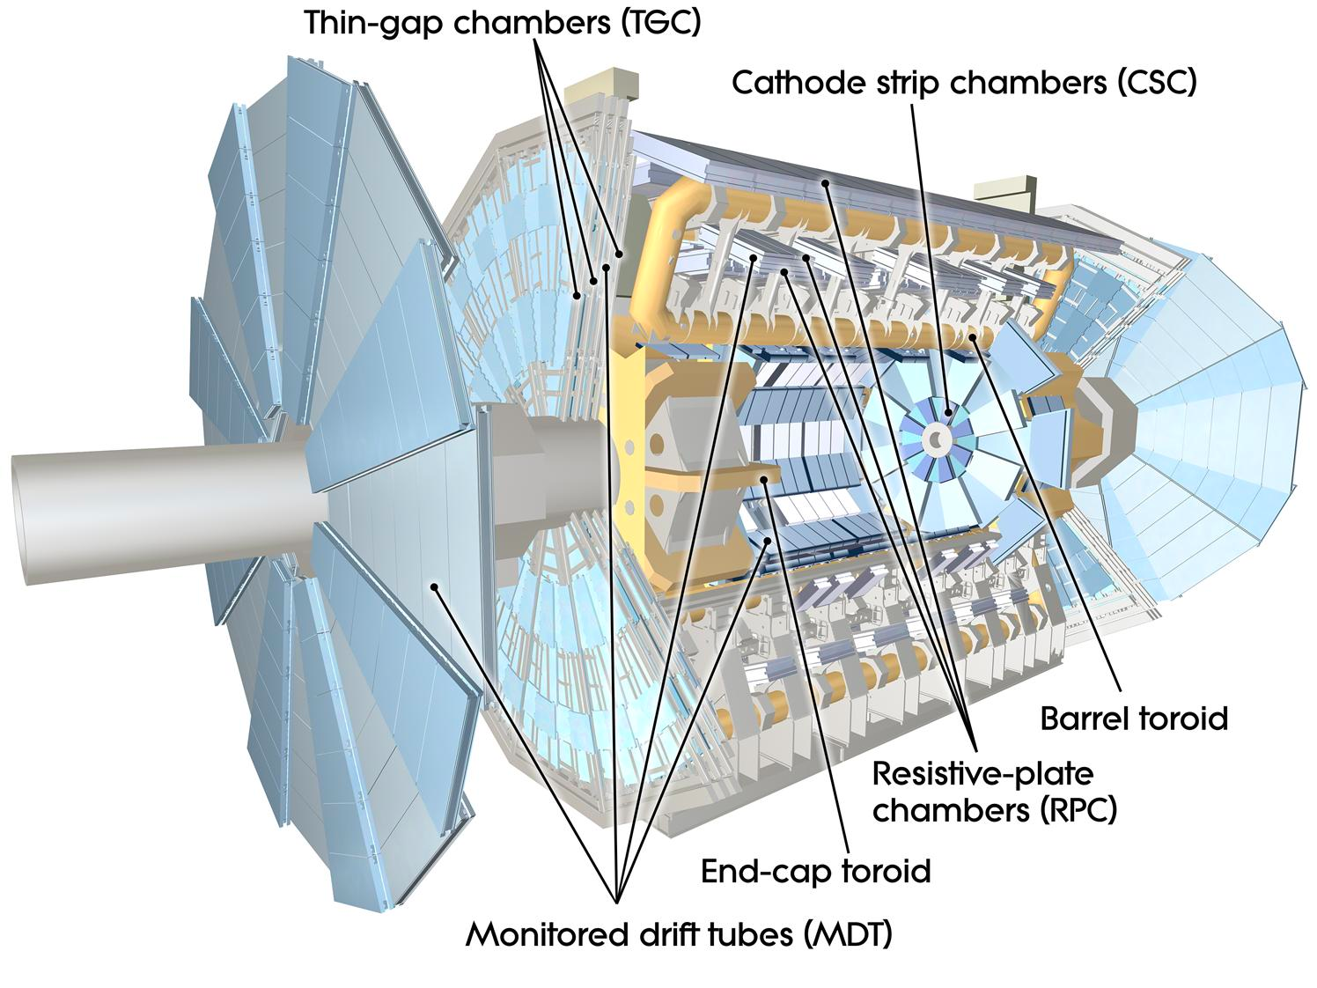
ATLAS Muon Spectrometer
Muons act like heavier versions of
the electron, with mass 105.7 MeV
Distance they travel (on average) before decay: d = βγcτ_{μ}
where velocity β = v/c
boost γ = E/m = 1/√(1−β²)
So a 10 GeV muon flies ~ 60 km before decay >> detector size
→ effectively stable
Since mass is large, Bremsstrahlung radiation is small, and as a lepton it does not feel the strong interaction

Slide 23
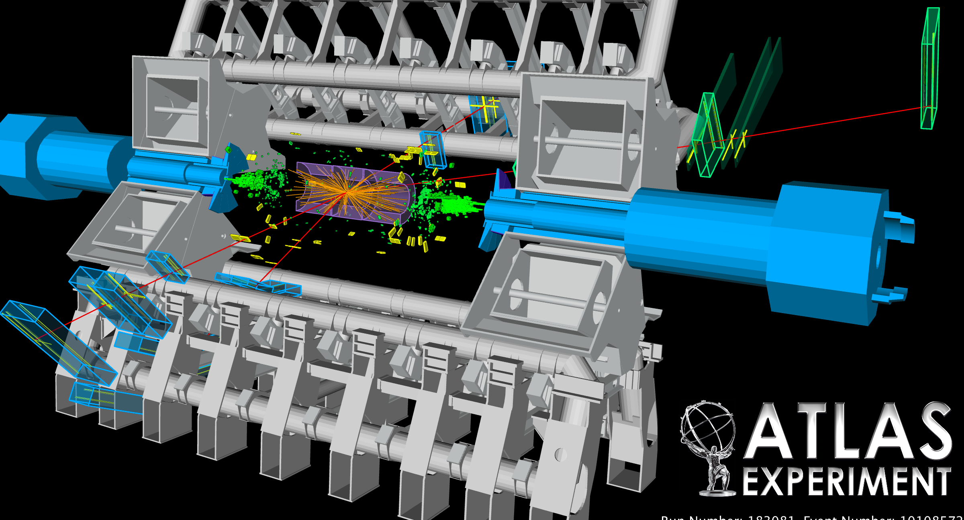
Z→ 4 muons

Slide 24
Particle identification detector
Cherenkov radiation: this is light emitted when a charged particle travels faster than the speed of light through a given medium. Combined with a measurement of the momentum of the particle the velocity can be used to determine the mass and hence to identify the particle.
Transition radiation: this radiation is produced by a fast charged particle as it crosses the boundary between two electrical insulators with different resistances to electric currents.
TOF (Time of Flight) detector is a particle detector which can discriminate between a lighter and a heavier elementary particle of same momentum using their time of flight between two scintillators. The first of the scintillators activates a clock upon being hit while the other stops the clock upon being hit.

Slide 25
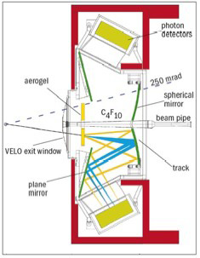
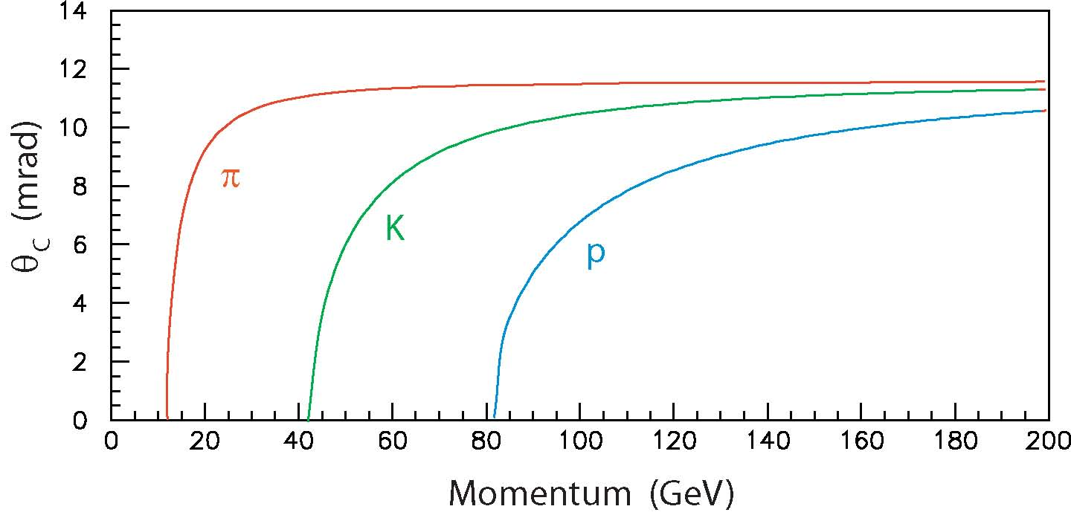
Cherenkov Detector
Ring Imaging Cherenkov detector (RICH detector) of LHCb
The LHCb RICH system has the task of identifying charged particles over the momentum range 1-150 GeV/c, within an angular acceptance of 10-300 milliradians (mrad)

Slide 26
Time Of Flight
OPERA: UPDATE 8 June 2012
Neutrinos sent from CERN to Gran Sasso respect the cosmic speed limit
At the 25th International Conference on Neutrino Physics and Astrophysics in Kyoto today, CERN Research Director Sergio Bertolucci presented results on the time of flight of neutrinos from CERN to the INFN Gran Sasso Laboratory on behalf of four experiments situated at Gran Sasso. The four, Borexino, ICARUS, LVD and OPERA all measure a neutrino time of flight consistent with the speed of light. This is at odds with a measurement that the OPERA collaboration put up for scrutiny last September, indicating that the original OPERA measurement can be attributed to a faulty element of the experiment’s fibre optic timing system.
“Although this result isn’t as exciting as some would have liked,” said Bertolucci, “it is what we all expected deep down. The story captured the public imagination, and has given people the opportunity to see the scientific method in action – an unexpected result was put up for scrutiny, thoroughly investigated and resolved in part thanks to collaboration between normally competing experiments. That’s how science moves forward.”
Detectors (scintillators)
Simple concept: measure the time difference between two detector planes
β = d / c Δt
For a 10 GeV K, the time to travel 12 m is 40.05 ns, whereas for a π it would be
40.00 ns, so the difference is only 50 ps
Modern detectors + readout electronics
have resolution σ_{t} ~ 10 ns, fast enough
for the LHC (bunch crossings 25 ns apart)
but need σ_{t} < 1 ns to do useful TOF
Track
d
TOF difference for d = 12 m

Slide 27
How does it work?
Some examples

Slide 28
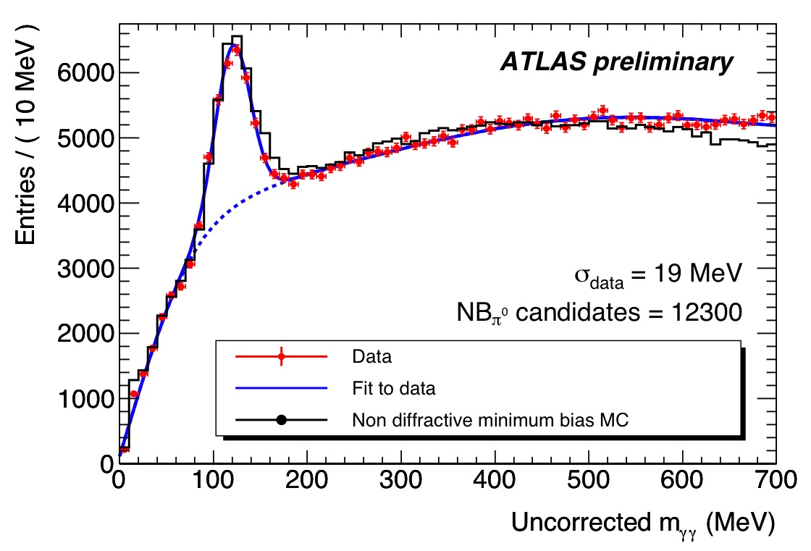
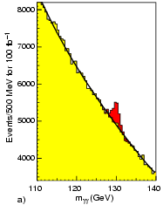
Mass reconstruction
Typical example of reconstruction of a particle decay: π⁰ → γγ
one of the first composite particles reconstructed in the LHC experiments
This technique an also be used to search for more exciting signals:
m(π⁰) = 135 MeV
Η → γγ
CMS simulation
100 fb⁻¹

Slide 29
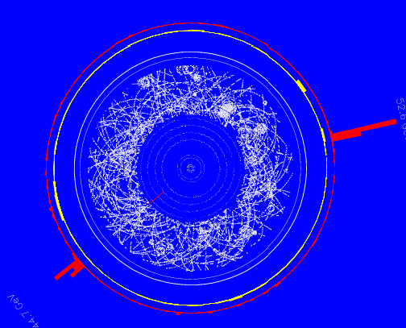
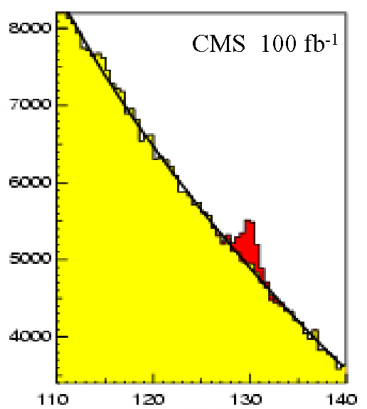
Higgs Detection: H -> γγ
A Higgs decaying to 2 energetic photons would be a striking event in the LHC detectors.
events
Higgs
signal
ATLAS
The combined energies of the signal photons would cluster at the mass of the Higgs boson. In contrast, background events include photon pairs with a variety of energies.
background
energy

Slide 30
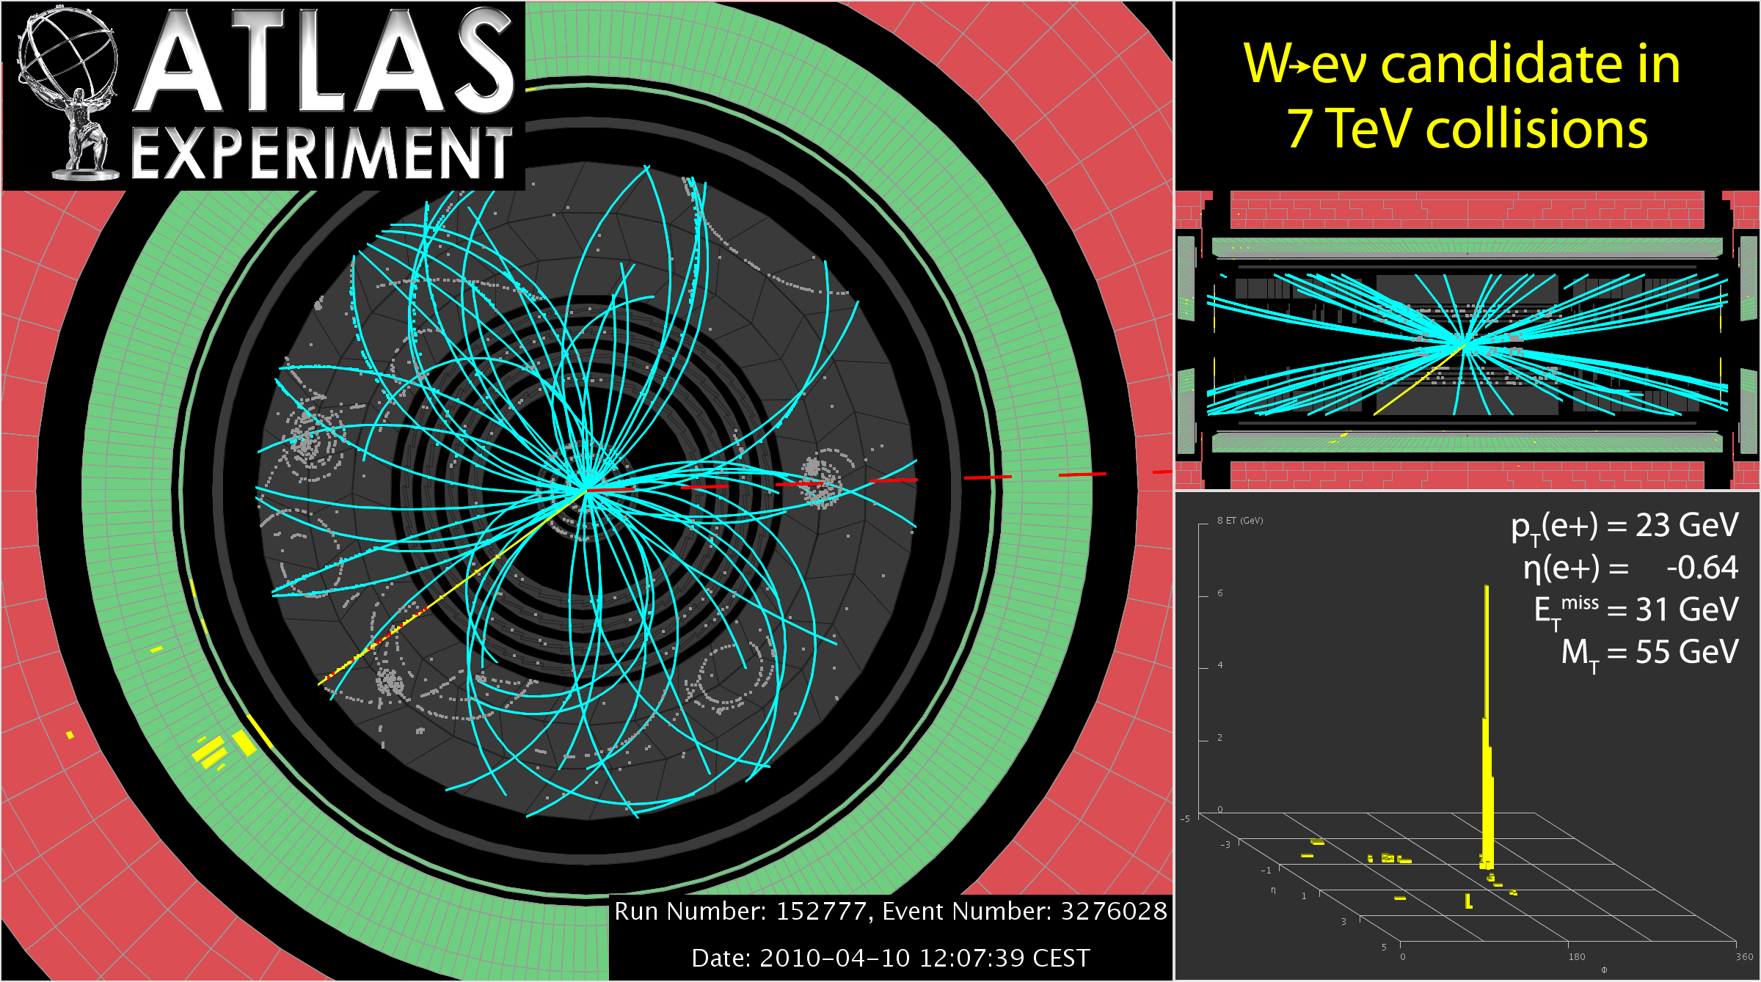
ATLAS example

Slide 31
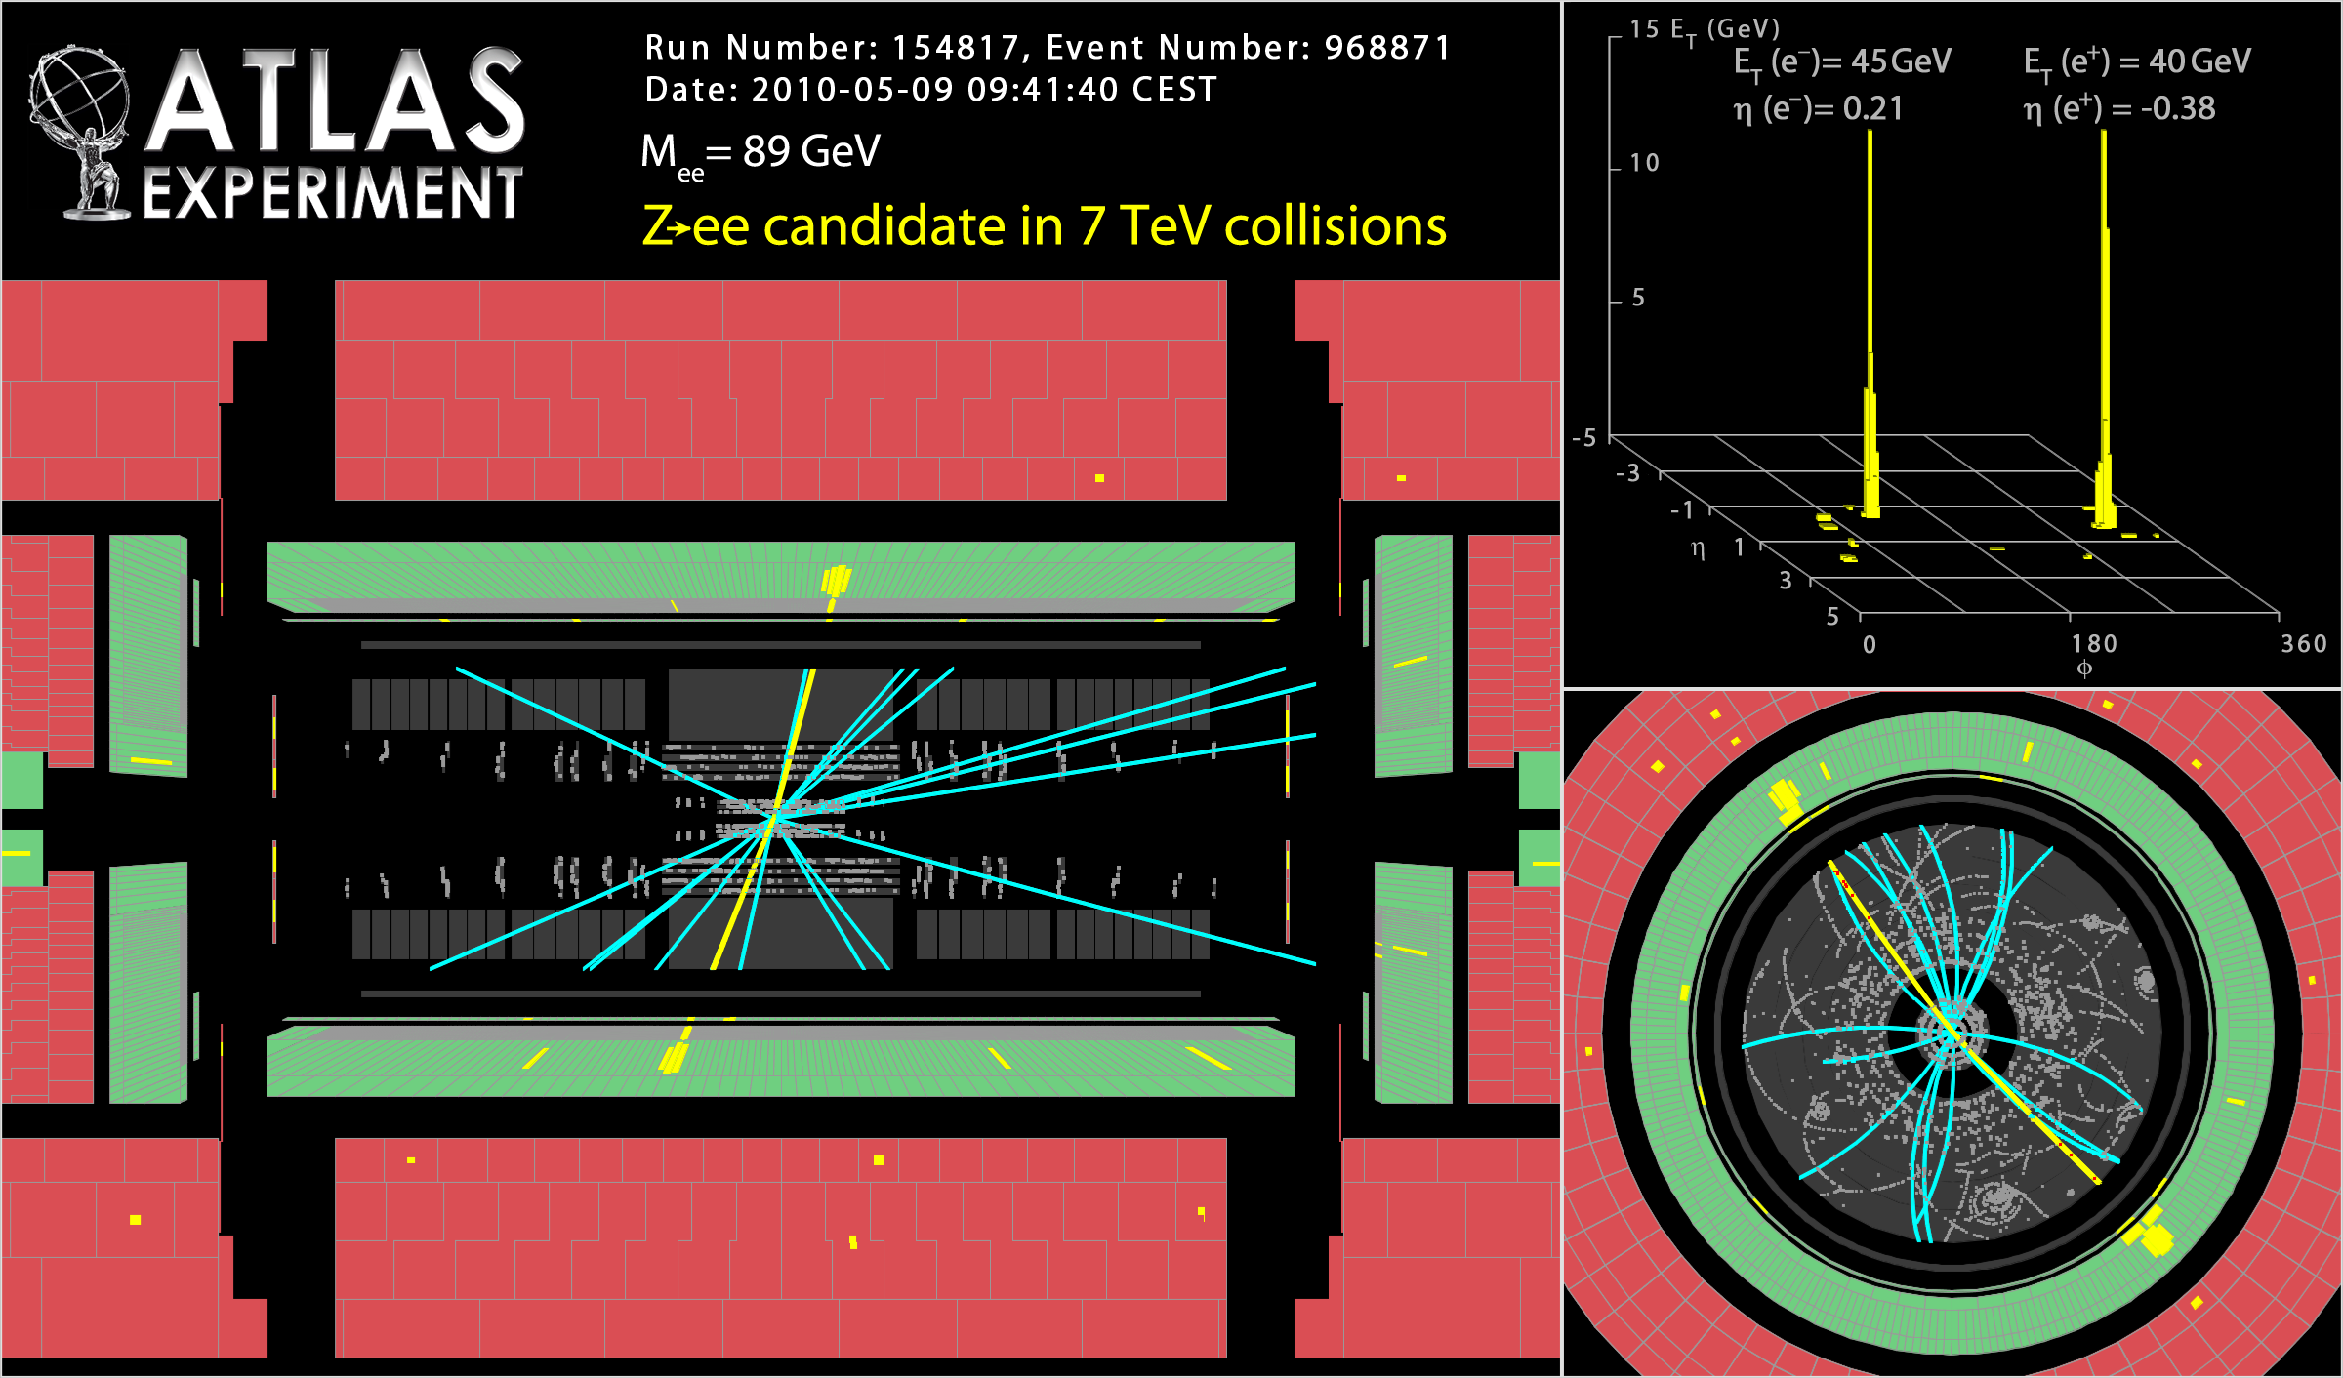
ATLAS

Slide 32
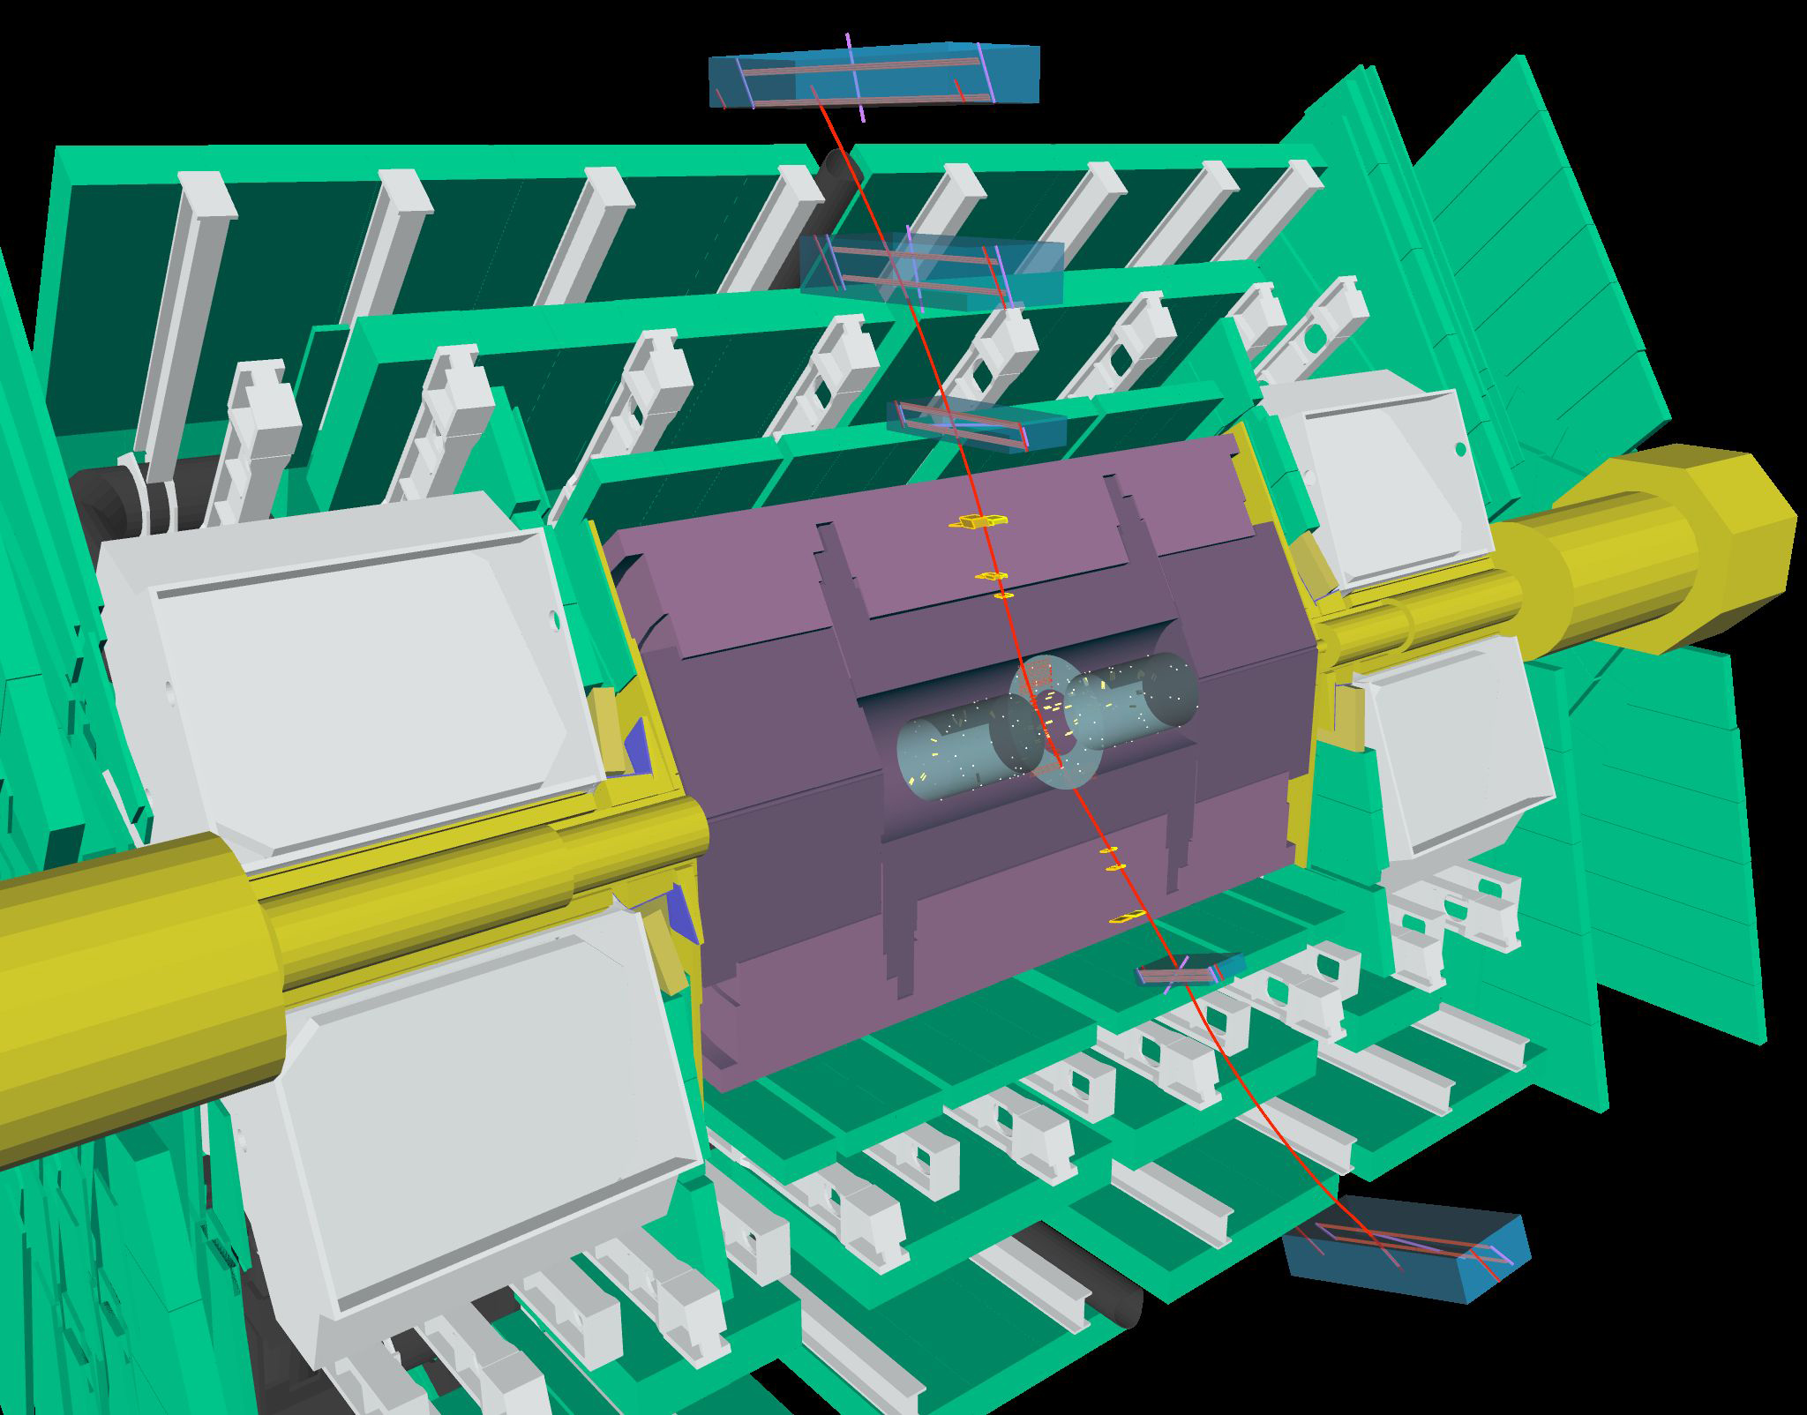
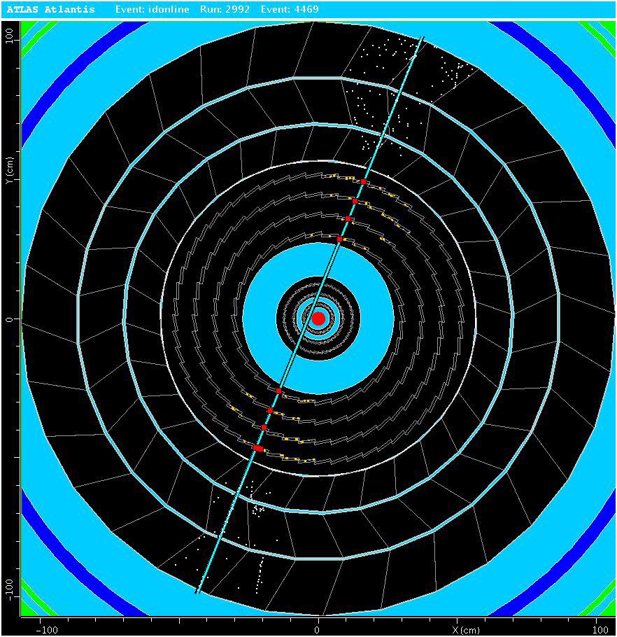
What is this???
(From ATLAS)

Slide 33
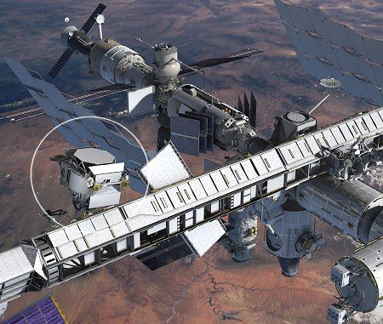
AMS (simulation)
Alpha Magnetic Spectrometer to study cosmic rays

Slide 34
References
Richard Kass, 880.P20 Winter 2006
Roger Forty, ICFA Instrumentation School, Bariloche, 19-20 January 2010.
Ana Henriques, on behalf of the ATLAS collaboration, ICATPP11 Como, 3-7October 2011

Slide 35
Spares

Slide 36
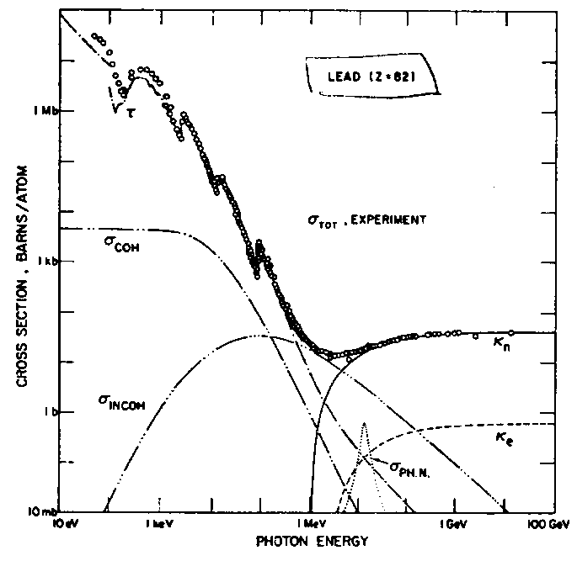
Interaction of Photons (γ’s) with Matter
There are three main contributions to photon interactions:
Photoelectric effect (Eγ < few MeV)
Compton scattering
Pair production (dominates at energies > few MeV)
Contributions to photon interaction cross section for lead
including photoelectric effect (τ), rayleigh scattering (σ_{coh}),
Compton scattering (σ_{incoh}), photonuclear absorbtion (σ_{ph,n}),
pair production off nucleus (K_{n}), and pair production
off electrons (K_{e}).
Rayleigh scattering (σ_{coh}) is the classical physics process
where γ’s are scattered by an atom as a whole. All electrons
in the atom contribute in a coherent fashion. The γ’s energy
remains the same before and after the scattering.
A beam of γ’s with initial intensity N₀ passing through a medium is attenuated in number (but not energy) according to:
dN=-μNdx or N(x)=N₀e^{-μx}
With μ= linear attenuation coefficient which depends on the total interaction
cross section (σ_{total}= σ_{coh}+ σ_{incoh} + +).

Slide 37
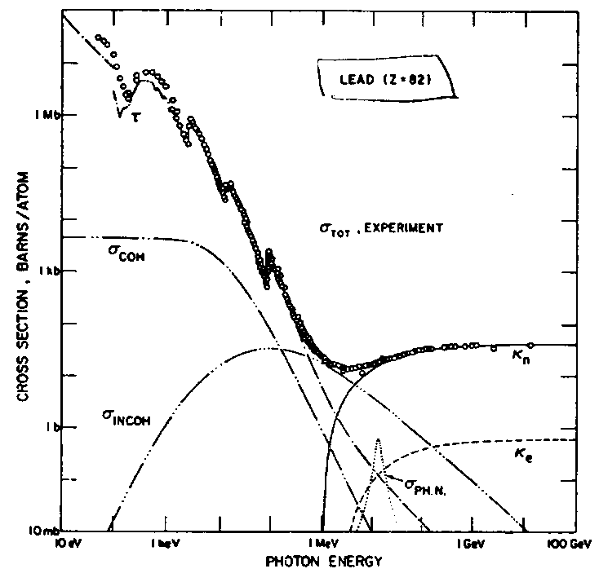
Photoelectric effect
The photoelectric effect is an interaction where the incoming photon (energy E_{γ}=hv) is absorbed by an atom and an electron (energy=E_{e}) is ejected from the material:
E_{e}= E_{γ}-BE
Here BE is the binding energy of the material (typically a few eV).
Discontinuities in photoelectric cross section due to discrete binding energies of atomic
electrons (L-edge, K-edge, etc).
Photoelectric effect dominates at low γ energies (< MeV) and hence gives low energy e’s.
Exact cross section calculations are difficult due to atomic effects.
Cross section falls like E_{γ}^{-7/2}
Cross section grows like Z⁴ or Z⁵ for E_{γ}> few MeV
Einstein wins Nobel prize in 1921 for his
work on explaining the photoelectric effect.
Energy of emitted electron depends on energy
of γ and NOT intensity of γ beam.

Slide 38
Compton Scattering
Compton scattering is the interaction of a real γ with an atomic electron.
γ_{out}
γ_{in}
θ
Solve for energies and angles
using conservation of energy
and momentum
•
φ
electron
The result of the scattering is a “new” γ with less energy and a different direction.
Not the
usual γ!
The Compton scattering cross section was one of the first (1929!) scattering cross sections to be calculated using QED. The result is known as the Klein-Nishima cross section.
At high energies, γ>>1, photons are scattered mostly in the forward direction (θ=0)
At very low energies, γ≈0, K-N reduces to the classical result:

Slide 39
Pair Production (γ→e⁺e⁻)
This is a pure QED process.
A way of producing anti-matter (positrons).
e⁻
e⁺
Threshold energy for
pair production in field
of nucleus is 2m_{e}c², in
field of electron 4m_{e}c².
γ_{in}
+
γ_{in}
γ_{v}
e⁺
γ_{v}
e⁻
Z
Z
Z
Z
Nucleus or electron
Nucleus or electron
First calculations done by Bethe and Heitler using Born approximation (1934).
At high energies (E_{γ}>>137m_{e}c²Z^{-1/3}) the pair production cross sections is ≈ constant.
σ_{pair} =4Z²αr_{e}²[7/9{ln(183Z^{-1/3})-f(Z)}-1/54]
Neglecting some small correction terms (like 1/54, 1/18) we find:
σ_{pair} = (7/9)σ_{brem}
The mean free path for pair production (λ_{pair}) is related to the radiation length (L_{r}):
λ_{pair}=(9/7) L_{r}
Consider again a mono-energetic beam of γ’s with initial intensity N₀ passing through
a medium. The number of photons in the beam decreases as:
N(x)=N₀e^{-μx}
The linear attenuation coefficient (μ) is given by: μ= (N_{a}ρ/A)(σ_{photo}+ σ_{comp} + σ_{pair}).
For compound mixtures, μ is given by Bragg’s rule: (μ/ρ)=w₁(μ₁/ρ₁)++ w_{n}(μ_{n}/ρ_{n})
with w_{i} the weight fraction of each element in the compound.

Slide 40
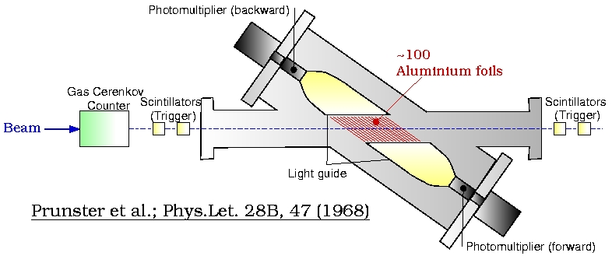
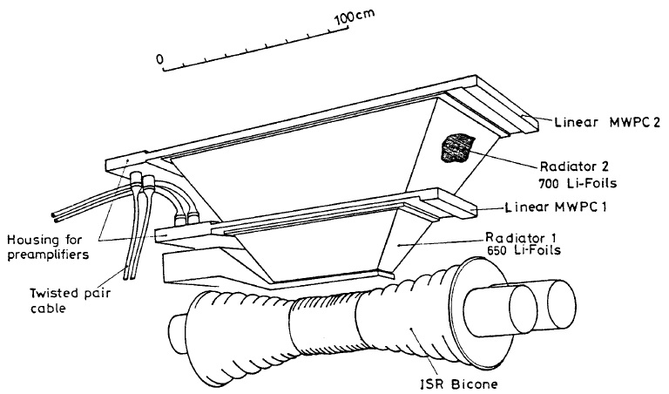
A bit of history
1919: J.E. Lilienfeld observes that surfaces emit light when hit by electron beam
  “Es ist Dunkeladaption des Auges notwendig um einen Leuchtfleck, erzeugt von einem Elektronenstrahl mit 5keV Energie und 20µA Strahlstrom wahrzunehmen” Physikalische Zeitschrift 1919 20, 280)
1946: W. Ginzburg and G. Frank publish their theory of transition radiation
>1960: experiments observe transition radiation,
A.I.Alikhanian and his collaborators from Armenia :
first XTR observations and investigations
1975: First TRD for electron ID in balloon flight
1976: First TRD in HEP experiment for electron ID R806 @ ISR (CERN)

Slide 42
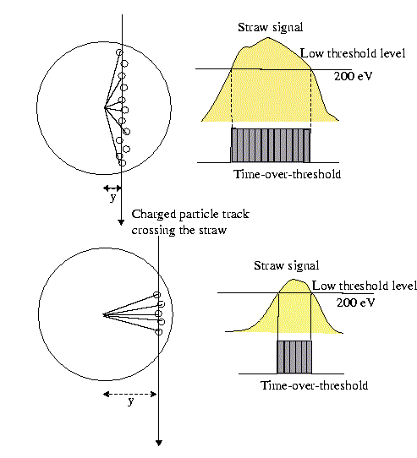
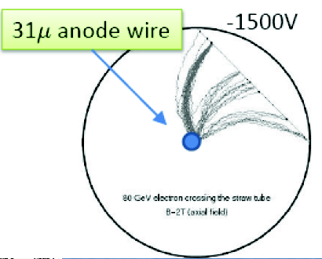
A bit more on the signal…
Tailing edge of the signal:
Independent of distance of track to wire
  “late” ionisations always originate from R=2mm
Leading edge of the signal:
Depends on distance of ionisation which happens closest to the wire
  “early” leading edge: particle crossed straw close to the wire
N.b.: drift is B-field dependent

Slide 43
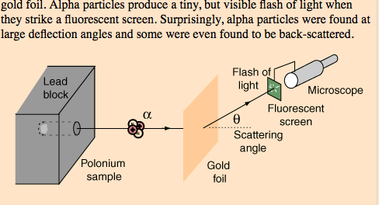
Scattering

