Slide 1
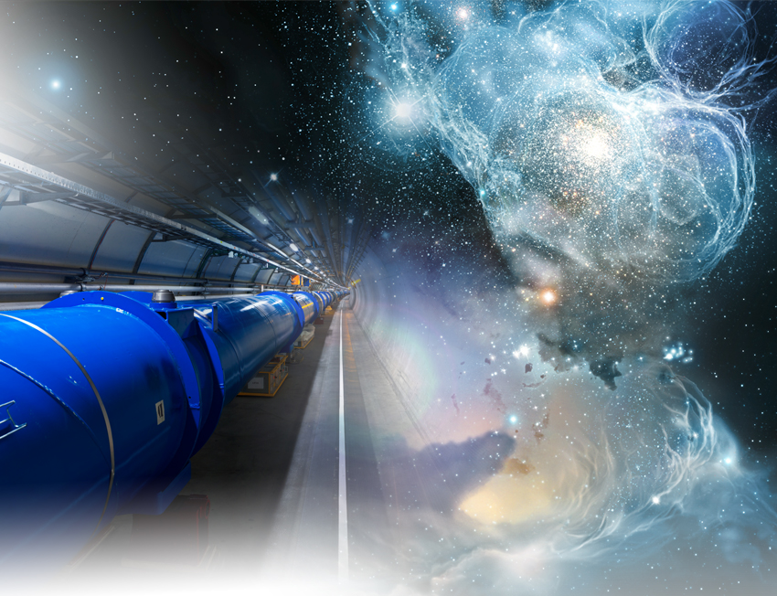
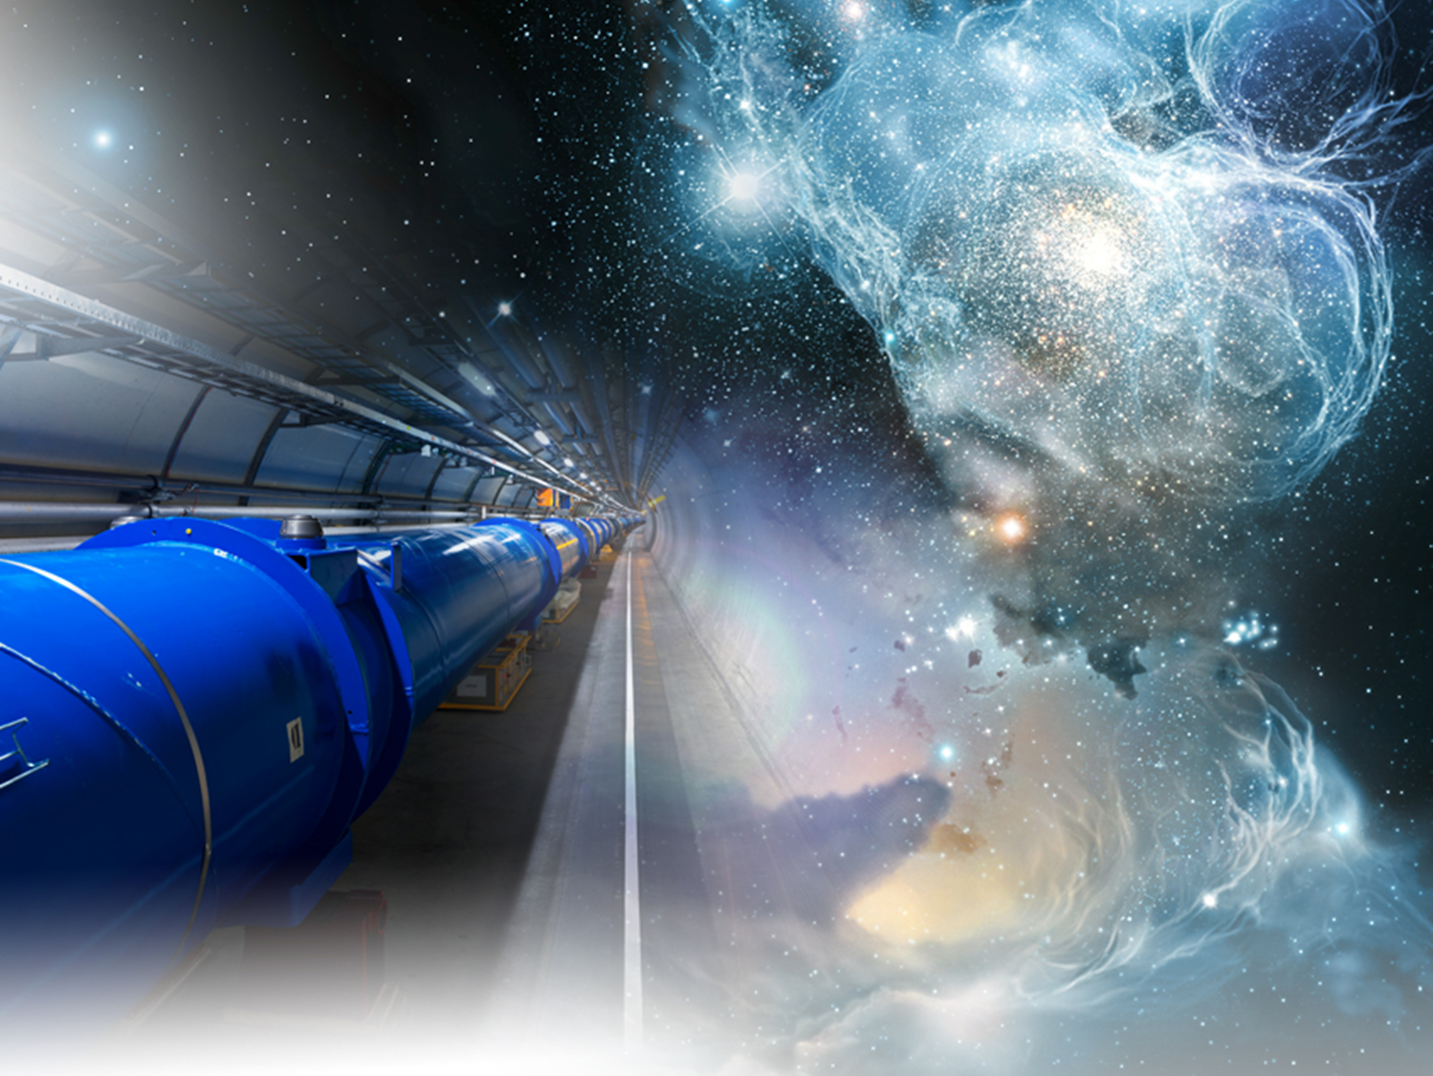


L’amélioration en luminosité du LHC : le projet HL-LHC
L’amélioration en luminosité du LHC : le projet HL-LHC
Lucio Rossi
CERN
High Lumi LHC Coordinator
AFF Commission Cryogénie et Supraconductivité.
Les Journées Thématiques au CERN:
LHC, premiers résultats et perspectives.
June 6th-7th, 2013

Slide 2
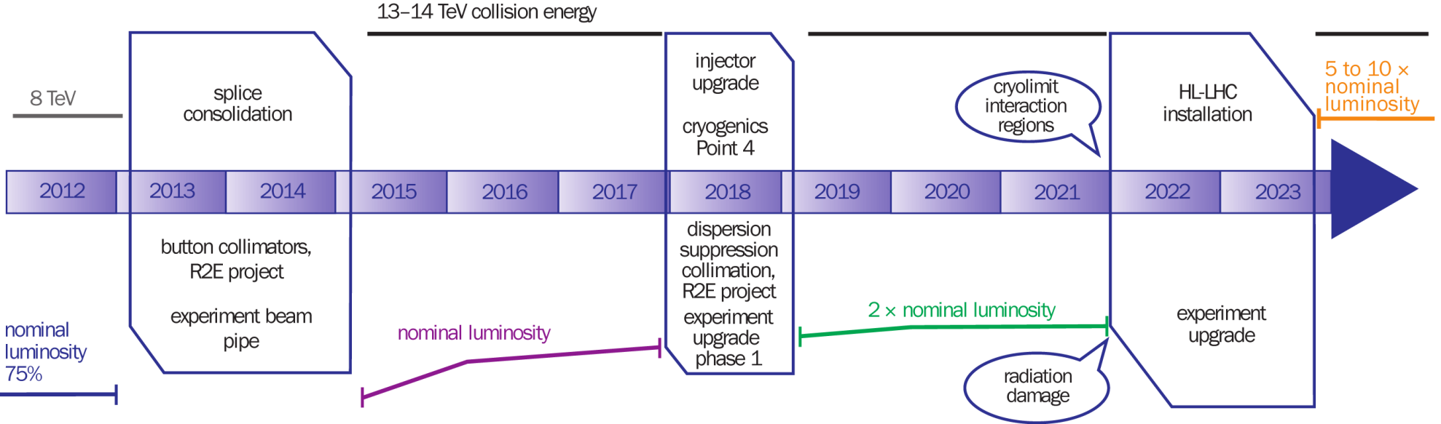
10 y plan of LHC
Luminosity L ≡ N_{events}/cross section ; N_{events} = L * σ
Luminostiy will continue to increase in LHC thanks to better understanding of the operations and thanks to interventions during LS
Around 2021 we expect to meet few limitations:
Radiation damage and general wear in the machine and detector
Limitation of the increase in luminosity, which is necessary for physics

Slide 3
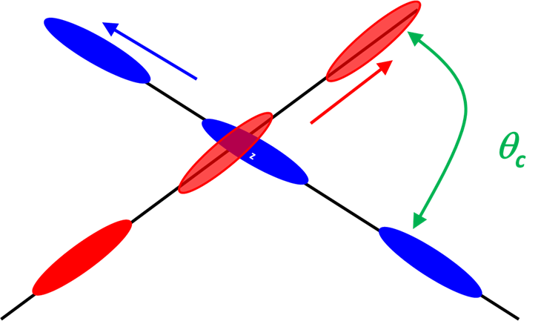

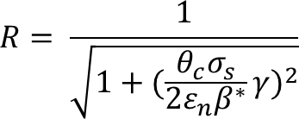
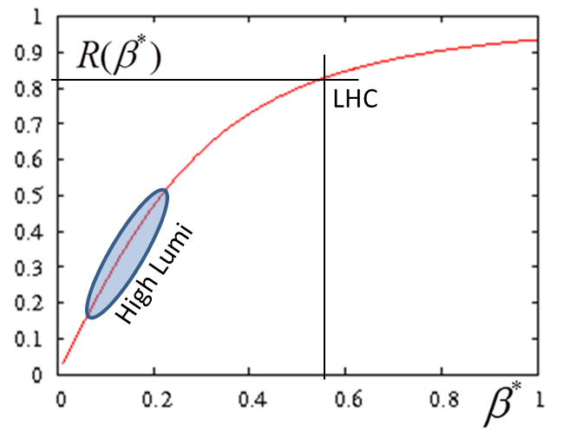

Lumi: main ingredients
Beam current
Small β* → big θ_{c}
energy
Beam size
Beam current and emittance: involve Inj chain and whole ring
β∗ involve «only» 2 IRs, 600 m.
Unit of lumi through the talk

Slide 4
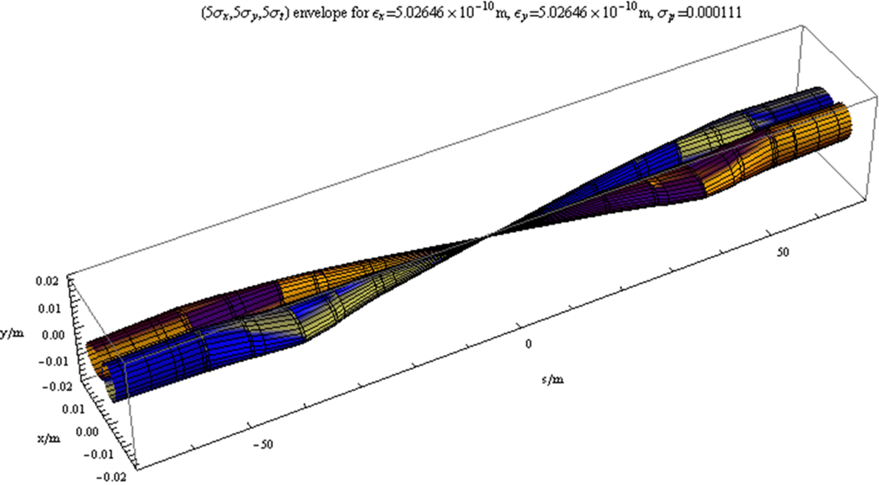
How to do small β*
Quadrupole triplet and D1

Slide 5
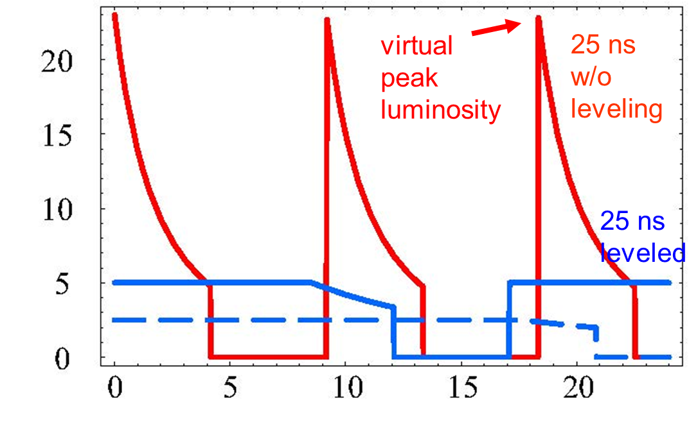
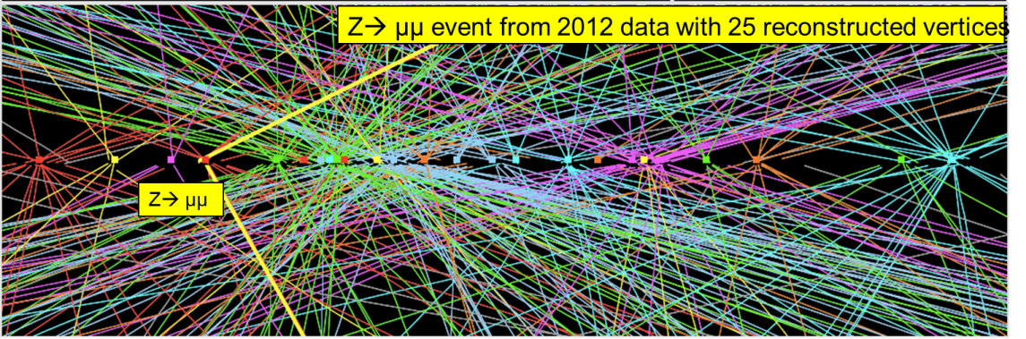
Goals of the HL-LHC established in autumn 2010
Working at levelled luminosity:
L_{const}= 5 L₀(5 10³⁴) limit pileup and heat depo
Produce ∼250 fb⁻¹/year⇒ 3000 fb⁻¹ by 2035
  Before LHC; ∼ 10-15 fb⁻¹
  LHC 2012: ∼ 25 fb⁻¹ with extended year
  LHC design : 300 (700) fb⁻¹
Lumi (L₀)
Time (h)

Slide 6
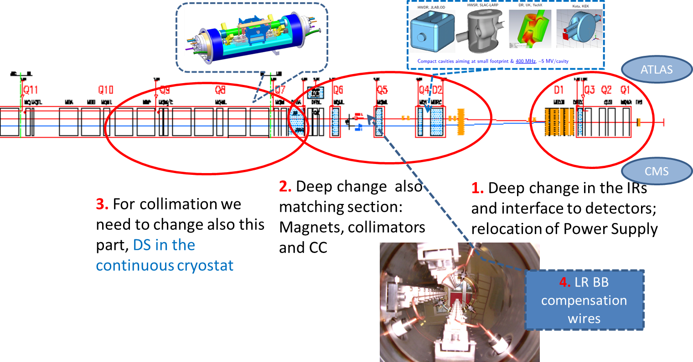
The LHC region(s) to change
1.2 km of LHC !!

Slide 7
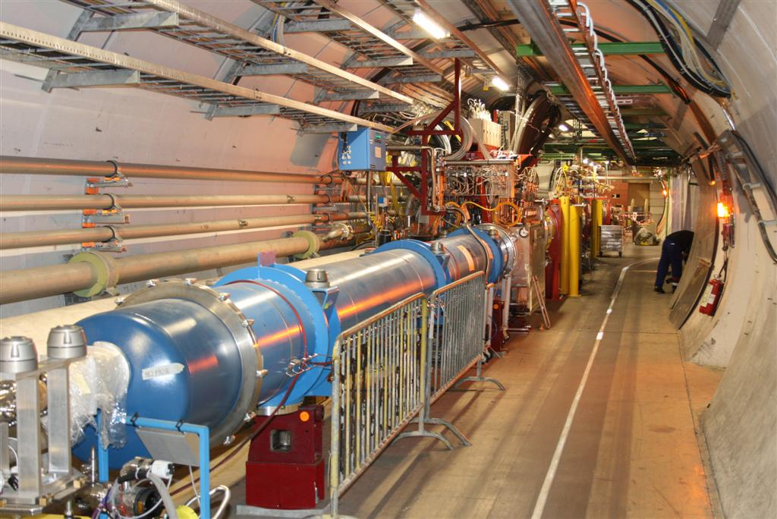
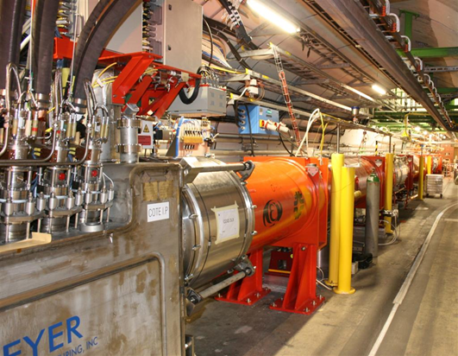
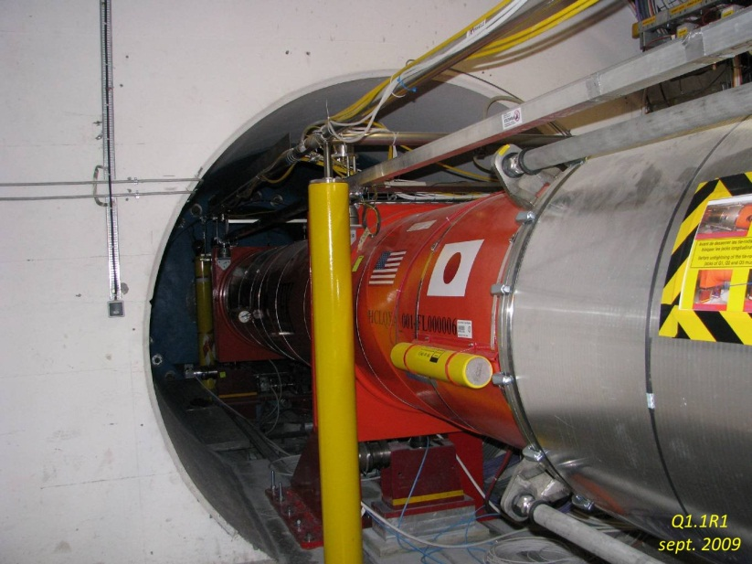
Here the region of low-β*

Slide 8
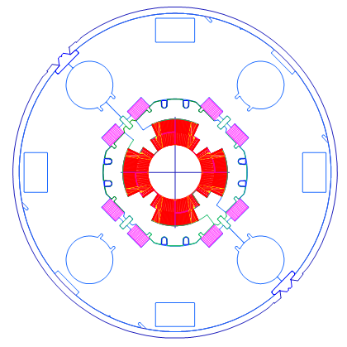
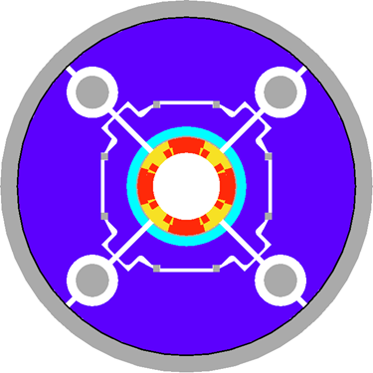
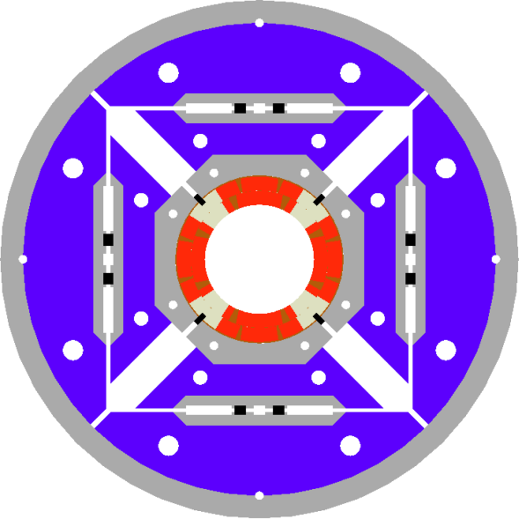
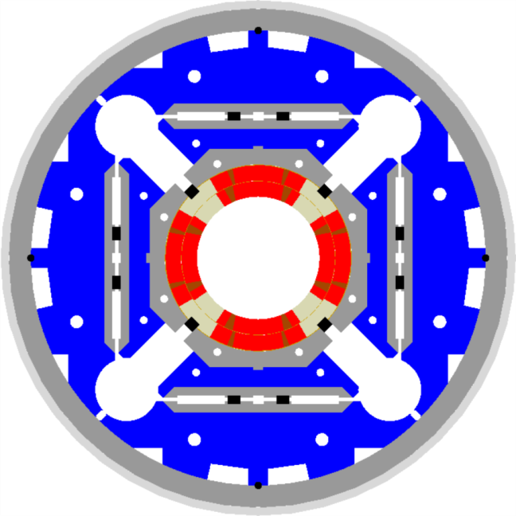
LHC low-β quads: steps from present LHC toward HL-LHC
LHC (USA & JP, 5-6 m)
∅70 mm, B_{peak}∼ 8 T
1992-2005
LARP TQS & LQ (4m)
∅90 mm, B_{peak}∼ 11 T
2004-2010
LARP HQ
∅120 mm,
B_{peak}∼ 12.5 T
2008-2014
LARP & CERN
MQXF
∅70 mm,
B_{peak}∼ 8 T
2013-2020

Slide 9
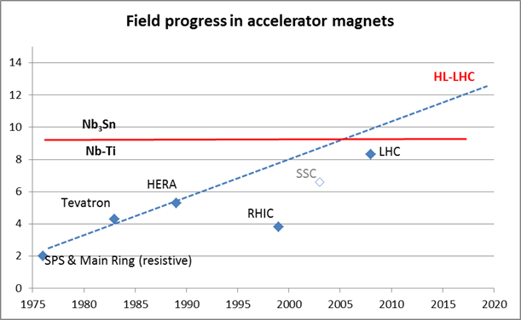
SC Magnets: evolution with projects

Slide 10

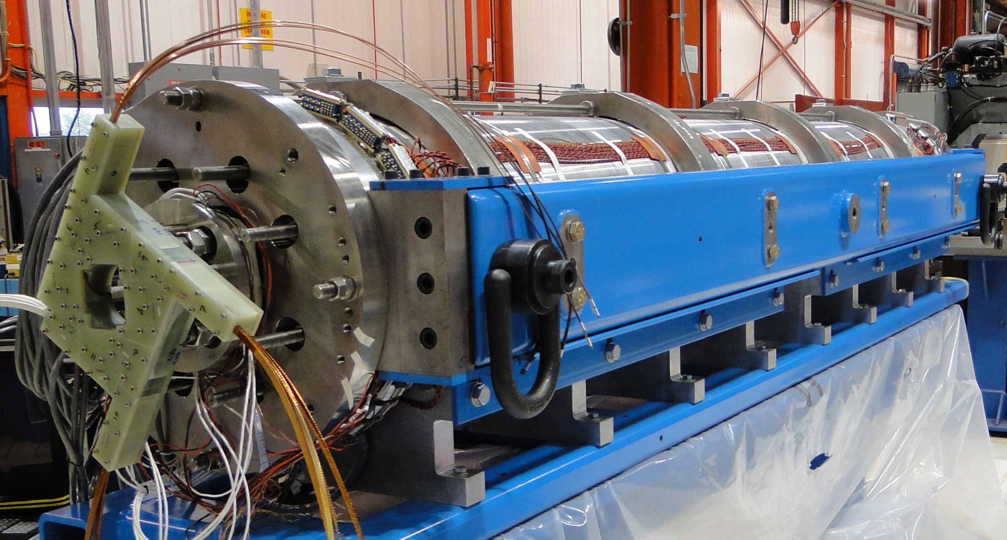
LSQ of LARP
3.3 m coils
90 mm aperture
Target:
200 T/m gradient at 1.9 K
LQS01a: 202 T/m at 1.9 K
LQS01b: 222 T/m at 4.6 K
227 T/m at 1.9 K
LQS03: 208 T/m at 4.6 K
210 T/m at 1.9 K
1st quench: 86% s.s. limit

Slide 11
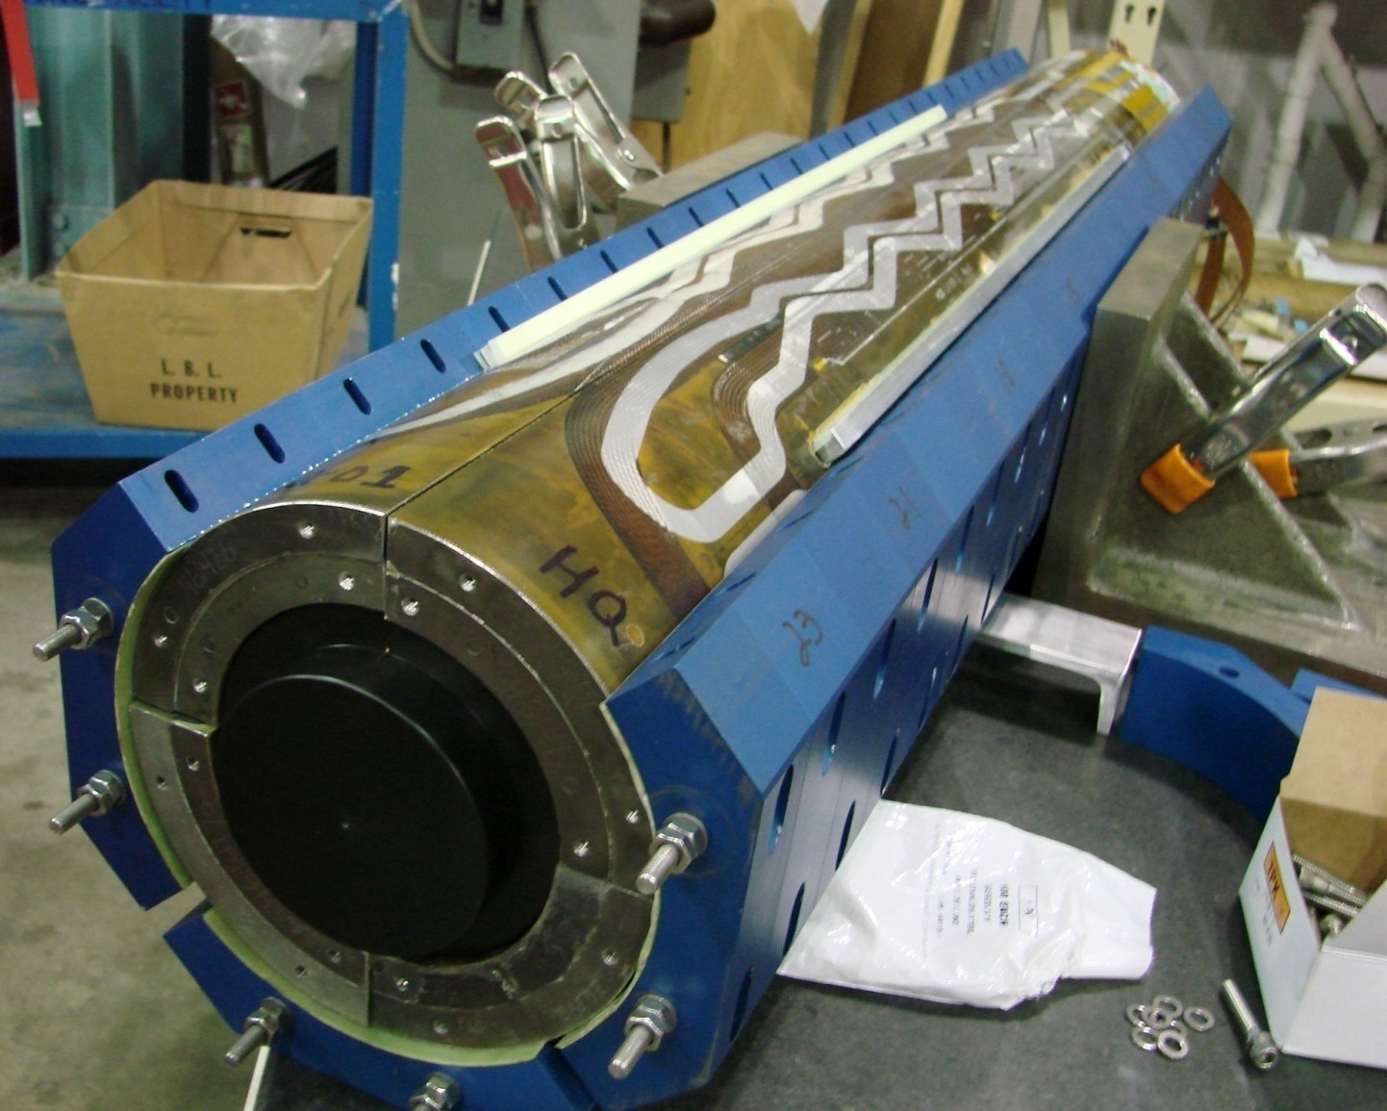
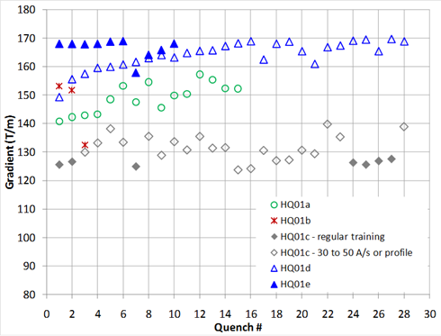
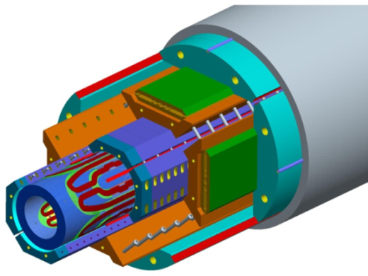
HQ – 1 m long - ∅120 mm
HiLumi
Present LHC
S. Caspi , H. Felice, G. Sabbi, LBNL

Slide 12

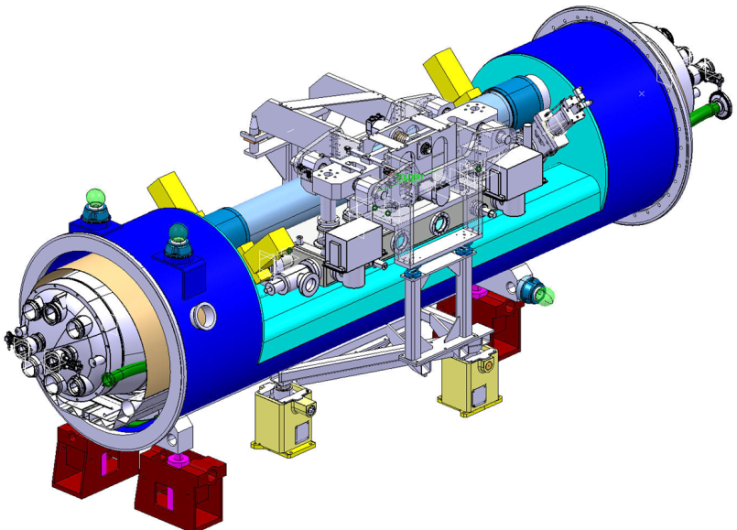
New collimation in the DS for off-momentum particles: 11 T dipole!
5.5 m Nb₃Sn
3.5 m Collim
5.5 m Nb₃Sn
5.5 m Nb₃Sn
3.5 m Collim.
5.5 m Nb₃Sn

Slide 13

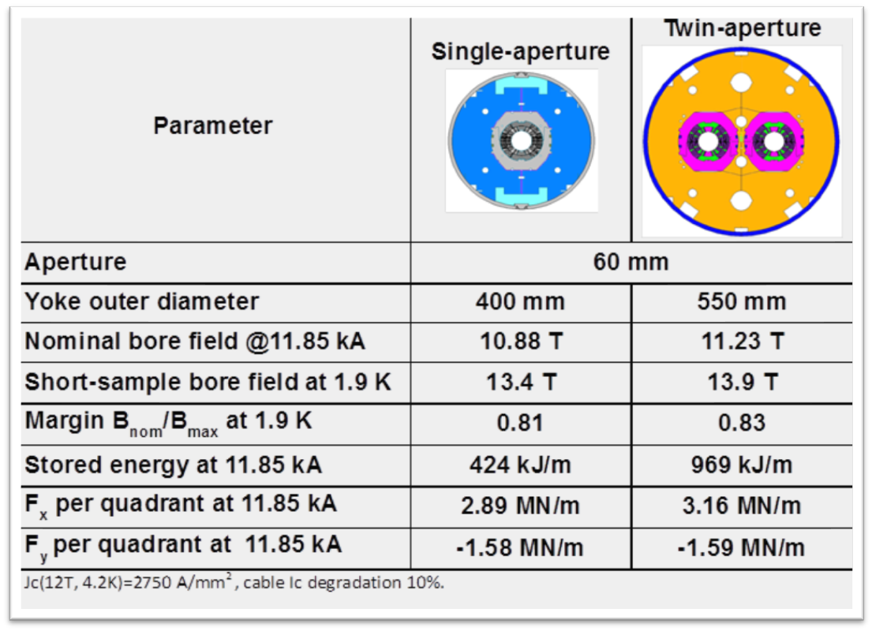
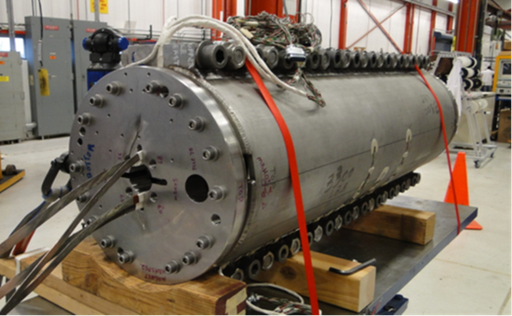
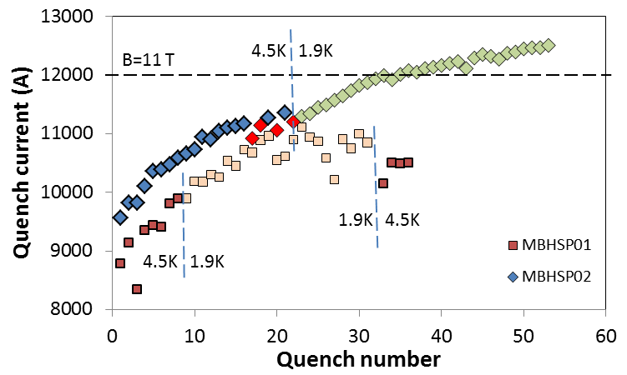
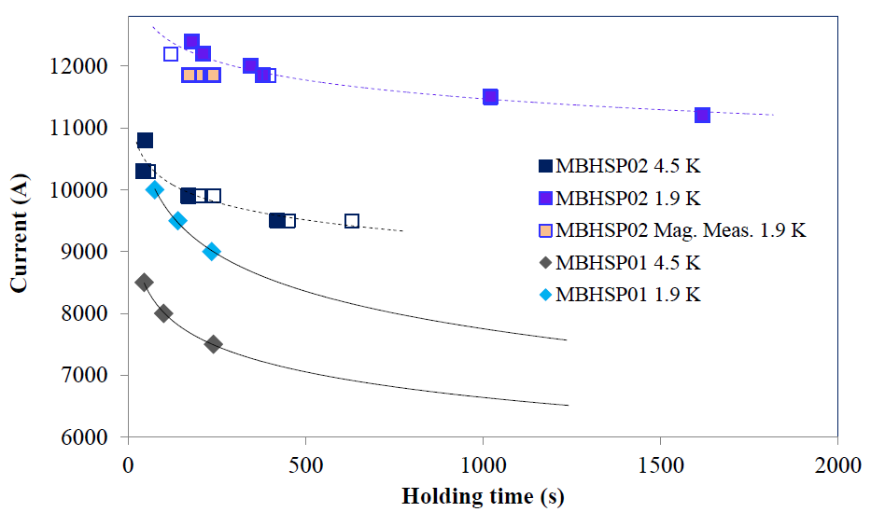
11 T results and issue
2nd model
steady state issue still tehre
Very good progress

Slide 14

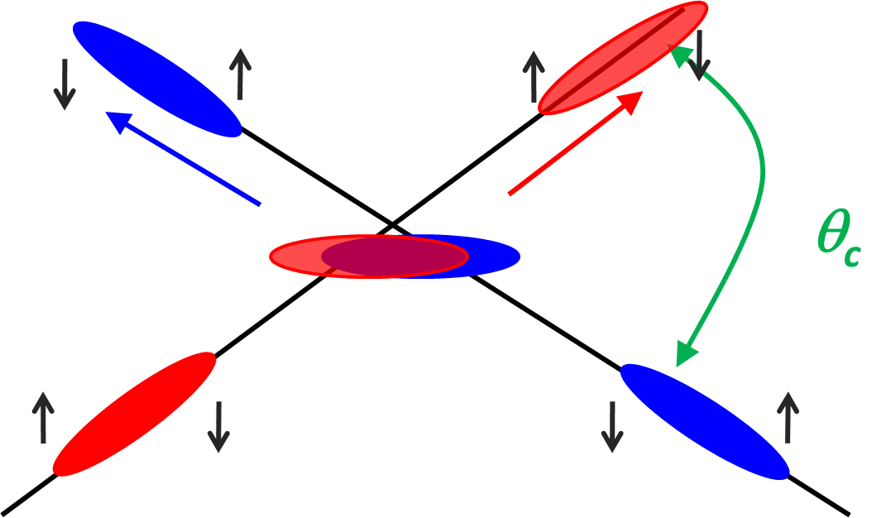
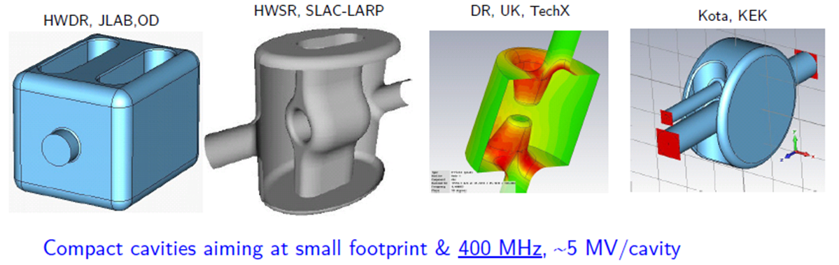
Beating the geometric reduction factor: Crab Cavity

Slide 15
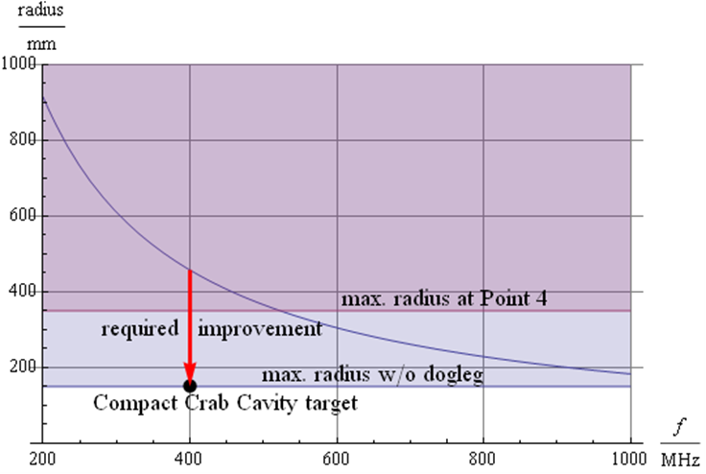
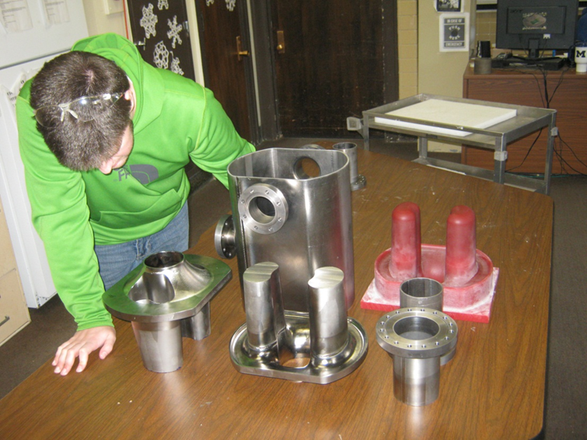
Really compact to fit into LHC
Lancaster cavity

Slide 16
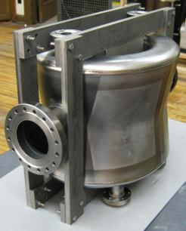
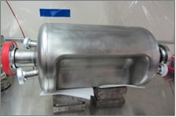
Present design of CCs
4-rod in SM18 for RF measurements
Cockroft Institute
& Lancaster Univ.
ODU (Old Dominion Univ.)
and JLAB (USA)
RF-Dipole Nb prototype
DQWR prototype (17-Jan-2013)
BNL

Slide 17
First test of RF dipole Apr 2013
(ODU-SLAC at J-LAB)
Courtesy
A. Ratti, LBNL

Slide 18
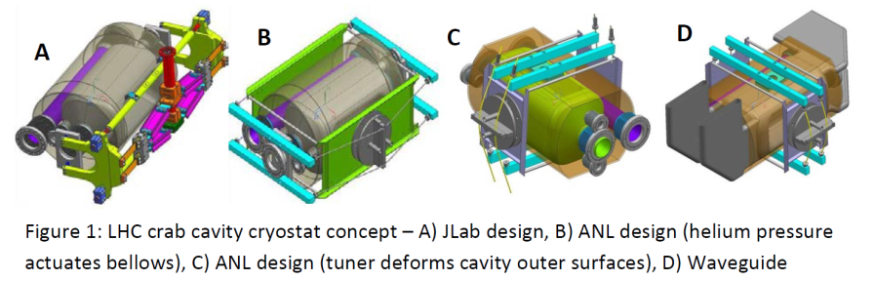
Thinking to cryomodule and test in SPS (2015-16)
Q4
D2
IP
D2
Q4
11 meters

Slide 19
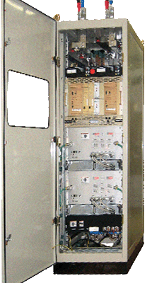
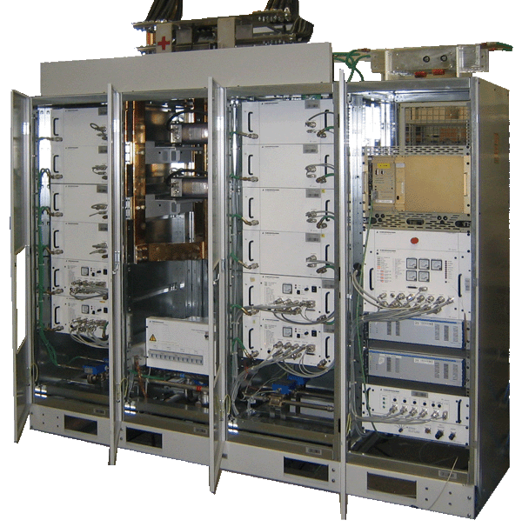
Reducing radiation risk at 3000 fb⁻¹ and increase availbility: SC links
ATLAS
CMS
Interface warm-cold requires intervention for maintenance ⇒ remove on surface
1. New Magnets in the IRs and interface to detectors; relocation of Power Supplies via use of SC links
Power convertes are very vulnerable to radiation (SEU)

Slide 20
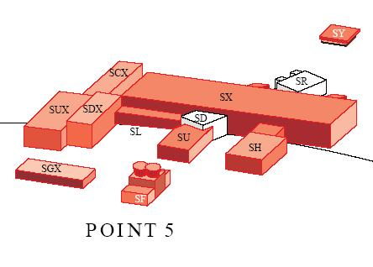
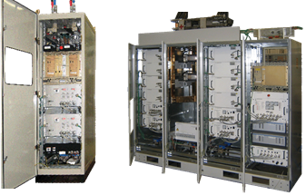
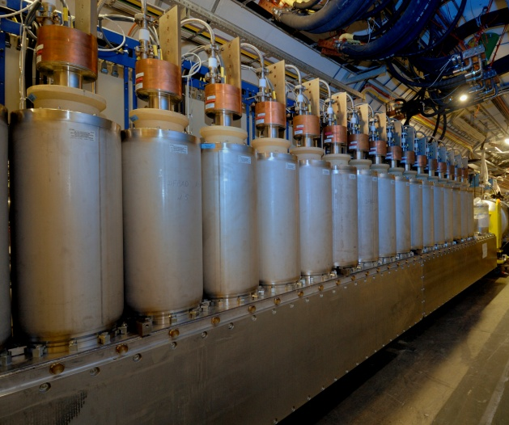
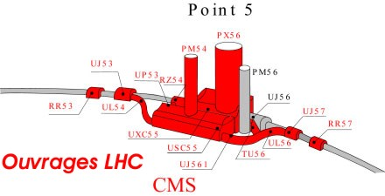
1 pair 700 m 50 kA – 2016-17
4 pairs 300 m 150 kA – 2018
4 pairs 300 m 150 kA – 2021 Many 6-18 kA HTS Cur.Leads
2×150 kA

Slide 21
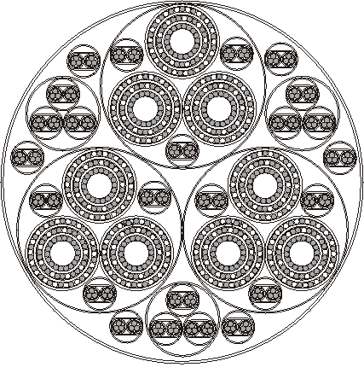
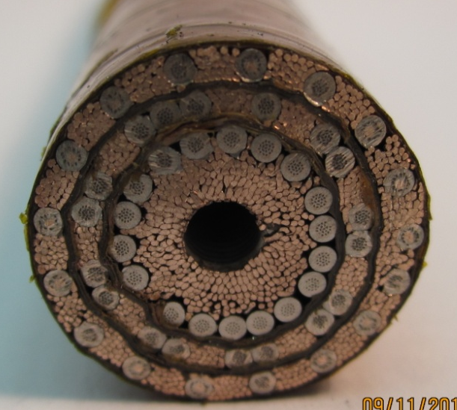
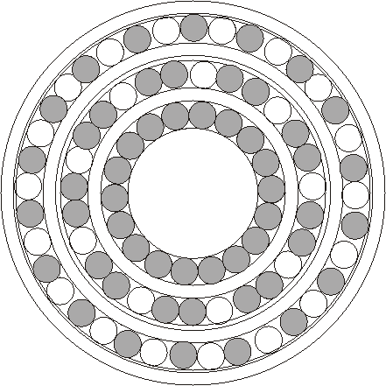
MgB2 baseline
Cable structure using MgB₂ wires
27 cables 6000 A
48 cables 600 A
Itot = 190 kA (∼2 × 95 kA)
3 × 6 kA
Φ = 75
7 kg/m
900 m_{HTS}/m_{cable}
Courtesy A. Ballarino, CERN

Slide 22
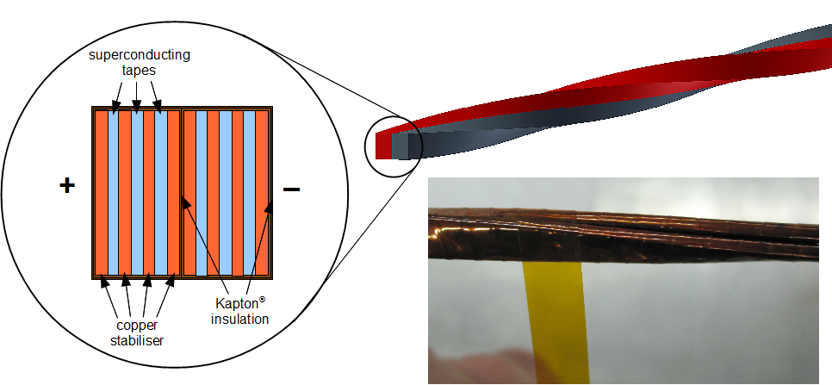

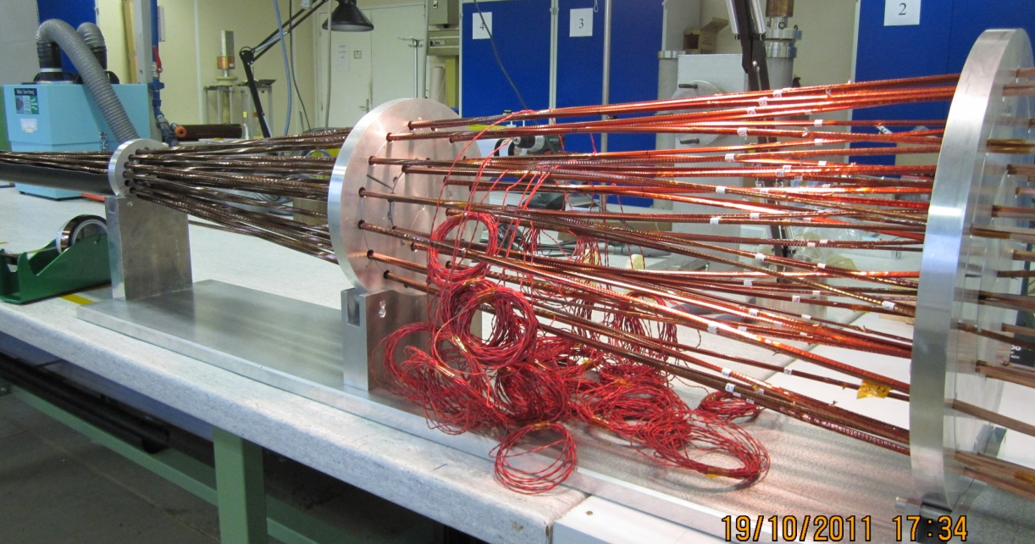
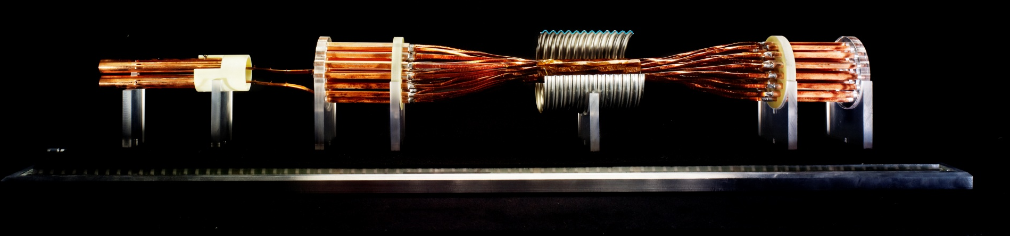
HTS possible for 600 A
“smaller cable”: 24 × 2 × 600 A (2 × 15 kA)
@ 25 K MgB₂
@ 65 K (YBCO and Bi-2223)
2 kg/m
200 m_{HTS}/m_{cable}
Novel cable concept using tapes (MgB2, YBCO or YBCO)
A. Ballarino, CERN

Slide 23
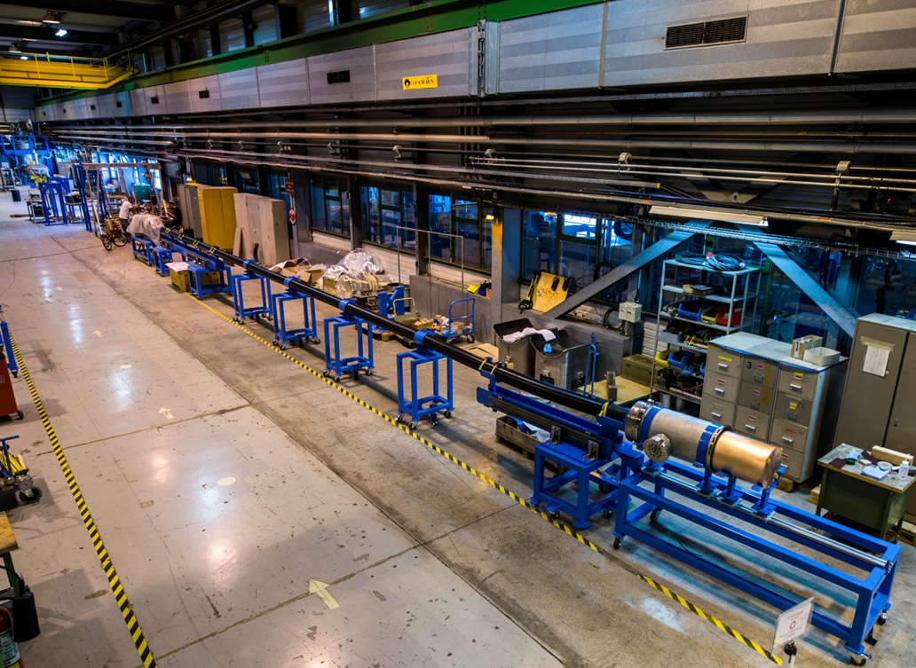
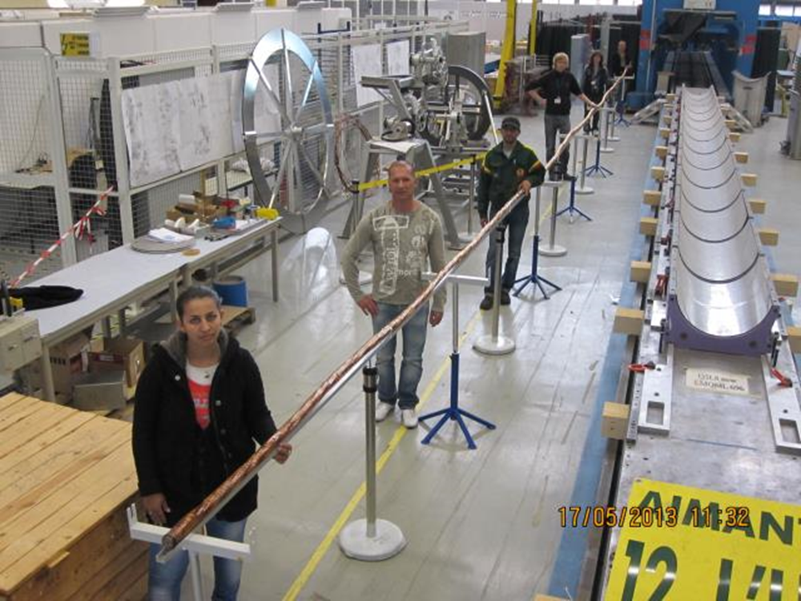
A unique tool: the CERN test station: 20 kA, variable temper.
Completion of 20 m long prototype superconducting link for P7 (50600 A @ 25 K, MgB2)

Slide 24
Overall new cryo HL-LHC layout
HL-LHC cryo-upgrade:
  2 new cryoplants at P1 and P5 for high luminosity insertions
  1 new cryoplant at P4 for SRF cryomodules
  New cooling circuits at P7 for SC links and deported current feed boxes
  Cryogenic design support for cryo-collimators and 11 T dipoles at P3 and P7

Slide 25
Low-β* and MS region (LSS) cryo
2 new plants for : 18 kW (4.2 K equiv.) delivering 1.8 K to:
2x (4xMQX,D1,D2,CC, Q4,Q5,Q6)
Providing redundancy with the arc
Liberating more cryopower for e-clouds and other effects

Slide 26
P4 Layout: new cryogenics for SRF module
S34
P4
S45
With interconnection for partial redundancy
(Accepted as baseline)

Slide 27
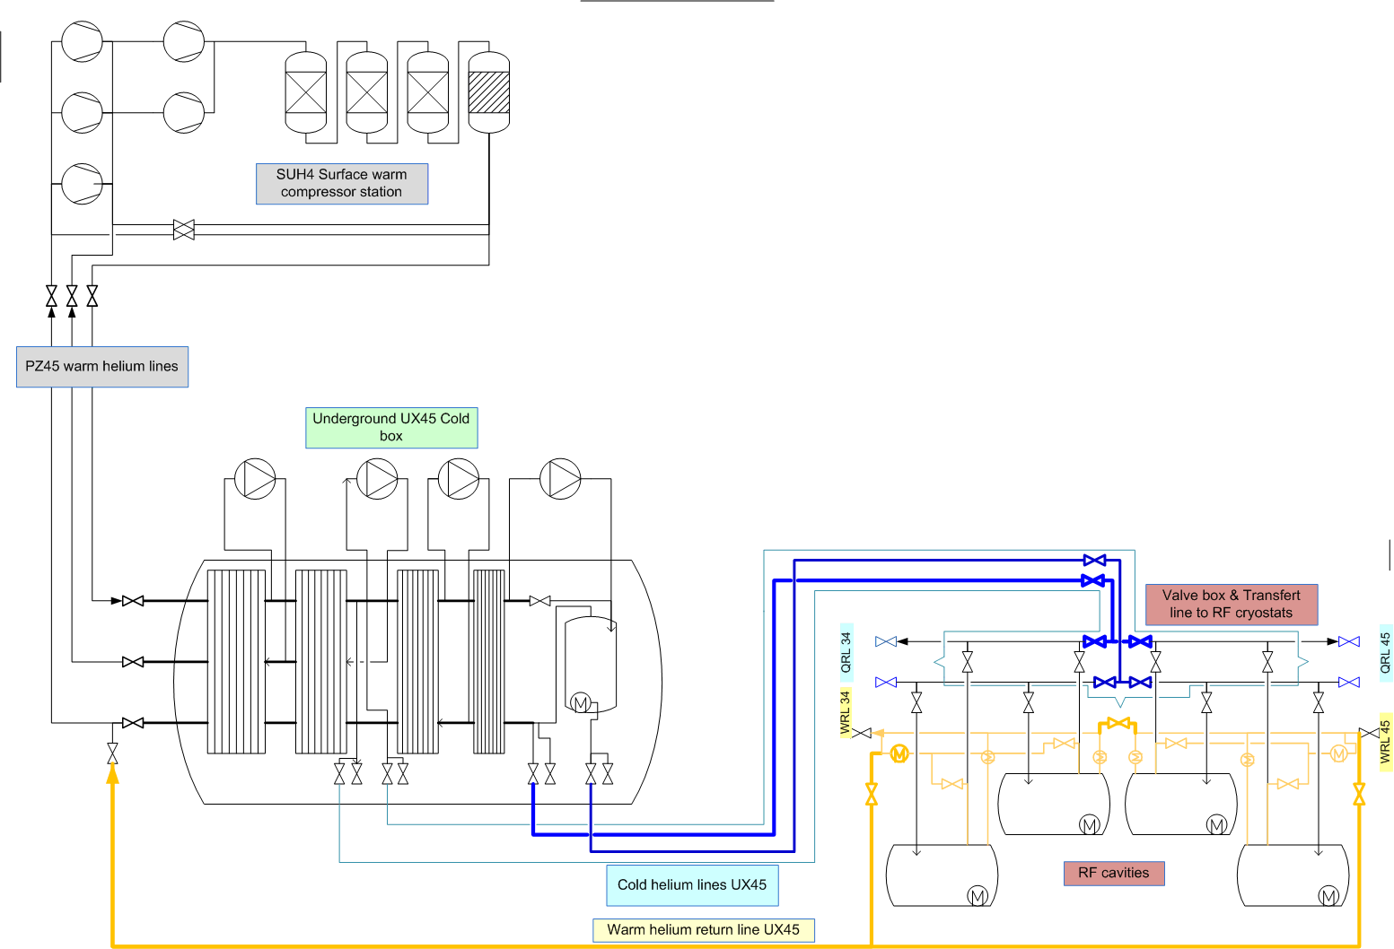
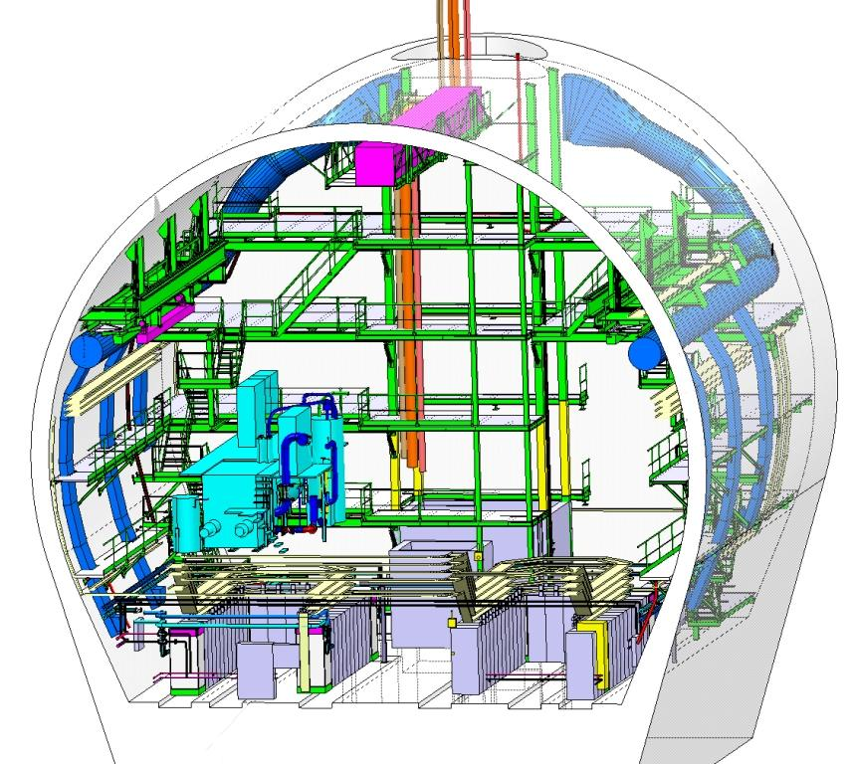
P4 cryogenic process & flow diagram
UCB:
6-7 kW @ 4.5 K
cryoplant (tbc)
UX45

Slide 28
EU strategy update document: approved 30 May 2013by Council
High-priority large-scale scientific activities
After careful analysis of many possible large-scale scientific activities requiring significant resources, sizeable collaborations and sustained commitment, the following four activities have been identified as carrying the highest priority.
c) The discovery of the Higgs boson is the start of a major programme of work to measure this particle’s properties with the highest possible precision for testing the validity of the Standard Model and to search for further new physics at the energy frontier. The LHC is in a unique position to pursue this programme. Europe’s top priority should be the exploitation of the full potential of the LHC, including the high-luminosity upgrade of the machine and detectors with a view to collecting ten times more data than in the initial design, by around 2030. This upgrade programme will also provide further exciting opportunities for the study of flavour physics and the quark-gluon plasma.

Slide 29


Required Budget
Performance Improving Consolidation (PIC): Equipment for which upgrade is a plus but change is a must
 | Improving Consolidation | Full performance | Total HL-LHC
Mat. (MCHF) | 476 | 360 | 836
Pers. (MCHF) | 182 | 31 | 213
Pers. (FTE-y) | 910 | 160 | 1070
TOT (MCHF) | 658 | 391 | 1,049

