Slide 1
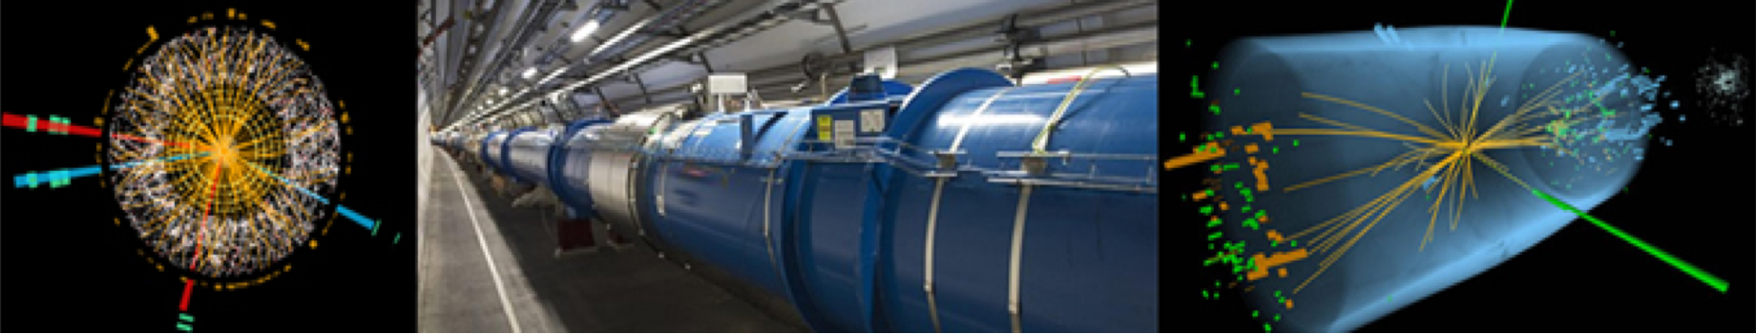

Fils et câbles supraconducteurs du futur
Luca.Bottura@cern.ch
AFF Commission Cryogénie et Supraconductivité.
Les Journées Thématiques au CERN:
LHC, premiers résultats et perspectives.
June 6th-7th, 2013

Slide 2
Overview
The drive from the LHC
  LTS wires and cables at 50
  HTS conductors at 25
Beyond the LHC
Summary and conclusions

Slide 3
Overview
The drive from the LHC
  LTS wires and cables at 50
  HTS conductors at 25
Beyond the LHC
Summary and conclusions

Slide 4
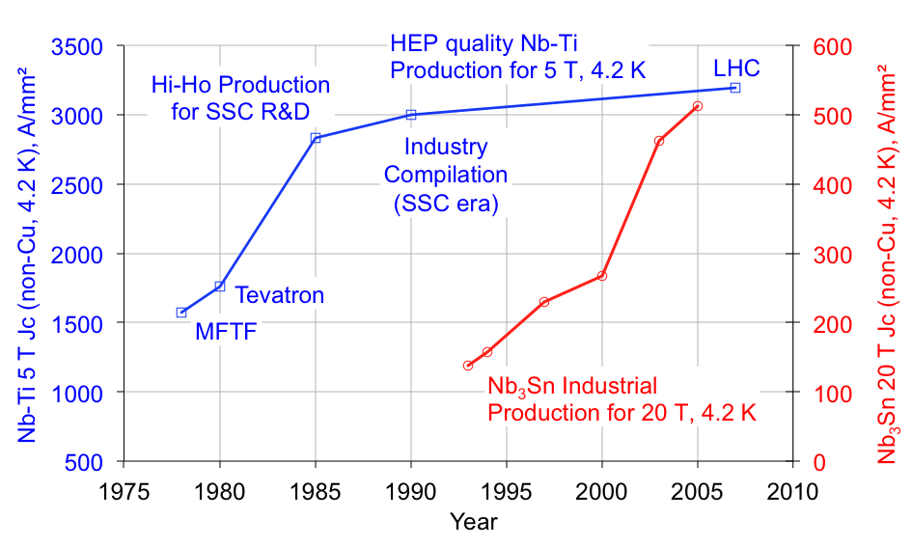
At 50, LTS’s have reached maturity ?
HL-LHC wire
ITER wire
Data by courtesy of J. Parrell (OST)

Slide 5


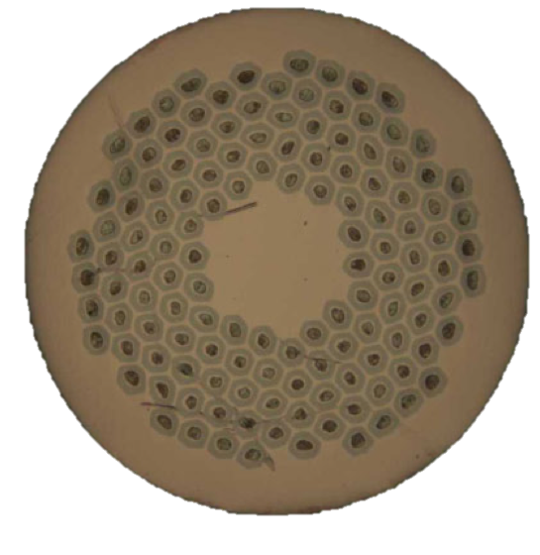
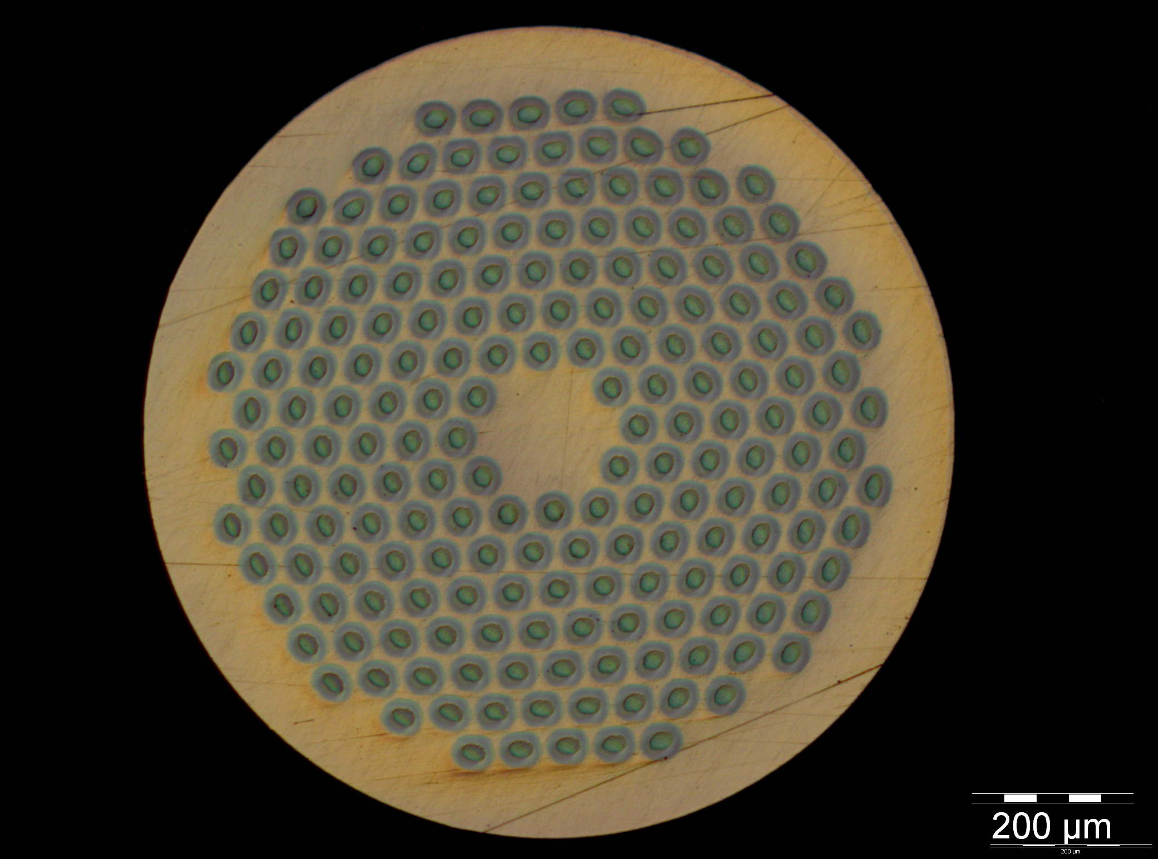
Typical HEP-grade Nb₃Sn wires
Micrographs by A. Bonasia (CERN)
Strand diameter: 1.0 mm
Cu:non-Cu: 1.25
Filament diameter: 58 μm
Number of filaments: 132
J_{C} (15 T. 4.2 K) > 1575 A/mm²
RRR > 150
UL > 400 m … 800 m
Strand diameter: 1.0 mm
Cu:non-Cu: 1.25
Filament diameter: 48 μm
Number of filaments: 192
J_{C} (15 T. 4.2 K) > 1350 A/mm²
RRR > 150
UL > 400 m … 800 m
NOTE: procurement assisted by the special in-kind contribution from France

Slide 6
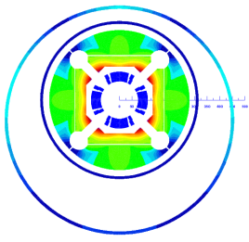
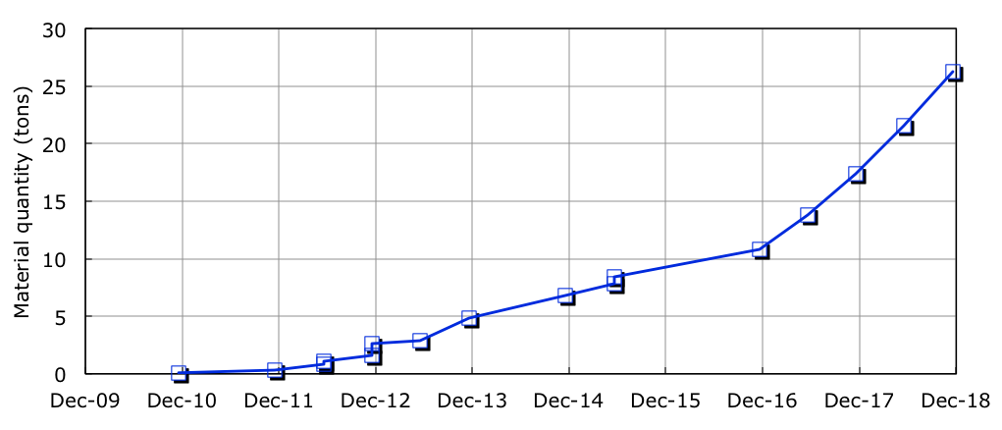
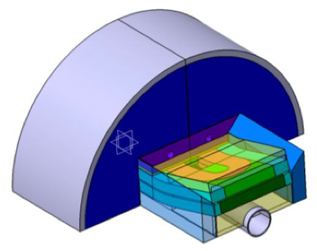
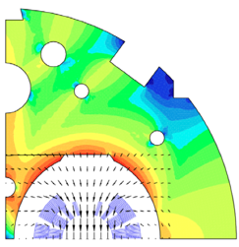
Material needs – Nb₃Sn
MQXF
FReSCa-II
DS 11 T MB
Approximately 26 tons of HEP-grade Nb₃Sn will be needed in the coming 5 years

Slide 7
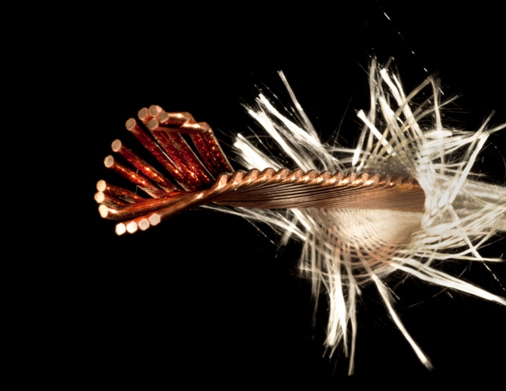
Cabling challenges
Cabling by A. Bonasia, L. Oberli; graphics by M. Brice (CERN)
14 strands, 1.25 mm Powder-in-Tube (PIT) SMC cable

Slide 8
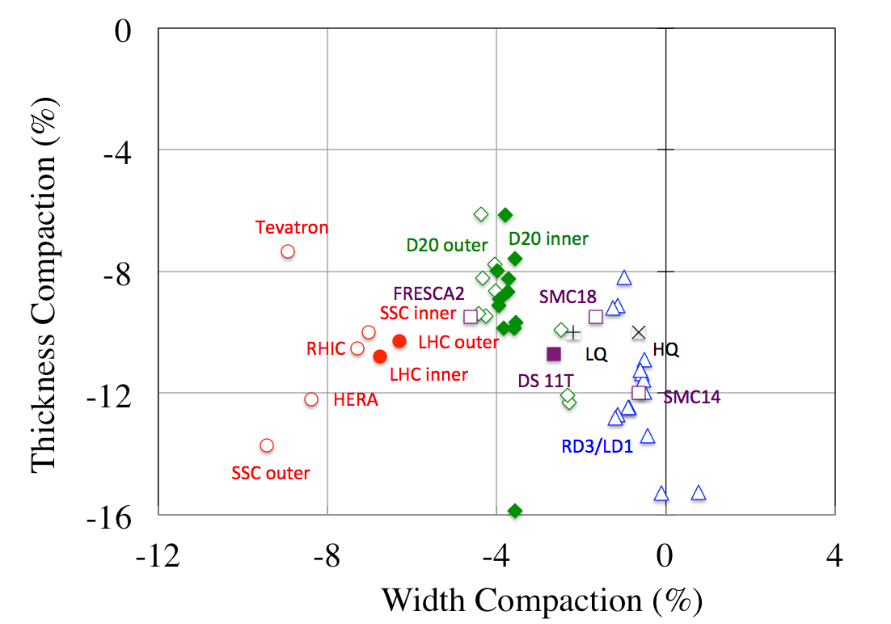
Range of Cabling Parameters
mechanically unstable
NbTi
Nb₃Sn
Data by courtesy of R. Scanlan, D. Dietderich, H, Highley (LBNL, Berkeley)
and L. Oberli (CERN)
Notes:
Petals were pre-shaped (CRPP found scratches on cable and some strands’ Cr plating was damaged). Final stage conductor was compressed.

Slide 9
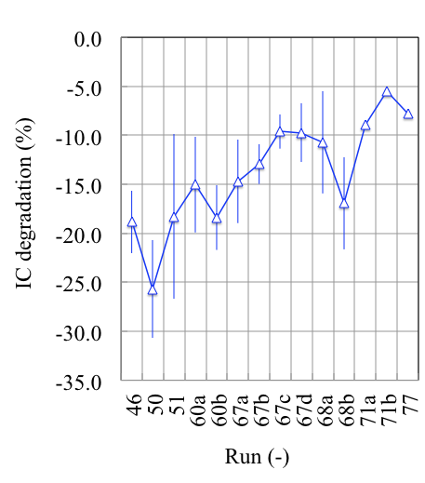
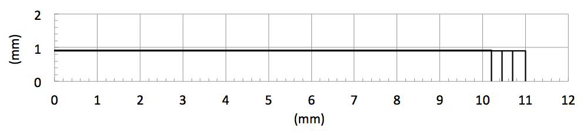
The case of the FRESCA2 cable
3 years of work
Data by courtesy L. Oberli (CERN)
Notes:
Petals were pre-shaped (CRPP found scratches on cable and some strands’ Cr plating was damaged). Final stage conductor was compressed.

Slide 10
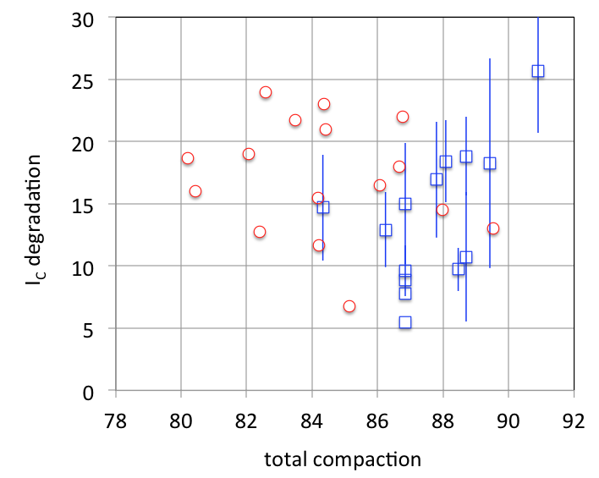

Compaction vs. Degradation
Lowest degradation is obtained when the compaction is in the range of 85%...86%
This is a delicate, lengthy and difficult optimization
FRESCA2
VLHC
Data by courtesy L. Oberli (CERN) and E. Barzi (FNAL)
Notes:
Petals were pre-shaped (CRPP found scratches on cable and some strands’ Cr plating was damaged). Final stage conductor was compressed.

Slide 11
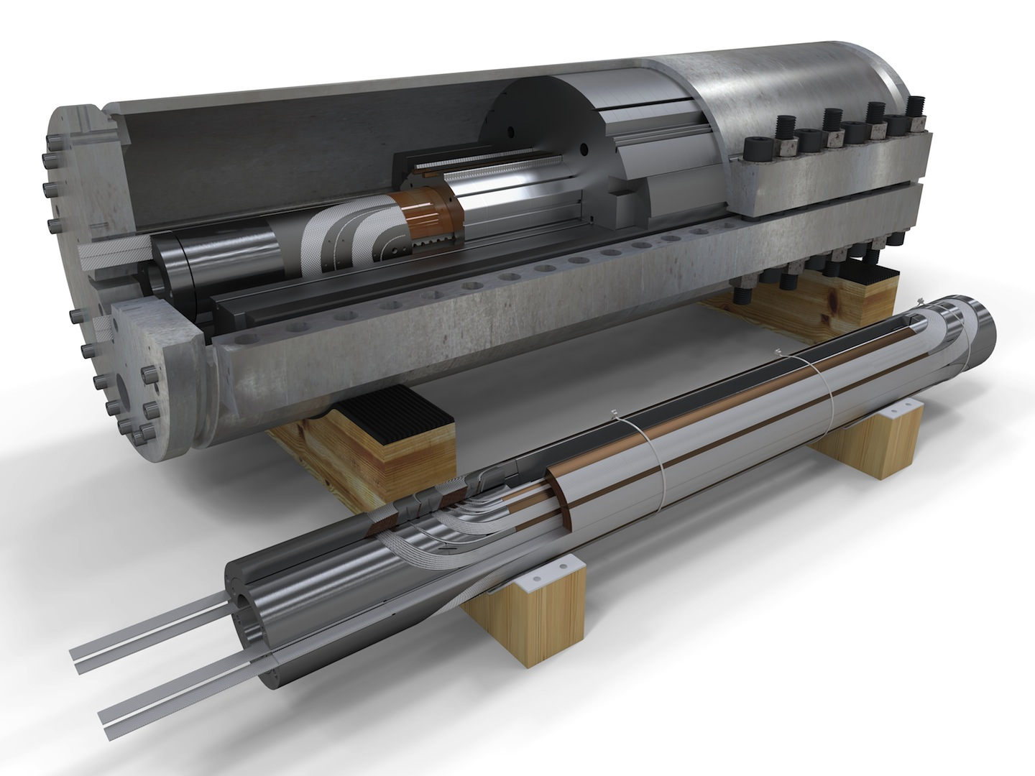
DS 11 T MB models
Fermilab MBHSP02
CERN coil
Courtesy of D. Mitchell, FNAL and M. Karppinen, CERN

Slide 12
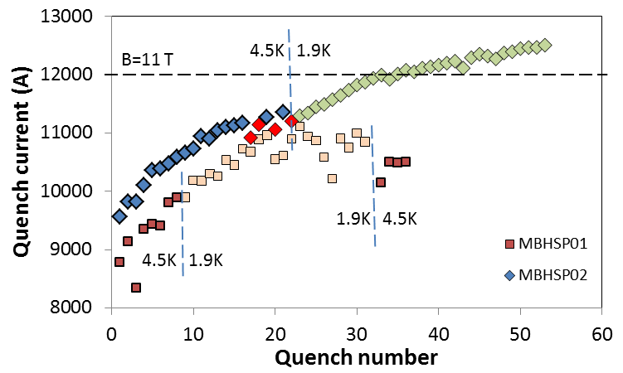
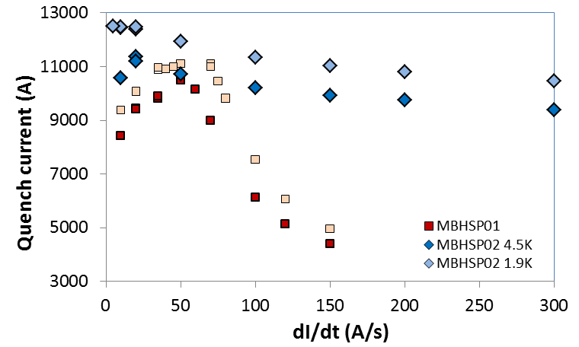
MBHSP02 Performance
Test completed in April 2013
  Bmax= 11.7 T – 97.5% of design field B=12 T (78% of SSL at 1.9 K)
Issues to be addressed
  Long training
  Conductor degradation
  Negative ramp rate dependence at dI/dt<20 A/s and 4.5 K
Magnet training
Tests at Fermilab, reported by courtesy of M. Karppinen, CERN
Ramp rate dependence

Slide 13
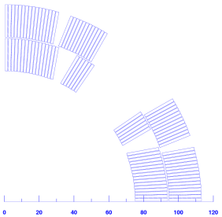
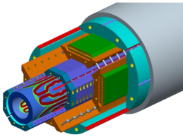
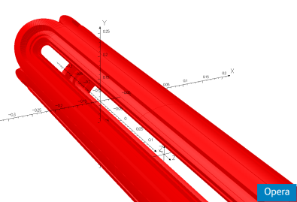
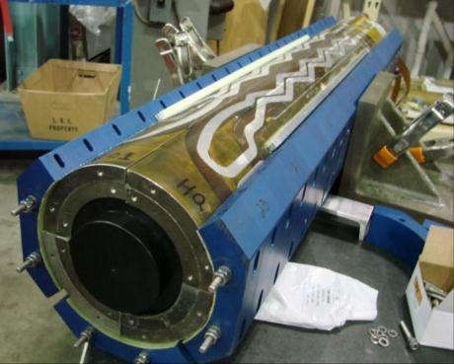
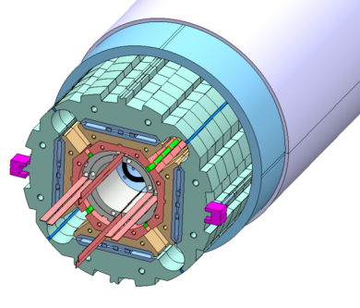
From HQ to MQXF
HQ, US-LARP
MQXF, joint development US-LARP and CERN

Slide 14
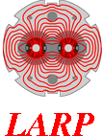
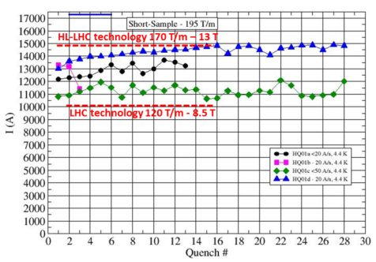
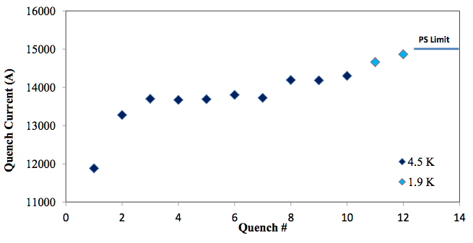
LARP HQ performance
Courtesy of G. Chlachidze, FNAL
HQ01
The test of HQ02 is on-going, but we see very promising results !
HQ02a

Slide 15
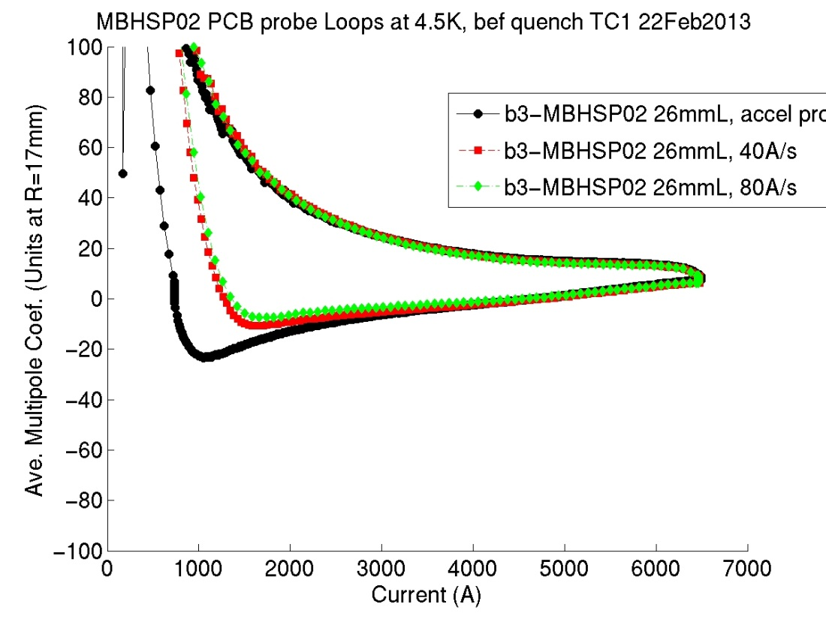
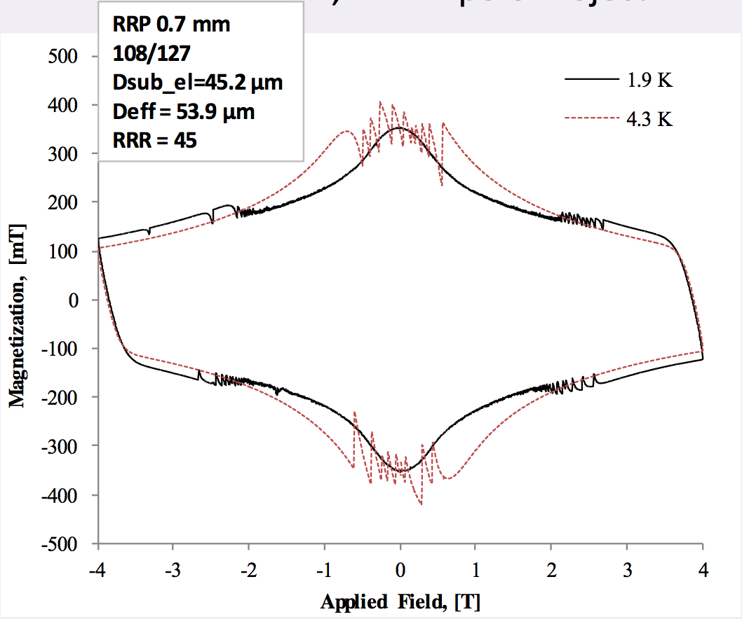
Effect of magnetization in dipoles
150/169
108/127
Tests at Fermilab, reported by courtesy of M. Karppinen, CERN
Measurement by D. Richter, CERN
Nb₃Sn magnetization is large, and affects field quality at injection: reduce filament diameter !

Slide 16
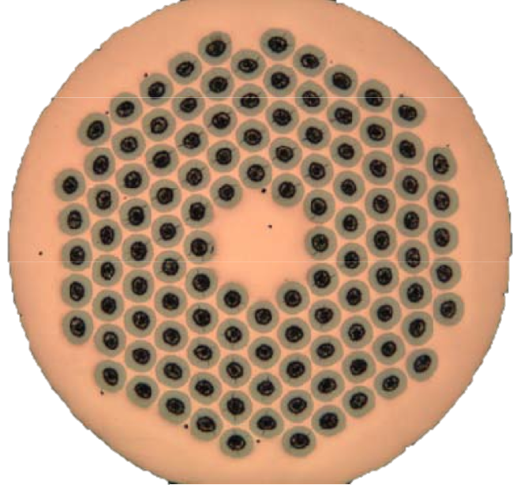
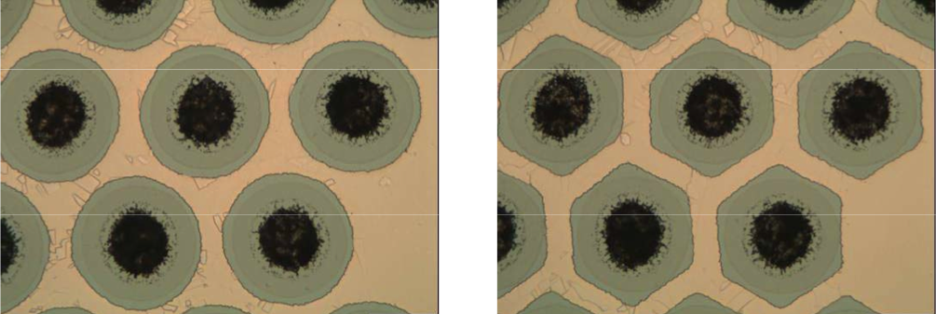
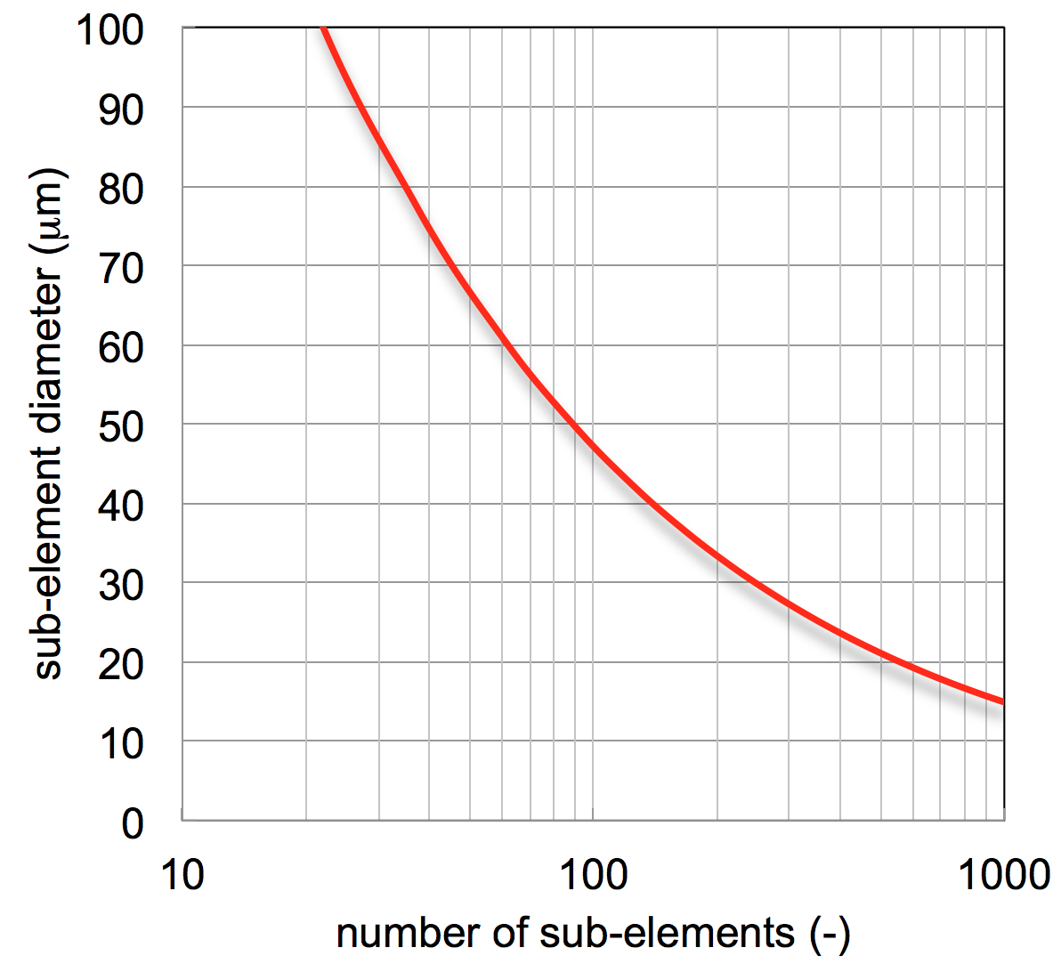
Sub-element diameter vs. counts
Filament diameter
Sub-element count
Small sub-elements (filament diameter) implies complex, costly and risky stacking

Slide 17
A Nb₃Sn dream wire for the LHC
Performance
Peak field
Cost
J_{C} (kA/mm²)
1
Dream wire
target performance:
Jc > 3 kA/mm²
D_{fil} < 20 μm
RRR > 100
1.5
2
2.5
PIT
3
3.5
target
Magnetization Field Quality
Stability
4
10
200
20
150
50
100
D_{fil} (μm)
100
50
RRR (-)
RRP
Stability Protection

Slide 18
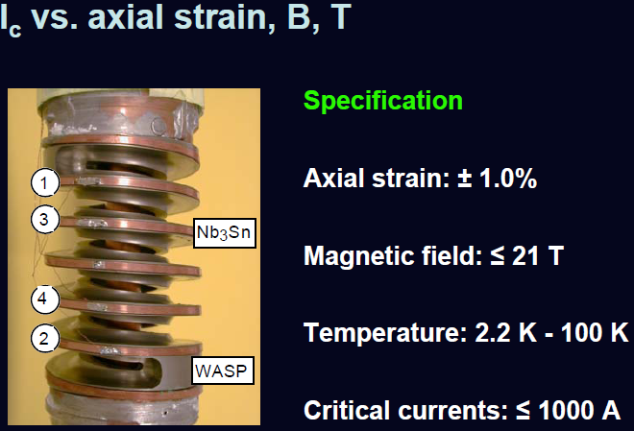
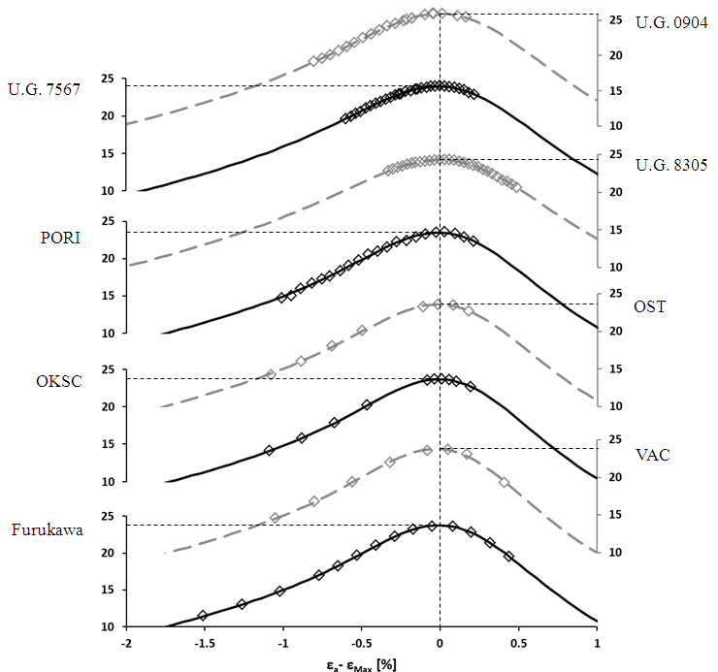
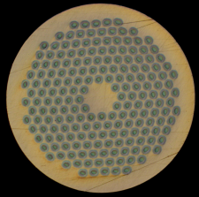
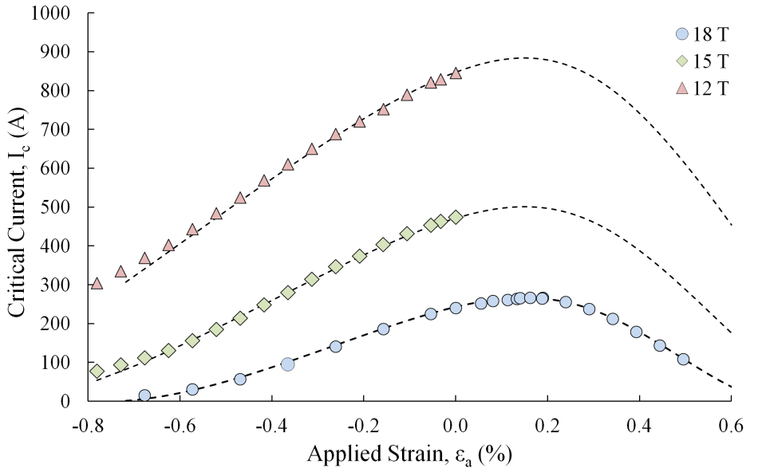
Longitudinal strain effects
University of Geneva
Bruker PIT, 1mm
4.2 K
University of Geneva
B Bordini et al 2013 Supercond. Sci. Technol. 26 075014 doi:10.1088/0953-2048/26/7/075014

Slide 19
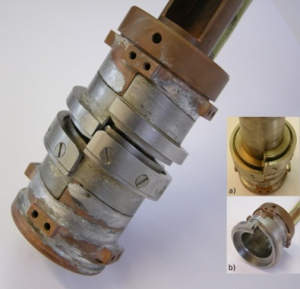
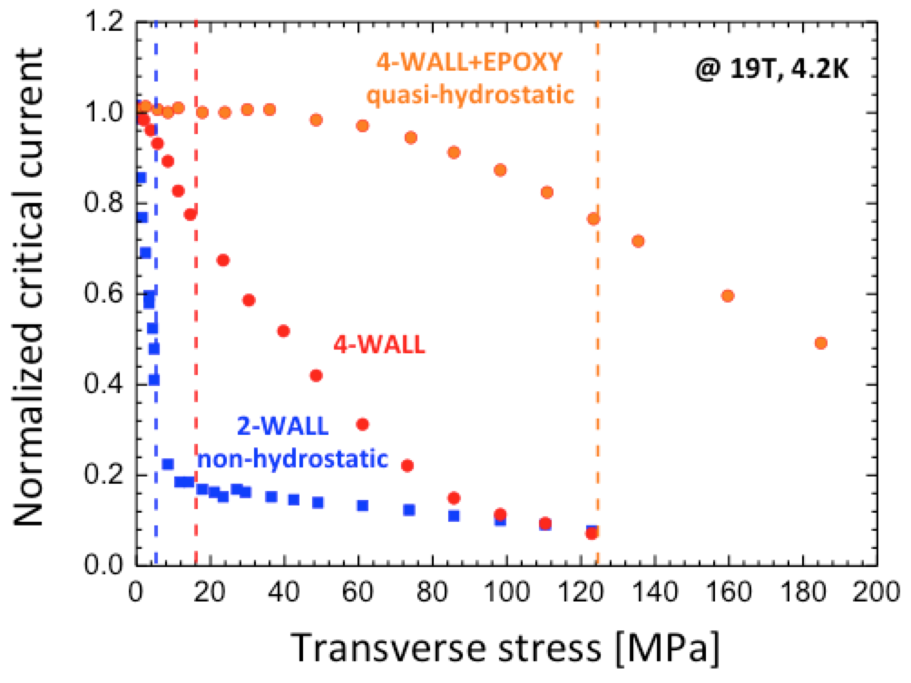
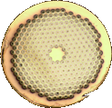
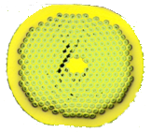
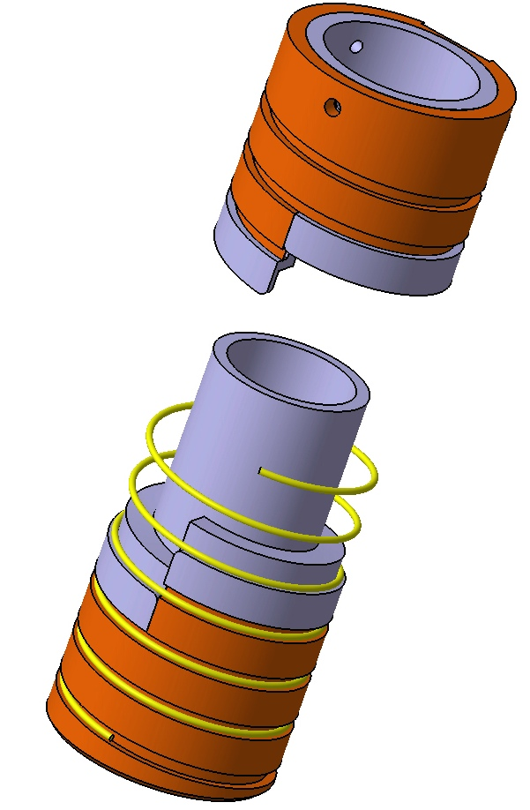
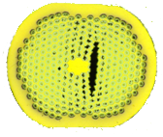
Transverse strain effects…
Measurements from University of Geneva

Slide 20
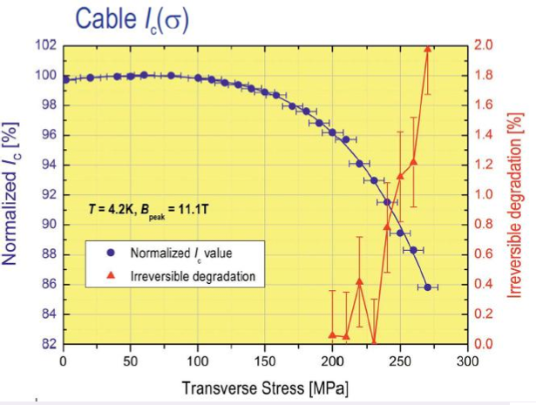
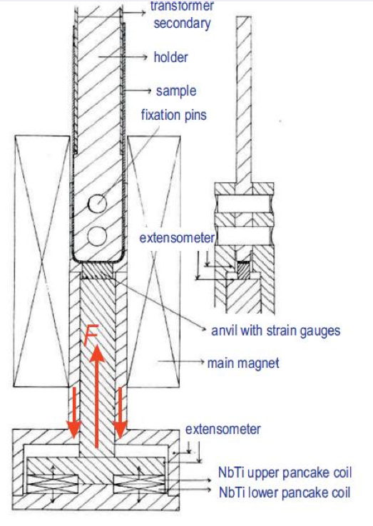
… more on transverse stress…
Measurements from University of Twente
No irreversible degradation till 200 MPa

Slide 21
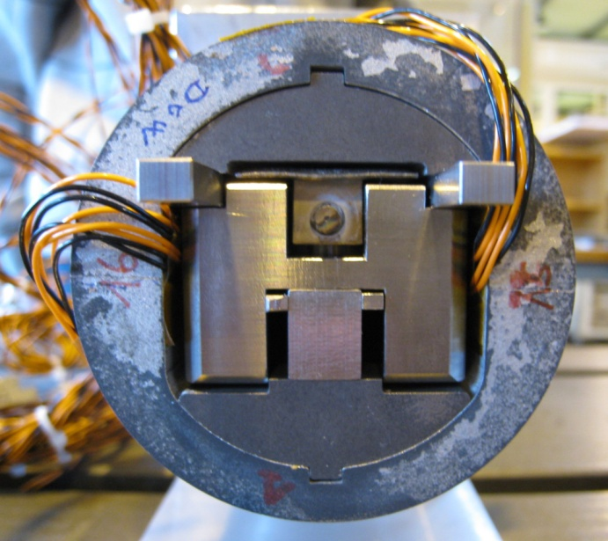
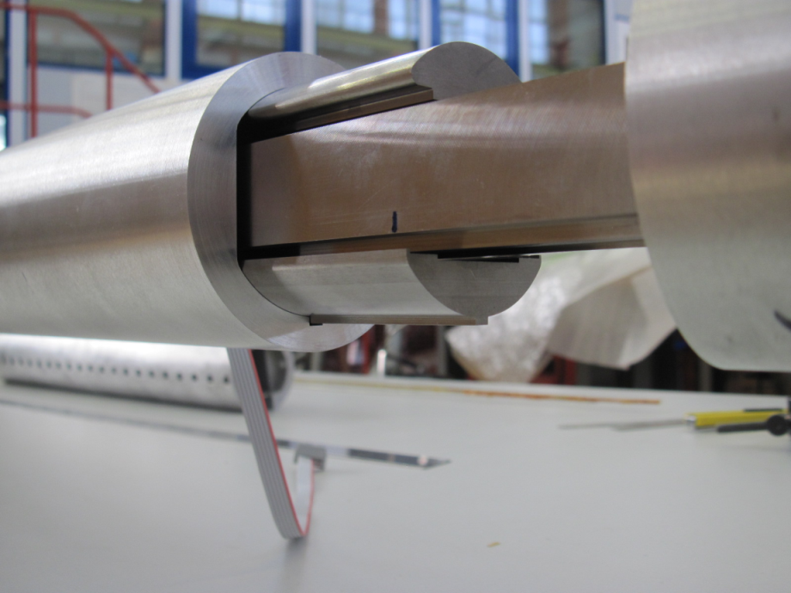
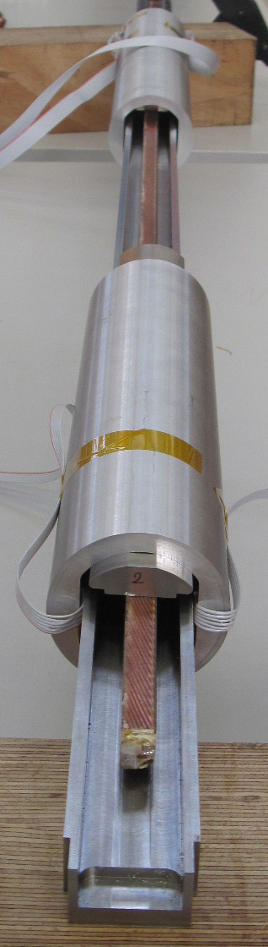
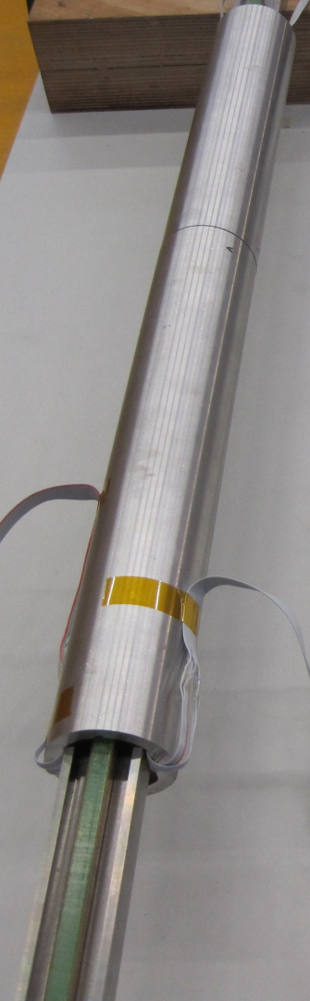
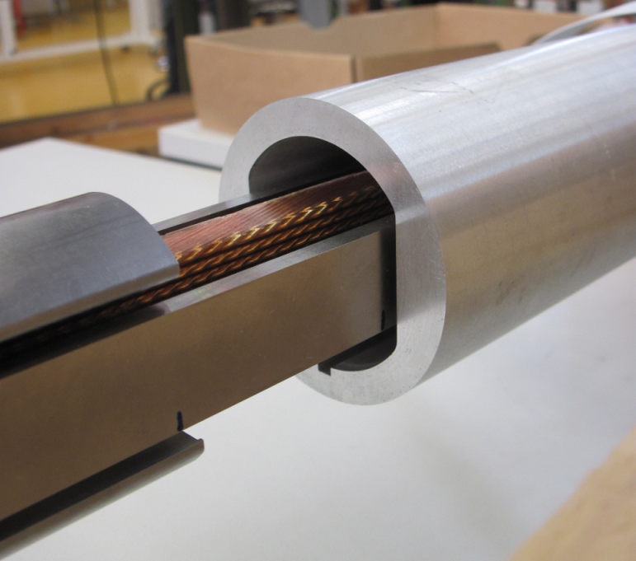
… and even more
By courtesy of B. Bordini (CERN)
Transverse stress sample holder in construction for the FReSCa-1 test facility, at CERN, 200 MPa capability in 10 T field and 32 kA (60 kA) current.

Slide 22
Overview
The drive from the LHC
  LTS wires and cables at 50
  HTS conductors at 25
Beyond the LHC
Summary and conclusions

Slide 23
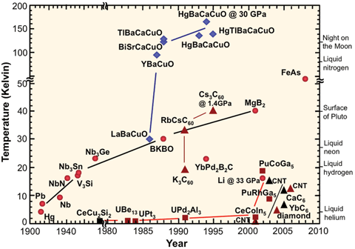
From materials to applications
Superconductors as seen by the eye of a physicist
The grand challenge of today is to find the room temperature superconductors

Slide 24
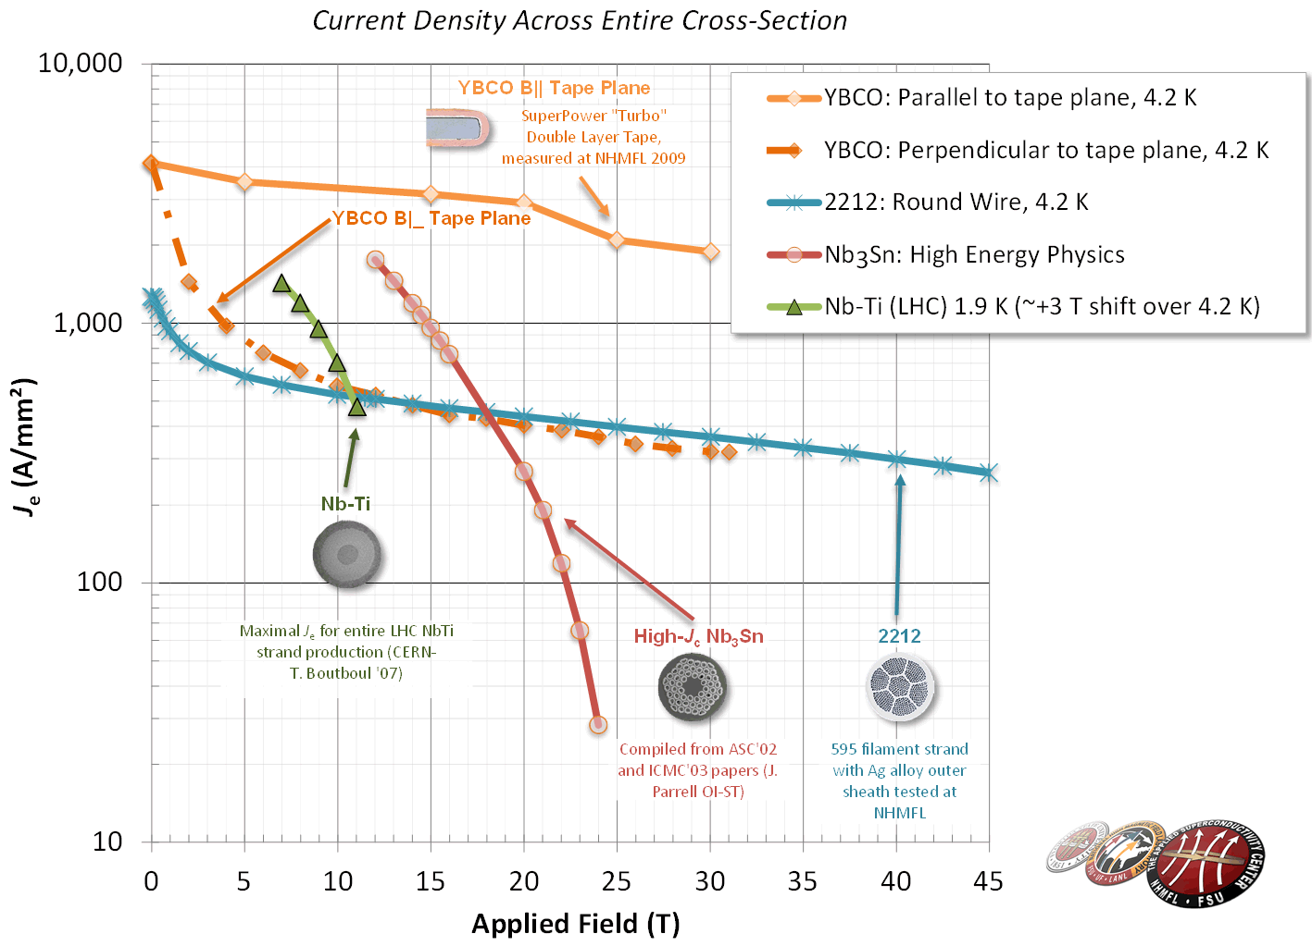
From materials to applications
Superconductors as seen by the eye of an engineer
The grand challenge of today is to develop the technology of high-field superconductors

Slide 25
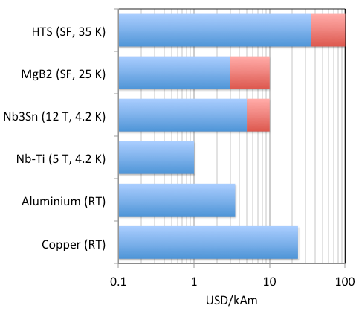
From materials to applications
≈100
Superconductors as seen by the eye of a manager
The grand challenge of today is availability of long lengths of reasonably priced commercial materials
≈10
≈10
≈1
≈4
≈20

Slide 26
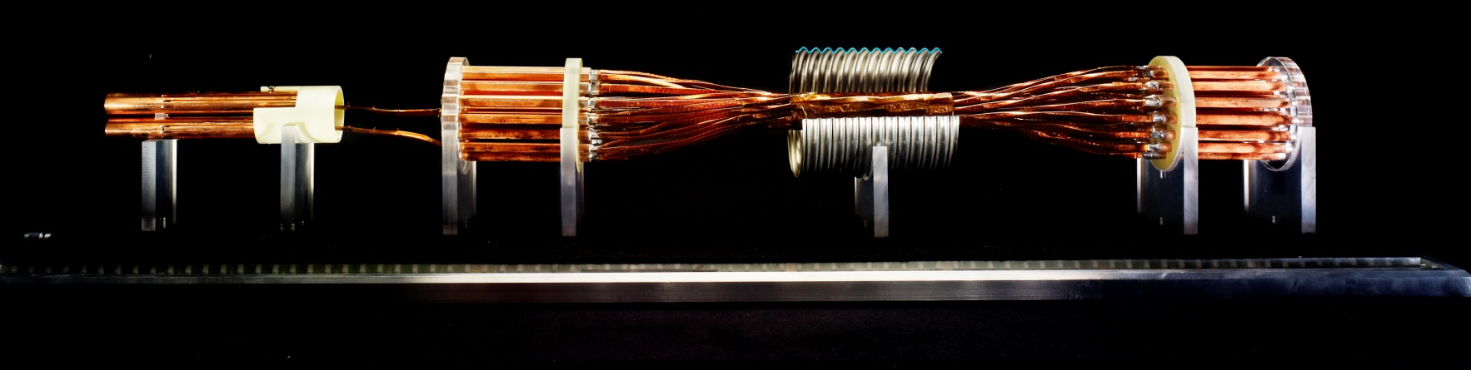
A future for HTS at the LHC
A model of link by A. Ballarino and the TE-MSC-SCD team (CERN)
SC links for the LHC
  Quasi-DC operation
  GHe operation (5 K … 25(35) K)
  Single cables operated at up to 20 kA
  Multi-cable ( 50 high-current cable) assemblies
  Horizontal + Vertical ( 80 m) configuration
  2 kV electrical insulation
Potential for use of MgB₂, or other HTS materials in specific location demanding for more margin and/or tolerance
More details in the talk of L. Rossi on HL-LHC

Slide 27
Superconductors for the LHC SC Links
 |  | Φ (mm) | W (mm) | Th (mm) | Tmax (K) | Ic ^{(‡)} (A)
^{(†)}MgB₂ | wire | < 1 | - | - | 25 | ≥ 400
MgB₂ | tape | - | 3.7 | 0.67 | 25 | ≥ 400
YBCO | tape | - | 4 | 0.1 | 35 | ≥ 400
BSCCO 2223 | tape | - | 4 | 0.2 | 35 | ≥ 400
Within reach today
^{(†)} bending radius R_{B} ≤ 80 mm
^{(‡)} applied field B ≤ 0.5 T
Reacted wires
Ltot ∼ 1000 km of conductor for series production
By courtesy of A. Ballarino (CERN)

Slide 28





SC Link cables
+ 600 A
- 600 A
Insulated and twisted tapes, for cables of modest amperage (can be assembled into larger cables for higher current)
Φ∼5.6 mm
Twisted wires for high current
3 kA @ 25 K
20 kA @ 25 K
(Dummy cables)
Work in TE-MSC-SCD, by courtesy of A. Ballarino (CERN)

Slide 29

SC Link prototype test
New feed-box for supercritical helium (10 g/s) variable temperature (5 K … > 77 K) and high current (13 kA)
Flexible cryostat to host various cable types and materials, up to 20 m length

Slide 30
Overview
The drive from the LHC
  LTS wires and cables at 50
  HTS conductors at 25
Beyond the LHC
Summary and conclusions

Slide 31


BSCCO-2212
As drawn
Quenched at 888 C
Fully processed
In-situ tomography
Voids in 2212 are a clear issue, that has been recently understood, but not yet mastered
  Is it originated by intrinsic or extrinsic sources ?
  What is a practical means to overcome it ?
F. Kametani, et al., Superconductor Science and Technology, 24, 075009(7pp) (2011)

Slide 32



Improvement by CIPping
Wire J_{E} improvement by CIPing
The Business of Science®
470 A/mm²
@ 15 T
15 T, 4.2 K
0.1 µV/cm
1.2 mm diameter
1 meter sample
Core densification result in double J_{E} values to ~470 A/mm² at 15 T
By courtesy of Y. Huang (OIST)

Slide 33

Improvement by OPHT
J. Jiang, E. Hellstrom, D. Larbalestier et al., NHMFL-FSU

Slide 34


Slide 35



BSCCO-2212, “easy” to cable
R. Scanlan, D. Dietderich, A. Godeke, LBNL
High Strength 6+1 Bi-2212 cable
High strength
alloy wire
Oxide
protection
layer
Bi-2212 round wire
T. Shen, Strand and Cable Engineering Group, Fermilab
nGimat/NCSU

Slide 36







REBCO – how do you cable tapes ?
Stacks in Conduit Conductor
M. Takayasu, MIT
Roebels, W. Goldacker, KIT
Cable-On-Round-Core
D. van der Laan
Stacked tapes conductors, EuCARD WP7 Task 4, Very High Field Dipole Insert

Slide 37





Roebel cables measured @ 4.2 K
Applied σ_{trans.} = 40 MPa
Roebel cable
2 × Nb-Ti Rutherford cables
J. Fleiter, CERN,
PhD thesis of the University of Grenoble
CERN, Superconductors Lab
MEM13, 12 March 2013

Slide 38


Roebel cables results
Measurements @ CERN in the FReSCa-1 Test Station
Ic (B⊥=9.6 T, 4.2 K) = 3.4 kA
Je (B⊥=9.6 T, 4.2 K) = 400 A/mm²
J. Fleiter, CERN, PhD thesis of the University of Grenoble
MEM13, 12 March 2013

Slide 39



Beyond the LHC
EuCARD2: Develop 10 kA class HTS accelerator cable using Bi-2212 and YBCO. Test stability, magnetization, and strain tolerance
YBCO
WP10: a 5 T, 40 mm bore
HTS dipole

Slide 40
Summary - LTS
Is Nb₃Sn mature ? Yes, and no
  performance of Nb₃Sn wires has seen a great boost in the past decade (factor 3 in J_{C} w/r to ITER)
  However, Nb₃Sn magnets were never built nor operated in accelerators. Manufacturing, quench, training, protection, strain tolerance, field quality are the focus today to make this new technology a reality
  A dream wire will pave the way for the next step in circular accelerators

Slide 41
Summary - HTS
Can HTS displace LTS ? Not today
  Much needs to be done to bring this technology to a point where it can be sold as “mature”
    Materials have potential that can be exploited
      OPHT for BSCCO-2212
      Thicker layer for YBCO tapes
      The Holy Grail of a round YBCO wire
  Production quantities, homogeneity and cost need to evolve
  Step-up application demands, from self-field (SC-link is an ideal test-bed) to high-field accelerator magnets (feasibility)

