Slide 2
The cryogenic systems of the
ATLAS and CMS detectors
Johan Bremer on behalf of TE/CRG

Slide 3
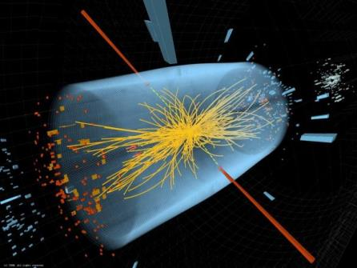

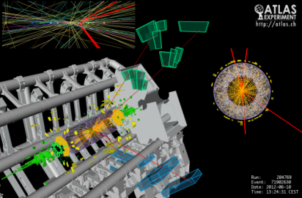
Higgs boson candidate decaying in two photons
Presence of cryogenics at ATLAS and CMS
solenoid field
toroid field
solenoid field
liquid argon calorimeter

Slide 4
Overview
Cryogenic system of
  the CMS magnet
  the ATLAS magnets
  the ATLAS calorimeter
Organization of the operation of these installations
Performance over 2011 and 2012
Helium inventory
Consolidations being applied
Conclusions

Slide 5
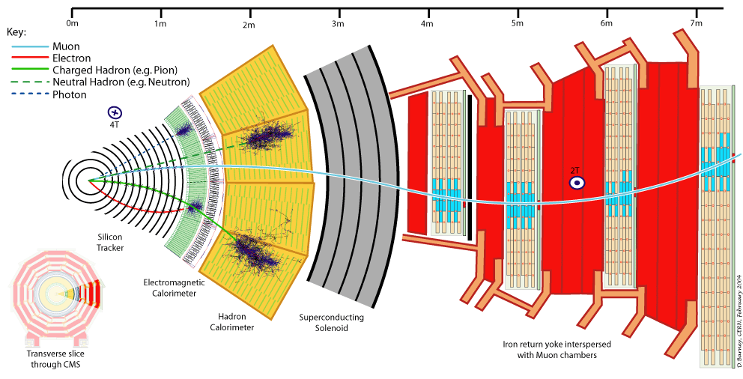
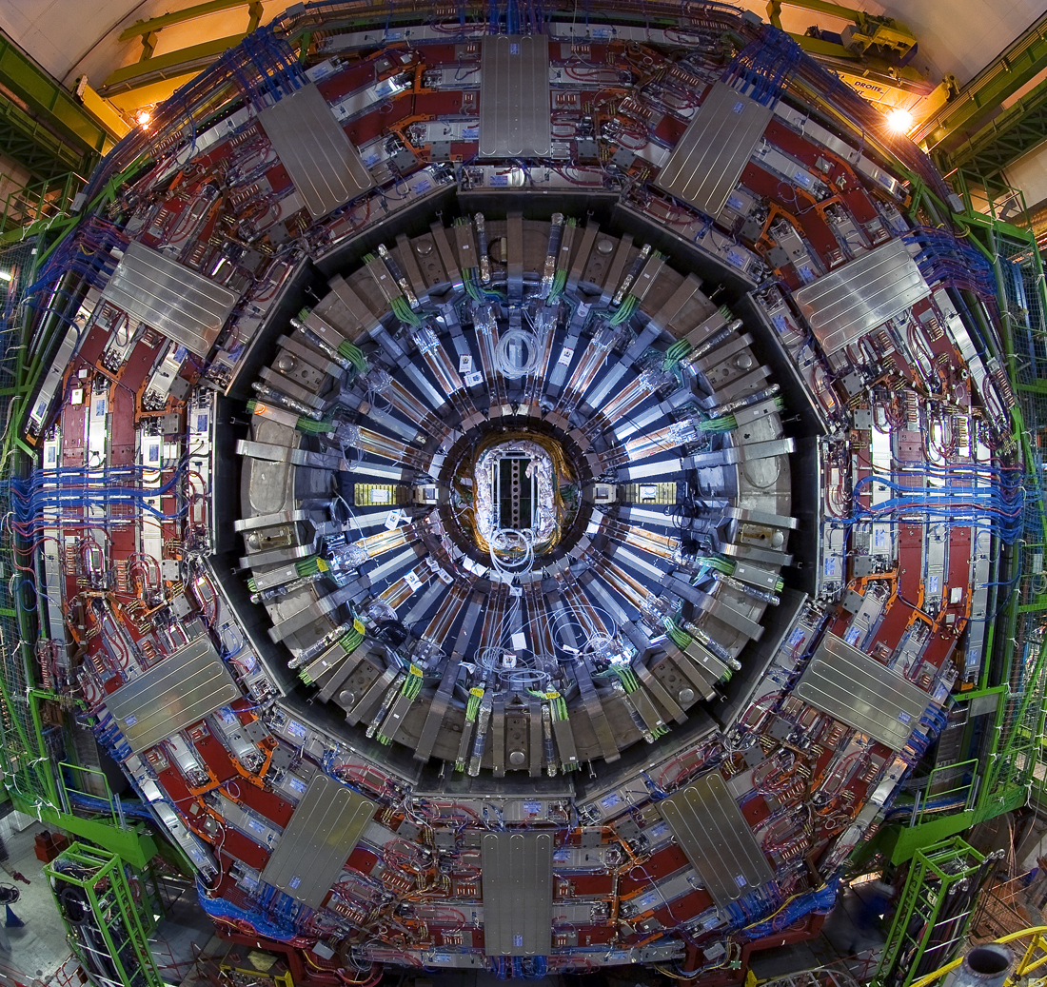
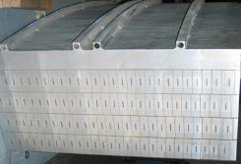
CMS magnet system
Magnet data:
Operation temperature: 4.5K
Dimensions 12.5 m long
6 m diameter
Cold mass 225 tons
Magnetic field 4T @ IP
Stored energy 2.6 GJ
LHe cooling circuit

Slide 6
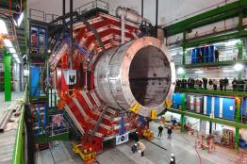
The CMS thermosyphon refrigeration mode
Driving force created by the difference in density between the liquid supply and the two phase return column
Natural circulation, no cold mechanical pump needed
When sufficient liquid available: magnet system can go into slow-dump in case of power failure

Slide 7
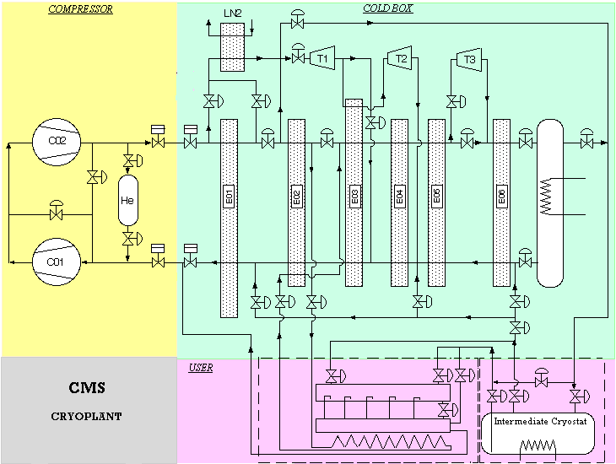
The CMS refrigerator system
At 4.5K
18 bar
4 bar
210 g/s
Refrigerator data:
800 W @ 4.5K
4.5 kW @ 70K
4 g/s for current leads

Slide 8
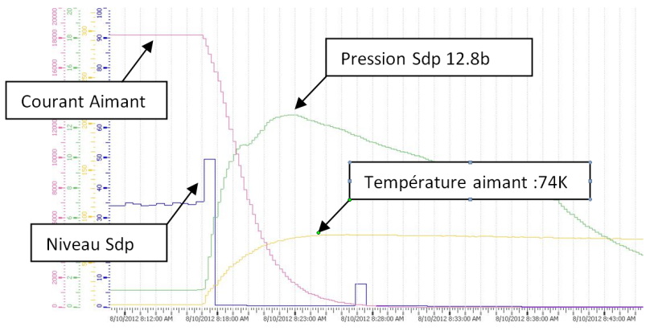
Fast dump CMS magnet
5 min
Helium loss: 180 kg

Slide 9
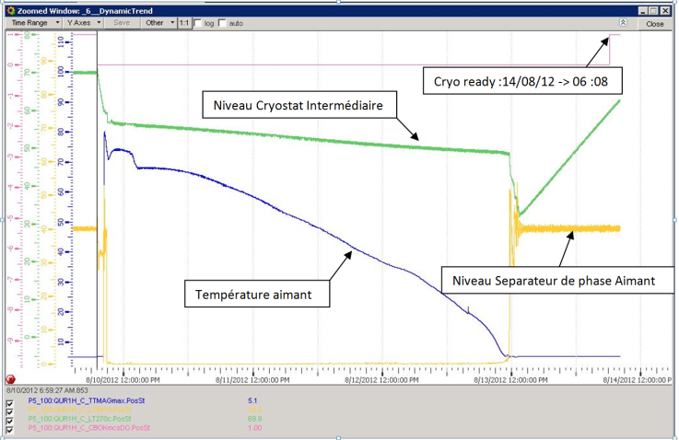
CMS: Recovery after fast dump
12 hours
Time from fast dump to cryo-ready: 95 hours

Slide 10
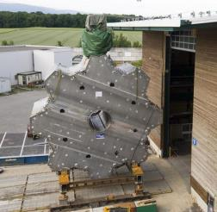
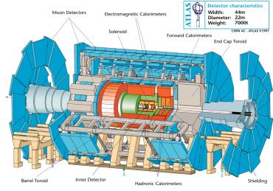
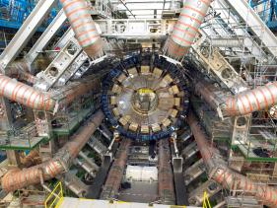
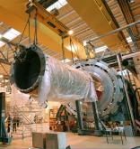
ATLAS magnet system
Dimensions: 8 x 25 m length
5 m width
Magnetic field 1T
Stored energy 1.1 GJ (total)
Dimensions: 2x 11 m diam.
5 m width
Magnetic field 1T
Stored energy 0.5 GJ
Dimensions 5 m length
2.5 m diam.
Magnetic field 2T
Stored energy 39 MJ
Total cold mass: 680 tons

Slide 11
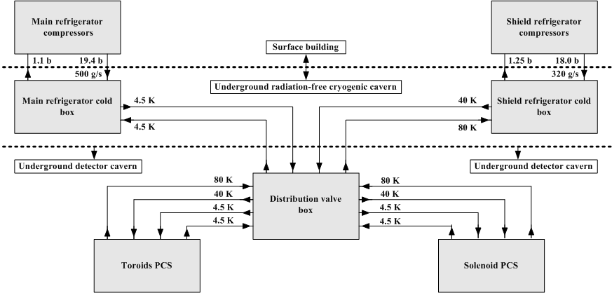
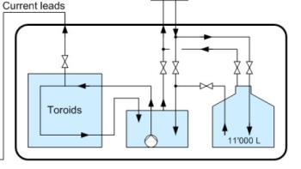
ATLAS refrigerator system
solenoid

Slide 12
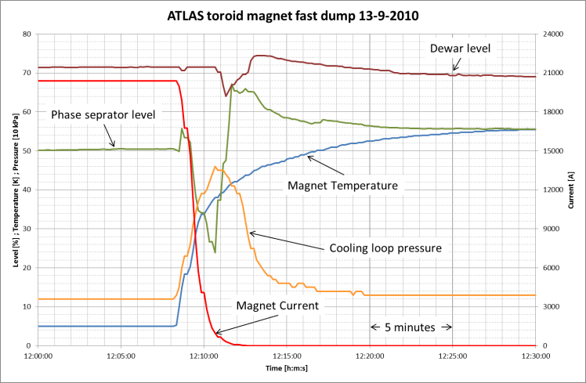
Fast dump ATLAS toroid magnets

Slide 13
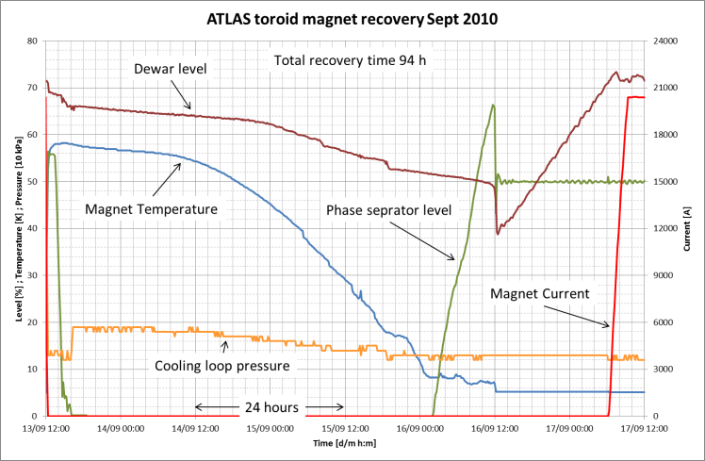
Fast dump ATLAS toroid magnets

Slide 14
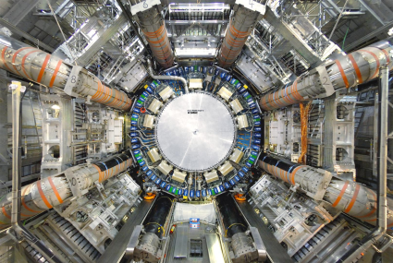
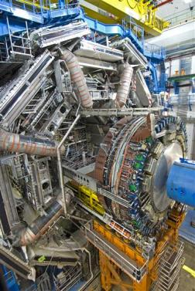
ATLAS calorimeter system
three cryostats, total mass 740 tons
- temperature around 88.3 K
- total liquid argon volume 100 m³ in underground
- 228000 signal wire feed-through
- operational 365/365 since 2005

Slide 15
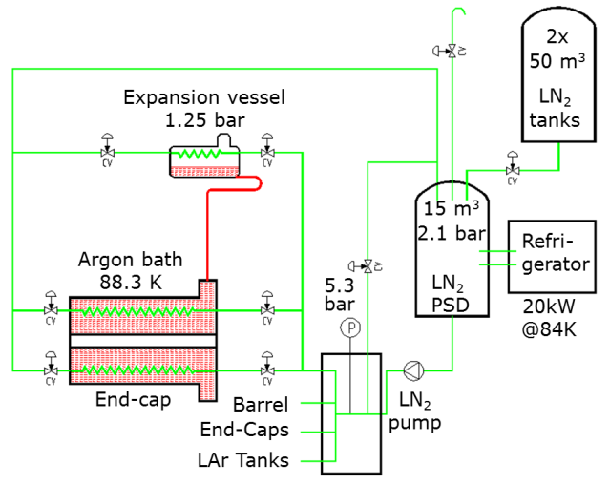
ATLAS calorimeter cryo system
  stability < 10 mK over stable operation periods

Slide 16
Operation of LHC detector cryogenic installations
LHC detectors operation:
  365 day operation
  by CERN staff
  daily operation by 4 operators and one team leader
On-call service for outside of working hours interventions :
  4 “entitled” operators and one team leader
  start of on-site intervention within 1 hour from triggering of alarm
  back- up by 2nd line “Best Effort” support :
    for operational or expert support in exceptional situation
    for assistance of other support services (controls, electricity, maintenance…)

Slide 17
Performance CMS of cryogenic system
2011:
3 long power cuts by thunder storms
problem current-lead regulation: fd → 83h
problems cryo mostly solved during TS
1.2
97.3
0
2012:
4 problems with compressor safety chain
1 fd: wrong operation on cryo system
cryo stop by problem UPS system
non
availability
96.2

Slide 18
Performance ATLAS of cryogenic system
2011:
3 long power cuts by thunder storms
stop of helium circulator: fd → 100h
problems cryo mostly solved during TS
1.2
97.3
0
2012:
Loss of magnet data: fd→ 94 h
Problem security chain T3, SD
96.5%
98.5%
96.2
non
availability

Slide 19
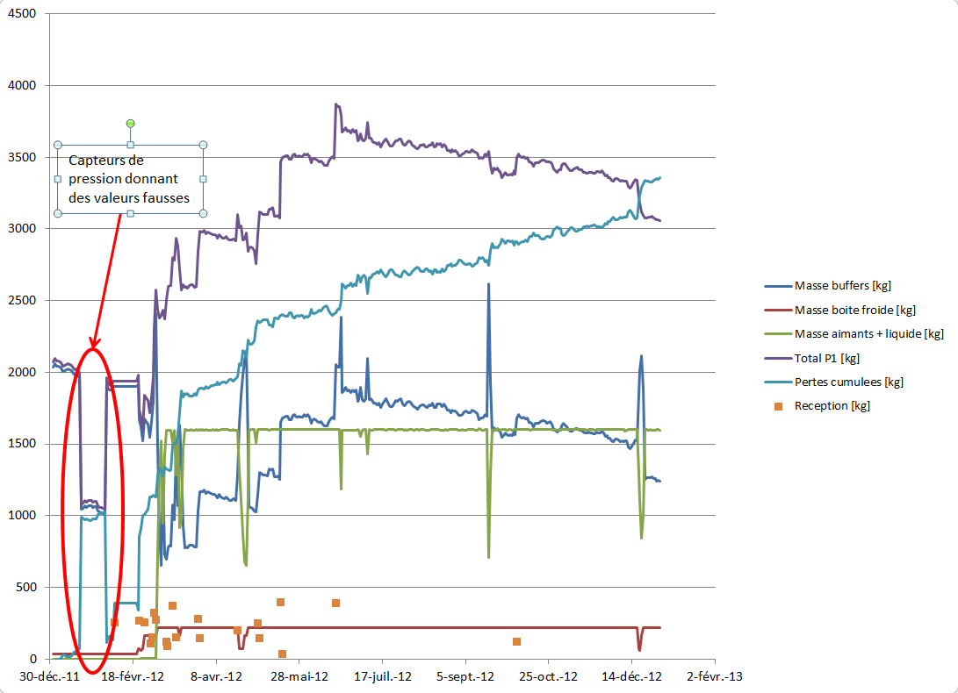
ATLAS helium inventory 2012
1.2
97.3
0
96.2

Slide 20
Performance of ATLAS cryogenic system
 | Nominal inventory (kg) | Strategic inventory (kg) | Total losses 2012 (kg) | Permament losses (kg) | Losses due to stops (kg) | Others
CMS | 900 | 1200 | -1600 | 330 (~27% of SI) (0.9 kg / day) | 660 (~ 80 kg / stop) | 610 (purges)
ATLAS | 2600 | 3500 | -3350 | 1095 (~30% of SI) (3 kg / day) | 740 (~185 kg / stop) | 1515 (purges + CP6 installation)
1.2
97.3
0
96.2

Slide 21
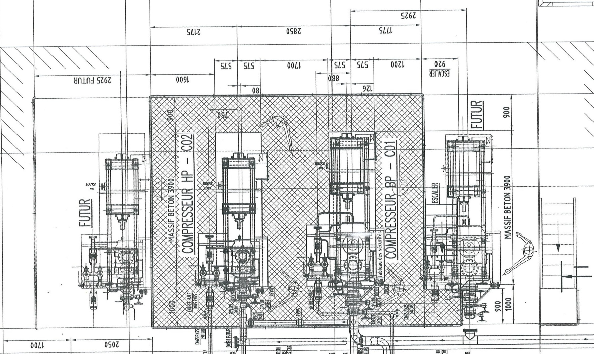
CMS Consolidation
Installation two “parallel” compressor stations:
  To diminish down-time in case of large equipment failure
1.2
97.3
0
New CP2
96.2
New CP1

Slide 22
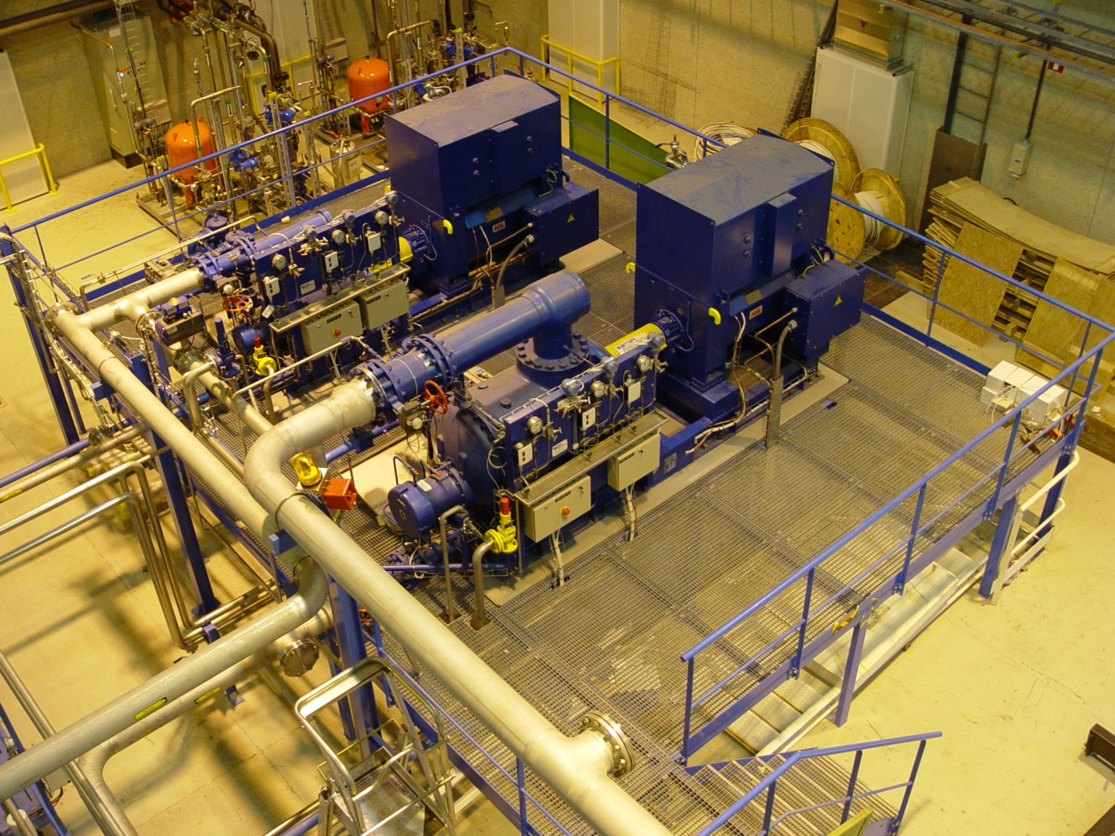
CMS Consolidation
conection new CP2 (HP)
1.2
Connection new CP2 (MP)
97.3
0
96.2
Connection new CP1 (BP)
Connection new C1 (MP)

Slide 23
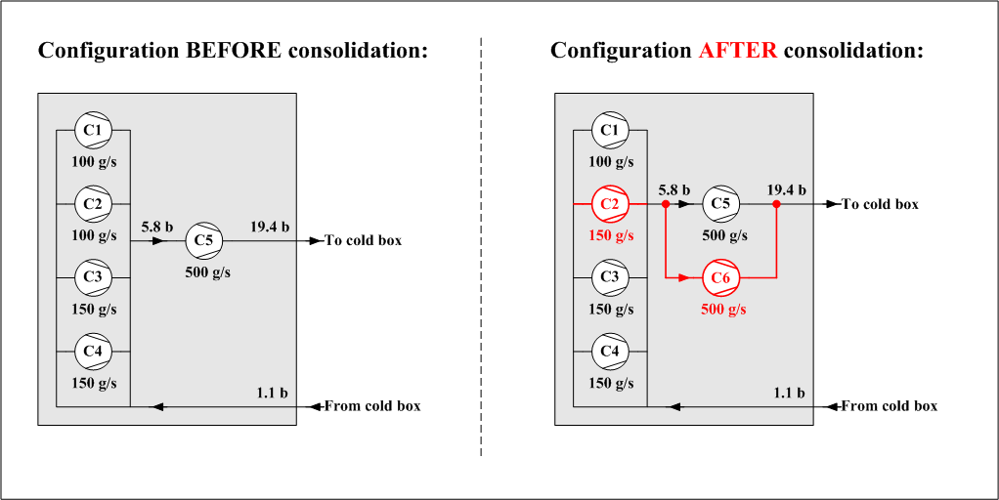
ATLAS Consolidation
Installation two compressor stations:
  to diminish down-time in case of large equipment failure, keeping same operation conditions

Slide 24

ATLAS Consolidation
De-coupling of the toroid and solenoid system by adding 11000 liter dewar to solenoid system

Slide 25
Conclusions
The ATLAS and CMS cryogenic installations are fulfilling the requirements of the detector systems;
The control systems (hardware and software) have been improved to diminish the down time (sensitivity for micro-power cuts)
Consolidations diminishing the long-term effect of mal-functioning compressor stations are implemented;
Concerning ATLAS: de-coupling of toroid and solenoid system will diminish the effect of an eventual toroid fast-dump on the physics measurements
The consolidation of the ATLAS and CMS cryogenic systems should be finished in the 2nd half of 2014.

