Slide 1
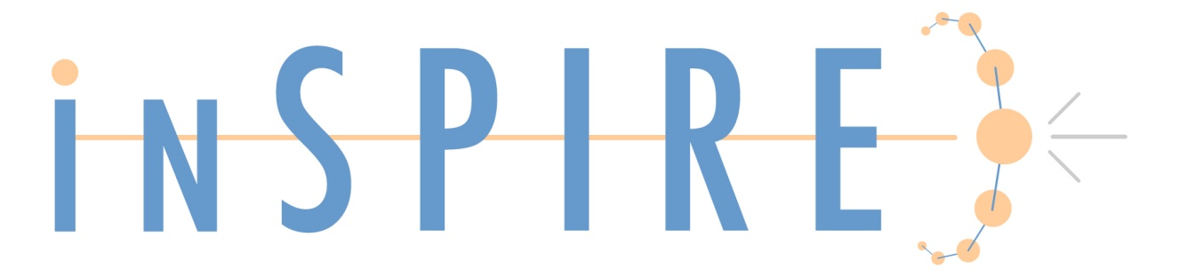
Who’s who?
Author identification in INSPIRE
-Heath O’Connell, Fermilab

Slide 2
What’s the problem?
Author search is the most popular search
Names are not unique
  Denis Bernard (theory),
  Denis Bernard (BABAR),
  Bernard Denis (accelerators)
  David Nathan Brown and David Norvil Brown (both BABAR)
2,800+ authors on ATLAS

Slide 3
How do we deal with this?
HEPNAMES database to collect information on scientists
  Establish identity of author as a person
  99,000 records managed by 1 FTE
  34,000 INSPIRE ID numbers assigned.
    Record checked for duplicates, etc.
Bib Author Identify (BAI): computer algorithm to identify author profile based on publication info such as affiliation and co-authors
  Establish BAI profile, may or may not correspond to a unique person

Slide 4
INSPIRE ID vs. ORCID ID
INSPIRE ID gives us immediate control
  New ATLAS member can be assigned an ID that day by us, do not have to wait for person
  HEPNames record curated for that person
IDs are all “one-to-one” and an association can be made at a later date (ask users?)
Mark Doyle:
  ORCID-0000-0001-5919-8670 | INSPIRE-00077990
Start promoting ORCID with button to ORCID in our system

Slide 5
Adding authors and affiliations to HEP records
1-10 authors
  Add by hand using an auto-suggest script which guesses the affiliation based on older records.
More than 10 authors (typically experimental)
  Did they use an authors.xml file?
    Yes: extract authors and affs cleanly in a few seconds.
    No: use script that extracts authors and affiliations from TeX file and matches their ID number based on name and experiment.
    e.g. “d. denisov” + “FNAL-E-0823” = INSPIRE-00076696
    Affiliations matched with INSTITUTIONS database

Slide 6
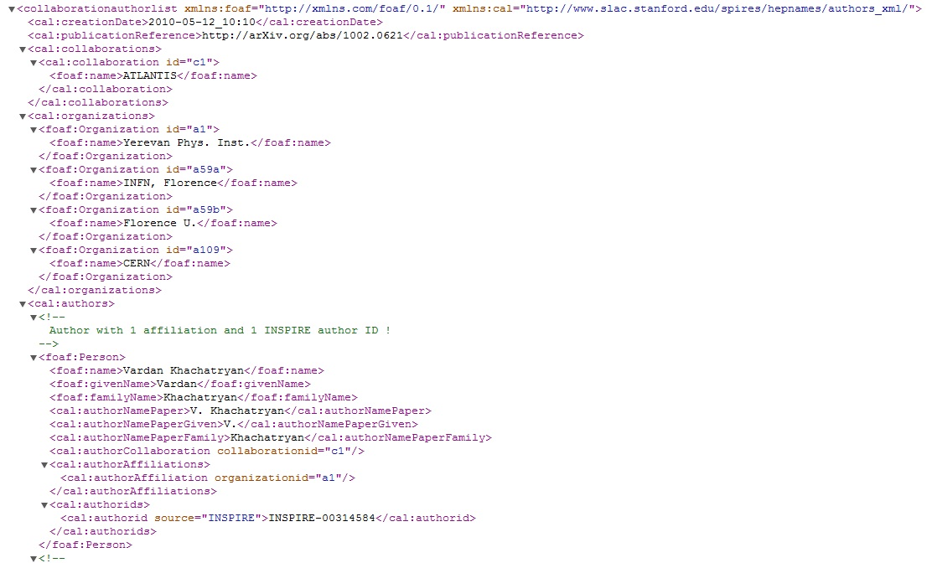




Authors.xml file
Authors.xml file was proposed by INSPIRE and developed in partnership with arXiv.org and publishers such as the APS to enable collaborations to ensure all authors are properly specified.

Slide 7
Helping the Smaller Collaborations
10-200 people
  Big enough to be a problem
  Small enough to have no system in place
INSPIRE has created a system these collaborations can use to manage their authors and create author.xml and LaTeX files

Slide 8
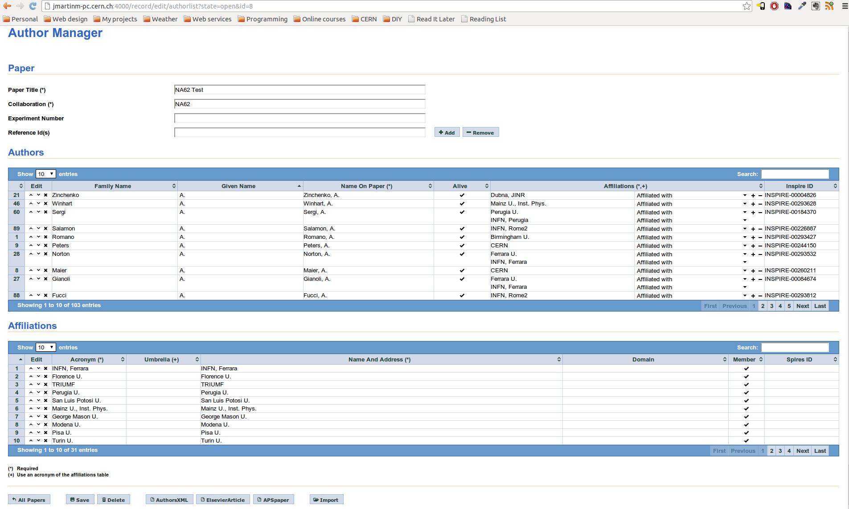
Author management for collaborations

Slide 9
Let’s get automated
Bib Author Identify (BAI): 12,000 lines of code that uses metadata to create likely author profiles to identify a person
6.7 M “signatures” on 1M papers in HEP
270,000 author profiles created
  cf. HEPNames: 100,000 records
On average each profile has 25 papers

Slide 10
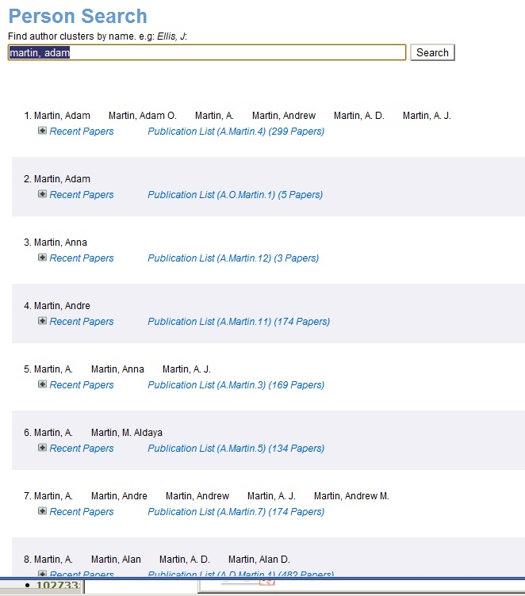
For people with very common names it naturally has some difficulties. These are cleaned by a combination of user and operator effort.
Algorithm will get smarter so
A.J. Martin and
A.D. Martin
aren’t in same profile.

Slide 11
How to reach users
Use the HEPNames database to identify candidates for a mailout.
Look for people who have verified their HEPNames record (know they respond).
10,000 emails have been sent out.

Slide 12
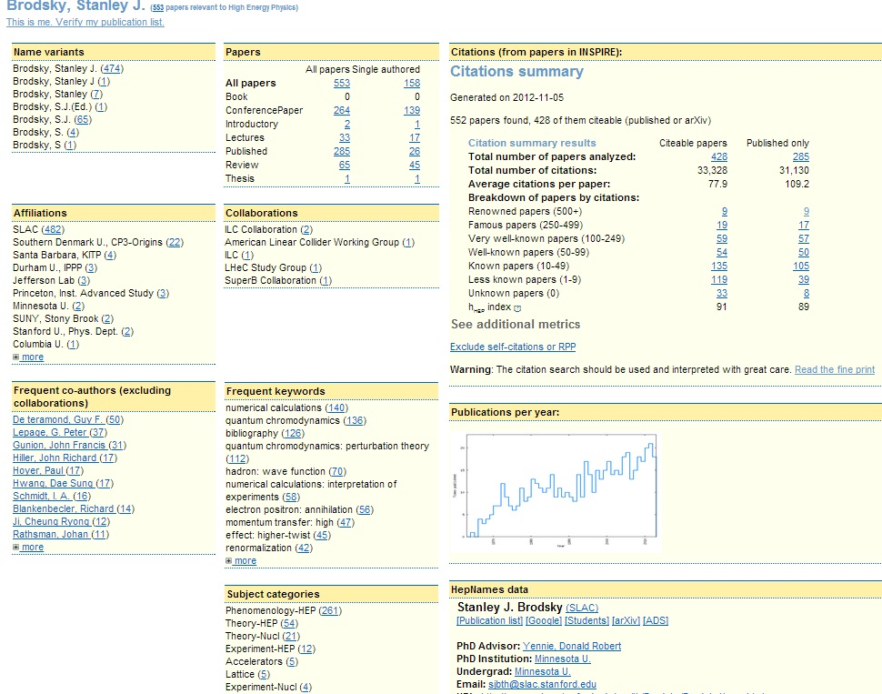
Author Publication Profile Page

Slide 13
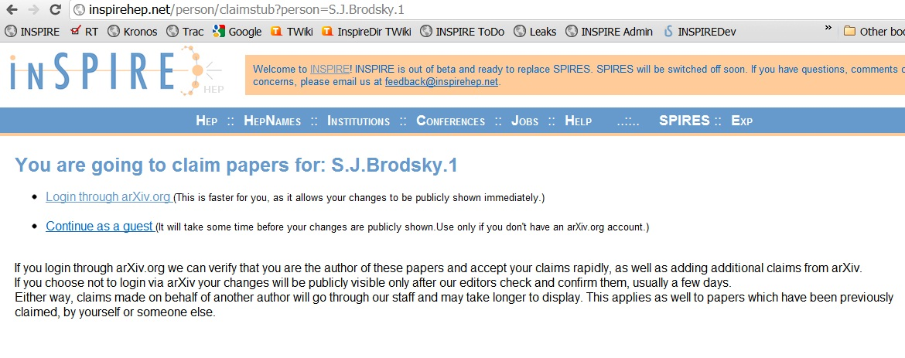
Login page: arXiv or “guest”

Slide 14
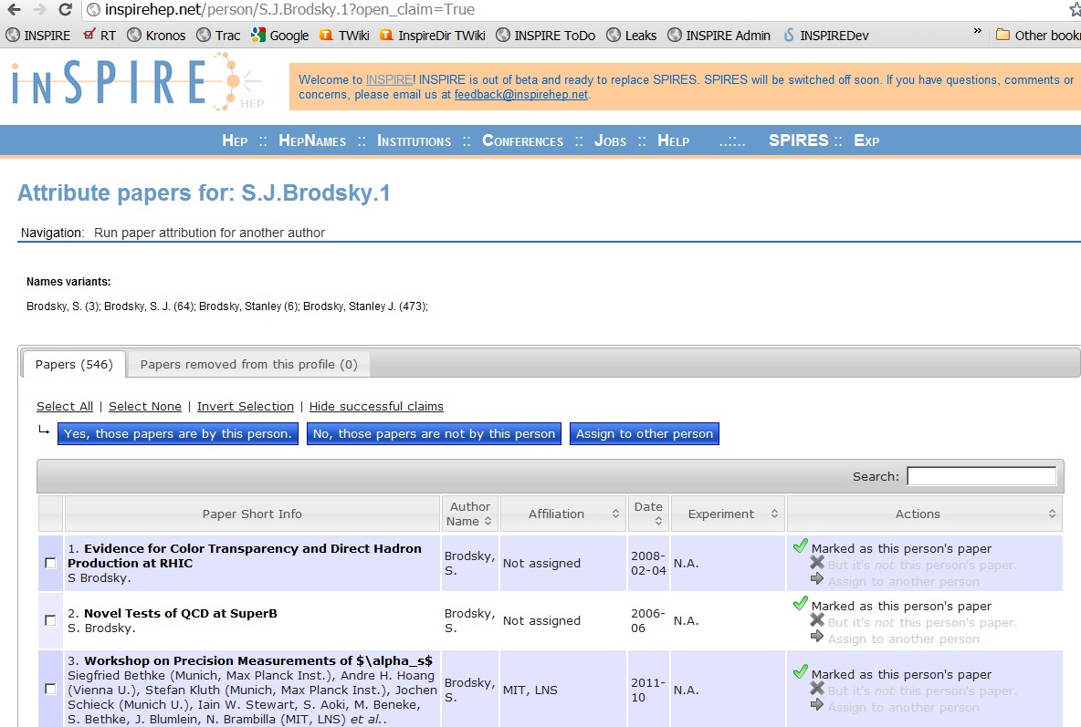
Claim your papers, remove others

Slide 15
Claiming results versus total
 | Papers | Signatures | Author Profiles
Total in HEP | 1,000,000 | 6,000,000 | 270,000
Claiming actions | 151,000 | 350,000 (4,000,000) | 5,000 (100,000)
N.B. Very high number of signatures (4,000,000) on small number of papers (151,000). Probably an effect of newer papers being claimed, hence more signatures from big collaborations.

Slide 16
Summary
98,000 records in HEPNAMES
  34,000 with INSPIRE ID (real, unique people)
Will integrate ORCID and INSPIRE
Created author.xml format for collaborations and system for them to manage authors
BAI algorithm created 270,000 author profiles
10,000 solicitation emails → 5,000 responses
150,000 papers claimed (out of 1,000,000)

