Slide 1

EO LTDP
And
The SCIDIP-ES project
Fulvio Marelli - ESA

Slide 2
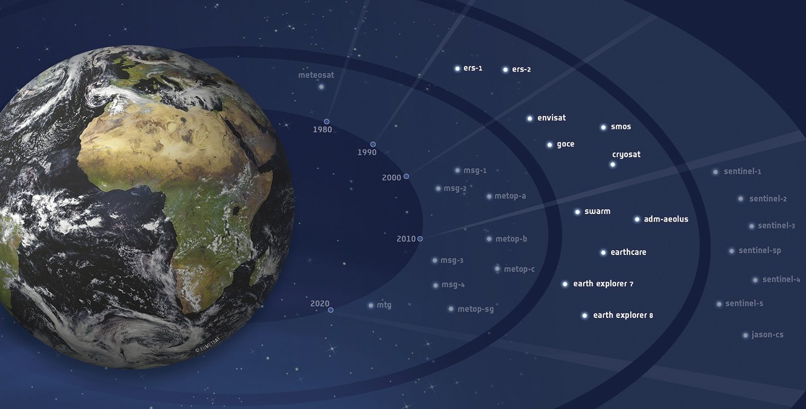

Slide 3
1986-2012 and future

Slide 4
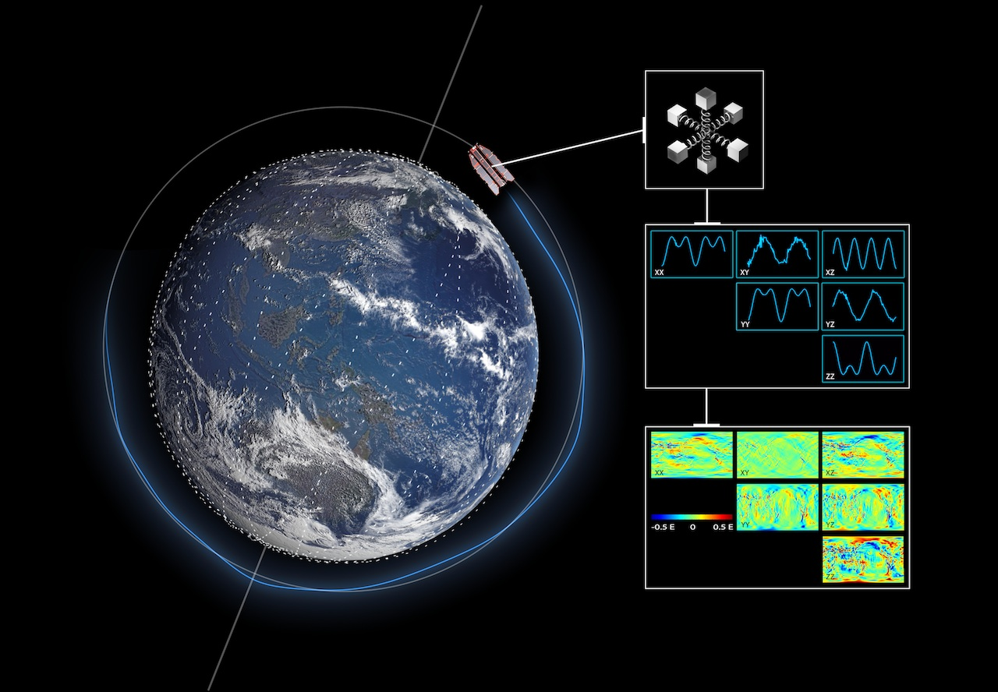

An example of data lifecycle: sensed data need to be acquired…
Level 0
001 | 4100
002 | 4102
003 | 4102
004 | 6144
005 | 6150
006 | 7168
007 | 6146

Slide 5
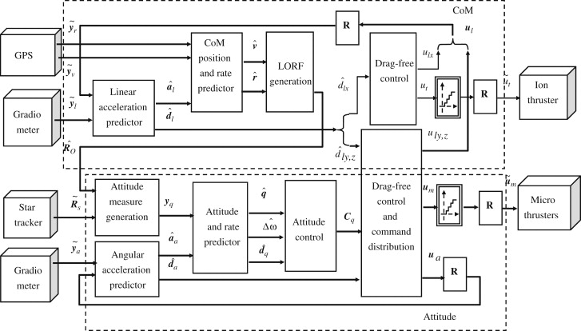
...through complex processing schemes
Algorithm
Manual

Slide 6
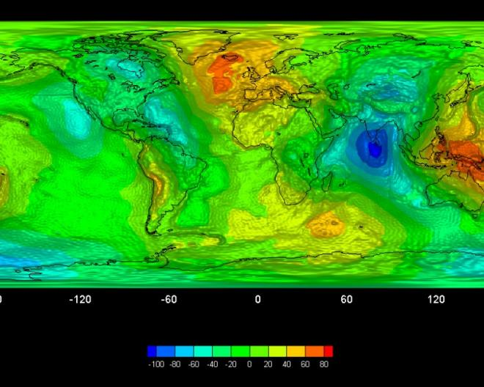
...to be combined and processed to get this
Processing/combining
Processing
Level 0
Level 1
Level 2

Slide 7
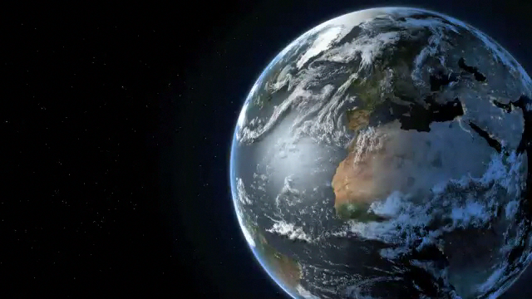
Example of Earth Science data use:
Arctic sea ice melting
Notes:
This time series is used to show the progressive reduction of the sea ice in the Arctic area. Sea Ice melting is one of the Essential Climate Variables.
Ice melting at the north pole would significantly impact on our global environment (which we need to model and forecast). Moreover it would have an incredible impact on sea routes traffic (90% of the goods are transported on the sea) and therefore on the global economy.
It is essential that our scientist have the full access to all information related to this (and other) phenomena.
Unfortunately satellites (and/or experiments) are not forever. The video you see was realized unifying over 4 missions (i.e. 4 different satellites and sensor).
This poses problems of file conversion, metadata harmonization. Which must be planned and have a cost.

Slide 8
International Context
“A fundamental characteristic of our age is the raising tide of data – global, diverse, valuable and complex. In the realm of science, this is both an opportunity and a challenge.”
  Report of the High-Level Group on Scientific Data, October 2010, “Riding the Wave: how Europe can gain from the raising tide of scientific data”
Data Intensive Science (4th Paradigm): data at the centre of the scientific process.
EC Recommendation 2012/417/EU, July 2012: “Access to and preservation of scientific information”.
Data is the new gold. “We have a huge goldmine ….. Let’s start mining it.”
  Neelie Kroes, Vice-President of the European Commission responsible for the Digital Agenda

Slide 9
Data & Knowledge Preservation
Level 0
Level 1
File specs.
Desc. Info
Processor
Algorithm
User Manual
Publications
The preservation of data (the “bytes”) is useless without the preservation of the knowledge associated with the data (e.g. the “quality”, the process to generate them).
We must:
  Ensure and secure the preservation of archived data and associated knowledge ideally for an unlimited time span.
  Ensure, enhance and facilitate archived data accessibility.
    Allowing to combine data from different sources and to perform more complex analyses (data unfamiliar become familiar)
  Ensure coherency of approaches among different Earth Science providers.

Slide 10
LTDP Key Aspects
  Preservation of EO data but also of all context information (documentation, CAL/VAL databases, algorithms, etc).
  Completeness and coherency among all elements to be preserved to ensure present and future exploitability.
  Data Quality, Context and Provenance (documented).
  Maintenance of capabilities to (re-)generate data products.
  Harmonized data and information accessibility.
  Coordinated and coherent approach in Europe.
Preservation has to be addressed in all phases of a mission starting from its design.
Incremental approach for past and current missions, systematic planning and approach for future missions.
Notes:
10

Slide 11







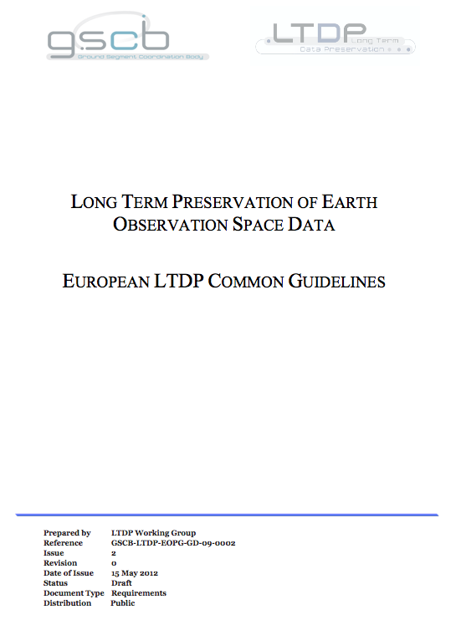
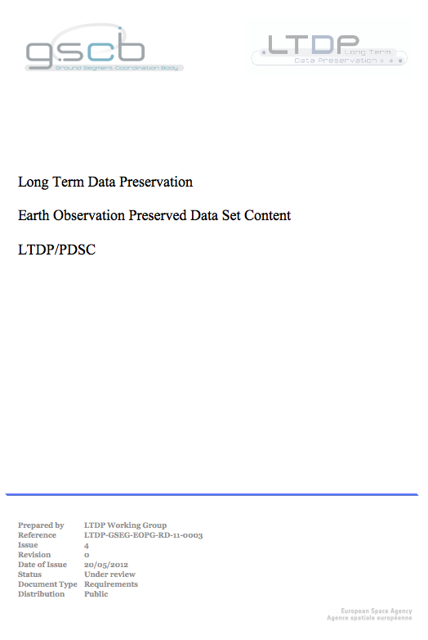
EO LTDP WG
ESA is coordinating the LTDP cooperation activities in the Earth Observation domain with European partners through the LTDP WG formed within the Ground Segment Coordination Body (GSCB).
Implemented the basic rules of the European LTDP Framework in Earth Observation: “LTDP Common Guidelines and Preserved Data Set Content”
  Reflecting the consensus of the European EO Data providers.
  Reviewed at GEO, CEOS and with NASA.
  Being reviewed with QA4EO.
New Issues available

Slide 12
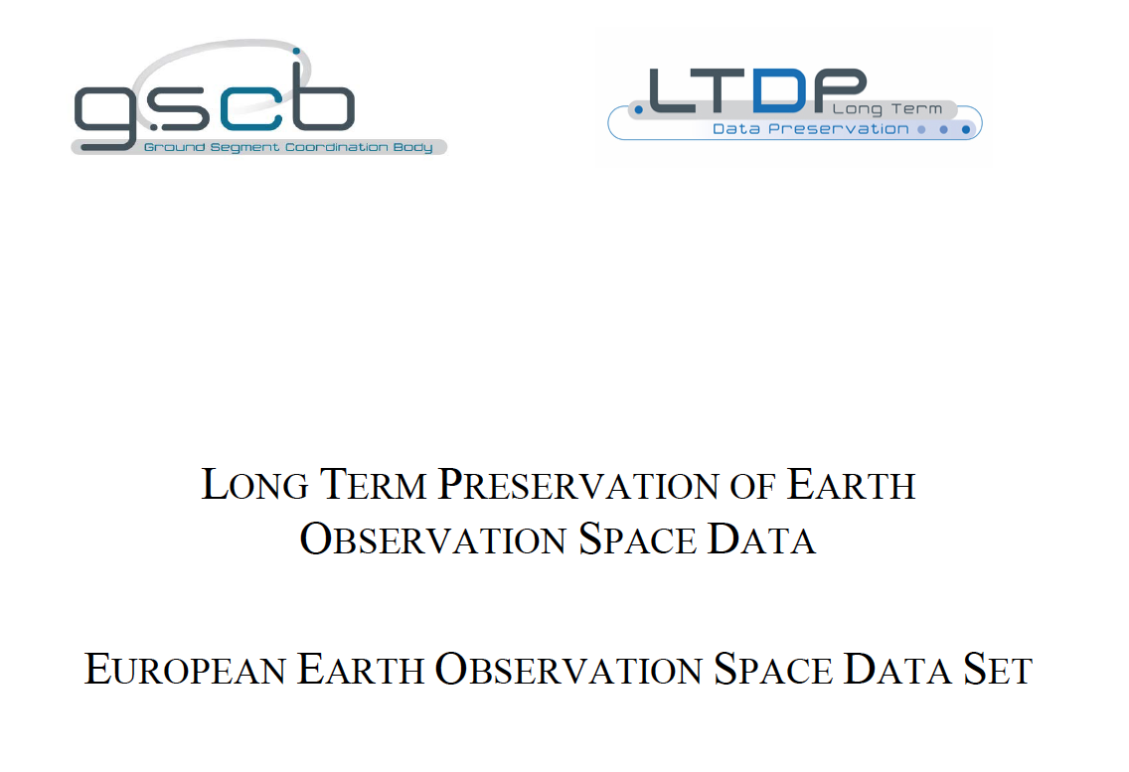
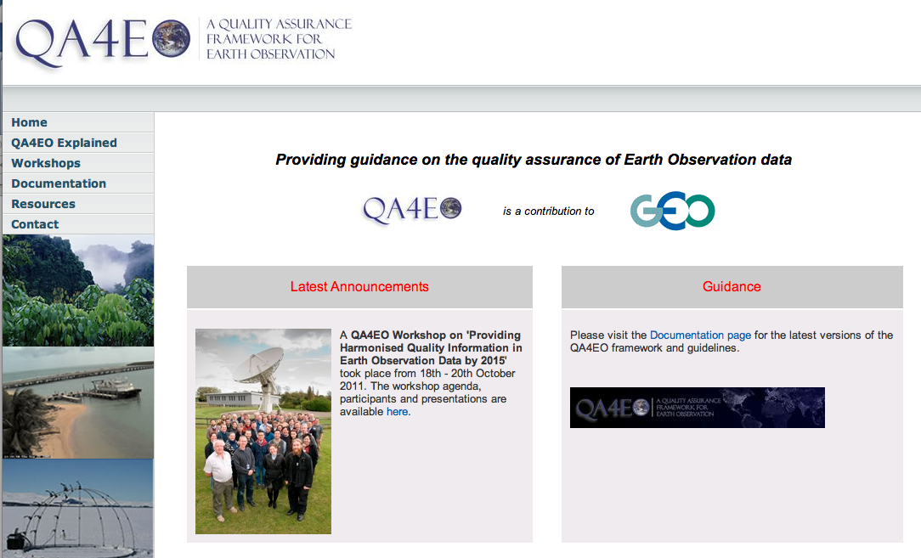

EO LTDP WG
Defined the initial data set to be preserved, including the related glossary.
Started several technical activities:
  LTDP User Requirements Study (FIRST)
  Archive Technology Study (LAST)
  LTDP Initiatives and Standards Survey
  LTDP/QA4EO Study
  LTDP Architecture Definition Project
Guaranteed the information flow through workshops, web sites, participation to conferences and LTDP related events.

Slide 13
LTDP Guidelines
Preserved data set content
Archive operations and organization
Archive security
Data ingestion
Archive maintenance
Data access and interoperability
Data exploitation and re-processing
Data appraisal and purge prevention

Slide 14
Mission phases
Mission Concept (MC)
Mission Definition (MD)
Mission Implementation (MI)
Mission Operation (MO)
Post Mission (PM)

Slide 15
Content
For an Earth Observation mission (i.e. project, campaign, experiment), the key data set target of preservation shall be composed by:
Data Records (ranging from raw data to higher level products, browses, auxiliary, ancillary and calibration and validation data set) including quality indicators..
Processing Software: this includes the processors to generate mission products, visualization, quality control and value adding software and tools.
Mission Documentation:

Slide 16

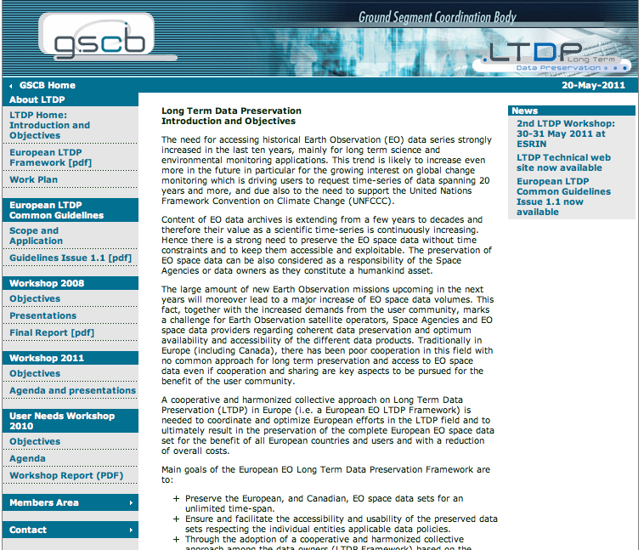
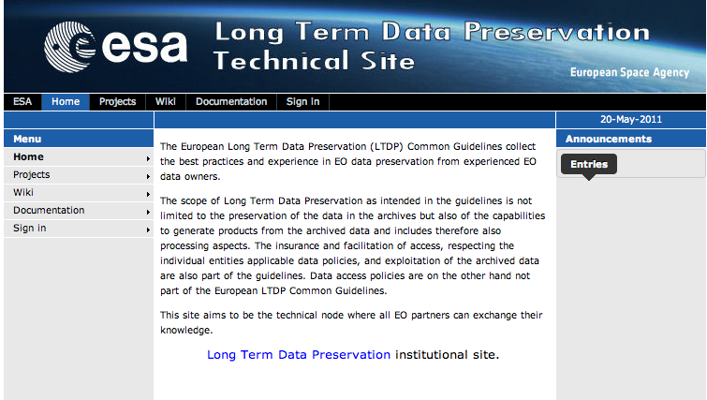
LTDP Web Sites
Web Sites
  Institutional web site:
  http://earth.esa.int/gscb/ltdp/
  Contains basic LTDP documents (e.g. Guidelines).
  LTDP events and related material (e.g. Workshops).
  Technical Web Site:
  http://ltdpts.eo.esa.int/
  Contains technical documentation and results of LTDP Cooperation activities.
  Forum for technical discussions.

Slide 17







International EO LTDP Context
ESA membership
Standards
Projects
European EO LTDP Framework
LTDP
Task
WGISS
Notes:
17

Slide 18
Project Overview

Slide 19


















Introduction & Participants
Project: SCIence Data Infrastructure for Preservation – Earth Science (SCIDIP-ES)
INFRA-2011-1.2.2 Data infrastructures for e-Science
Project ID: 283401
Project Type: CP-CSA
Start Date: 01.09.2011
Duration: 36 Months
Website: www.scidip-es.eu
Total Budget: 7,721,082 €
EC Funding: 6,599,992 €
Total funded effort in person/months: 605
Coordinator: European Space Agency
Contact Person: Mirko Albani (ESA)
Project Consortium (17 partners):
Earth Science
Industrial
Researchers
Notes:
The consortium consists of partners dealing with Data Preservation from different perspectives:
Earth Science Data Managers: applying data preservation to own data holdings and making those available to end users.
Researchers in Digital Data Preservation, standards and modelling.
Industrial Partners: performing R&D activities and software development.
Earth Science repositories - Operative context - Provide precise use cases, needs, constraints.
Industrial partners guarantee a professional approach to software modelling, coding and assessment
Research and development - OAIS - bringing experience coming from prjs such as CASPAR and SCHAMAAN into SCIDIP
Big industry is not inside the consortium: we do not want to relay on proprietary solutions
Users are involved indirectly through our surveys and workshops
19

Slide 20
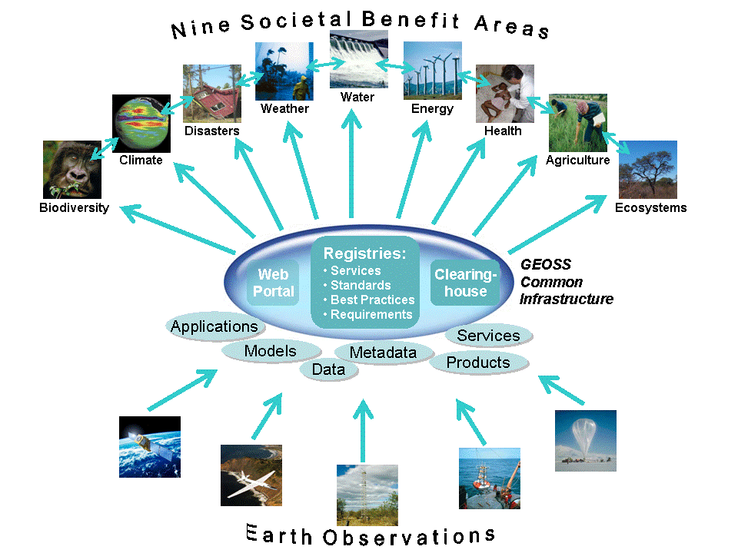
Our context

Slide 21
Earth Science can count 9 different data categories.
Each of them has its own:
  Data preservation policies and approaches (if available)
  Metadata and data formats
  Data description and semantic
  Different also inside each category depending on the owner
  Data are used by different categories of users with different tools and techniques.
  Products generated by users are often not duly preserved.

Slide 22
SCIDIP-ES Objectives
To develop and deploy generic and sustainable digital data preservation services and toolkits.
    Validate and use them in the Earth Science domain as a start.
To harmonise data preservation policies and approaches, metadata and ontologies in the Earth Science domain:
    Paving the way for the set-up of an harmonized and common approach for the Long Term Preservation of Earth Science Data.

Slide 23
Earth Science Data Preservation status and needs
Earth-Science data managers have individually dealt for decades with preservation and access to heterogeneous and complex scientific data.
BUT need to:
  Improve effectiveness of data preservation through the application of standard approaches and tools and exploitation of latest Digital Preservation developments and achievements (i.e. SCIDIP-ES services and toolkits). Reduce preservation threats.
  Ensure preservation of data but also of all context/provenance/quality information: Data Records, Processing Software, Documentation.
  Harmonize preservation approaches and policies and coordinate efforts to better support pressing needs from very sensitive applications.
  Enhance interoperability and facilitate data usability and access by the scientific user community.

Slide 24
SCIDIP-ES Services & Toolkits
External PI services
Persistent ID i/f Service
Certification Toolkit
ISO Certification Organisation
Services: run on remote servers
External Access/Use Services
RepInfo Registry Service
Gap Identification Service
Orchestration Service
Storage Service
Toolkits Runs on local machines
Preservation Strategy Toolkit
Finding Aid Toolkit
RepInfo Toolkit
Packaging Toolkit
Cloud Storage
Data Virtualisation Toolkit
Process Virtualisation Toolkit
Authenticity Toolkit
These SUPPLEMENT what repositories do (customised for repositories)
Make it easier for repositories to do preservation – share the effort
Notes:
Services and toolkits:
Facilitating data owners in implementing their data preservation activities.
Allowing what is unfamiliar and unusable to become familiar and usable.
Increasing interoperability within Earth Science data domains and among different disciplines outside Earth Science.

Slide 25
What will SCIDIP-ES do for Earth Science?
Provide state of the art data preservation services and toolkits.
Raise awareness on data preservation issue and enhance dialogue in this context between ES data repositories:
  Paving the way for the set-up of an Earth Science LTDP Framework
Define common preservation policies and approaches.
Propose path for harmonizing metadata, semantics, ontologies, and data access policies:
  Facilitating data discovery and use.
Define an Earth Science LTDP framework governance model and architecture.

Slide 26
Earth Science Activities Workflow
www.scidip-es.eu

