Slide 1
LBS and LBE measurement lines for Linac4
JB Lallement, for the beam dynamics team.
Linac4 BCC meeting – 02/10/2012

Slide 2
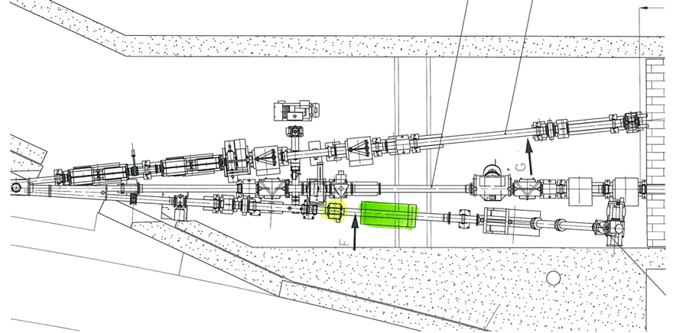
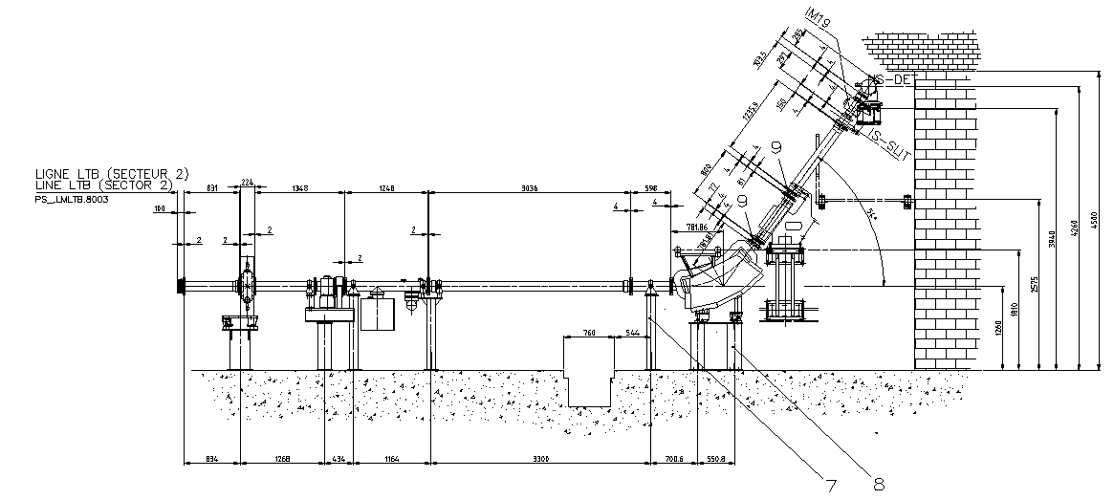
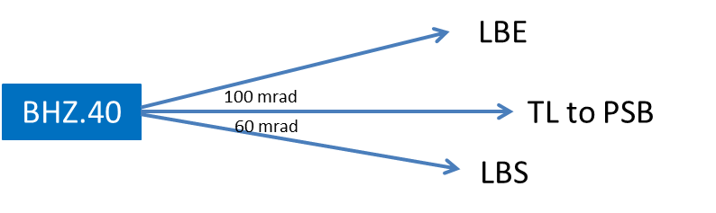
Introduction
Need for similar diagnostic lines before PS Booster injection with the present Linac2
LBS : Energy and energy spread
LBE : Transverse emittance

Slide 3
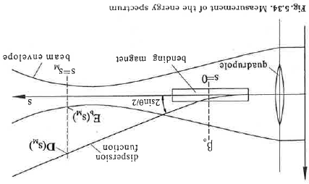
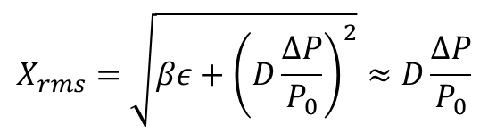
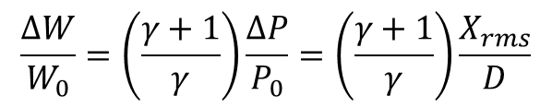

LBS – Measurement principle
Generate dispersion with a bending magnet.
Reduce the non-dispersive contribution to beam size.
Measure the beam size.
SEMGrid or Wire Scanner.
Calculate the energy spread (dispersion is known).
L’
$$D=L.2 sin\left(\frac{θ}{2}\right)$$
L
$$X_{rms}=\sqrt{βε+{\left(D\frac{∆P}{P_{0}}\right)}^{2}}≈D\frac{∆P}{P_{0}}$$
$$\frac{∆W}{W_{0}}=\left(\frac{γ+1}{γ}\right)\frac{∆P}{P_{0}}=\left(\frac{γ+1}{γ}\right)\frac{X_{rms}}{D}$$

Slide 4
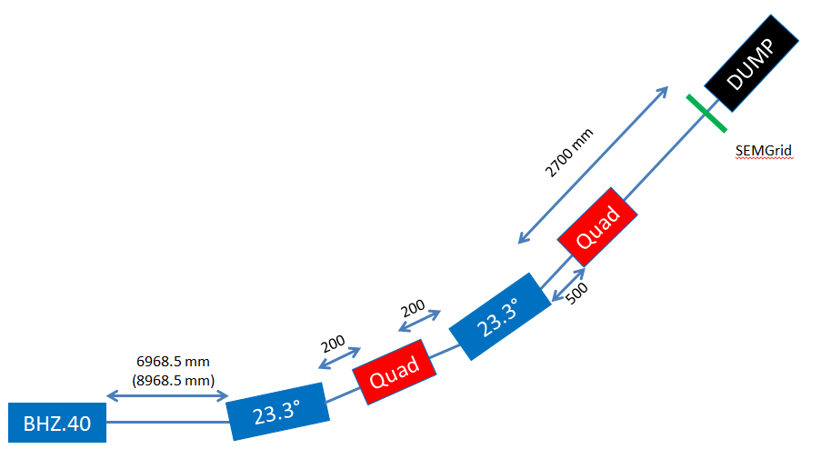
LBS - Layout
2 L4 type bendings – Shorten the distance F quad to profile monitor – Reduce the beam size at the waist.
1 focusing quad – Beam waist at profile monitor.
1 defocusing quad – Increase the dispersion
1 profile monitor
1 BCT (not on the sketch)
1 Beam dump

Slide 5
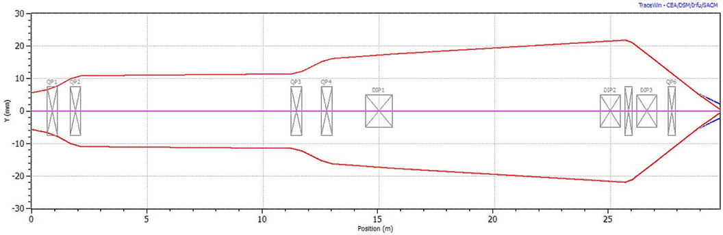
LBS - Layout
 | Gradient | Integrated gradient
QFW.30 | -1.46 T/m | -0.674 T
QDW.40 | 1.56 T/m | 0.717 T
QFW.50 | -1.21 T/m | -0.557 T
QDW.60 | 0.79 T/m | 0.366 T
The 4 upstream quadrupoles settings are adjusted for the measurements !

Slide 6
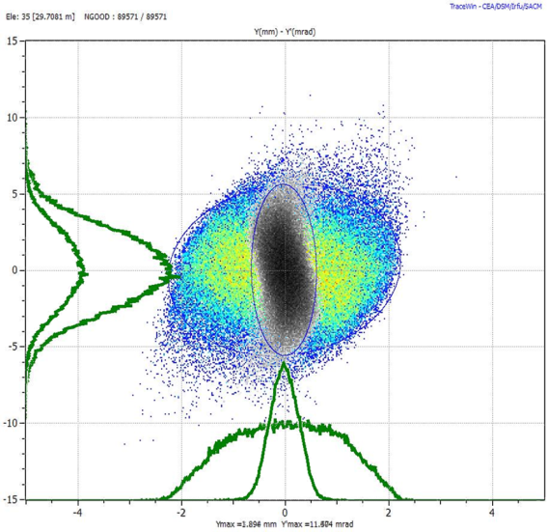
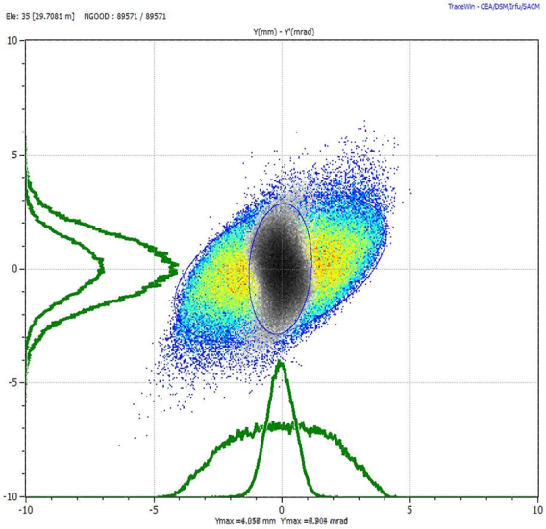
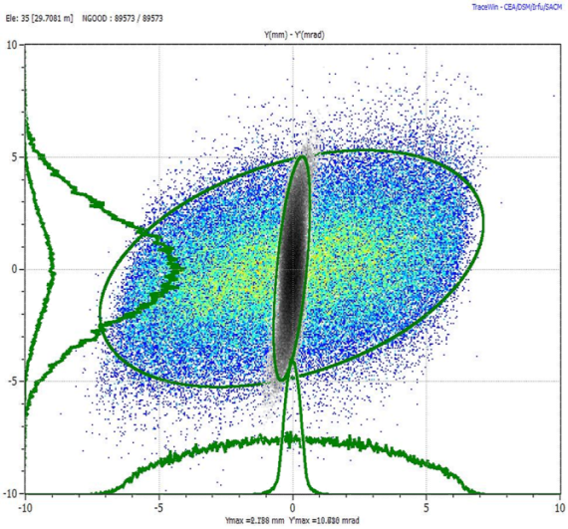
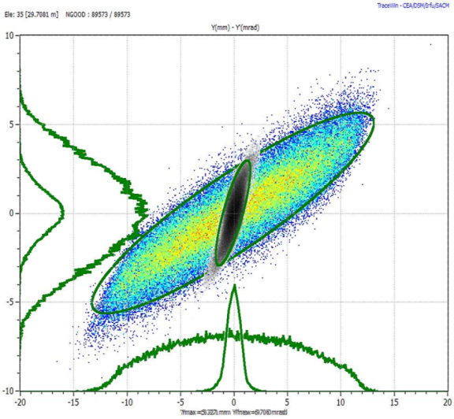
LBS – Simulation results
Low Dispersion
High Dispersion
 | Low Disp | High Disp
F Quad | 1.80 T/m | 2.72 T/m
D Quad | 0 T/m | -6 T/m
Disp. | 2.87 m | 5.28 m
Y rms Cav. ON | 1.00 mm | 1.85 mm
Y mono Cav. ON | 0.28 mm | 0.55 mm
Y rms Cav. OFF | 3.21 mm | 5.90 mm
Y mono Cav. OFF | 0.30 mm | 0.72 mm
Debuncher ON
Debuncher OFF
Not on the same scale !

Slide 7
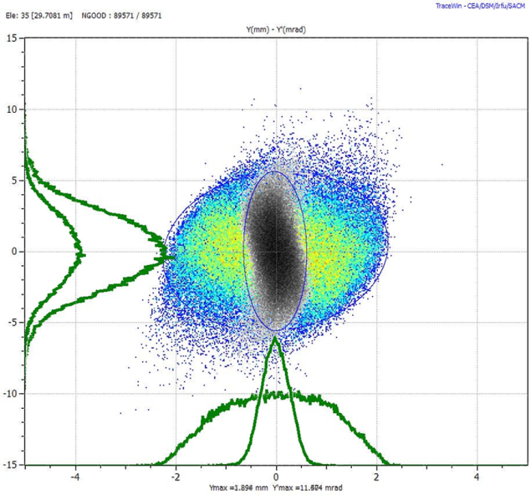
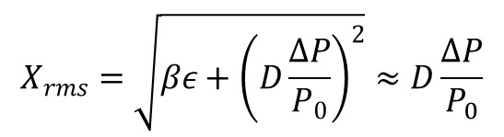
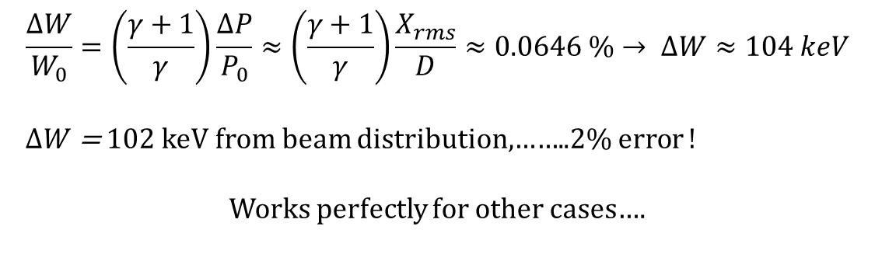
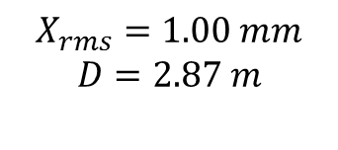
LBS – Simulation results
Is the approximation correct?
$$X_{rms}=\sqrt{βε+{\left(D\frac{∆P}{P_{0}}\right)}^{2}}≈D\frac{∆P}{P_{0}}$$
$$X_{rms}=1.00 mm$$
$$D=2.87 m$$
$$\frac{∆W}{W_{0}}=\left(\frac{γ+1}{γ}\right)\frac{∆P}{P_{0}}≈\left(\frac{γ+1}{γ}\right)\frac{X_{rms}}{D}≈0.0646 \%→ ∆W≈104 keV$$
$∆W$= 102 keV from beam distribution,……..2% error !
Works perfectly for other cases….

Slide 8
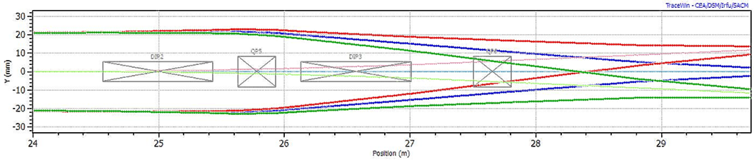
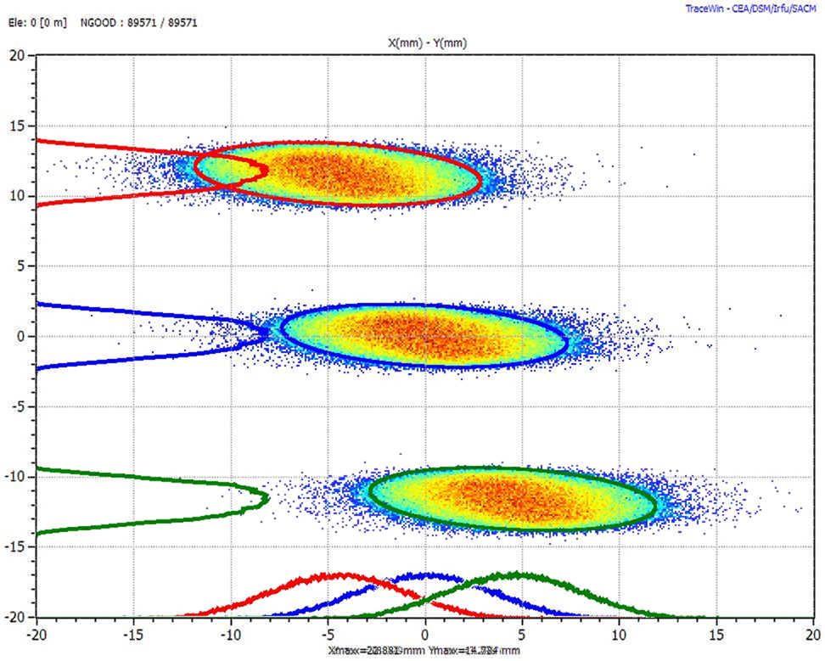
LBS – Simulation results – Energy painting
Done with low dispersion case
Energy painting +/- 1.2 MeV.
Displacement on PM +/- 11.5 mm
As for energy spread measurement
Approx 100 keV / mm
(or adjust bending current by +/- 0.4%)

Slide 9
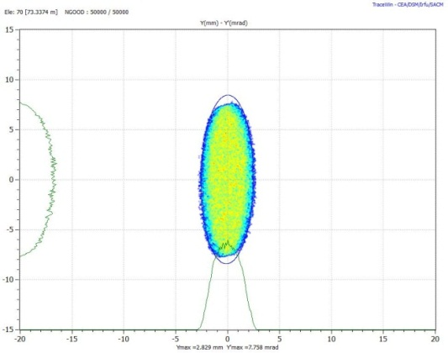
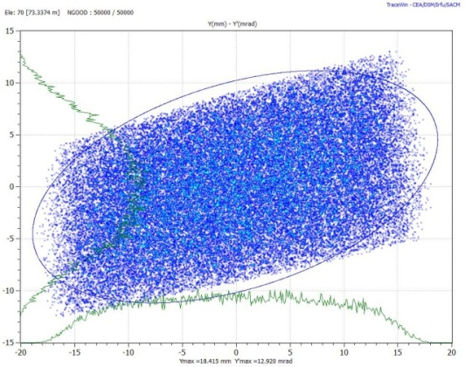
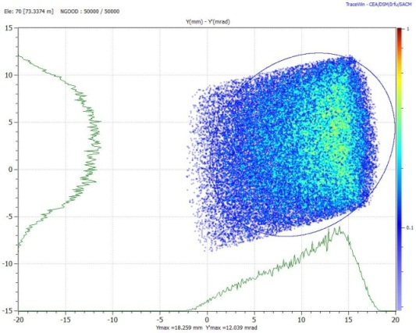
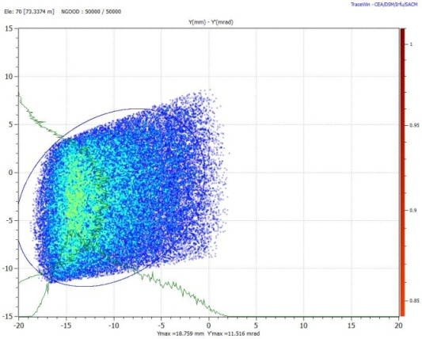
LBS – Compatibility with L3
 | -90° | 0° | 90° | 180°
Y rms (mm) | 1.12 | 4.38 | 8.41 | 4.43
Δ Y (mm) | 0 | 10.1 | 0 | 10.3
W₀ (MeV) | 874.6 | 880.8 | 874.6 | 868.5
ΔP/P | 0.013 % | 0.149 % | 0.288 % | 0.149 %
ΔW (MeV) | 0.224 | 2.586 | 5.032 | 2.579
Setting the buncher cavity phase
For absolute energy spread measurement :
High Disp 7 m
Beam size 2.69 mm
ΔW < 0.675 MeV

Slide 10
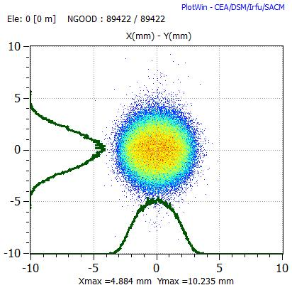
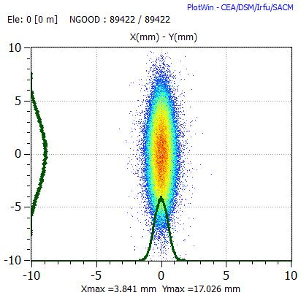
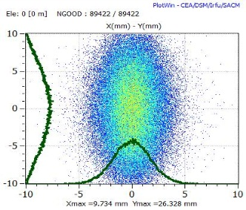

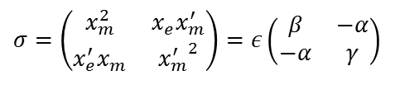

LBE – Measurement principle – 3 monitor method
$$σ=\left(\begin{matrix}x_{m}^{2} & x_{e}^{}x_{m}^{′} \\ x_{e}^{′}x_{m}^{} & {x_{m}^{′}}^{2}\end{matrix}\right)=ε\left(\begin{matrix}β & −α \\ −α & γ\end{matrix}\right)$$
$$R=\left(\begin{matrix}R_{11} & R_{12} \\ R_{21} & R_{22}\end{matrix}\right)$$
$$σ\left(L\right)=R∗σ\left(0\right)∗R^{T}$$
X
~ 60°
~ 60°
Z
R(1)
R(2)
R(3)
$$x_{monitor1}^{2}=σ_{11}(1)=R_{11}^{2}(1)εβ−2R_{11}^{}{\left(1\right)R}_{22}^{}(1)εα+R_{12}^{2}(1)εγ$$
$$x_{monitor2}^{2}=σ_{11}(2)=R_{11}^{2}(2)εβ−2R_{11}^{}{\left(2\right)R}_{22}^{}(2)εα+R_{12}^{2}(2)εγ$$
$$x_{monitor3}^{2}={σ_{11}(3)=R}_{11}^{2}(3)εβ−2R_{11}^{}{\left(3\right)R}_{22}^{}(3)εα+R_{12}^{2}(3)εγ$$

Slide 11
LBE - Layout
2 Quadrupoles (foc and defoc, bipolar power supplies).
3 profile monitors.
1 BCT (not on the sketch).
1 Beam dump.
5766.5mm
300 mm
500 mm
300 mm
500 mm
2700 mm
3000 mm
2000 mm
3000 mm
BHZ.40
QF.10
QD.20
DUMP
3 Profile monitors
Quad Settings | Horizontal Plane | Vertical Plane
QFW.30 | -1.41 T/m | -1.41 T/m
QDW.40 | 1.66 T/m | 1.66 T/m
QFW.50 | -1.28 T/m | -1.28 T/m
QDW.60 | 1.21 T/m | 1.21 T/m
Quad1 | -1.92 T/m | 0 T/m
Quad2 | 0.60 T/m | 0.62 T/m
The 4 upstream quadrupoles settings are adjusted for the measurements !

Slide 12
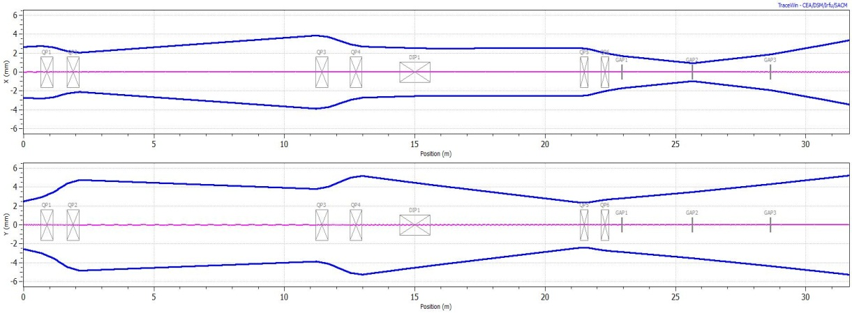
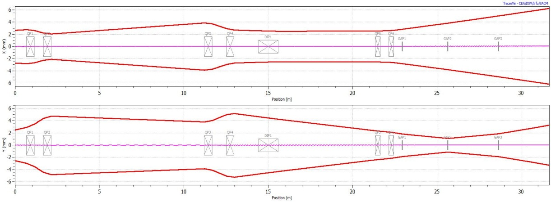
LBE – Simulation results
Hor. plane Meas. | Hor. rms size | Vert. rms size
PM 1 | 1.70 mm | 2.85 mm
PM 2 | 0.95 mm | 3.51 mm
PM 3 | 1.90 mm | 4.35 mm
Vert plane Meas. | Hor. rms size | Vert. rms size
PM 1 | 2.83 mm | 1.85 mm
PM 2 | 3.82 mm | 1.11 mm
PM 3 | 4.99 mm | 1.88 mm
 | From Distribution | From Emit. recons
α_{x} | 1.82 | 1.77
β_{x} (mm/mrad) | 7.44 | 7.31
ϵ_{x} (mm.mrad) | 0.305 | 0.310
α_{y} | 1.60 | 1.57
β_{y} (mm/mrad) | 7.40 | 7.32
ϵ_{y} (mm.mrad) | 0.352 | 0.355
Space charge effect not included !

Slide 13
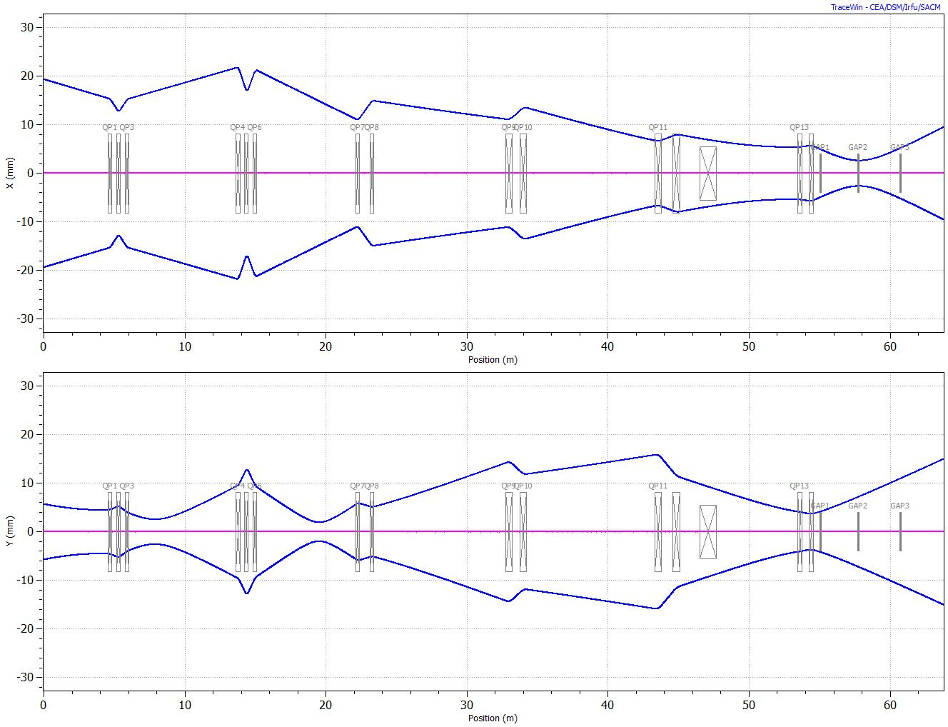
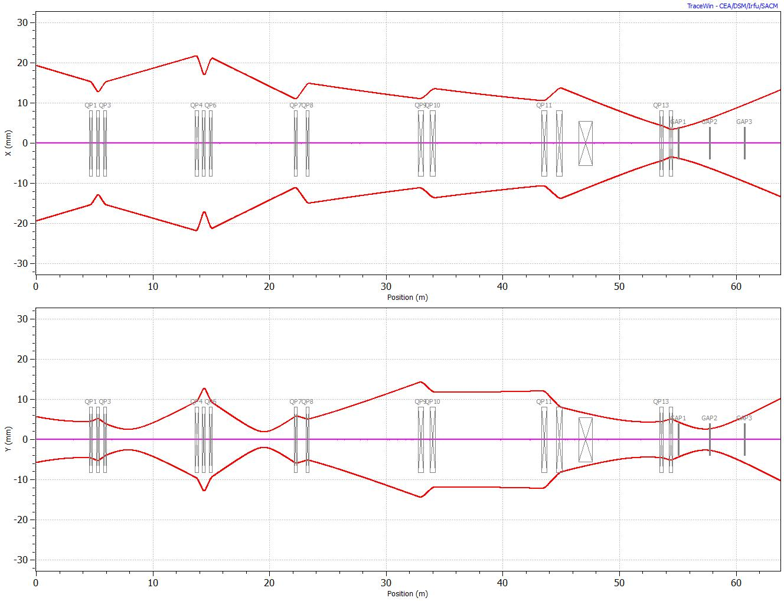
LBS – Compatibility with L3
 | Hor. rms size | Vert. rms size
PM 1 | 4.91 mm | 4.33 mm
PM 2 | 2.62 mm | 2.71 mm
PM 3 | 5.26 mm | 5.87 mm
 | From Distribution | From Emit. recons
α_{x} | 1.87 | 1.88
β_{x} (mm/mrad) | 7.73 | 7.75
ϵ_{x} (mm.mrad) | 0.381 | 0.381
α_{y} | 1.61 | 1.60
β_{y} (mm/mrad) | 6.15 | 6.14
ϵ_{y} (mm.mrad) | 0.381 | 0.381
Quad Settings | Horizontal Plane | Vertical Plane
QFW.30 | -0.659 T/m | -0.659 T/m
QDW.40 | 0.641 T/m | 0.557 T/m
QFW.50 | -0. 634 T/m | -0.670 T/m
QDW.60 | 0. 539 T/m | 0. 698 T/m
Quad1 | -0. 233 T/m | 0.456 T/m
Quad2 | 1.253 T/m | -1.674 T/m

Slide 14
Summary
LBS, spectrometer line, “resolution” 100 to 180 keV/mm.
2 Linac4 type bendings.
2 L4T type quadrupoles.
1 profile monitor.
1 BCT.
LBE, emittance reconstruction with the 3 monitor method.
2 L4T type quadrupoles.
3 profile monitors.
1 BCT.

Slide 15
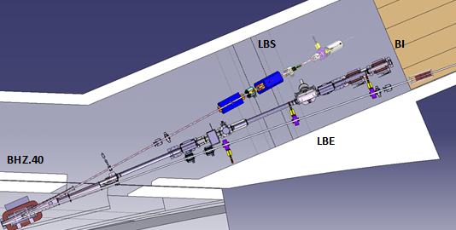
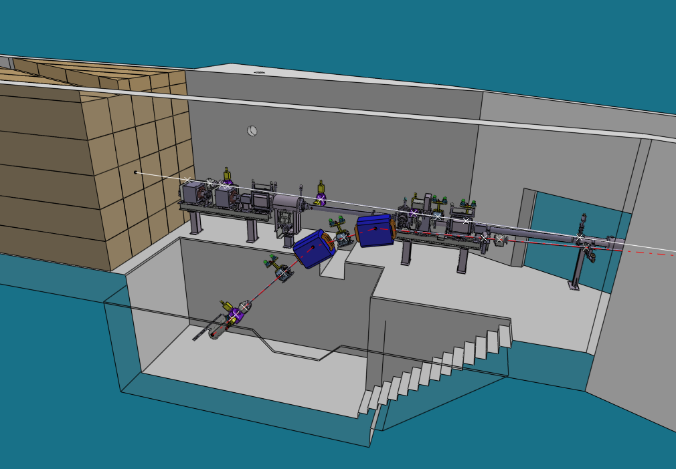
LBS / LBE integration
For beam dynamics, no preference, just 1 constraint :
LBS in vertical plane.
Choice driven by:
Access
Dump and shielding integration
Civil engineering induced…
… see next talks

Slide 16
Thank you
Any comment, questions ?

