Slide 1
Status of RP analysis for LBE/LBS dumps
J. Vollaire DGS-RP, 02/10/2012

Slide 2
Status of analysis
LBS design (in the ceiling) looked by H. Richter in 2011 (prompt dose in accessible areas) and residual dose rates
Concept of dump in the floor (solution 1) obviously presents advantages from a RP standpoint :
Access
Prompt radiation issues
Shielding implementation

Slide 3
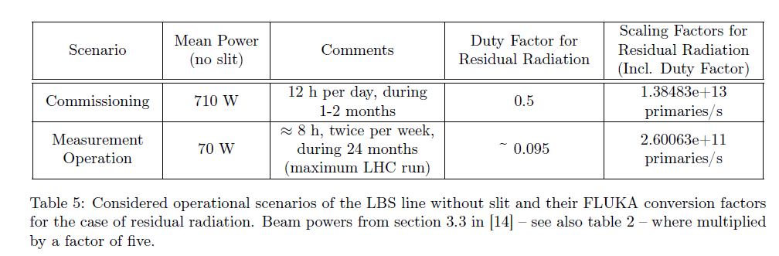
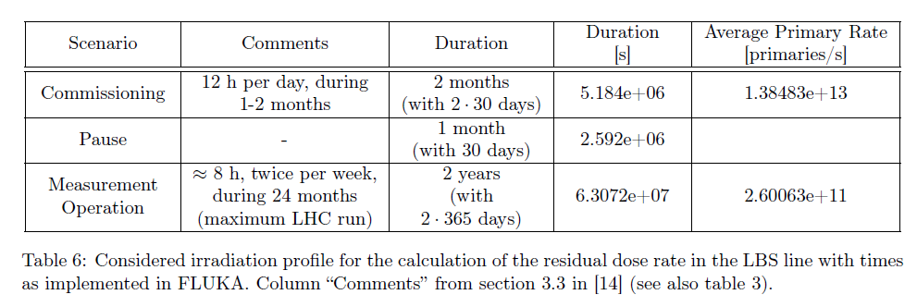
2011 analysis : operational scenario

Slide 4
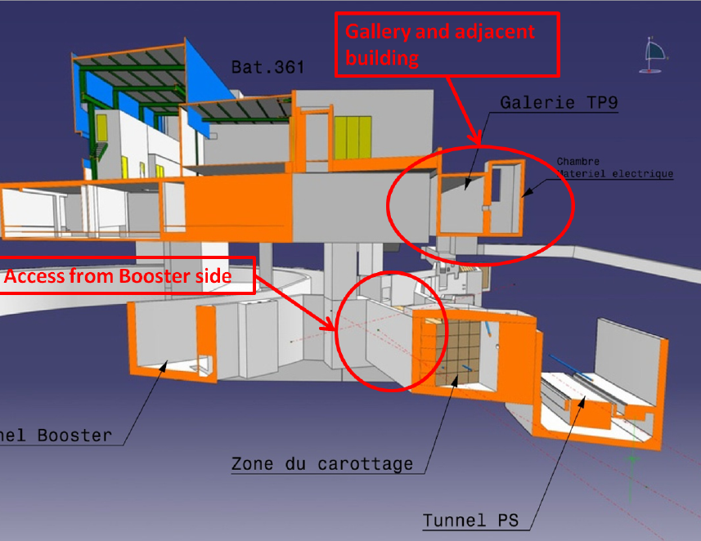
Layout of the area and adjacent facilities

Slide 5
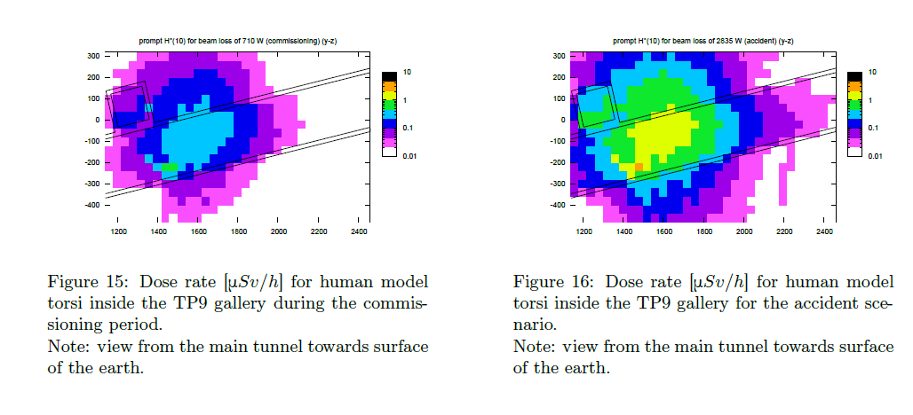
Some results (prompt radiation)

Slide 6
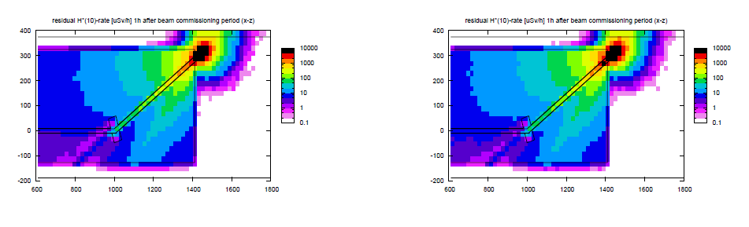
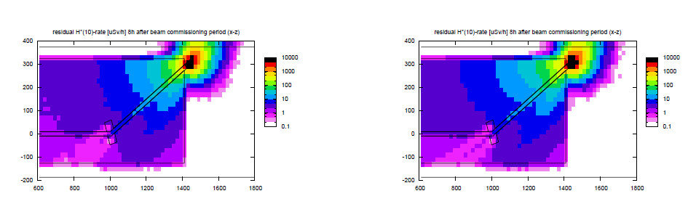
Residual dose rate
Copper Jacket
Steel Jacket

Slide 7
Conclusions
Solution 1 seems the more practical from a RP standpoint
No show-stopper for RP aspects
Commissioning scenario still to be defined (block transfer line to PSB to allow access ?)
LBE shielding to be specified

