Slide 1

DAQ software
E. Pasqualucci
INFN Roma

Slide 2
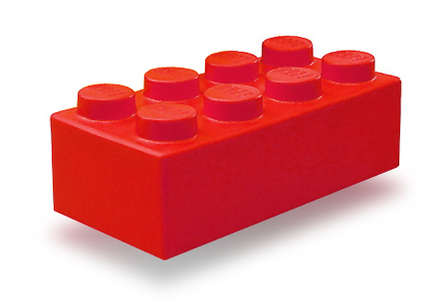
You saw many bricks up to now…
VME
Network
Trigger
Buffers
Threads

Slide 3



… and some cathedrals …

Slide 4

… but if you want to build a cathedral from bricks
you have to start this way …

Slide 5
Overview
Aim of this lecture is
  Give an overview of a medium-size DAQ
    Starting from the general picture given by W. Vandelli
  Analyze its components
    Using the concepts introduced by previous lectures
  Introduce the main concepts of DAQ software
    As “bricks” to build larger system
    … with the help of some pseudo-code …
  Give more technical basis
    For the implementation of larger systems
      See S. Ballestrero’s and C. Schwick’s lectures

Slide 6
Software components
Trigger management
Data read-out
Event framing and buffering
Data transmission
Event building and data storage
System control and monitoring
Data sampling and monitoring

Slide 7

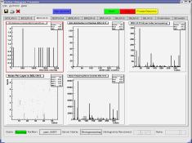



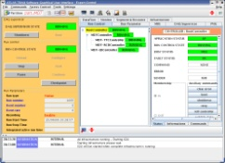
A multi-crate system
Trigger
Detector 1
Trigger
Detector N
C
P
U
Configuration
Trigger
A
D
C
A
D
C
T
D
C
T
D
C
C
P
U
Configuration
Trigger
A
D
C
A
D
C
T
D
C
T
D
C
. . .
Online monitoring
Trigger
Trigger
Readout
Readout
Run Control
Event Flow Manager
E
B
(1)
. . .
E
B
(M)

Slide 8
Data readout (a simple example)
Trigger
Detector
C
P
U
Trigger
A
D
C
A
D
C
T
D
C
T
D
C
Configuration
Trigger
Readout
Data digitized by VME modules (ADC and TDC)
Trigger signal received by a trigger module
  I/O register or interrupt generator
Data read-out by a Single Board Computer (SBC)

Slide 9
Trigger management
How to know that new data are available?
  Interrupt
    An interrupt is sent by an hardware device
    The interrupt is
      Transformed into a software signal
      Catched by a data acquisition program
        Data readout starts
  Polling
    Some register in a module is continuously read out
    Data readout happens when register “signals” new data
In a synchronous system (the simplest one…)
  Trigger must also set a busy
  The reader must reset the busy after read-out completion

Slide 10
Managing interrupts
irq_list.list_of_items[i].vector = 0x77;
irq_list.list_of_items[i].level = 5;
irq_list.list_of_items[i].type = VME_INT_ROAK;
signum = 42;
ret = VME_InterruptLink(&irq_list, &int_handle);
ret = VME_InterruptWait(int_handle, timeout, &ir_info);
ret = VME_InterruptRegisterSignal(int_handle, signum);
ret = VME_InterruptUnlink(int_handle);
From M. Joos’ lecture

Slide 11
Real time programming
Has to meet operational deadlines from events to system response
  Implies taking control of typical OS tasks
    For instance, task scheduling
  Real time OS offer that features
Most important feature is predictability
  Performance is less important than predictability!
It typically applies when requirements are
  Reaction time to an interrupt within a certain time interval
  Complete control of the interplay between applications

Slide 12
Is real-time needed?
Can be essential in some case
  It is critical for accelerator control or plasma control
    Wherever event reaction times are critical
    And possibly complex calculation is needed
Not commonly used for data acquisition now
  Large systems are normally asynchronous
    Either events are buffered or de-randomized in the HW
      Performance are usually improved by DMA readout (see M. Joos)
    Or the main dataflow does not pass through the bus
  In a small system dead time is normally small
Drawbacks
  We loose complete dead time control
    Event reaction time and process scheduling are left to the OS
  Increase of latency due to event buffering
    Affects the buffer size at event building level
  Normally not a problem in modern DAQ systems

Slide 13
Polling modules
Loop reading a register containing the latched trigger
while (end_loop == 0)
{
uint16_t *pointer;
volatile uint16_t trigger;
pointer = (uint16_t *) (base + 0x80);
trigger = *pointer;
if (trigger & 0x200) // look for a bit in the trigger mask
{
... Read event ...
... Remove busy ...
}
else
sched_yield (); // if in a multi-process/thread environment
}

Slide 14
Polling or interrupt?
Which method is convenient?
It depends on the event rate
  Interrupt
    Is expensive in terms of response time
      Typically (O (1 μs))
    Convenient for events at low rate
      Avoid continuous checks
      A board can signal internal errors via interrupts
  Polling
    Convenient for events at high rate
      When the probability of finding an event ready is high
    Does not affect others if scheduler is properly released
    Can be “calibrated” dynamically with event rate
      If the input is de-randomized…

Slide 15
The simplest DAQ
Synchronous readout:
  The trigger is
    Auto-vetoed (a busy is asserted by trigger itself)
    Explicitly re-enabled after data readout
Additional dead time is generated by the output
// VME interrupt is mapped to SYSUSR1
// (See M. Joos presentation)
static int event = FALSE;
const int event_available = SIGUSR1;
// Signal Handler
void sig_handler (int s)
{
if (s == event_available)
event = TRUE;
}
event_loop ()
{
while (end_loop == 0) {
if (event) {
size += read_data (*p);
write (fd, ptr, size);
busy_reset ();
event = FALSE;
}
}
}

Slide 16
Fragment buffering
Why buffering?
  Triggers are uncorrelated
  Create internal de-randomizers
    Minimize dead time
      See Wainer’s and Francesca’s lecture
    Optimize the usage of output channels
      Disk
      Network
    Avoid back-pressure due to peaks in data rate
  Warning!
    Avoid copies as much as possible
      Copying memory chunks is an expensive operation
      Only move pointers!

Slide 17
A simple example…
Ring buffers emulate FIFO
  A buffer is created in memory
    Shared memory can be requested to the operating system
    A “master” creates/destroys the memory and a semaphore
    A “slave” attaches/detaches the memory
  Packets (“events”) are
    Written to the buffer by a writer
    Read-out by a reader
  Works in multi-process and multi-thread environment
    See G. Ünel’s lecture about threading
  Essential point
    Avoid multiple copies!
    If possible, build events directly in buffer memory

Slide 18
Ring buffer
ceiling
tail
ceiling
tail
head
head
head
head
head
head
Writer:
Reserve a chunk of memory:
Build event frame and calculate (max) size
Protect pointers
Move the head
Write the packet header
Set the packet as FILLING
Unprotect pointers
Reader:
Release
Protect pointers
Move tail
Unprotect pointers
Reader:
Work on data
Reader:
Locate next available buffer:
Protect pointers
Get oldest event (if any)
Set event status to EMPTYING
Unprotect pointers
Writer:
Validate the event:
Protect the buffer
Set the packet as READY
(Move the head to correct value)
Unprotect the buffer
Writer:
Build the event fragment in memory:
Prepare event header
Write data to the buffer
Complete the event frame
The two processes/threads can run concurrently
  Header protection is enough to insure event protection
  A library can take care of buffer management
    A simple API is important
  We introduced
    Shared memories provided by OS
    Buffer protection (semaphores or mutexes)
    Buffer and packed headers (managed by the library)
struct header
{
int head;
int tail;
int ceiling;
…
}

Slide 19
Event buffering example
Data collector
Data writer
int cid = CircOpen (NULL, Circ_key, size));
while (end_loop == 0) {
if (event) {
int maxsize = 512;
char *ptr; uint32_t *p; uint32_t *words;
int number = 0, size = 0;
while ((ptr = CircReserve (cid, number,
maxsize)) == (char *) -1)
sched_yield ();
p = (int *) ptr;
*p++ = crate_number; ++size;
*p++; words = p; ++size;
size += read_data (*p);
*words = size;
CircValidate (cid, number, ptr,
size * sizeof (uint32_t));
++number;
busy_reset ();
event = FALSE;
}
sched_yield ();
}
CircClose (cid);
int fd, cid;
fd = open (pathname, O_WRONLY | O_CREAT);
cid = CircOpen (NULL, key, 0));
while (end_loop == 0)
{
char *ptr;
if ((ptr = CircLocate (cid, &number,
&evtsize)) > (char *) 0)
{
write (fd, ptr, evtsize);
CircRelease (cid);
}
sched_yield ();
}
CircClose (cid);
close (fd);
Find next event
Write to the output and release the buffer
Open the buffer in master mode
Prepare the header
Set TRUE by a signal handler upon trigger arrival
Reserve the buffer (maximum event size)
Validate the buffer
Read data and put them directly into the buffer
Reset the busy
Release the scheduler
Release the scheduler
Close the buffer

Slide 20
By the way…
In these examples we were
  Polling for events in a buffer
  Polling for buffer descriptor pointers in a queue
  We could have used
    Signals to communicate that events were available
    Handlers to catch signals and start buffer readout
If a buffer gets full
  Because:
    The output link throughput is too small
    There is a large peak in data rate
  The buffer gets “busy” and generates back-pressure
    Thresholds must be set to accommodate events generated during busy transmission
These concepts are very general…

Slide 21
Event framing
Fragment header/trailer
  You will see that during exercise number 4
Identify fragments and characteristics
  Useful for subsequent DAQ processes
    Event builder and online monitoring tasks
  Fragment origin is easily identified
    Can help in identifying sources of problems
  Can (should) contain a trigger ID for event building
  Can (should) contain a status word
Global event frame
  Give global information on the event
Very important in networking
    Though you do not see that
    See networking lecture

Slide 22
Framing example
typedef struct
{
u_int startOfHeaderMarker;
u_int totalFragmentsize;
u_int headerSize;
u_int formatVersionNumber;
u_int sourceIdentifier;
u_int numberOfStatusElements;
} GenericHeader;
Event
Payload
Header
Status words

Slide 23
What can we do now….
We are now able to
  Build a readout (set of) application(s) with
    An input thread (process)
    An output thread (process)
    A de-randomizing buffer
  Let’s elaborate a bit…

Slide 24
A more general buffer manager
Same basic idea
  Use a pre-allocated memory pool to pass “events”
Paged memory
  Can be used to minimize pointer arithmetic
  Convenient if event sizes are comparable
    At the price of some memory
Buffer descriptors
  Built in an on-purpose pre-allocate memory
  Pointers to descriptors are queued
Allows any number of input and output threads

Slide 25


A paged memory pool
Reserve memory
Create descriptor
Buffer release
Queue buffer pointer
Writer
Reader
Queue (or vector)

Slide 26
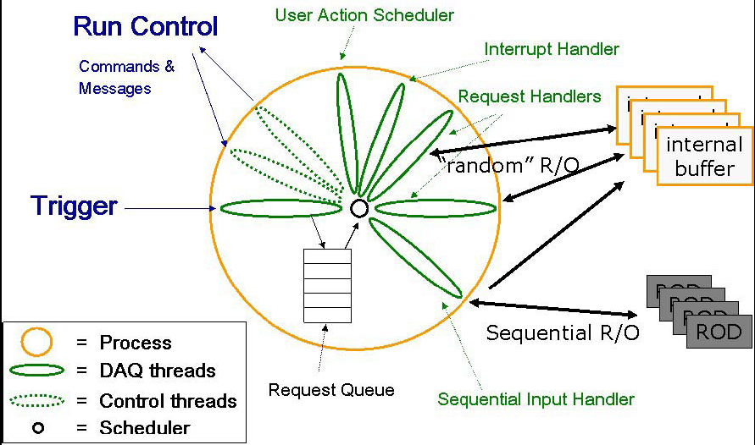
Generic readout application
Module
Input Handler

Slide 27
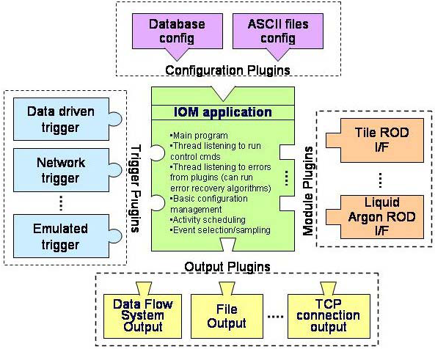
Configurable applications
Ambitious idea
  Support all the systems with a single application
    Through plug-in mechanism
    Requires a configuration mechanism
    You will (not) see an example in exercise 4

Slide 28
Some basic components
We introduced basic elements of IPC…
  Signals and signal catching
  Shared memories
  Semaphores (or mutexes)
  Message queues
…and some standard DAQ concepts
  Trigger management, busy, back-pressure
  Synchronous vs asynchronous systems
  Polling vs interrupts
  Real time programming
  Event framing
  Memory management

Slide 29
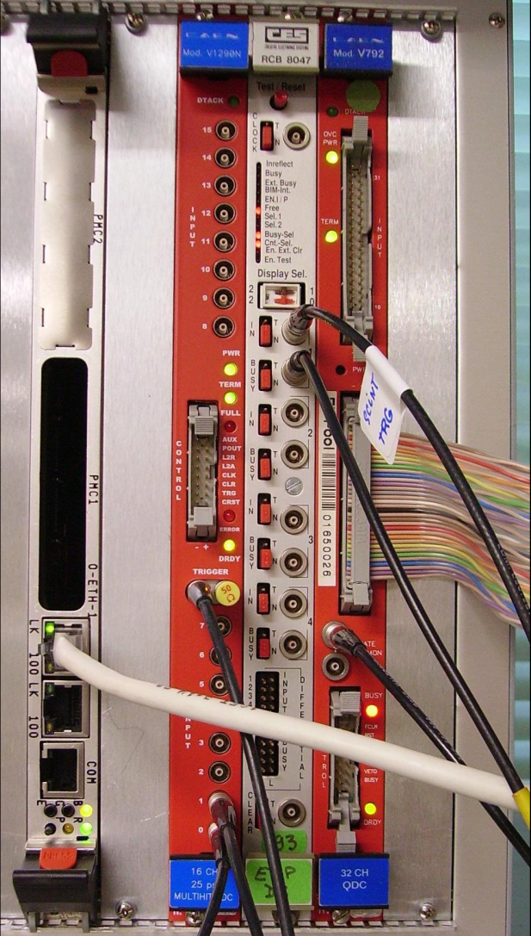
What will you find in the lab?
Theory at work…
Exercise 4
  Simple DAQ with
    VME crate controller
    CORBO module
      Upon trigger reception
        Sets busy
        Sends a VME interrupt
        Latch the trigger in a register
    QDC
    TDC

Slide 30
A multi-crate system again…
Trigger
Detector 1
Trigger
Detector N
C
P
U
Configuration
Trigger
A
D
C
A
D
C
T
D
C
T
D
C
C
P
U
Configuration
Trigger
A
D
C
A
D
C
T
D
C
T
D
C
. . .
Online monitoring
Trigger
Trigger
Readout
Readout
Run Control
Event Flow Manager
E
B
(1)
. . .
E
B
(M)

Slide 31
Event building
Large detectors
  Sub-detectors data are collected independently
    Readout network
    Fast data links
  Events assembled by event builders
    From corresponding fragments
  Custom devices used
    In FEE
    In low-level triggers
  COTS used
    In high-level triggers
    In event builder network
DAQ system
  data flow & control
  distributed & asynchronous
Detector Frontend
Level 1
Trigger
Readout
Systems
Event
Builder Networks
Controls
Manager
Filter
Systems
Computing Services

Slide 32
Data networks and protocols
Data transmission
  Fragments need to be sent to the event builders
    One or more…
  Usually done via switched networks
User-level protocols
  Provide an abstract layer for data transmission
    … so you can ignore the hardware you are using …
    … and the optimizations made in the OS (well, that’s not always true) …
  See the lecture and exercise on networking
Most commonly used
  TCP/IP suite
    UDP (User Datagram Protocol)
      Connection-less
    TCP (Transmission Control Protocol)
      Connection-based protocol
      Implements acknowledgment and re-transmission

Slide 33
TCP client/server example
struct sockaddr_in sinhim;
sinhim.sin_family = AF_INET;
sinhim.sin_addr.s_addr = inet_addr (this_host);
sinhim.sin_port = htons (port);
if (fd = socket (AF_INET, SOCK_STREAM, 0) < 0)
{ ; // Error ! }
if (connect (fd, (struct sockaddr *)&sinhim,
sizeof (sinhim)) < 0)
{ ; // Error ! }
while (running) {
memcpy ((char *) &wait, (char *) &timeout,
sizeof (struct timeval));
if ((nsel = select (nfds, 0, &wfds,
0, &wait)) < 0)
{ ; // Error ! }
else if (nsel) {
if ((BIT_ISSET (destination, wfds))) {
count = write (destination, buf, buflen);
// test count…
// > 0 (has everything been sent ?)
// == 0 (error)
// < 0 we had an interrupt or
// peer closed connection
}
}
}
close (fd);
struct sockaddr_in sinme;
sinme.sin_family = AF_INET;
sinme.sin_addr.s_addr = INADDR_ANY;
sinme.sin_port = htons(ask_var->port);
fd = socket (AF_INET, SOCK_STREAM, 0);
bind (fd0, (struct sockaddr *) &sinme,
sizeof(sinme));
listen (fd0, 5);
while (n < ns) { // we expect ns connections
int val = sizeof(this->sinhim);
if ((fd = accept (fd0,
(struct sockaddr *) &sinhim, &val)) >0) {
FD_SET (fd, &fds);
++ns;
}
}
while (running) {
if ((nsel = select( nfds, (fd_set *) &fds,
0, 0, &wait)) [
count = read (fd, buf_ptr, buflen);
if (count == 0) {
close (fd);
// set FD bit to 0
}
}
}
close (fd0);

Slide 34
Data transmission optimization
When you “send” data they are copied to a system buffer
  Data are sent in fixed-size chunks
At system level
  Each endpoint has a buffer to store data that is transmitted over the network until the application is busy
  TCP stops to send data when available buffer size is 0
    Back-pressure
  With UDP we get data loss
  If buffer space is too small:
    Increase system buffer (in general possible up to 8 MB)
  Too large buffers can lead to performance problems
You will play in lab. 9 with
  Data transmission
  Event builders

Slide 35
Controlling the data flow
Throughput optimization
Avoid dead-time due to back-pressure
  By avoiding fixed sequences of data destinations
  Requires knowledge of the EB input buffer state
EB architectures
  Push
    Events are sent as soon as data are available to the sender
      The sender knows where to send data
      The simplest algorithm for distribution is the round-robin
  Pull
    Events are required by a given destination processes
      Needs an event manager
        Though in principle we could build a pull system without manager

Slide 36

Pull example
Trigger
Sender
Sender
Sender
Event Manager
Builder network

Slide 37
Push example
Trigger
Sender
Sender
Sender
Event Manager
Builder network

Slide 38
System monitoring
Two main aspects
  System operational monitoring
    Sharing variables through the system
  Data monitoring
    Sampling data for monitoring processes
    Sharing histogram through the system
    Histogram browsing
      See also O. Cobanoglŭ’s lecture

Slide 39
Event sampling examples
Spying from buffers
Sampling on input or output
Writer
Spy
Writer
Reader
Reader
To monitoring
process
To monitoring
process
Sampling is always on the “best effort” basis and cannot affect data taking

Slide 40
Histogram and variable distribution
Histo
Service
Sampler
Monitoring process
DAQ process
Info Service

Slide 41
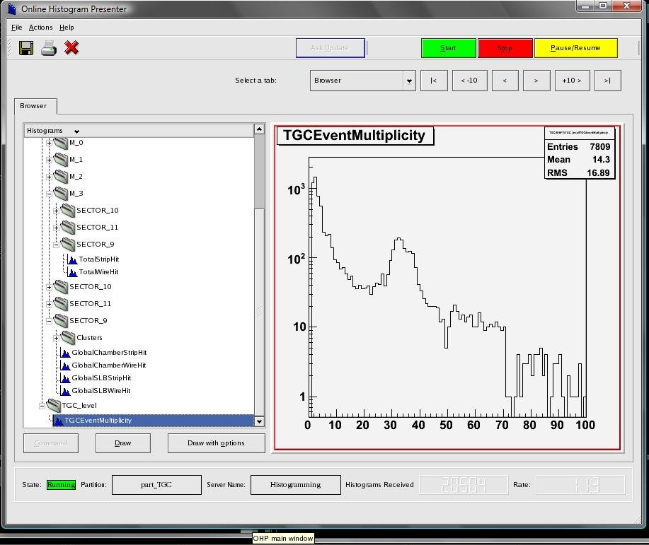
Histogram browser

Slide 42
Controlling the system
Each DAQ component must have
  A set of well defined states
  A set of rules to pass from one state to another
  Finite State Machine
A central process controls the system
  Run control
    Implements the state machine
    Triggers state changes and takes track of components’ states
      Trees of controllers can be used to improve scalability
A GUI interfaces the user to the Run control
  …and various system services…

Slide 43
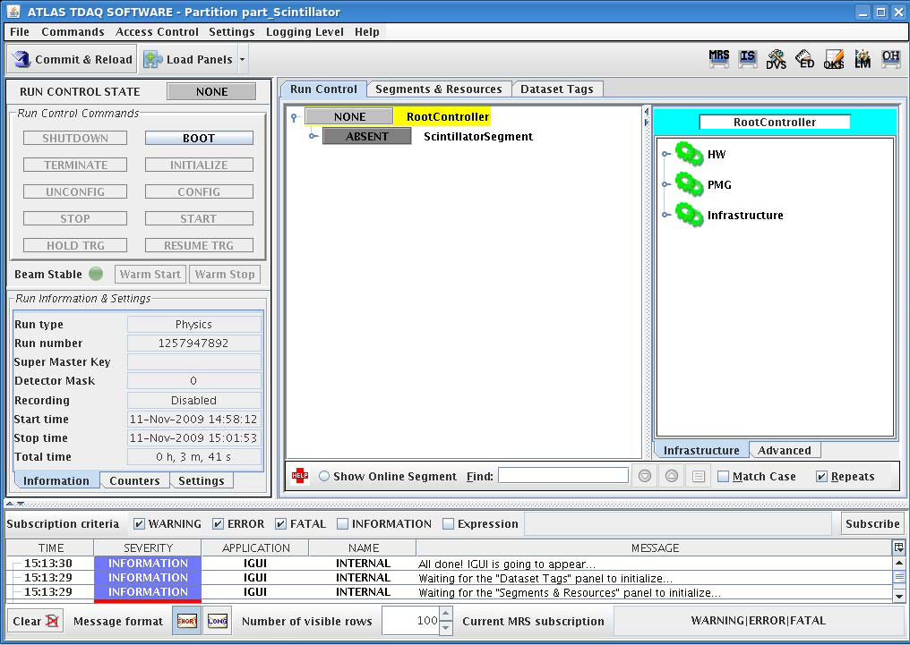
GUI example
From exercise 4…
  … and Atlas!

Slide 44
Finite State Machines
Models of the behaviors of a system or a complex object, with a limited number of defined conditions or modes
Finite state machines consist of 4 main elements:
  States which define behavior and may produce actions
  State transitions which are movements from one state to another
  Rules or conditions which must be met to allow a state transition
  Input events which are either externally or internally generated, which may possibly trigger rules and lead to state transitions
Recover
NONE
ERROR
Boot
Reset
BOOTED
Configure
Unconfigure
CONFIGURED
Start
Stop
RUNNING

Slide 45
Propagating transitions
Each component or sub-system is modeled as a FSM
  The state transition of a component is completed only if all its sub-components completed their own transition
  State transitions are triggered by commands sent through a message system
Subsystem Control
Final Process
NONE
ERROR
BOOTED
NONE
ERROR
BOOTED
Run Control
NONE
ERROR
CONFIGURED
BOOTED
CONFIGURED
BOOTED
BOOTED
BOOTED
CONFIGURED
CONFIGURED
RUNNING
CONFIGURED
CONFIGURED
RUNNING
RUNNING

Slide 46
FSM implementation
State concept maps on object state concept
  OO programming is convenient to implement SM
State transition
  Usually implemented as callbacks
    In response to messages
Remember:
  Each state MUST be well-defined
  Variables defining the state must have the same values
    Independently of the state transition
You will work with a state machine
  In exercise 12

Slide 47
Message system
Networked IPC
I will not describe it
  You see a message system at work in exercise 12
Many possible implementations
  From simple TCP packets…
  … through (rather exotic) SNMP …
    (that’s the way many printers are configured…)
    Very convenient for “economic” implementation
      Used in the KLOE experiment
  … to Object Request Browsers (ORB)
    Used f.i. by ATLAS

Slide 48
A final remark
There is no absolute truth
  Different systems require different optimizations
  Different requirements imply different design
System parameters must drive the SW design
  As for DAQ HW design (see W. Vandelli’s talk)
  Examples:
    An EB may use dynamic buffering
      Though it is expensive
      If bandwidth is limited by network throughput
    React to signals or poll
      Depends on expected event rate
    Event framing is important
      But must no be exaggerated

Slide 49

Thanks for your attention!

