Slide 1
Introduction to Detector Readout and Front End Electronics
ISOTDAQ 2013
Aristotle University of Thessaloniki, Thessaloniki, Greece
Niko Neufeld
CERN

Slide 2
Thanks…
…to all my colleagues at CERN and elsewhere who taught me what I know

Slide 3
Initial questions
When working on the DAQ why should we care about Detector Readout and Frontend Electronics?
It is important to understand our colleagues
The Frontend electronics is the source of the data
When designing an experiment the overall cost and complexity will be a compromise between what you can do in your electronics and what you must do in your data acquisition

Slide 4
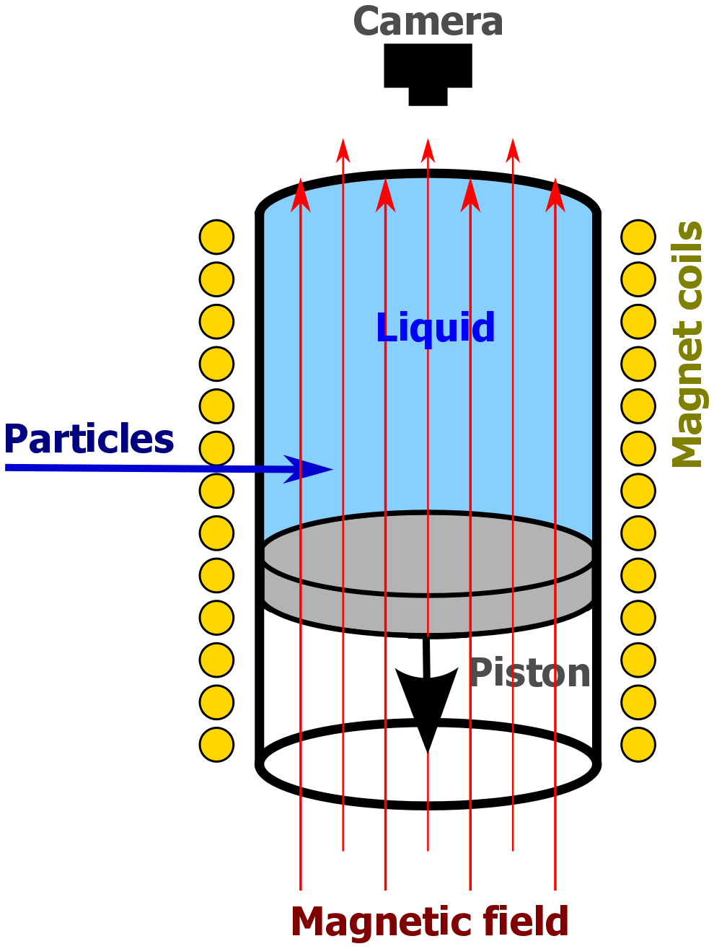
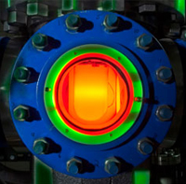
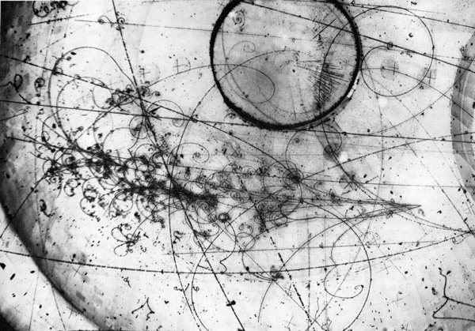
Once upon a time…
from Wikipedia
Notes:
COUPP experiment – searching for WIMPs with a bubble-chamber!

Slide 5
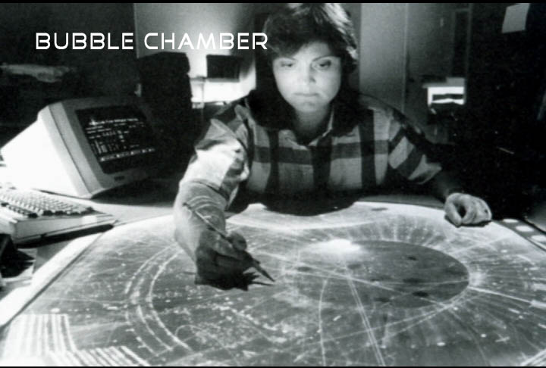
...experiment-data were read

Slide 6
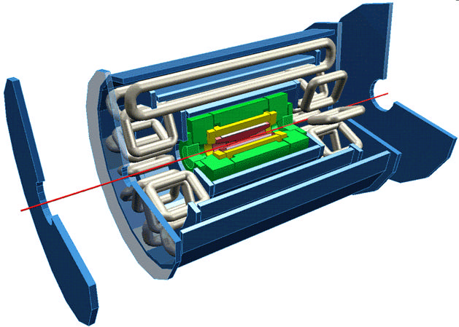
How do we “read” ATLAS data?
Electromagnetic Calorimetry
Muon chambers
Beam pipe
Tracking (in solenoid field)
Hadronic Calorimetry

Slide 7
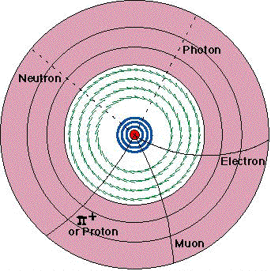
Tracking
Separate tracks by charge and momentum
Position measurement layer by layer
  Inner layers: silicon pixel and strips → presence of hit determines position
  Outer layers: “straw” drift chambers → need time of hit to determine position
Notes:
Si Tracking position to ~10 μm accuracy in rφ (through segmentation) timing to 25 ns accuracy to separate bunch crossings
Straw Tracker position to 170 μm at r > 56 cm

Slide 8
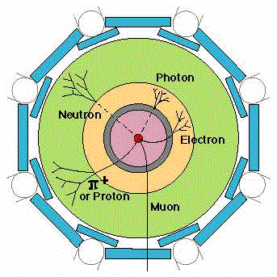
Calorimetry
Particles generate showers in calorimeters
  Electromagnetic Calorimeter (yellow): Absorbs and measures the energies of all electrons, photons
  Hadronic Calorimeter (green): Absorbs and measures the energies of hadrons, including protons and neutrons, pions and kaons
→ amplitude measurement required to find deposited charge
position information provided by segmentation of detector
Notes:
EM calorimeter energy via LAr ionization chambers position through segmentation
Hadron calorimeter energy via plastic scintillator tiles position through segmentation

Slide 9
Muon System
Track
Electrons formed along the track drift towards the central wire.
The first electron to reach the high-field region initiates the avalanche, which is used to derive the timing pulse.
Since the initiation of the avalanche is delayed by the transit time of the charge from the track to the wire, the detection time of the avalanche can be used to determine the radial position^{(*)}
→ need fast timing electronics
Δt
ATLAS Muon drift chambers have a radius of 3 cm and are between 1 and 6 m long
(*) Clearly this needs some start of time t=0 (e.g. the beam-crossing)
Notes:
This is also the principle of the straw tracker. Muon System signal via ionization chambers position through timing measurement

Slide 10
Many different detectors – very similar goals
Although these various detector systems look very different, at the end it comes down to this:
Sensors (“detector-elements”) must determine
  presence of a signal and/or
  magnitude of the signal created and/or
  time of arrival of the signal
Some measurements depend on sensitivity, i.e. detection threshold, e.g.: silicon tracker, to detect presence of a particle in a given electrode
Others seek to determine a signal very accurately, i.e. resolution, e.g. : calorimeter – magnitude of absorbed energy; muon chambers – time measurement yields position

Slide 11
The signal
The signa l S is usually a small current pulse varying in duration (from ~ 100 ps for a Si sensor to O(10) μs for inorganic scintillators)
There are many sources of signals. Magnitude of signal depends on deposited signal (energy / charge) and excitation energy
Signal | Physical effect | Excitation energy
Electrical pulse (direct) | Ionization | 30 eV for gases 1- 10 eV for semiconductors
Scintillation light | Excitation of optical states | 20 – 500 eV
Temperature | Excitation of lattice vibrations | meV

Slide 12
The “front-end” electronics`
Front-end electronics is the electronics directly connected to the detector (sensitive element)
Its purpose is to
  acquire an electrical signal from the detector
  tailor the response of the system to optimize
    the minimum detectable signal
    energy measurement (charge deposit)
    event rate
    time of arrival
    in-sensitivty to sensor pulse shape
  digitize the signal and store it for further treatment
incident radiation
Digitization
Amplifier
digitization
pre-amplifier
Detector
detector
DSP
DSP
DAQ
Buffering
DAQ
Shaping
buffering
shaping
Interface
Triggering
Interface
triggering
Multiplexing
multiplexing
ETC.
etc.

Slide 13
The read-out chain
Detector / Sensor
Amplifier
Filter
Shaper
Range compression
clock
Sampling
Digital filter
Zero suppression
Buffer
Feature extraction
Buffer
Format & Readout
to Data Acquisition System

Slide 14
Acquiring the signal
Detector / Sensor
Need to match to the specific detector
Fight noise, radiation, consume (ideally) no power, be weight-less, zero-configuration etc…
In practice achieved using ASICs made by and for HEP experiments →
Amplifier
Filter
Shaper
Range compression
Low level front-end design
Ozgur COBANOGLU

Slide 15
After the black analogue magic
As usual (☺ )what you do depends on many factors:
Number of channels and channel density
Collision rate and channel occupancies
Triggering: levels, latencies, rates
Available technology and cost
What you can/want to do in custom made electronics and what you do in standard computers (computer farms)
Radiation levels
Power consumption and related cooling
Location of digitization
Given detector technology

Slide 16
The read-out chain: sampling
Detector / Sensor
Amplifier
Filter
Shaper
Range compression
clock
Sampling
Digital filter
Zero suppression
Buffer
Feature extraction
Buffer
Format & Readout
to Data Acquisition System

Slide 17
Single integrator
Simple (only one sample per channel)
Slow rate (and high precision) experiments
Long dead time
Nuclear physics
Not appropriate for HEP
ADC
DAQ
Collect charge from event
Convert with ADC
Send data to DAQ

Slide 18
Double buffered
Use a second integrator while the first is readout and reset
Decreases dead time significantly
Still for low rates
ADC
DAQ

Slide 19
Multiple event buffers
Good for experiments with short spills and large spacing between spills (e.g. fixed target experiment at SPS)
Fill up event buffers during spill (high rate)
Readout between spills (low rate)
ADC can possibly be shared across channels
Buffering can also be done digitally (in RAM)
Shaping
Channel mux.
ADC
DAQ

Slide 20
Digitisation Options (ATLAS / CMS)
ATLAS scheme
Digitisation
Calorimeter signals
Analogue Σ for trigger
Trigger
(Digitizer)
Register
BC clock
(every 25 ns)
Pipeline
(analogue)
Readout
Digitisation
Calorimeter signals
CMS scheme
Readout &
trigger
Readout
(Digitizer)
Register
BC clock
(every 25 ns)
Pipeline
(digital)
Digitisation
(40 MHz)
Trigger
Digital Σ for trigger

Slide 21
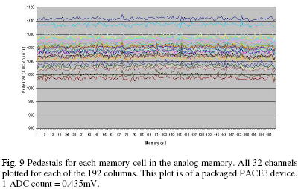
Analog Buffers
Extensively used when ADC not available with sufficient speed and resolution or consuming too much power
Large array of storage capacitors with read and write switches (controlled digitally)
Examples:
  Sampling oscilloscopes
  HEP: CMS tracker, ATLAS calorimeter, LHCb trackers, etc.

Slide 22
Constantly Sampled Readout
Needed for high rate experiments with signal pileup
Shapers and not switched integrators
Allows digital signal processing in its traditional form (constantly sampled data stream)
Output rate may be far to high for what following DAQ system can handle
With local zero-suppression this is suitable for future high rate experiments (LHC, CLIC, FAIR)
Sampling clock
Shaping
ADC
DSP
(zero-sup.)
DAQ

Slide 23
Excursion: zero-suppression
Why spend bandwidth sending data that is zero for the majority of the time?
Perform zero-suppression and only send data with non-zero content
  Identify the data with a channel number and/or a time-stamp
  We do not want to loose information of interest so this must be done with great care taking into account pedestals, baseline variations, common mode, noise, etc.
  Not worth it for occupancies above ~10%
Alternative: data compression
  Huffman encoding and alike (slow, power-intensive)

Slide 24
TANSTAFL
(There Aint No Such Thing As A Free Lunch)
Data rates fluctuate all the time and we have to fit this into links with a given bandwidth
It is difficult to define a priori what to consider a zero channel
Not any more event synchronous
Complicated buffer handling (overflows)
Before an experiment is built and running it is very difficult to give reliable estimates of data rates needed ( background, new physics, etc.)
→ “They” will always want to read it out non-zero suppressed

Slide 25
Synchronous Readout
Data buffering
during trigger
Global clock
All channels are doing the same “thing” at the same time
Synchronous to a global clock (bunch crossing clock)
Data-rate on each link is identical and depends only on trigger -rate
On-detector buffers (de-randomizers) are of same size and there occupancy (“how full they are”) depends only on the trigger-rate
☹ Lots of bandwidth wasted for zero’s
  Price of links determine if one can afford this
☺ No problems if occupancy of detectors or noise higher than expected
  But there are other problems related to this: spill over, saturation of detector, etc.
On-detector
Derandomizer
buffer
Trigger
MUX
Zero-
suppression
Off-detector
Data
formatting
DAQ
Notes:
This is done for several LHC experiment readout systems. For example everywhere in LHCb.

Slide 26
Synchronicity at the LHC
N (channels) ~ O(10⁷); ≈20 interactions every 25 ns
  need huge number of connections
  Need to synchronize detector elements to (better than) 25 ns
In some cases: detector signal/time of flight > 25 ns
  integrate more than one bunch crossing's worth of information
  need to identify bunch crossing...
It's On-Line (cannot go back and recover events)
  need to monitor selection –
  need very good control over all conditions

Slide 27
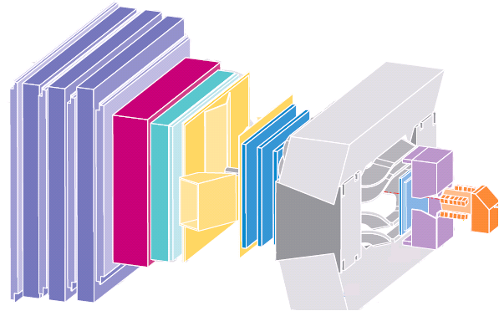
Distributing Synchronous Signals @ the LHC
An event is a snapshot of the values of all detector front-end electronics elements, which have their value caused by the same collision
A common clock signal must be provided to all detector elements
  Since the c is constant, the detectors are large and the electronics is fast, the detector elements must be carefully time-aligned
Common system for all LHC experiments TTC based on radiation-hard opto-electronics
Plus:
Trigger decision
Bunch cross ID

Slide 28
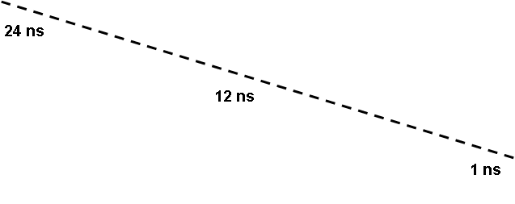
Time Alignment

Slide 29
Trigger
(Sneak Preview)
SPOILER ALERT

Slide 30
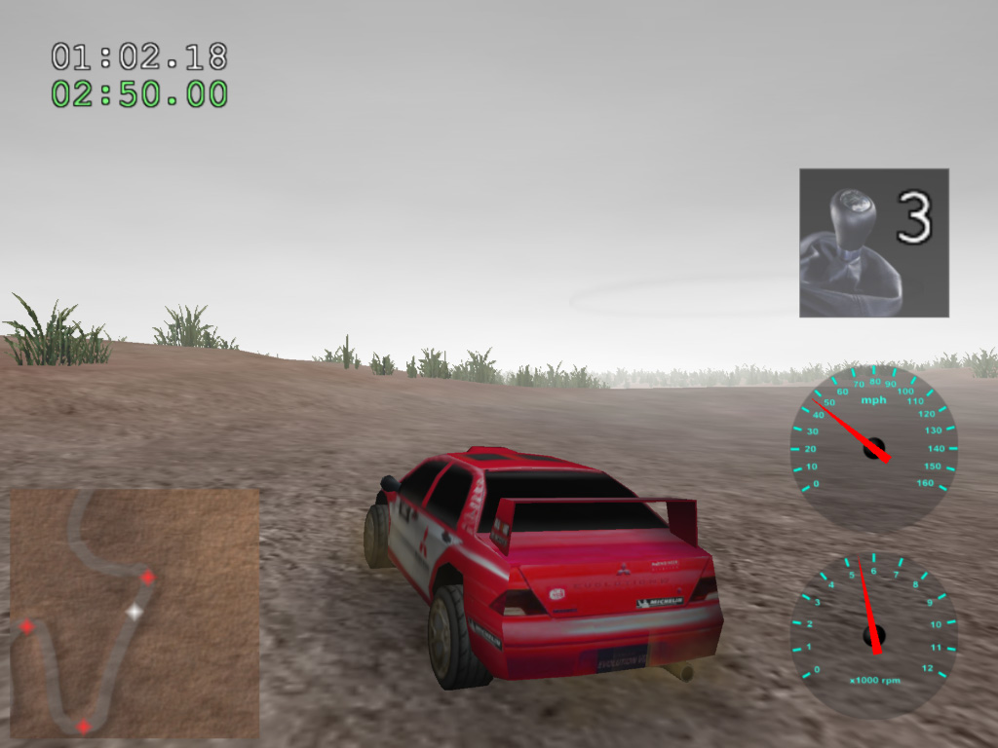
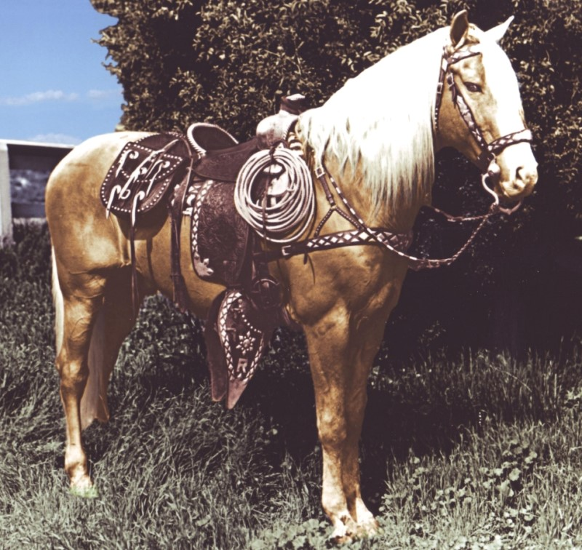
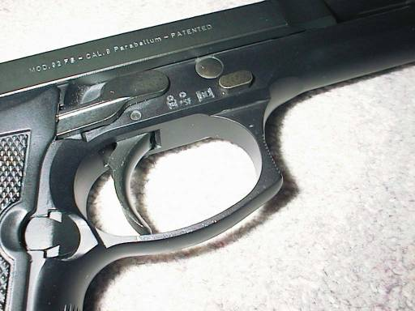
What is a trigger?
An open-source
3D rally game?
An important part
of a Beretta?
The most famous
horse in
movie history?

Slide 31


What is a trigger?
Wikipedia: “A trigger is a system that uses simple criteria to rapidly decide which events in a particle detector to keep when only a small fraction of the total can be recorded. “
Simple
Rapid
Selective
When only a small fraction can be recorded
Notes:
This is not a scientific precise definition, but it catches what most physicists think about, when they hear “trigger”
Simple: because you want to be able to understand what the trigger did to your measurement – a selection of data will influence the result!
Rapid: because the data you want to keep, might be lost if you wait to long to decide
Decide to keep: a trigger is a selection mechanism, depending on what you want and what your apparatus is
When only a small fraction can be recorded: most of the time we are a looking for rare event and consider all events, which create similar signals in our detectors as “background”, the cheap & dumb approach would be to record everything and then try to select in the analysis the good events. Even though sometimes this would be nice, in practice we do not have enough money to do that.

Slide 32
Trivial DAQ
External View
sensor
Physical View
sensor
CPU
ADC Card
disk
Logical View
Proces-
sing
ADC
storage

Slide 33
Trivial DAQ with a real trigger
Sensor
Trigger
Delay
Discriminator
ADC
Start
Proces-
sing
Interrupt
storage
What if a trigger is produced when the ADC or
processing is busy?

Slide 34
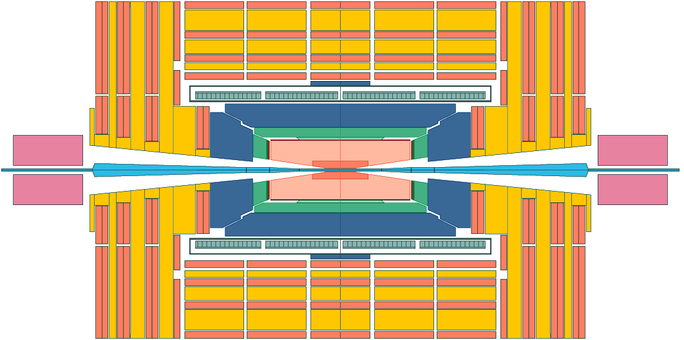
Distributing the Trigger
Assuming now that a magic box tells for each bunch crossing (clock-tick) yes or no
This decision has to be brought for each crossing to all the detector front-end electronics elements so that they can send of their data or discard it
Use the same Timing and Trigger Control (TTC) system as for the clock distribution
Local level-1 trigger
Global Trigger 1
Primitive e, γ, jets, µ
≈ 2-3 µs latency loop
Front-End Digitizer
Trigger
Primitive Generator
Pipeline delay
( ≈ 3 µs)
Accept/Reject LV-1

Slide 35
Trigger rate control
Trigger rate determined by physics parameters used in trigger system:
1 kHz – 1MHz for LHC experiments
  The lower rate after the trigger allows sharing resources across channels (e.g. ADC and readout links)
Triggers will be of random nature i.e. follow a Poisson distribution → a burst of triggers can occur within a short time window so some kind of rate control/spacing is needed
  Minimum spacing between trigger accepts → dead-time
  Maximum number of triggers within a given time window
Derandomizer buffers needed in front-ends to handle this
  Size and readout speed of this determines effective trigger rate

Slide 36
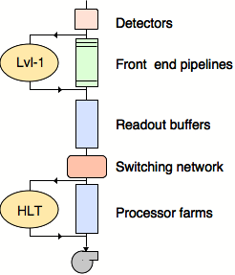
Trigger for LHC
No (affordable) DAQ system could read out O(10⁷) channels at 40 MHz → 400 TBit/s to read out – even assuming binary channels!
What’s worse: most of these millions of events per second are totally uninteresting: one Higgs event every 0.02 seconds
A first level trigger (Level-1, L1) must somehow* select the more interesting events and tell us which ones to deal with any further
Black magic happening here
(*) See any lecture on LHC trigger systems
Notes:
c.f. 2 500 000 000 simultaneous(!) phone conversations (practically everybody on the planet is on the phone - like 31st of December 23:59)

Slide 37
Multilevel triggering
First level triggering.
  Hardwired trigger system to make trigger decision with short latency.
  Constant latency buffers in the front-ends
Second level triggering in DAQ interface
  Processor based (standard CPU’s or dedicated custom/DSP/FPGA processing)
  FIFO buffers with each event getting accept/reject in sequential order
  Circular buffer using event ID to extracted accepted events
    Non accepted events stays and gets overwritten by new events
High level triggering in the DAQ systems made with farms of CPU’s: hundreds – thousands.
(separate lectures on this)
DAQ interface
Front-end
MUX
DAQ
Data
formatting
Zero-
suppression
Trigger L2
Trigger L1

Slide 38
Asynchronous Readout
Remove zeros on the detector itself
  Lower average bandwidth needed for readout links Especially interesting for low occupancy detectors
Each channel “lives a life of its own” with unpredictable buffer occupancies and data are sent whenever ready (asynchronous)
In case of buffer-overflow a truncation policy is needed → BIAS!!
  Detectors themselves do not have 100% detection efficiency either.
  Requires sufficiently large local buffers to assure that data is not lost too often (Channel occupancies can be quite non uniform across a detector with same front-end electronics)
Data
formatting
MUX
DAQ
Data
formatting
Zero-
suppression
Derandomizer buffer

Slide 39
Asynchronous Readout - continued
DAQ must be able to handle this (buffering!)
Async. readout of detectors in LHC: ATLAS and CMS muon drift tube detectors, ATLAS and CMS pixel detectors, ATLAS SCT, several ALICE detectors with a relatively low trigger rate (few kHz).
Data buffering
during trigger
On-detector
Off-detector
Data
formatting
MUX
DAQ
Data
formatting
Zero-
suppression
Trigger

Slide 40
The Read Out Chain
Detector / Sensor
Amplifier
Filter
Shaper
Range compression
clock
Sampling
Digital filter
Zero suppression
Buffer
Feature extraction
Buffer
Format & Readout
to Data Acquisition System

Slide 41
To the DAQ: The Readout Link
Large amount of data to bring out of detector
  Large quantity: ~ 100k links in large experiments (cost!)
  High speed: Gbits/s
Point to point unidirectional
Transmitter side has specific constraints
  Radiation
  Magnetic fields
  Power/cooling
  Minimum size and mass
  Must collect data from one or several front-end chips
Receiver side can be commercially available module/components (use of standard link protocols whenever possible, e.g. 64/66 bit encoding like in Ethernet)

Slide 42
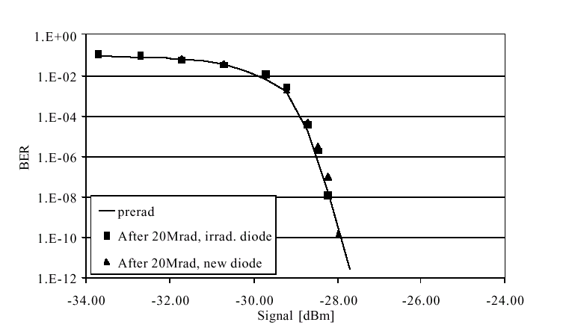
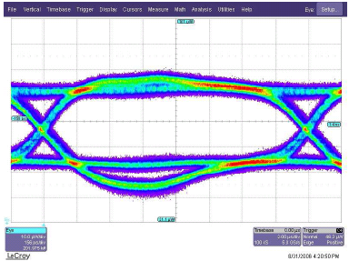
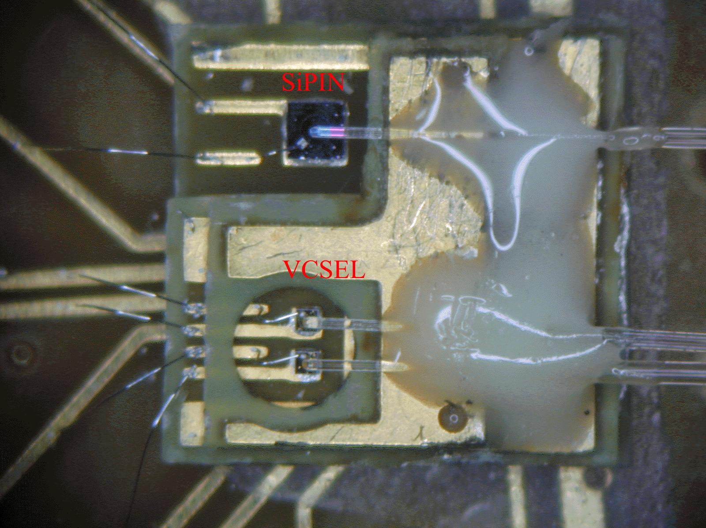
Digital optical links
High speed: 1 Ghz – 10 GHz – 40 GHz
Extensively used in telecommunications (expensive) and in computing (“cheap”)
Encoding
  Inclusion of clock for receiver PLL’s
  DC balanced
  Special synchronization characters
  Error detection and or correction
Reliability and error rates strongly depending on received optical power and timing jitter
Multiple serializers and deserializers directly available in modern high end FPGA’s.
Used everywhere in the LHC experiments, will be sole standard for future upgrades (Versatile Link / GBT)

Slide 43
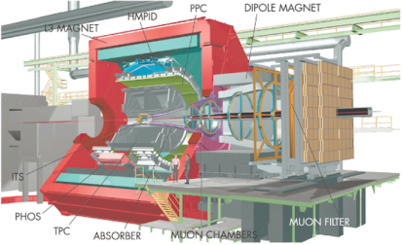
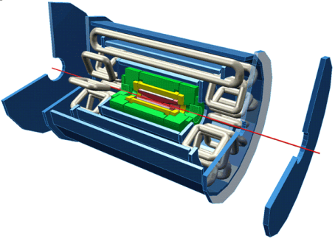
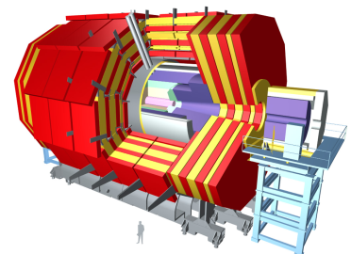
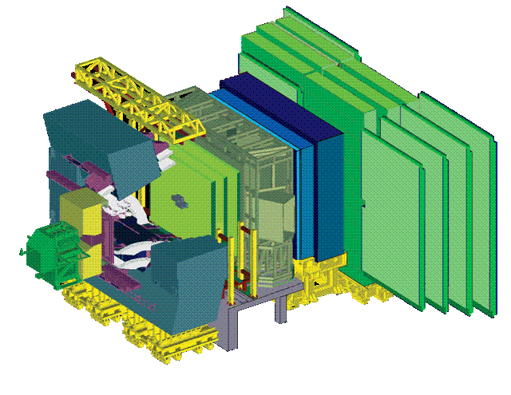
Readout Links of LHC Experiments
 | DDL | Optical 200 MB/s ≈ 400 links Full duplex: Controls FE (commands, Pedestals, Calibration data) Receiver card interfaces to PC | yes
 | SLINK | Optical: 160 MB/s ≈ 1600 Links Receiver card interfaces to PC. | yes
 | SLINK 64 | LVDS: 200 MB/s (max. 15m) ≈ 500 links Peak throughput 400 MB/s to absorb fluctuations Receiver card interfaces to commercial NIC (Myrinet) | yes
 | Glink (GOL) | Optical 200 MB/s ≈ 4000 links Receiver card interfaces to custom-built Ethernet NIC (4 x 1 Gbit/s over copper) | (no)
Flow Control
Notes:
Note that all these links are in the Gigabit / s class – in fact they are faster (about a factor 2). This trend is (unfortunately) broken with the GBT link, which is only 3.2 Gbit/s (net) as compared to the typical network link of the 201x (10 Gigabit/s) (exception ALICE DDL3)

Slide 44
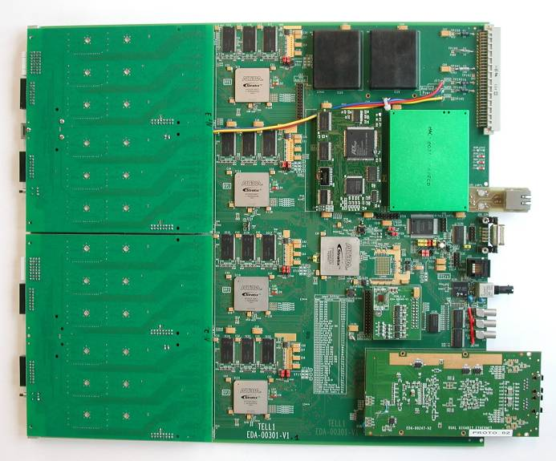
DAQ interfaces / Readout Boards
Front-end data reception
  Receive optical links from multiple front-ends: 24 - 96
  Located outside radiation
Event checking
  Verify that data received is correct
  Verify correct synchronization of front-ends
Extended digital signal processing to extract information of interest and minimize data volume
Event merging/building
  Build consistent data structures from the individual data sources so it can be efficiently sent to DAQ CPU farm and processed efficiently without wasting time reformatting data on CPU.
  Requires significant data buffering

Slide 45
DAQ interfaces / Readout Boards 2
High level of programmability needed
Send data to CPU farm at a rate that can be correctly handled by farm
  1 Gbits/s Ethernet (next is 10Gbits/s)
  In house link with PCI interface: S-link
Requires a lot of fast digital processing and data buffering: FPGA’s, DSP’s, embedded CPU
Use of ASIC’s not justified
Complicated modules that are only half made when the hardware is there: FPGA firmware (from HDL), DSP code, on-board CPU software, etc.
PC provides standardised interface and buffering!
Readout Link
Readout PC
PCI interface card

Slide 46
(Large) Systems

Slide 47
The Challenge
The goal of the LHC is clear: find the Higgs and (at least hints of) new physics →
  Lots of collisions (to find rare events)
  High energy (to find heavy particles)
It turns out that the best way to get the most collisions is to increase N and to decrease f
In 2011 and 2012: f = 20 MHz, N = 1.5 10¹¹ (and can go higher!)
This has a price → high number of interactions per crossing (“pile-up”) → large occupancy in the detectors → big events

Slide 48
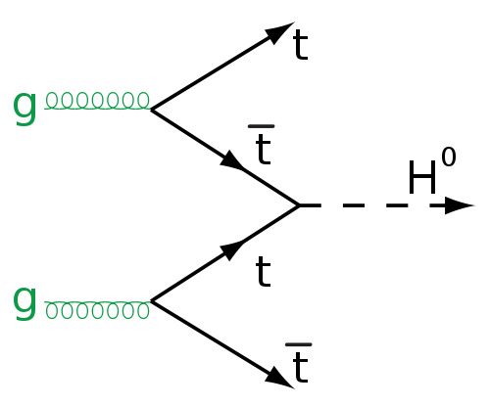
Physics, Detectors, Trigger & DAQ
High rate collider
Fast electronics
signals
decisions
data
Trigger
Data acquisition
rare, need many collisions
decisions
data
Event Filter
Mass
Storage

Slide 49
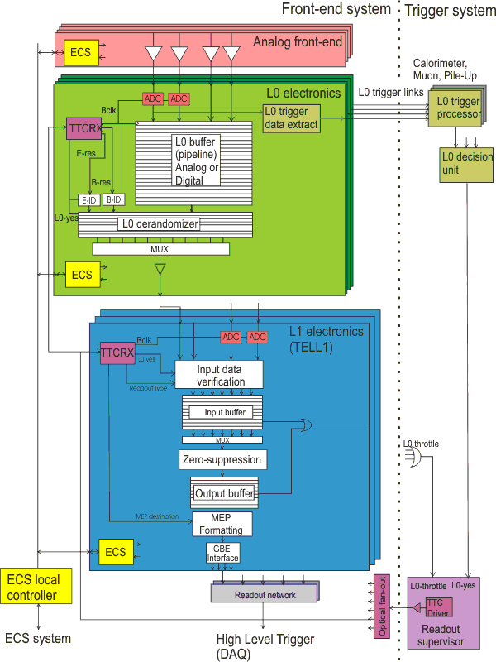
Readout Architecture (LHCb)
Architecture imposed on all sub-systems
Independent implementations from multiple designers and institutes must be checked for strict conformity (hardware!)
Errors and misunderstandings will likely impact physics performance

Slide 50
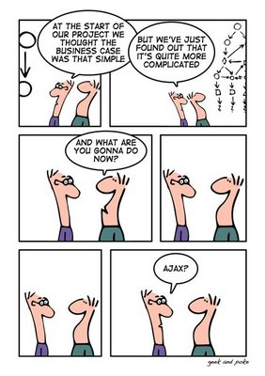
New Problems
Going from single sensors to building detector read-out of the circuits we have seen, brings up a host of new problems:
  Power, Cooling
  Crosstalk
  Radiation (LHC)
Some can be tackled by (yet) more sophisticated technologies

Slide 51
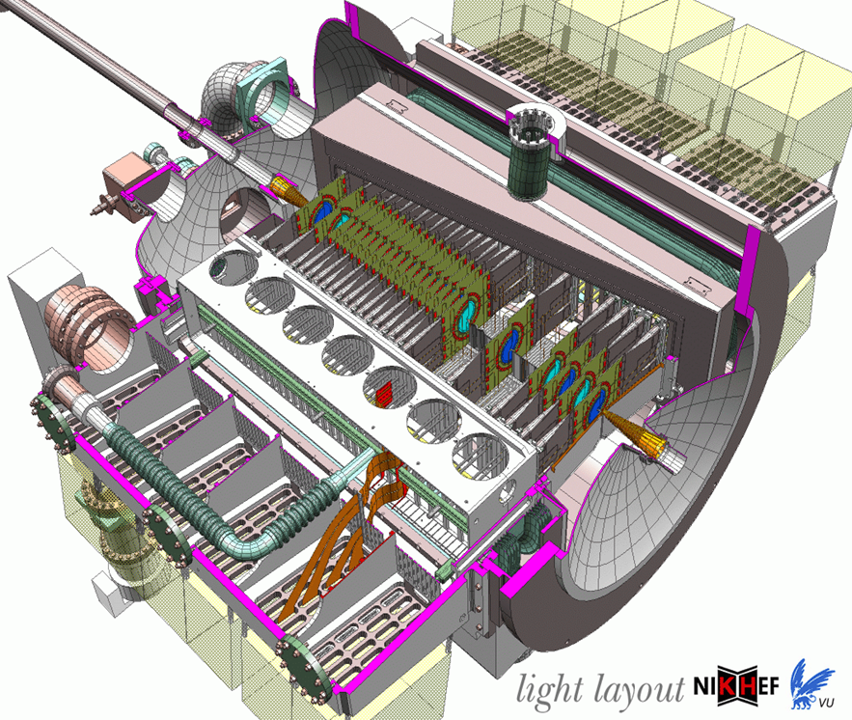
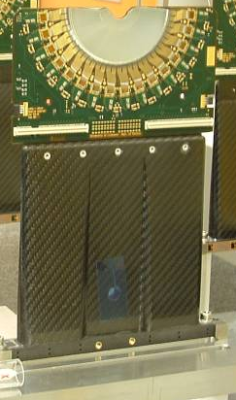
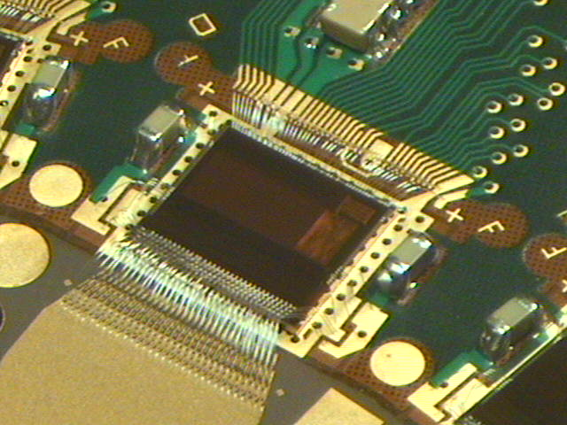
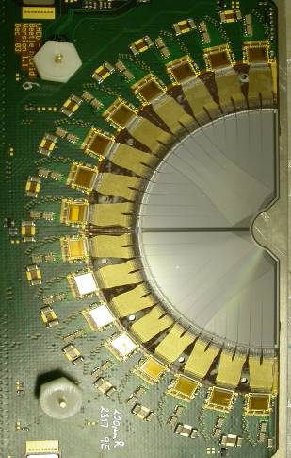
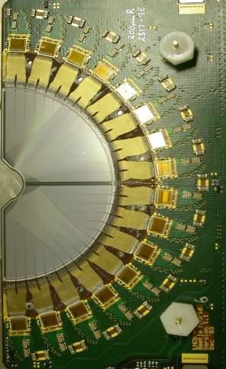
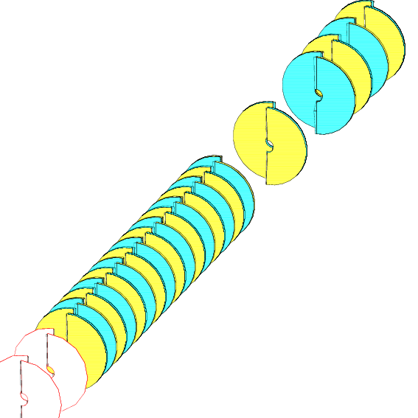
An example: the LHCb Vertex detector
172k channels
Strips in R and φ projection
(~10 um vertex resolution)
Located 1 cm from beam
Analog readout (via twisted pair cables over 60 m)
Interaction
region
Beam
~1m

Slide 52
The Undiscovered Country
…(“the future of detector readout”)

Slide 53
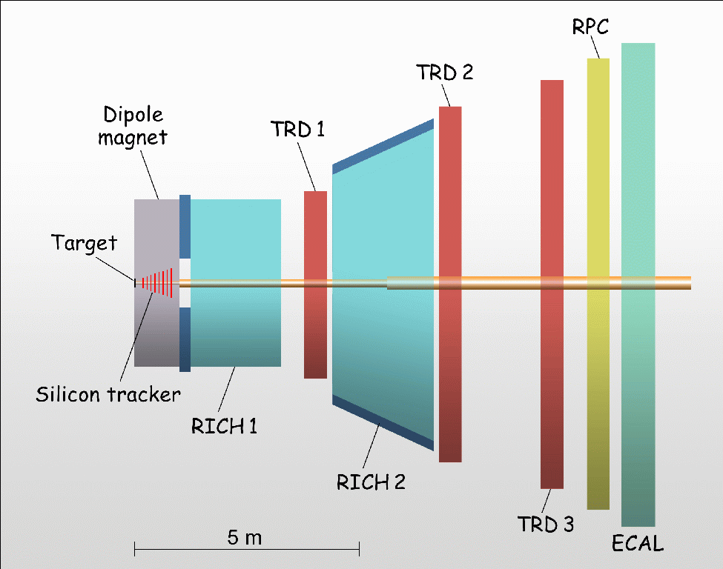
Compressed Baryonic Matter (CBM)
Heavy Ion experiment planned at future FAIR facility at GSI (Darmstadt)
Timescale: ~2018
Detector Elements
Si for Tracking
RICH and TRDs for Particle identification
RPCs for ToF measurement
ECal for Electromagnetic Calorimetry
Average Multiplicities:
160 p
400 π⁻
400 π⁺
44 K⁺
13 K
800 g
1817 total at 10 MHz

Slide 54
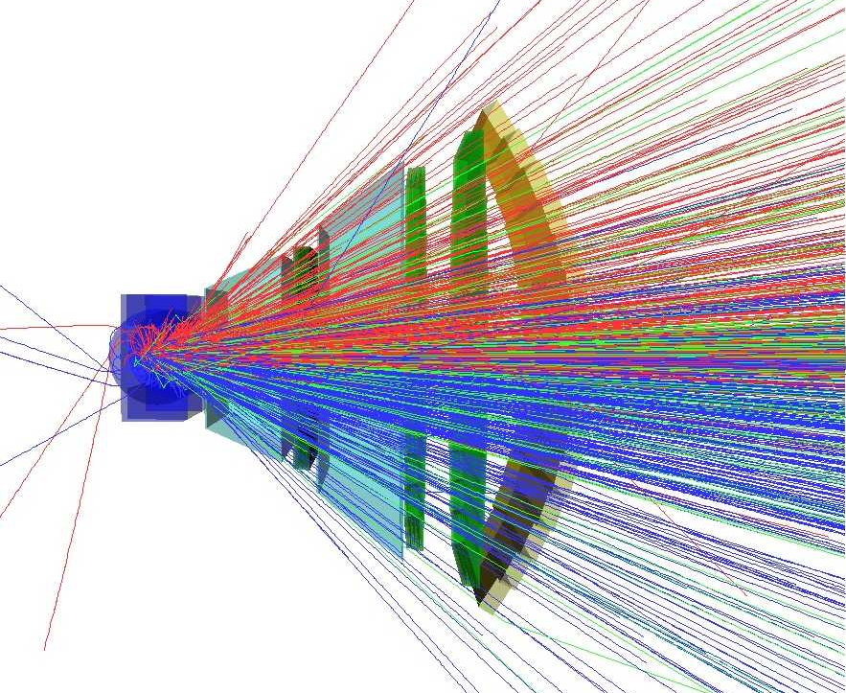
High Multiplicities
Hardware triggering problematic
  Complex Reconstruction
  ‘Continuous’ beam
Trigger-Free Readout
  ‘Continuous’ beam
  Self-Triggered channels with precise time-stamps
Correlation and association later in CPU farm
Quite Messy Events… (cf. Alice)

Slide 55
CBM Characteristics/Challenges
Very low-jitter (10 ps) timing distribution network
Data collection network to link detector elements with front-end electronics
(link speed O(GB/s))
High-performance (~O(TB/s)) event building switching network connecting O(1000) Data Collectors to O(1000) Filter Nodes

Slide 56
CBM DAQ Architecture

Slide 57
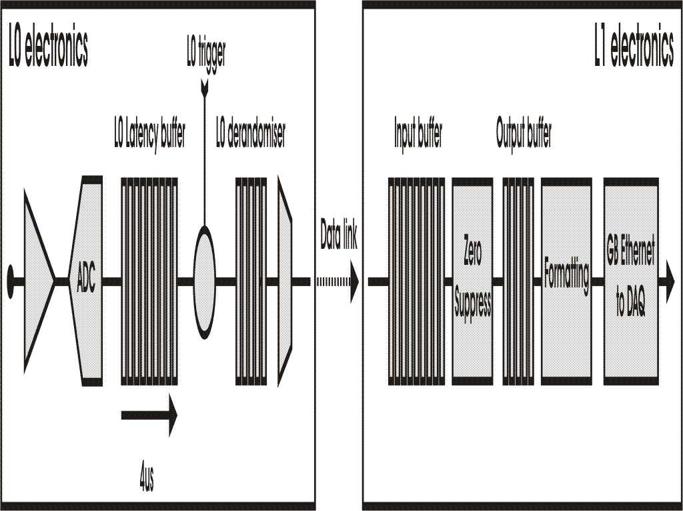
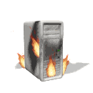
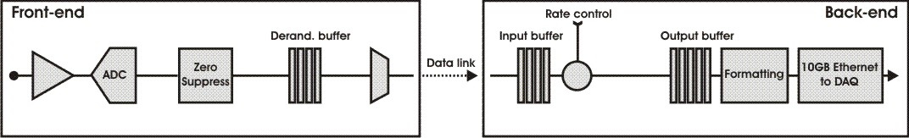
LHCb DAQ Architecture from 2018
Readout
Supervisor
L0 Hardware
Trigger
Current
HLT
1 Gb
Ethernet
1 MHZ
Tell1
Readout
Supervisor
Interaction
Trigger
40 MHZ
10 Gb
Ethernet
HLT++
Upgrade
1…40 MHZ
Tell40
GBT (4.8Gb/s)
data rate 3.2 Gb/s
- All data will be readout @ collision rate 40 MHz by all frontend electronics (FEE) → a trigger-free read-out!
- Zero-suppression will be done in FEEs to reduce the number of the GigaBit Transceiver (GBT) links

Slide 58
In conclusion…

Slide 59
What Do We Need to Read Out a Detector (successfully)?
A selection mechanism (“trigger”)
Electronic readout of the sensors of the detectors (“front-end electronics”)
A system to keep all those things in sync (“clock”)
A system to collect the selected data (“DAQ”)
A Control System to configure, control and monitor the entire DAQ
Time, money, students (lots of them, I mean YOU!)

Slide 60
Further Reading
H. Spieler, “Semiconductor Detector Systems”, Oxford Univ. Press, 2005
A. Sedra, K. Smith, “Microelectronic Circuits”, Oxford Univ. Press, 2009
W. R. Leo, “Techniques for Nuclear and Particle Physics Experiments”, Springer, 1994
O. Cobanoglu “Low-level front-end design”, this school
Wikipedia!
Conferences
  IEEE Realtime
  CHEP
  TWEPP
  IEEE NSS-MIC
Journals
  IEEE Transactions on Nuclear Science, in particular the proceedings of the IEEE Realtime conferences

