Slide 1

Laser based experiments OSQAR
Miroslav Sulc
on behalf of OSQAR collaboration

Slide 2

















26 Members from 11 Institutes (CERN, Cz, Fr & Po)
CERN, Geneva, Switzerland
G. Deferne, P. Pugnat (now at LNCMI-CNRS) spokeperson, M. Schott, A. Siemko
Charles University, Faculty of Mathematics & Physics, Prague, Czech Republic M. Finger Jr., M. Finger, M. Slunecka
Czech Technical University, Faculty of Mechanical Engineering, Prague, Czech Republic J. Hošek, M. Kràl, K. Macuchova, M. Virius, J. Zicha
ISI, ASCR, Brno, Czech Republic
A. Srnka
IMEP/LAHC - INPG, 38016 Grenoble, France L. Duvillaret, G. Vitrant, J.M. Duchamp
IN, CNRS – UJF & INPG, BP 166, 38042 Grenoble, France
B. Barbara, R. Ballou
LASIM , UCB Lyon1 & CNRS, 69622 Villeurbanne, France
M. Durand (now at NIST, Gaithersburg), J. Morville
LSP, UJF & CNRS, 38402 Saint-Martin d'Hères, France R. Jost, S. Kassi, D. Romanini
TUL, Czech Republic
M. Šulc, S. Kunc, R.Puliček, F.Švec
Warsaw University, Physics Department, Poland
A. Hryczuk, K. A. Meissner

Slide 3
Outline
Scientific Motivations
OSQAR experiments
  LHC magnets
  Photon regeneration effect
  Data analysis
  Vacuum Magnetic Birefringence
  Cavities preparation
OSQAR Contributions to International Conferences
Conclusion
Perspectives

Slide 4
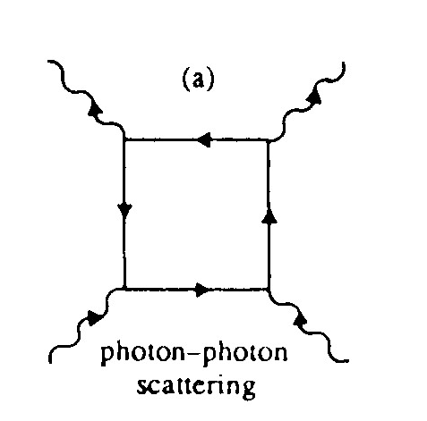
Scientific Motivations in a Nutshell
(P. Pugnat)
To measure for the 1st time the QED Vacuum
Magnetic Birefringence (Heisenberg & Euler,
Weisskopf, 1936) i.e. the vacuum magnetic
“anomaly” of the refraction index
“ n-1” ~ 10⁻²² in 9.5 T
To explore the Physics at the Low Energy Frontier (sub-eV)
  Axion & Axion Like Particles i.e. solution to the strong CP problem (Weinberg, Wilczek, 1978) & Non-SUSY Dark Matter candidates (Abbott & Sikivie; Preskill, Wise & Wilczek, 1983)
  Paraphotons (Georgi, Glashow & Ginsparg, 1983), Milli-charged Fermions
  Chameleons (Khoury & Weltman, 2003)
  The Unknown … “Exploring a new territory with a precision instrument is the key to discovery”, Prof. S.C.C. Ting
A New Way of doing Particle Physics based on Laser beam(s)
New very precise and sensitive optical method needed - big challenge
x
x
Delbrück scattering

Slide 5
  Theoretical Developments at the Warsaw University
Detailed arguments and calculations have been presented by Adam Latosinski, Krzysztof A. Meissner and Hermann Nicolai to support their recent proposal that identifies the axion arising in the solution of the strong CP problem, with the Majoron i.e. the (pseudo-) Goldstone boson of spontaneously broken lepton number symmetry
The axionic couplings are found to be fully computable in terms of known SM parameters and the Majorana mass scales. The determination of these couplings is presented involving certain three-loop diagrams, with a UV finite neutrino triangle taking over the role of the usual triangle anomaly.
A. Latosinski, K. A. Meissner, and H. Nicolai, "Axions without Peccei-Quinn Symmetry", http://arxiv.org/abs/1010.5417
A. Latosinski, K. A. Meissner, and H. Nicolai, “Neutrino Mixing and the Axion-Gluon Vertex”, http://arxiv.org/abs/1203.3886

Slide 6
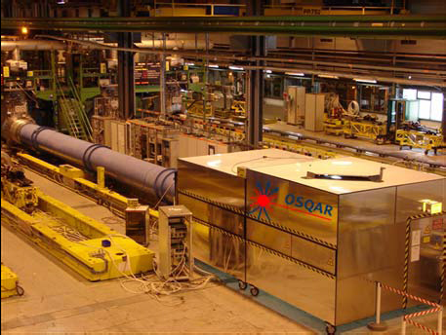
OSQAR
Optical Search for QED vacuum magnetic birefringence, Axions and photon Regeneration
situated at CERN, magnet test hall SM 18
purely laboratory laser-based experiment for search of axions and axion-like particles
it focuses on precision measurements of the magnetic properties of the quantum vacuum

Slide 7
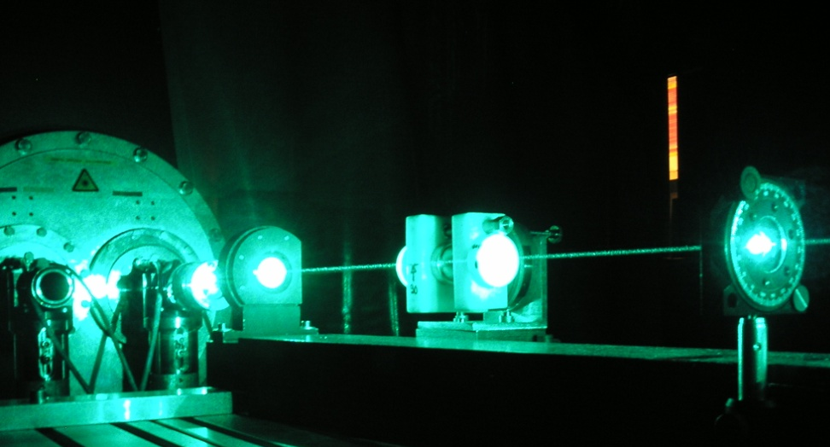
OSQAR experiments
  1.Aperture
  Photon Regeneration Experiment
it combines the simultaneous use of high magnetic field with laser beams in two distinct experiments
two state-of-the-art superconducting decommissioned LHC magnets at CERN with double apertures, 9 T over 2 x 14.3 m
  2. Aperture
  Vacuum Magnetic Birefringence

Slide 8
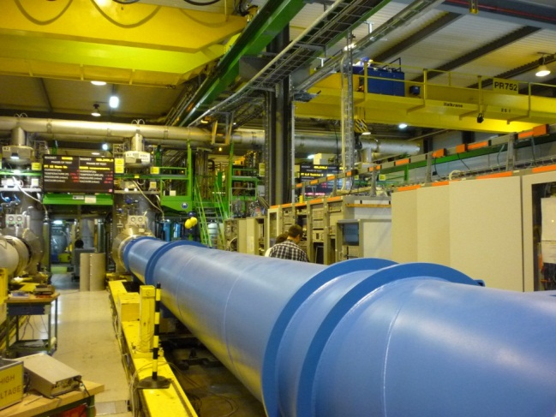
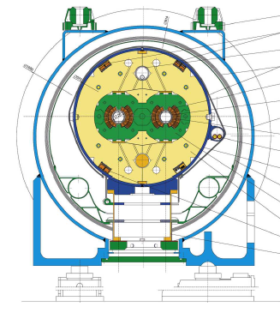
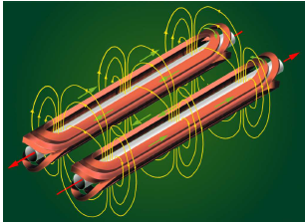
LHC magnets
Standard spare magnets for LHC
Cooling (1.9 K) and vacuum facilities
at CERN SM18 magnet testing hall
Approximately 6-8 weeks per year for OSQAR experiment
Absolute priority of LHC experiment
Magnetic field of LHC
dipole 9.5 T
Effective length 14.3 m
Filed is perpendicular
to the 2 apertures

Slide 9
VMB Measurements : Unique opportunity with LHC dipole(s)
Experiment | BFRT | PVLAS | BMV | OSQAR
Status | Terminated | Achieved | Achieved/ Phase-1/Phase-2
λ (nm) | 514.5 | 1064 | 1064 | 632.8
Finesse of the FP cavity | N ~250 | 10⁵ | 5.10⁴/6.10⁵/10⁶ | 10³/10⁵ expected
Sensitivity (rad/Hz^{1/2}) | 4.10⁻¹⁰ | 10⁻¹¹ | 10⁻⁹/10⁻¹⁰ | 10⁻¹³/10⁻¹⁵
B (T) | 4 | 6 | 14.3 (during 0.1 s) | 9.5
B² l (T² m) for QED Test | 140 | 36 | 28 | 1 290
B² l² (T² m²) for ALPs Search | 1 240 | 36 | 4 | 18 460
B² l³ (T² m³) for ALPs Search | 10 900 | 36 | 0.5 | 263 910
Magnetic duty cycle (R)* | ~1 | ~1 | 10⁻⁴ | ~1
Also Q&A collaboration has reported in 2007 a sensitivity of 4∙10⁻¹¹ rad/√Hz with a cavity of finesse equal to 30 000 and a modulation frequency of 10 Hz

Slide 10
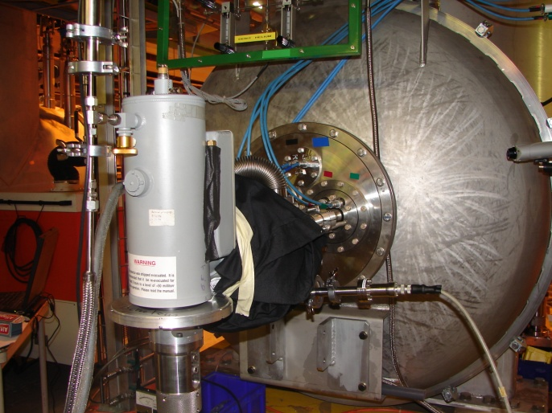
Photon regeneration effect
The photon regeneration effect is looked as a light shining through the wall
a
γ
γ
9.5 T
Opti
cal barrier
x
x
Polarizer
~ 53 m
Ar+ Laser
A
N
cooled
2
CCD
γ
γ
Detector
LN₂ cooled CCD
x
x
Detection:
B
=
9
T
counting
laser beam
S
ource of scalar or
Photon regeneration
pseudo
-
scalar particles
region
Two magnets separated by an optical barrier
Argon laser is a source of 3-7 W beam
The CCD detector, cooled by liquid nitrogen, measures the laser beam profile by photon counting method

Slide 11
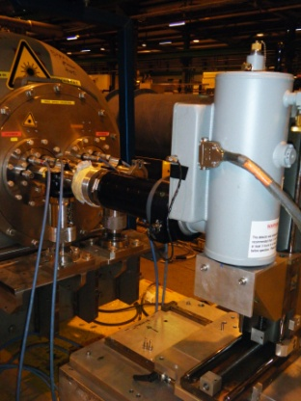
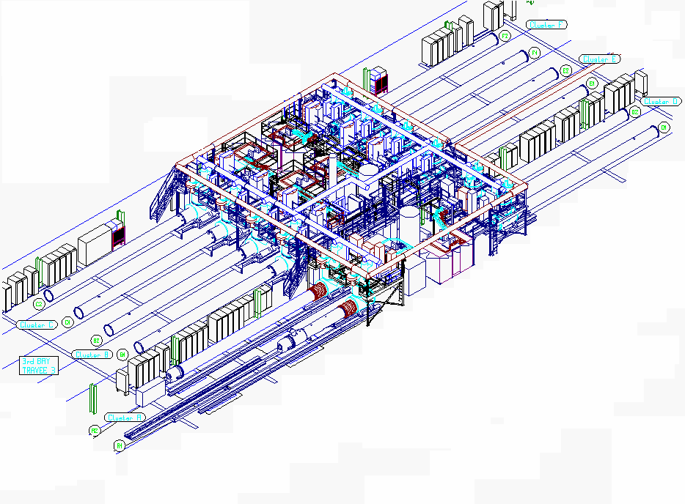
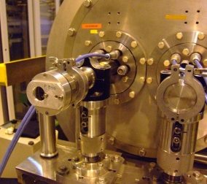
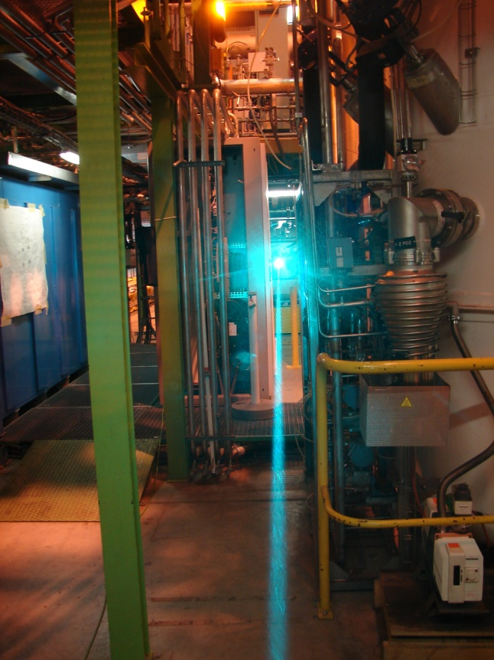
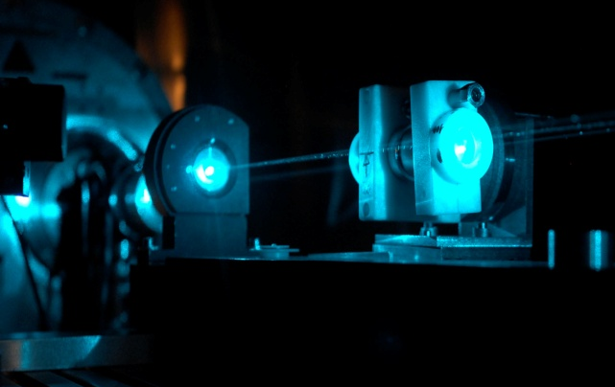
Photon Regeneration Experiment at CERN SM18
Two spare LHC dipoles assigned to OSQAR and installed on the test benches B1 and E2 have been used.
F
53 m
F
E
E
D
E1
D
B1
C
C
B
B
A
A
“An invisible light shining through a wall”
K. van Bibber et al. PRL 59 (1987) 759

Slide 12
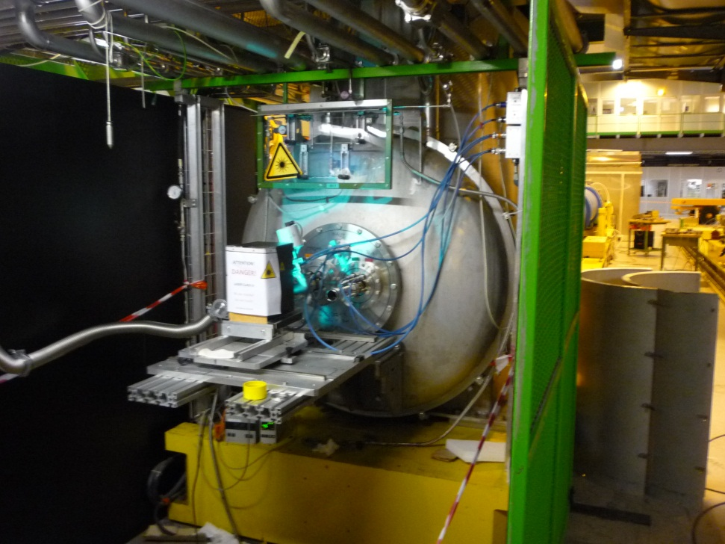
Light shining through the wall
Argon laser is a source of 3 W beam
488-514 nm, reduced optical power of the laser is limitation
A typical experimental run started and ended with the beam alignment using absorptive filters to reduce the laser intensity below the saturation level of the LN2 cooled CCD detector
Wall was inserted
The laser beam had a well defined linear polarization parallel to the magnetic field
This configuration was suitable for the search of pseudoscalar/axion particles.
For scalar particle, a half-wave plate oriented at 45° was inserted at the laser exit to align the polarization perpendicular to the magnetic field.

Slide 13

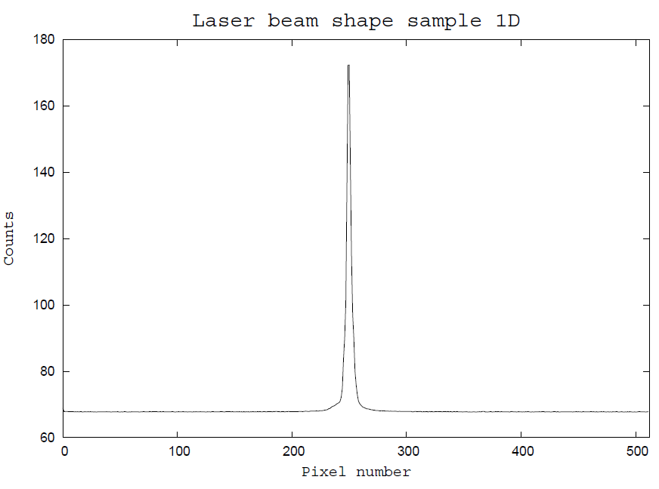
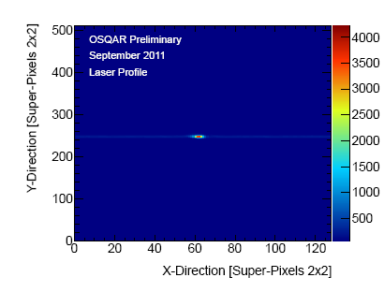
1-D CCD replaced by new 2-D CCD in 2011
LN/CCD-
1024E/1
1-D
- Lowest read noise in the industry
Lowest dark current using cryogenic cooling
QE ~ 30 % at 488-514 nm
CCD chip, EEV 1024 × 256 square
pixels of 26 μm, 26.6 x 6.7 mm
2-D
Spurious signals coming from cosmic rays
Optimisation of the CCD use 1D vs. 2D
Impact to 1 stripe x pixel

Slide 14
Run in 2012
Both spare LHC dipoles used for OSQAR experiments have been affected to the LHC and removed from the SM18 test benches
Two new dipoles have been selected, installed and cold tested
Alignment tests with the laser beam have demonstrated that the beam pipe geometry of both these new dipoles is suitable for the OSQAR photon regeneration experiment, which is planned to restart in 2013.
The laser beam has been successfully aligned within the dipole apertures and has reached the CCD detector located at a distance of 55 m

Slide 15
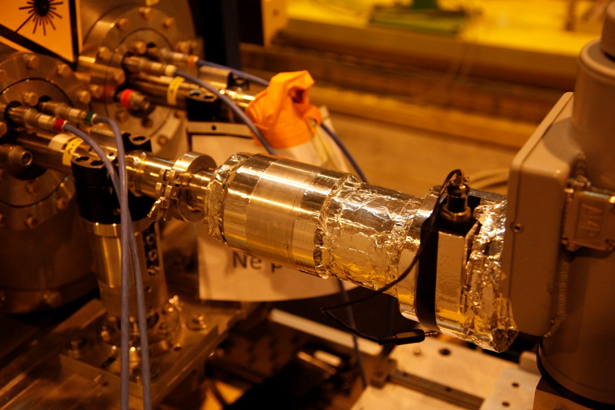
Adjustments to improve the experiment
The adjustable beam expander helps to receive appropriate intensity profile at the outer window of the second magnet. It has helped to focus the beam to very small spot on CCD, roughly to one double binning (2x2) superpixel. FWHM was about one superpixel ≈ 60 µm
light- tightness mechanical connection of CCD camera to anticryostat window
suppress light background to almost zero level

Slide 16
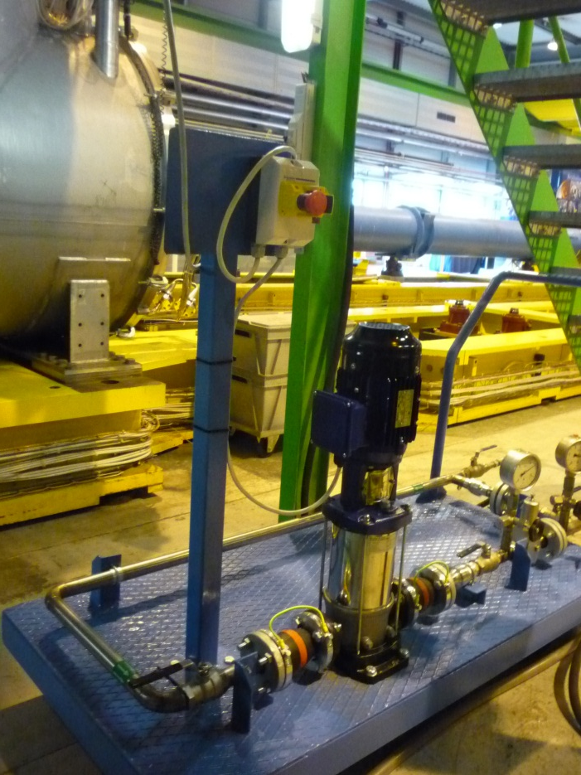
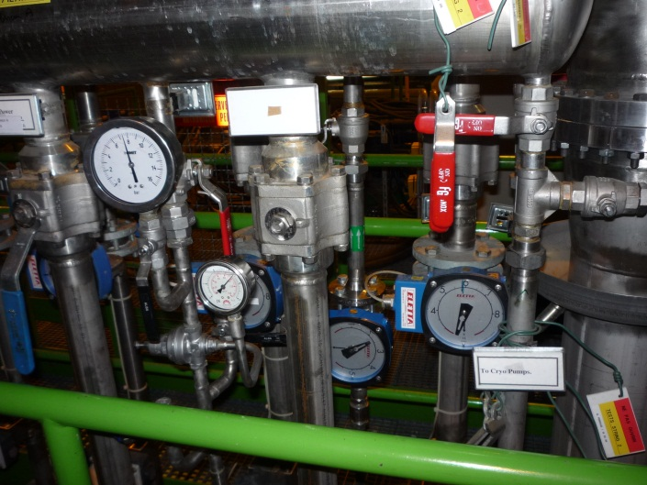
Laser cooling for photon regeneration
The laser cooling system has been successfully improved with the installation and the commissioning of a dedicated pressurize unit for demineralized water in 2012
This new unit allows overcoming the limitation of the total water flow in the SM18 hall

Slide 17
Problem & Solution
Unfortunately output power of Ar laser was falling down to 0.3-1.1 W, so next data taking had no sense due a ten times longer time to receive the same statistics, as at previous run
New laser needed
Two solutions (ongoing)
  Work in close collaboration with ALPS (discussions well advanced)
  Rent a new laser from industry or institute

Slide 18
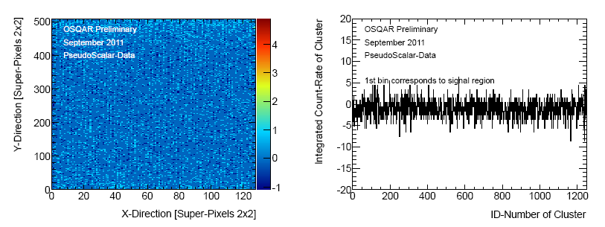
Data analysis from previous run
The effective beam spot on the CCD was decreased by using an optical lens with a focal length of 100 mm
It consists of 120 physical pixels, connected to 30 superpixels (Due to double binning at the readout-step, i.e. summing the recorded entries of four neighbour pixels (2*2) into one superpixel, the spectra have 512*128 values each).
It was measured that the signal shape of regenerated photons is close to the recorded laser spectrum when removing the barrier between the two LHC magnets.
Cosmic noise (high signal in area smaller than 4 superpixel in width) was removed
Preliminary results with 2-D CCD leads to improving of coupling constants exclusion limit 2-3x
with respect to our published one

Slide 19
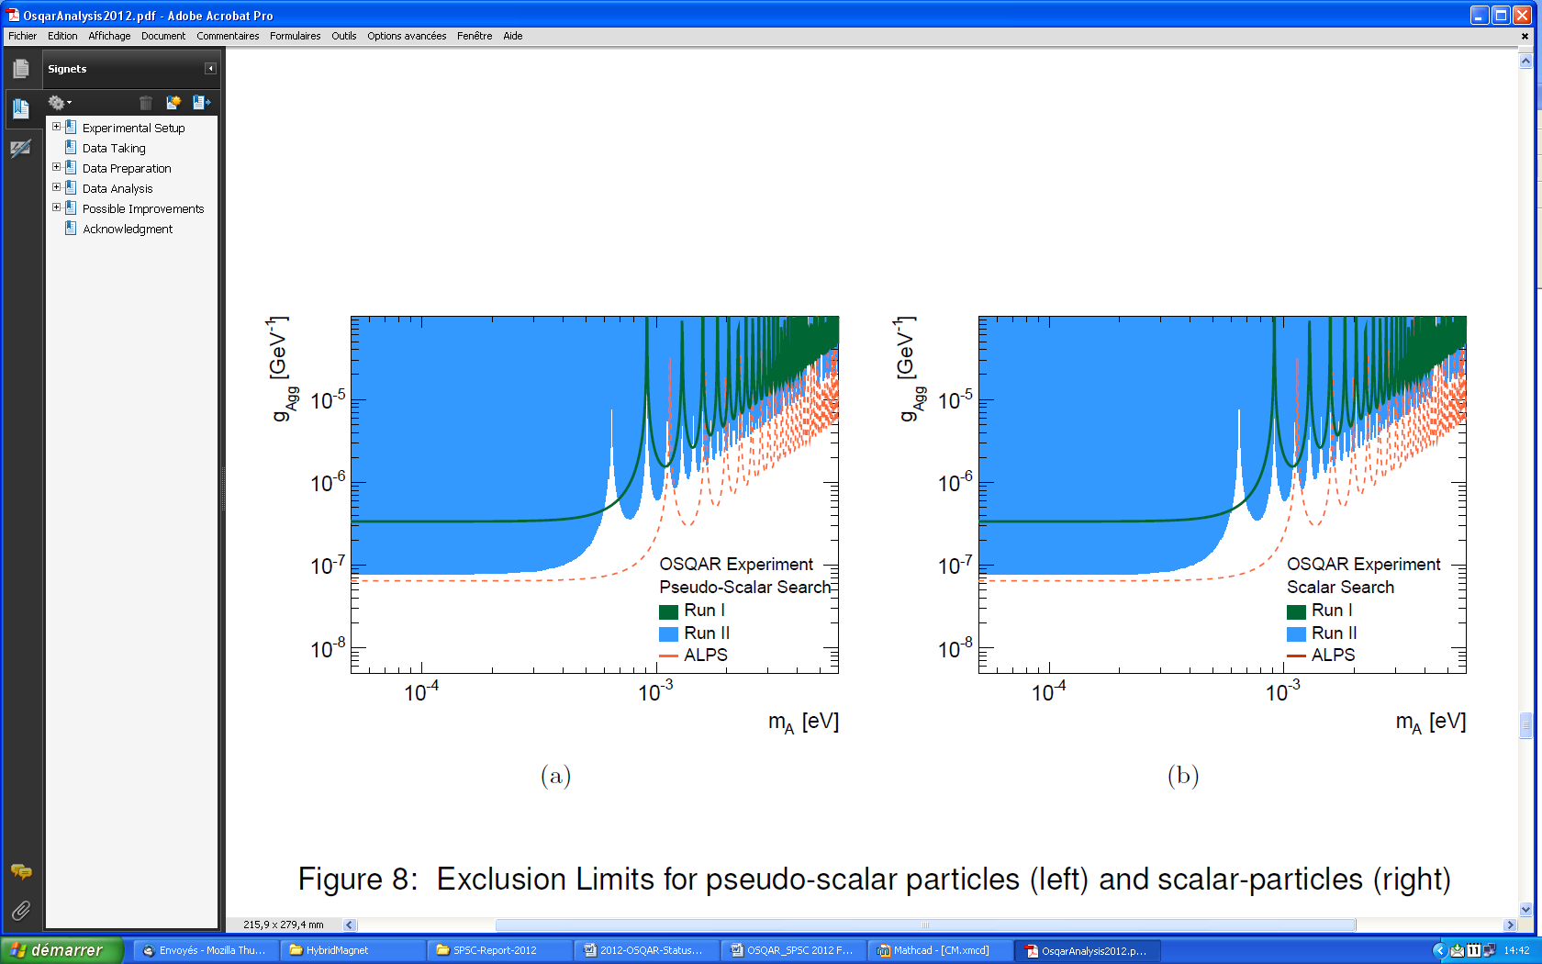
Data analysis from 2011 in French Institutes (CNRS/UJF-Grenoble1) and at CERN
Exclusion limits confirm the present reference results obtained by the ALPS collaboration
The preliminary exclusion limits of coupling constants that can be deduced are 7.8∙10⁻⁸ GeV⁻¹ for pseudo-scalar and scalar particle search in the massless limit
Preliminary
Preliminary exclusion limits for the search of new pseudo-scalar and scalar WISPs.

Slide 20
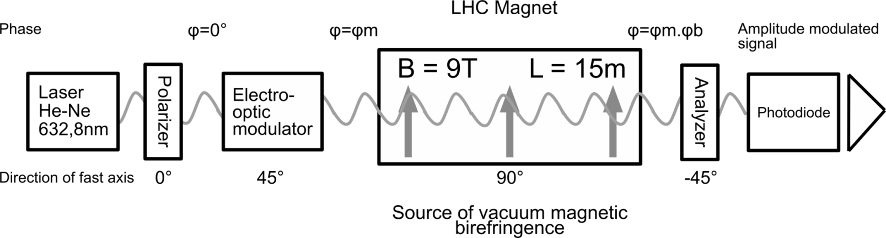
Vacuum Magnetic Birefringence
Preparatory phases in Czech Institutes
This method want to measure the ultrafine Vacuum Magnetic Birefringence
The change of the light velocity in a background magnetic field is given by QED prediction
expected value by QED is Δn ≈ 3.6 10⁻²² in 9.5 T field
axion presence can partially modify this birefringence

Slide 21
Birefringence
Anisotropy of refractive index, the birefringence δ shown by the vacuum (or gas) after the light has propagated along an optical path L is
δ = 2π Δn (L/ λ)sin2θ and Δn = C_{CM}λ₀B²
the initially linearly polarized light beam acquires in magnetic field ellipticity
The predicted VMB effect is very weak so subsequent steps must be done
VMB experiment starts from measurement magnetic-field-induced birefringence at gases, also known as a Cotton-Mouton, in air, in nitrogen, helium and finely in vacuum

Slide 22
VMB modulation detection techniques
Noise limitation coming mostly from the shot noise of the photodetector. Signal must be modulated for Signal/Noise optimization.
The modulation techniques are sensitive with dedicated filtering techniques
Variation of relative directions of electric and magnetic field is needed (or magnetic field pulses….)
Magnetic filed rotation
Field Modulation at 1-1000 mHz (PVLAS …)
Electric filed rotation
Half-wave plate ~300 Hz (OSQAR 2007)
Electro-optical modulator EOM ~ 30 MHz

Slide 23
Half-wave plate vs. EOM
Half-wave plate, turning around with ω, rotates electric field with 2 ω
Electro-optical modulator for phase modulation
E
E
B
B
Standard frequency:
up to
300 Hz 30 MHz

Slide 24
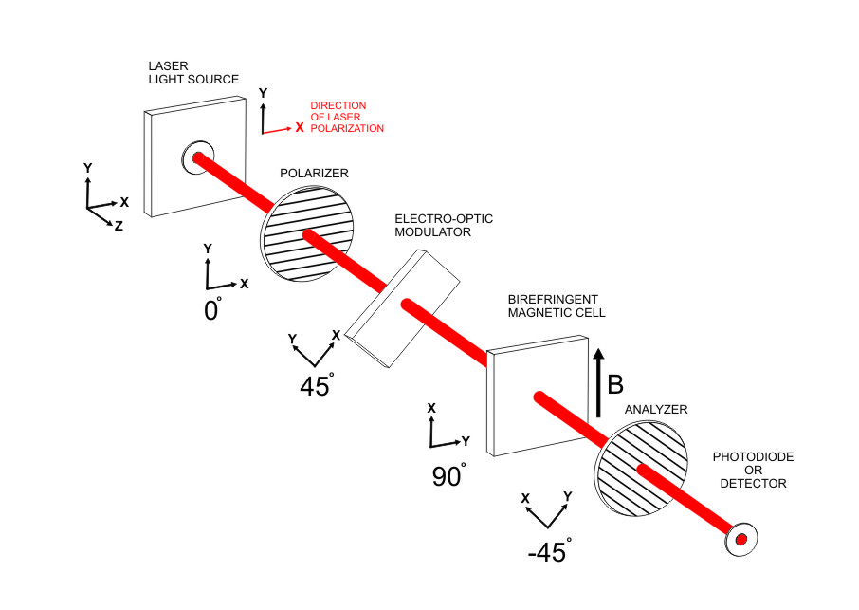
VMB with EOM -experimental set-up
The set of possible configurations of polarized elements was investigated. Calculus with Jones symbolic matrixes was done.
Laser beam increases degree of polarization by passing Glan-Thomson polarizer prism
The beam then goes through the electro-optical modulator
than propagate trough magnetic field where the light acquires an ellipticity from induced anisotropy
The polarization of the beam is finally analyzed by an analyzer.
The best orientation of the each successive component in set up is at 45 degree relative to its previous element

Slide 25
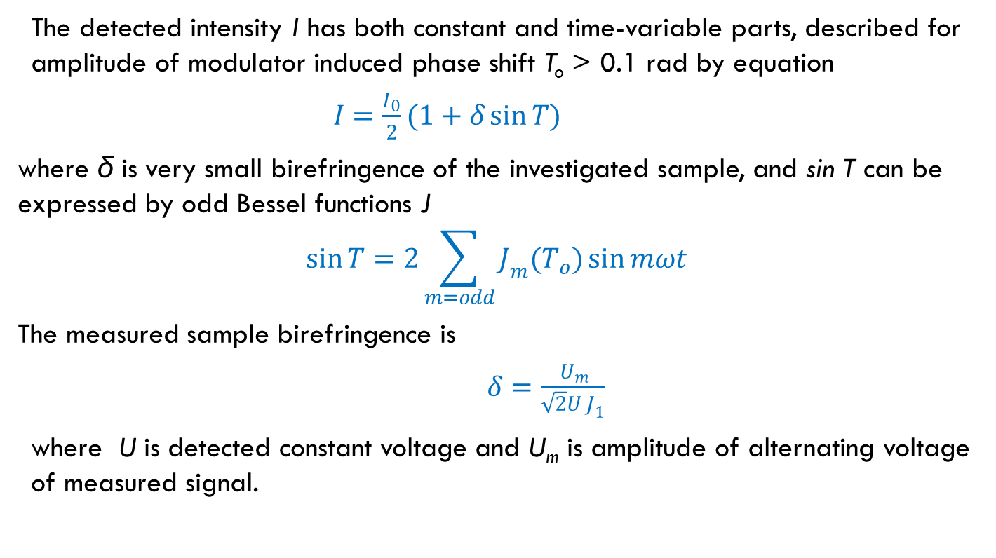
Detection in experiment with EOM
The detected intensity I has both constant and time-variable parts, described for amplitude of modulator induced phase shift T_{o} > 0.1 rad by equation
$I=\frac{I_{0}}{2}(1+δ\sin{T})$
where δ is very small birefringence of the investigated sample, and sin T can be expressed by odd Bessel functions J
$$\sin{T}=2\sum_{m=odd}{J_{m}(T_{o})\sin{mωt}}$$
The measured sample birefringence is
$δ=\frac{{ U}_{m}}{\sqrt{2}U J_{1}}$
where U is detected constant voltage and U_{m} is amplitude of alternating voltage of measured signal.

Slide 26
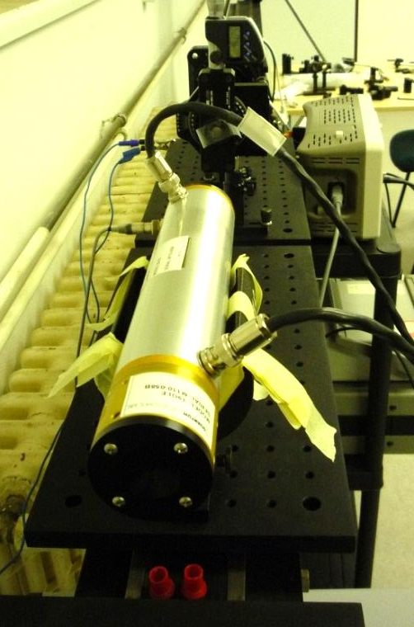
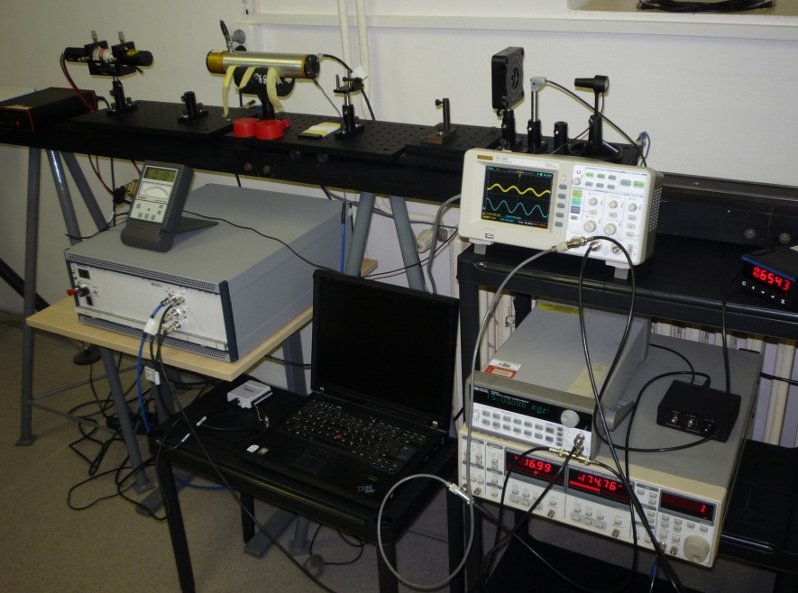
Laboratory test
New laboratory set-up was build in universities laboratories to solve stability problems
New 50 MHz electro-optical modulator from Quantum Technologies

Slide 27
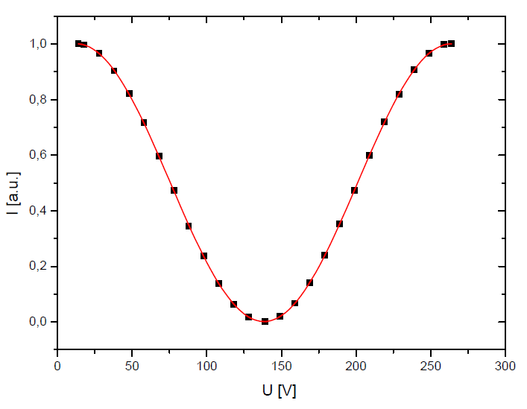
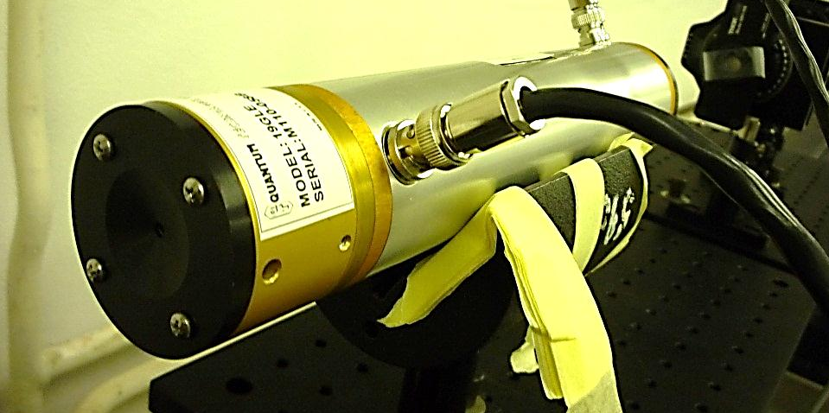
Electro-optical modulator
50 MHz electro-optical modulator from Quantum Technologies
We check working condition, influence of environment
We change our set-up from phase modulation to intensity modulation and intensity modulation was measured
Result
modulator works properly
it has very good stability
Deep modulation 99,5 % , perfect sinusoidal signal (agreement 0.99998), half-wave voltage 125,57 V

Slide 28
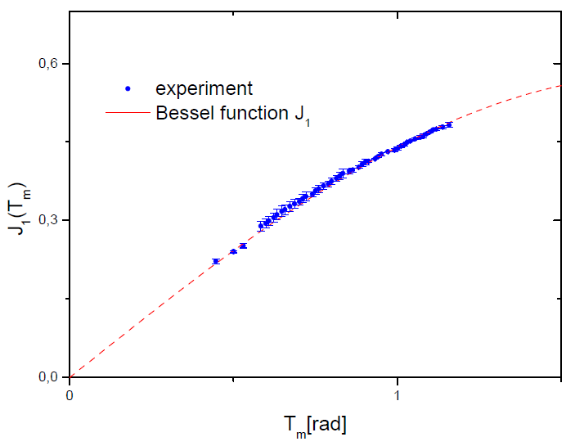
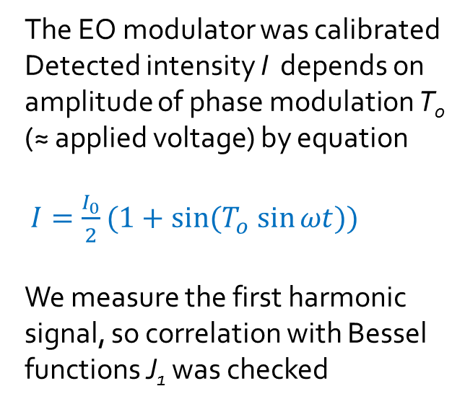
Calibration curve
The EO modulator was calibrated
Detected intensity I depends on amplitude of phase modulation T₀ (≈ applied voltage) by equation
$I=\frac{I_{0}}{2}(1+\sin{{(T}_{o} \sin{ωt})})$
We measure the first harmonic signal, so correlation with Bessel functions J₁ was checked
Good agreement with prediction was achieved
Due a technical limits of our EOM (maximal applied voltage), it is not be able to work at the maximum of Bessel function (highest signal)
We work at phase shift amplitude about 1 rad

Slide 29
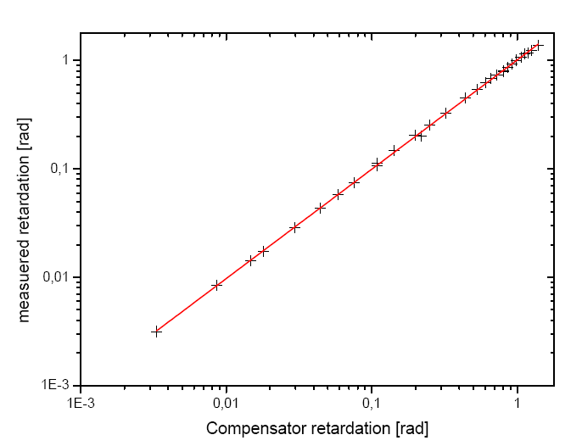
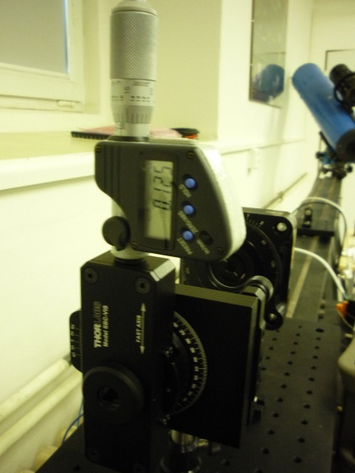
Method was checked by Soleil-Babinet compensator measurement
Perfect agreement between adjusted value at S-B compensator and measured values
Pearson product-moment correlation coefficient 0.99998
expected sensitivity 10⁻⁴ rad, with accuracy ~5%

Slide 30
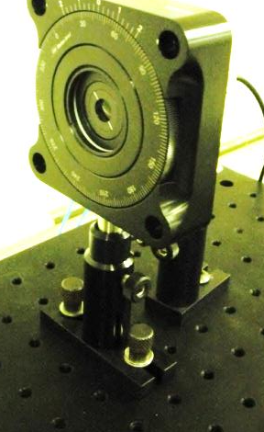
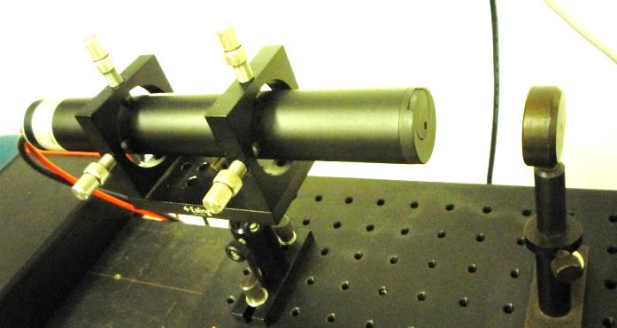
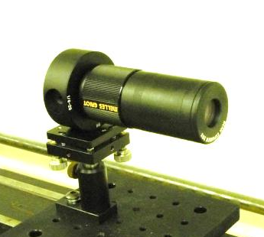
Run in CERN SM18 test hall, August -September 2012
Cotton- Mouton constant at nitrogen was measured
The new components were used
Glan-Thompson prisms (CVI Melles Griot) were used for polarization of light. They provides extinction ratio 1:10000.
The base element of the set-up was stabilized 1mW He-Ne laser (Melles Griot)
HAMATSU photodiode detector with preamplifier with optical fiber input was used for light detection
The new beam expanders were used for precision collimation of laser beam inside the LHC magnet pipe

Slide 31
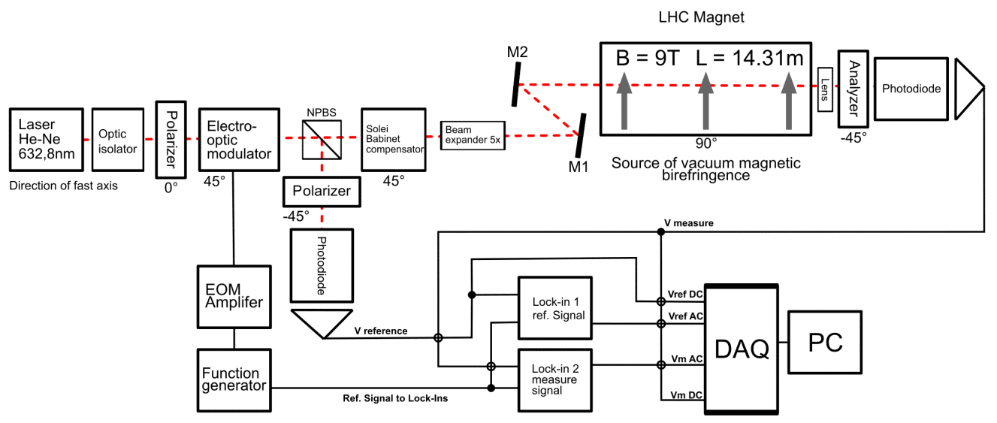
Set-up for the measurement of the Gas Magnetic Birefringence with electro-optic modulator
AC modulation signal is built up by wave function generator
System response was analysed by 100 kHz Lock-in amplifier Stanford Research 830 DSP
New DAQ had took data

Slide 32
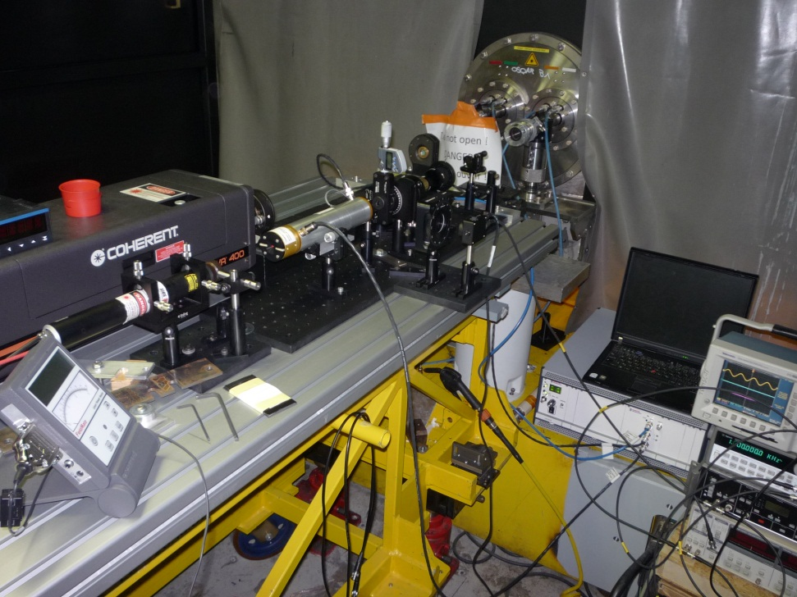
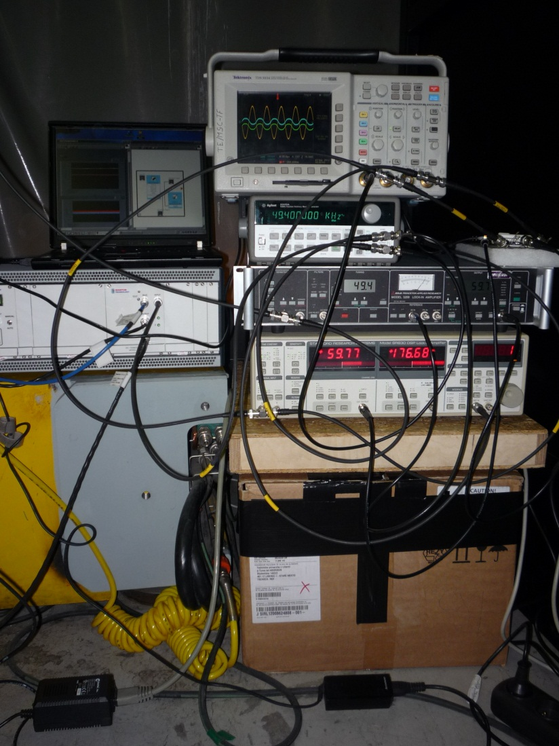
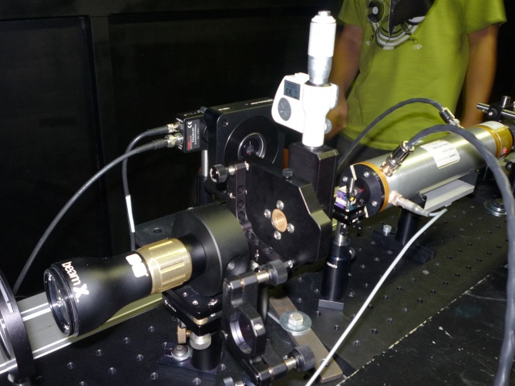
Photos of real experiment September 2012

Slide 33
The Cotton-Mouton effect in N₂
Results of the measured optical retardance δ has been found to increase with the square of magnetic field
The constant of the Cotton-Mouton effect for N₂ at 1 bar is found to be equal to -3.6∙10⁻⁷ rad T⁻²m⁻¹.
The difference in refractive indices is
Δn ≈ (2.28∙±0.16)∙10⁻¹³
for N₂ at atmospheric pressure in 1 T field
This result is in good agreement with published values !!!!

Slide 34
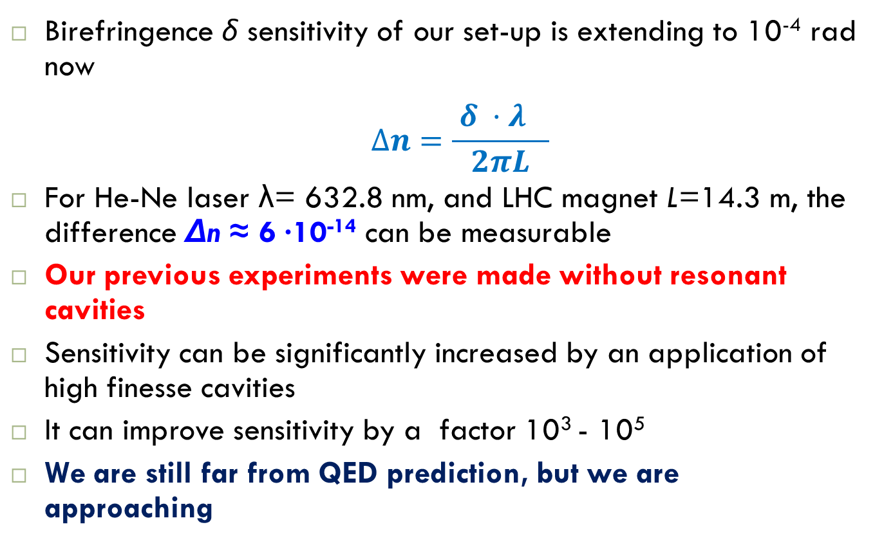
Expected OSQAR VMB sensitivity
Birefringence δ sensitivity of our set-up is extending to 10⁻⁴ rad now
$$∆n=\frac{{ δ ·λ}_{}}{2πL}$$
For He-Ne laser λ= 632.8 nm, and LHC magnet L=14.3 m, the difference Δn ≈ 6 ∙10⁻¹⁴ can be measurable
Our previous experiments were made without resonant cavities
Sensitivity can be significantly increased by an application of high finesse cavities
It can improve sensitivity by a factor 10³ - 10⁵
We are still far from QED prediction, but we are approaching

Slide 35
Cavities
Increasing path of the laser beam in the magnetic field
→ using a cavity
Magnetic length of LHC magnets of 14.3 m
Inner tubes are curved – effective aperture is about 23 mm
Aim and challenge
  preparation of 2 Fabry-Perot cavities, 19.6 m long, for the photon regeneration run (with Ar+, Nd:YAG laser??)
  completion of full length 19.6 m cavity for VMB, implementation to LHC magnet, for stabilized He-Ne laser, 632.8 nm
  We have new experiences with optical elements mounting, beam alignment and stability from previous runs

Slide 36
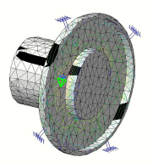
Development of high finesse optical cavity
The preparation of one meter long prototype of the Fabry-Perot cavity started at Czech Technical University , Prague
The light will be locked inside the cavity by using the Pound-Drever-Hall lock-in technique
The work was concerning about the design of mirror geometry, parameters of optical reflective layers, calculation of beam matching for optical coupling of the laser beam to the cavity
The development of a rotating FP cavity to suppress parasitic birefringence of the mirrors

Slide 37
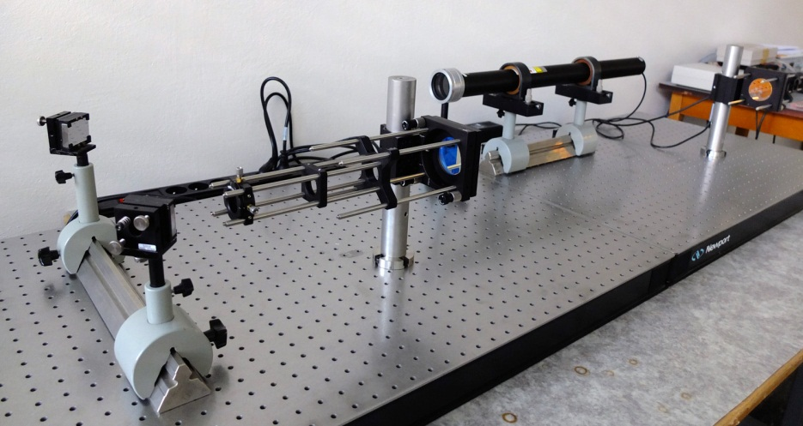
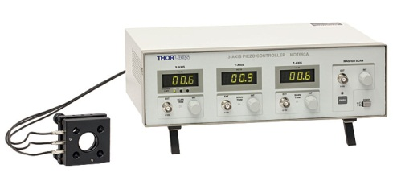
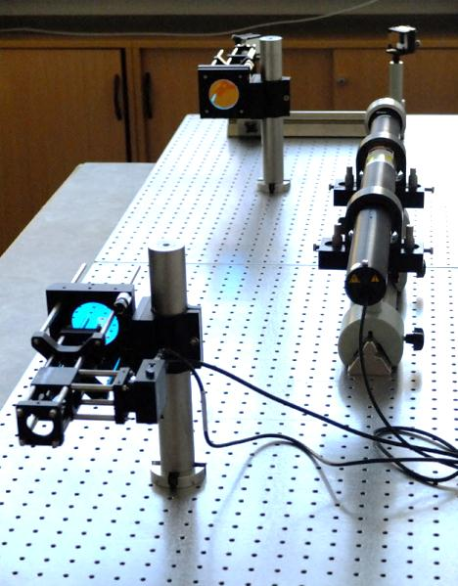
Prototype of 1m long cavity at CTU Prague
THORLABS
PZ631-EC - Complete System
Planar 2’’ mirror mount
Used for locking the cavity‘s resonance frequency
Adjustable in 5 DOF (two rotation and three translation moves)
Automated by a close loop controller
Mirror mount actuated by piezo drivers (Thorlabs)
Concave 2’’ mirror mount
Adjustable in 4 DOF (two rotation and three translation moves)
Automated by a open loop controller
Mirror mount actuated by piezo drivers
Vacuum compatible (10⁻⁹ mbar)

Slide 38
Conclusion
Unexpected circumstances linked to the preparation of the first long shutdown period of the LHC have implied the replacement of both spare LHC dipoles dedicated to OSQAR.
Two new ones have been installed, aligned, successfully tested and commissioned to perform photon regeneration experimental runs.
Photon regeneration
Several improvements have been implemented (water circuits, optics)
The results of the 2011 photon regeneration experimental run for pseudoscalar/axion and scalar particle search have been deeply analyzed
They confirm the results published by the ALPs collaboration and will be submitted for publication

Slide 39
VMB
Progress toward the measurement of the VMB has been achieved
The new set-up with electro-optical modulator was tested
Cotton-Mouton effect in air and nitrogen was measured
We confirmed that refractive index difference
Δn ≈ 6 ∙10⁻¹⁴ can be measurable at LHC magnets at CERN without cavity
Cavity
The building of 1 m long prototype is well advanced

Slide 40
Perspectives & Request
Two solutions are presently under consideration to perform photon regeneration runs at CERN combining optical power up to 1 kW with the simultaneous use of 2 LHC dipoles, each of them providing a magnetic field of 9 T over 14.3 m.
This will allow completing the revised program in 2013-14 with as main objectives for the photon regeneration experiment to improve the present reference results
For 2013, the request from the OSQAR collaboration concerns the possibility to use both dedicated test benches with new dipoles and the required cryogenic cooling capacity at 1.9 K together with dedicated resources.
The minimum requirement for run durations at cold conditions in 2013 are: 1 period of 2 weeks and 4 periods of 1 week each.

Slide 41
OSQAR Contributions to International Conferences
20 – 25 May 2012, 12th Pisa Meeting on Advanced Detectors, La Biodola, Isola d'Elba, Italy, http://www.pi.infn.it/pm/2012/, contribution submitted to NIMA_PROCEEDINGS-D-12-00275
1 – 8 July 2012, Advanced Studies Institute – Symmetries and Spin, Prague, Czech Republic, http://theor.jinr.ru/~praha/2012/, oral contribution, to be submitted to The European Physical Journal Special Topics
18 – 22 July 2012, 8th Patras Workshop on Axions, WIMPs and WISPs, Chicago IL, USA, http://axion-wimp2012.desy.de/, oral contribution
10 – 12 September 2012, Open Symposium - European Strategy Preparatory Group, Krakow, Poland, http://indico.cern.ch/conferenceDisplay.py?confId=175067, contribution ID : 105
16 – 18 October 2012, Optics and Measurement 2012, Liberec, Czech Republic, http://oam.kez.tul.cz/, to be submitted to The European Physical Journal Special Topics

Slide 42
Acknowledgement
The OSQAR collaboration would like to thank the CERN teams of the SM18-test hall (MSC-TF, CRG-OD, RF-KS) for their valuable technical contributions, inputs and advices for the operation of the LHC dipoles as well as the management of CERN-TE department for continuous support

Slide 43
THANK YOU FOR YOUR ATTENTION

