Slide 1
LHCb ideas and path toward vectorization and parallelization
Niko Neufeld
CERN, Wednesday, Nov 28th 2012
Fourth International Workshop for Future Challenges in Tracking and Trigger Concepts

Slide 2
Disclaimer & Acknowledgements
This talk contains very few technical results
  Short notice, LHCb week ☺ and … most work in LHCb is simply at a very early stage today
Material presented comes of of many discussions with my colleagues in and outside LHCb, both from the online and offline world
Very few of what is presented is LHCb specific

Slide 3
From the Intro to the LHCb Manycores workshop April 2012
How well can many-cores solve important LHCb problems (many small events, secondary vertices, tracking, particle-ID)
How do we evaluate the overall (cost-)effectiveness of these technologies?
How can we make a code-base working with and without these (albeit at different performance) so that things can be run also “off-line” on other sites
  Not all Grid sites will have “our” chosen coprocessor-cards
How will these codes be maintained?
Can we develop frameworks allowing non-expert developers to contribute → you think Boost and STL are tricky to master? Have a look at a decent technical book on CUDA

Slide 4
Two approaches for better CPU use
“Evolutionary”: better use of modern processor-resources within existing frameworks
  Make classical event-parallel processing more efficient: late fork-ing, x32, …
  Try to make key, well isolated, pieces of code thread-safe
“Revolutionary”: re-think everything
  New frame-works for many-core architectures: GPU, MIC, etc…

Slide 5
LHCb specialties
Main specialty are the small events (60 kB today, ~ 100 kB after the upgrade) with little pileup (today about 1.5 to 2, later up to 4) and consequently relatively short processing time (about 30 ms for the sequential trigger code)
→ it seems that more can be gained by processing many events in parallel rather than individual events in a parallel fashion

Slide 6
Reducing memory footprint
Many efforts under way...
Analysis of the ROOT Persistence I/O Memory Footprint
Working on GaudiMP (c.f. talk on Friday morning)
Kernel Same page Merging (KSM)
"Reducing the Memory Footprint of Parallel Applications with KSM”
“X32” ABI i.e. 32 bits pointers in 64 bit linux

Slide 7
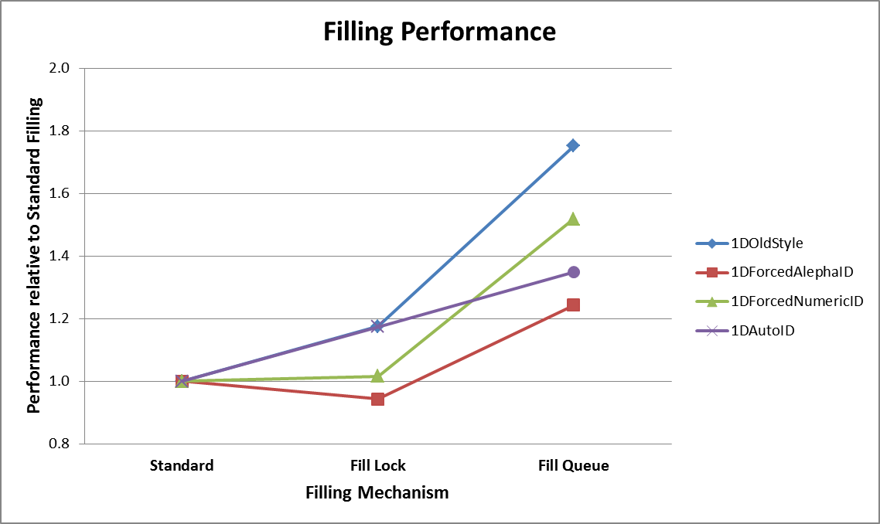
Targeted paralellisation:
Histogram filling
Solutions b (pthread mutex) and c (TBB concurrent queue) have been implemented in a prototype of the histogram service
  Choice between old functionality and b) or c) via job options
  Tested with histogram test option file from Gaudi Examples
The test delivers also some sort of performance summary
Results from B. Jost

Slide 8
SIMD / vectorization
Not much explicitly done right now, but we understand that this will be very important
So far only tried with auto-vectorization (gcc 4.6) → no gain
Lack of vectorization felt most painfully on Xeon/Phi and GPUs

Slide 9
Two time-scales
LHCb software today and through LS1 and LS2
  CPU evolution is not standing still
  But need to support a large software base for a large user community (ongoing analyses) → can only apply “transparent” improvements
LHCb software for the upgraded experiment after LS2 (major upgrade)
  Need to try to anticipate what will be “the” way to go from 2018: GPUs? Xeon/Phi? Something else?
  Everything is on the table

Slide 10

The dataflow for the upgraded DAQ
Detector
GBT: custom radiation- hard link over MMF, 3.2 Gbit/s (about 10000)
Input into DAQ network (10/40 Gigabit Ethernet or FDR IB) (1000 to 4000)
Output from DAQ network into compute unit clusters (100 Gbit Ethernet / EDR IB) (200 to 400 links)
Readout Units
DAQ network
100 m rock
Compute Units

Slide 11
Two worlds
Online:
  Trigger system for the LHCb upgrade (next slide)
  Full control over hardware (servers, interconnect)
  Limited essentially only by power, cooling, money and – most importantly – imagination and creativity
  Continuous support by comparatively small & close-knit teams of system and development experts
Offline:
  Need to work with what is “there” – only one of many clients to Grid/Cloud resources
  Need to provide software which runs the same way on large batch-farms and on the laptop of individual researchers
  Works with a large, “anonymous” or at least remote, user-base

Slide 12
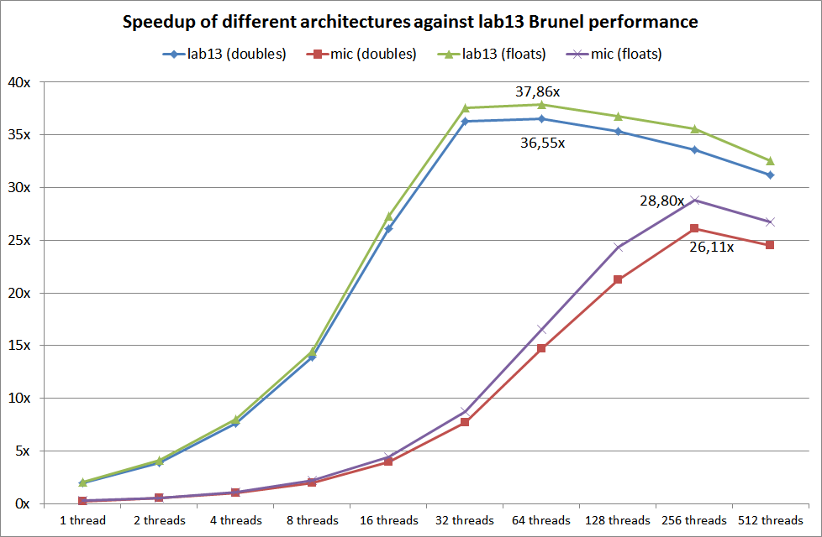
Online Pixel reconstruction using TBB
Results from D. Campora

Slide 13
The compute unit
Receives event-fragments and assembles complete events (actually multiple events simultaneously)
  No separate event-builder PC forseen
Runs the selection algorithm
Using some rough back-of-the-envelope estimates and Moore’s law about 1600 servers (dual-socket) of the 2017 will be needed for the baseline upgrade event-filter (10 MHz)
Each server needs to absorb about 8-9 Gigabit (1GB) of data per second (depends on event-size)

Slide 14
Challenges on the compute unit
The CU must absorb 8 Gbit/s
Feeding all data through a co-processor card will at least double the through-put to the system bus
  Unless “snooping” is used and part of the processing can only be done on co-processor card, this will be tricky at these rates

Slide 15
The server of 2017
It will be based on PCIe Gen 3 as the I/O system
Current generation of Intel CPU (and the next two on the road-map) offer 40 PCIe Gen 3 lanes per socket → theoretical I/O of 320 Gbit/s
  Need to verify what this means in practice but should get close to 90% → partially done on SandyBridge using GPUs and InfiniBand cards
  Data can be DMA-ed directly to processor cache (by-passing slow main-memory)
Optimal use of off-load engines and data distribution requires some control over the data-flow (not good for blind push)

Slide 16
LHCb “strategy”
In a few preliminary discussions we have very quickly settled on the following “musts”
Any physics algorithm must be able to run on any offline / online available hardware producing the exactly same results (crucial for systematics etc…)
We do not want a vendor / technology lock-in (for competitive prices online but also because we can not (strongly) influence what is offered on the Grid)
We need a data-processing framework, which can process many events in parallel

