Slide 1
Flash-box results
by Alexey Dubrovskiy
thanks to Roger Ruber, Marek Jacewicz and Volker Ziemann
CTF3 working meeting
October 11, 2012

Slide 2
Layout of FlashBox experiment
Drive beam line
RF
1 m
Probe beam line
ACS1
ACS2
Ag
7
6
5
4
3
2
1
e⁺
e⁻
Cu
7
6
5
4
3
2
1
ACS Tank
Corrector
Flash Box
Pick up
+
-
FlashBox applications:
Fundamental BD study;
Compact beam spectra analyzer.
U=20-60 V

Slide 3
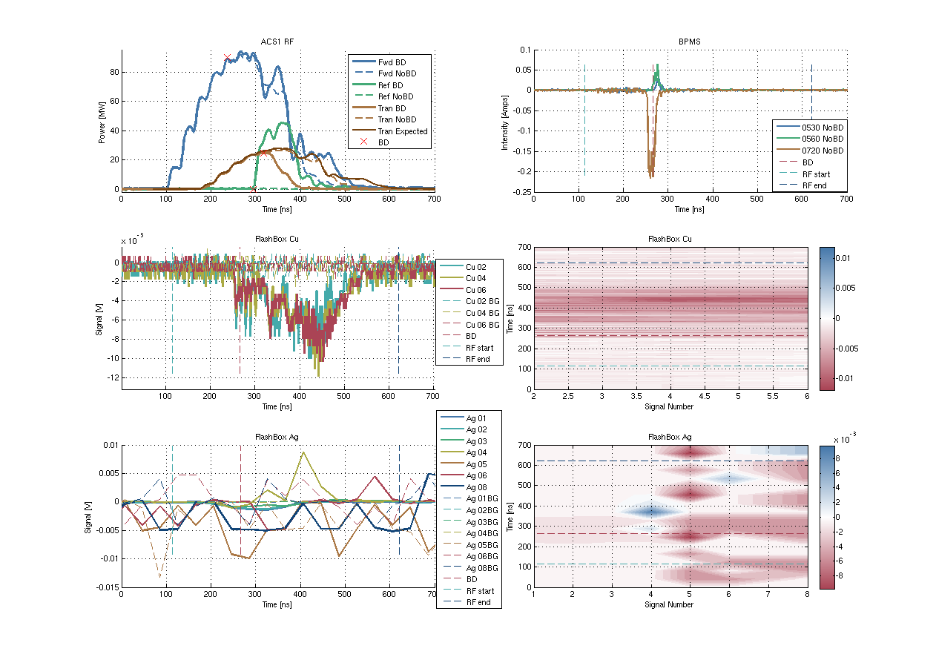
Low energy electrons: measurement
Electrons
Poor resolution
Noise

Slide 4
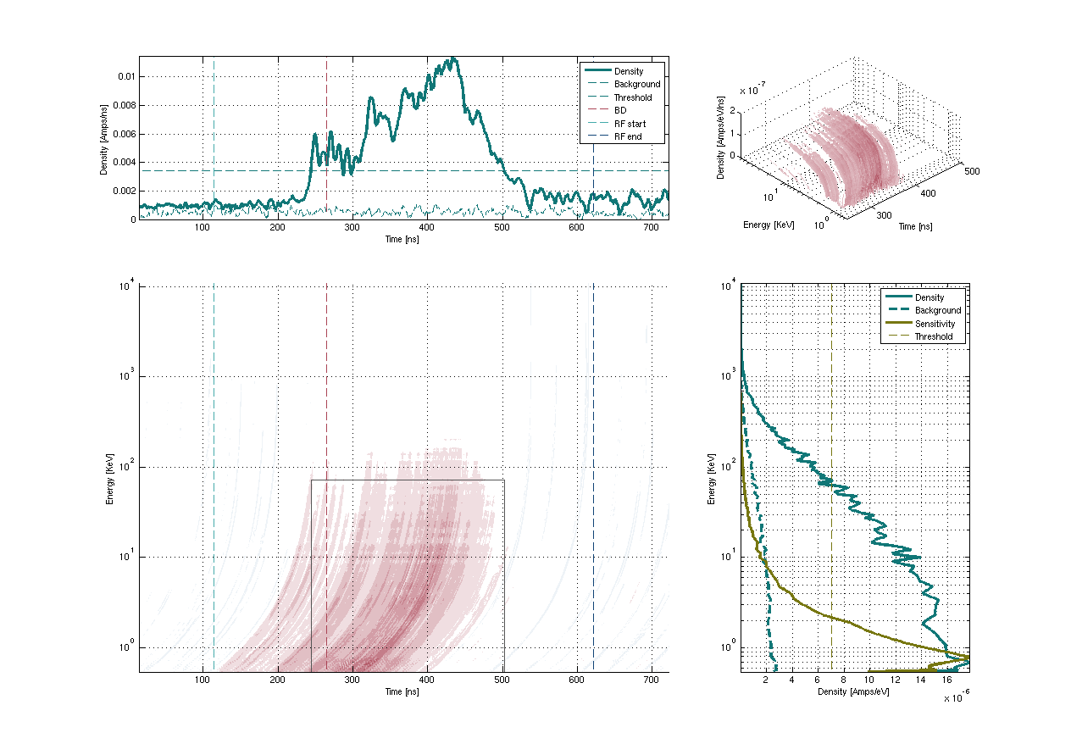
Low energy electrons: distributions
Without channels Cu8, Ag1-8

Slide 5
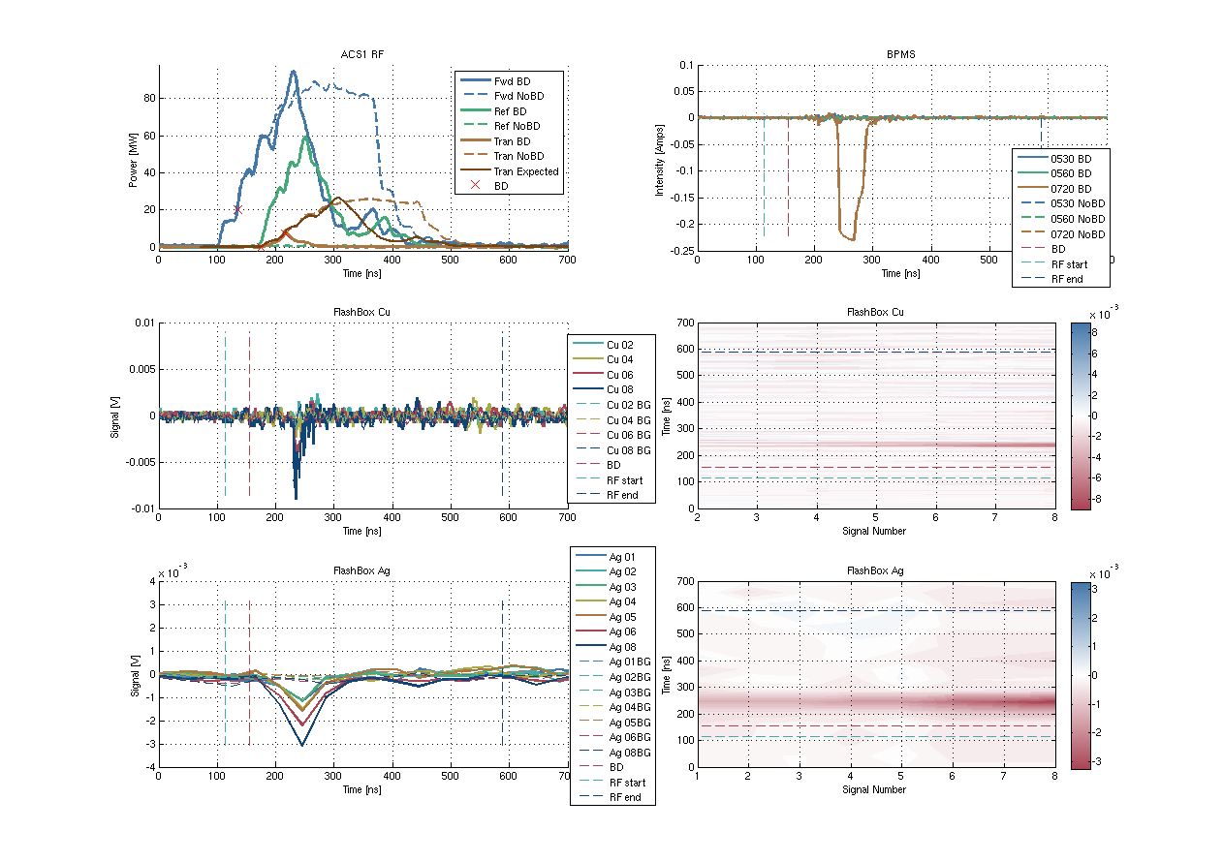
High energy electrons: measurement
Measurement has been improved

Slide 6
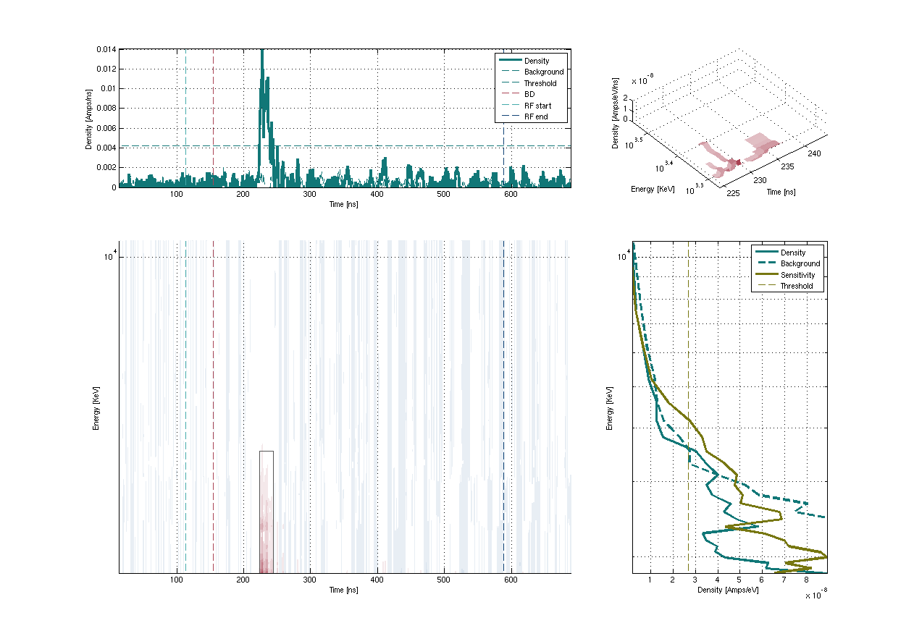
High energy electrons: distributions
Subtracted background
10 MeV
3 MeV
2 MeV

Slide 7
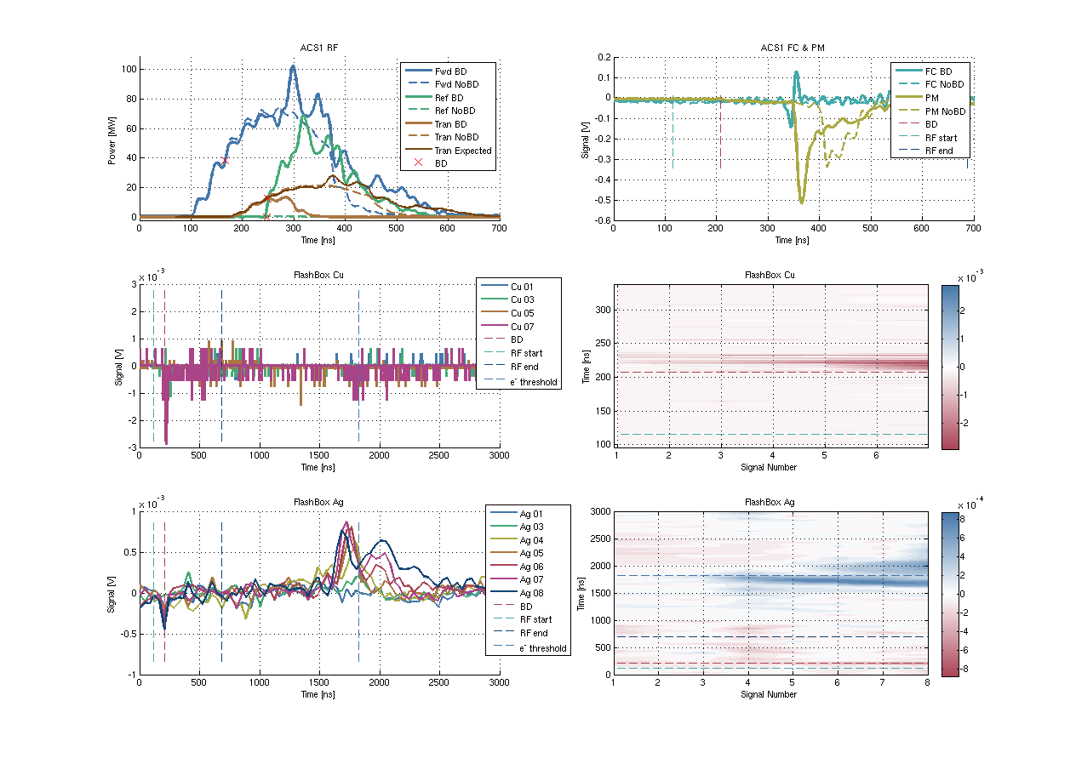
Ions: measurement
V≈1.7m/1480ns=0.3-0.4%c
V≈0.125m/80ns=0.5%c
1480 ns
From the magnet: m/e = 2.1-4.5×10³ m_{e}/e⁺:
H₂¹, He², Cu²⁶⁻²⁹ etc
1880 ns

Slide 8
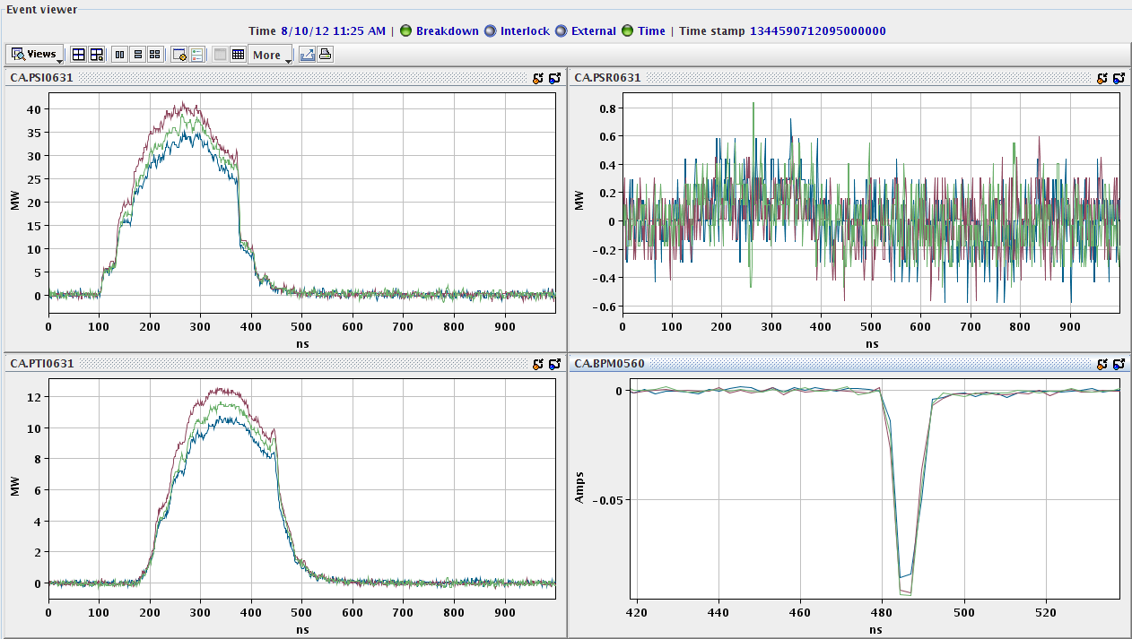
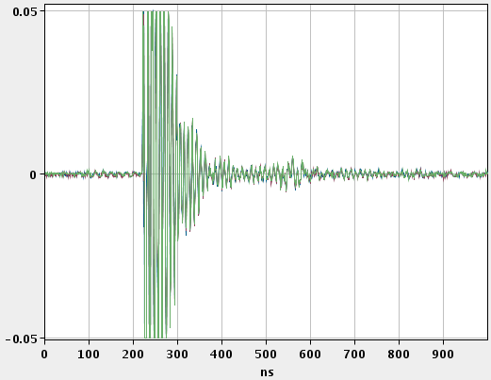
Obstacles: Probe beam is ON
ACS Forward power
ACS Reflected power
ACS Transmitted power
Probe beam current
FlashBox signals
The probe beam has a strong influence on the flash box signals

Slide 9
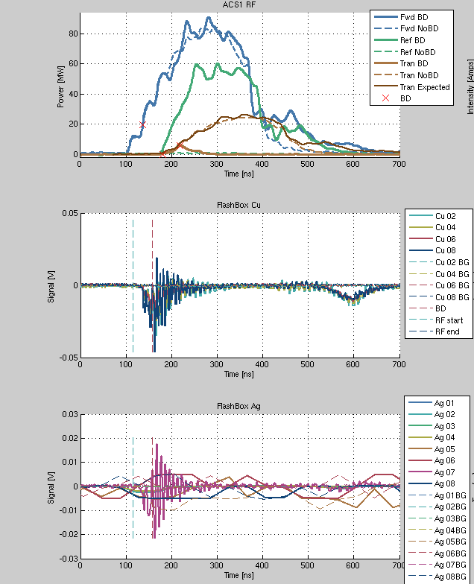
Obstacles: Wrong polarity
Solved!
Wrong polarity on the plates was the reason of signals ringing and creating secondary electrons.
Secondary electrons

Slide 10
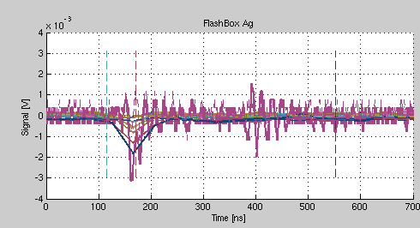
Obstacles: Ag signals ringing
Ag signals revealed ringing at a higher sampling frequency. New connection plate might help to rid of it.

Slide 11
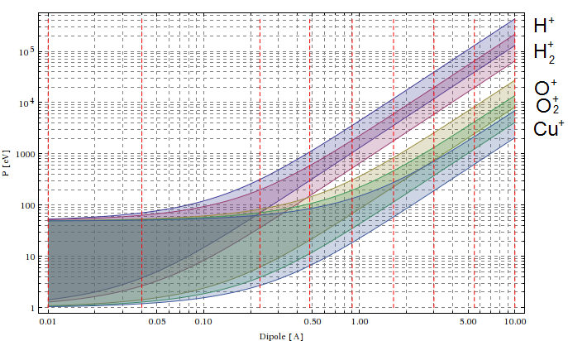
Ions: programme
Covered in Summer 2012
(visibility range was limited due to
a short time window)
Found H₂⁺
To complete the ion scan it is necessary to apply
9 dipole magnet strengths (red dashed lines on the plot) for the same RF conditions =>
Needed No Pulses ≈ 9 Dipole sets × 3 RF power levels × 50 BDs / 10⁻⁴ BDR ≈ 10⁷ pulses
≈ 400 days (8 hours a day of operation)
It is essential to have a high BDR of 10⁻² -10⁻³ => 2 months can be enough!
1500 BDs are wanted!!!

Slide 12
Summary
Energy of emitted electrons was measured in the KeV-MeV range.
H₂ ions were detected with an energy of a few KeV.
Acquisition system has been improved.
The FlashBox experiment programme has been worked out.
Currently the ion scan is completed by only 0.67%.
The more BDs the more results!

