Slide 1


Slide 2

Black Holes (Amanda Lear)
I'm trying to understand why
Like a black hole in the sky….
A door opening on a new dimension…
It’s another time
And it's another space
It’s something that science can't describe
No one has ever seen (???)
No one has ever been
A black hole in the sky, why?

Slide 3
Supermassive black hole at the Galactic Center
Amanda Lear: A black hole in the sky, why?
А.Ф. Захаров (Alexander F. Zakharov)
E-mail: zakharov@itep.ru
Institute of Theoretical and Experimental Physics,
B. Cheremushkinskaya, 25, 117218 Moscow
Bogoliubov Laboratory of Theoretical Physics
Joint Institute for Nuclear Research, Dubnan high, Russia
XXIXth International Workshop High Energy Physics, IHEP, Protvino, Russia
28 June, 2013

Slide 4
Outline of my talk
Introduction
Crafoord prize and its winners
Shadows for Kerr as a tool to evaluate BH characteristics
Shadows around Reissner-Nordstrom BHs
Observations of BH at Sgr A and a tidal Reissner-Nordstrom BH
Bright star trajectories around BH at GC as a tool to evaluate BH parameters and DM cluster
Conclusions

Slide 5
References
AFZ, F. De Paolis, G. Ingrosso, and A. A. Nucita, New Astronomy Reviews, 56, 64 (2012).
D. Borka, P. Jovanovic, V. Borka Jovanovic and AFZ, Physical Reviews D, 85, 124004 (2012).

Slide 6
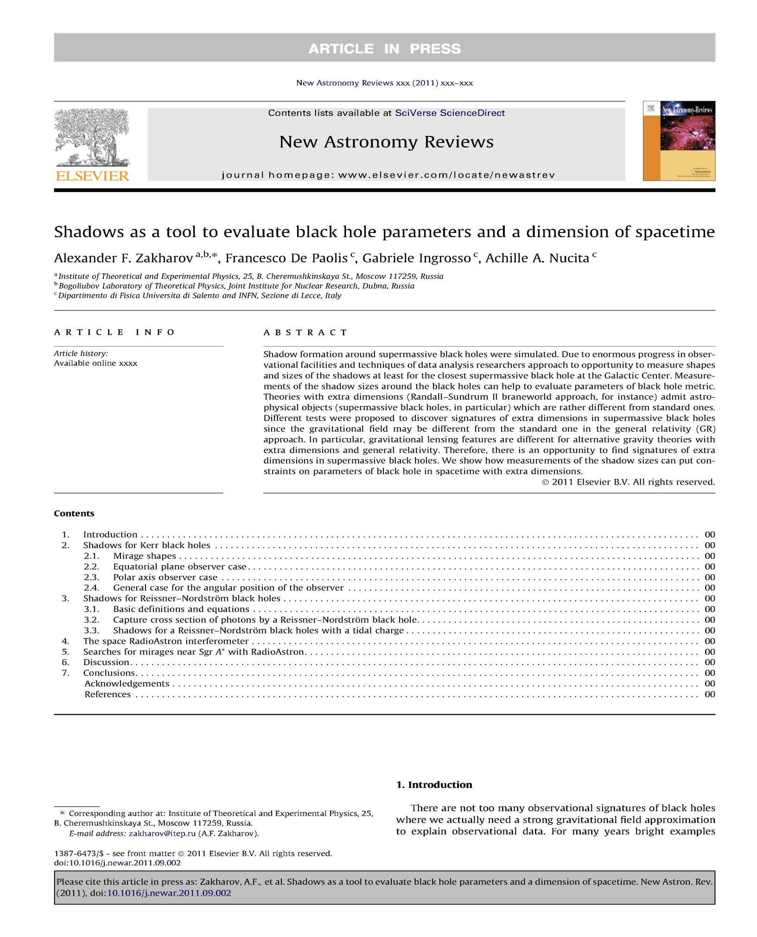

Slide 7
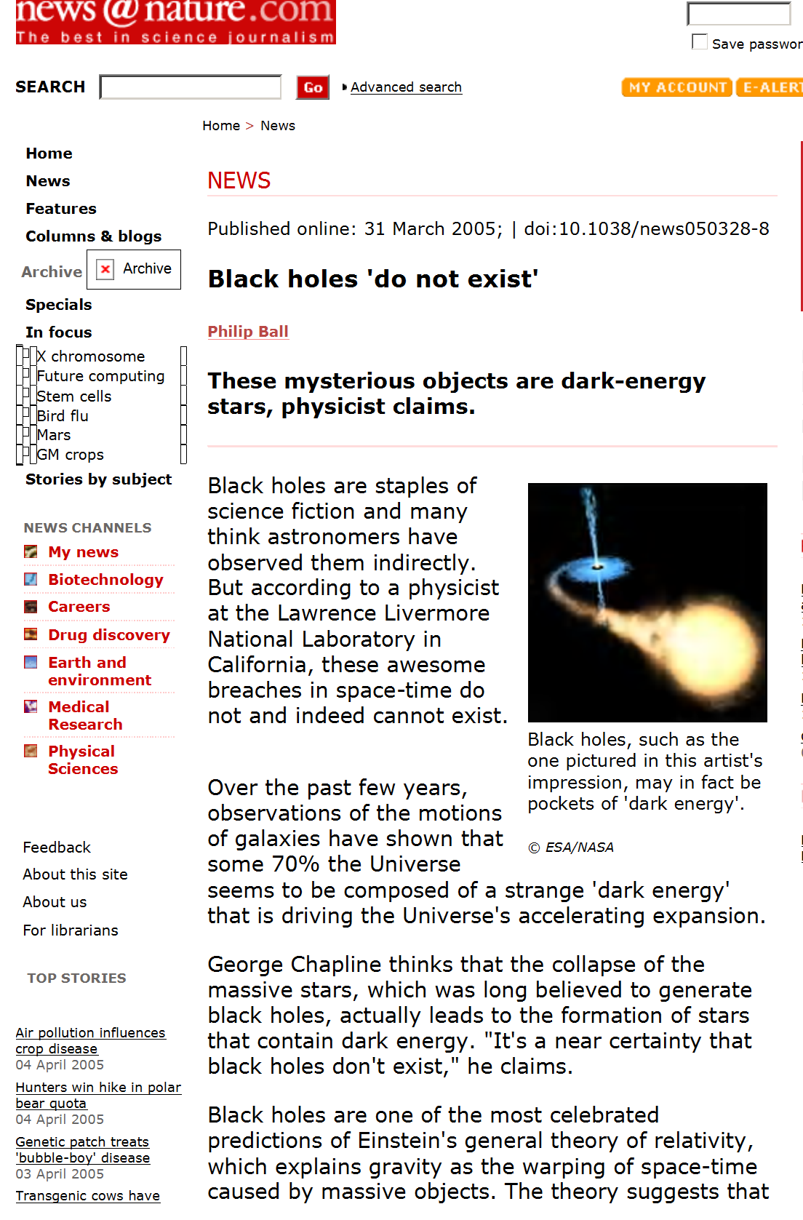

Slide 8
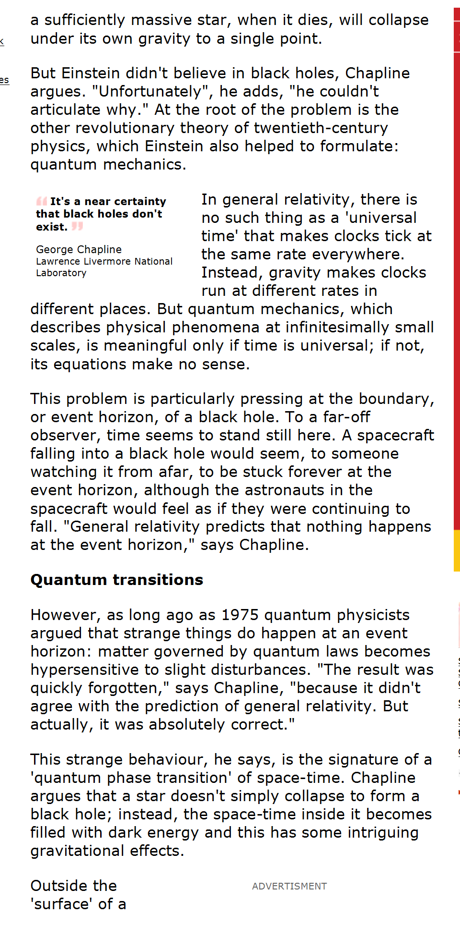

Slide 9
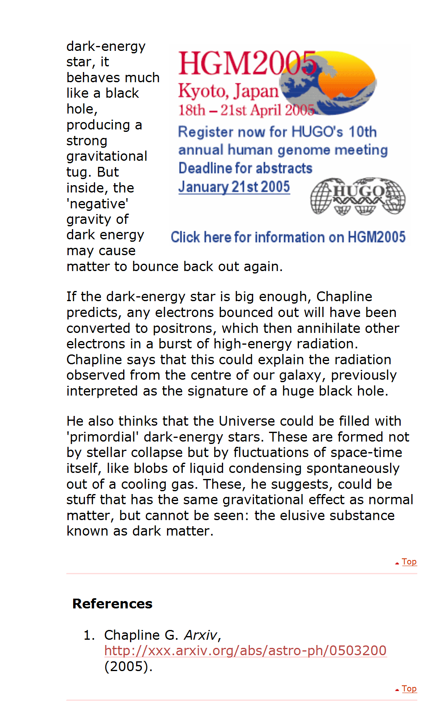

Slide 10
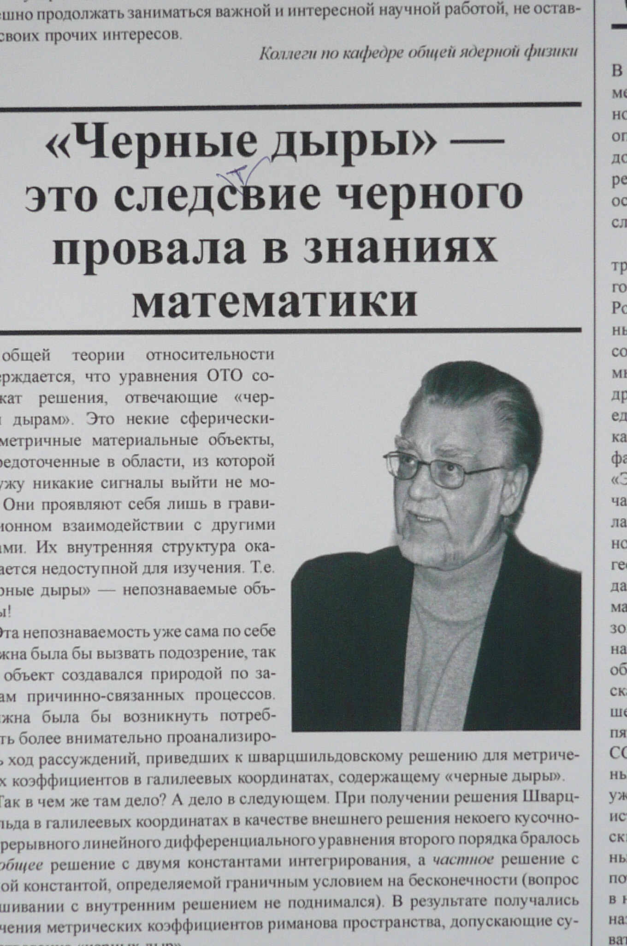
BHs is a consequence of black failure in knowledge of mathematics

Slide 13
2012 Crafoord Prize in Astronomy Goes to Genzel & Ghez
The Royal Swedish Academy of Sciences has decided to award the Crafoord Prize in Astronomy 2012 to Reinhard Genzel, Max Planck Institute for Extraterrestrial Physics, Garching, Germany and Andrea Ghez, University of California, Los Angeles, USA, "for their observations of the stars orbiting the galactic centre, indicating the presence of a supermassive black hole".
The Dark Heart of the Milky Way
This year's Crafoord Prize Laureates have found the most reliable evidence to date that supermassive black holes really exist. For decades Reinhard Genzel and Andrea Ghez, with their research teams, have tracked stars around the centre of the Milky Way galaxy. Separately, they both arrived at the same conclusion: in our home galaxy resides a giant black hole called Sagittarius A*.

Slide 14
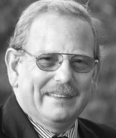
Reinhard Genzel, Prof. Dr.
Max Planck Institute for Extraterrestrial Physics, Garching
Curriculum Vitae
Born on March 24, 1952 in Bad Homburg v.d.H. Study of physics Bonn Univ., doctorate Max Planck Institute for Radioastronomy Bonn (1978), Postdoctoral Fellow, Harvard-Smithsonian Center for Astrophysics (1978-1980), Cambridge, MA, Associate Professor of Physics and Associate Research Astronomer, Space Sciences Laboratory, University of California, Berkeley (1981- 1985), Full Professor of Physics, University of California, Berkeley (1985-1986), Director and Scientific Member at the Max Planck Institute for Extraterrestrial Physics (since 1986), Honorary Professor Munich Univ. (since 1988), Full Professor of Physics University of California Berkeley (since 1999).

Slide 15
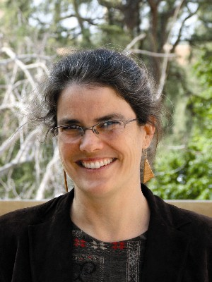
American citizen. Born 1965 in New York City, NY, USA. Ph.D. 1992 at California Institute of Technology, Pasadena, CA, USA. Professor at University of California, Los Angeles, CA, USA.

Slide 16
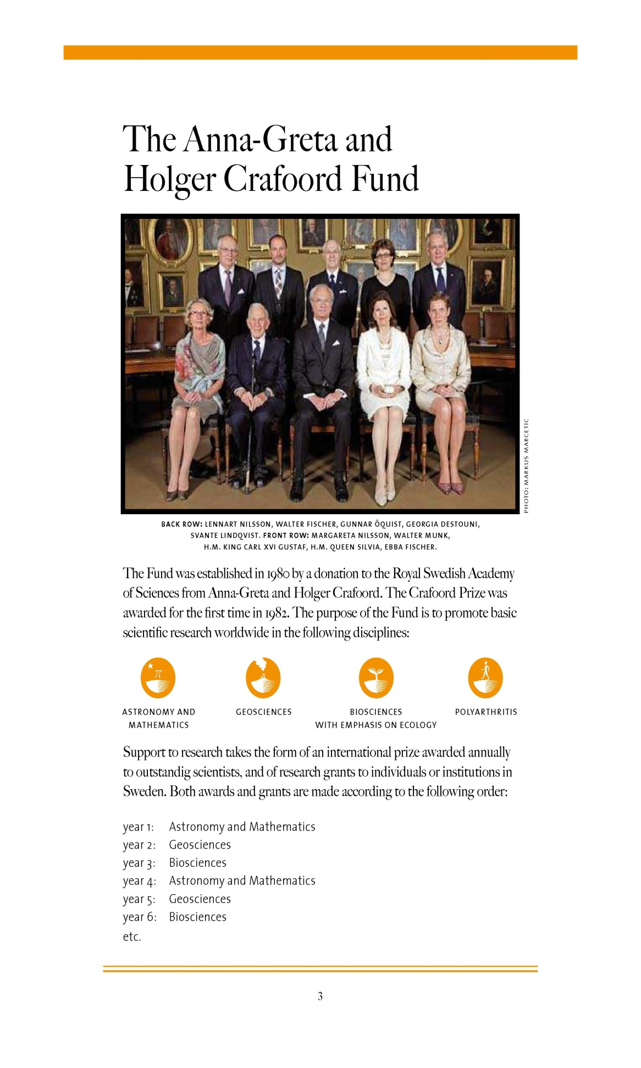

Slide 17
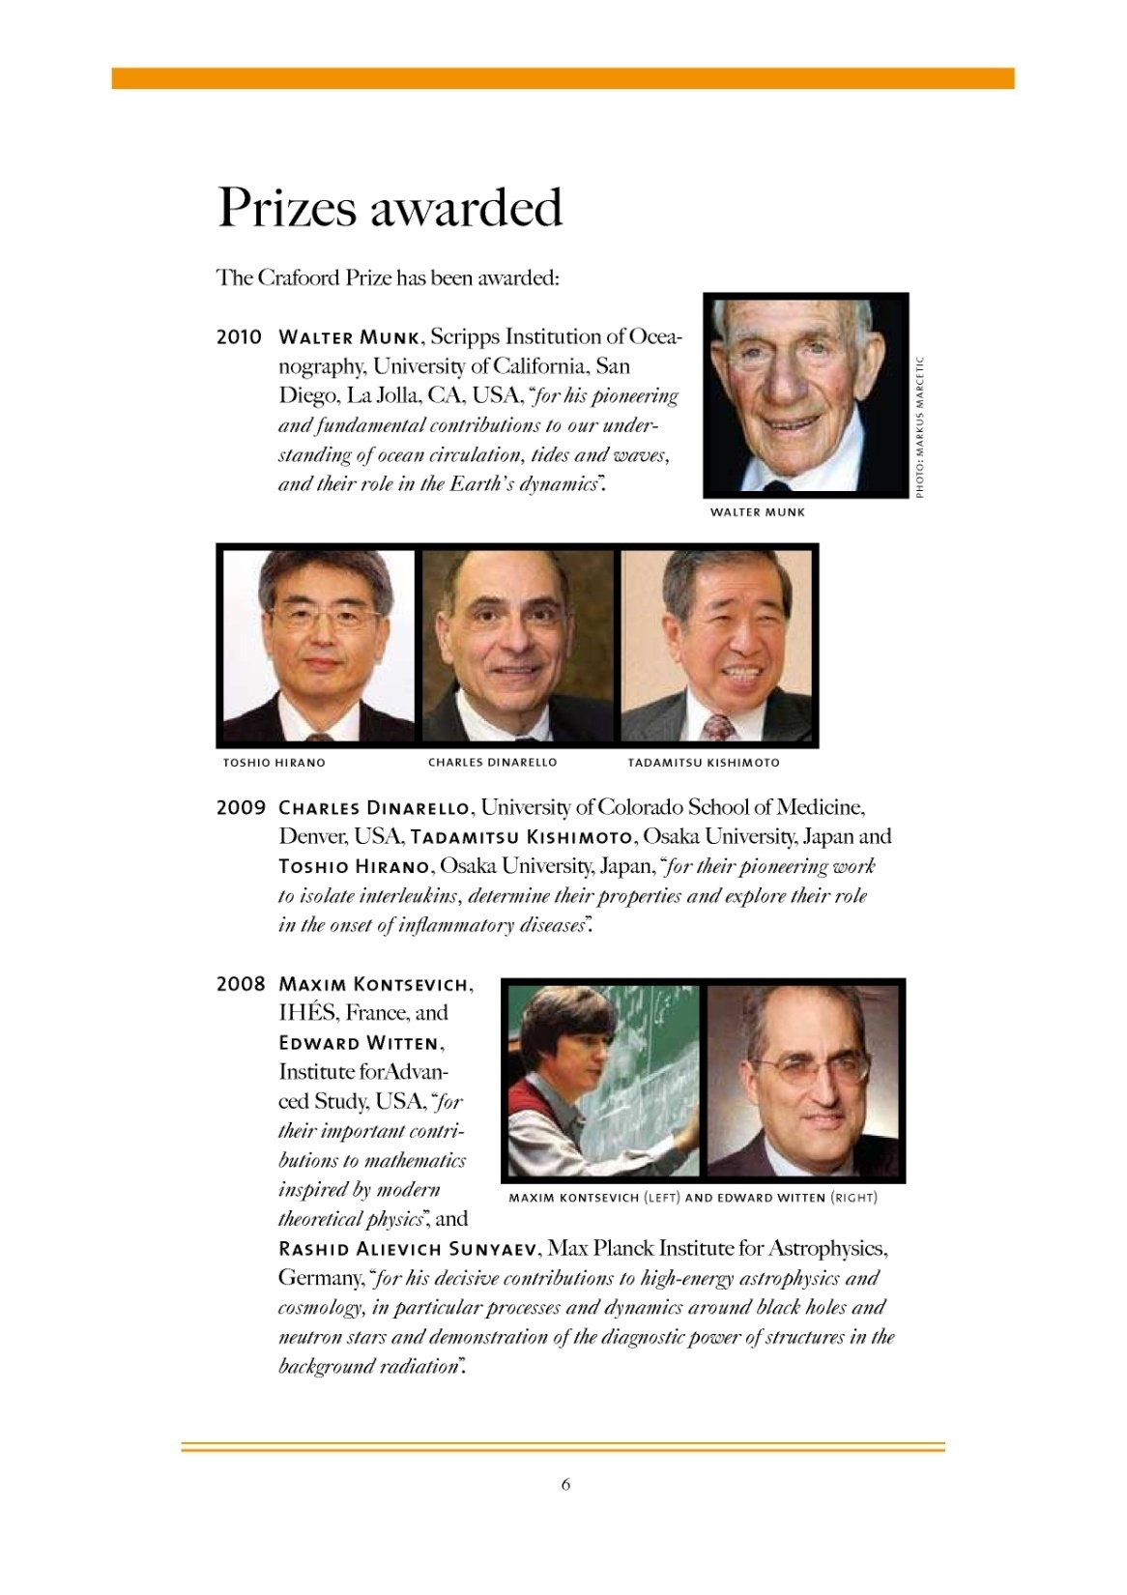

Slide 18
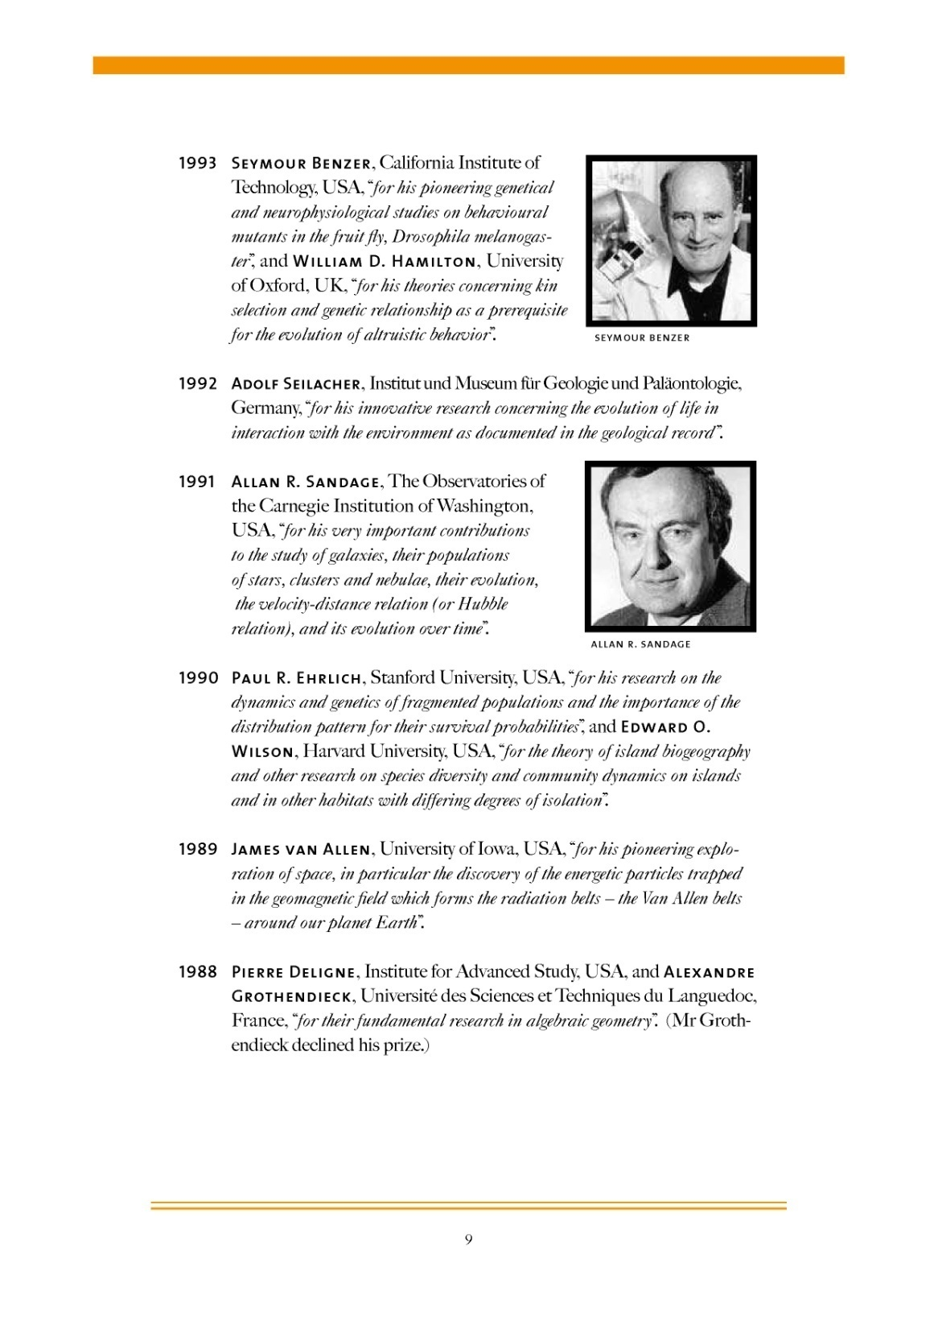

Slide 19
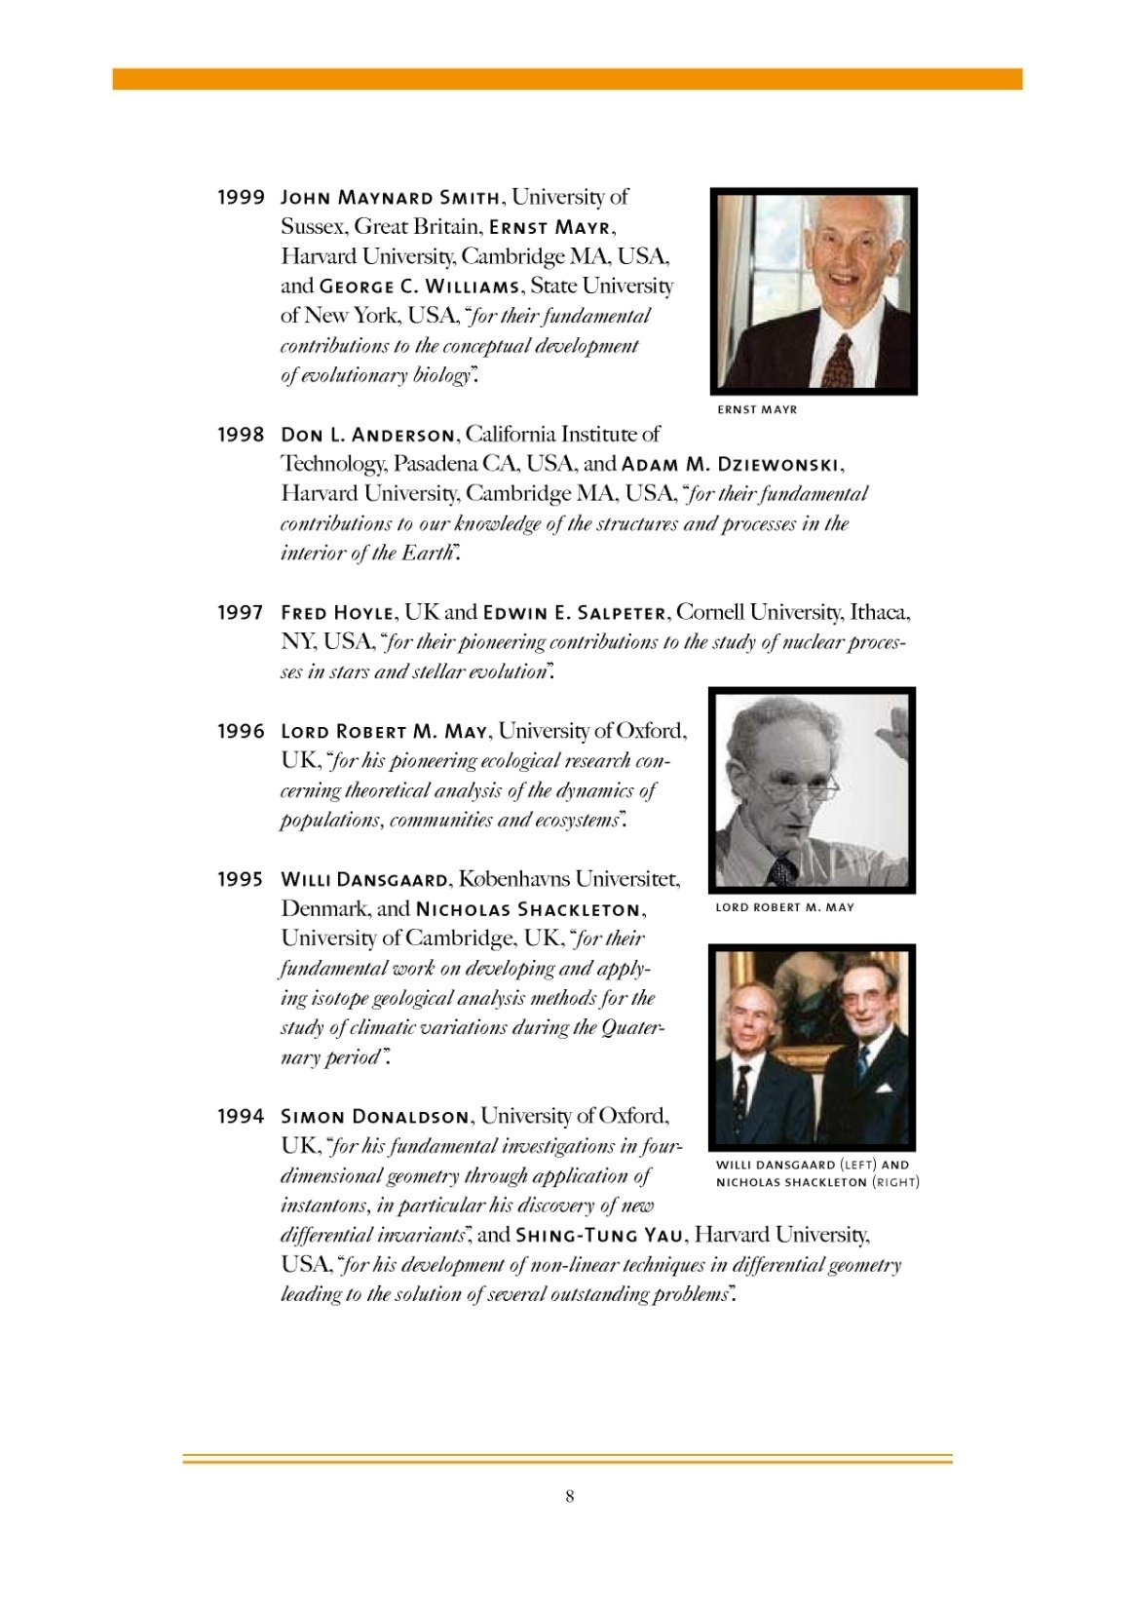

Slide 20
