Slide 8
A.F. Zakharov & F. De Paolis, A.A. Nucita, G.Ingrosso, Astron. & Astrophys., 442, 795 (2005)

Slide 9
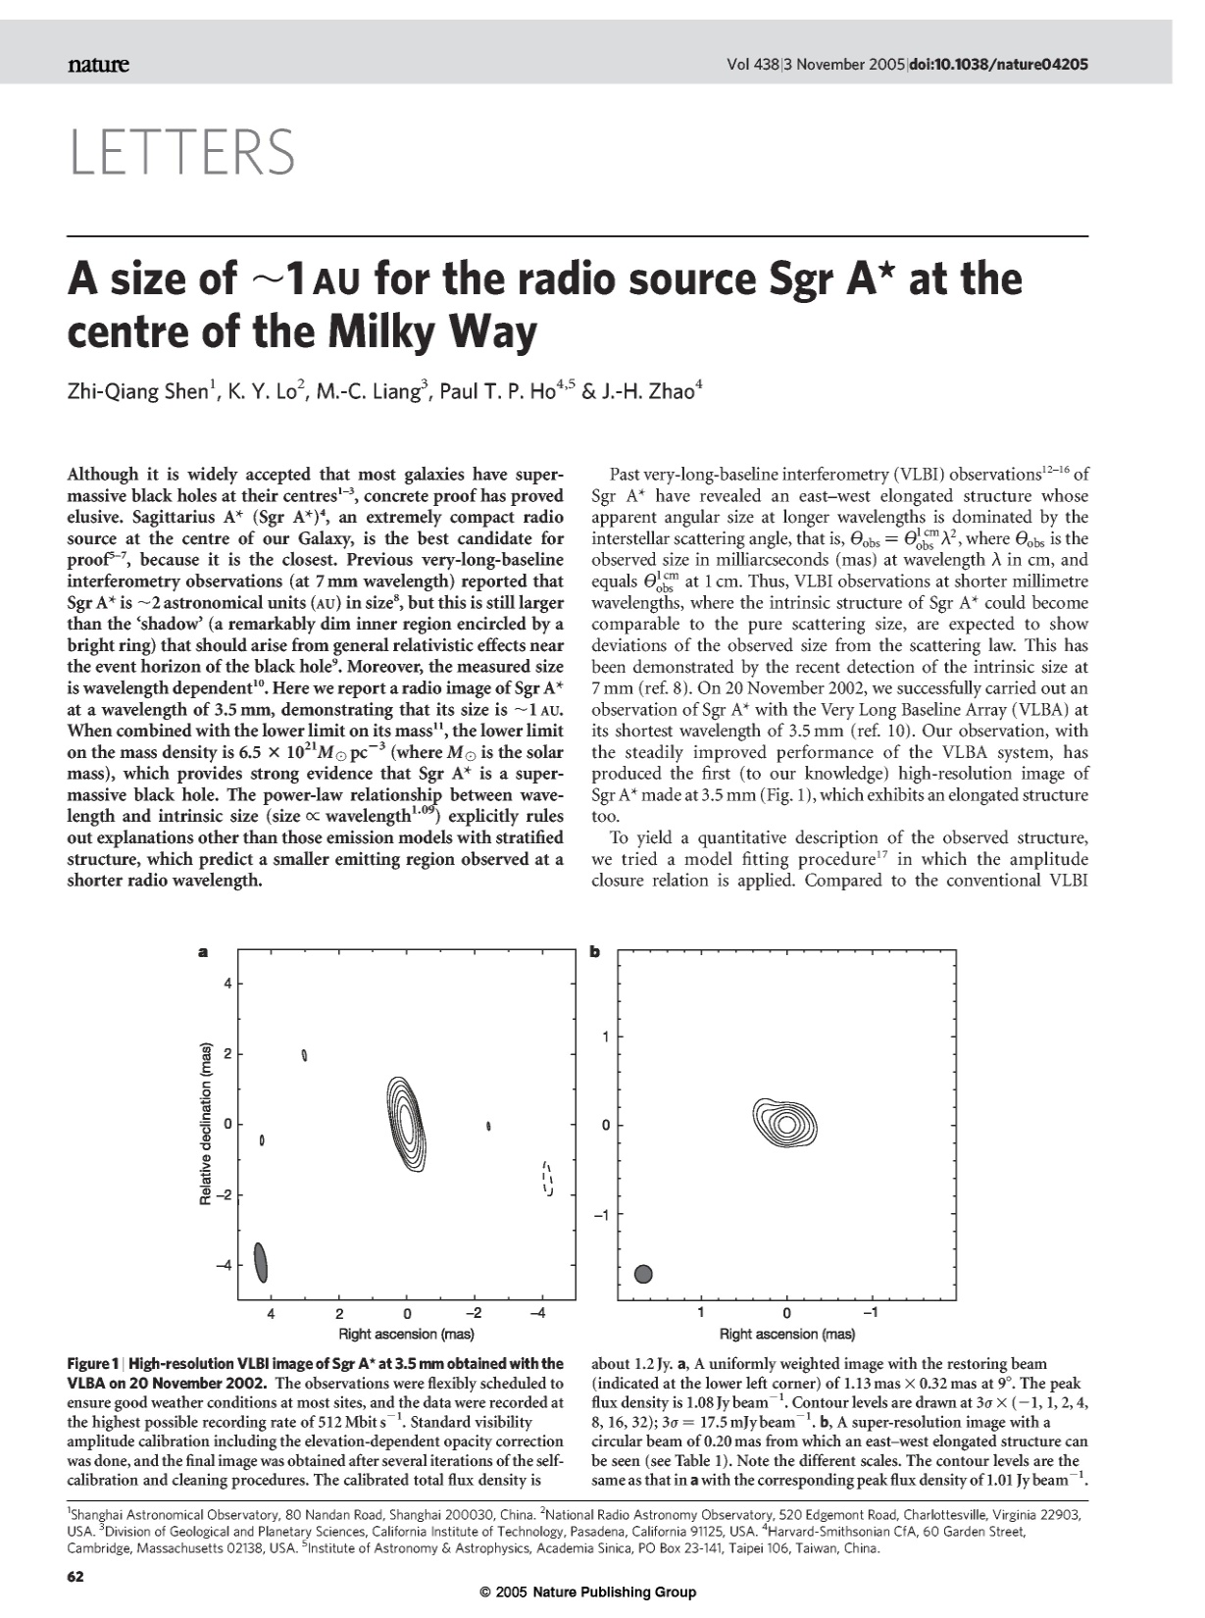

Slide 10
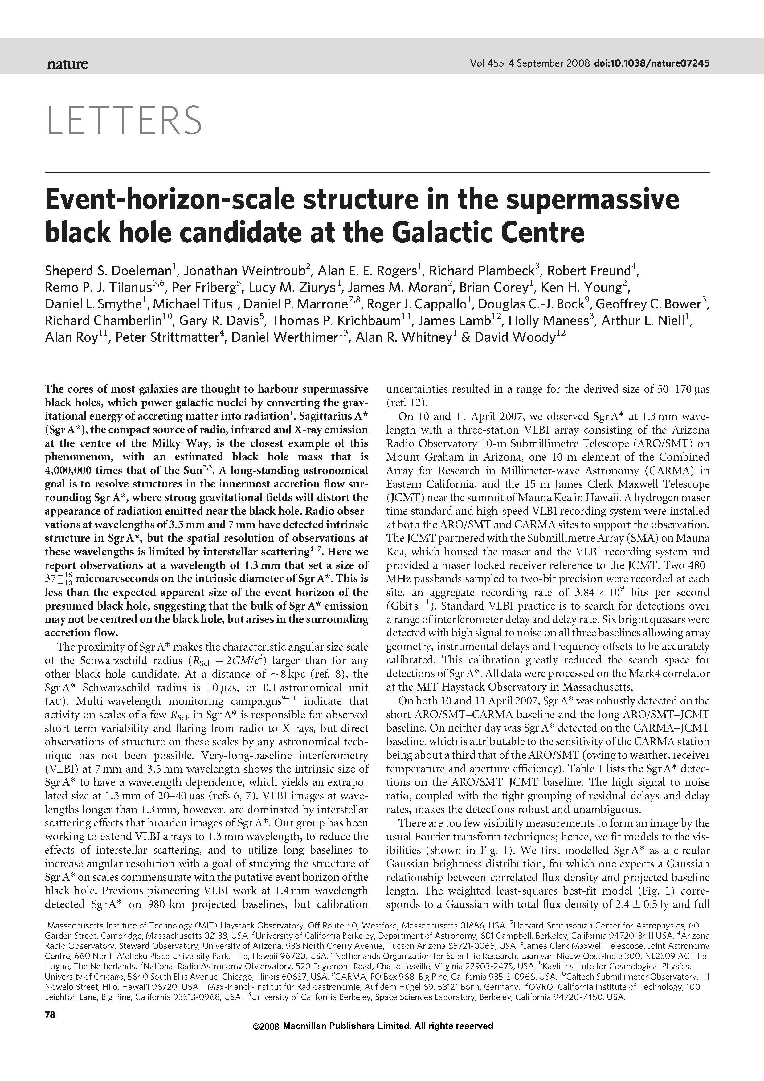

Slide 11
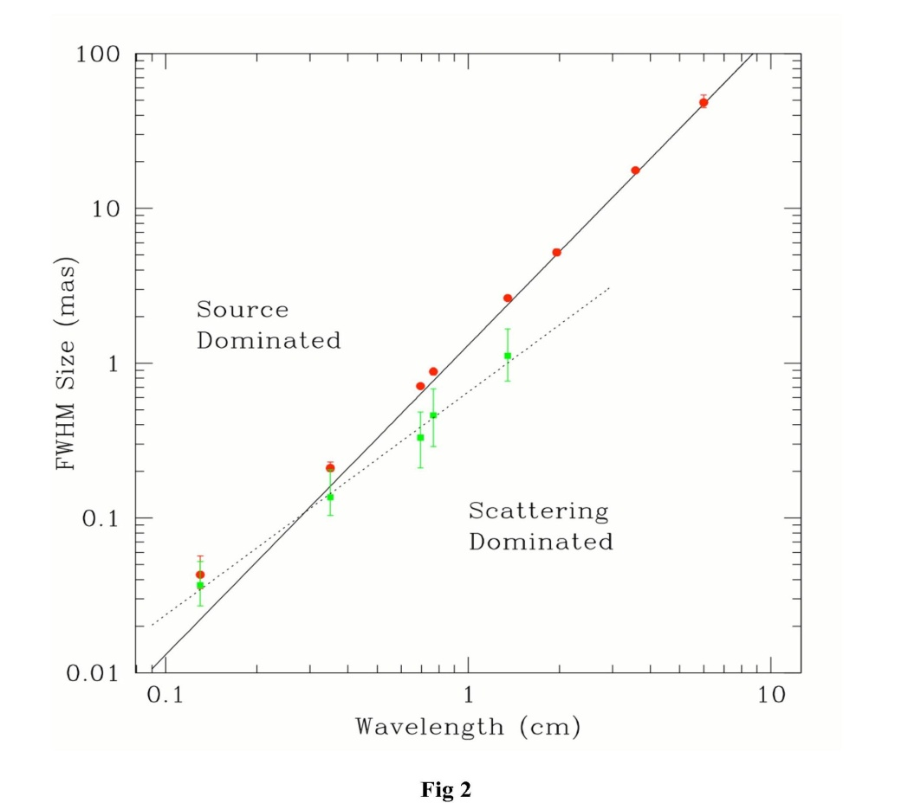
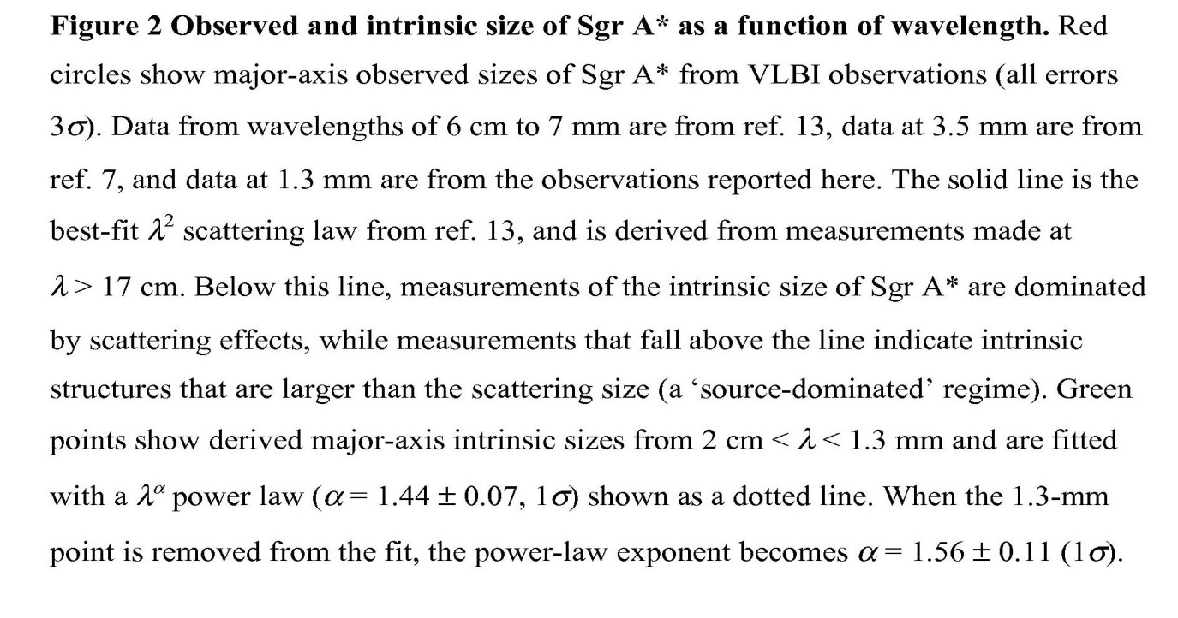

Slide 13
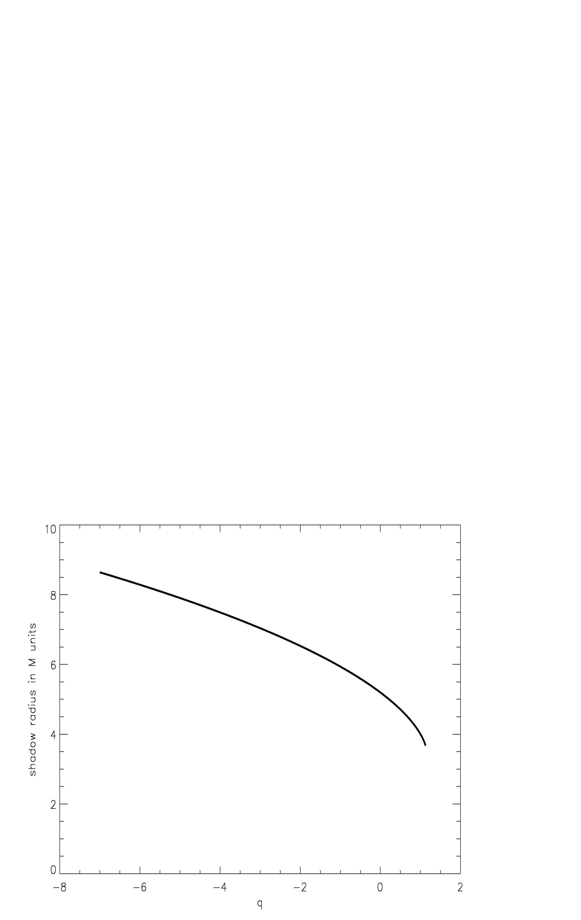

Slide 14
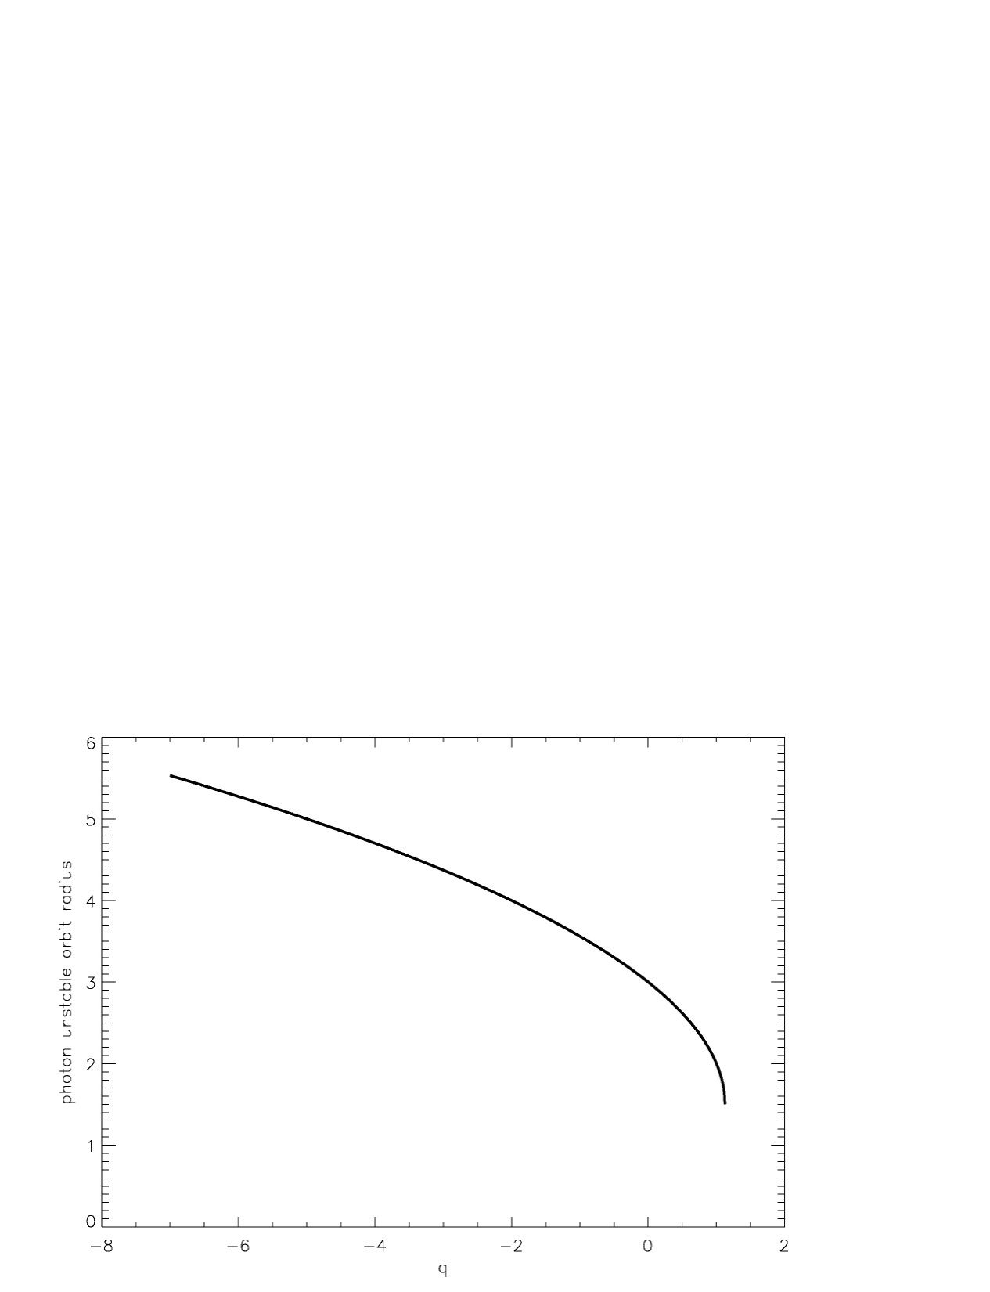

Slide 15
Recently,Bin-Nun (2010) discussed an opportunity that the black hole at the Galactic Center is described by the tidal Reissner-- Nordstrom metric which may be admitted by the Randall--Sundrum II braneworld scenario. Bin-Nun suggested an opportunity of evaluating the black hole metric analyzing (retro-)lensing of bright stars around the black hole in the Galactic Center. Doeleman et al. (2008) evaluated a shadow size for the black hole at the Galactic Center. Measurements of the shadow size around the black hole may help to evaluate parameters of black hole metric Zakharov et al (2005). We derive an analytic expression for the black hole shadow size as a function of charge for the tidal Reissner-- Nordstrom metric. We conclude that observational data concerning shadow size measurements are not consistent with significant negative charges, in particular, the significant negative charge Q/(4M^2)=-1.6 (discussed by Bin-Nun (2010) is practically ruled out with a very probability (the charge is roughly speaking is beyond
9 σ confidence level, but a negative charge is beyond
3 σ confidence level).

Slide 16
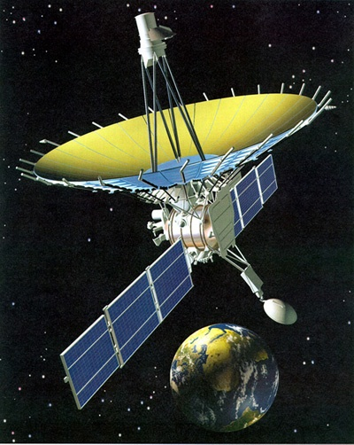
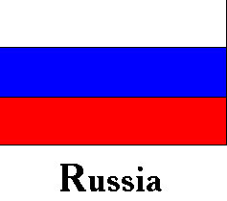



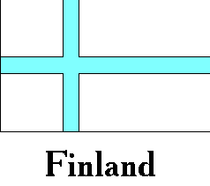


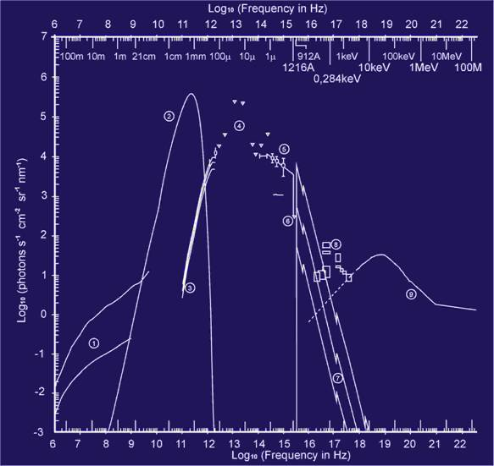

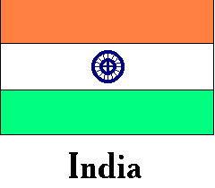




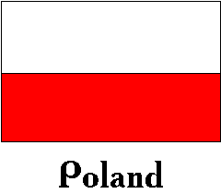

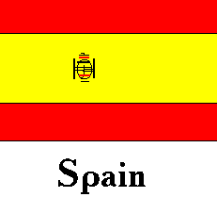
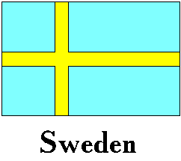

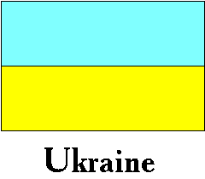


RADIO INTERFEROMETER MUCH LARGER THE EARTH
“SPECTR-R” (Mission “RadioAstron”)
Main scientific tasks of the mission –
syntheses of high-precision images of various Universe objects, its coordinates measurements and search their variability with the time. A fringe width of the system is
up to 7 micro arc seconds.
Main characteristics of the space radio telescope
Spectral band:
wavelength (cm) - 92; 18; 6.2; 1.19-1.63
frequency (GHz) - 0.327; 1.66; 4.83; 18-26
Main organizations:
on scientific complex - Astro Space Center of Lebedev Physical Institute of Russian Academy of Science;
of spacecraft - Lavochkin Research Production Association of Russian Space Agency.
Planned launch date of the mission is 2007.
The orbit of the mission :
apogee - 310 000 - 370 000 km
perigee - 10 000 - 70 000 km
declination - 51.6 °
period variation - 7 - 10 days
Guarantied time of activity - 5 years
Scientific payload mass - 2100 kg
Pointing accuracy of radio telescope - 35"

Slide 17
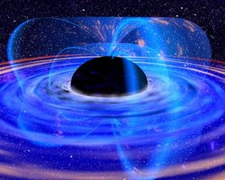

Slide 19
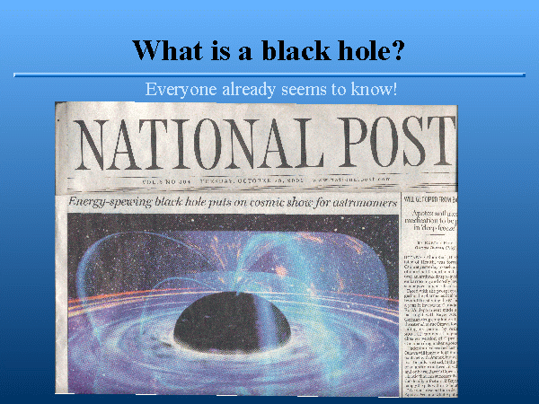

Slide 20


