Slide 1
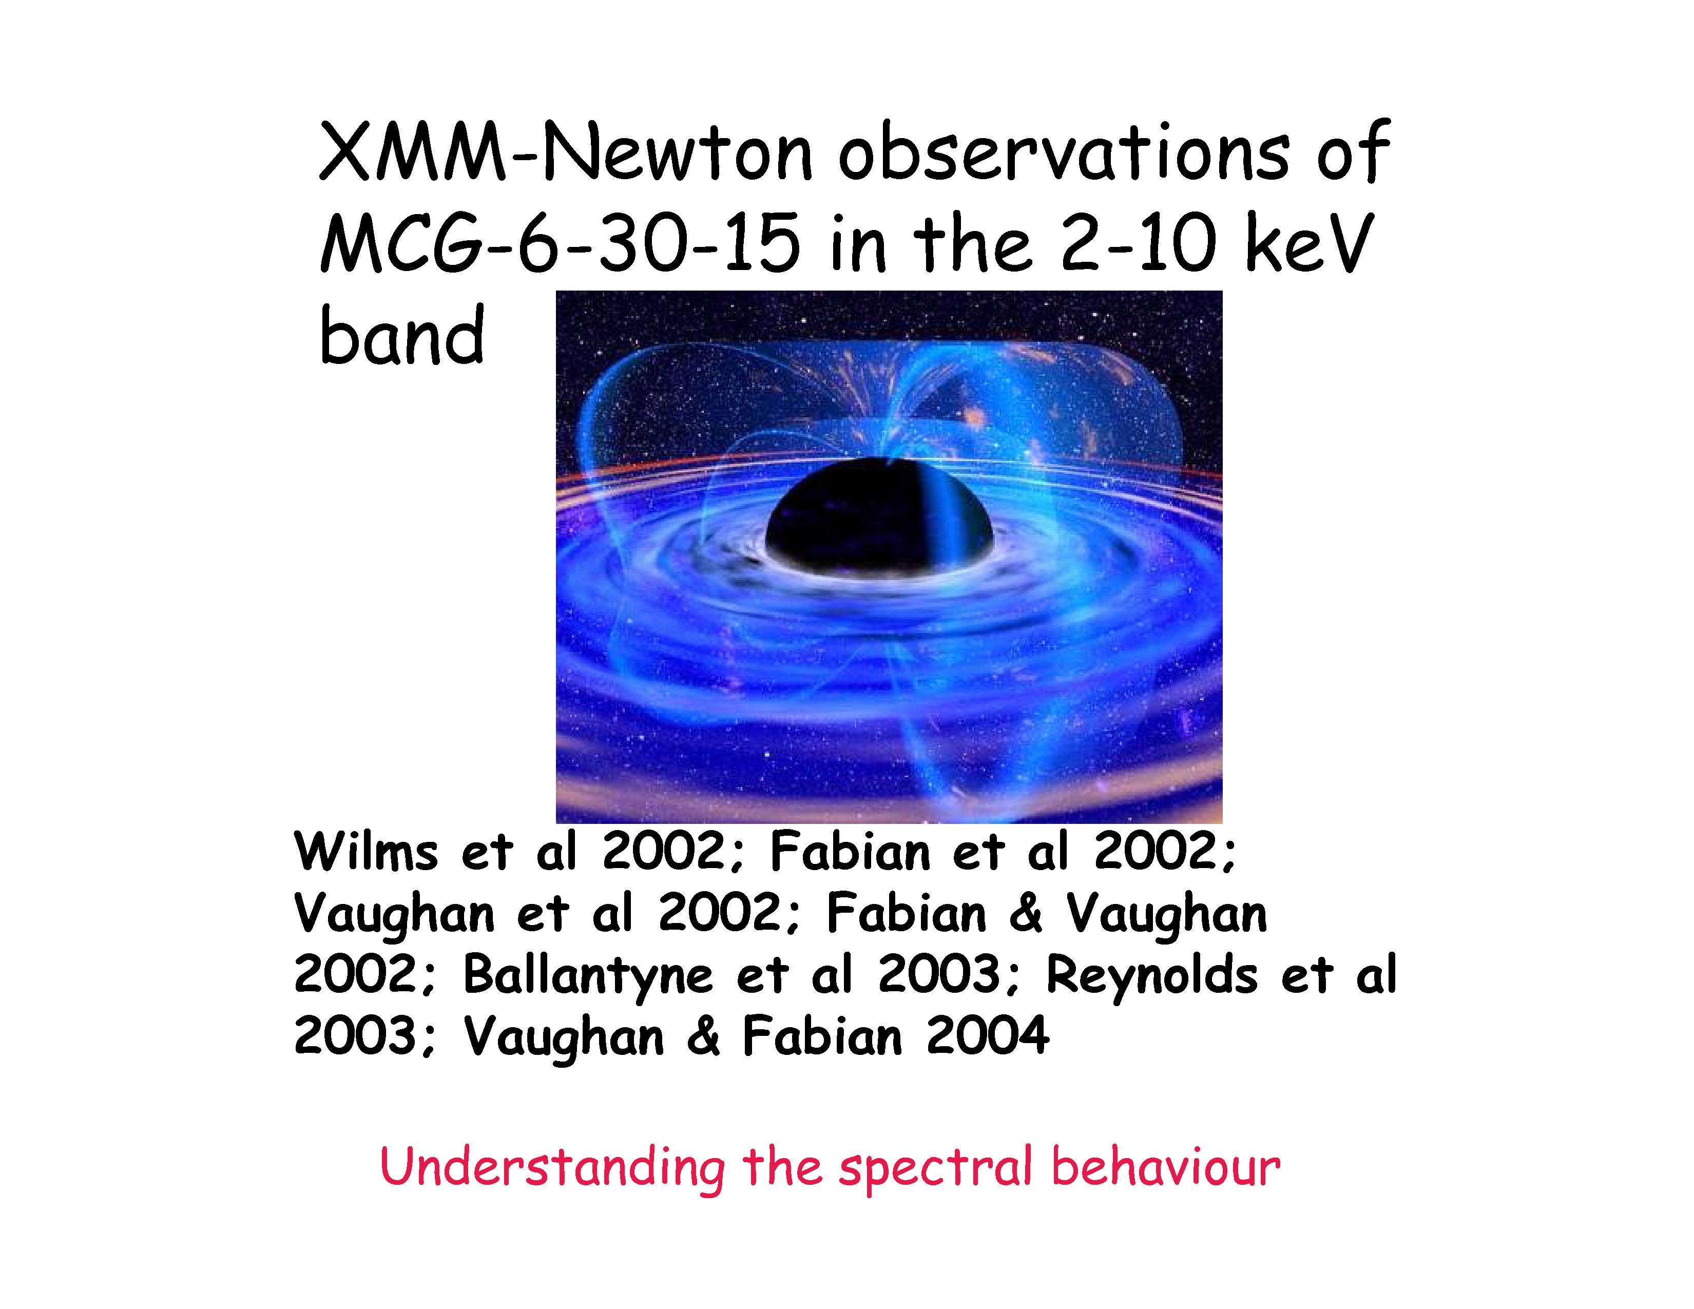

Slide 2
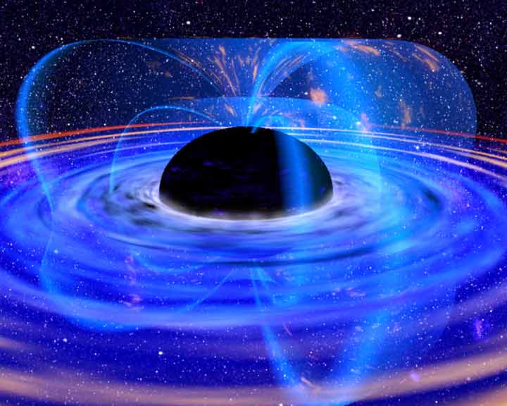
What Makes them Black Holes
Other than the classical Rees argument about efficiency, size and luminosity what observational properties make these objects black holes ?
  High mass in a small volume via direct measurements
    SGR A*, NGC4258 etc
  Mass functions of stellar systems
  For the vast majority of objects thought to be black holes such information is not available
  We must use indirect observational data
    Spectra
    Timing
    Spectral/timing (reverberation mapping)
    Imaging (micro-lensing)
Why are black hole interesting today
Black Holes and Strong Gravity
  Spectral and timing probes of strong gravity
  Astrophysics in the strong gravity region
AGN Winds & effect of BHs on cosmic structure
  Outflows from AGN
  Cooling flow and cluster entropy problems
  Role of AGN in galaxy formation
Evolution of AGN and SMBH growth
  Paradigm shift in AGN evolution

Slide 3
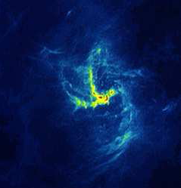
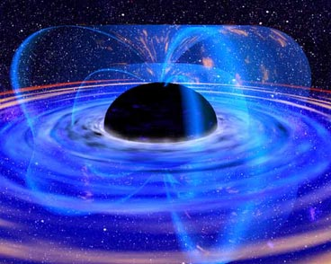
The environment of Sgr A*
Sgr A*
10 µas
Mini spiral
(50’’)
Central cluster
(2 disks)
(0.5 pc-12.5’’)
S star cluster
(12-400 mas)
Notes:
Pièces du puzzle, schéma grossier
Le centre galactique est très divers et assez complexe, en plus la dénomination est assez vague, elle sous-entend plrs échelles et des objets de natures très différentes
Donc je vais m’intéresser à la centre galactique que le large program l’obser
C’est à dire une échelle de 1 pc
Et principalement 4 constituants….
Disques : (115 deg , clock wise counter clockwise
Amas central (90 étoiles WR et O/B
Minispirale (2 pc centraux,
Arches (100 WR à 35 pc au nord)
Poussières molécules et H2
(100 étoiles type O ou A,
dans 0,01pc ou à 120 UA (S2) UA)
Minispirale en H2

Slide 4
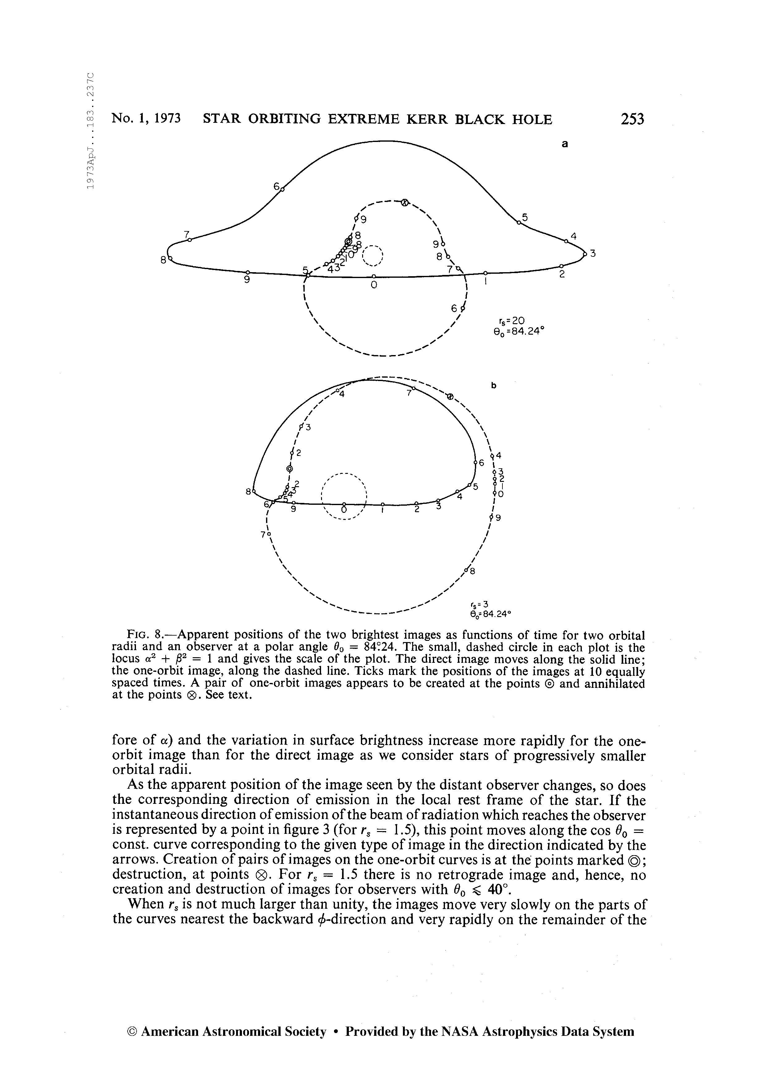

Slide 5
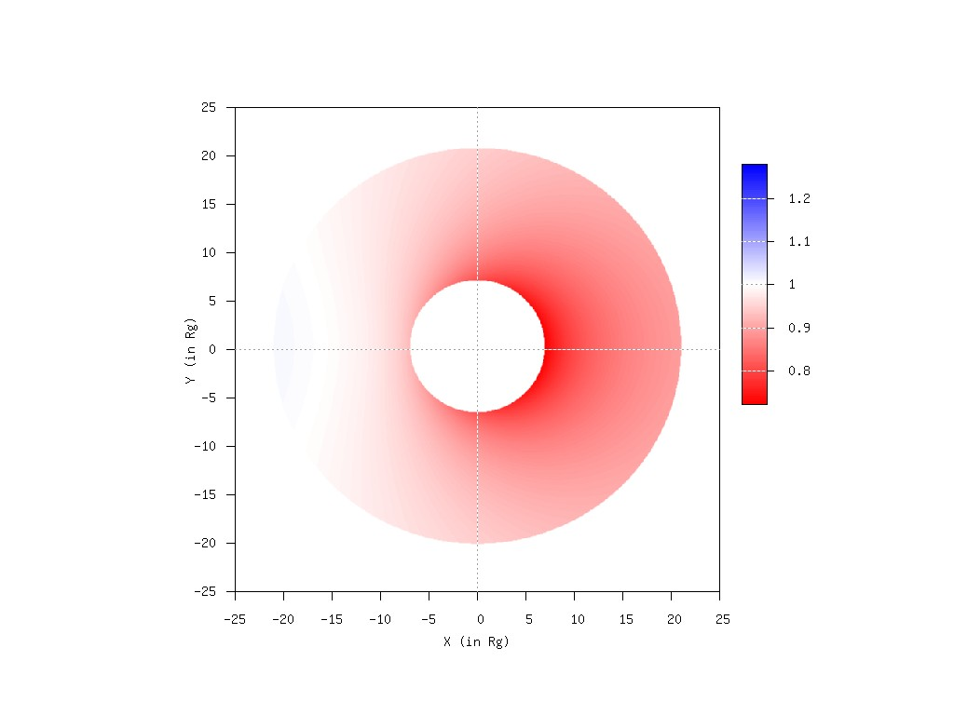
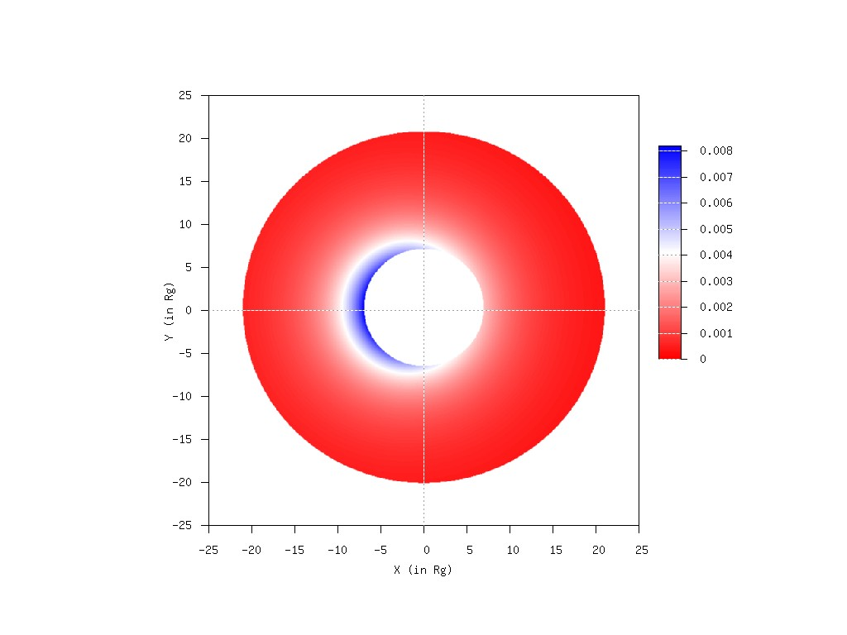
Schwarzschild black hole images
(P. Jovanovic , L.C. Popovic & А.F.Z. in preparation)
θ=15 deg
Redshift map Intensity map

Slide 6
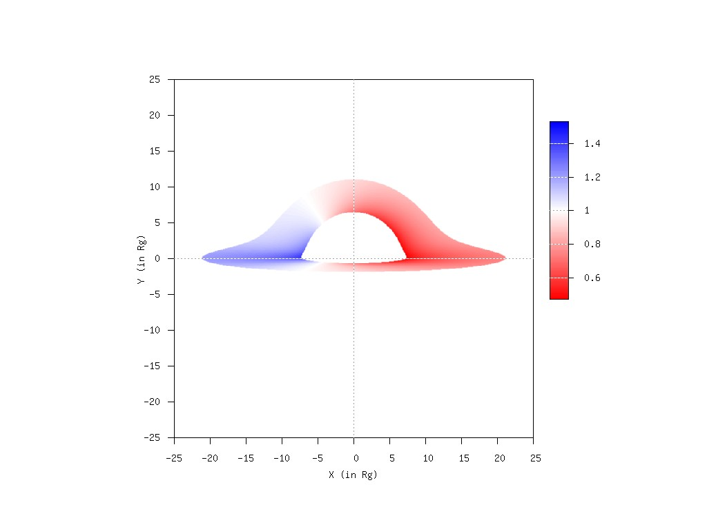
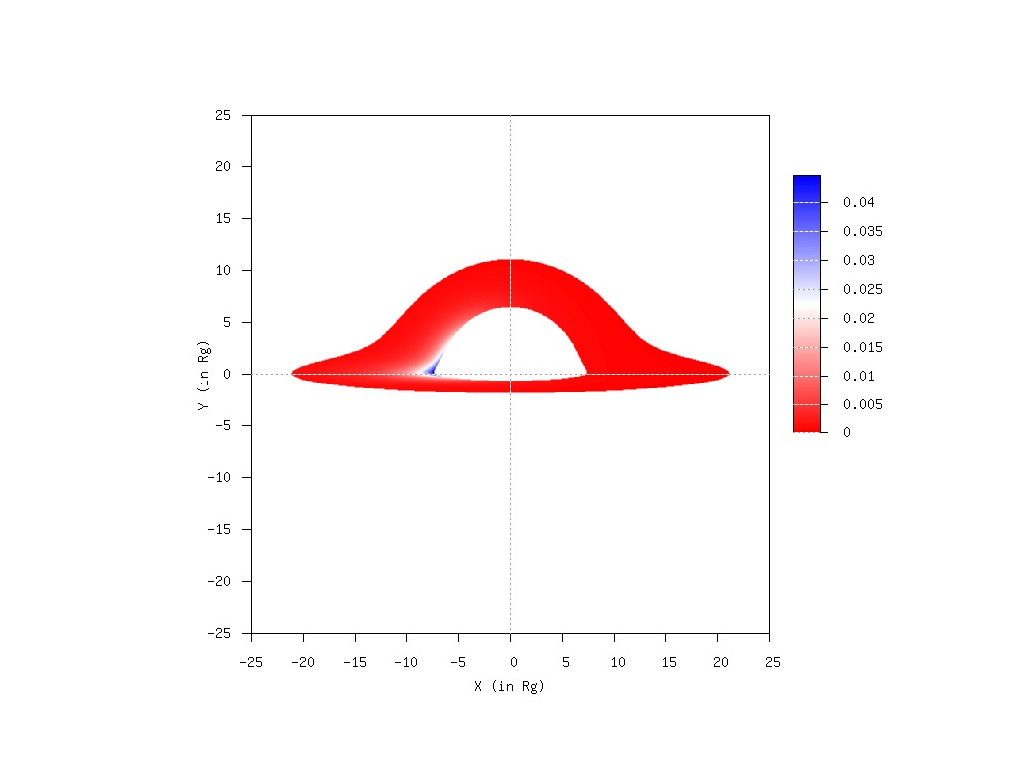
Schwarzschild black hole images: θ=85 deg
Redshift map
Intensity map

Slide 7
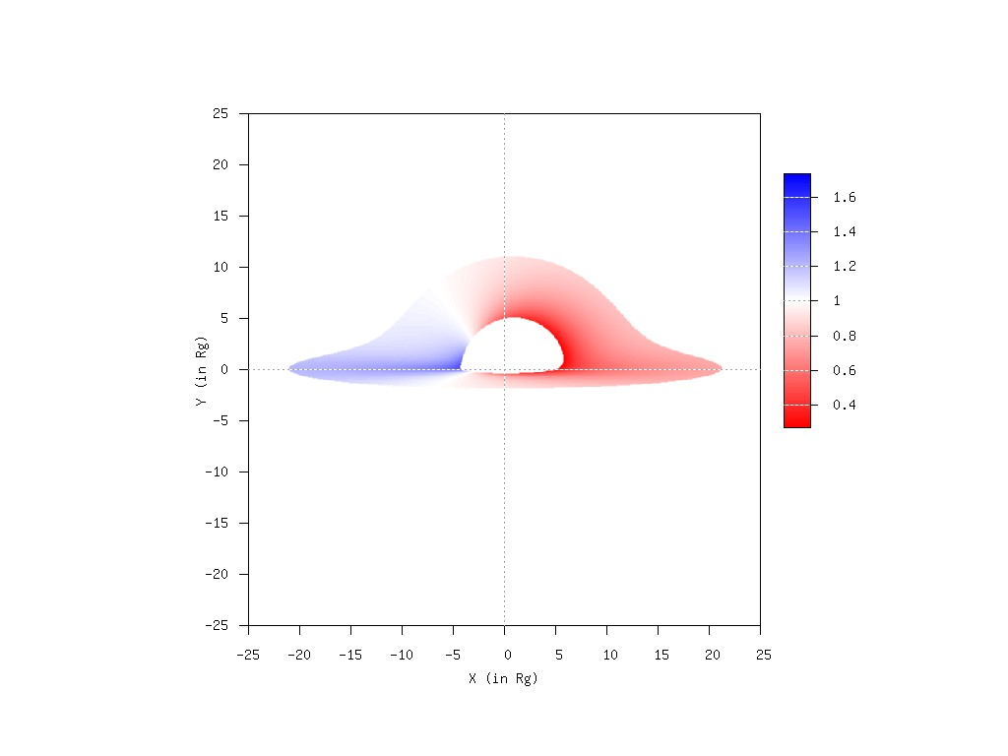
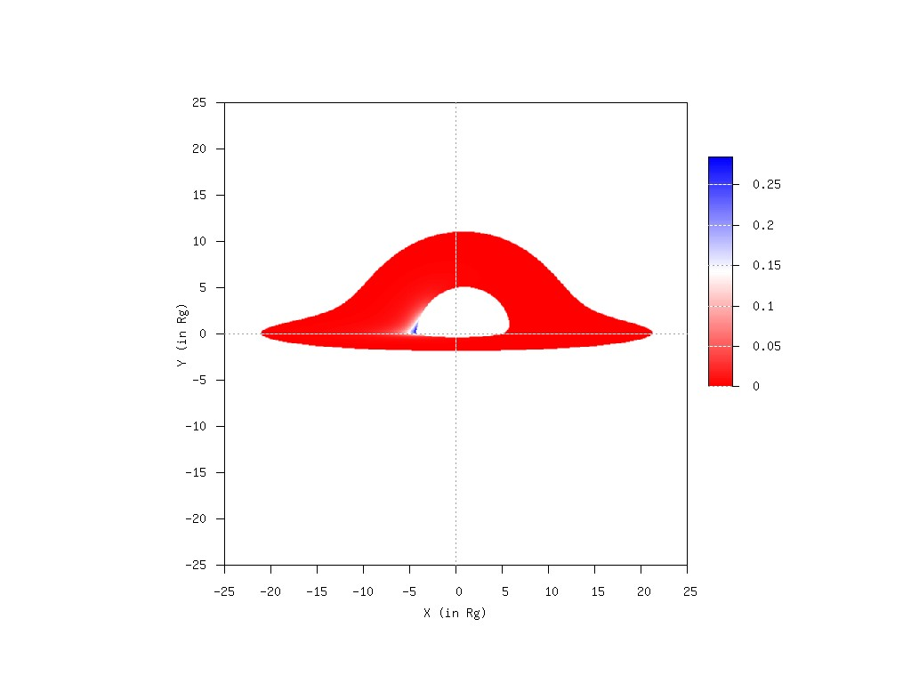
Kerr black hole images (a=0.75): θ=85 deg
Redshift map
Intensity map

Slide 8
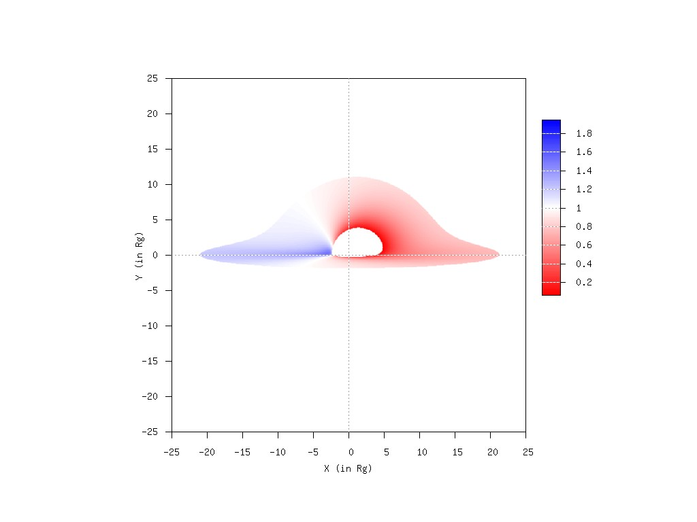
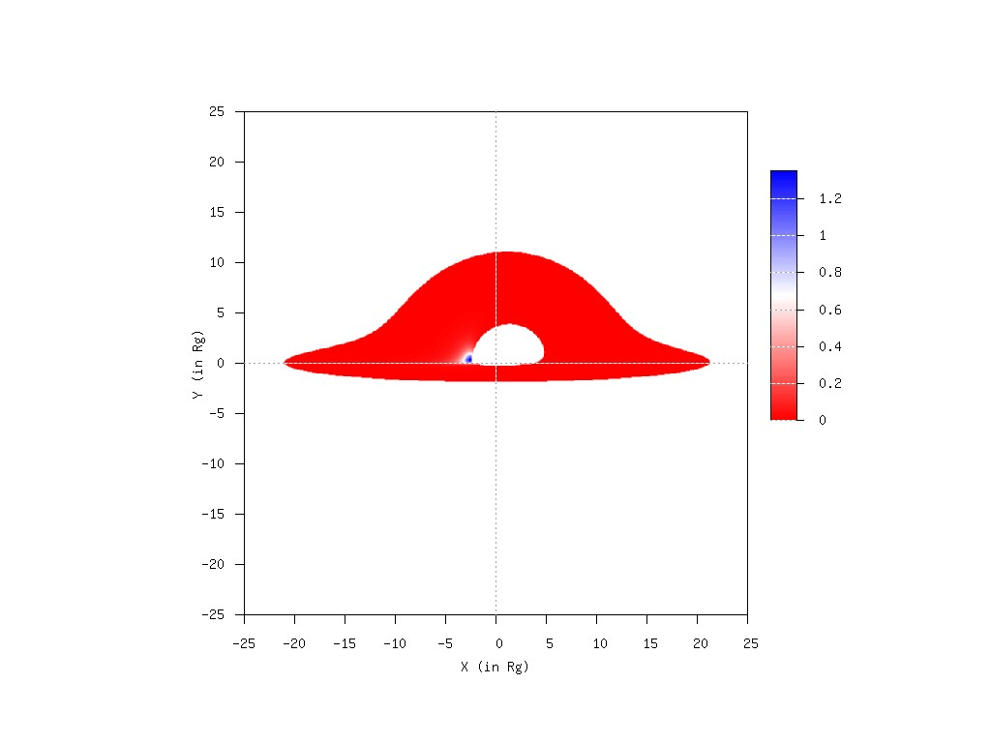
Kerr black hole images (a=0.99): θ=85 deg
Redshift map
Intensity map

Slide 9
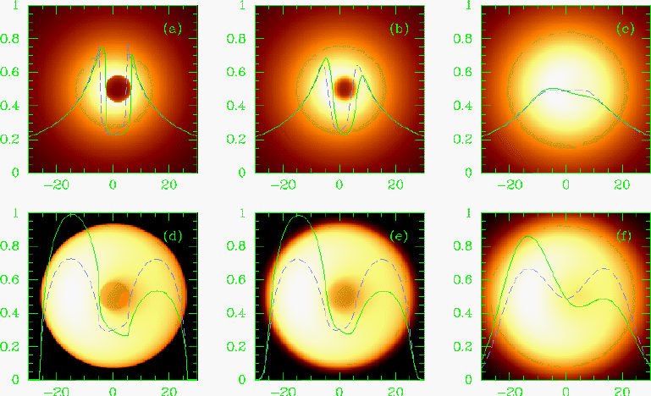
Falcke, Melia, Agol

Slide 10
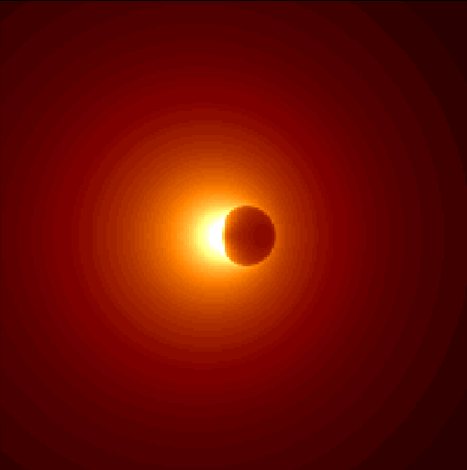
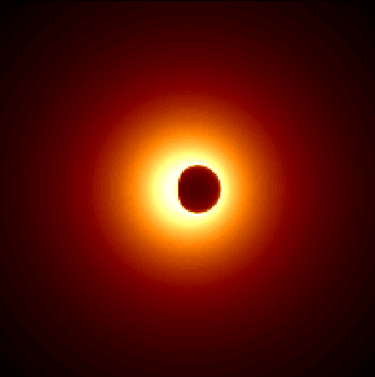
Shadows from Melia

Slide 11
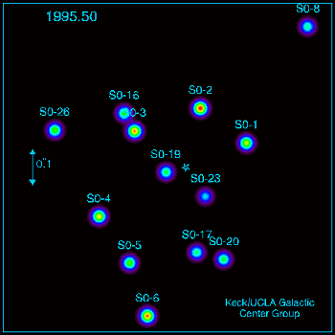

Slide 12
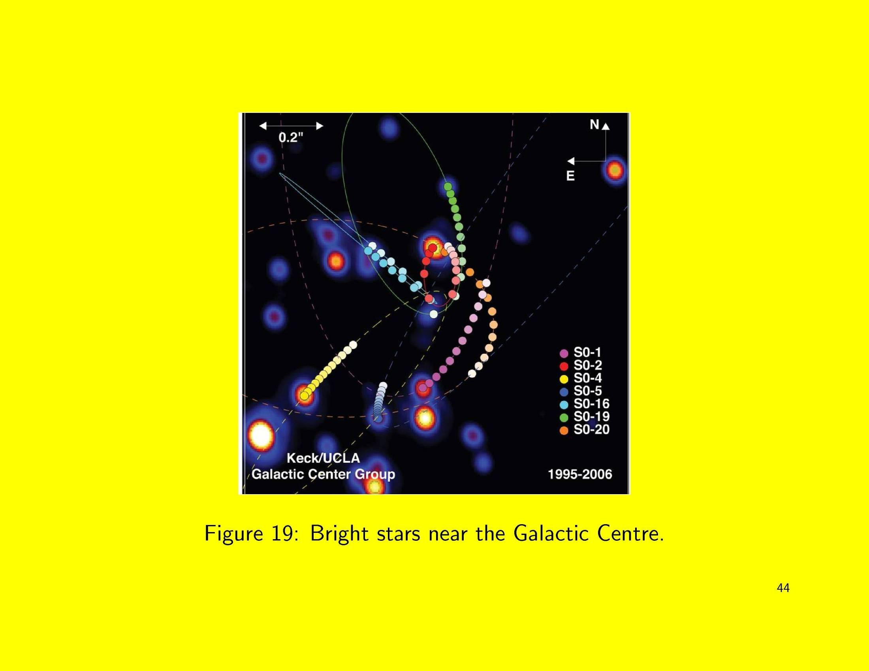

Slide 13
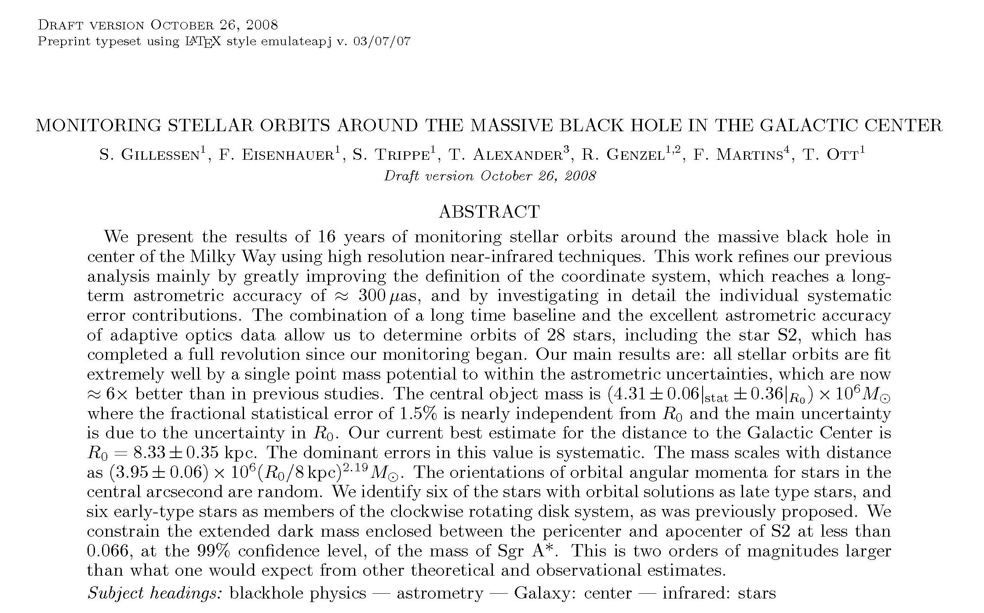

Slide 14
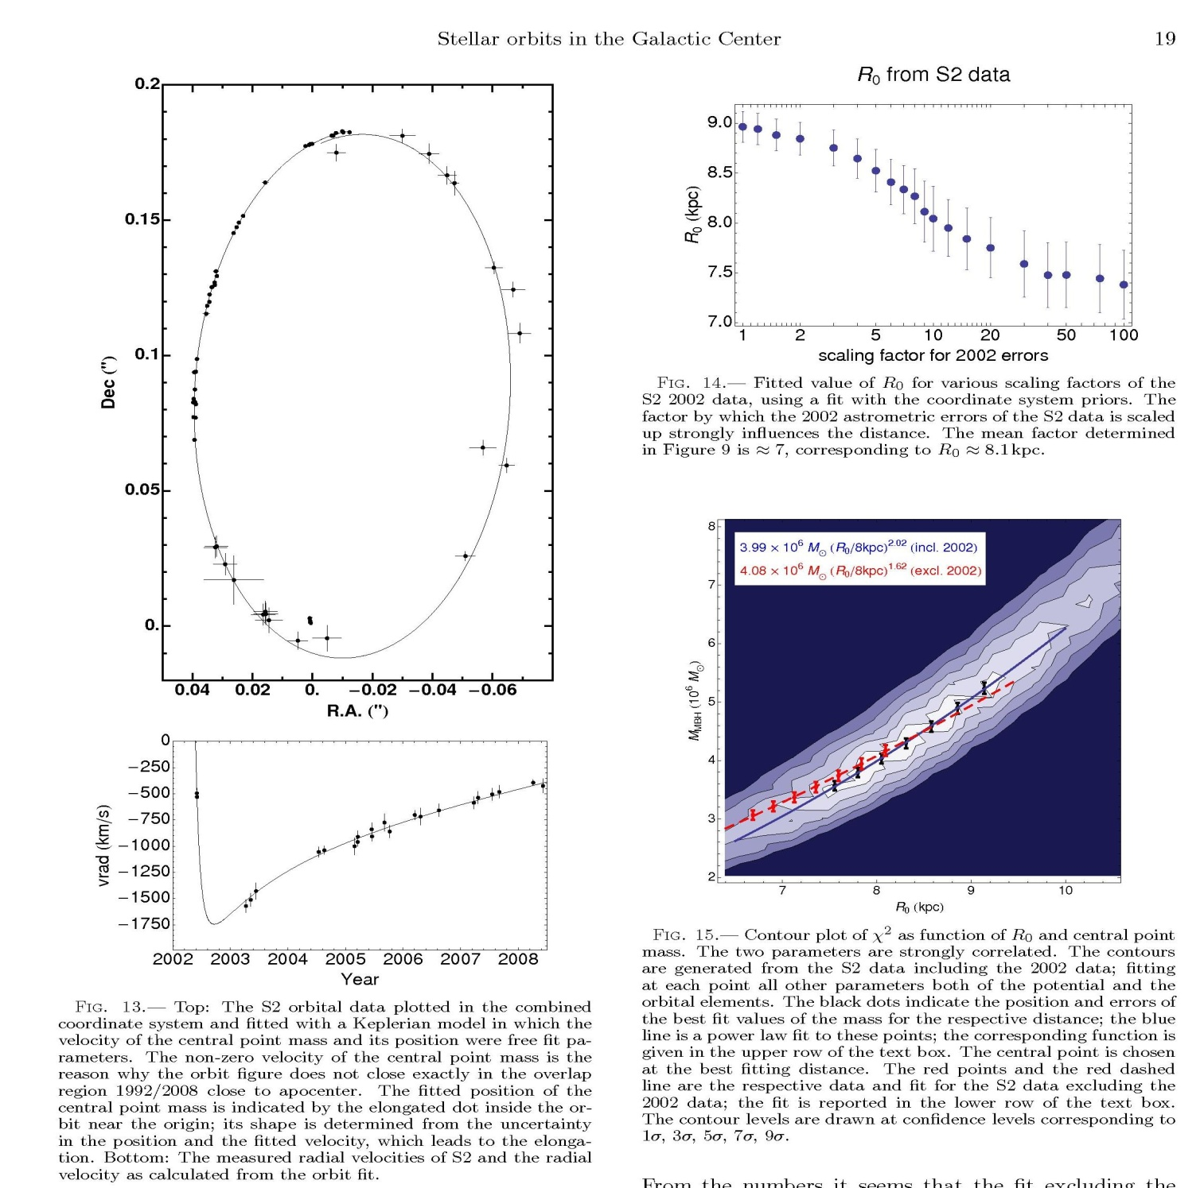

Slide 15
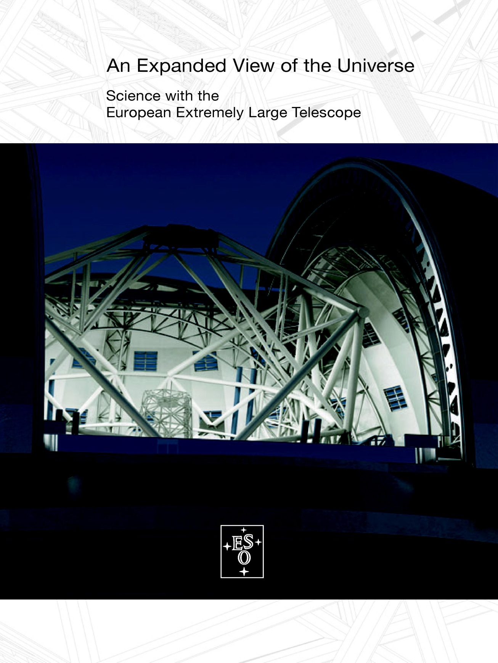

Slide 16
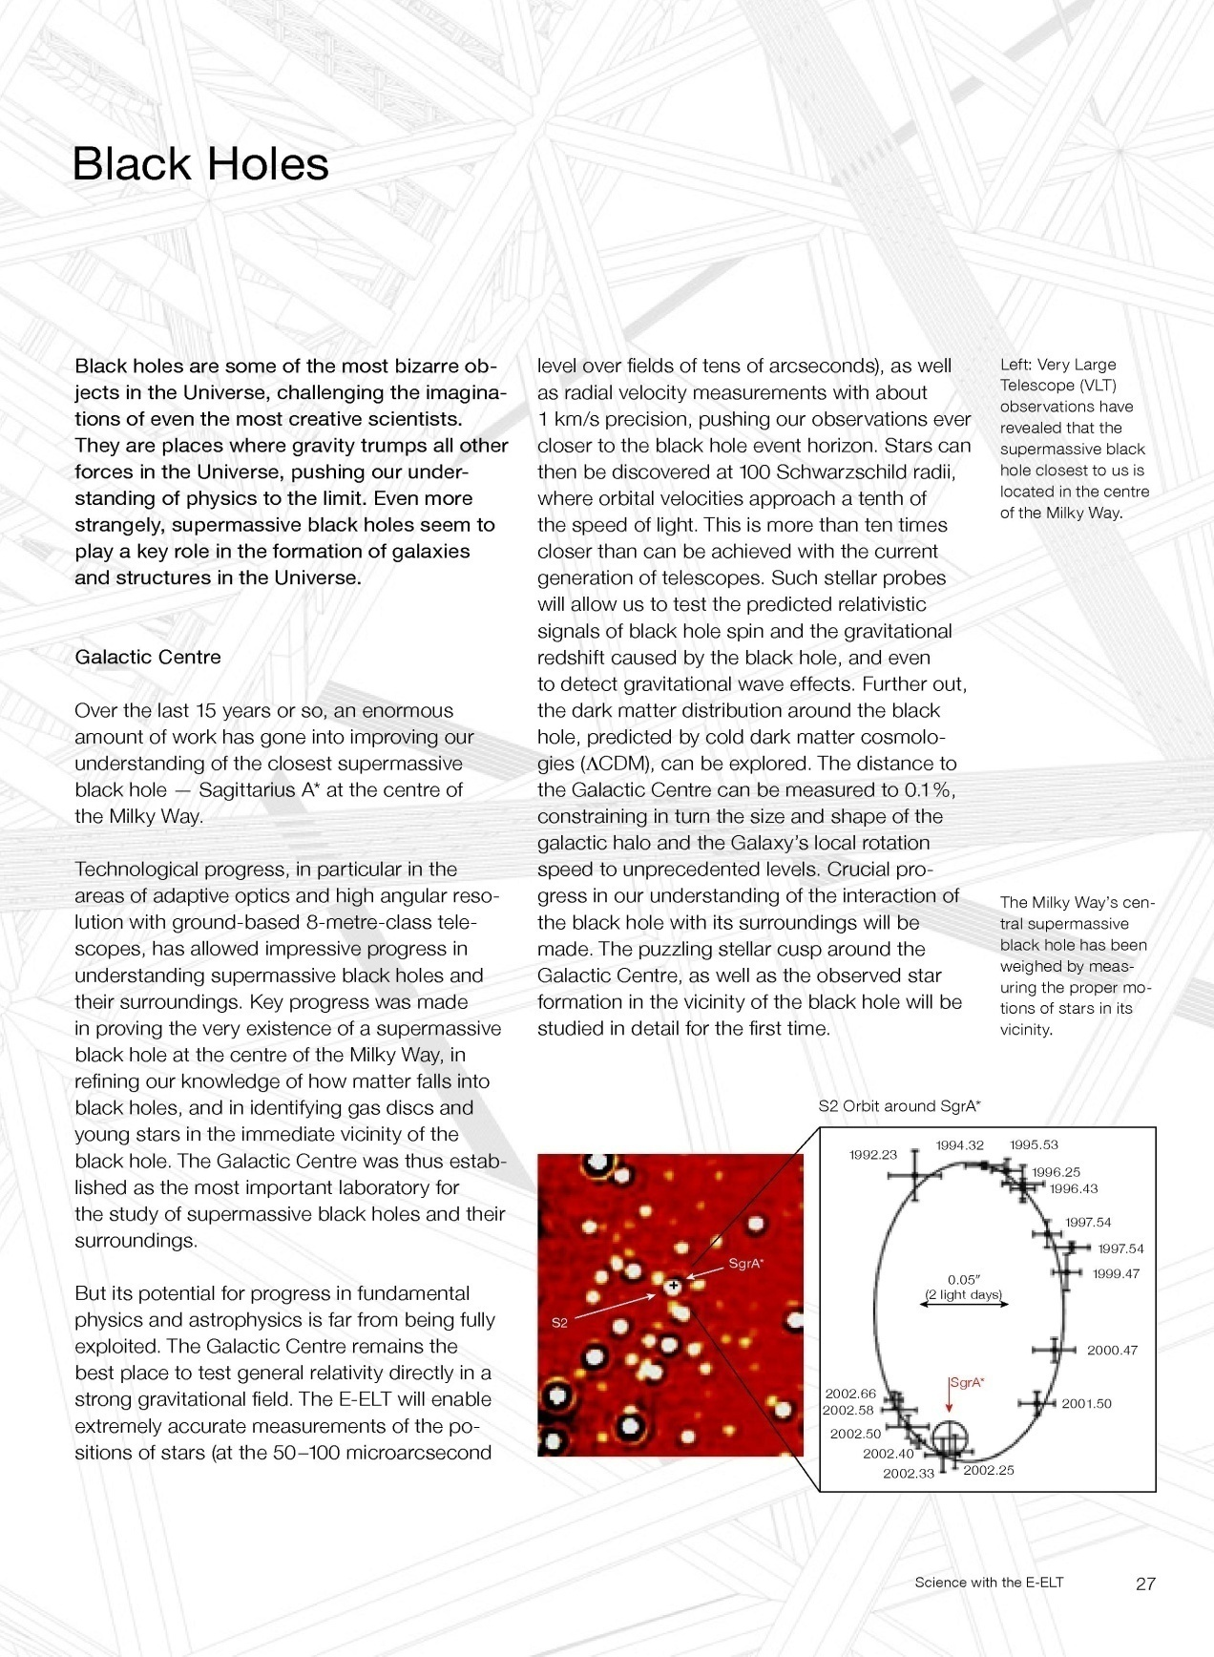

Slide 17
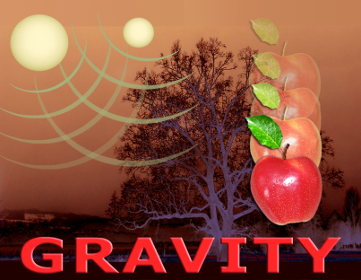

GRAVITY
Studying the supermassive black hole at the center of the Galaxy
46th Rencontres de Moriond and GPHyS colloquium 2011
Gravitational Waves and Experimental Gravity
Guy Perrin and the GRAVITY consortium
Thursday 25 March 2011

Slide 18
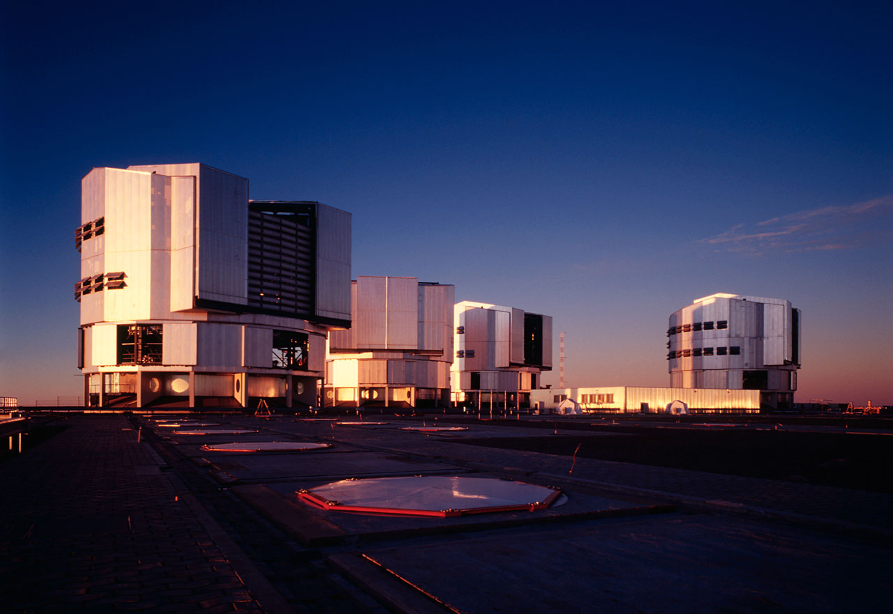
The VLT, Very Large Telescope
4 european 8 m telescopes at Cerro Paranal in Chili
λ/D @ 2 µm = 60 mas (600 a.u. or 0.003 pc)

Slide 19
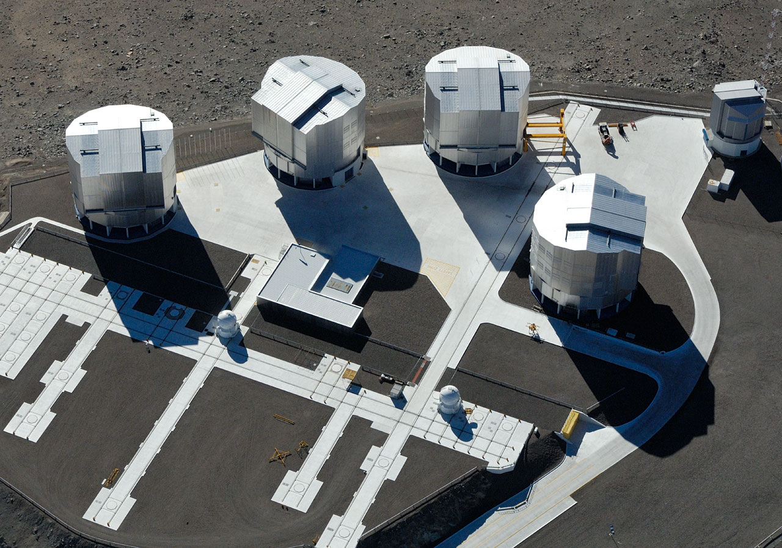
GRAVITY – 4 giant telescope interferometer
(General Relativity viA Vlt InterferomeTrY)
λ/B @ 2 µm = 3 mas (30 a.u. or 0.00015 pc)

Slide 20
Going beyond boundaries thanks to accurate spatial information
Bring the ultimate evidence that Sgr A* is a black hole: the mass is contained in the Schwarzschild radius.
Understand the nature of flares.
Use the black hole as a tool to study general relativity in the strong field regime
Study relativistic effects on nearby stars
Understand the nature of S stars and their distribution
Scale ~ 1 R_{s} 10 µas
Scale ~ 100 R_{s} 1 mas

