Slide 1
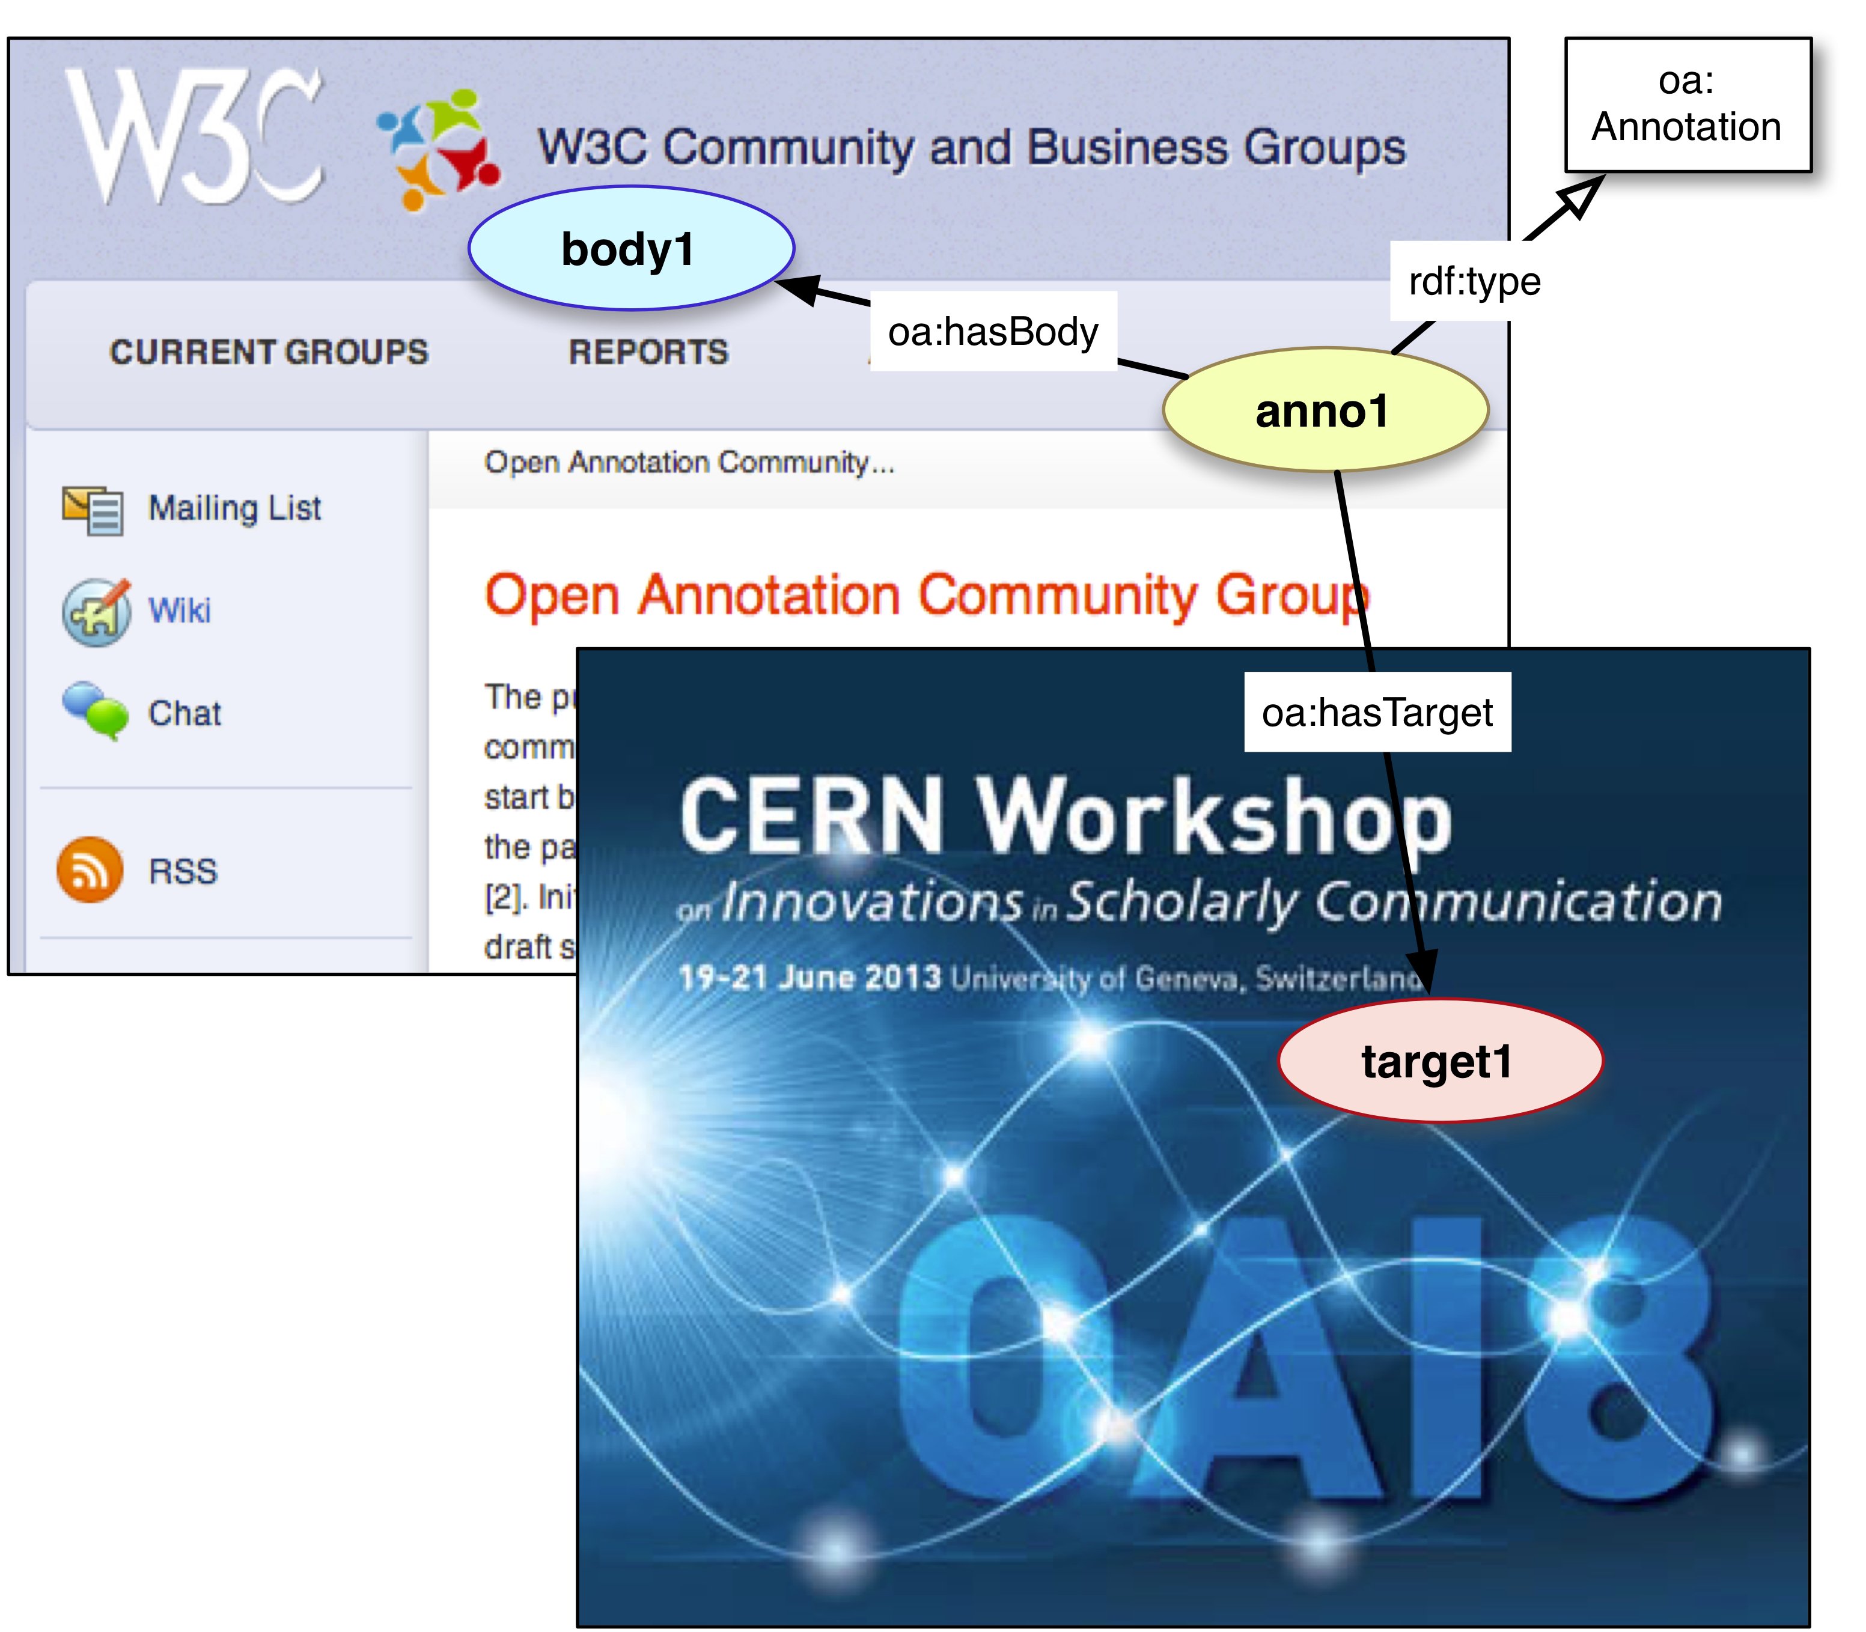


W3C Open Annotation: Status and Use Cases
Robert Sanderson
azaroth42@gmail.com
Los Alamos National Laboratory
@azaroth42
Paolo Ciccarese
paolo.ciccarese@gmail.com
Harvard Medical School
@paolociccarese
(Community Group Co-Chairs)

Slide 2
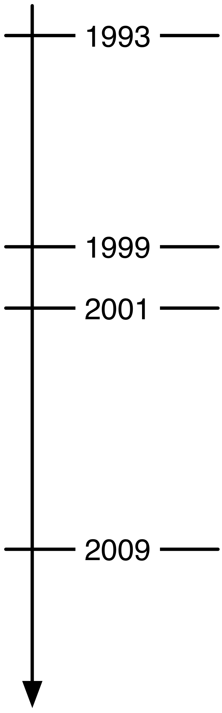
Web Annotation History
Andreessen adds and removes annotation capabilities from Mosaic
… many failed annotation start ups …
Third Voice (discontinued 2001)
W3C Annotea (nothing new after 2005)
… many more failed annotation start ups …
Google Sidewiki (discontinued 2011)
Open Annotation Collaboration
Annotation Ontology

Slide 3
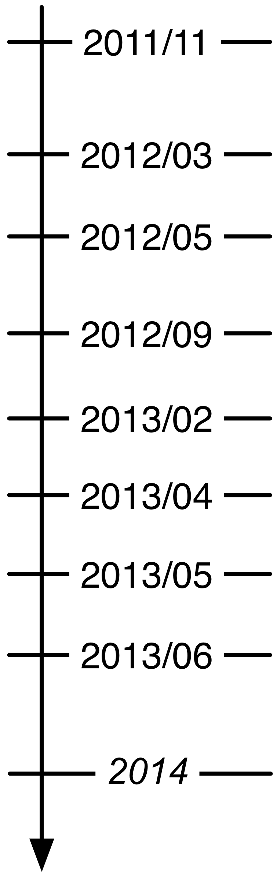
Community Group History
AO and OAC initial Face to Face in Albuquerque
Community Group Face to Face in Boston
First Draft of Joint Specification
Community Group Face to Face in Chicago
Second Draft of Joint Specification
West Coast (US) Rollout, iAnnotate13
East Coast (US) Rollout, WebSci13
European Rollout, OAI8
???

Slide 4
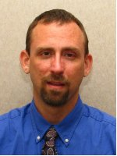
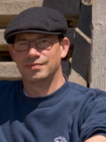

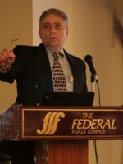


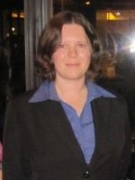


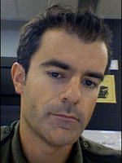

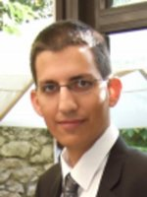

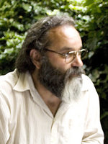


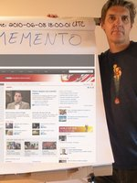

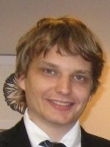
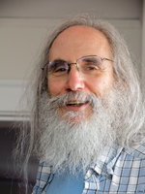







Why a Community Group?
Interoperability is made of People
http://www.w3.org/community/openannotation/

Slide 5



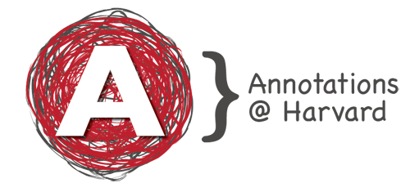
Drilling Down a Little…

Slide 6
W3C Open Annotation Community Group
Established after reconciliation of Open Annotation Collaboration and Annotation Ontology models
89 participants from around the world: 6th largest of 128 groups
Many universities, also commercial and not-for-profit
Mission:
Interoperability between Annotation systems and platforms, by
…following the Architecture of the Web
…reusing existing web standards
…providing a single, coherent model to implement
…which is orthogonal to the domain of interest
…without requiring adoption of specific platforms
…while maintaining low implementation costs

Slide 7

Why Care About Interoperability?
Users:
  Avoid vendor lock-in
  Avoid end-of-life loss of content
  Share with yourself or others using different systems

Slide 8


Why Care About Interoperability?
Developers:
  Build on existing code libraries, tools and systems
  Community of developers for questions
  Data model covers a myriad of use cases,
  No need to think them all up again

Slide 9
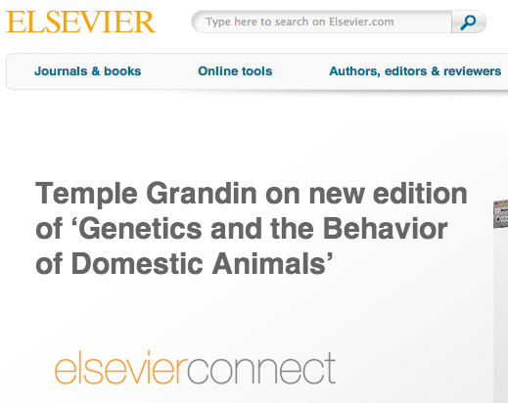
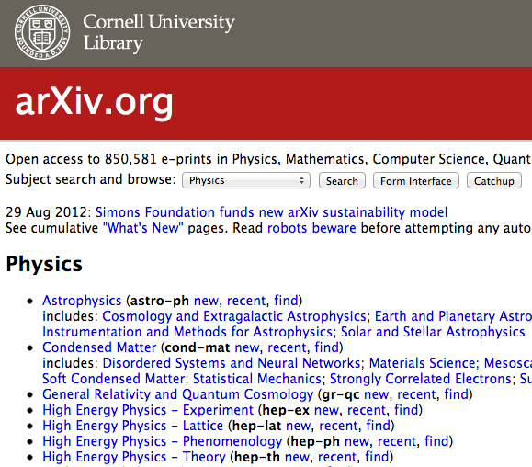
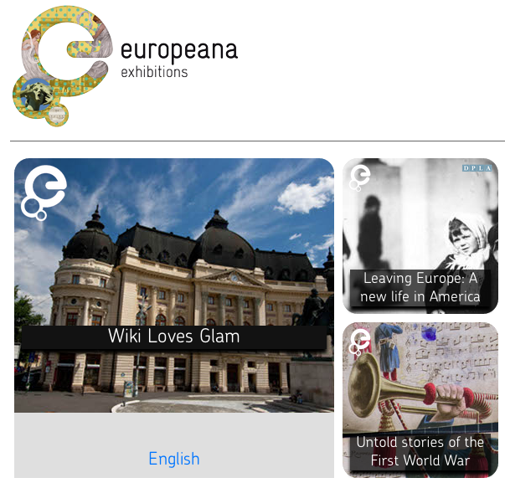
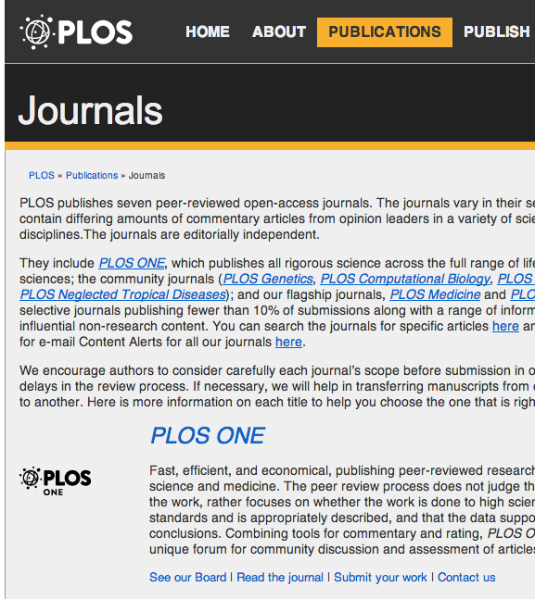
Why Care About Interoperability?
Content Providers:
  Leverage what your users are saying, where they say it
  Build community around your resources
  Consumer as Producer (Web 2.0)
  Semantic Web (Web 3.0)
  Someone else will do it…

Slide 10
Why Care About Interoperability?
Annotation is made of People!

Slide 11
What is Annotation?
“
”
An Annotation is considered to be a set of connected resources, typically including a body and target, where the body is related to the target.
Users Annotate To:
…Provide an Aide-Memoire
…Share and Inform
…Improve Discovery
…Organize Resources
…Interact with Others
…Create as well as Consume
Highlighting, Bookmarking
Commenting, Describing
Tagging, Linking
Classifying, Identifying
Questioning, Replying
Editing, Moderating

Slide 12
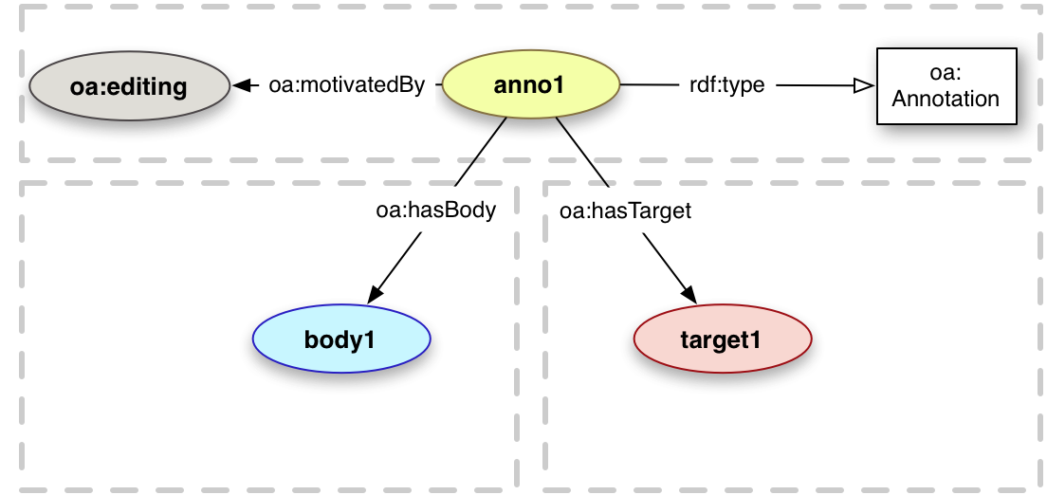
Basic Data Model
http://www.openannotation.org/spec/core/

Slide 13
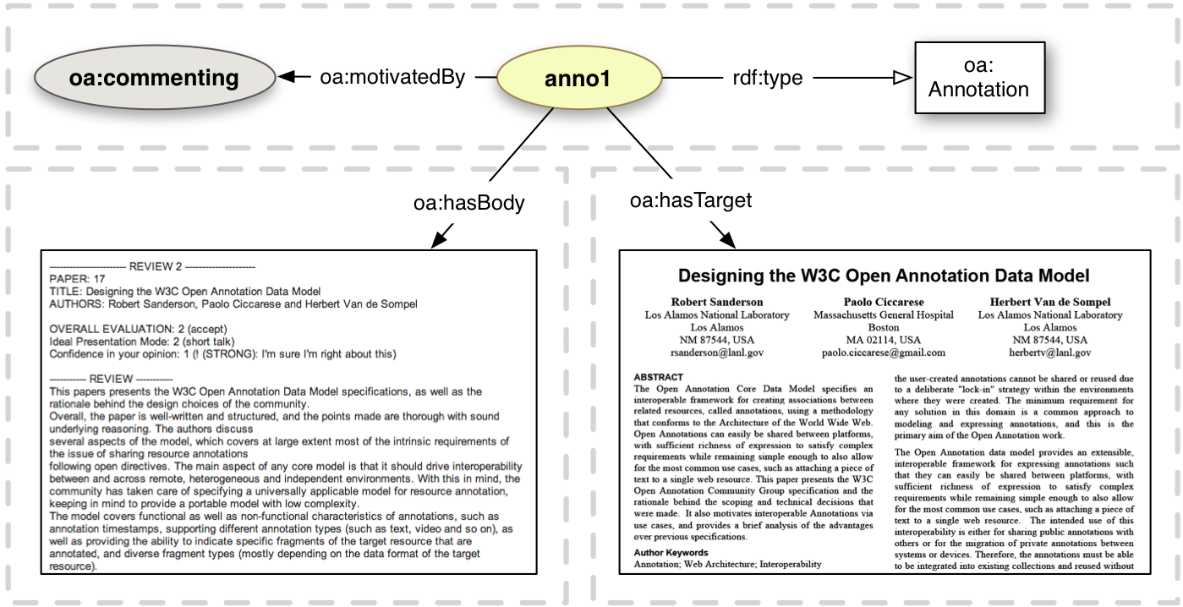
Use Case: Peer Review

Slide 14
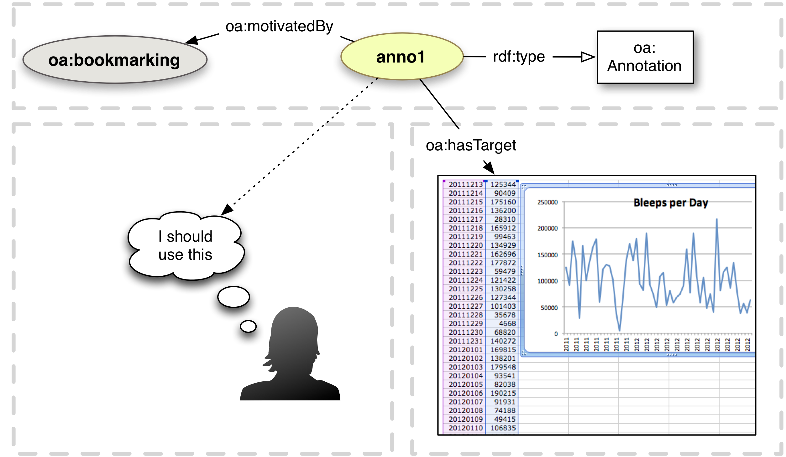
Use Case: Organization - Bookmarking

Slide 15
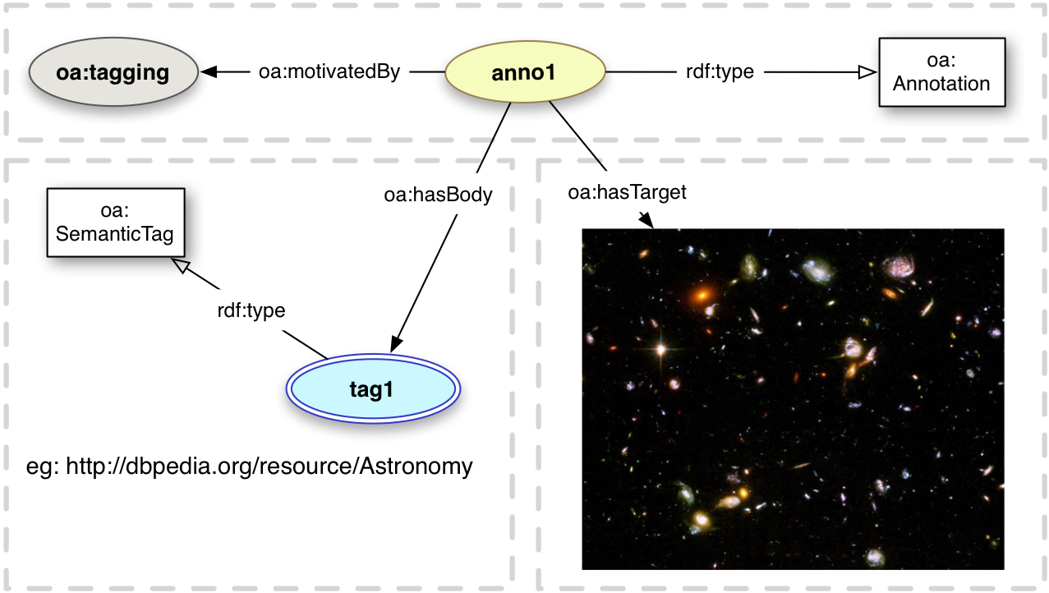
Use Case: Organization - Tagging

Slide 16
Further Specification of Resources
Specific Body and Specific Target resources identify the region of interest, and/or the state of the resource.
Need to be able to describe the state of the resource, the segment of interest, and potentially styling hints for how to render it.
We introduce:
State Describes how to retrieve representation
Selector Describes how to select segment
Style Describes how to render/process segment
Scope Describes context of the resource

Slide 17
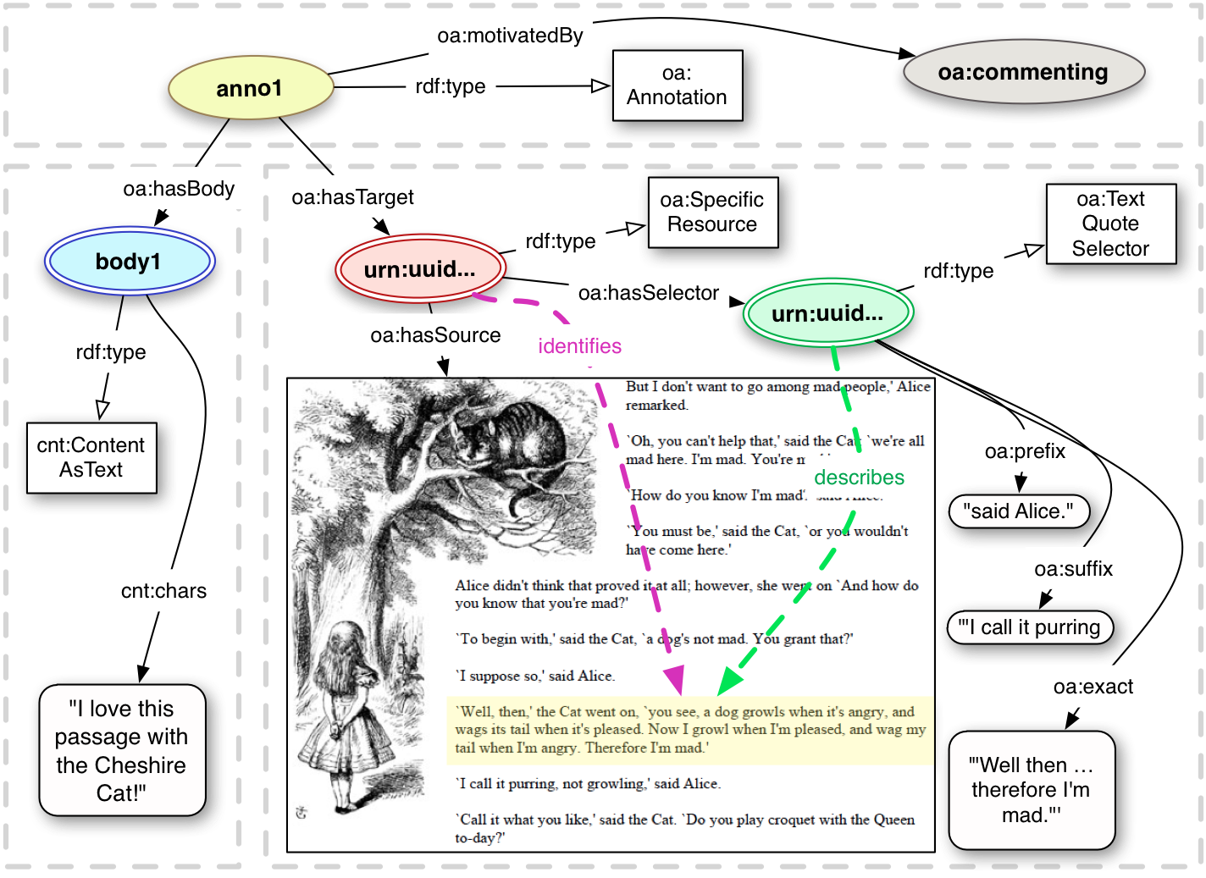
Use Case: Specific Note Taking

Slide 18
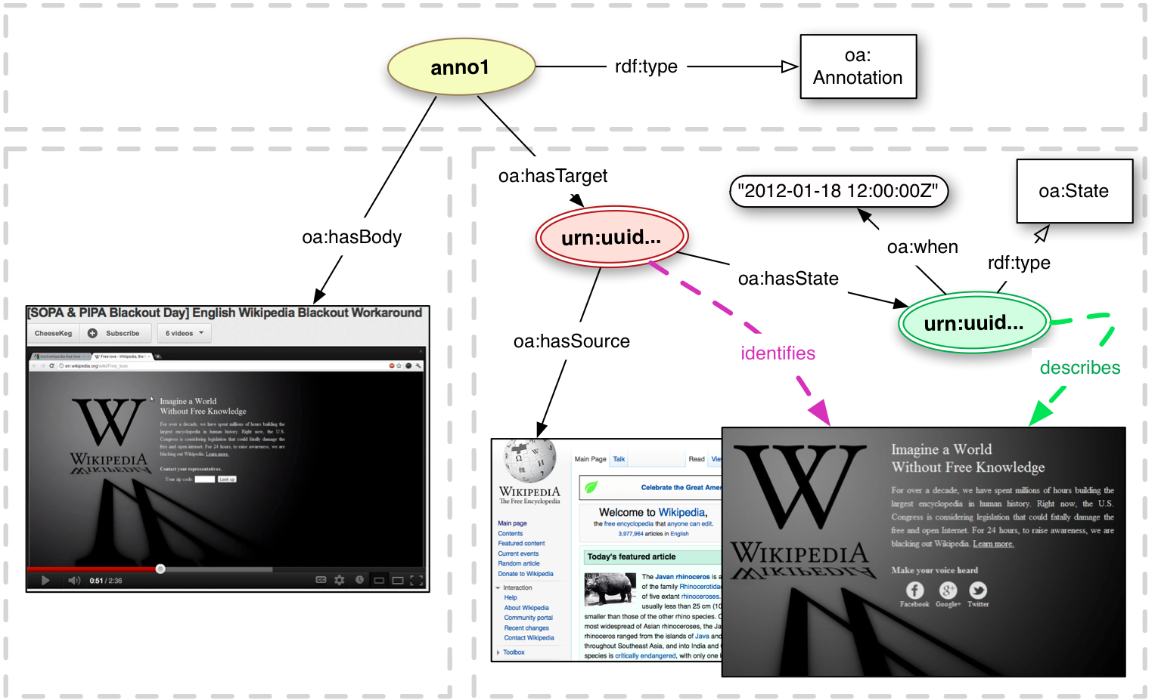
Use Case: Dynamic Knowledge

Slide 19
Future of Annotation
Model:
  Selectors for new media types
  More explicit motivations
  Collections of Annotations
Protocols:
  REST
  Search and Ranking Results
Trust:
  Reputation and Identity
  Controlling Access and Digital Signatures

Slide 20
Future of Annotation?
Challenge to know if/when to move to formal standards process
Informal (Community Group):
  More flexible
  No membership requirements
  Important for short term engagement
Formal (Working Group):
  Actually becomes a standard
  Important for long term adoption
Likely move to formal process in 2014,
unless objections or significant changes required

Slide 21
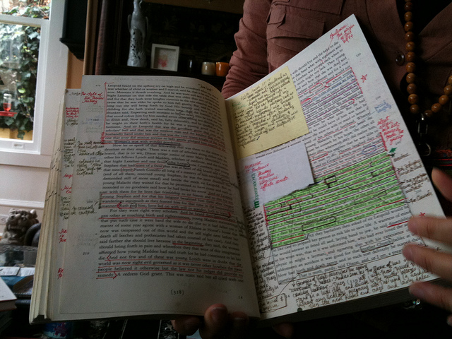
Thank You
Robert Sanderson
azaroth42@gmail.com
Los Alamos National Laboratory
@azaroth42
Paolo Ciccarese
paolo.ciccarese@gmail.com
Harvard Medical School
@paolociccarese
(Community Group Co-Chairs)
http://www.flickr.com/photos/hinkeb/5232293964/
http://www.w3.org/community/openannotation/
http://www.openannotation.org/

