Slide 1
Potential performance: pulling it all together
Thanks to Jorg, Gianluigi, Rudiger, Rhodri for their input

Slide 2
Workshop outline
Availability
Cycle
  & optics & emittance & beam loss
Systems
  BI, RF, ADT, injection, beam dump
Systems
  vacuum, cryogenics, collimation, BLMs
Limitations
  heating, e-cloud, instabilities, UFOs
2014

Slide 3
Availability
LHC is a critical asset
  5-6 billion capital cost; 300 MCHF/year operating costs
Effective fault tracking, analysis etc. for targeting weak-points, improvements are mandatory
Some team (AWG perhaps) need to be give a mandate and resources to put in place an effective, robust solution for the re-start.
  note other initiatives… operational issue management as part of the Maintenance Management project

Slide 4
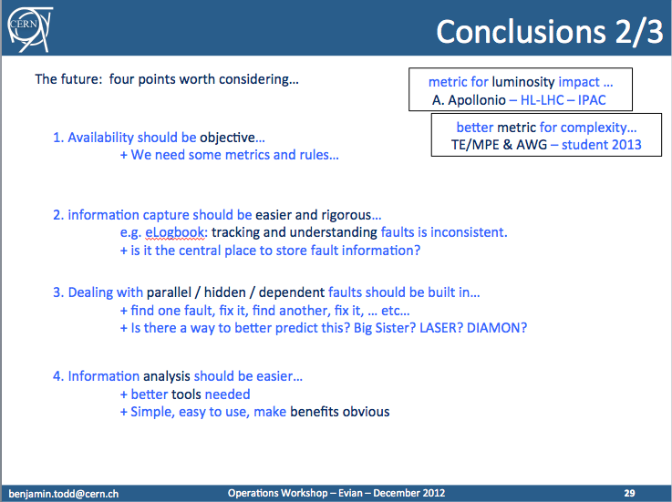

Slide 5
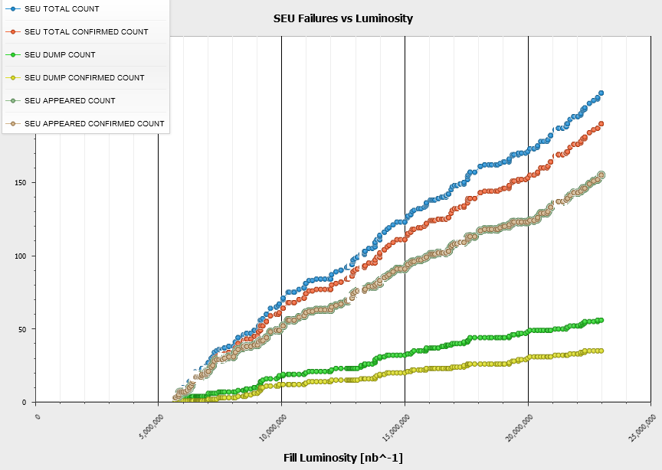
R2E: Past/Present/Future
2012 SEE Failure Analysis
2011
Several shielding
campaigns prior
the 2011 Run +
Relocations ‘on the fly’
+ Equipment Upgrades
~12 dumps per fb⁻¹
2011/12 xMasBreak
‘Early’ Relocation
+ Additional Shielding
+ Equipment Upgrades
~3 dumps per fb⁻¹
2012
R2E-Project aiming for …
< 0.5 dump per fb⁻¹
>LS1 (nominal -> ultimate)
Equipment relocations @ 4 LHC Points
(>100 Racks, >60 weeks of work)
Additional shielding
Critical system upgrades (QPS, FGC)
We owe R2E and the concerned equipment groups a huge thank you

Slide 6

Machine protection
Some interesting probes of failure space this – still learning
  OFSU
  LBDS 12V
  BSRT mirror
  TL collimators
  Injecting H9
MD enforcement
Workshop….

Slide 7
Cycle
Operational cycle is well optimized and transfers reasonably to 7 TeV
“Aggressive” modifications
  precycle non MB to less than 7 TeV
  combined ramp and squeeze
  partial squeeze with colliding beams
  beta* levelling
    Options for these two and possible implementations need to be explored
    An effective solution should be in place for post LS1
Operational robustness – first priority
  personally I wouldn’t rely completely on reproducibility
Start up with conservative cycle, then become more aggressive when the dust has settled.

Slide 8
Spectrometers
Switch crossing angle in point 8 to vertical at injection, while being elegant solution, implies global change of aperture limit to point 8 – implications to be fully explored
(Lack of) possibility to rotate beam screen during LS1 to be confirmed..
Bernhard Holzer

Slide 9

Systems
Delphine
  Iron fist in a velvet glove

Slide 10
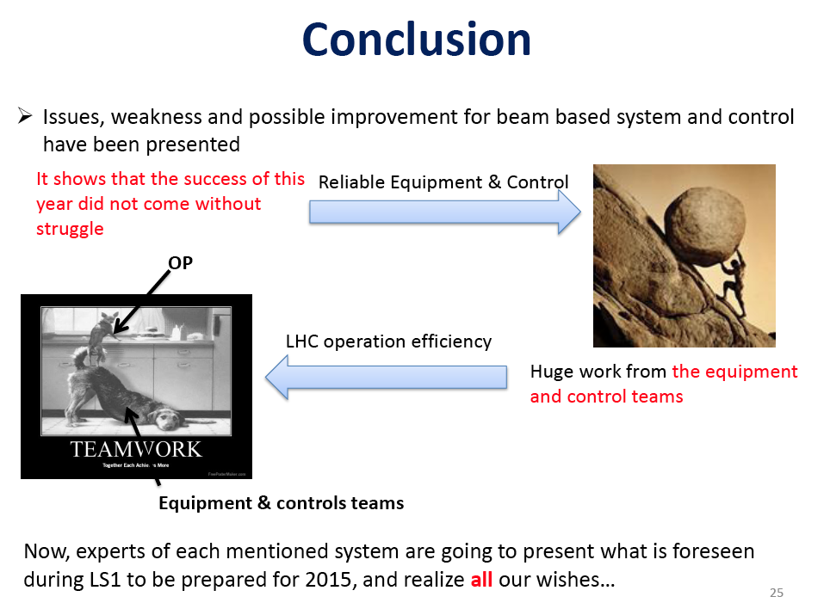

Slide 11
Systems
Systems (BI, RF, ADT, Injection, LBDS)
  in general very good performance
  mature systems – issues identified – improvements planned
  imagine these coming back post LS1 in good shape
  with appropriate time dedicated to re-commissioning and tests

Slide 12
Systems
BI
  DOROS looking very encouraging – certainly address IR requirements – triplet BPMs thus equipped could certainly help lumi stability in beta* levelling
  Interlocked BPMS should not dump the beam when the bunch intensity drops below Ne10
  Orbit feedback review incoming
  High intensity test for BSRT required in the New Year
  Abort gap monitoring from an MP perspective…
RF
  importance of cavity voltage set-point modulation for 25 ns
  cryo module 1B2 to be replaced
  Heating/bunch length – distribution is key

Slide 13
Systems
Injection
  MSE current ripple
  flat-top orbit variation in SPS
  It weren’t always the satellites – correct for the right problem - diagnostics
  288b looks good
  Sunglasses LICs – follow-up, follow-up….
  TDI – even after refurbishment – does this remain a risk?
LBDS
  New TCDQs
  Common mode failure on 12V line – addressed but worry about increasing probability of asynchronous dump with additional interlocks
  Higher voltages on switches at 6.5 TeV – increased risk of erratics

Slide 14
ADT
ADT
  it’s good, it’s mature and getting better
  operational rigour identified as a possible issue in expert setting management
  Do we keep the witness bunches?
    Yes – any objections?
  ADT2 post LS2 will require some concerted recommissioning

Slide 15
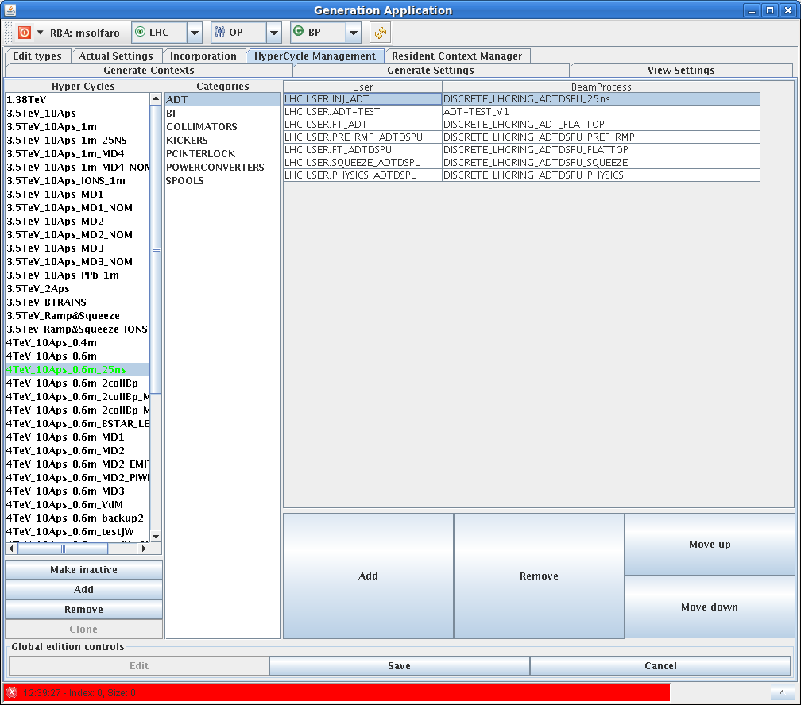
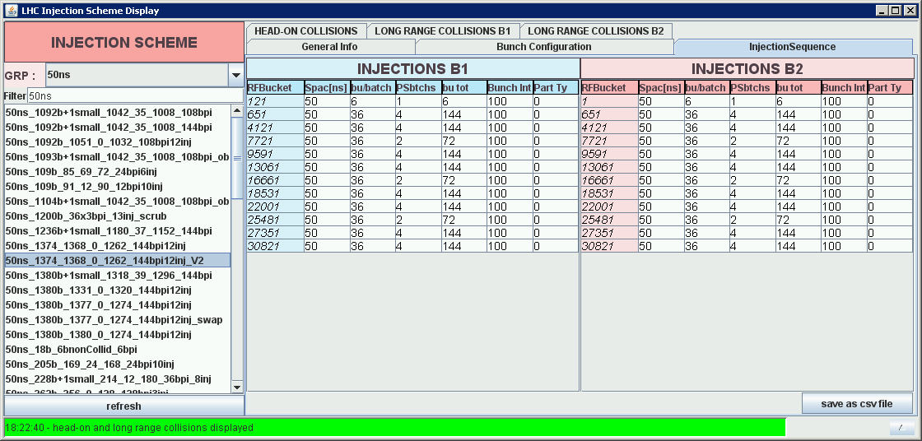
ADT Settings management
Why not yet automatic?
Could be made automatic, but it requires stringent control of the process from the OP side!
25ns Hypercycle was using ADT 50ns beam process for several days!
According to this we are injecting precisely 1e11 ppb since 2008…

Slide 16
Controls
Major infrastructure upgrades planned – commissioning time required
  don’t forget requirements of ongoing TI monitoring etc.
Timing/cycle management – improvements required and incoming – coherent approach required
Data analysis tools – yes, yes, yes
We’ve learnt a lot, we know how to operate the machine – “Can we do it better?”
  Note for Operations!!!!
    ergonomics and software coherency in the CCC is barely acceptable
Steen Jensen

Slide 17
Session 4a summary
Performance limitations: 2012 review and 2014 outlook (6.5 TeV, 25ns, higher total I...)
Courtesy Gianluigi

Slide 18
Limitations
Guidelines:
  Levelling by separation is to be avoided
  Long range separation of 10 (12) sigmas in IP1/5 for 50(25) ns operation and 15 sigmas in IP2/8
  Non colliding bunches to be avoided
25 ns preferred for single beam instability
We will have to operate at high octupole current and high damper gain/bandwidth (50 turn damping time).
Old octupole polarity is preferred for single beam stability
Schemes for going in collision as fast as possible should be pursued. IP1 and IP5 should be staggered.
  Go fast – keep it simple

Slide 19
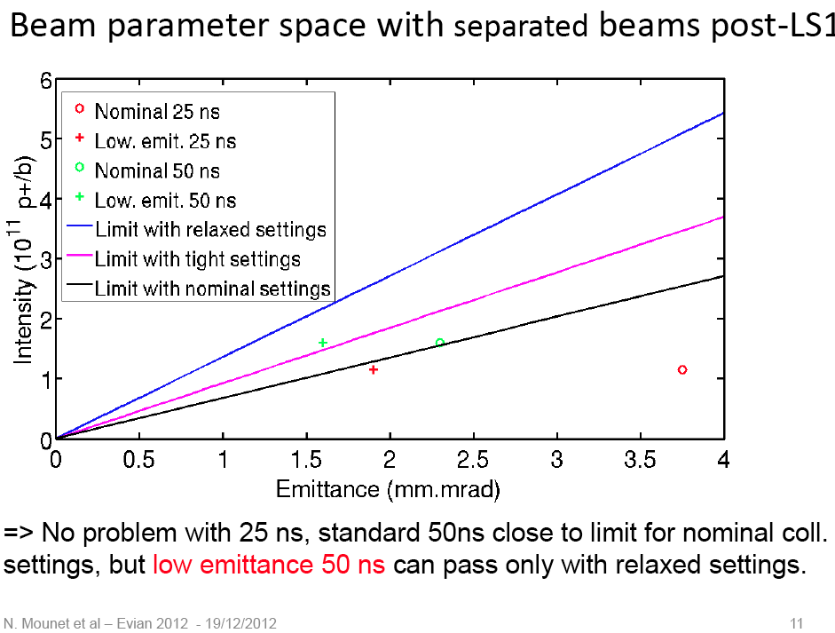

Slide 20
Limitations
Heating will remain an issue (in particular upgrade of TDI should be pursued).
Maximum bunch length should be pursued compatibly with maximum extension of the luminous region 1.35/1.4 ns seems to be within reach

Slide 21
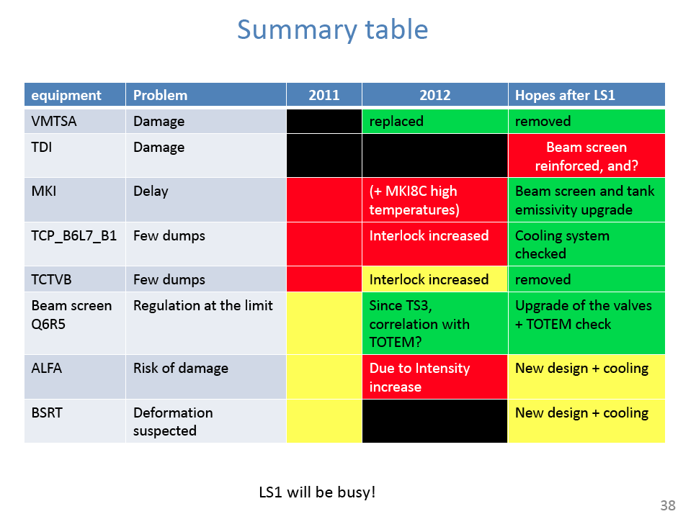
Beam induced heating
Benoit Salvant

Slide 22
25 ns & electron cloud
There is a change of mode of operation with 25 ns. Electron cloud free environment after scrubbing at 450 GeV seem not be reachable in acceptable time.
Operation with high heat load and electron cloud density (with blow-up) seems to be unavoidable with a corresponding slow intensity ramp-up.
Will start with a new (unconditioned) machine
Will need to start with 50 ns and only later to move to 25 ns to recover vacuum, cryogenics, UFOs conditions we were used in 2012

Slide 23
25 ns & electron cloud
Scrubbing in 2012 limited by heat load in the stand alone at 450 GeV and in the arcs at 4 TeV.
Triplet cryogenic limit on luminosity
  1.7e34 cm⁻²s⁻¹ (+/- 20%)
Need to change the valve poppets for sector 34 arcs and stand-alone magnets to increase margin and electron dose rate during scrubbing by up to factor 2.
Do we need interlocks on temperatures (possibly integrated)?

Slide 24
Cryogenics
Scaling with 2015 beam parameters shows sufficient margin with respect to local and global cooling limitations by implementing the following consolidations:
  Consolidation of the Cu braid configuration on 6/8 IT (planned for LS1)
  Increase of the maximum flow coefficient of the BS control valve of the standalone magnets (seat and poppet exchange) -> compatible with e-cloud deposition of 1.6 W/m per aperture -> to be planned for LS1
Laurent Tavian

Slide 25
Session 4b summary
Performance limitations: 2012 review and 2014 outlook (6.5 TeV, 25ns, higher total I...)
Courtesy Rudiger

Slide 26
Vacuum, Giulia Lanza
All RF non-conformities repaired
Vacuum interlocks with (tight) required for integrity of the vacuum system (e.g. NEG coating)
Vacuum interventions need a lot of care – to minimize unacceptable conditions after the interventions
No particular issues for scrubbing
2015: SEY etc. will be reset - initial conditioning required – better to start with 50 ns

Slide 27
UFOs
UFOs: showstopper for 25 ns and 6.5 TeV?
  10x increase and harder UFOs
  (but no increase in low intensity fills)
UFO “scrubbing”: does it work? What parameters?
Deconditioning expected after LS1
Operational scenario to be developed: start with lower energy and/or 50 ns beam, ….
What priority from physics: high integrated luminosity versus high energy collisions as soon as possible
Tobias Baer

Slide 28
BLM thresholds - past experience.
Eduardo Nebot Del Busto
Modified BLM layout is essential – otherwise thresholds to prevent quenches fro UFOs in dipole magnets are too low
  Risk of magnet quenching must be accepted at the start
We need to plan for beam induced quenches !
  BLM thresholds in arc to be set above expected quench threshold (as propose in Chamonix 2012 for 2012, but not done)
Can we use different algorithms to detect UFOs from BLMs?
  E.g. validation time as for QPS?
Quench tests will hopefully give more insight – important for establishing thresholds
Noise: optimistic that BI will solve this issue
Triplets: IR8 will be in the shadow of 1 and 5

Slide 29
Cleaning and collimator operation – outlook,
Belen Maria Salvachua Ferrando
Excellent performance and fast setting up and validation
  TCL collimators reduced luminosity debris
Improvement expected with buttons
Move only primary collimators (very) close to the beam to limit impedance?
Different scenarios for collimation settings proposed
Pessimistic scenario (larger emittance)
  β* = 70cm at 25ns
  β* = 57cm at 50ns
Optimistic scenario (H9 emittance)
  β* = 37cm at 25ns
  β* = 30cm at 50ns
Quench tests will provide more input
Start with a relaxed approach

Slide 30
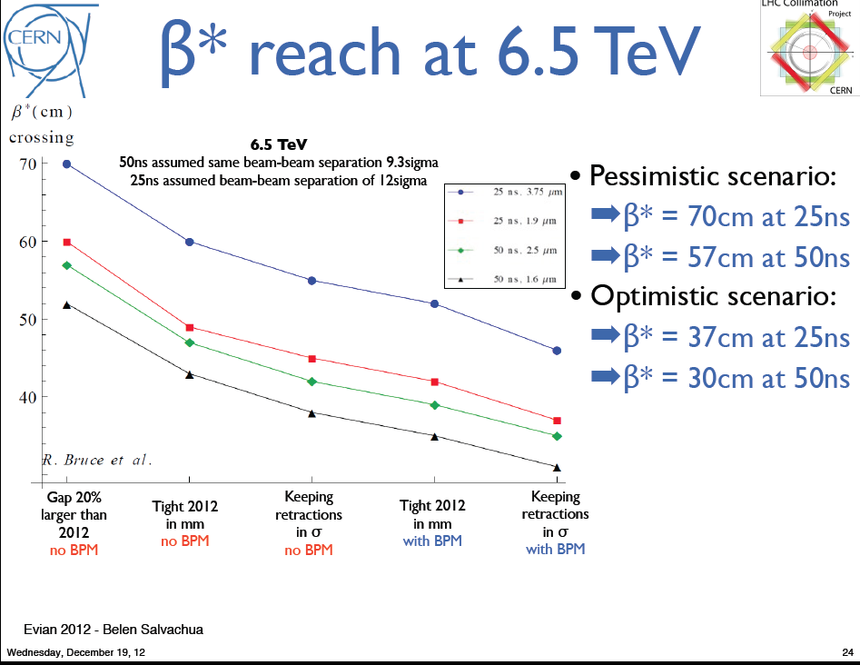

Slide 31
Emittance preservation,
Maria Kuhn
Q20 and Q26 end up the same in physics
Wire-scanner calibration as an issue:
  WS ne Lumi etc.
Sitting on 50 Hz at injection causes blow-up but not in ramp…?
Blow-up during ramp still not understood

Slide 32

Summary Optics and dynamic aperture at 4 at 6.5 TeV, Rogelio Tomas Garcia
Excellent understanding of linear and nonlinear optics (including corrections)
1% errors in MQY – nice find
MO, MCO and MCOX can be used to increase Landau damping to an equivalent of 1100 A, but DA is a concern… to be tested
Beating, injection tunes, injection beta*, optics, luminosity predictions used below used below
4 to 10 shifts!

Slide 33
After LS1

Slide 34
Post LS1
“It’s going to be like after a war”
Serge Claudet
In what forum do we track, coordinate system tests, cross-system tests, dry runs etc.?

Slide 35
Parameters
Energy | 6.5 TeV
Bunch spacing | 25 or 50 ns
Transfer line collimators | 4.5 sigma
Injection tunes | 0.31/0.32 (tbc)
Injection beta* | 7 m (tbc)
Optics | flat ATS (tbc)
beta* | I didn’t see less than 30 cm
beta beating | 3%
Chromaticity | 10 - 20
Collimators | nominal +50% tight +10% relaxed -25%
Octupole current | Between +550 and -550 A
Damper gain | To the max

Slide 36
Cycle
Inject into collision tunes at beat* = 7 m
Combined ramp and squeeze
Ramp, squeeze, collide, squeeze
Pre-cycle non MB magnets to < 6.5 TeV
Triplet strengths in 2 & 8 to be brought down at some point
Staggered collisions

Slide 37
Beam from injectors LS1 to LS2
 |  | Bunch intensity [10¹¹ p/b] | Emittance,[mm.mrad] | Into collisions
25 ns ~nominal | 2760 | 1.15 | 2.8 | 3.5
25 ns BCMS | 2520 | 1.15 | 1.4 | 1.9
50 ns | 1380 | 1.65 | 1.7 | 2.3
50 ns BCMS | 1260 | 1.6 | 1.2 | 1.6
While recognizing Rende’s numbers

Slide 38
50 versus 25 ns
 | 50 ns | 25 ns
GOOD | Lower total beam current Higher bunch intensity Lower emittance | Lower pile-up
BAD | High pile-up Need to level Pile-up stays high High bunch intensity – instabilities… | More long range collisions: larger crossing angle; higher beta* Higher emittance Electron cloud: need for scrubbing; emittance blow-up; Higher UFO rate Higher injected bunch train intensity Higher total beam current
Expect to move to 25 ns because of pile up…

Slide 39
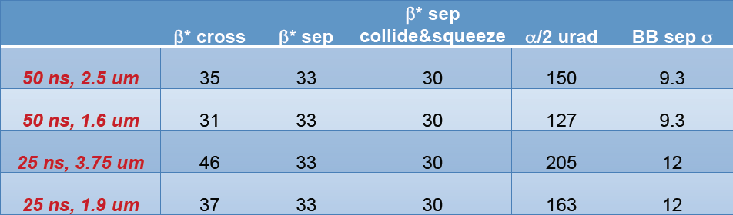
Beta* & crossing angle
Courtesy Roderik Bruce
Collimation Scheme |  | Beta* [cm] 25ns | Half X-angle [microrad] 25 ns | Beta* [cm] 50 ns | Half X-angle [microrad] 50 ns
S1 | Same in mm | 50 | 190 | 40 | 140
S2 | Same in sigma | 45 | 200 | 35 | 150
S3 | 1 sigma retraction | 40 | 210 | 30 | 160
S4 | Low emittance | 40 | 150 | 40 | 120

Slide 40
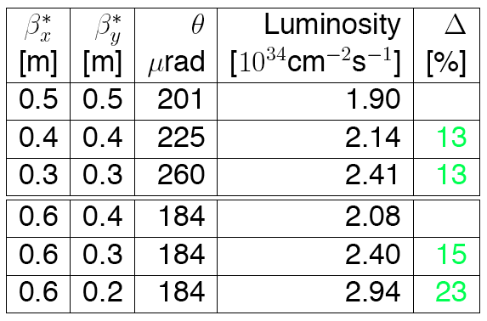
50ns H9

Slide 41
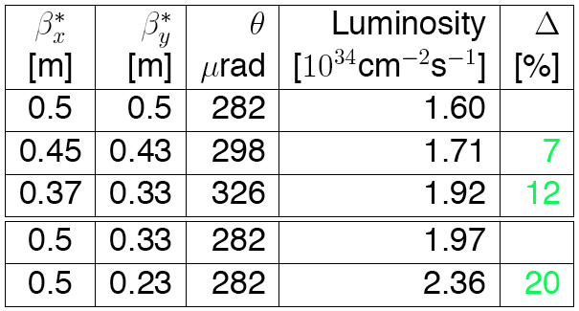
25 ns H9

Slide 42
Potential performance
 | Number of bunches | Ib LHC FT[1e11] | Collimator scenario | Emit LHC (SPS) [um] | Peak Lumi [cm-²s⁻¹] | ~Pile-up | Int. Lumi [fb⁻¹]
25 ns | 2760 | 1.15 | S1 | 3.5 (2.8) | 9.2e33 | 21 | 24
25 ns low emit | 2320 | 1.15 | S4 | 1.9 (1.4) | 1.6e34 | 43 | 42
50 ns | 1380 | 1.6 | S1 | 2.3 (1.7) | 1.7e34 level 0.9e34 | 76 level 40 | ~45*
50 ns low emit | 1260 | 1.6 | S4 | 1.6 (1.2) | 2.2e34 | 108 | …
6.5 TeV
1.1 ns bunch length
150 days proton physics, HF = 0.2
70 mb visible cross-section
* different operational model – caveat - unproven
All numbers approximate
OLD NUMBERS

Slide 43
In words
Nominal 25 ns
  gives more-or-less nominal luminosity
BCMS 25 ns
  gives a healthy 1.6e34
  peak <mu> around 40
  83% nominal intensity
Nominal 50 ns
  gives a virtual luminosity of 1.7e34 with a pile-up of over 70
  levelling mandatory
BCM 50 ns
  gives a virtual luminosity of 2.2e34 with a pile-up of over 100
  levelling even more mandatory

Slide 44
Comments
50 ns implies the existence of a robust levelling technique
A non EC free 25 ns?
  bench marked very recently…
The 25 ns will bring issues:
  UFOs, beam inducing heating, vacuum
Low emittance 25 ns option is attractive for a number of reasons
  lower total beam current, performance…

Slide 45
2015 strategy – for discussion
Low intensity commissioning of full cycle – 2 months
  First pass machine protection commissioning and validation
First stable beams – low luminosity
Intensity ramp-up – 1 to 2 months
  Commissioning continued: system (instrumentation, RF, TFB etc.), injection, machine protection, instrumentation…
  Variables: bunch intensity, number of bunches, emittance
  Pass straight to 50 ns, step up in no. batches
  Scrubbing for a few days will be required early on
50 ns operation (at pile-up limit)
  Characterize vacuum, heat load, electron cloud, losses, instabilities, UFOs, impedance
  Nominal bunch intensity, 40 cm, 2.3 microns gives 9e33 cm⁻²s⁻¹ and a pile-up of around 40
Options thereafter:
  2 weeks scrubbing for 25 ns, say 1 week to get 25 ns operational (if beta* and crossing angles are changed), intensity ramp up with 25 ns
  Commission levelling of 50 ns and push bunch intensity up, emittance down…

Slide 46
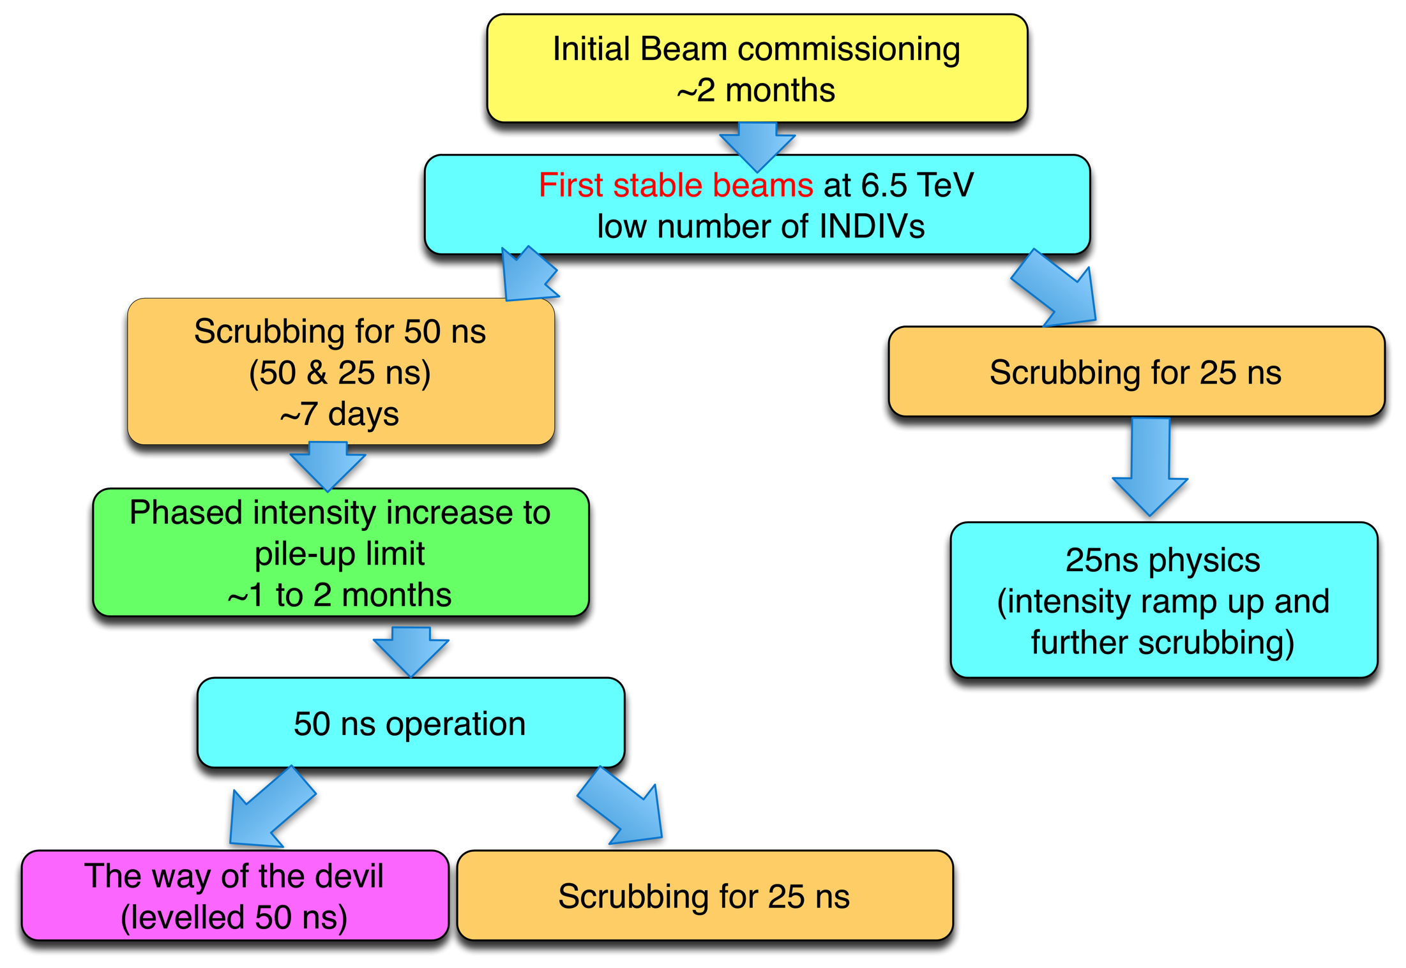

Slide 47
Conclusions
Magnetically, optically, operationally well understood
System performance
  generally good to excellent
  issues identified and being addressed
Limitations well studied, well understood and quantified
25 ns it is (via 50 ns)
  but in a non EC free environment at least initially

Slide 48
Misc eternal questions
Eternal can we minimize or be more flexible with the technical stops

