Slide 1
PLC NANO MANAGING SAFETY FUNCTIONS
acting on electrical power
for MEY/NA Experiments/Barracks

Slide 2
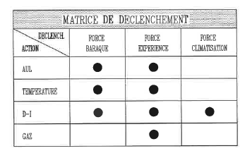
PLC TYPE AND FUNCTION
PLC SCHNEIDER of type TSX-NANO (TSX-07 312422), out of production by SCHNEIDER
Installed by EL at the end of the ’90’s
It manages safety inputs, such as FIRE, GAS, TEMPERATURE and AUL to cut the power of the Experiment and/or its barracks and/or its clim, based on the logic below:

Slide 3
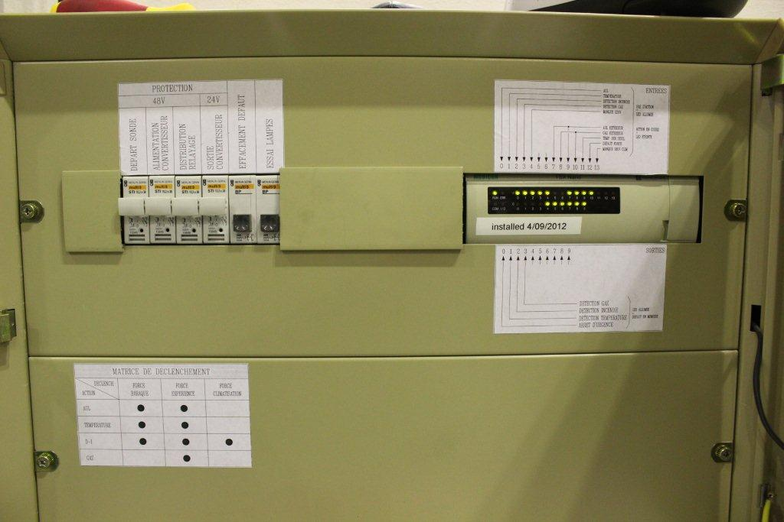
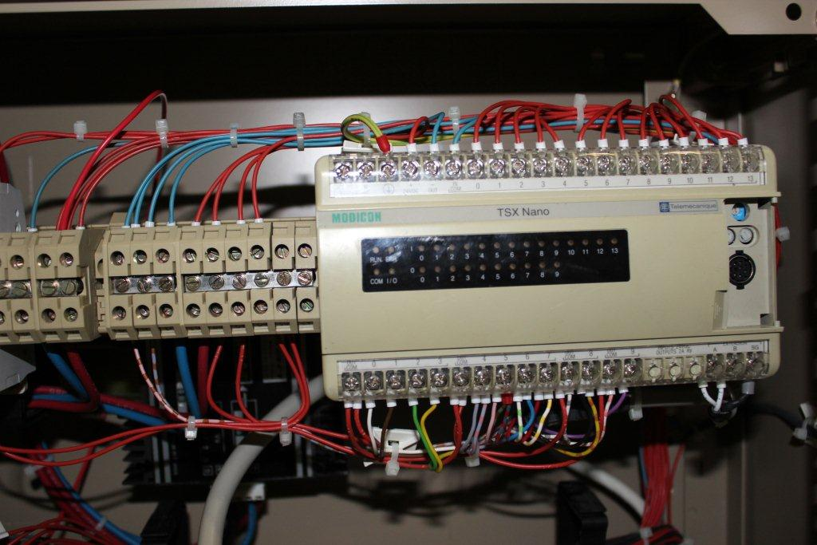
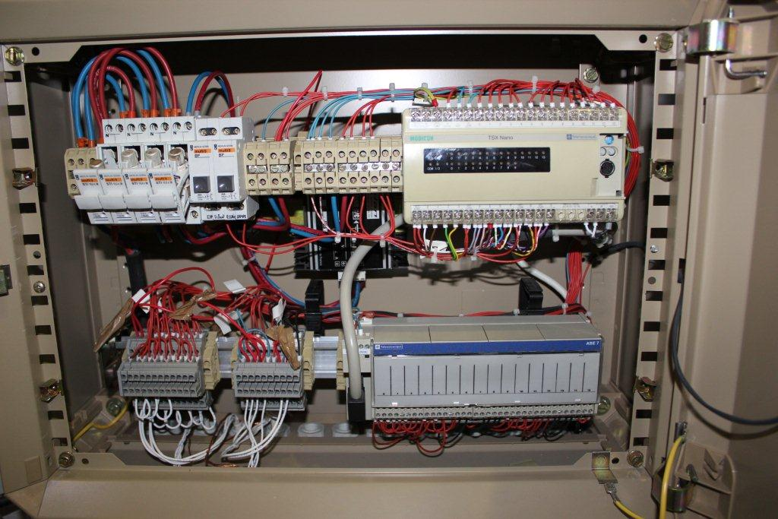
Some photos

Slide 4
POWER CUT OF ALPHA EXP.
After the power cut of ALPHA Experiment (193 - AD Complex) on the 28/07/2012, due to failure of a PLC NANO, a MERI was issued (EDMS 1234142) and the incident discussed during a TIOC meeting.
The Group EL clarified that, although the PLC’s had been installed by EL based on Users request at the time, they are are not EN/EL responsibility, nor within EL competences and mandate.

Slide 5
NUMBER OF PLC installed
An inventory has been done by EL in the mean time. 21 PLC’s of this type have been found in Meyrin and North Area experimental areas:
            3 in AD
            2 in West Hall
            7 in East Hall
            1 in nTOF
            3 in EHN1
            5 in EHN2

Slide 6
Current situation
By a visual inspection of the installations, it has been noted that the majority of inputs are bridged (Temp, Gas,..) and some are not even cabled.
In West Hall 2 PLC’s still running could be dismantled since all inputs are bridged (no more beam lines).
2 versions of PLC software programs have been found (with a minor variant between the 2 programs).
A general PLC electrical drawing exists, that would need to be crosschecked for each installed PLC (to mark what is really cabled and what it is not).

Slide 7
Common approach for all PLC
Due to the obsolescence of the material, the installation and the difficulty to have PLC NANO spares, all PLC’s will have to be replaced
  In the mean time the 2 PLC in WH could be removed and kept as spare
The visual inspection in the PLC rack proved that a risk analysis should be re-evaluated for each installation, to know exactly what information should cut the power of an Experiment and its barracks.
Extreme difficulty we’ve found so far to know who to contact to bring up this issue (Facility Manager, Infrastructure Responsible, Experiment Responsible, TSO’s, DSO’s, HSE, GS-ASE, EN-MEF,…).
Who will have to take care of this upgrade has to be clarified!

