Slide 1

EATM 12-09 – NA62
Lau Gatignon / EN-MEF

Slide 2
Outline of preparations for Technical RUN
Beam installation to be completed according to planning by Sylvain.
Follow list of missing items (see next slide).
DSO tests planned for Wednesday 17th of October. No access to ECN3!
Thursday 18th is reserved as back-up in case there would be delays.
Successfully prepared on 3rd of October.
Beam start on 29th of October.
All this pending the solution of an issue with the Aluminum end-cap of
the vacuum decay volume (PH responsibility).

Slide 3
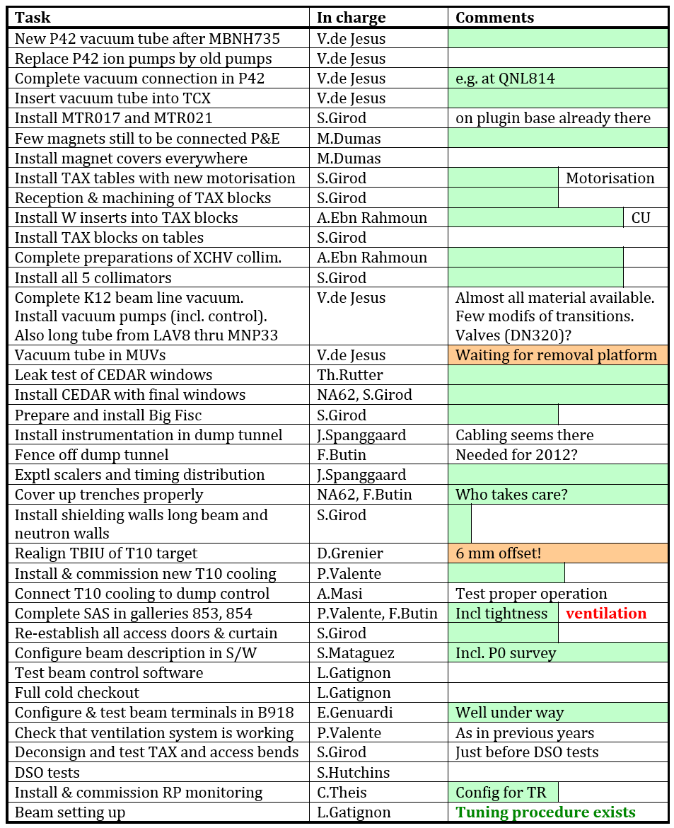
Green shading reflects
status at NA62 infrastructure
meeting last Wednesday

