Slide 1

EATM 12-09 – East Area
Lau Gatignon / EN-MEF

Slide 2
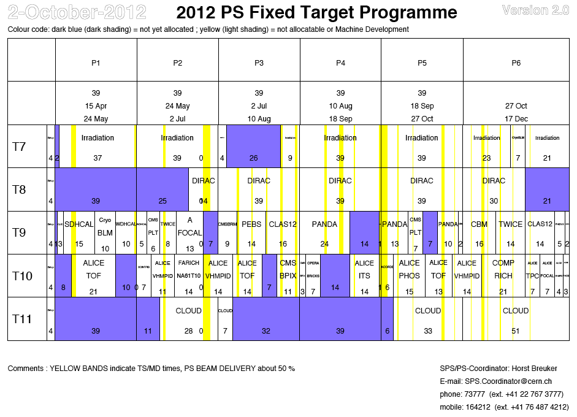

Slide 3
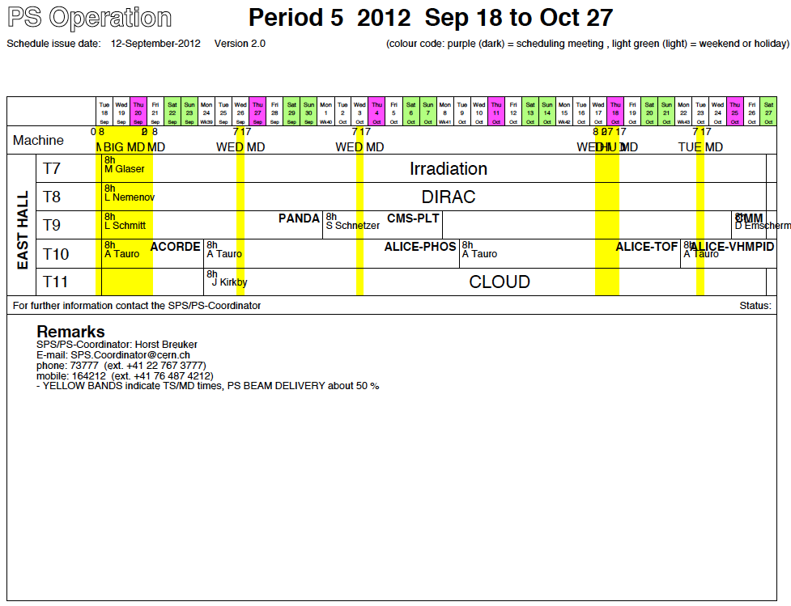
PANDA
Updated version not yet available……

Slide 4
Rest of P5
T7 IRRAD continues, no changes.
T8 DIRAC continues, no changes.
T9 Following the time lost during the two magnet repairs, PANDA has been compensated with beam time now. Two detectors are running in parallel: a lead tungstate calorimeter prototype upstream and a 10 tons muon range system downstream.
On Thursday 25th of October change to CBM with a Cerenkov gas detector,
using the full length of the area. They have 3 m³ of CO₂ for the RICH and
Xe/CO₂ or Ar/CO₂ (few l/hr) for the TRD’s. They may use a source.
T10 Change to ALICE/TOF on October 15th, no changes.
On Monday 22nd of October swap to ALICE/VHMPID. No changes .
T11 CLOUD continues, no changes.

Slide 5
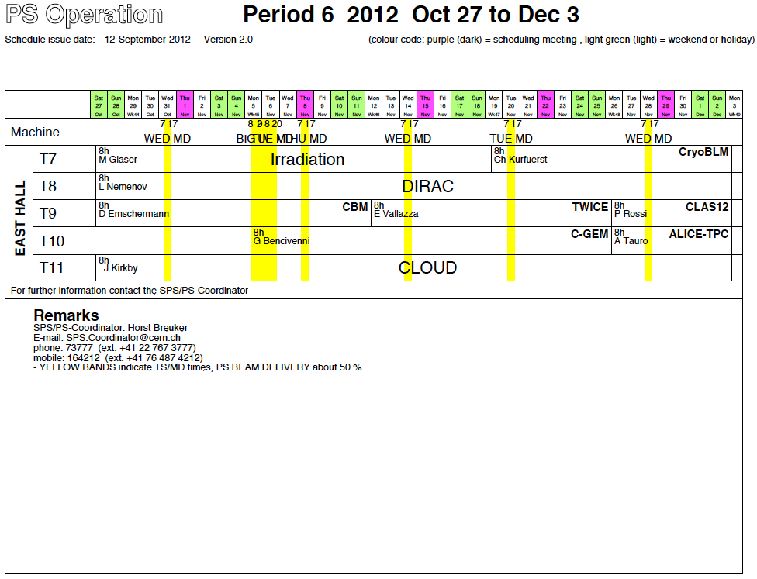
Next EATM

Slide 6
First weeks of P6 (up to next EATM)
The crane consolidation starts on Monday 5th of October. For a two-week period,
ad-hoc solutions must be found for equipment handling.
T7 IRRAD continues, no changes.
T8 DIRAC continues, no changes.
T9 CBM continues, no changes.
T10 ALICE/VHMPID continues without changes till Monday 5th of November.
Then change to COMPASS-RICH. This is a THGEM-based photon detector prototype of 30x30 cm² active area, total weight 120 kg.
No special requirements, but use a 50/50 Ar-CH₄ mix.
T11 CLOUD continues, no changes

