Slide 1




ODR - a non-invasive Beam Size Measurement Technique for CLIC
L. Bobb^{1, 2}, T. Aumeyr¹, M. Billing³, E. Bravin², N. Chritin², P. Karataev¹, T. Lefevre², S. Mazzoni²
John Adams Institute at Royal Holloway, Egham, Surrey, United Kingdom
CERN European Organisation for Nuclear Research, CERN, Geneva, Switzerland
Cornell University, Ithaca, New York, USA

Slide 2
Contents
Motivation
Aim
Diffraction Radiation
Experimental preparation for Phase 1
  Simulations
  Vacuum assembly
  Optical system
Future work
  Outlook for Phase 2

Slide 3
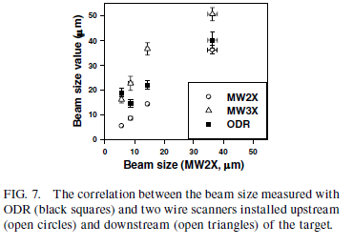
Most recent experiments using Optical Diffraction Radiation (ODR) for beam diagnostics
E. Chiadroni, M. Castellano, A. Cianchi, K. Honkavaara, G. Kube, V. Merlo and F. Stella, “Non-intercepting Electron Beam Transverse Diagnostics with Optical Diffraction Radiation at the DESY FLASH Facility”, Proc. of PAC07, Albuquerque, New Mexico, USA, FRPMN027.
A.H. Lumpkin, W. J. Berg, N. S. Sereno, D. W. Rule and C. –Y. Yao, “Near-field imaging of optical diffraction radiation generated by a 7-GeV electron beam”, Phys. Rev. ST Accel. Beams 10, 022802 (2007).
P. Karataev, S. Araki, R. Hamatsu, H. Hayano, T. Muto, G. Naumenko, A. Potylitsyn, N. Terunuma, J. Urakawa, “Beam-size measurement with Optical Diffraction Radiation at KEK Accelerator Test Facility”, Phys. Rev. Lett. 93, 244802 (2004).
σ_{y} = 14 µm measured ATF2@KEK

Slide 4
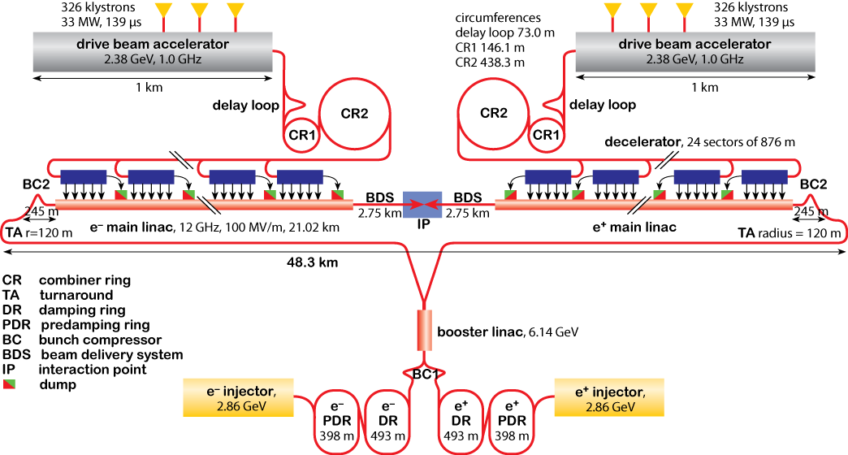
Motivation
Baseline high resolution non-interceptive beam profile monitor:
Laser Wire Scanners
S. T. Boogert et al., “Micron-scale laser-wire scanner for the KEK Accelerator Test Facility extraction line”, Phys. Rev. S. T. – Accel. and Beams 13, 122801 (2010)
Transverse beam size requirements for the Compact Linear Collider (Table 5.62 CDR Volume 1, 2012):
Section of machine | Beam Energy [GeV] | Beam size [µm] | Requirement
PDR (H/V) | 2.86 | 50/10 | Micron-scale resolution
DR (H/V) |  | 10/1
RTML (H/V) | 2.86 - 9 | 10/1
Drive Beam Accelerator | 2.37 | 50 -100 | Non-invasive measurement
http://www.clic-study.org/

Slide 5
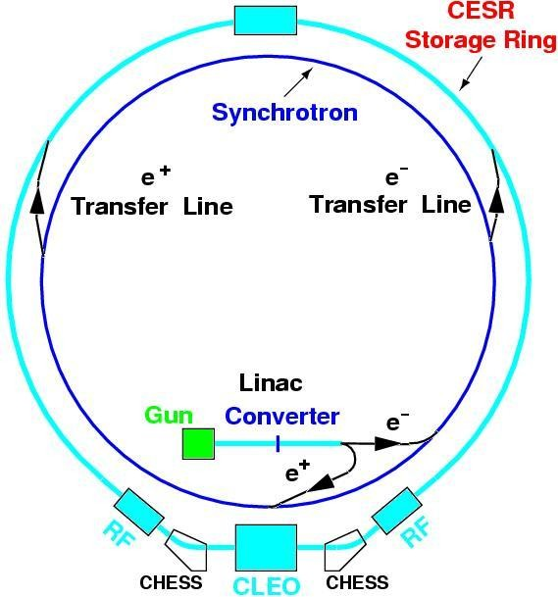
Our experiment
Project aim:
To design and test an instrument to measure on the micron-scale the transverse (vertical) beam size for the Compact Linear Collider (CLIC) using incoherent Diffraction Radiation (DR) at UV/soft X-ray wavelengths.
Cornell Electron Storage Ring Test Accelerator (CesrTA) beam parameters:
 | E (GeV) | σ_{H} (µm) | σ_{V} (µm)
CesrTA | 2.1 | 320 | ∼9.2
 | 5.3 | 2500 | ∼65
D. Rubin et al., “CesrTA Layout and Optics”, Proc. of PAC2009, Vancouver, Canada, WE6PFP103, p. 2751.
http://www.cs.cornell.edu

Slide 6
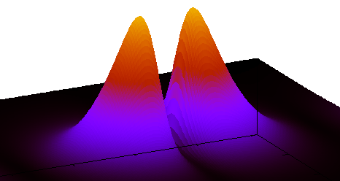
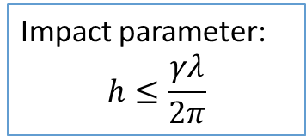
Diffraction Radiation
Principle:
Electron bunch moves through a high precision co-planar slit in a conducting screen (Si + Al coating).
Electric field of the electron bunch polarizes atoms of the screen surface.
DR is emitted in two directions:
  along the particle trajectory “Forward Diffraction Radiation” (FDR)
  In the direction of specular reflection “Backward Diffraction Radiation” (BDR)
DR Angular distribution
θ_{y}
e⁻
θ₀
Impact parameter:
$$h≤\frac{γλ}{2π}$$
h
Generally:
DR intensity ⇧ as slit size ⇩

Slide 7
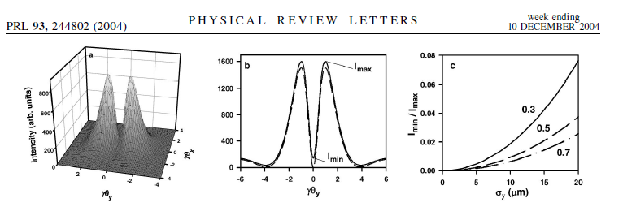
Vertical Beam Size Measurement using the Optical Diffraction Radiation (ODR) model + Projected Vertical Polarisation Component (PVPC)
P. Karataev et al.
Vertical polarisation component of 3-dimensional (θ_{x}, θ_{y}, Intensity) DR angular distribution.
PVPC is obtained by integrating over θ_{x} to collect more photons.
Visibility (I_{min}/I_{max}) of the PVPC is sensitive to vertical beam size σ_{y}.

Slide 8
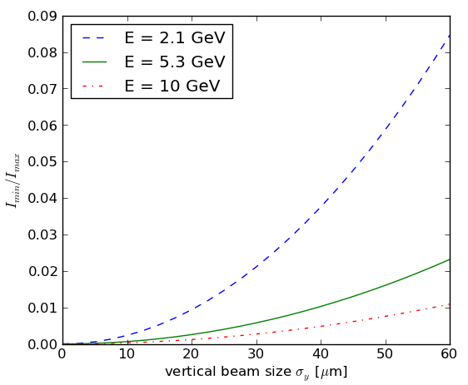
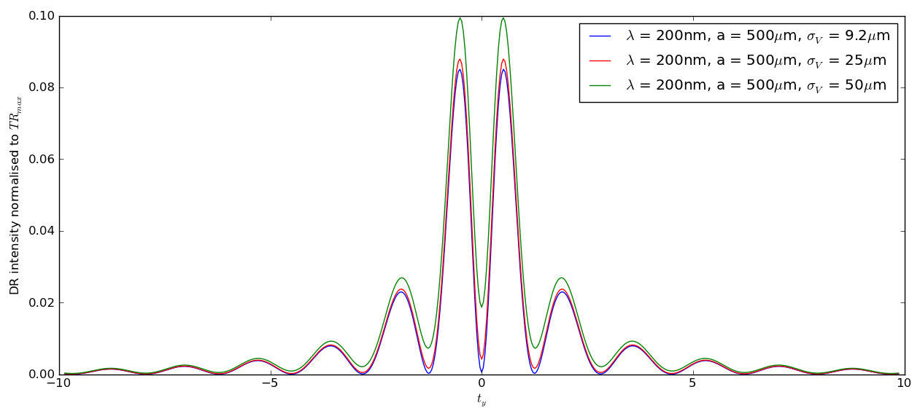


Phase 1 Experiment Simulations for CesrTA
Measureable visibility for initial test at parameters:
λ = 200 - 400 nm
a = 0.5, 1 mm
σ_{y} = 50 µm
To compare with TR intensities:
TR_{max} $=\frac{αγ^{2}}{2π}$
$$t_{y}=γθ_{y}$$

Slide 9
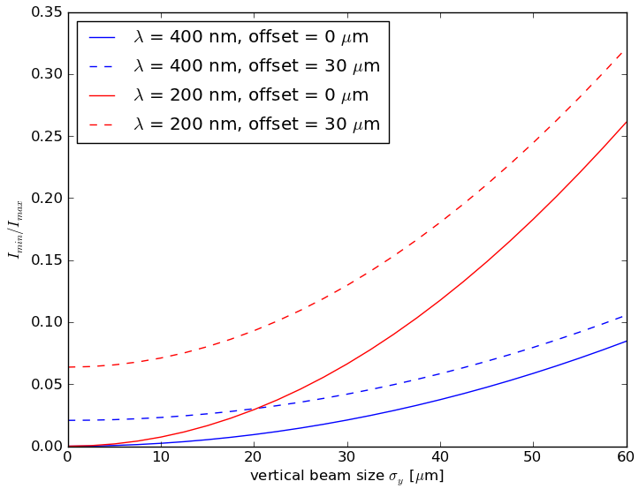
Beam lifetime and beam jitter
target slit size [mm] | vertical beam size [µm] | beam lifetime [min]
0.1 | 9.2 | 2.40
0.5 | 30 | 60 (max)
 | 50 | 2.22
1.0 | 50 | 60 (max)
M. Billing, "Introduction to Beam Diagnostics and Instrumentation for Circular Accelerators", AIP Conference Proc. 281, AIP 1993, pg.75 ff.
a_{target} ≥ 5∙σ_{y,}
preferably a_{target} = 7-10∙σ_{y}
Large aperture = low DR intensity
Multiple turns of a single bunch through the target aperture
Errors due to beam jitter are reduced by including turn-by-turn vertical position measurements of the bunch in the target aperture.

Slide 10
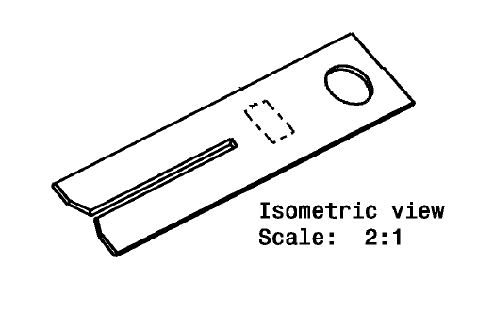
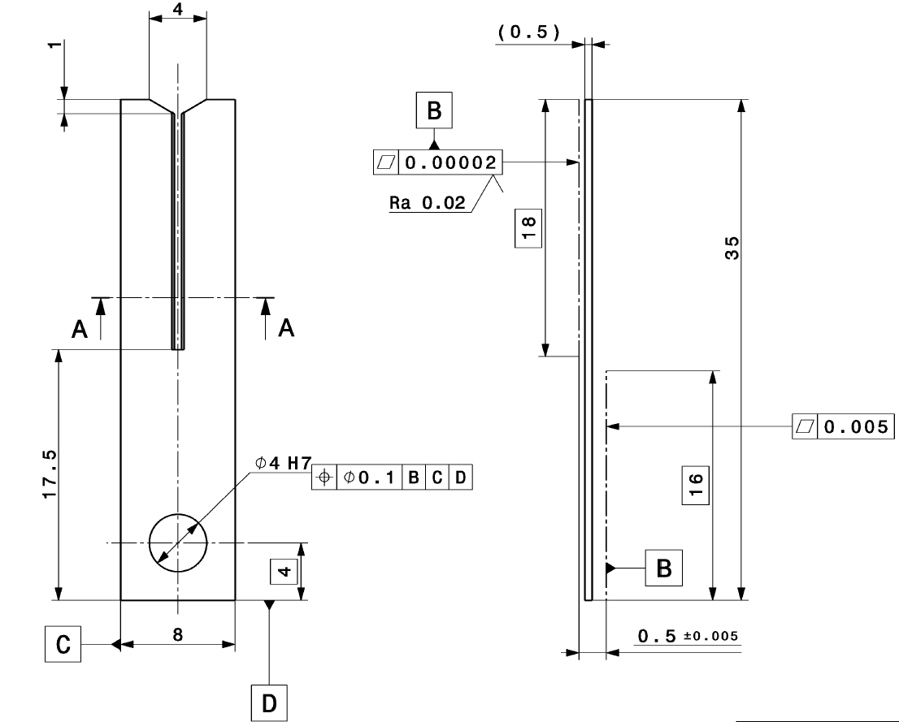
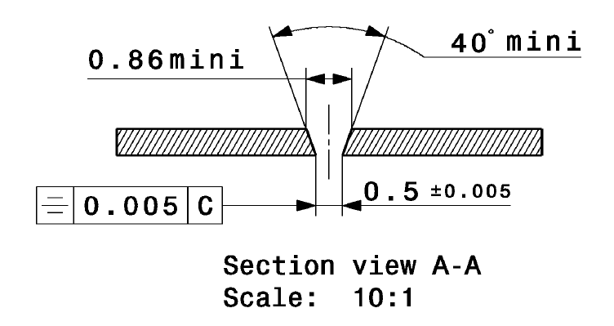
Target design
Requirements:
High precision slit size
Coplanarity ≤ 10% ∙ λ
High reflectivity at λ
Aperture sizes a:
0.5 mm, 1 mm
Material: Si
Technical drawings by N. Chritin

Slide 11
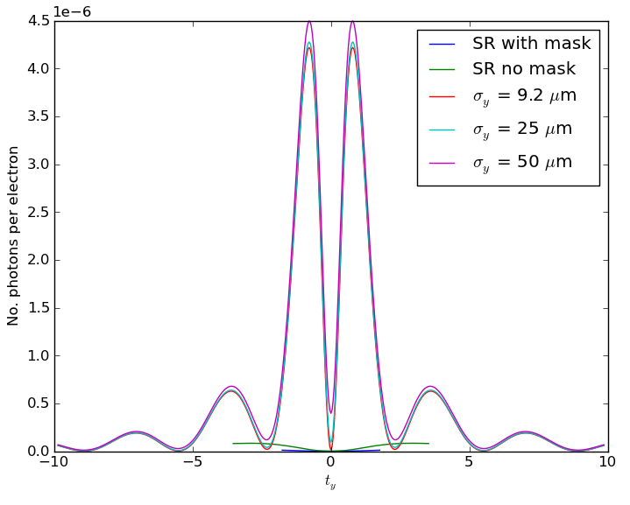
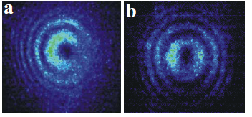
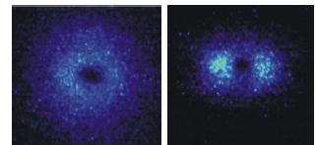
Synchrotron Radiation (SR)
E = 2.1 GeV
λ = 400 nm
a = 0.5 mm
Source of background | Contribution
SR from beamline optics | High
Camera noise | Low
Residual background
SR + DR interference
Use a mask upstream of target to suppress SR contribution.
OTR
ODR
θ_{y}
e⁻
θ₀
SR suppression
P. Karataev et al., Proc. of EPAC 2004, THPLT067
Mask
Target

Slide 12
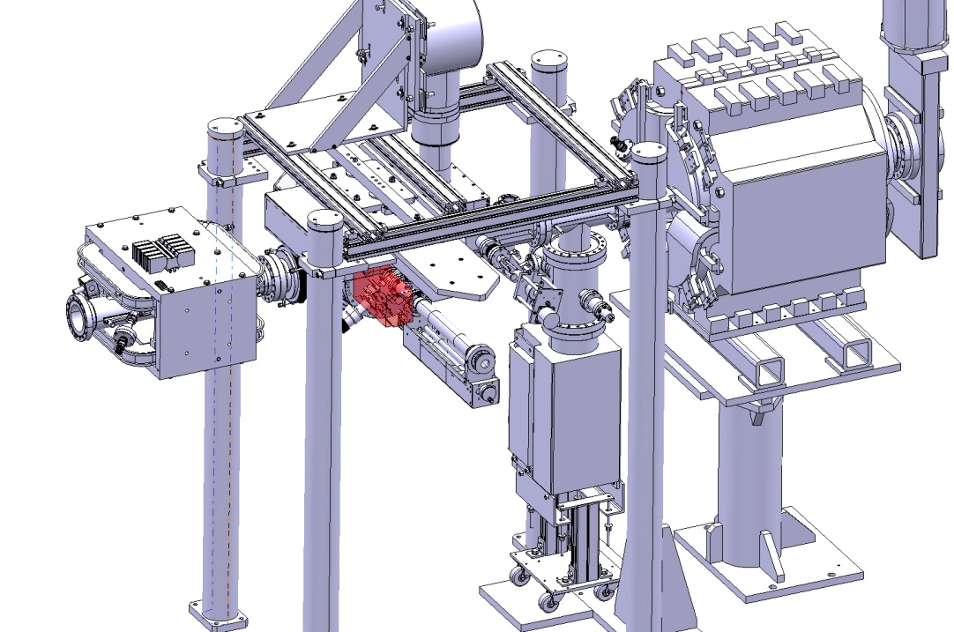
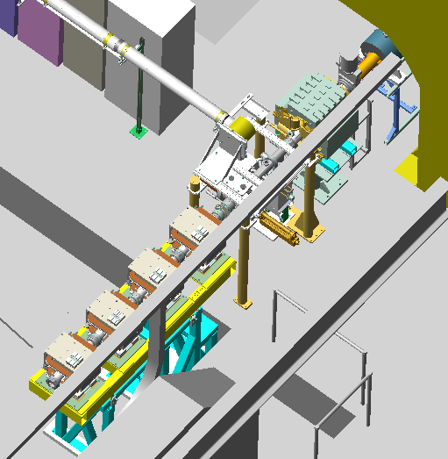
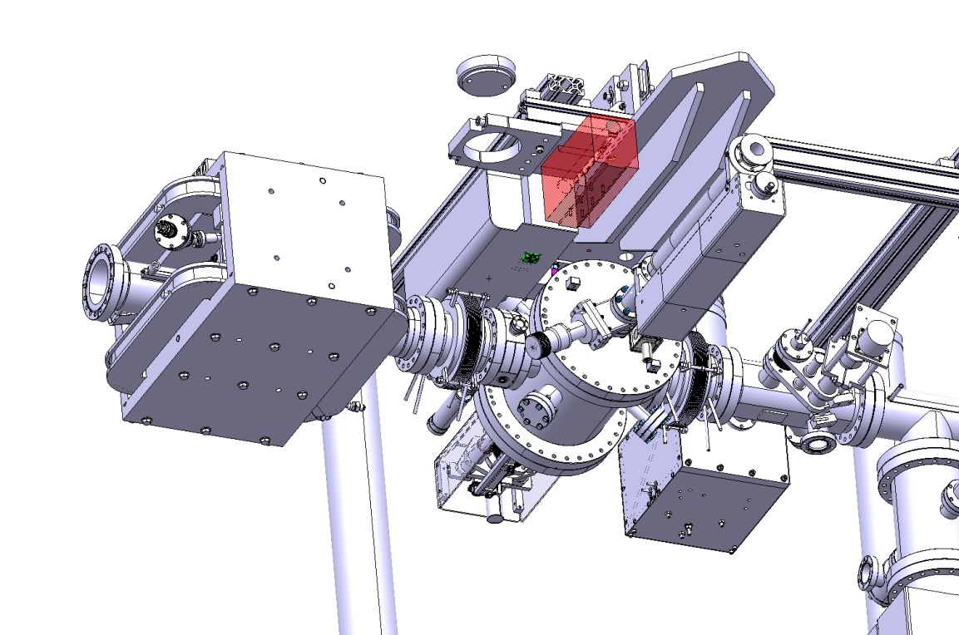
L3 layout @CesrTA
Electron beam direction
DR experiment
Technical drawings by N. Chritin

Slide 13
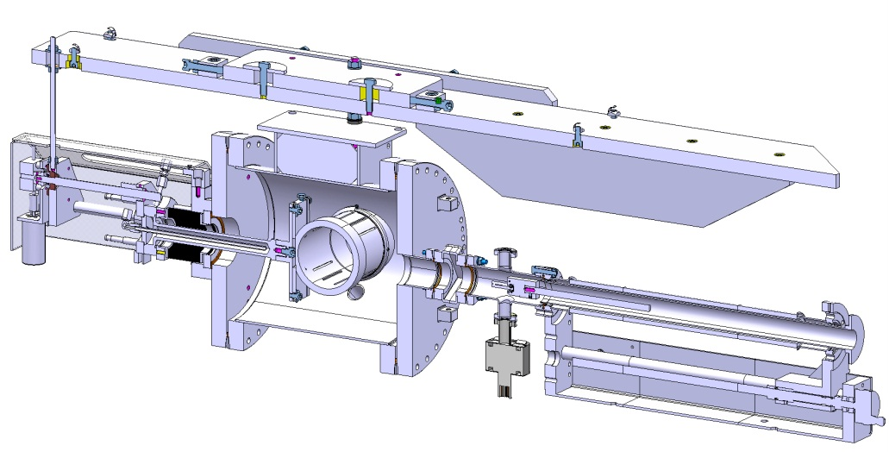
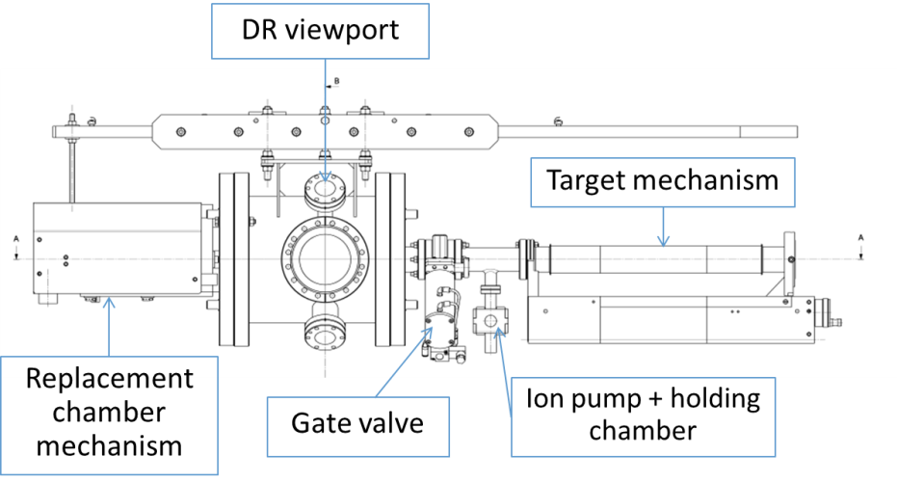
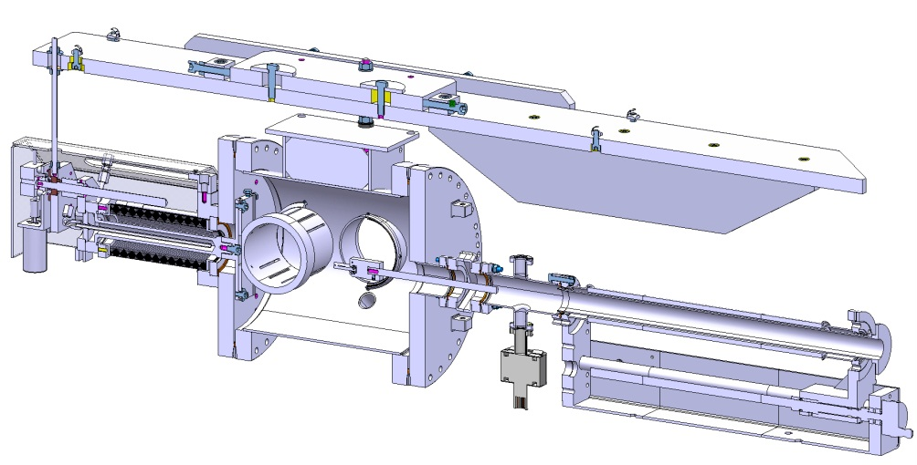
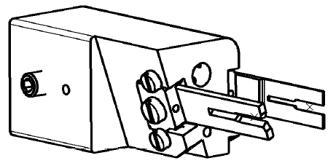
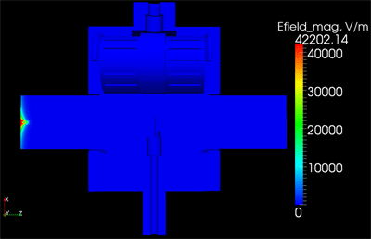
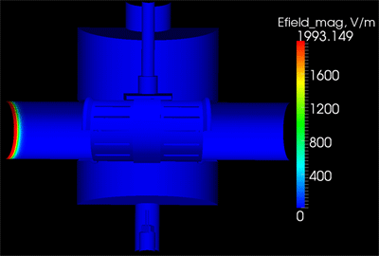
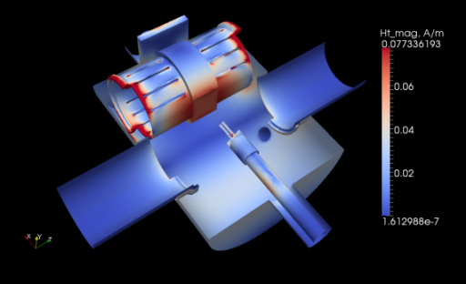
Vacuum chamber assembly
Technical drawings by N. Chritin
Simulations by A. Nosych
E-field magnitude of a single bunch pass in time domain (Gaussian bunch, length = [-4σ,4σ], σ = 10mm)
H-field surface tang complex magnitude (Loss map)
Mode Fr = 1.19 GHz, Q = 3309, Ploss = 0.075 W
Total power loss for single bunch = 0.6 W

Slide 14
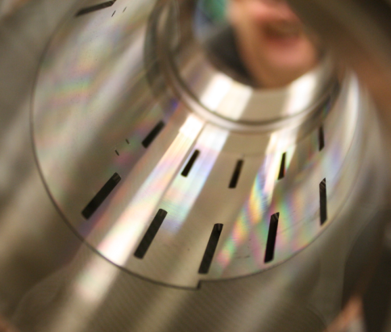
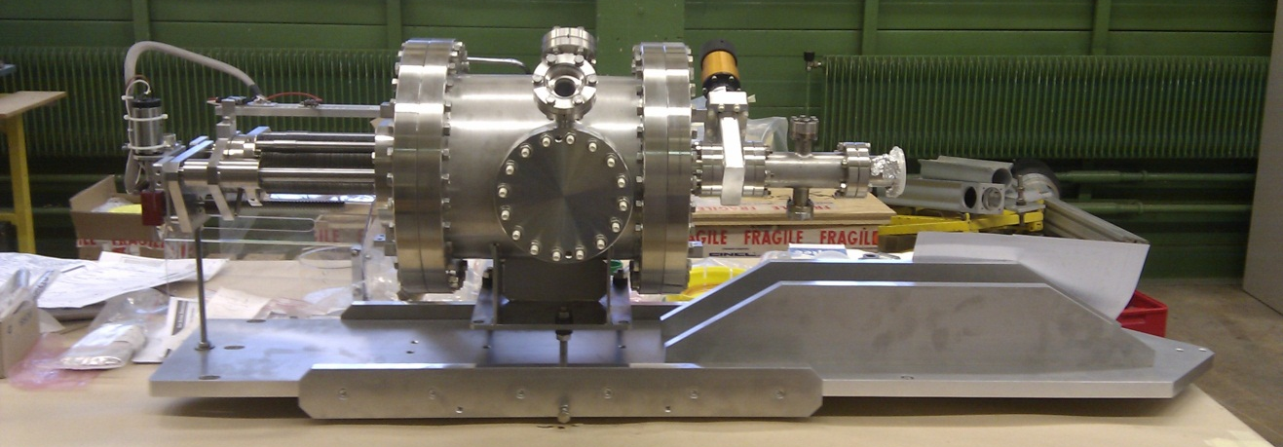
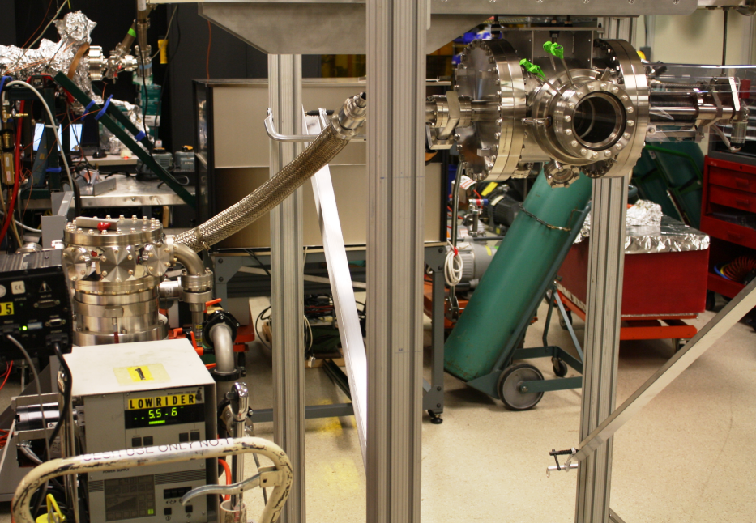
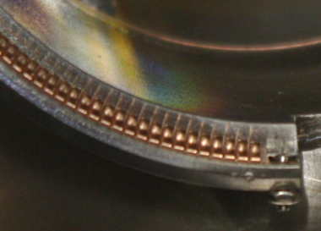
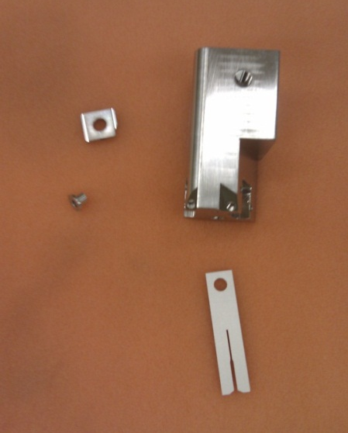
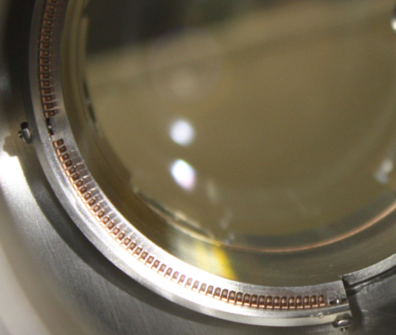
Vacuum chamber assembly cont’d
Images taken during assembly at CERN and current testing at Cornell.

Slide 15
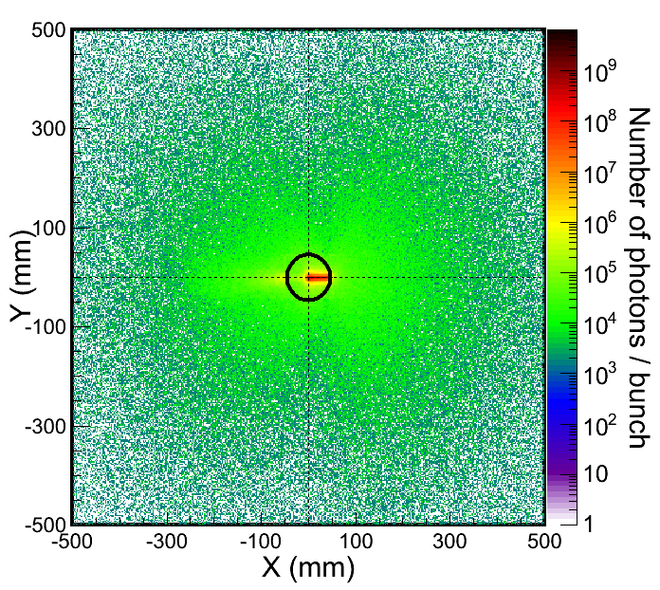
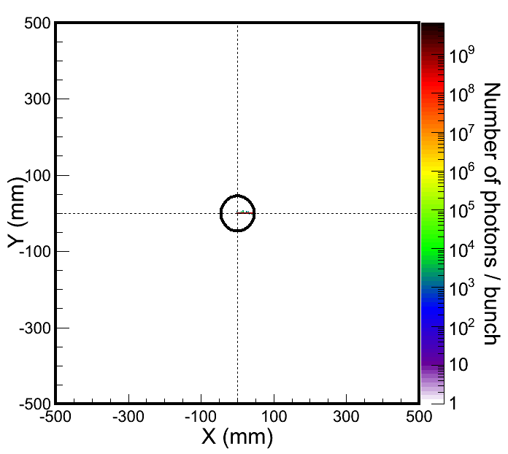
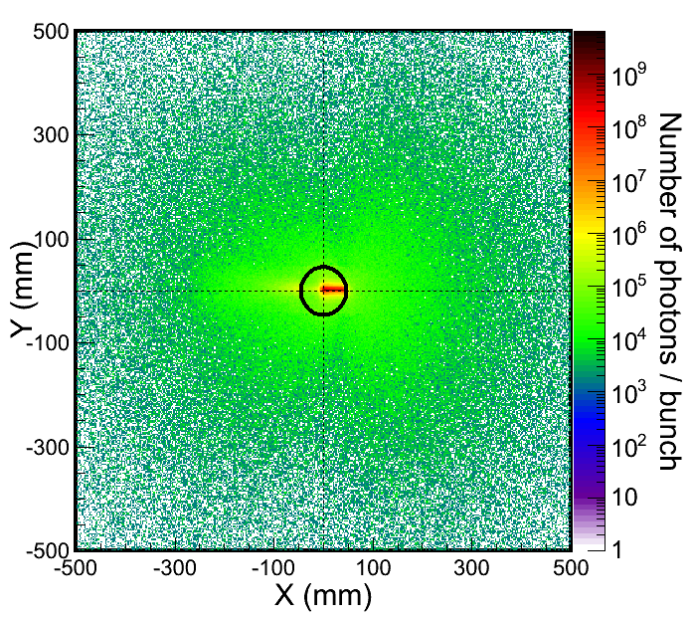
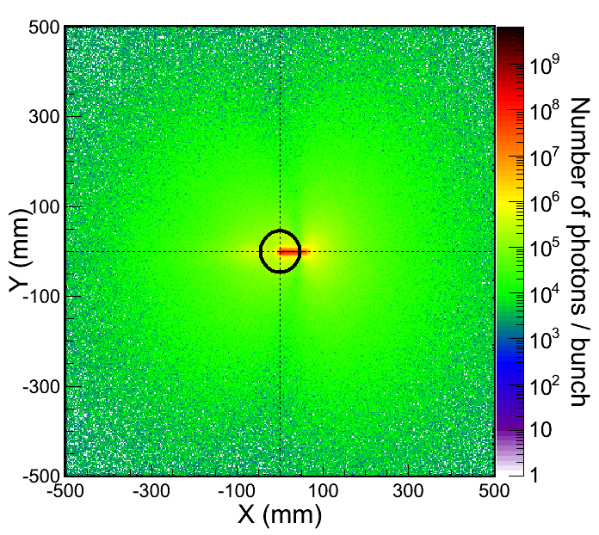
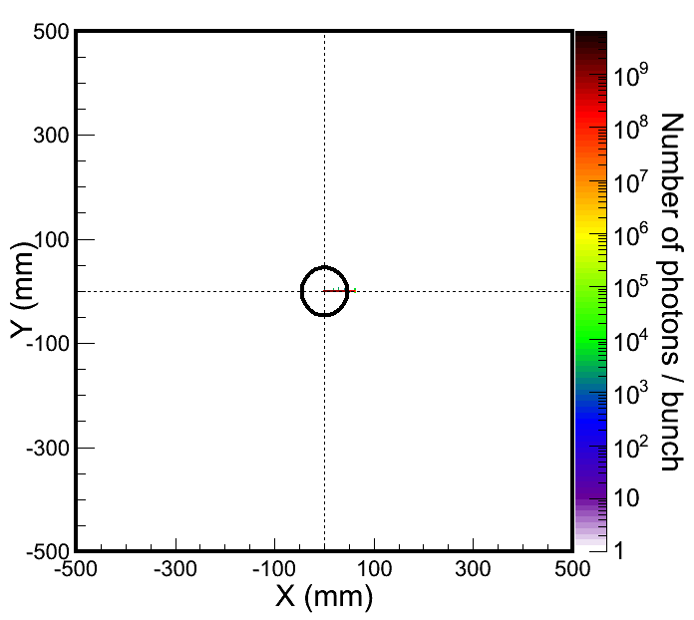
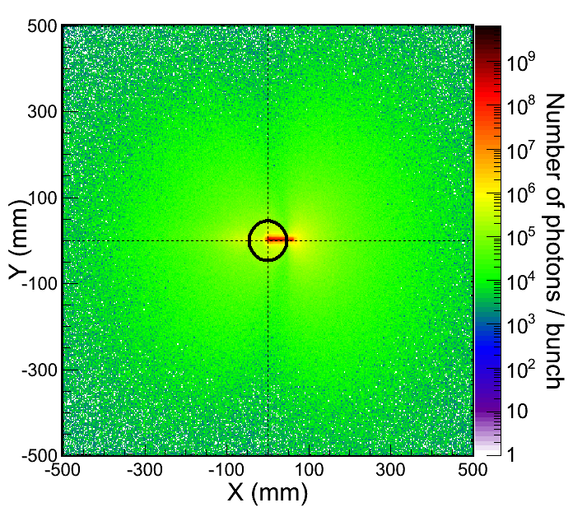
Quadrupole
Method of Operation
Si
1
Alignment of the electron beam with the target aperture:
  BPMs for centering (~10 microns resolution)
  Target imaging to look for OTR from beam halo
  Correlate with BLMs:
DR vertical beam size measurement
2
Dipole
3
Virtual BLMs
4
Virtual Detector 3
-400μm off
center
+400μm off
Virtual Detector 4
Simulations by A. Apyan

Slide 16
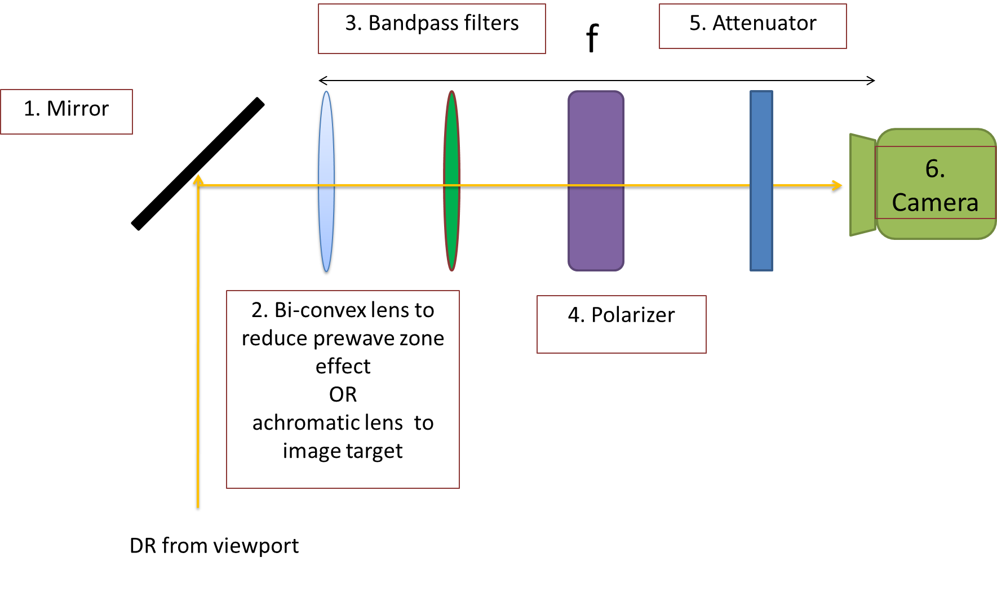
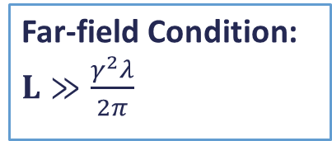

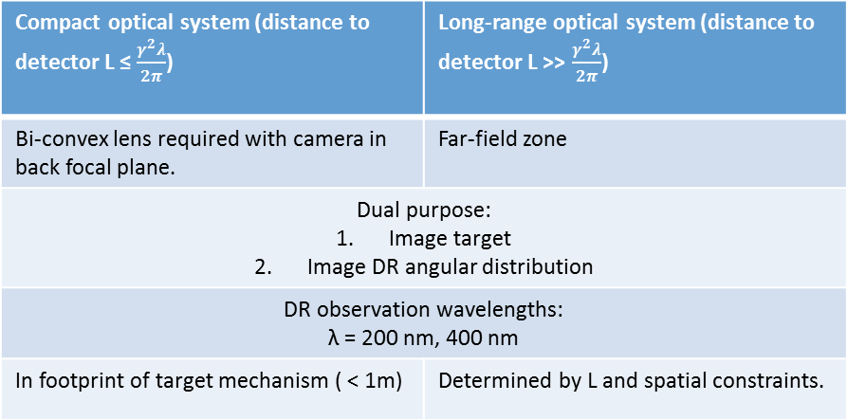
Optical System
Far-field Condition: $L≫\frac{γ^{2}λ}{2π}$
L = distance from source of DR to detector.
Compact optical system is in the prewave zone
(Pre-wave zone effect in transition and diffraction radiation: Problems and Solutions -P. V. Karataev).
Compact optical system (distance to detector L ≤ $\frac{γ^{2}λ}{2π}$) | Long-range optical system (distance to detector L >> $\frac{γ^{2}λ}{2π}$)
Bi-convex lens required with camera in back focal plane. | Far-field zone
Dual purpose: Image target Image DR angular distribution
DR observation wavelengths: λ = 200 nm, 400 nm
In footprint of target mechanism ( < 1m) | Determined by L and spatial constraints.
$\frac{γ^{2}λ}{2π}$ given γ and λ:
 | 2.1 GeV | 5 GeV
200 nm | 0.54 m | 3.18 m
400 nm | 1.08m | 6.37 m

Slide 17
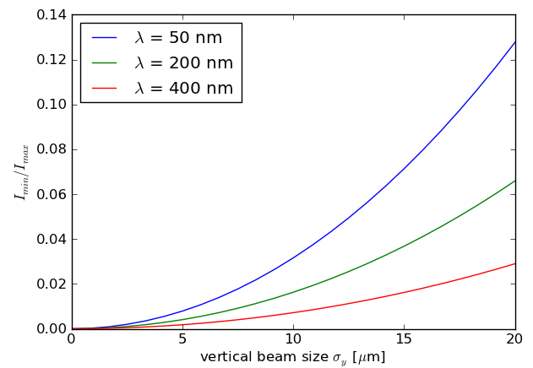
Phase 2: Micron-scale resolution
DR at soft X-ray wavelengths:
  More complex optical system.
  Grazing target tilt angle
Aperture size determined by impact parameter for given wavelength
E = 5.3 GeV
a_{target} = 0.2 mm
Main requirement:
Micron-scale resolution
Must use shorter wavelengths
Sensitivity @50 nm ≈ 2x sensitivity @200 nm

Slide 18
Summary + Conclusion
Simulations have demonstrated the feasibility of vertical beam size measurements at CesrTA. The preliminary phase 1 experiment will take place at the end of December 2012.
The design must account for the experiment location in a circular machine. This introduces some advantages and disadvantages not applicable for linacs.
Preliminary simulations for the phase 2 test aiming for the soft x-ray spectral range have been presented.
Acknowledgements
I would like to thank J. Barley, J. Conway, J. Lanzoni, Y. Li, T. O'Connell, M. Palmer, D. Rice, D. Rubin, J. Sexton, C. Strohman and S. Wang (@Cornell) for all technical contributions and advice. In addition, O.R. Jones and H. Schmickler for organisation of the collaboration, A. Apyan, S. Burger, A. Jeff, A. Nosych and S. Vulliez (@CERN).

Slide 19
Thank you for your attention
Questions?

Slide 20
Extra slides

Slide 21
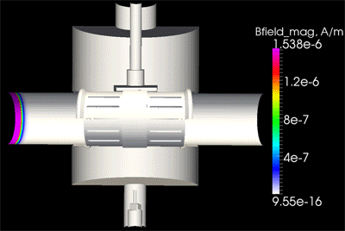
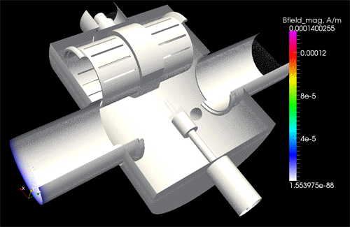
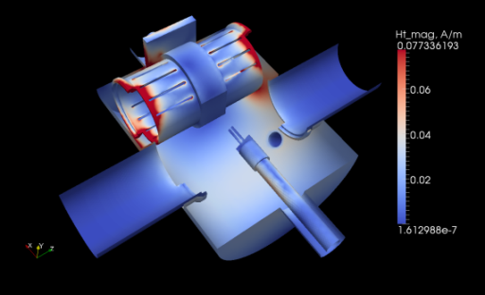
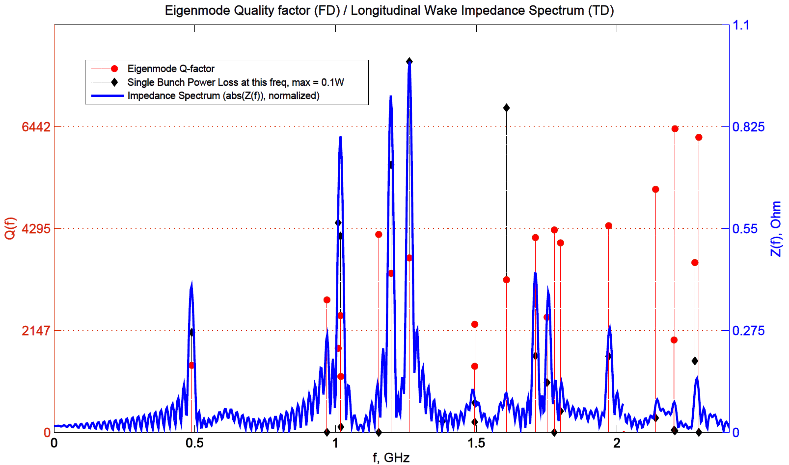
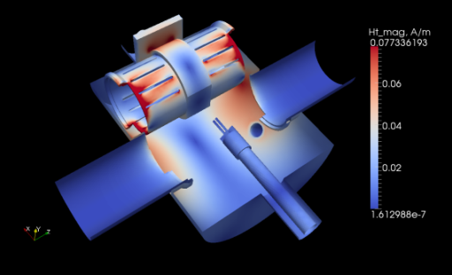
Higher Order Modes (HOMs)
Fork OUT, Chamber IN
E-field + B-field magnitude of a single bunch pass in time domain (Gaussian bunch, length = [-4σ,4σ], σ = 10mm)
H-field surface tang complex magnitude (Loss map)
1.017 GHz
1.26 GHz
1.19 GHz
Ploss_total = 0.6W
1.017 GHz
Simulations by A. Nosych
1.19 GHz
1.26 GHz

Slide 22
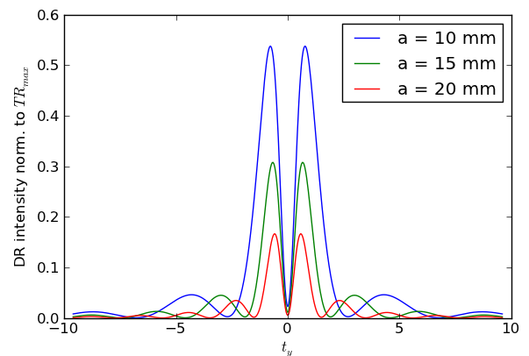
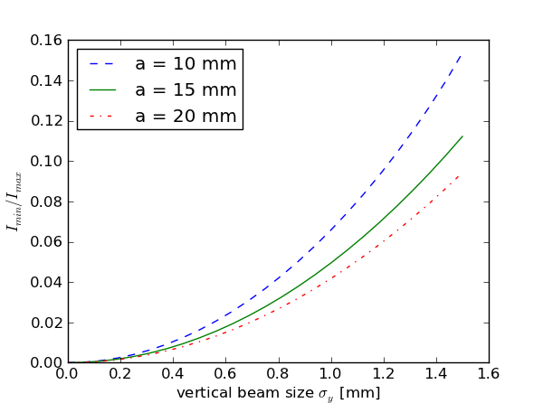
Feasibility of a ring beam size monitor
LHC also has γ ≈ 4000 (@ E = 4000 GeV)
Using proton beam:
  Reduced SR background
  Larger beam size
Wavelengths in the infrared spectral range
Main requirement:
Non- invasive measurement
Must use large target aperture

Slide 23
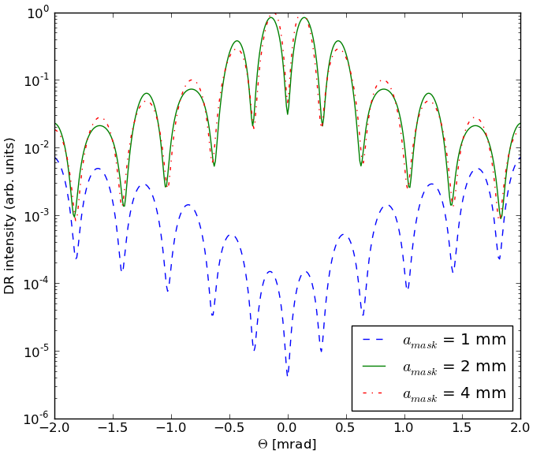
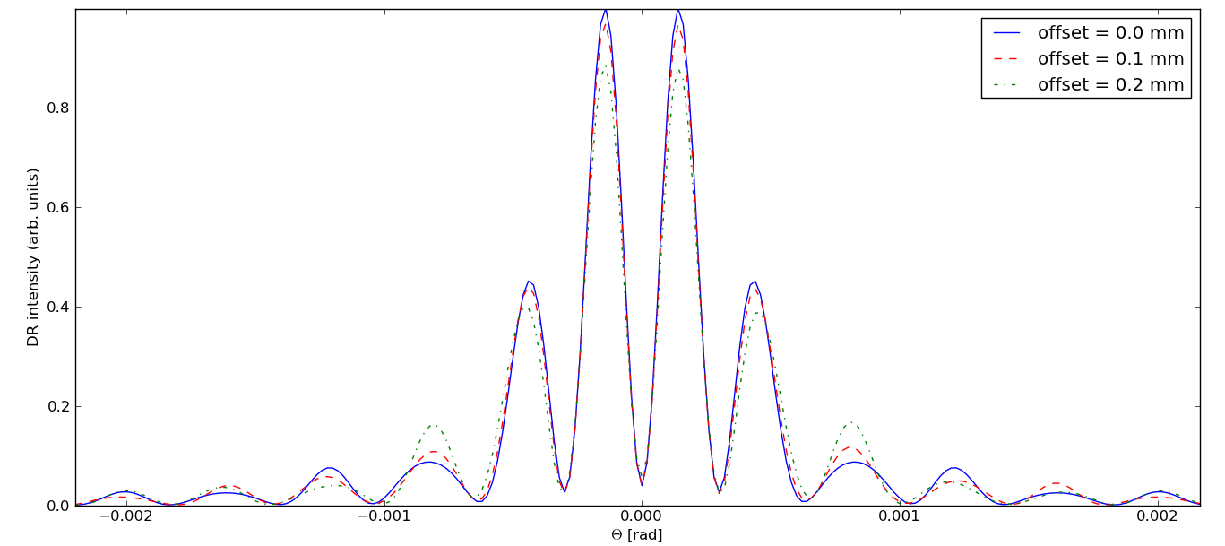
Optical Diffraction Radiation Interference (ODRI)
A. Cianchi et al., Phys. Rev. ST Accel. Beams 14 (10) 102803 (2011)
Aperture sizes | Interference
a_{mask} = a_{target} | Complete destructive interference of FDR + BDR (blue)
a_{mask} ≈ 2∙a_{target} | Measureable interference (green)
a_{mask} ≥ 4∙a_{target} | Negligible interference (red)
Using non-collinear slits (i.e. centres of mask + target do not coincide) allows measurement of beam size, beam offset from the target centre and angular divergence.
E = 2.1 GeV
λ = 400 nm
a_{mask} = 2 mm
a_{target} = 1 mm
σ_{y} = 50 µm

Slide 24
ODR movements
There are 2 stepping motors:
  1x linear movement of the fork
  1x angular movement of the fork
There is 1 DC (+24V) motor that drives a linear movement for the replacement chamber
The linear (stepping) movement of the fork and the linear (DC) movement of the
replacement chamber have to be interlocked one with respect to the other to avoid
collision (see next slide)
Cabling of stepping motors has to be adapted to available driver (unipolar/bipolar)
(tests @ CERN were performed with bipolar driver and cabling)
S. Burger

Slide 25

Replacement Chamber
(linear movement)
ODR fork
(linear movement)
Cornell connection
Burndy 12M
Socket
Burndy 4M
Socket
Burndy 4F
Socket
OUT
IN
IN
Stepping switches cabling
OUT
1
2
3
4
1
2
3
4
NO
NC
NO
NO
NC
NO
Cable
Burndy
4M/F
1 to 1
OUT switch 5
COM switches 8
IN switch 11
Motor + 9
M
Motor - 10
DC motor
24V
S. Burger
Hardware INTERLOCK logic: ODR fork can not move if replacement chamber not OUT
Replacement chamber can not move if ODR fork not OUT
Interlock ODR movement
(as connected with CERN screen
instrumentation ‘standard’ driver)
Stephane.burger@cern.ch

