Slide 1
Optical Transition Radiation
@ CTF3 & ATF2
Benoit Bolzon
BI day, 06/12/2012

Slide 2
Layout
Beam imaging system and choice of
Optical Transition Radiation @ CTF3 and ATF2
2. OTR @ CTF3
3. OTR @ ATF2
4. Conclusion

Slide 3
Beam imaging system and
choice of OTR @ CTF3 and ATF2

Slide 4
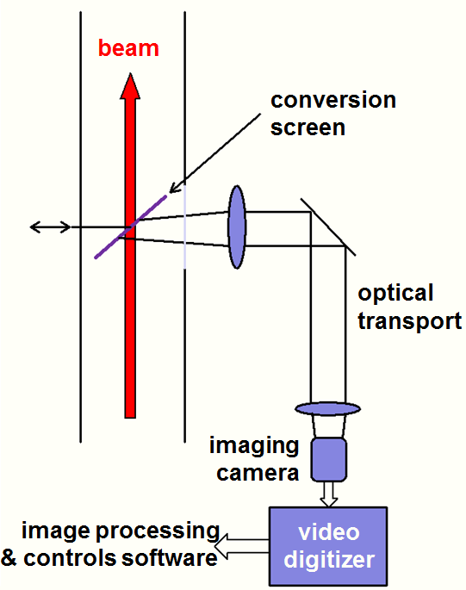
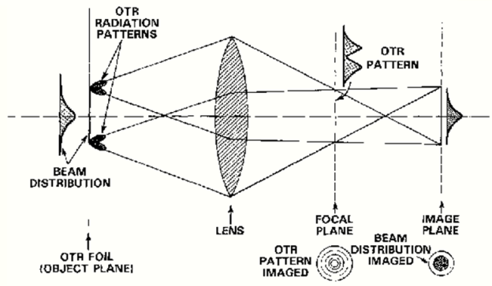
Beam imaging systems and OTR
The charged-particle beam transverse size and profiles are part of the basic characterizations needed in accelerators to determine beam quality, e.g. transverse emittance
A basic imaging system includes:
  Conversion mechanism (scintillator, optical or x-ray synchrotron radiation (OSR or XSR), Cherenkov radiation (CR), optical transition radiation (OTR), undulator radiation (UR), and optical diffraction radiation (ODR)).
  Optical transport (lenses, mirrors, filters, polarizers)
  Imaging sensor such as CCD, CID, CMOS camera, with or without intensifier and/or cooling
  Video digitizer
  Image processing software
OTR is emitted when a charged particle goes from a medium to another with different dielectric properties.

Slide 5
Choice of OTR at CTF3 and ATF2
CTF3: Beam intensity from 3.5 A during 1.4 µs (pulse length), to 28 A during 140 ns Beam size ~1 mm, pulse frequency up to 5 Hz
ATF2: Single bunch (~1*10¹⁰ electrons), bunch frequency of 1.56 to 6.24Hz, 30ps bunch length but beam size down to the µm scale at the location of imaging systems
Thermal load too high for scintillating screens
High intensity compensates for lower light yield
Up to coherence, perfectly linear with beam charge (no saturation)
Femto-second time resolution possible
Allows for longitudinal profile imaging (bunch length measurements at CTF3)
Due to properties of the emitted light, it can be used to determine several beam properties (profile/size, position, divergence, energy, relative intensity, bunch length)

Slide 6
2. OTR @ CTF3

Slide 7
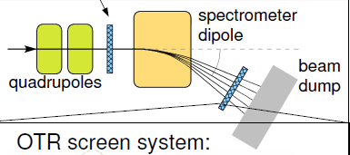
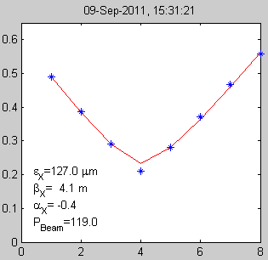
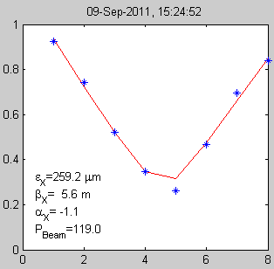
Challenge of OTR at CTF3: vignetting effect
14 TV stations for OTR based emittance measurements (beam size ~few mm)
7 TV stations for OTR based spectrometry (energy): located in spectrometer lines for beam size and energy spread measurements (beam size ~few cm)
Spectrometer screen
Emittance screen
For emittance measurements (quad scan), beam size can increase consequently
Narrow range
Large range
Large range on quad current: large beam size
➔ Vignetting effect underestimating beam size!!
➔ Emittance overestimated!!
ε_{x}=127µm
ε_{x}=259µm
r
In the spectrometer lines, large beam size of the order of ~ cm due to steering magnet
Large vignetting factor can decrease the accuracy of measurements

Slide 8
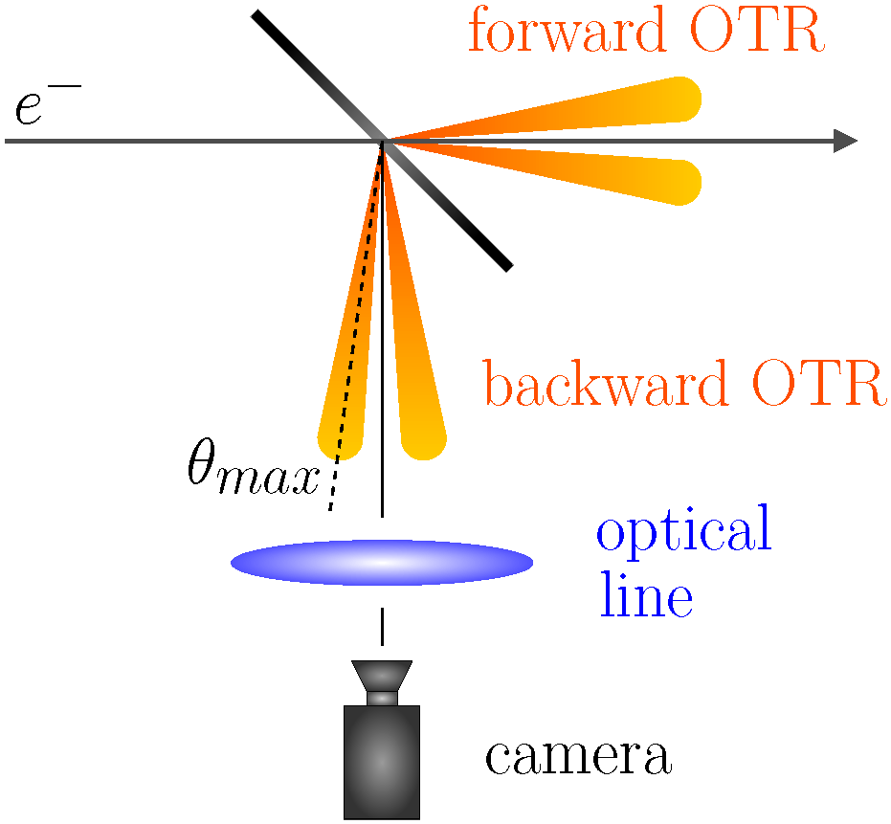
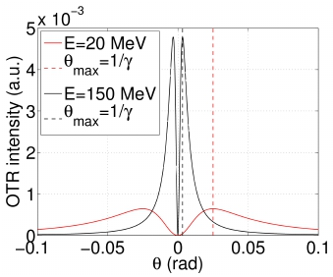
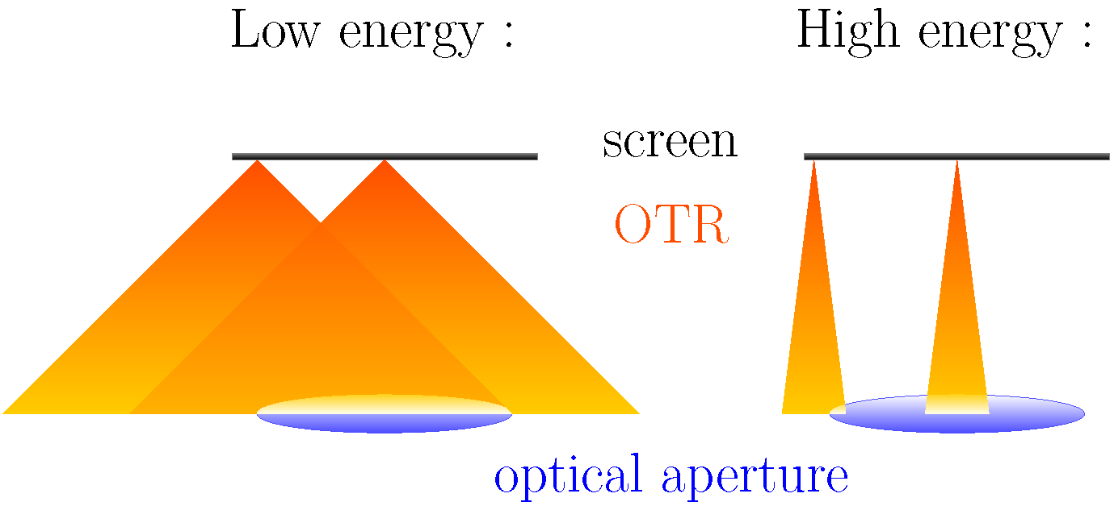
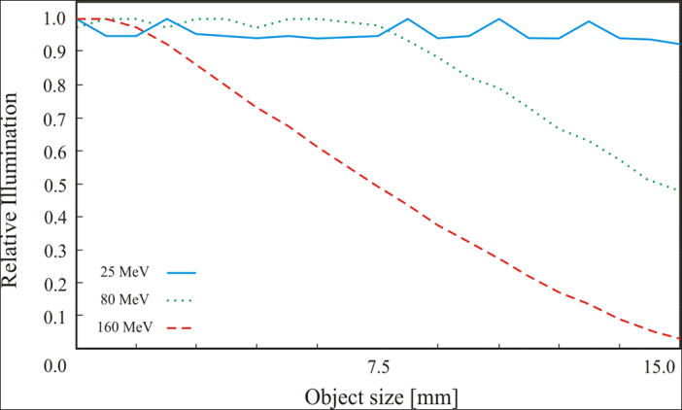
Vignetting effect
OTR radiation is emitted in forward and backward direction, of which the latter is generally used due to easier extraction.
OTR Angular distribution
➔ Emitted light cone gets narrower with increasing beam energy.
Vignetting: less light collected from the edges of the screen due to the finite optical aperture of the optical system (first lens: strong limiting factor) and the screen size
Effect stronger for higher beam energy, due to the distribution of the OTR emission.
Zemax simulation
8

Slide 9
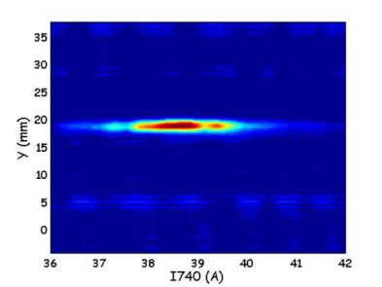
Mitigation of vignetting effect
Mitigating the effect means removing the correlation between position on the screen and the amount of light seen by the camera.
Two ways: concentrate the light (parabolic screens) or diffuse the light (diffusive screens).
Parabolic screen: it is possible to – already from the emission point – concentrate the light onto the optical aperture.
Curvature: z=x²/f (f: distance between the screen and the first lens)
Beam (hitting the screen at 3 locations)
Diffusive screen: A depolished screen will diffuse the generated light.
Flat (regular)
On average, this leads to a more isotropic light emission and the low energy scenario is recovered

Slide 10
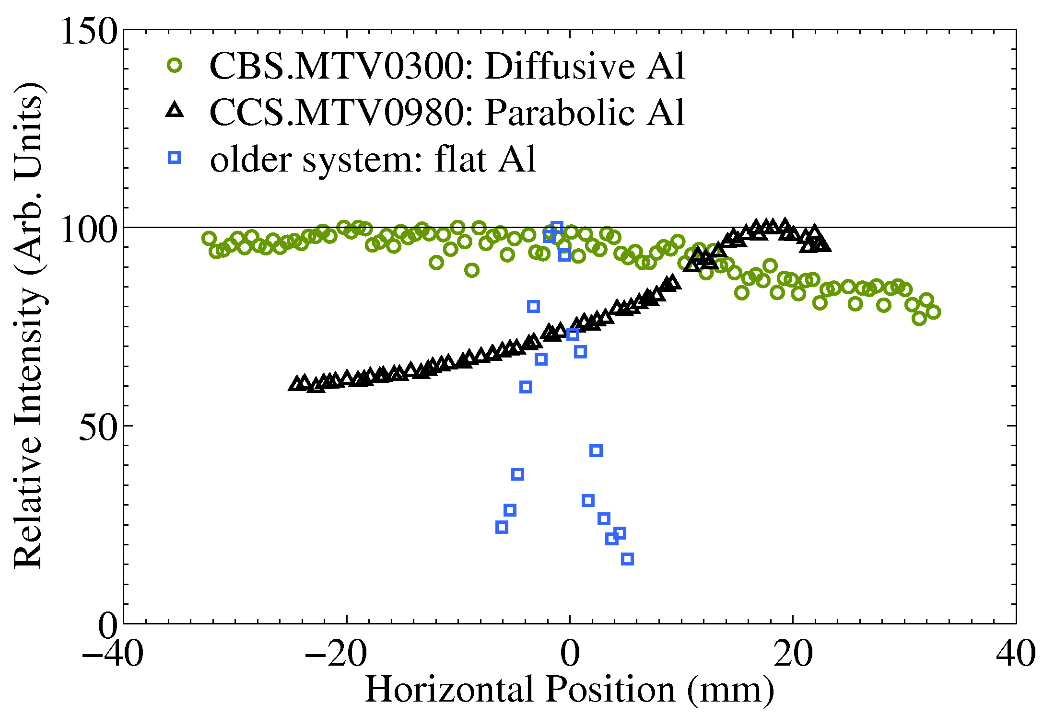
Mitigation results with spectrometer screens
Beam size relatively large (order of cm) for spectrometer screens
Vignetting effect should be important with standard high reflectivity flat screens
➔ Parabolic and diffusive screens have been installed in order to mitigate vignetting
Results
Parabolic
Diffusive
The vignetting effect is reduced
The vignetting effect is efficiently reduced compared to a standard flat screen
But maximum of light intensity when the beam is off-centered
Misalignment on both screens certainly
Conclusion
Harder requirements for manufacturing and alignment.
Parabolic screens should only be considered where light intensity is an issue.
In terms of manufacturing and installation, this is a less complicated improvement, compared to parabolic screens. Where the light density allows it, diffusive screens should be the primary choice.
Notes:
Older system: Linac or tl1 (kind of system like in spectrometer 4)

Slide 11
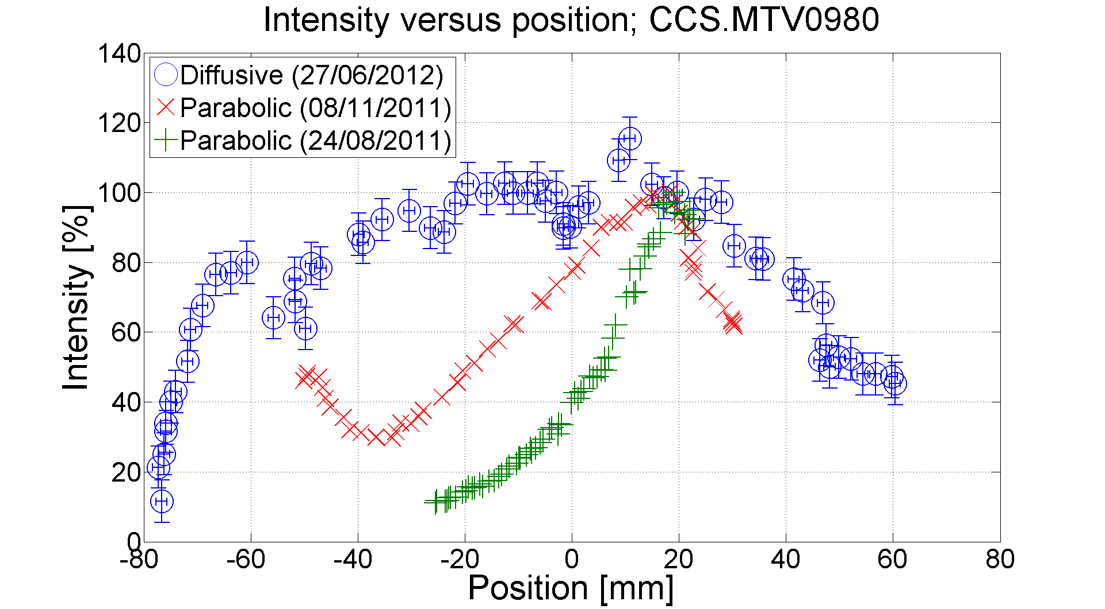
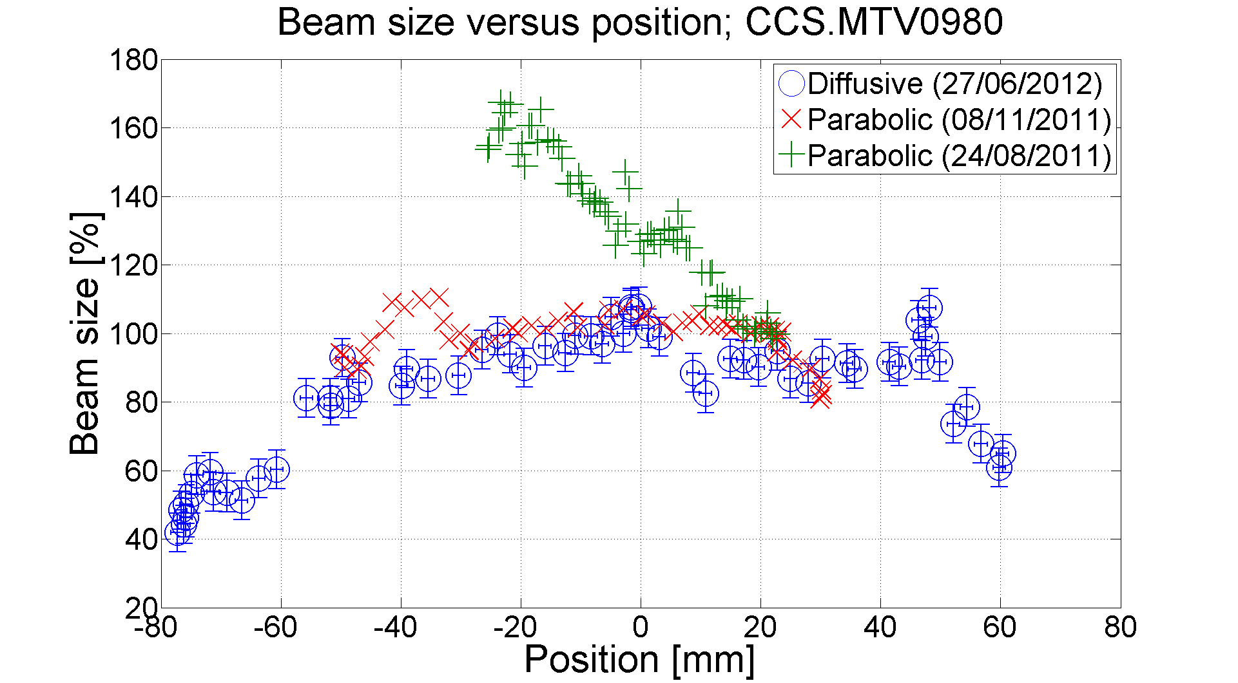
Improvement of the spectrometer screens
Change of the four parabolic screens of the CTF3 spectrometer lines by diffusive screens during the last winter shutdown
Comparison between diffusive and parabolic screens for the same MTV
With parabolic screens:
  Different responses versus position for different beam steerings (measurements done on different days) since these screens are much sensitive to misalignments
  Maximum of intensity off-centered, fast intensity fall, beam sizes can vary much
With diffusive screens:
  Maximum of intensity at the screen center
  Constant intensity and beam size within ±10% over a large position range

Slide 12
3. OTR @ ATF2

Slide 13


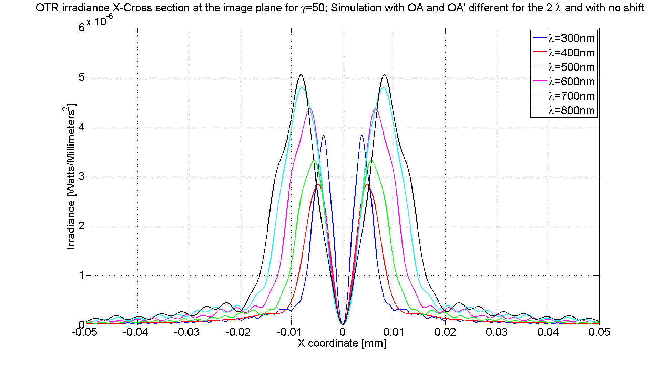
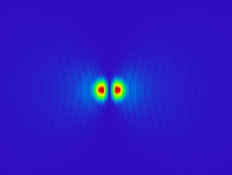
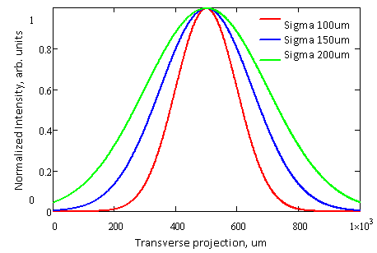



High resolution OTR measurements at ATF2
Challenge of OTR system at ATF2: measurements of micrometer beam size
The resolution (PSF) is determined by the source dimensions induced by a single particle plus distortion caused by the optical system (diffraction of OTR tails)
If we consider physical beam size, the resulting image on the camera is the convolution of the beam spatial distribution with the optical system PSF
To visualize the beam, PSF has to be smaller than the beam size (➔ aberrations/diffraction reduction)
OTR vertical polarization component, for sigma < ~15 µm
Point spread function of OTR imaging system
~ Image generated by a single electron (Zemax simulations)
“Usual” OTR image
A. Aryshev, N. Terunuma, J. Urakawa, S. Boogert, P. Karataev, L. Nevay, T. Lefevre, B. Bolzon

Slide 14
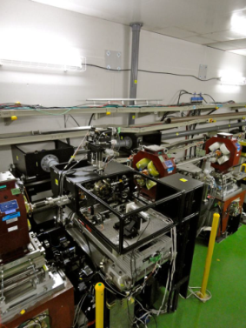
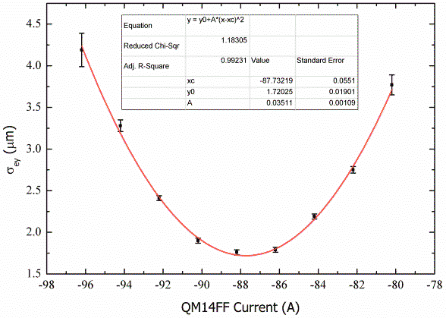
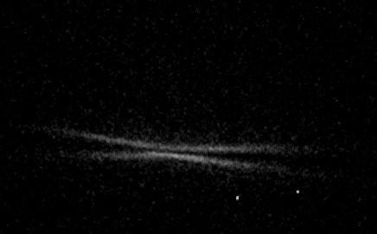
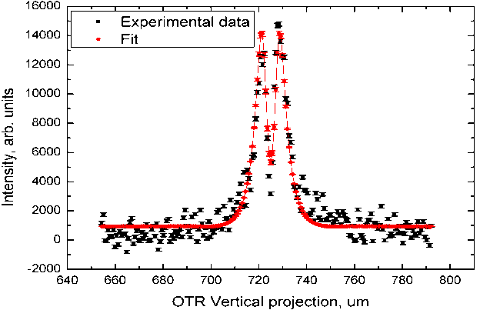
High resolution OTR measurements at ATF2
Simple system composed of:
  An OTR target (Silicon, coated Al)
  A plano-convex lens and mirrors
  A vertical polarizer (σx>>σy)
  A filter wheel (chromatic aberration)
  CCD camera
QM14FF
e- beam
QM13FF
‘Typical scan’
Vertical projection
I_{max}
I_{min}
a 522.981 +/- 4.43887
b 37773.1 +/- 116.182
c 0.231221 +/- 0.00049
Δx 786.905 +/- 0.00679
σ calibrated 1.28202 +/- 0.0479
Need of a vertical polarizer to see the PSF (σ_{x}>>σ_{y})
P. Karataev et.al, Phys. Rev. Letters 107, 174801 (2011)
A. Aryshev, et.al, Journal of Physics: Conference Series 236 (2010) 012008
Improving image quality (aberration, field of depth,..)
Propose to test similar system close to final focus (<300nm)

Slide 15
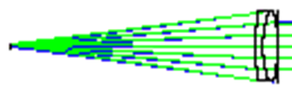
Need of a simulation tool for OTR
To improve the current optical line (minimization of aberrations and diffractions to minimize the PSF), need of an optical design tool with the simulation of OTR source
For now, analytical calculations enable to simulate very accurately diffractions, but not aberrations (use of thin lens approximation)
Zemax commercial optical software can simulate real commercial lenses and take into account both diffractions and aberrations
In the BI group, Zemax was used in the ray-tracing mode with an object cone angle as source in order to simulate the angular distribution of OTR, but:
➔ The object cone angle does not include the tails of OTR which have an important impact on the aberrations and diffractions
➔ Ray-tracing mode only takes into account diffractions from the exit pupil of an optical system to the image plane (diffractions through the lens not taken into account)
➔ Ray-tracing mode uses Fraunhofer diffraction algorithm for far field while the OTR system of ATF2 is in near field (near field conditions: λϒ²>>a)
a: distance source-lens
ATF2: a=104mm; λ=400nm; ϒ=2500
➔ λϒ² =2500mm>>a=104mm
Object cone angle=1/ϒ
(angular distribution of OTR lobe)

Slide 16


Physical Optics Propagation mode of Zemax
Physical Optics Propagation mode of Zemax: Use of diffraction calculations to propagate a wavefront through an optical system surface by surface
As a wavefront travels through free space or optical medium, the wavefront coherently interferes with itself and the coherent nature of light is fully accounted
To propagate the beam from one surface to another, either a Fresnel diffraction propagation (beam out of focus)or an angular spectrum propagation is used (in focus)
Fresnel diffraction (near field)
$E\left(x_{2},y_{2},z_{2}\right)=\left[\frac{e^{ikz}}{iλΔz}\right]q(r_{2},Δz)\iint_{−∞}^{∞}{E(}x_{1},y_{1},z_{1})q(r_{1},Δz)e^{−\frac{i2π}{λΔz}\left(x_{1}x_{2}+y_{1}y_{2}\right)}dxdy, where$
$$q\left(r, Δz\right)= e^{(iπr^{2})/(λΔz)}$$
$E\left(x_{1},y_{1},z_{1}\right):electric field at the source$
  Zemax provides already some DDLs for electric field of Gaussian beams
  But it is possible to specify our own electric field in a C source file and to compile it in order to be used as a DDL in Zemax

Slide 17
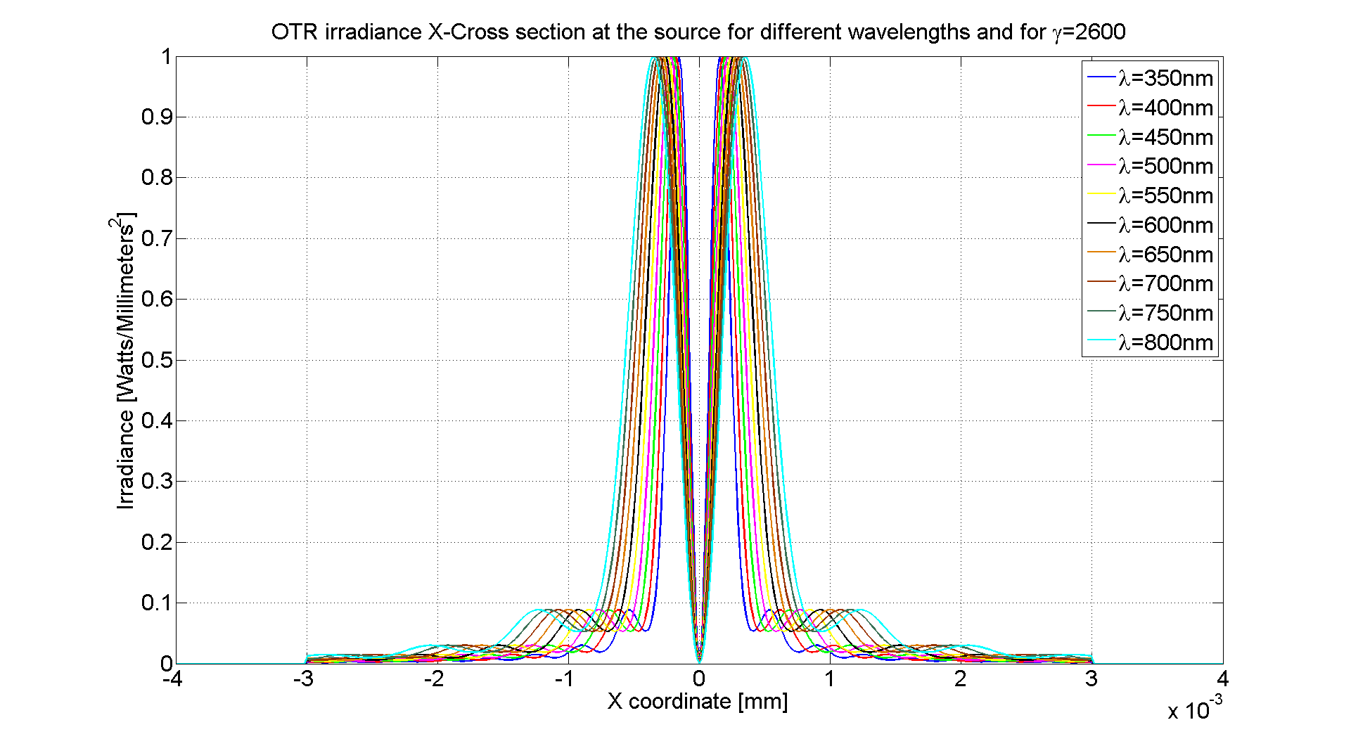
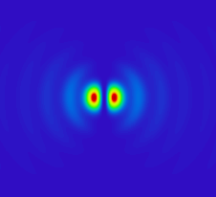

Physical Optics Propagation mode of Zemax
Electric field for vertical polarization component induced by a single electron on a target surface can be approximated as:
$E_{y}real=const.\frac{y}{\sqrt{x^{2}+y^{2}}}\left[\frac{2π}{ϒλ}K_{1}\left(\frac{2π}{ϒλ}\sqrt{x^{2}+y^{2}}\right)−\frac{J_{0}\left(\frac{2π}{λ}\sqrt{x^{2}+y^{2}}\right)}{\sqrt{x^{2}+y^{2}}}\right]$ where:
$$ϒ:charged particle Lorentz factor and λ:radiation wavelength$$
In Zemax, simulation of the electric field at the source for different wavelengths:
Then, Zemax propagates this electric field through the designed optical line up to the image plane by taking into account both diffractions and aberrations
At the image plane, we get the Point Spread Function, which represents the resolution of our system since the electric field at the source comes from 1 electron
N.B: I have created an option in the DLL which allows to perform the convolution of the OTR electric field (for a single electron) by the electric field of a Gaussian beam

Slide 18
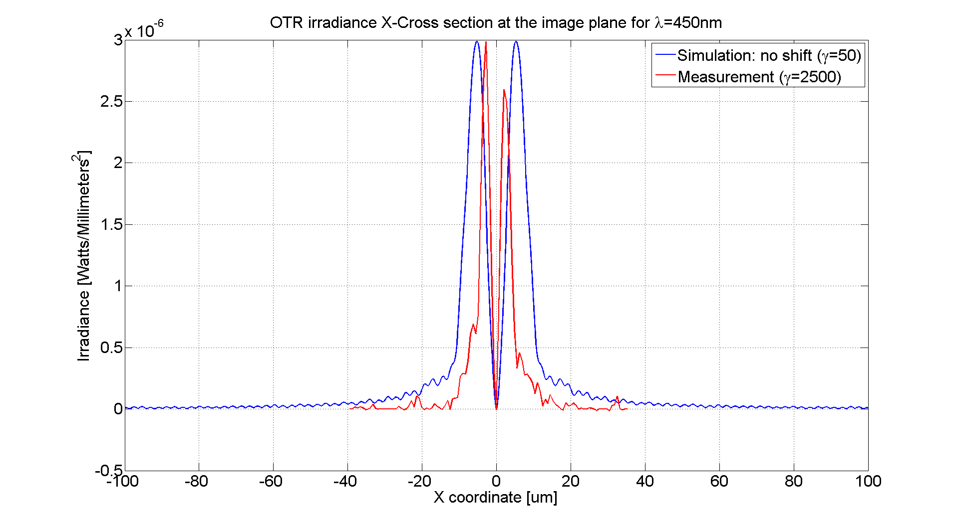
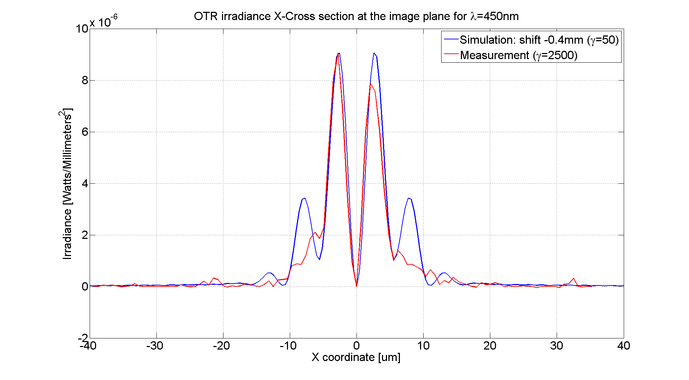
Measurements/simulations for the current set-up
Experimentally, the lens is shifted longitudinally by step of 50µm to find the real focus (aberrations minimum ➔ lobes width and distance between 2 peaks minimum)
Distance between the two peaks:
  Simulation (paraxial focus): 8µm
  Measurement: 4µm
Lobes width:
  Simulation (paraxial focus): 40µm
  Measurement: 20µm
For a longitudinal shift of the lens position of -0.4mm (simulation):
Same distance between the 2 peaks (4µm)
Same width of the main lobes (~10µm)
Tail of high amplitude
N.B: A large tails appears in simulations
➔ Probably due to a higher angular divergence in simulations since ϒ=50 (in the process to order a very powerful computer to go up to ϒ=2500)
➔ This is very encouraging results in terms of simulations!!

Slide 19
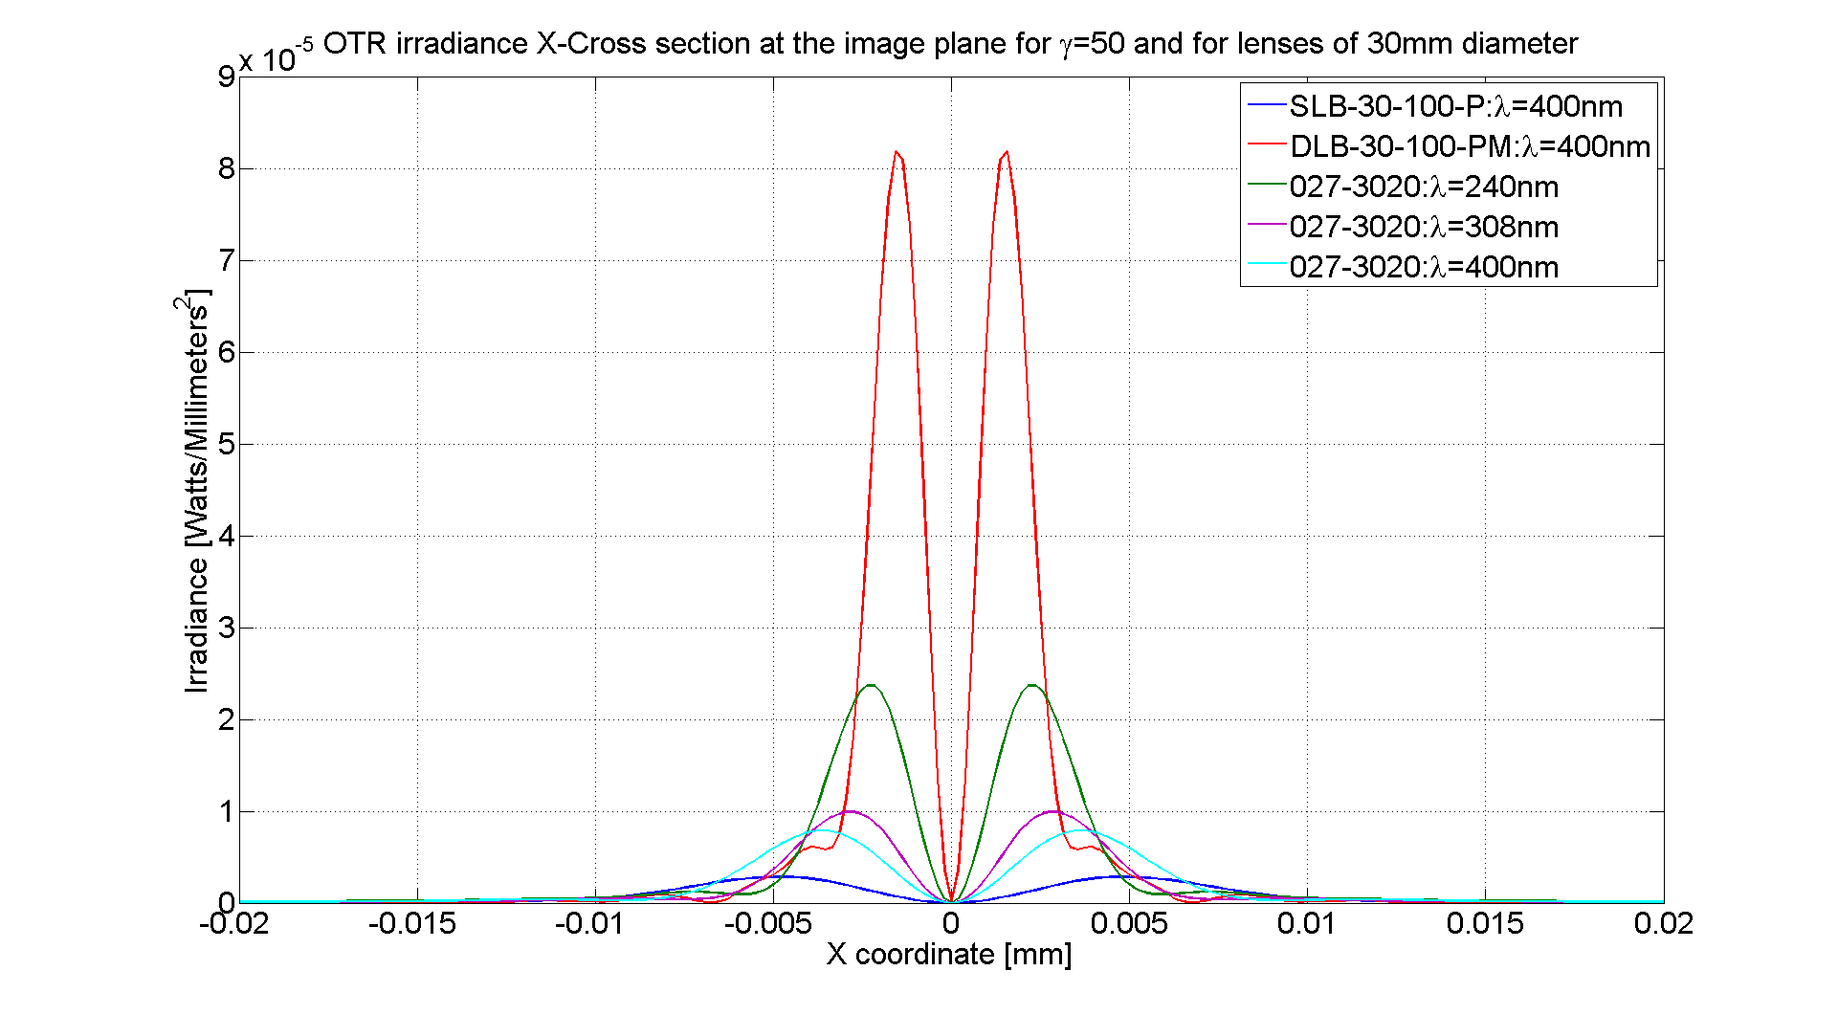
Simulations of the PSF for different kind of lenses
SLB-30-100-P: plano-convex lens (current lens)
DLB-30-100-PM: visible classical achromat doublet
027-3020: Precise Ultra-Violet achromat doublet
In ATF2, the current lens is a plano-convex lens with large aberrations (large PSF)
With a visible classical achromat doublet, aberrations are much reduced and we are close to the diffraction limitation for this kind of lens
With a precise ultra-violet achromat doublet, PSF is reduced when reducing the wavelength but PSF is still larger than with the visible achromat doublet at 400nm
  Certainly due to the materials used for ultra-violet lenses
➔ Choice done for beginning of next year: we will stay in the visible light but we will change the current plano-convex lens by the achromat doublet DLB-30-100-PM

Slide 20
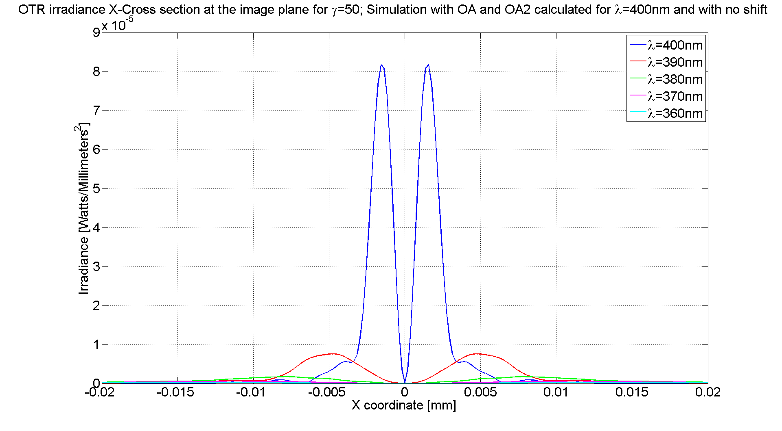
Study of the filter bandwidth (40nm) on the PSF
Achromat doublet DLB-30-100-PM
Focus for λ=400nm only
λ [nm] | 400 | 390 | 380 | 370 | 360 | 350
Distance between the 2 peaks [µm] | 2.89 | 10.05 | 15.61 | 22.58 | 28.18 | ----
Very important to select a filter wheel with a bandwidth as narrow as possible
➔ Compromise between intensity and filter bandwidth (intensity already not that high)
Since the achromat doublet allows a PSF size twice smaller than with the current plano-convex lens, we should have twice more light par pixel and we will test a filter wheel with a bandwidth twice narrow than the current one (from 40nm to 20nm)

Slide 21
4. Conclusion

Slide 22
OTR @ CTF3
Almost all OTR screens have been characterized experimentally (in terms of vignetting, misalignment and damages) using a dipole scan technique
  Emittance screens: constant beam size within ±10% over a large position range
  Spectrometer screens: after having changed parabolic screens by diffusive ones during the last winter shutdown, same conclusion than for emittance screens
  With the development of the OTR simulation tool (see below…), possibility to study very accurately vignetting now (before, object cone angle:1/ϒ (ray tracing)
OTR @ ATF2
Development of a very accurate simulation tool of the OTR Point Spread Function taking into account all diffractions and aberrations occurring through an optical line
This kind of simulations has never been done in the past and can be very useful for the BI group, especially when encountering problems of diffraction (and aberrations)
Simulations had reproduced the PSF measurements, which is very encouraging for the validity of the source model and for the accuracy of diffractions/aberrations prediction
Next step: Change the plano-convex lens by an achromat doublet and try to reduce the filter bandwidth by two in order to increase the resolution (reduction of PSF size)
  I should go to ATF2 next February to perform PSF measurements and validate simulations with these new measurements

Slide 23
SPARES

Slide 24
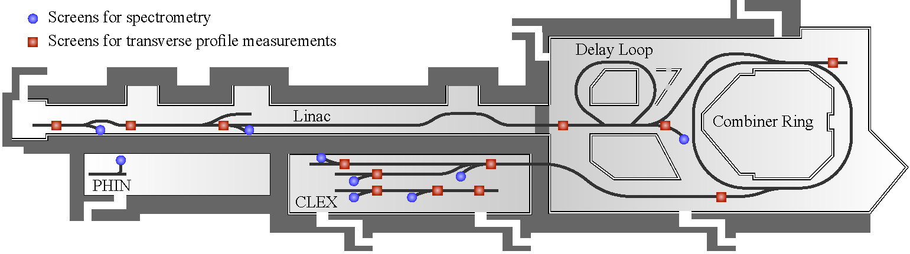
Locations and types of the OTR screens at CTF3
Screens | Screen type | Materials | Energy (MeV) | Current (A)
CT.MTV0435 | Flat, reflective | Al, C | 118.5 | 3.5
CL.MTV0500 | Flat, reflective | Al,C | 18.5 | 3.5
CL.MTV1026 | Flat, reflective | Al, C | 65.4 | 3.5
CC.MTV0253 | Flat, reflective | Si, SiC | 118.5 | 28
CC.MTV0970 | Flat, reflective | Si, SiC | 118.5 | 28
CTS.MTV0550 | Flat, reflective | Si, SiC |  | 7
CLS.MTV0440 | Flat, reflective | Al |  | 3.5
CLS.MTV1050 | Parabolic | Al | 60-75 | 3.5
CTS.MTV0840 | Flat, diffusive | Al | 100-150 | 7
CCS.MTV0980 | parabolic | Al | 100-150 | 28
CMS.MTV0630 | parabolic | Al | 100-150 | 28
CBS.MTV0300 | Flat, diffusive | Al | 60-150 | 28
Emittance screen
Spectrometer screen
Different screen shapes, screen materials, energies, current and optical lines
Notes:
Say that we have spectrometer and emittance screens with different energies, different materials and important: different optical lines…

