Slide 1
Electro-Optic Bunch Profile Monitor for the CERN-CTF3 probe beam
BI Day----Convention Centre of Archamps
6th of Dec. 2012
R. Pan, T. Lefevre , S.P. Jamison, W.A. Gillespie
CERN
STFC Daresbury Laboratory
University of Dundee

Slide 2
Outline
Introduction for CALIFES
EOSD principle and Simulation
EO bunch profile monitor system
Resolution
Summary

Slide 3
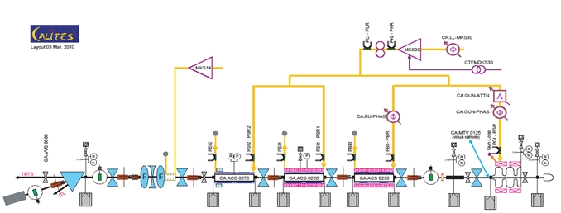

Introduction ---- CALIFES
3
single klystron
Standing-wave photo-injector
4
4
to Two Beam Test Stand (TBTS)
RF network
6
1
5
Complete set of diagnostics
2
3 travelling-wave structures (LIL)
Existing bunch profile monitor:
Deflecting cavity (bunch head downward, tail upward)
Bunch length measurement with an acceleration structure (bunch head decelerated, tail accelerated)
Energy | 200 MeV
Train duration max. | 140ns
Train rep. rate | 5 Hz
Bunch length | 8-10 ps (1.4 ps)
Bunch rep. rate | 1.5 GHz
Bunch charge | 0.1–0.05nC (0.6 nC)

Slide 4

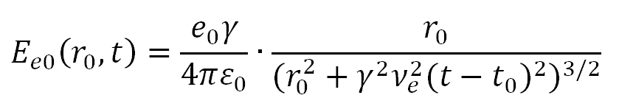

Coulomb field of e-bunch
Coulomb field temporal profile
β=0
β=0.9
β=0.9999
Coulomb field of one electron
High energy , Coulomb field temporal profile is approximately the bunch temporal profile
Broadening of profile:

Slide 5
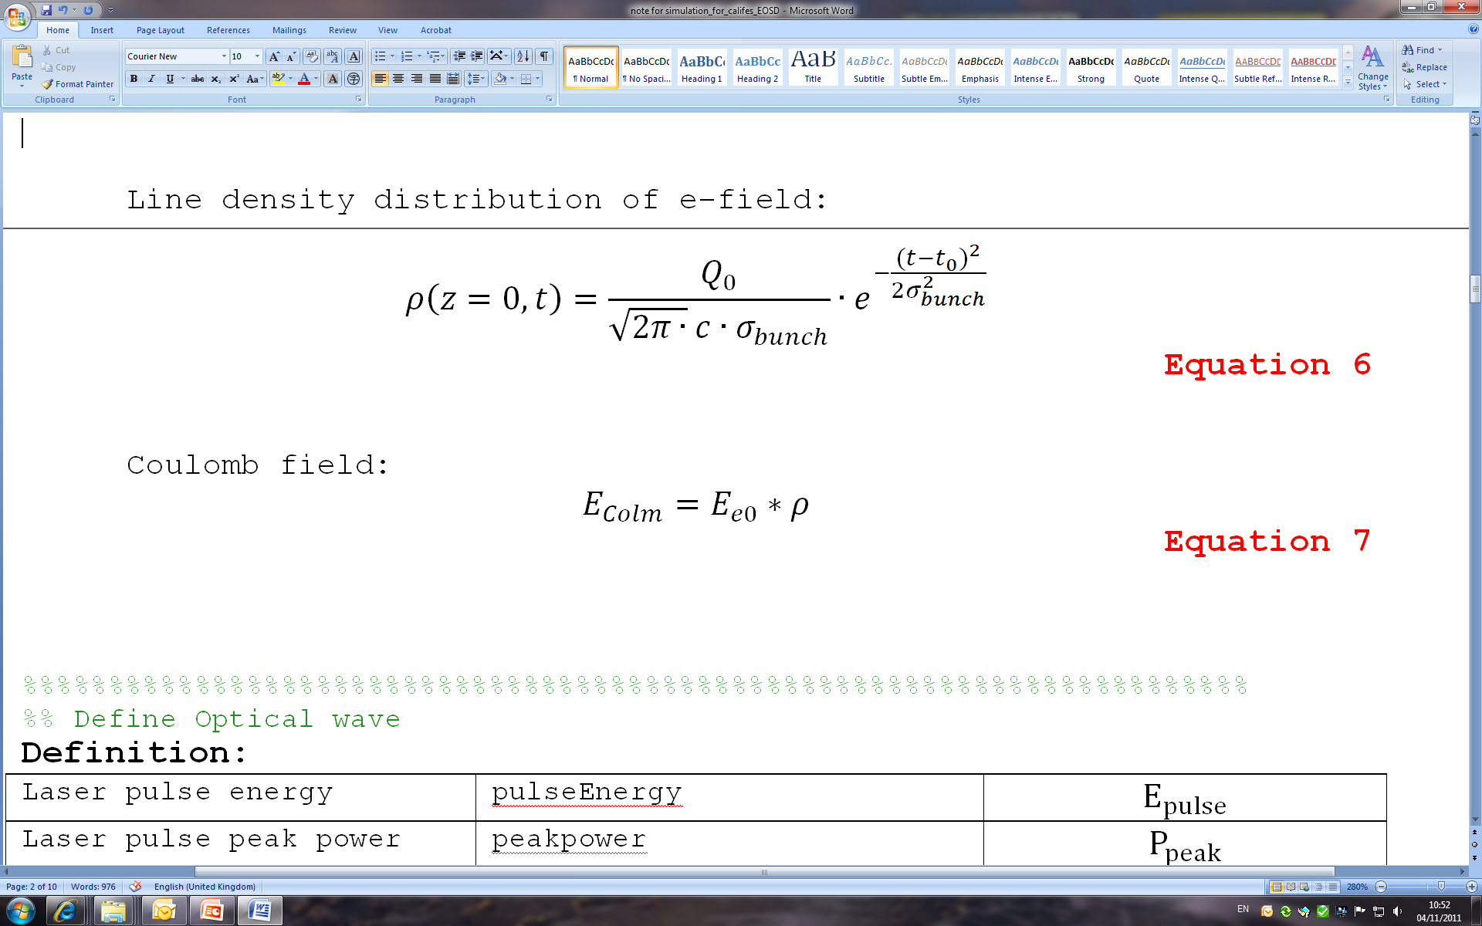
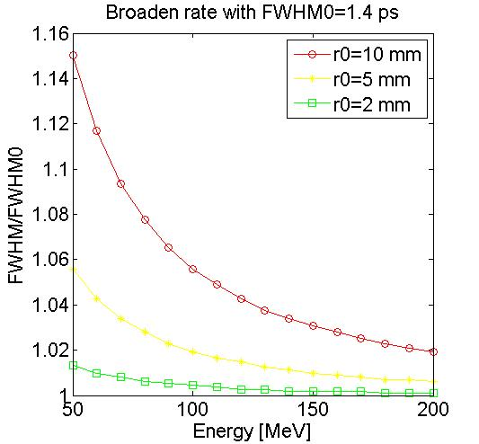
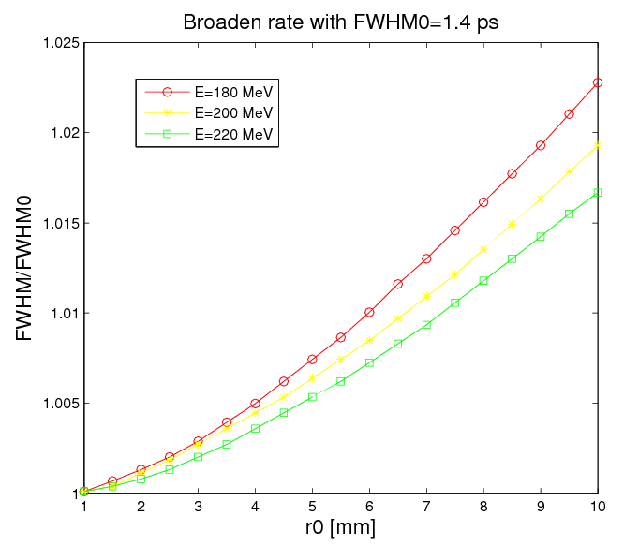
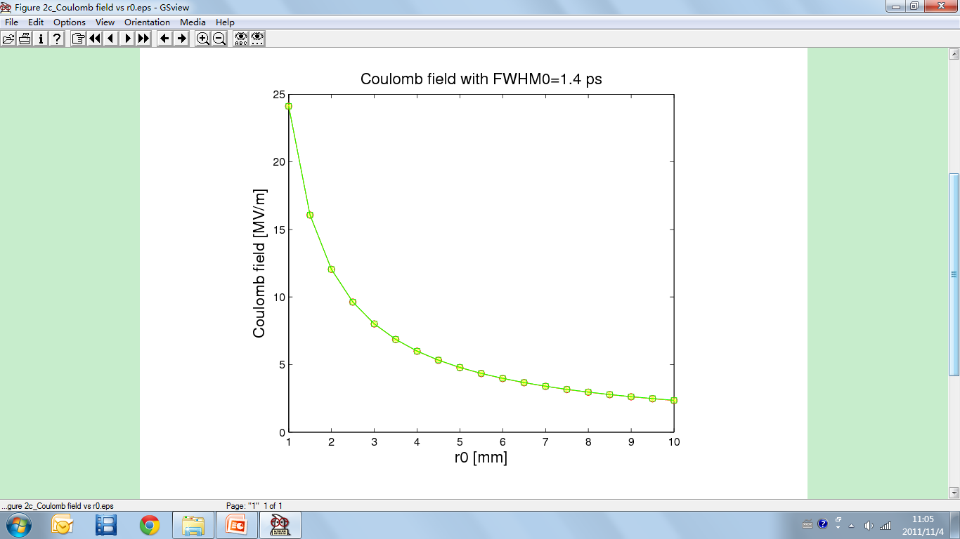
Simulation: Coulomb field of e-bunch
Coulomb field temporal profile and broadening
Radial offset from single electron
Electrons’ density distribution within one bunch
Convolution
2%
For high energy beam (200 MeV):
Broadening rate < 2% @ 10 mm
r0: the distance far away from e-bunch
Damage to crystal
Closer
Further
Crystal survives, low Coulomb field

Slide 6
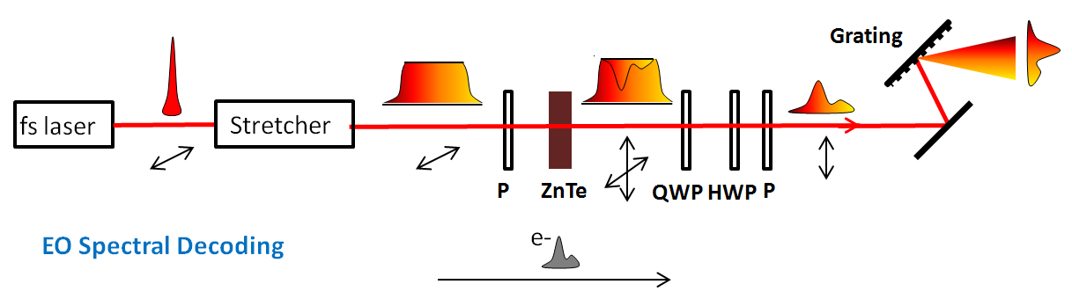
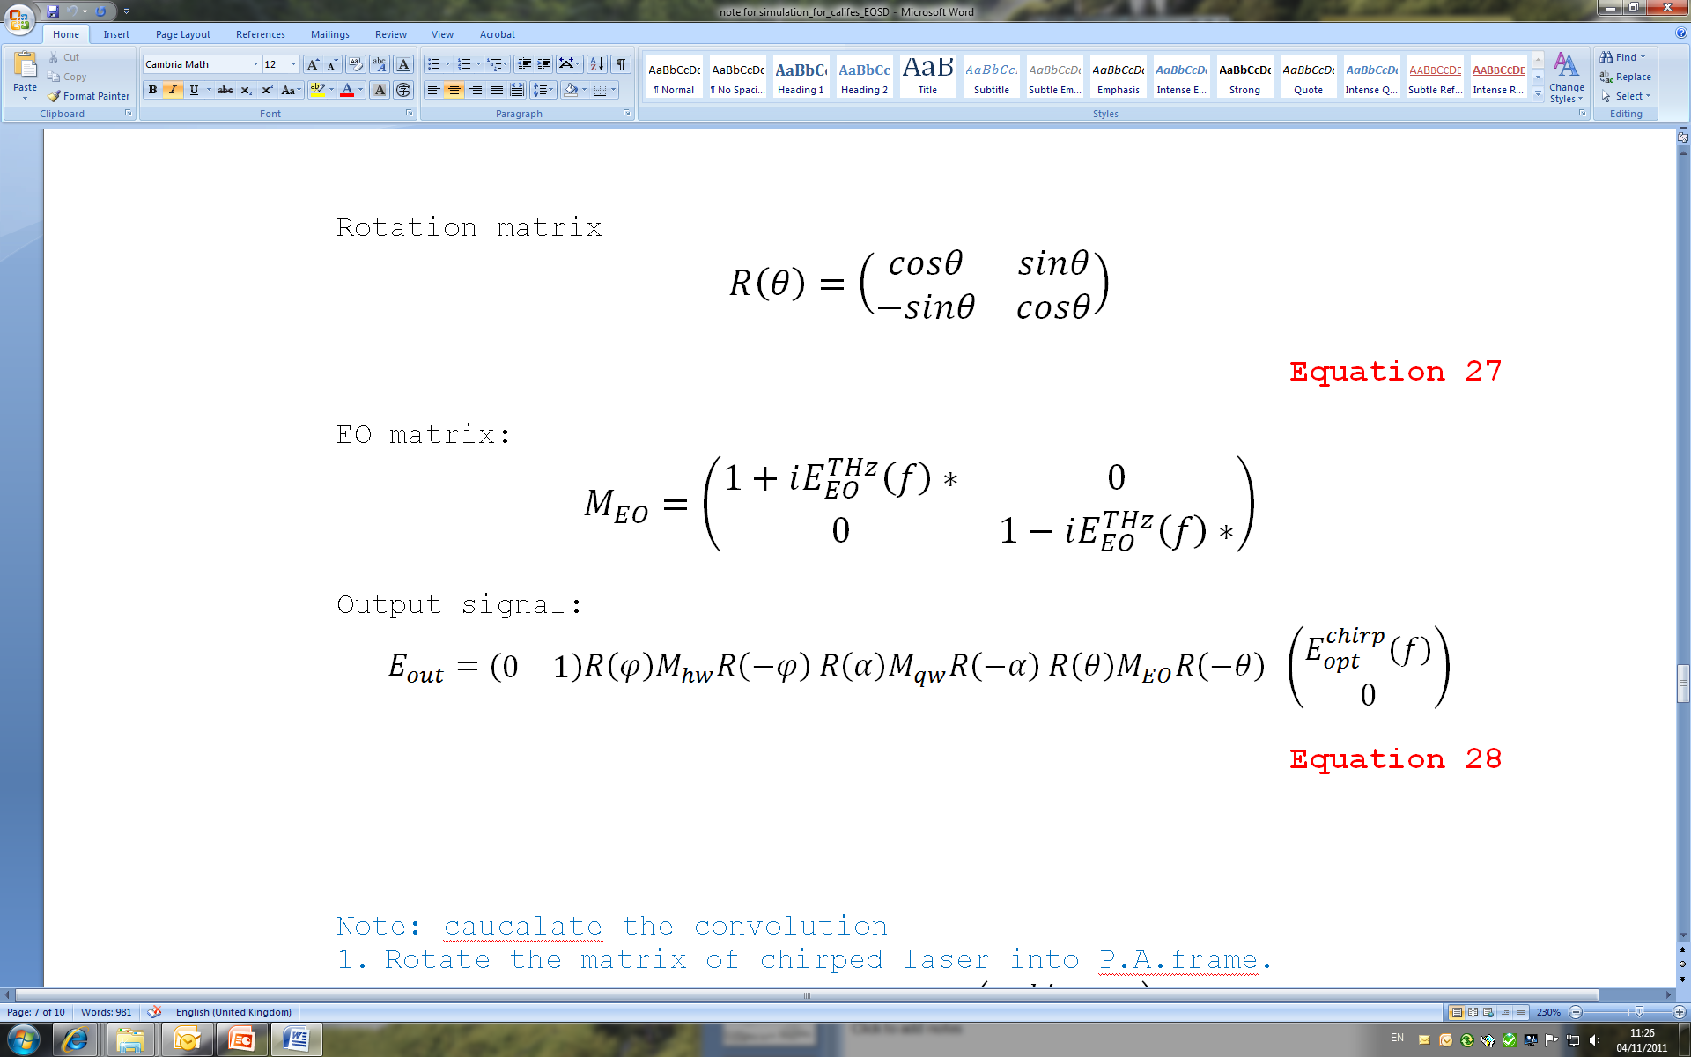
Simulation: EOSD
Electro-Optical Spectral Decoding:
EO bunch profile measurements:
--EO spectral decoding
--EO temporal decoding
--EO spatial encoding
--EO up conversion
Linear chirped optical pulse
Polarization variation caused by Coulomb field—laser nonlinear effect
Polarization → Intensity, by two crossed polarizers
I(λ) ←→ I(t)
---- rotation matrix
----Jones matrix for quarter waveplate
----Jones matrix for half waveplate

Slide 7
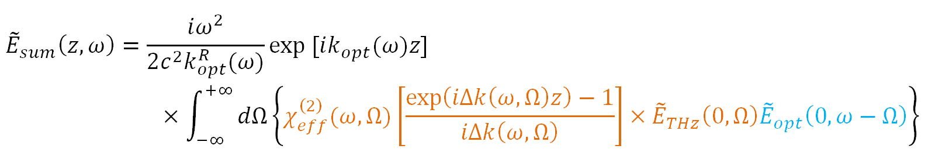
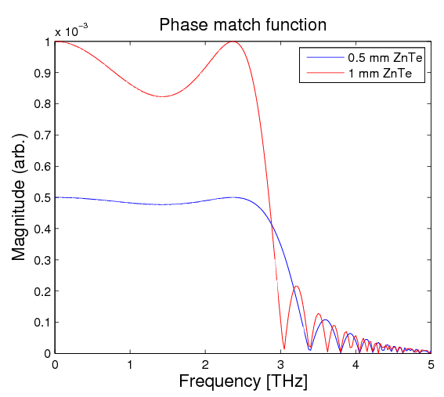
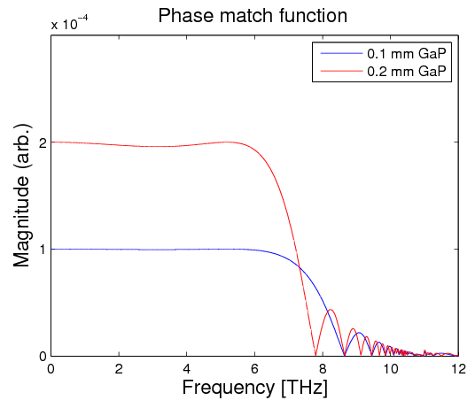
Simulation: EO phase mismatching
induce
EO effect:
Frequency mixing
Polarization variation
Coulomb field
Laser
Wider bandwidth, better resolution !

Slide 8
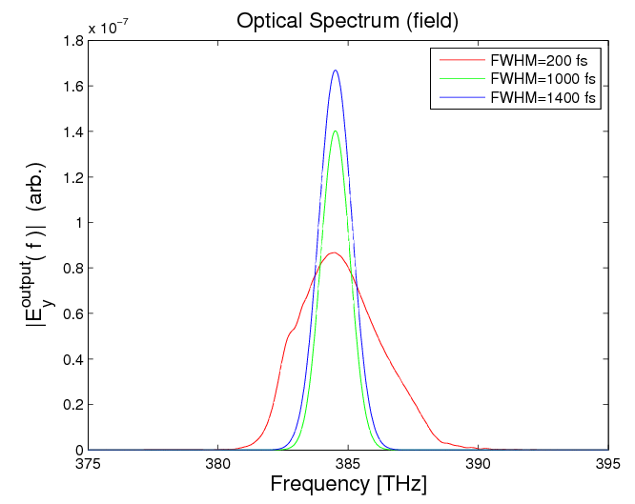
Simulation: EOSD results and limitation
distortion
Other parameters:
Laser wavelength: 780nm
Laser pulse energy: 1.5nJ
Pulse duration: 150fs
Short bunch----fast temporal modulation---- spectral content
---- t~λ mapping
Crystal thickness: 1mm
Distance: 5mm

Slide 9
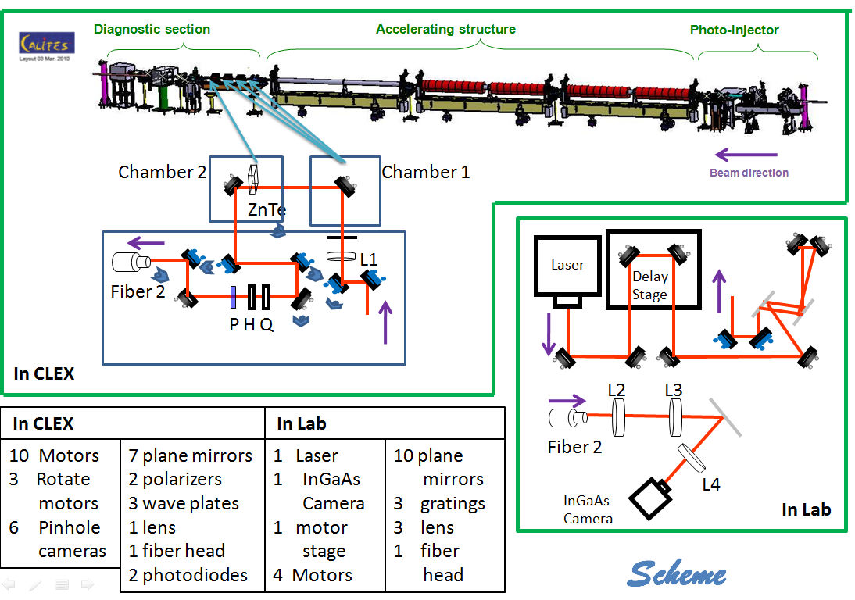
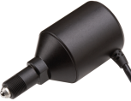
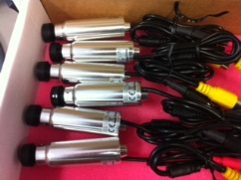
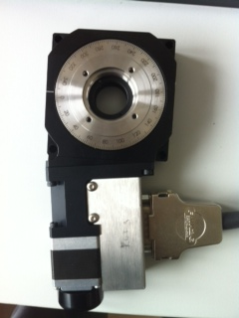
EO monitor Design for CALIFES
Stretcher:
SF11 glass
100fs----3.24ps
Actuator
Cameras
Rotation stage

Slide 10
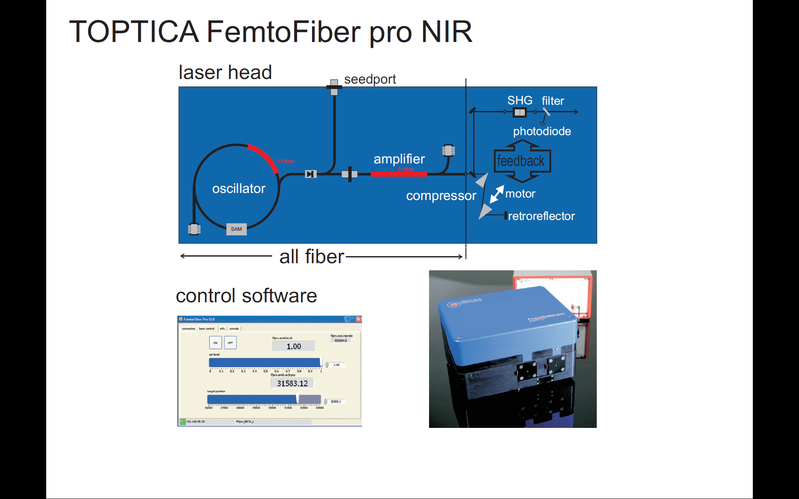
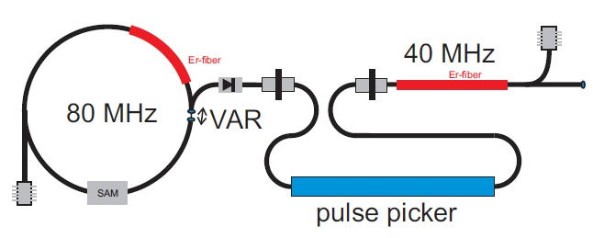
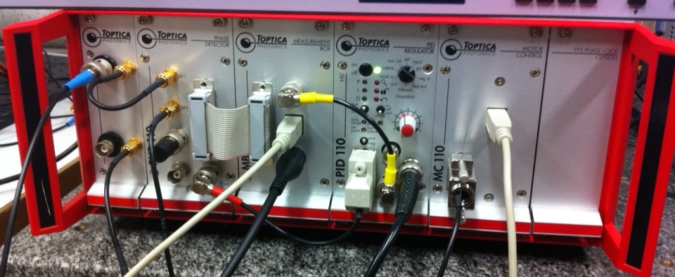
Laser system
Laser system
37.5 MHz
75 MHz
Laser head and controller
Custom Erbium fiber laser with pulse picker
PD in
RF 1
RF 2
PID: Proportional Integral Differential
Fundamental wavelength | 1560 nm
Laser output power | > 350 mW
Pulse width | < 120 fs
Repetition rate | 37.482 MHz
Second-harmonic wavelength | 780 nm
Laser output power | > 120 mW
Pulse width | < 120 fs
Beam size (1/e²) | Typ. Ø 1.2 mm (780 nm) Typ. Ø 3.5 mm (1560 nm
Beam divergence | < 1 mrad (780 nm) < 2 mrad (1560 nm)
Phase out
PID in
Piezo control
Motor control
Synchronization box

Slide 11
Timing and synchronization scheme
RF (74.963 MHz, 13.3ns)
Phase shifter
Streak
Camera
Pulse generator
OTR
e-
5 Hz rep.
RF (37.4815 MHz, 26.6 ns)
Ref (74.963 MHz)
RF (74.963 MHz)
Optical system
Photodiode
(5 ns)
Amplifier
Oscillator
Pulse picker
signal (fibre, 20m, ~100 ns)
Delay stage (6 fs step, 0.75 ns range)
ICCD
Camera
Trigger from the accelerator
3 ns min. exposure

Slide 12
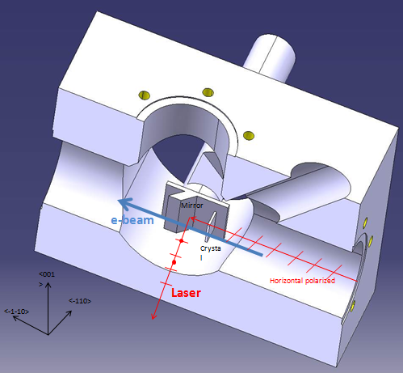
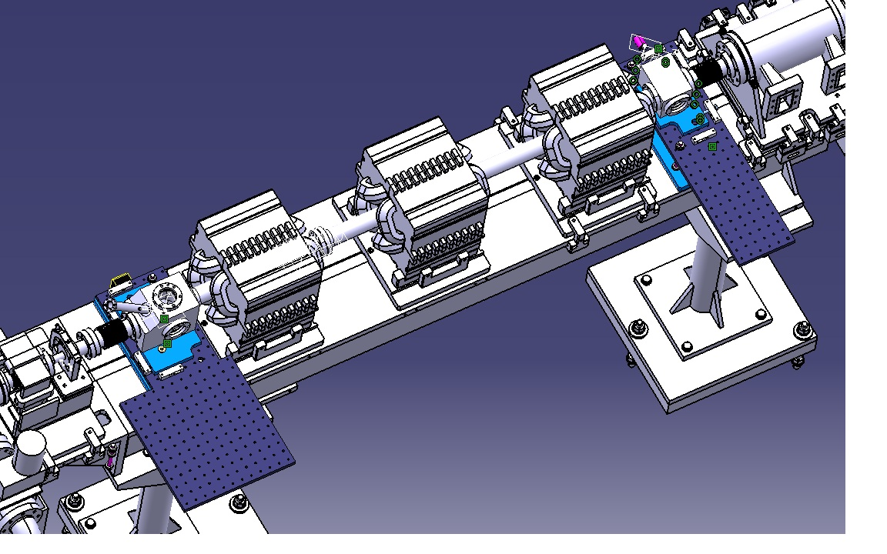
EO monitor Design for CALIFES
Chamber design
OTR
<001>
First chamber includes a mirror
The second chamber includes a mirror, a crystal and a OTR screen
<-110>
Crystal orientation
<100>
<010>
<-1-10>

Slide 13
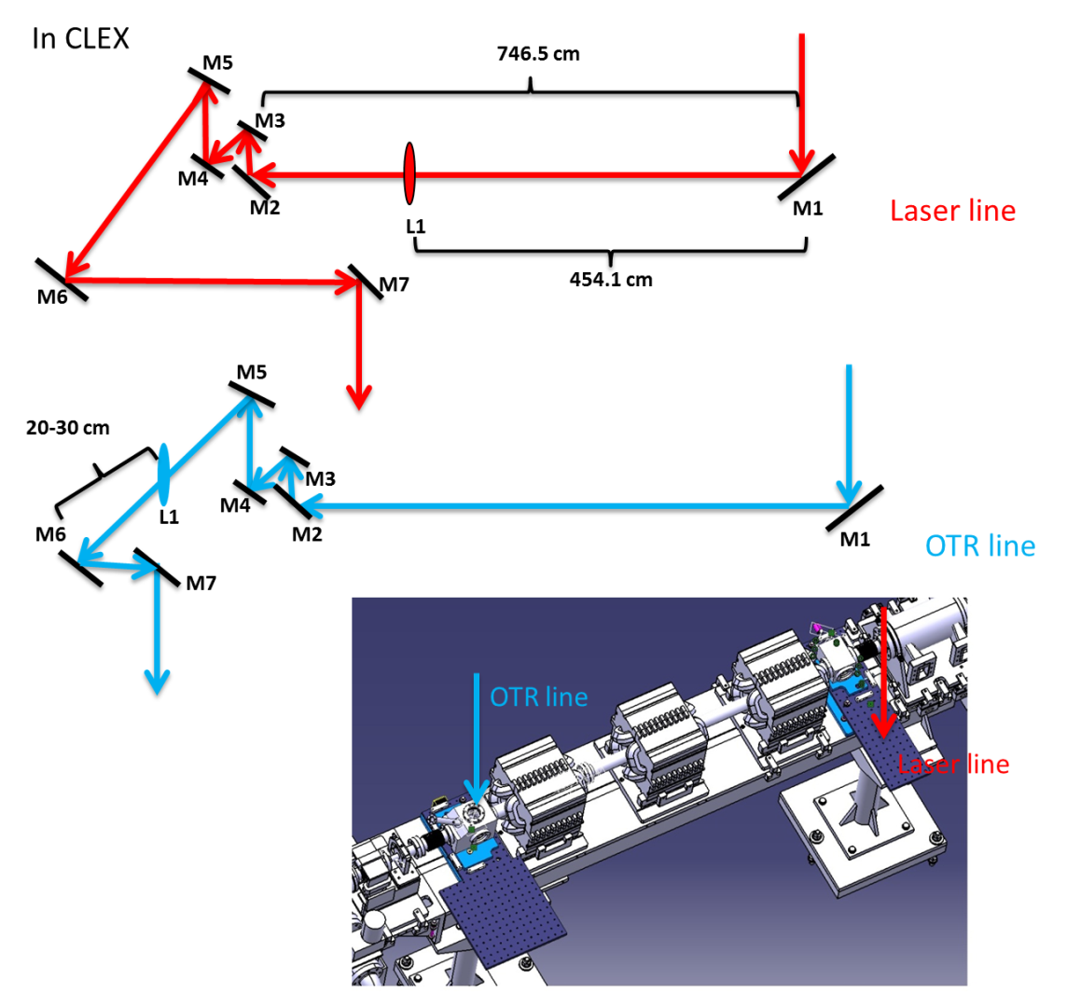
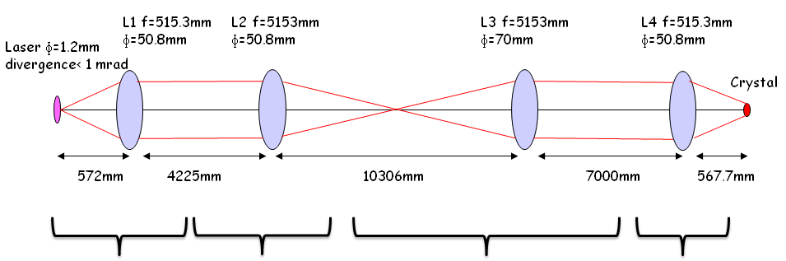
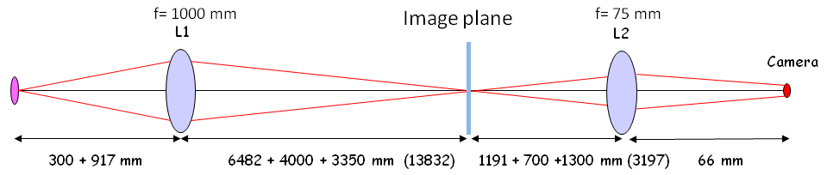
Laser/OTR Transfer Line
Laser lab
Streak camera room
CLEX
CLEX
We transfer the 780nm fs laser from our laser lab (building 2010-1-002) to CLEX, and transfer the OTR photons from CLEX to our lab.

Slide 14
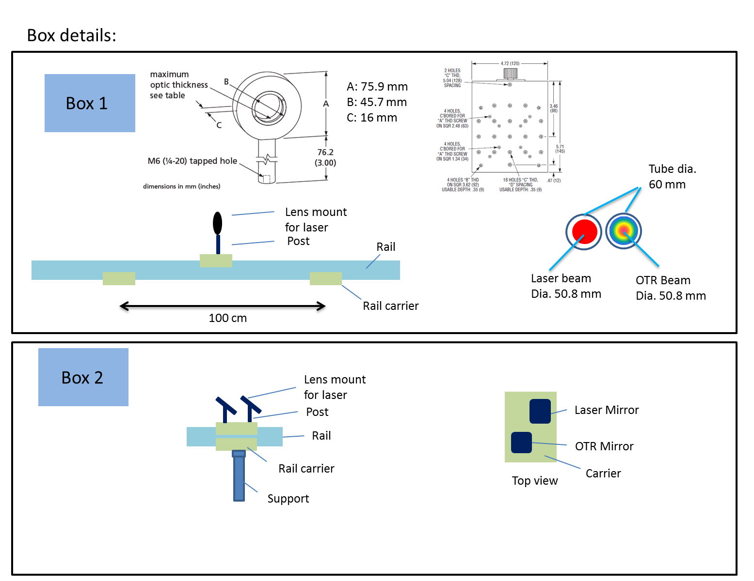
Laser/OTR Transfer Line 2
Installation:
Take the box1 and box2 for example
Mirror/lens cover box

Slide 15
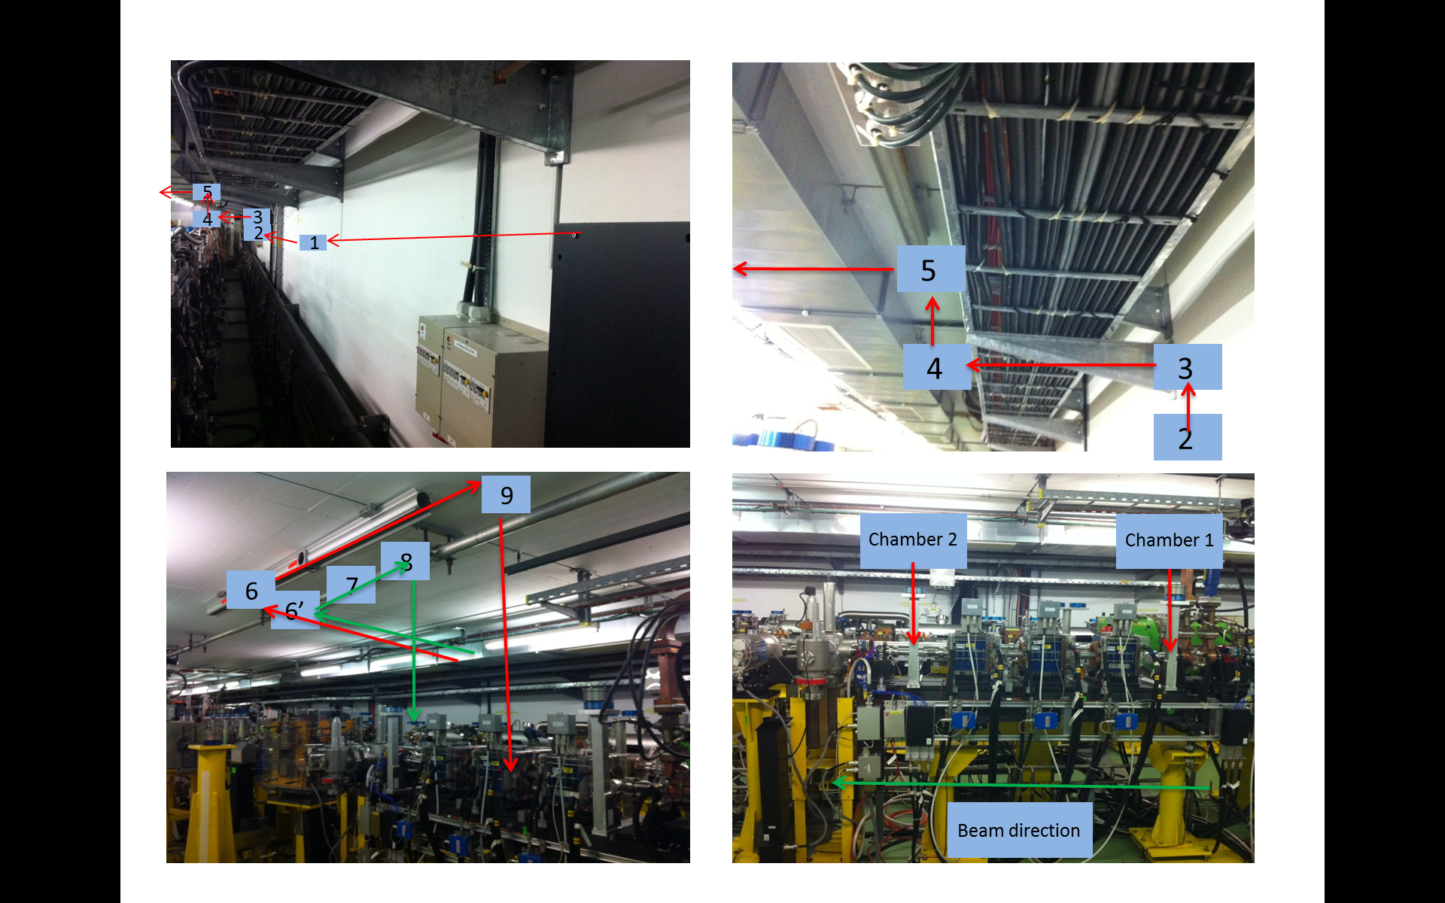
Laser/OTR Transfer Line 3

Slide 16
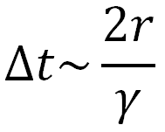
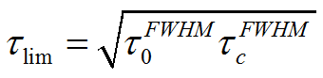
Expected Resolution
1. Distance between crystal and e-beam
~10 fs at r=5 mm
2. The frequency response of crystal (material and thickness)
for 1 mm ZnTe: ~333 fs ~1/(3THz)
3. EOSD limitation (Laser pulse duration and chirped duration)
~550 fs (100 fs→3 ps)
4. Resolution of spectrometer and CCD ~40 fs (512 pixels)
Grating

Slide 17
Summary & Outlook
Summary:
EO technique is a non-destructive testing technique, and has the feasibility in fs resolution.
System simulation, designs of laser system, transfer line, chambers, detection system and timing and synchronization have done.
Based on numerical simulation, the resolution of this system is expected to be sub-picosecond.
Outlook:
The system waiting for being installed during the winter shut down. First measurement in the beginning of next year.
Resolution improvement study
This research project has been supported by a Marie Curie Early Initial Training Network Fellowship of the European Community’s Seventh Framework Programme under contract number (PITN-GA-2008-215080-DITANET)

Slide 18
Thank You !

Slide 19
References
[1] X. Yan, A. M. MacLeod, W. A. Gillespie, G. M. H. Knippels, D. Oepts, A. F. G. van der Meer and W. Seidel, Phys. Rev. Lett. 85, 3404 (2000).
[2] I. Wilke, A. M. MacLeod, W. A. Gillespie, G. Berden, G. M. H. Knippels, and A. F. G. van der Meer, Phys. Rev. Lett. 88, 124801 (2002).
[3] A. Azima, S. D¨usterer, H. Schlarb, J. Feldhaus, A. Cavalieri, D. Fritz, and K. Sengstock, In Proceedings of the EPAC 2006, Edinburgh, Scotland, 2006, p. 71.
[4] G. Berden, S. P. Jamison, A. M. McLeod, W. A. Gillespie, B. Redlich, and A. F. G. van der Meer, Phys. Rev. Lett. 93, 114802 (2004).
[5] S. P. Jamison, G. Berden, P. J. Phillips, W. A. Gillespie, and A. M. MacLeod, Appl. Phys. Lett. 96, 231114 (2010).
[6] J. D. Jackson. Classical Electrodynamics (John Wiley and Sons, Inc., 1999).
[7] S. P. Jamison, A. M. MacLeod, G. Berden, D. A. Jaroszynski, W. A. Gillespie, Opt. Lett. 31, 1753 (2006).
[8] S.P. Jamison, G. Berden, W.A. Gillespie, P.J. Phillips, A.M. MacLeod, in Proceedings of EPAC08, Genoa, Italy, 2008, p. 1149.
[9] J. Breunlin, Diploma thesis, University Hamburg, 2011.
[10] B.Steffen et al., Phys. Rev. ST Accel. Beams 12, 032802 (2009).
[11] A. Yariv. Quantum electronics (1989).

