Slide 1


STATUS OF THE
LHC SCHOTTKY MONITORS
Mathilde FAVIER
Fellow in BE/BI/QP

Slide 2
Introduction
Beam = Large, but finite number of individual particles typically moving in both, a coherent and incoherent, manner.
Schottky noise : based on the statistical fluctuations of these finite number of charge carriers.
LHC has Bunched Beam:
  Look at the individual motion of particles inside a bunch.
Schottky system = Non destructive way to determine important beam parameters such as: Tune, Chromaticity, Emittance and Momentum Spread.

Slide 3
OVERVIEW
I/ WHAT IS SCHOTTKY NOISE?
  a) Longitudinal Schottky Noise
  b) Transverse Schottky Noise
II/ THE LHC SCHOTTKY SYSTEM
  a) Analogue Signal Processing
  b) Schottky Spectra
III/ MEAUREMENTS
IV/ ISSUES & LIMITATIONS
CONCLUSION

Slide 4
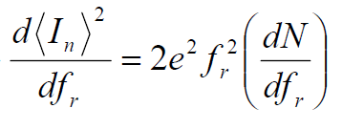

I/ WHAT IS THE SCHOTTKY NOISE? a) Longitudinal Schottky Noise
Consider 2 particles circulating in a machine:
  The first one has charge e, velocity v and revolution time t₀ = 1/f₀.
  The second one has a slightly different energy and hence revolution frequency f₁. With f₁ = f₀ + Δf .
Looking at the Longitudinal Spectra :
For a subset of N particles with random initial phase and a revolution frequency spread of: f0 + Δf/2.
The power spectral density of the noise in the n^{th} band is:
I(f)
∆f
2∆f
n∆f
Fig 1: two particles with a slight frequency offset Δf .
f₀
2f₀
f₁
2f₁
nf₀
nf₁
frequency
$$\frac{d{\left\langle I_{n}\right\rangle }^{2}}{df_{r}}$$
(n-1)∆f
Overlapping or Mixing
n∆f
(n+1)∆f
(n-1)f₀
nf₀
(n+1)f₀
frequency
Fig 2: A schematic picture of longitudinal Schottky bands

Slide 5

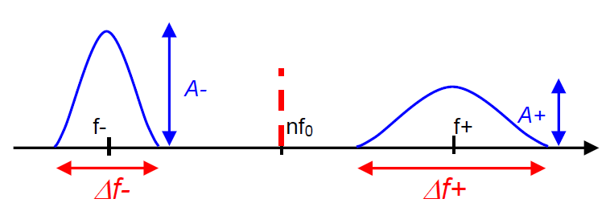
I/ WHAT IS THE SCHOTTKY NOISE? b) Transverse Schottky Noise
For a bunched beam two signal contributions:
  Amplitude modulation du to betatron oscillations.
  Time (frequency) modulation due to synchrotron oscillations.
From the Spectral Point of View:
Each Schottky band has a finite width which results from the spread of revolution frequencies and betatron frequencies:
n : harmonic number
q : non integer part of the tune
ξ : chromaticity
η : slip factor
Q : betatron Tune
~ 136
Varies from 1 to 10
Fig3: Transverse Spectrum of the Transverse Schottky side bands

Slide 6
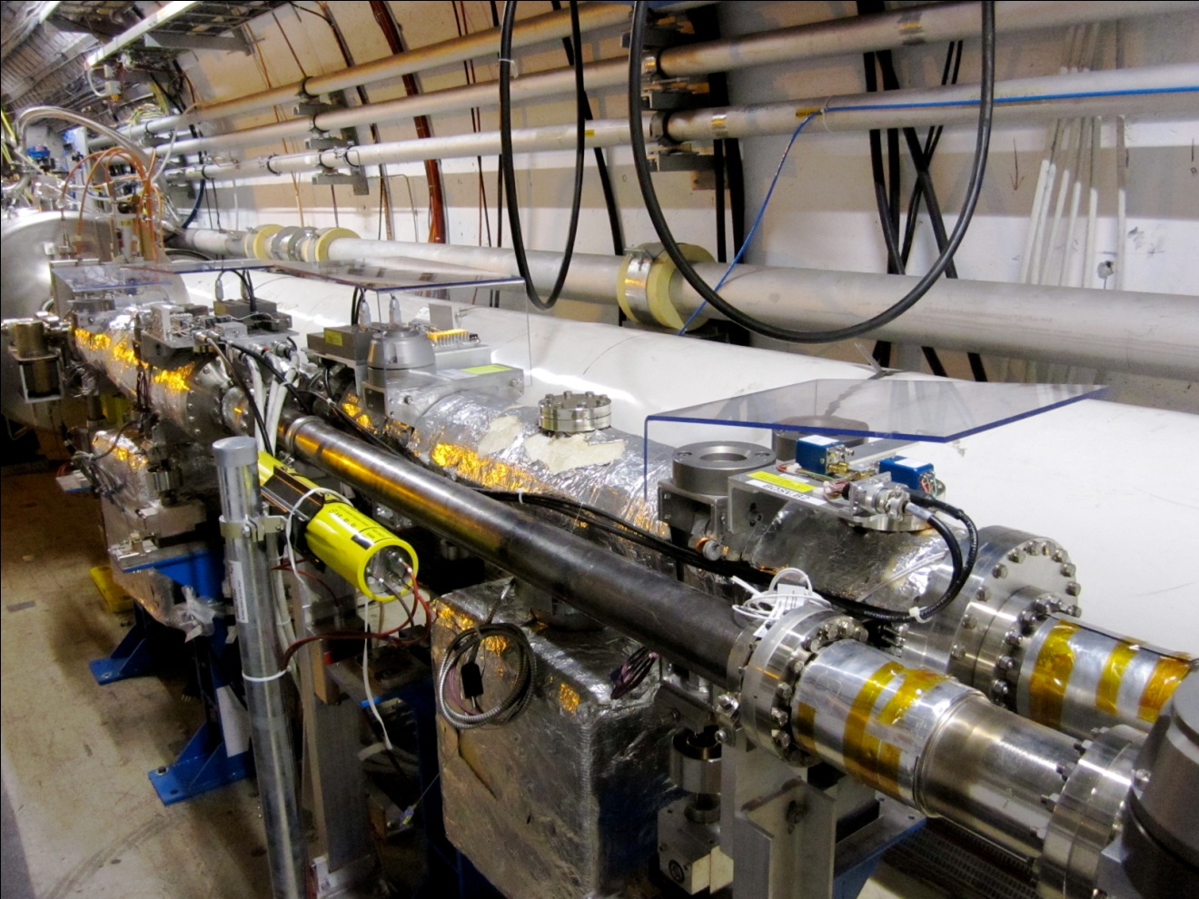
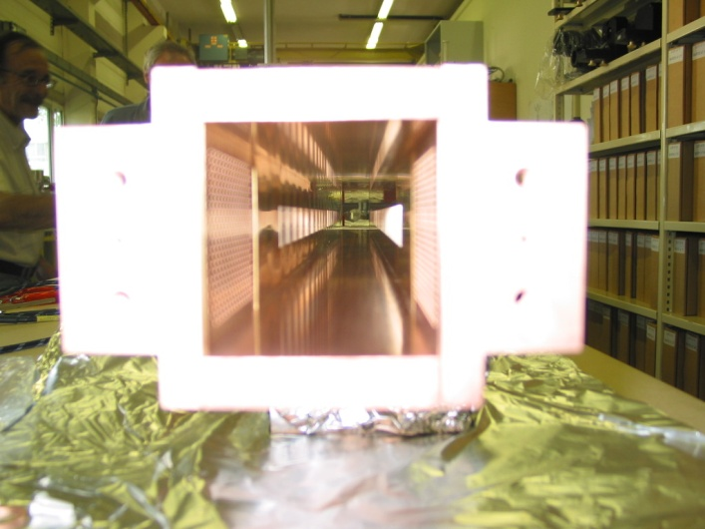
II/ The LHC Schottky System
      Too High in frequency Overlap of the Schottky bands
      Too low in frequency To much Coherent Signal
  Design done for a frequency at 4.8GHz
Fig4: Theoretical bunch spectrum (coherent signals) of a nominal LHC beam at top energy.
Fig 5: Picture of the Schottky monitor at LHC Point 4
4 Schottky devices were installed at Point 4 in the LHC. One for each transverse plane for the two beams.
A high sensitivity pickup operating at 4.8GHz, which corresponds to the 427000 harmonic of the revolution frequency
Fig6: Picture of the Sloted Wave Guide Structure

Slide 7
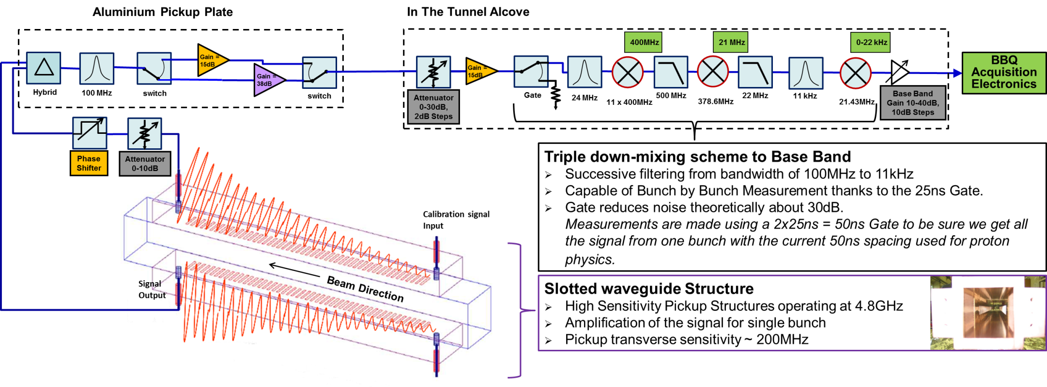
II/ The LHC Schottky System a) Analog Signal Processing
Slotted Wave Guide Structure operating at 4,8 GHz.
Preamplifiers.
Gate to allow bunch by bunch measurements
Triple down converter mixing chain plus band pass filtering converting the 4.8GHz signal to baseband.
Fig7: The LHC Schottky analogue treatment Channel
Notes:
Triple down Convertion Mixing:
Keep the phase Noise Low, has the Schottky signal is really low.
Possibility to follow the RF during the Ramp to avoid the signal to jump by few KHz
Conserve the dynamic Range which is about 100dBm.

Slide 8
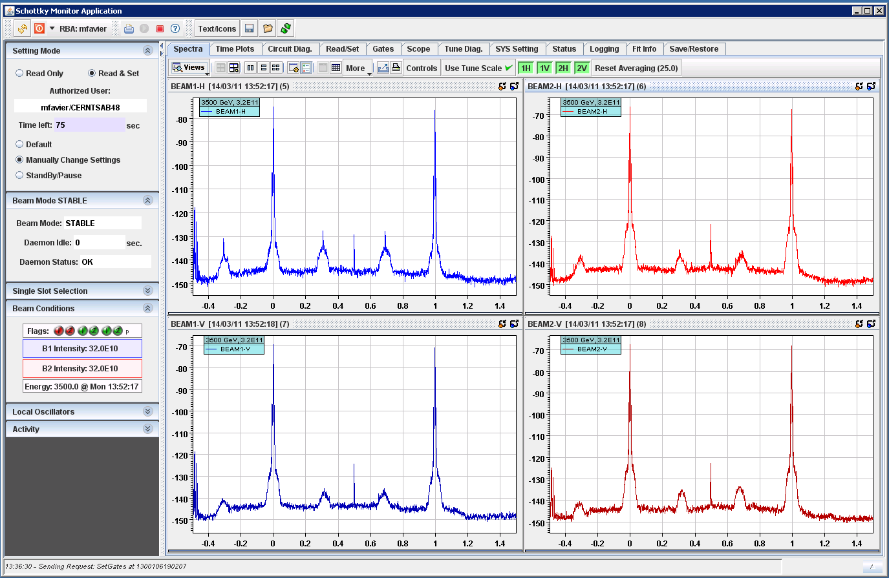
II/ The LHC Schottky System b) Schottky Spectra
Revolution Frequency
Schottky bands
Fig8: Schottky spectra with protons at stable beam (view from the GUI).

Slide 9
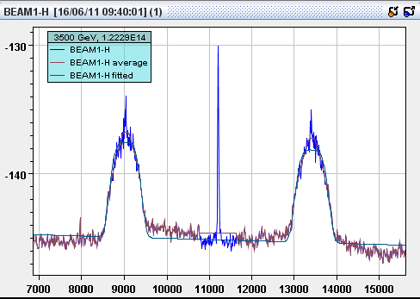




III/ MEASUREMENTS
Spectra Fit Beam Parameters
  Incoherent Tune
  Momentum spread
  Chromaticity
  Emittance
A1
A2
W1
W2
f1
f2
Fig 9: Zoom on the Schottky bumps, B1H spectra with protons at stable beam (view from the GUI).

Slide 10
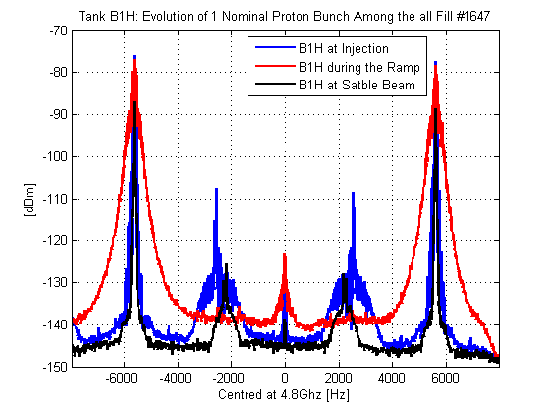
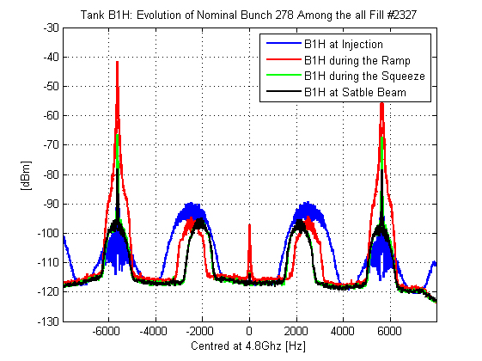
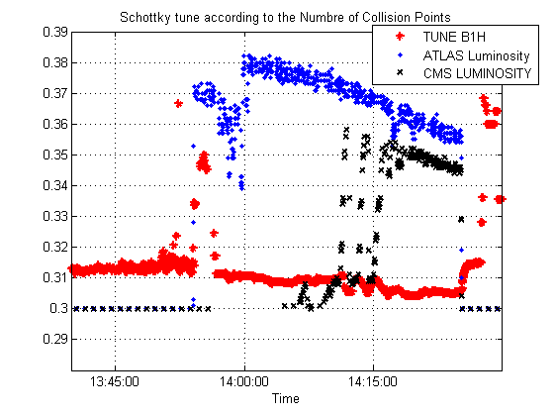
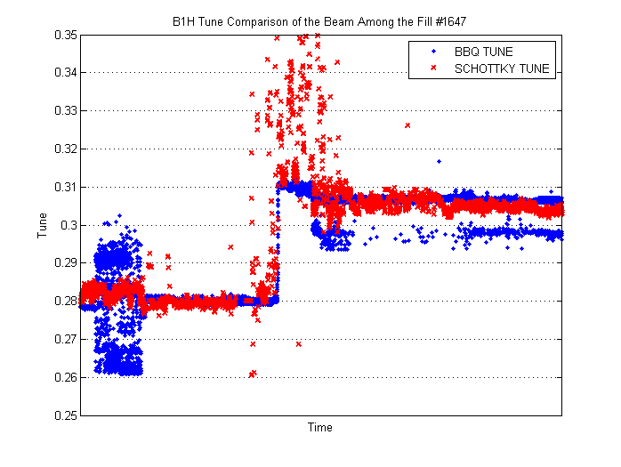
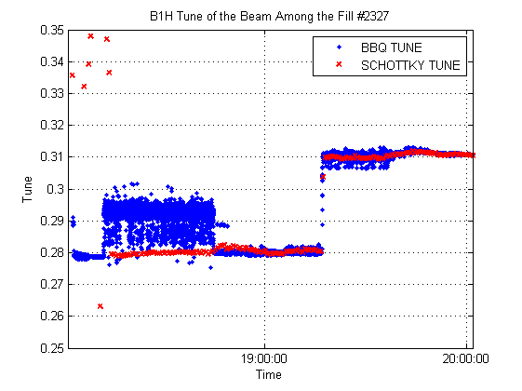
III/ MEASUREMENTS
Protons and Ions Measurements
  Proton Spectra
  Ion Spectra
  Tune Measurements during the Beam Beam MD
Tune shift clearly visible
  Proton spectra lost during the ramp.
  Reliable bunch by bunch tune measurements on B1H.
  Chromaticity measurements possible but need to be crossed checked.

Slide 11
III/ MEASUREMENTS
Protons VS Ions
  Nominal Bunch at Injection
  Nominal Bunch at Stable
 | Intensity | Bunch Length [ns]
Protons | 1.26 e+11 | 1.19
Ions | 6.9 e+09 | 1.9
 | Intensity | Bunch Length [ns]
Protons | 1.20 e+11 | 1.13
Ions | 7.41 e+09 | 1.7

Slide 12
IV/ ISSUES & LIMITATIONS
Schottky devices are really sensitive to:
  Coherent longitudinal oscillations
    Longitudinal blow-up during ramp
    No more signal right after the Ramp and Squeeze
      30 MINS BEFORE SIGNAL APPEARS
  Coherent transverse Signal
    System has 100dB dynamic range but still sensitive to:
      Bunch position.
      Bunch Intensity -> Saturation of the Electronic
  B1H always gives better results, investigation s underway to understand why the other systems don’t perform as well!!?
  Modification have been tested at B2V to reduce the coherent transverse signals.

Slide 13

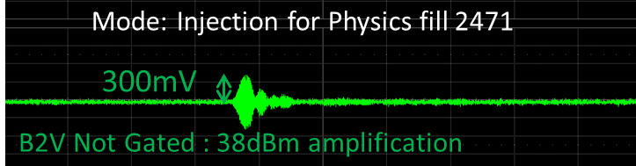
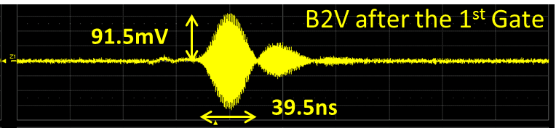
IV/ ISSUES & LIMITATIONS
Modification on Pickup plate on B2V:
  Additional Gate and improved filtering.
  Avoid the saturation of the Preamp
Aluminium Pickup Plate
Signals
from ->
pickups
Circulator
Gain = 15dB
Gain = 38dB
Signal to alcove->
Hybrid
Gate
100 MHz
24 MHz
switch
switch
  Fig 10: New electronic installed on the B2V pick-up plate.
  Fig 11: Amplitude of the signal at injection of nominal protons in B2V before the addition of the Gate.
  Output Voltage (and hence input voltage) of the front end amplifier is reduced by a factor of 3.
  Fig 12: Amplitude of the signal at injection of nominal protons in B2V after the addition of the Gate on the Pick-up plate.

Slide 14
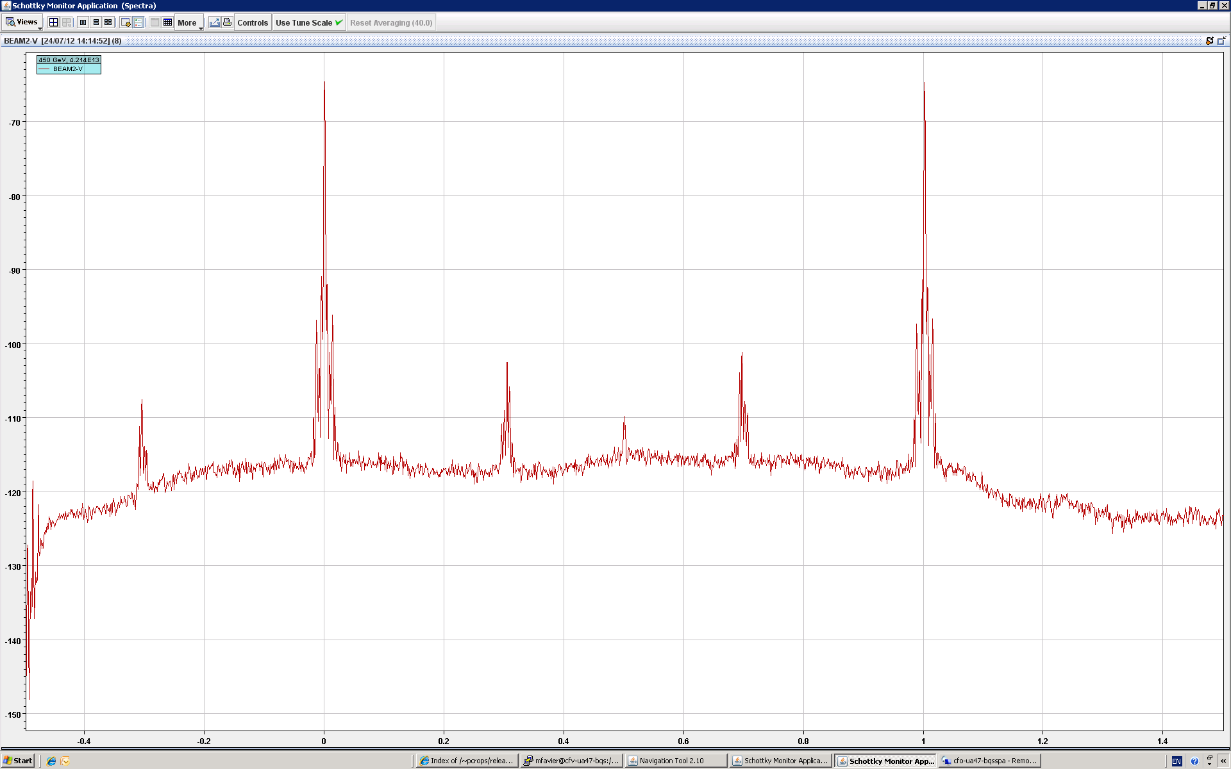
IV/ ISSUES & LIMITATIONS
B2V Spectra at injection for a Nominal bunch with the modified system
Coherent signal significantly decreased (by ~ 15dB to 20dB).
No nice Schottky “bump” visible.

Slide 15
CONCLUSION
Gate needed on the other pickup plates to avoid the saturation of the pre-amplifiers.
Keep Investigating to understand why B1H gives always better signals.
Plan for LS1:
  Dismount some of the Schottky devices to investigate more an the wave guide and the pick-up system.
  Test bench in the Lab.

Slide 16
THANK YOU
ANY QUESTIONS?

Slide 17
Some References
Schottky Beam Instrumentation, Linnecar, T, CERN- PE-ED 001-92, Geneva, CERN, 1992.
Schottky Noise And Beam Transfer Function Diagnostics, Boussard, D, CERN, Geneva, Switzerland.
Shottky Signal for Longitudinal and Transverse Bunched Beam Diagnostics, Fritz Caspers, Jocelyn Tan, CERN, Geneva, Switzerland.
The 4.8 GHZ LHC Shottky Pick-up System, Proceedings of PAC07, Albuquerque, New Mexico, USA.
Capabilities and performance of the LHC Schottky Monitors, M. FAVIER, T. Bogey, O. R. Jones, Proceedings of DIPAC11, Hamburg, Germany.

