Slide 1


RF Simulations for the LHC
Beam Instrumentation Day 2012
Andriy Nosych
CERN Fellow
BE / BI / QP
Dec 6, 2012

Slide 2
Outline
Tools
WCMs
Non-linearities
BPMs
Modeling
Meshing
HOMs
Strip-lines
Beam loss
Collimators
Heating
BSRT

Slide 3

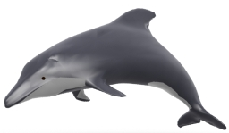




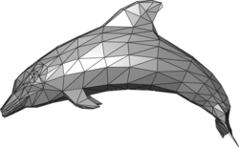

Electromagnetic tools Modeling process
2. model
Beam, TD, FD
EM tools usage
1. real device
4. realistic result
Beam, TD, FD
3. mesh
FD

Slide 4

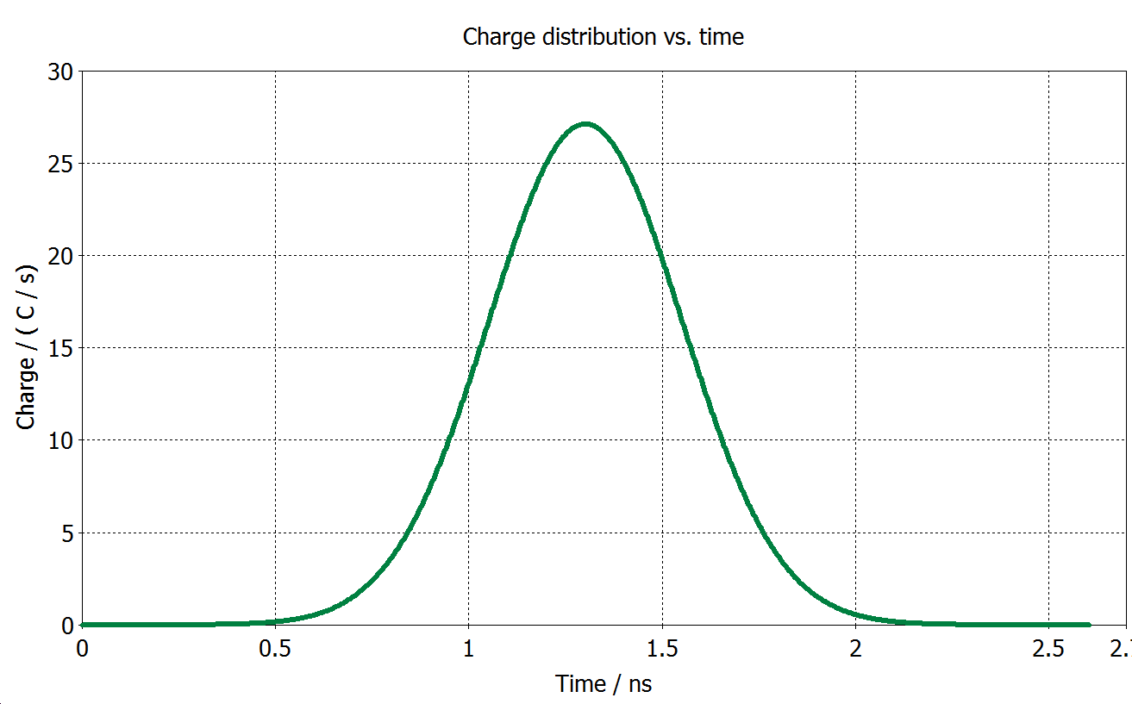
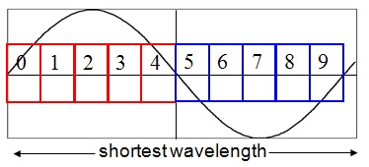
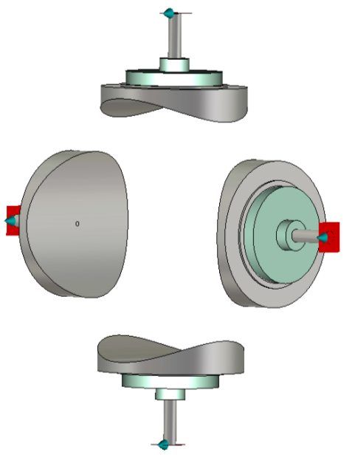

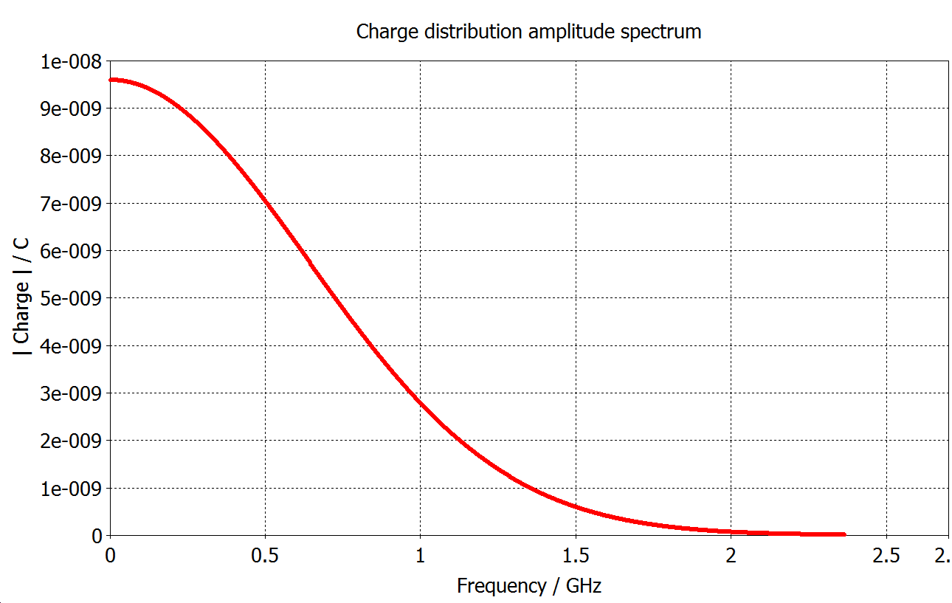
Electromagnetic tools Modeling process
2. model
Beam, TD, FD
EM tools usage
1. real device
4. realistic result
4. Otherwise…
surrealistic result
Beam, TD, FD
3. mesh
FD
Bunch charge distribution in Time
Geometry & Smallest detail
Simulation constraints:
Smallest/largest meshcell
Total meshcount
Simulation timestep
Frequency range
Bunch charge distribution spectrum, Freq
Max bunch frequency

Slide 5
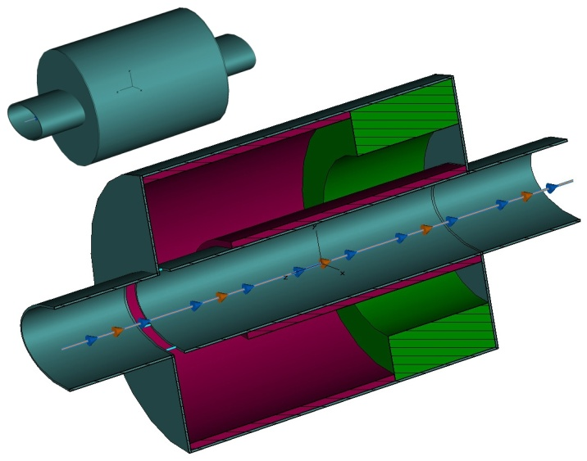
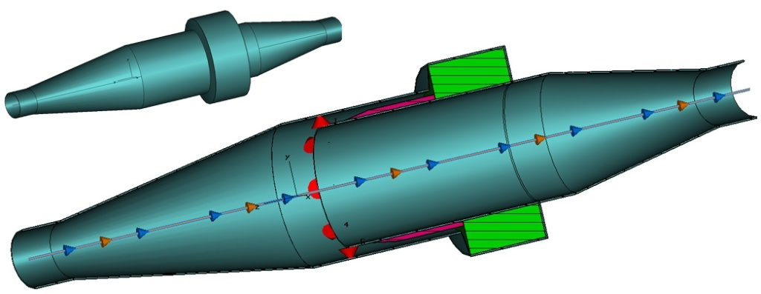
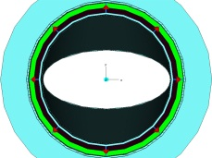
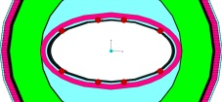
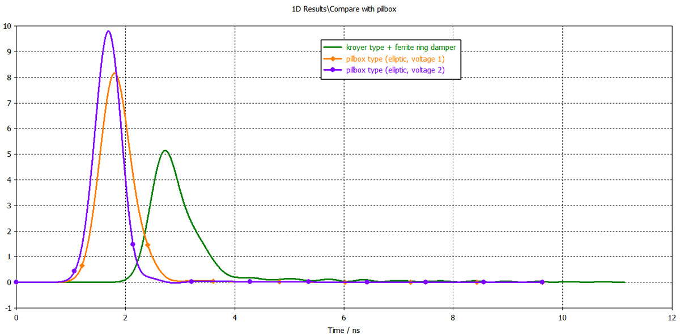
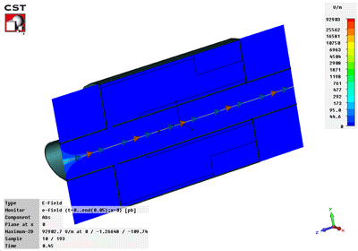
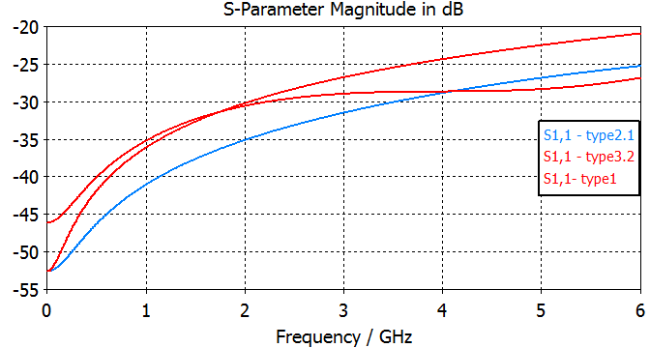
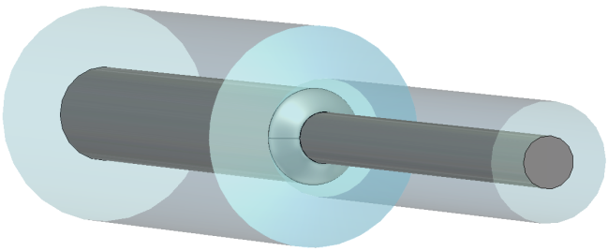
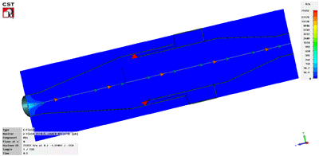
EM study of PS-dedicated Wall Current Monitors
Target: a WCM with 3GHz bandwidth to be used for beam shape monitoring and longitudinal tomography.
+ Short
+ No transitions
- Resistors on elliptical arc
- More complex feedthroughs
Pill-box WCM
+ Simple feedthroughs
+ Resistors on circular arc
- Long design
- Resonant cavity
Transition WCM
Simulated time response of resistors for both types of WCM.
Feedthrough design for WCM

Slide 6
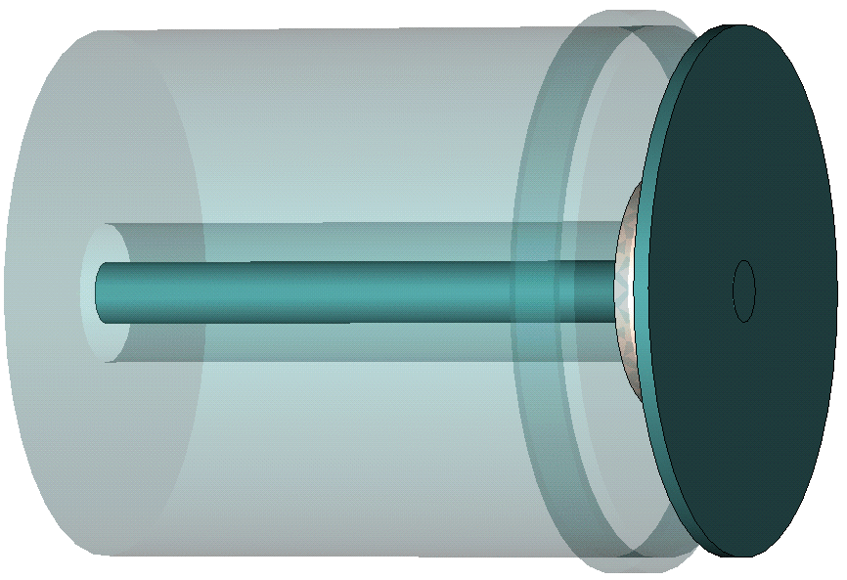
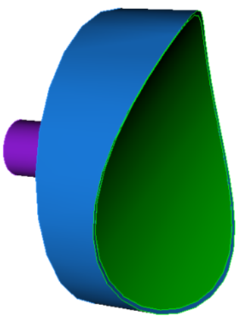
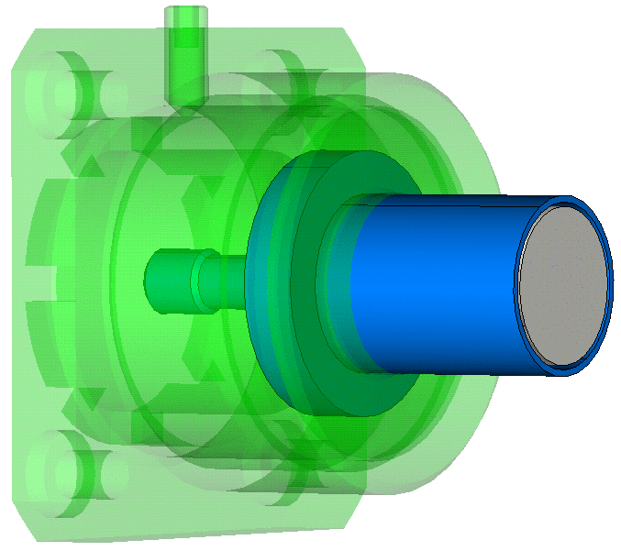
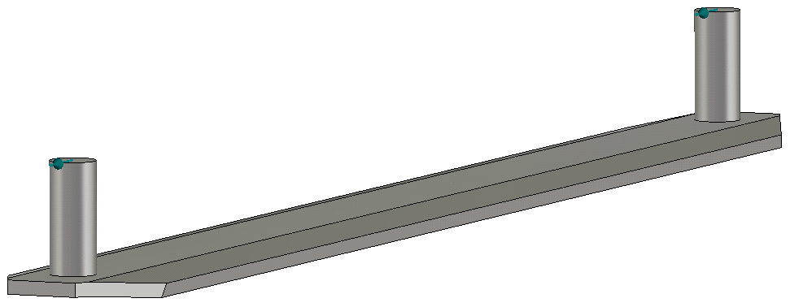
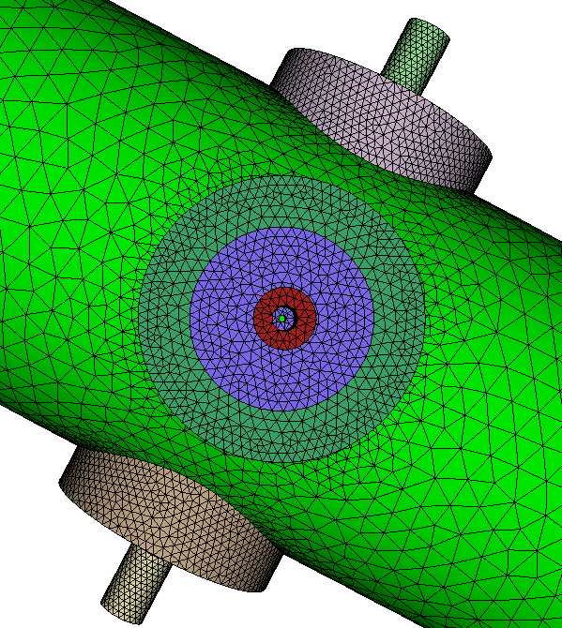
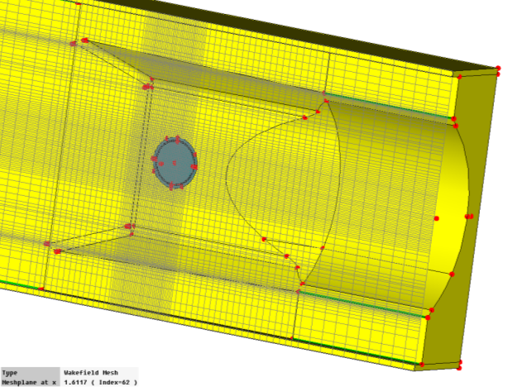
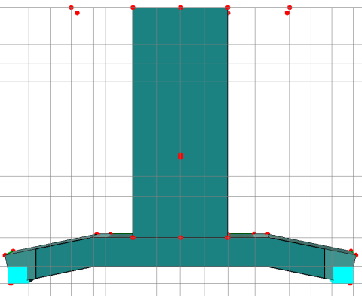
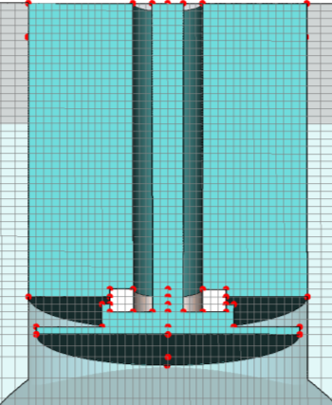
Beam Position Monitors: types / purposes / meshing
3.4 cm
3.4 cm
1 cm
12 cm
Flat-head buttons:
Transfer lines
Curved-head
buttons: LHC
Movable buttons:
LHC Collimators
Strip-lines: directional PS/LHC BPMs

Slide 7
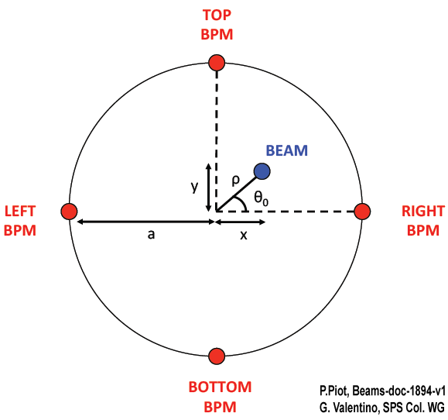
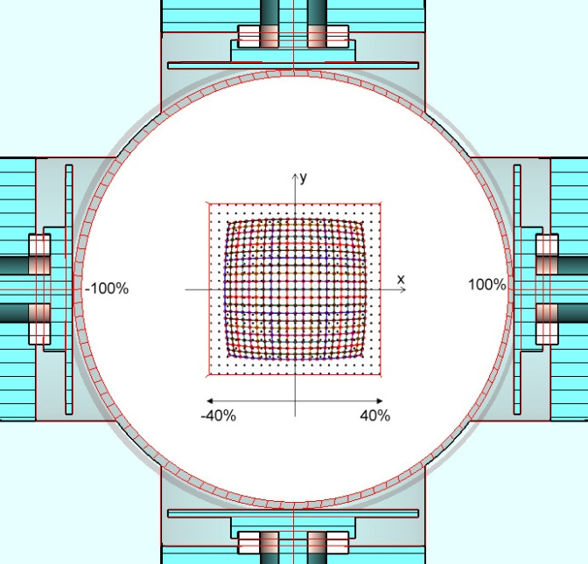
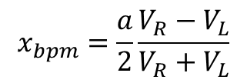
Beam Position Monitors: 1D/2D non-linearity and correction
What is BPM non-linearity?
SPS-LHC
transfer line BPMI
An approximation!
BPM readout
Geometrical scaling factor

Slide 8
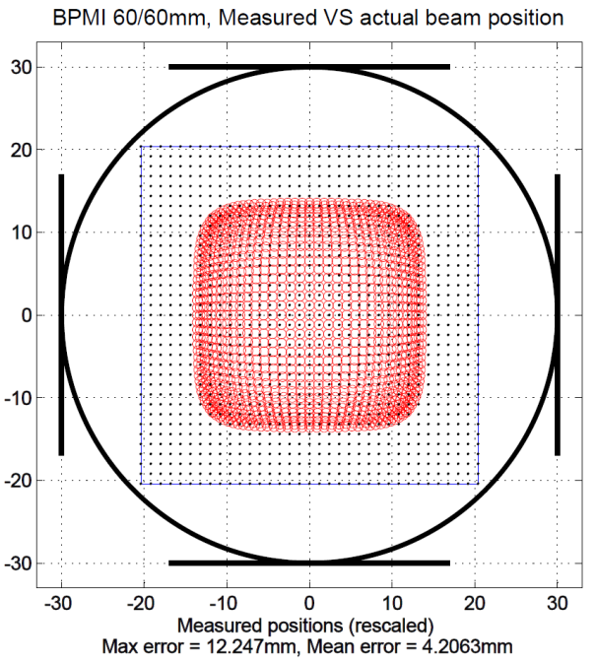
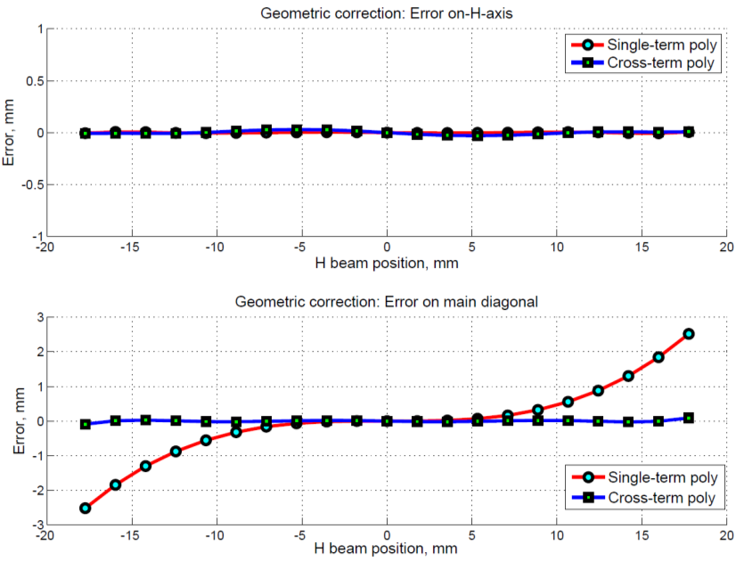
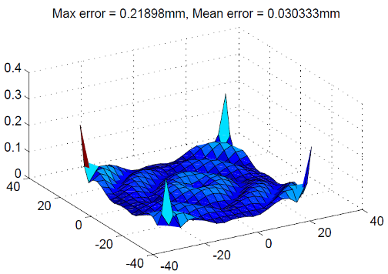
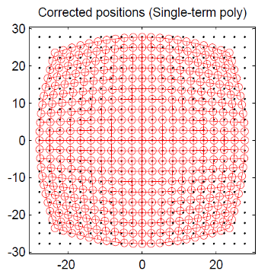
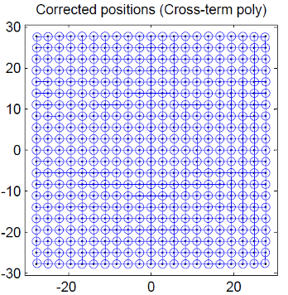
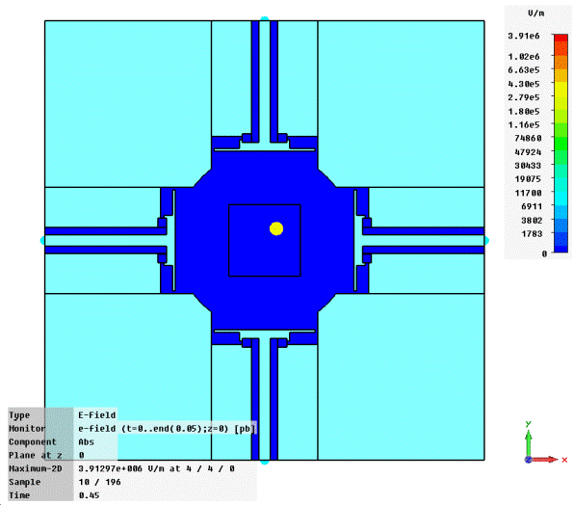
Beam Position Monitors: 1D/2D non-linearity and correction
What is BPM non-linearity?
An approximation!
BPM readout
Geometrical scaling factor
Average error in beam allowed area: 1.1 mm
Max error for on-diag beam: 6mm!
Max error for on-diag beam: < 100 um
BPMD 131 mm
Before BPM “pillow-shaped” readback versus initial beam position map After

Slide 9
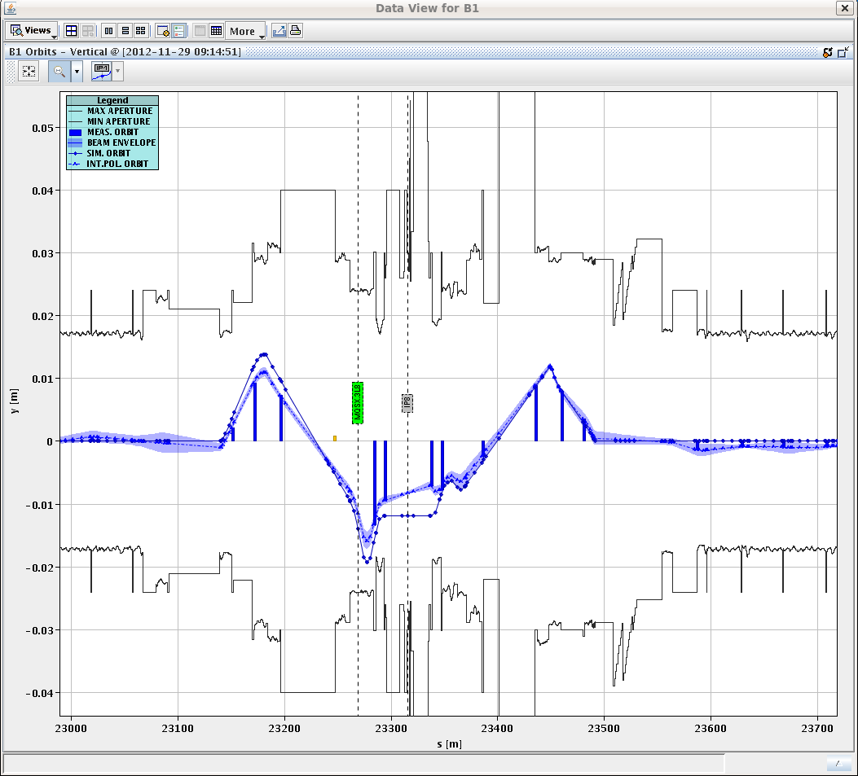
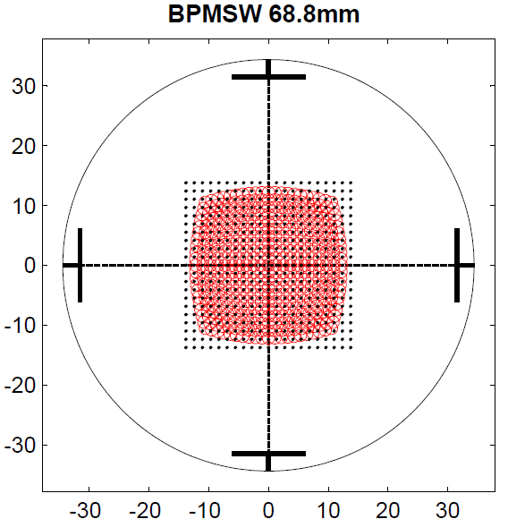
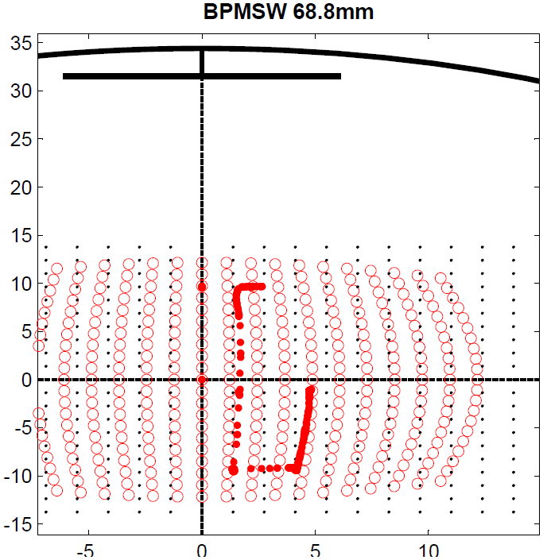
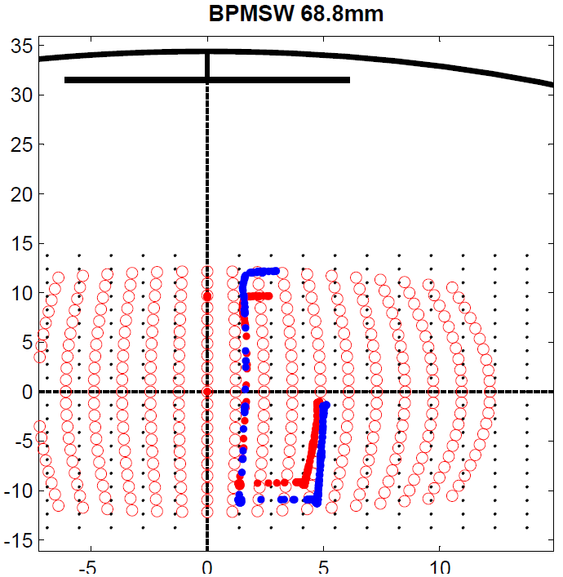
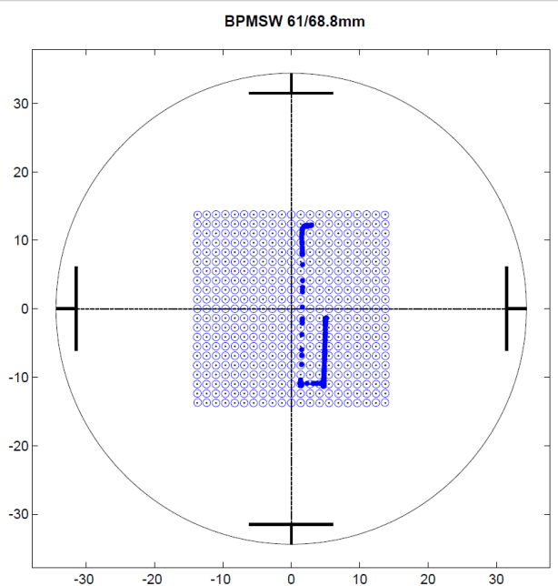
Beam Position Monitors: BI MD4 IR8 scan (29 Nov. 2012)
B1 Vertical orbit. Snapshot in time
BPMSW.1L8.B1
Single-term poly used
Difference btw Optics prediction and BPM measurement: ~2mm
EM Model: prediction map
Overlay of scan trajectory over prediction map.
Single-term poly correction
Single-term poly
VS.
Cross-term poly
Cross-term poly used
Difference between positions: ~1.8mm

Slide 10
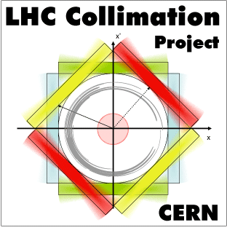
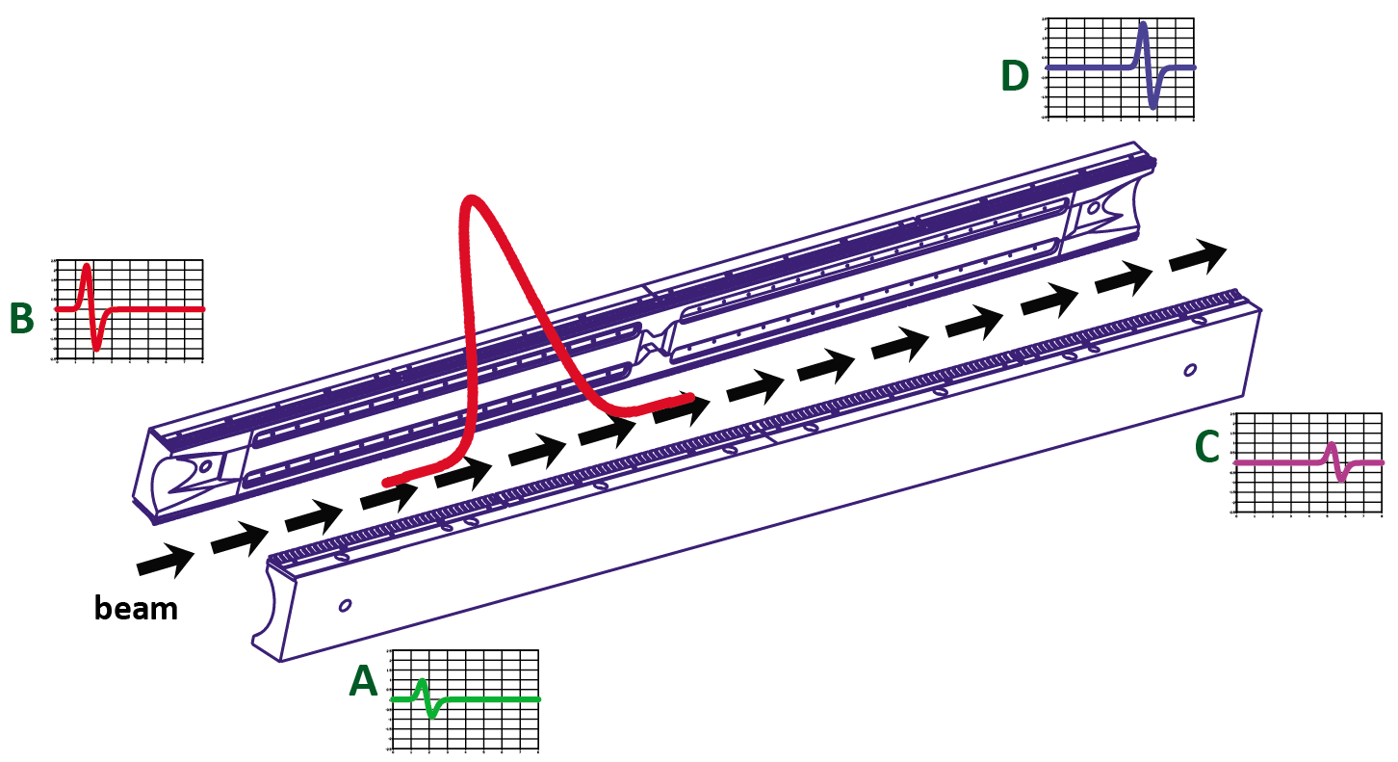
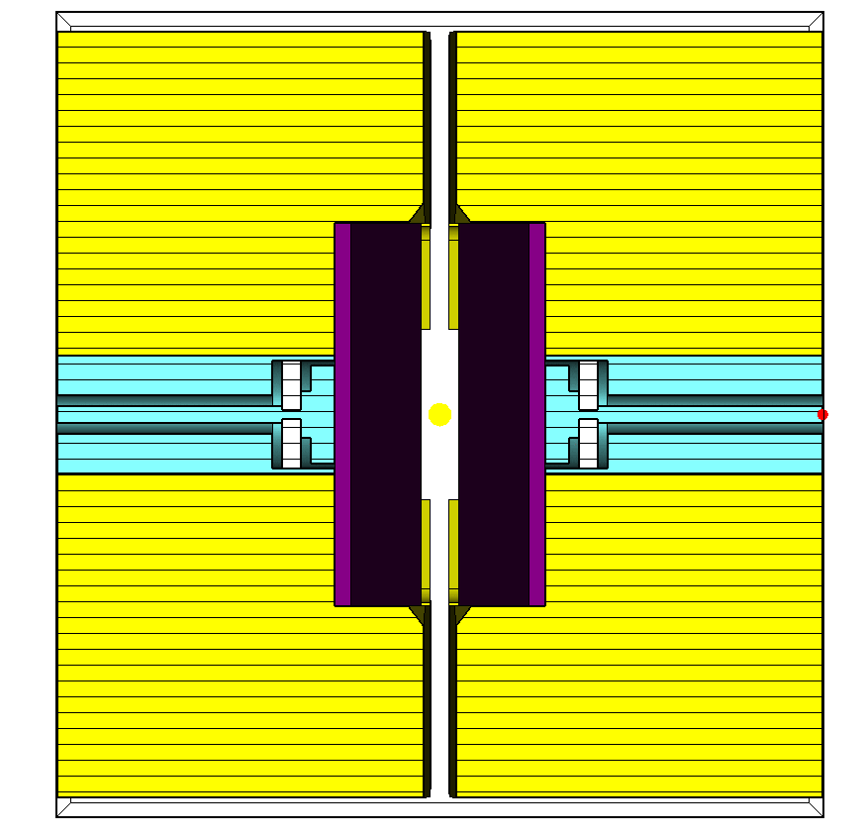
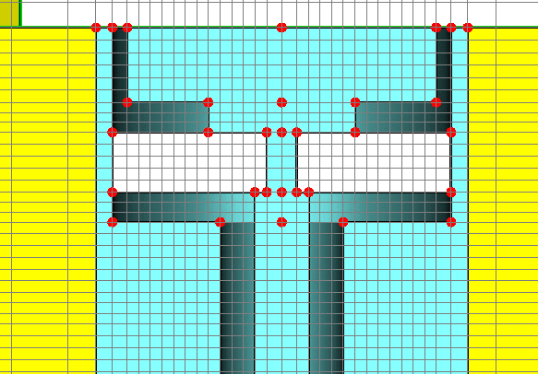
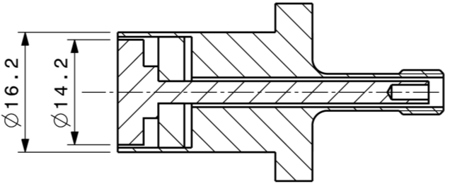
Collimators with embedded BPMs: LHC prototype in SPS
Used for LHC beam-cleaning, the cryo-cooled collimators have embedded button BPMs in the ends of each jaw to ensure fast and accurate centering of jaws around the beam.
Smallest mesh edge length: ≤ 0.5 mm!
mm
mm
4 small buttons
Local mesh density increase
1 m
Small pick-ups increase model’s mesh density.
Delicate BPM parts require manual mesh refinement

Slide 11
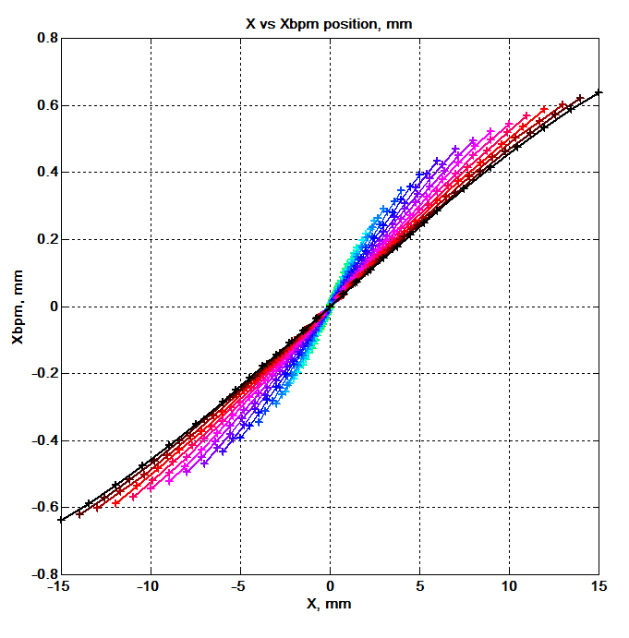
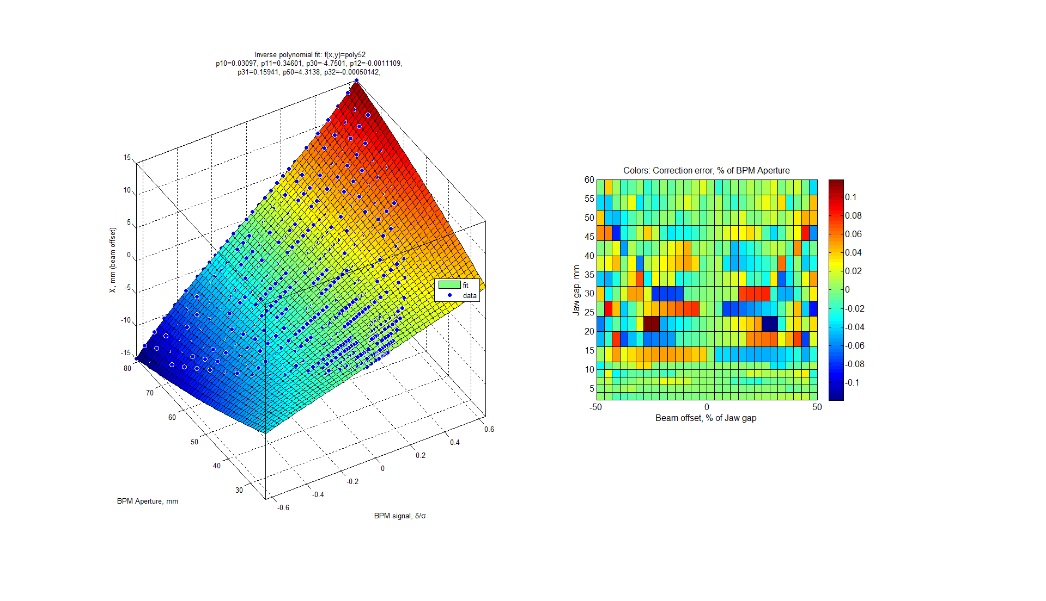
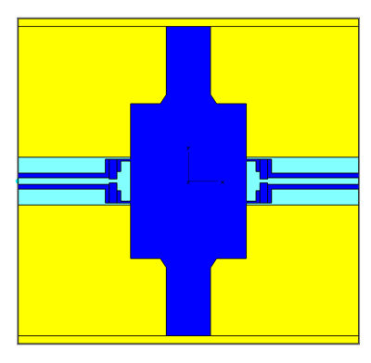
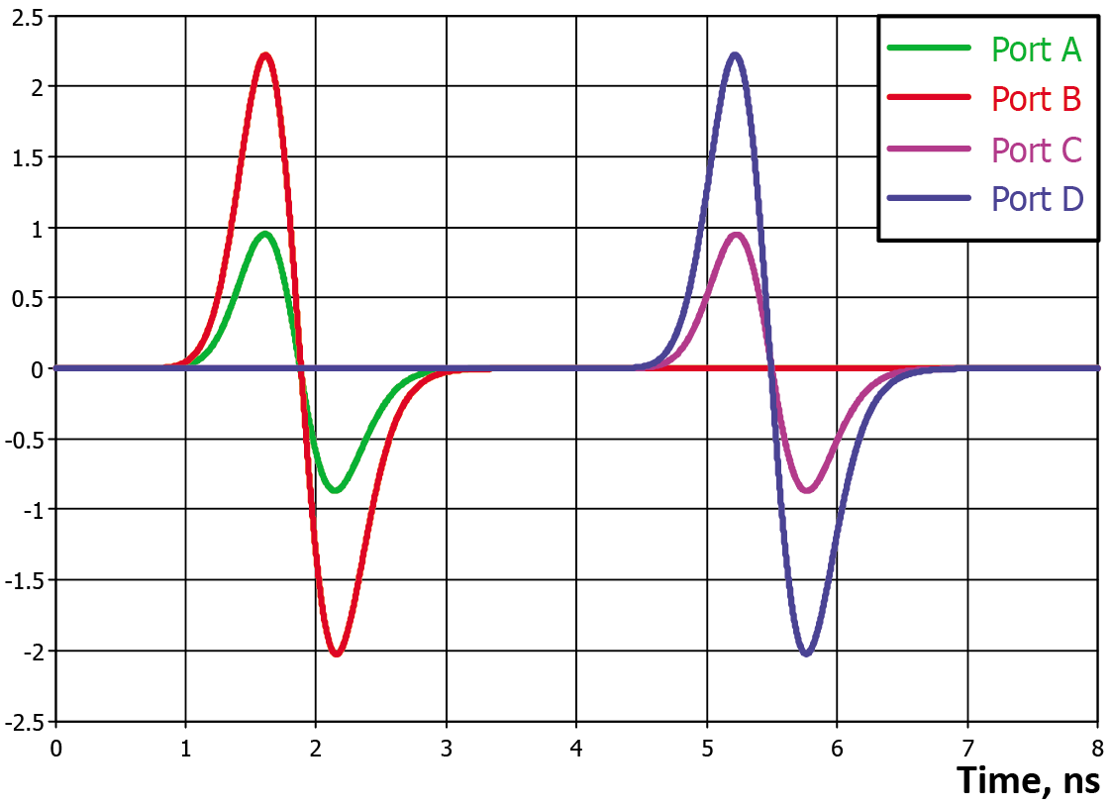
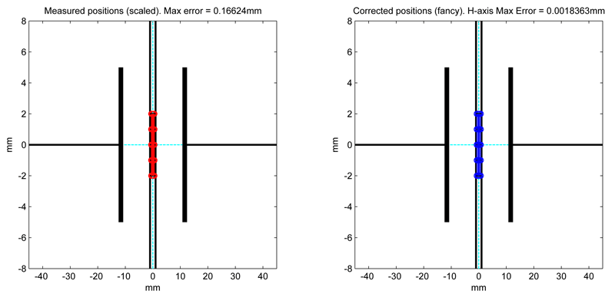
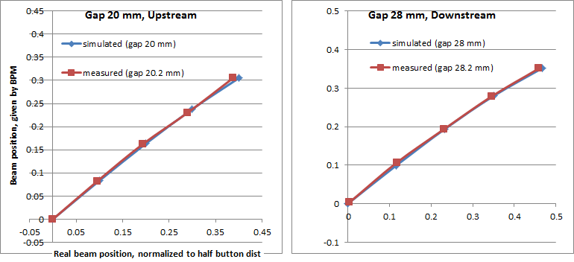
Collimators with embedded BPMs: non-linearities
2D non-linearity: Jaw gaps VS. BPM signals
By mapping beam offsets for various jaw gaps it is possible to build a 2D correction polynomial (3D surface): Xbpm = f(Gap,LRsignals)
without non-linearity correction
with
correction
Typical view of upstream/downstream port time signals for displaced beam
Animation of simulated H&V beam-sweep maps.
Jaws gaps vary: 2, 10, 20, 40, 60 mm
Very good agreement between simulated and measured horizontal non-linearities.

Slide 12
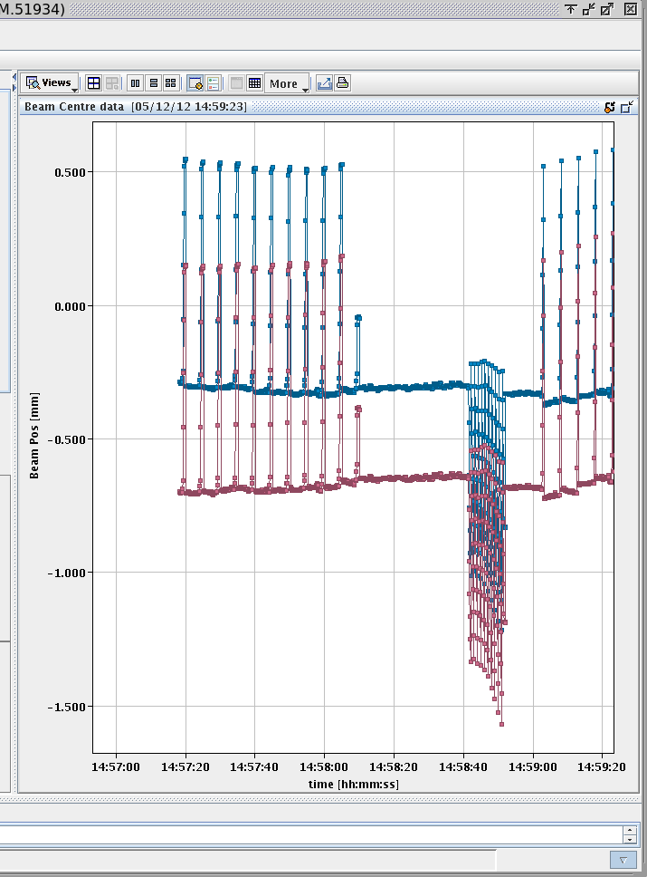
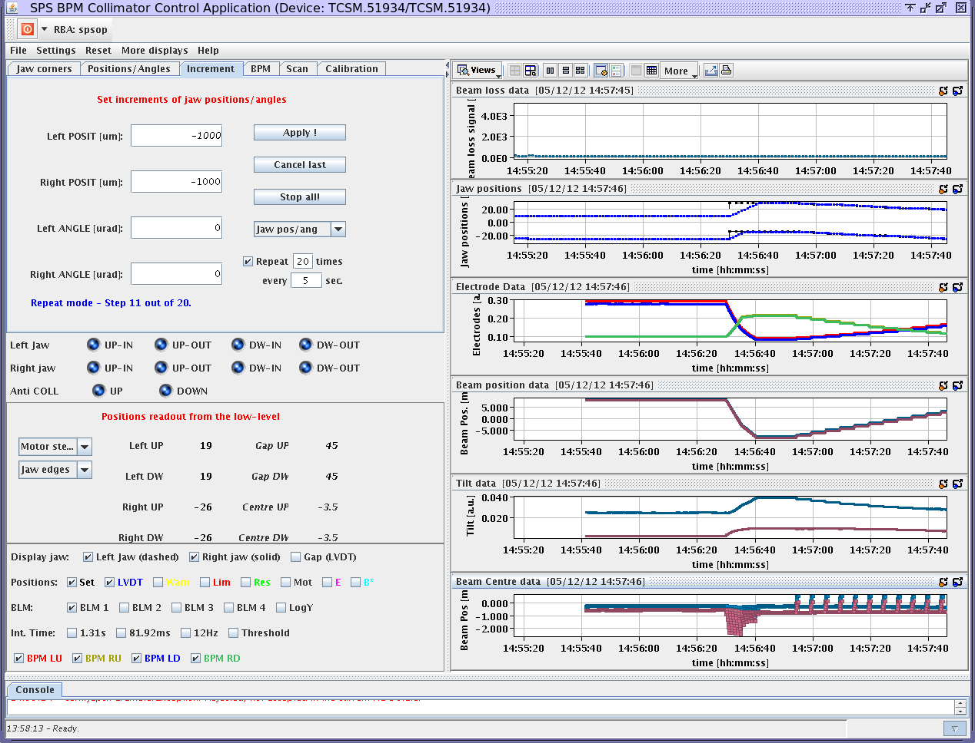
Collimators with embedded BPMs: SPS coasting MD (5 Dec.2012)
Using the most advanced corrections at the moment: for electronic gain/offset (M.Gasior) and 2D non-linearity correction (A.Nosych) , the SPS collimator with embedded BPMs was used for beam position measurement and automatic centering with moving Collimator jaws (jaw position and jaw distance).
The compensation of the BPM and electronics errors allowed large improvement of the absolute accuracy of the beam position measurement.
Credits: S. Redaeli, M. Gasior, G. Valentino, R. Bruce, B. Salvachua, A. Nosych

Slide 13






CLIC damping ring ODR chamber: modes of operation
1. ODR detector (fork) in the beam.
Replacement chamber retracted.
2. Replacement chamber inserted.
Detector hidden from the beam.
Beam
20 cm
E-field magnitude of a single bunch (σ = 10mm) pass through ODR
Objective:
Study structure for HOMs and Estimate heating areas
No trapped modes when using replacement chamber.
Several strong resonances observed when the detector is IN the beam.
With L. Bobb
CERN, Uni. of Cornell, R.H. Uni. Of London

Slide 14






CLIC ODR chamber: HOM and Power loss calculation
Search for trapped modes (HOMs) with Eigenmode Frequency domain solver:
many eigen-solutions, but it doesn’t mean that they are all excited by beam
1.017 GHz
1.19 GHz
1.018 GHz
1.26 GHz
…..

Slide 15

CLIC ODR chamber: HOM and Power loss calculation
It appears that not all resonant modes are present in current ODR setup:
only a few can be selected as potential beam power loss / heating threat
1.017 GHz
1.19 GHz
1.018 GHz
1.26 GHz
……

Slide 16





CLIC ODR chamber: HOM and Power loss calculation
For each resonant modes the Beam Power Loss is calculated (for 1-2 cm bunch).
Surface loss maps are calculated from H-field of resonant mode (surface tangents complex magnitude)
1.017 GHz
1.26 GHz
Ploss_total = 0.6W
1.19 GHz
1.017 GHz
1.19 GHz
1.26 GHz
Total Power loss estimation for Sharp resonances (cycling beam)
Surface power loss maps
for given eigenmodes
Considered:
R: longit. shunt impedance
I = 1 mA
M = 1 (num of circ. bunches)
Pdb(f) = 0 (assumed for f < 2 GHz)
Credits: Elias Métral, CERN LRFF meeting, 20/03/2012

Slide 17



LHC BSRT extraction mirror: Power loss calculation
BSRT is placed in a beampipe of extended diameter (212 mm vs. normal 80mm)
Transition-to-transition length of ~20m makes it a long cavity
beam
Extraction mirror holder forms another cavity
beam
mirror
Silicon Low Tq ferrite
Downstream view into BSRT
With Profile Measurements section / CERN

Slide 18



LHC BSRT extraction mirror: Power loss calculation
BSRT is placed in a beampipe of extended diameter (212 mm vs. normal 80mm)
Transition-to-transition length of ~20m makes it a long cavity
beam
Before Aug.2012 Main damage: clamps, mirror After Sept.2012
beam
mirror
Downstream view into BSRT
Extreme RF heating of the mirror holder (up to 500 C) lead to intervention and replacement, and still poses a threat to LHC machine protection until LS1.
With Profile Measurements section / CERN

Slide 19






LHC BSRT extraction mirror: RF resonance + Power loss calculation
Time domain: 6 LHC bunches with 50 ns spacing.
First bunch introduces clear resonance, next bunches contribute.
LHC bunch power spectrum
F = 650 MHz
P_loss = 10-50W
Mirror front
Credits: T.Mastoridis,
P.Baudrenghien/CERN
Mirror Back
Measured LHC bunch power spectrum. A 650 MHz resonance is very dangerous.
B-filed of the beam in Time Domain.
Red = Hot (bigger current density)
Blue = Cold
Longit. wake impedance of BSRT
with Ferrite damping and without

Slide 20

LHC BSRT extraction mirror: RF resonance + Power loss calculation
Time domain: 6 LHC bunches with 50 ns spacing.
First bunch introduces clear resonance, next bunches contribute.
E-field of a dominant resonating mode at 650 MHz.
(Q = 1263 / Rsh = 25841 Ohm)
Longit. wake impedance of BSRT
with Ferrite damping and without

Slide 21

Conclusions, plans, wishlist
Acknowledgements:
Marek Gasior, Christian Boccard, Eva Calvo, Ralph Steinhagen and each and every one in QP section;
Special thanks to Rhodri Jones, Federico Roncarolo, Gianluca Valentino, Jeroen belleman, Benoit Salvant, Jorg Wenninger, Oleksiy Kononenko, and many others!

Slide 22
Thank you!
Acknowledgements:
Marek Gasior, Christian Boccard, Eva Calvo, Ralph Steinhagen and each and every one in QP section;
Special thanks to Rhodri Jones, Federico Roncarolo, Gianluca Valentino, Jeroen belleman, Benoit Salvant, Jorg Wenninger, Oleksiy Kononenko, and many others!

Slide 23






Reserved 1
EM study of a PS-dedicated stripline pick-up prototype
Pick-up is designed to cover the available slot length and aimed for proton/ion bunches up to 50 ns in length.
Available slot: 1 m
A close-up on electrodes, standard configuration (and a proposed “triangled” mod.)
Simulated time and freq response of up-stream / down-stream ports.
No significant influence of electrode modification yet.

Slide 24





Reserved 2
LHC stripline
Two-beam directional stripline BPM (around interaction points): BPMSW, BPMS:
BPMSW:
120mm stripline length
61mm beampipe diameter
~1M mesh cells (less for longer bunches)
20 minutes of CPU time per simulation (3.1 GHz 2 core PC)
Upstream port
Horizontal non-linearity
Downstream port
V(time) & V(Freq) of upstream and downstream ports
E-field of a short bunch (sigma=25mm) passing through BPMSW

Slide 25




Reserved 3
Flat button BPM
Flat LEP-button BPM family (transfer lines warm pick-up): BPMI, BPMIA, BPMBV, BPMBH
V(time) and V(Freq) response for offset bunch
BPMI:
60mm beampipe diameter
34mm button head diameter
~2M mesh cells
40 minutes of CPU time per simulation
E-field of the off-centered nominal LHC bunch passing through BPMI
BPMI non-linearity map

Slide 26




Reserved 4
Non-linearity correction experiment with LHC beam
81mm BPMSY
Position scan with LHC beam
Obtained noisy measurements
Objective: Scan BPMSY with LHC beam & test the new simulated correction polynomial.
Result of the scan:
Verification of CROSS-term polynomial correction.
On axis beam: correction identical to single-term polynomial.
Off-axis beams: cross-terms reduce error down to ~20 um within 10mm (~500 um with single-terms)
Position measurement errors for single/cross term poly

