Slide 1

Quench thresholds of LHC magnets
-
measurements and simulations
Agnieszka Priebe
CERN
BE-BI-BL
BI Day
6th December 2012

Slide 2
Outline
BLM and QPS systems as the LHC magnet main protection
Overview of Quench Tests
Quench thresholds of BLM system
Steady State Quench Test:
Experiment on 17th October 2010
Geant4 simulations
Loss pattern optimization and simulation validation
Fast Losses Quench Test in 2013
Summary
BI Day
Agnieszka Priebe
6th December 2012

Slide 3
Introduction
The LHC superconducting magnets protection
Beam Loss Monitoring System (BLM)
Quench Protection System
(QPS)
Based on ionization chambers located outside the magnet cryostats
Measures radiation dose of secondary particle shower
If a threshold value is exceeded, the beam dump is triggered
The beam can be extracted from the accelerator before quenching occurs
Based on voltage measurements between two parts of superconducting coils
If the voltage difference exceeds 100 mV for a time longer than 10 ms, the quench heaters are fired to dissipate the energy stored in the magnetic field over the whole volume of the coil
The system reacts when a resistive volume is already developed
BI Day
Agnieszka Priebe
6th December 2012

Slide 4
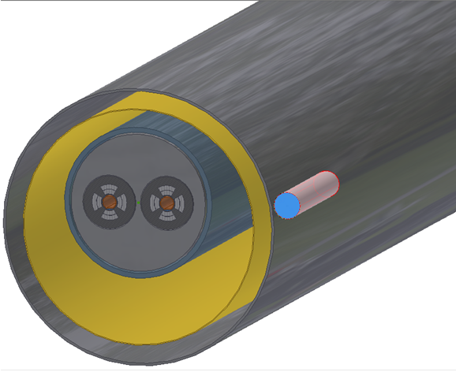
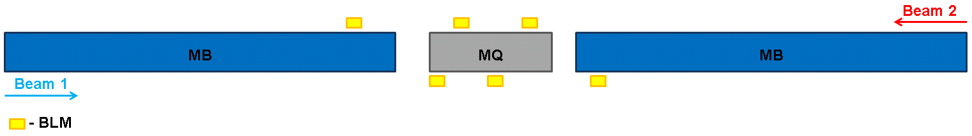
Beam loss monitoring system (blm)
Each LHC arc Main Quadrupole is equipped with 6 monitors (3 per beam)
Thresholds are set with correspondence to current knowledge on the quench limit
(particle energy, loss duration)
A precise correlation between energy deposited inside the superconducting coils and BLM signals is required for a proper threshold estimation
BI Day
Agnieszka Priebe
6th December 2012

Slide 5
Quench Tests overview
Fast Losses QT (injection & dump = single turn)
No | Quenching magnet | Energy [TeV] | Beam | Date
1 | MB.A8L3 | 0.45 | B1V | 9.08.2008
2 | MB.B10R2 | 0.45 | B1V | 7.09.2008
3 | MB.A12L6 | 0.45 | B1H | 20.11.2009
4 | MB.A15R2 | 0.45 | B1V | 4.12.2009
5 | MB.A20R1+others | 0.45 | B1H | 18.04.2010
6 | MQ.14R2 | 0.45 | B2V | 6.10.2010
7 | MQ.14R2 | 0.45 | B2V | 6.10.2010
8 | MQ.14R2 | 0.45 | B1H | 6.10.2010
9 | MBRB (RD4.L4) | 3.50 | B2 | 1.11.2010
10 | MQ.14R2 | 0.45 | B1H | 3.07.2011
Steady State QT (with circulating beam)
No | Quenching magnet | Energy [TeV] | Beam | Date
1 | MQ.14R2 | 3.50 | B2V | 17.10.2010
There were also other Quench Tests but unsuccessful (no quench)
BI Day
Agnieszka Priebe
6th December 2012

Slide 6
Quench Tests overview
Fast Losses QT (injection & dump = single turn)
No | Quenching magnet | Energy [TeV] | Beam | Date
1 | MB.A8L3 | 0.45 | B1V | 9.08.2008
2 | MB.B10R2 | 0.45 | B1V | 7.09.2008
3 | MB.A12L6 | 0.45 | B1H | 20.11.2009
4 | MB.A15R2 | 0.45 | B1V | 4.12.2009
5 | MB.A20R1+others | 0.45 | B1H | 18.04.2010
6 | MQ.14R2 | 0.45 | B2V | 6.10.2010
7 | MQ.14R2 | 0.45 | B2V | 6.10.2010
8 | MQ.14R2 | 0.45 | B1H | 6.10.2010
9 | MBRB (RD4.L4) | 3.50 | B2 | 1.11.2010
10 | MQ.14R2 | 0.45 | B1H | 3.07.2011
Fast Losses QT (circulating beam)
No | Quenching magnet | Energy [TeV] | Beam | Date
2 | MQ.12L6 | 4.00 | B2H | winter 2013
?
Steady State QT (with circulating beam)
No | Quenching magnet | Energy [TeV] | Beam | Date
1 | MQ.14R2 | 3.50 | B2V | 17.10.2010
2 | MQ.12L6 | 4.00 | B2H | winter 2013
?
BI Day
Agnieszka Priebe
6th December 2012

Slide 7
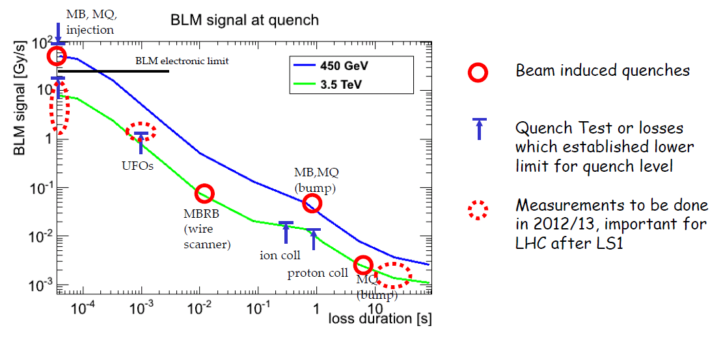
Quench threshold of blm system
M.Sapinski, “Proposal for Beam Induced Quench Tests at the end of 2013 run”, LMC 154, 24.10.2012
Quench Test are important to revise currently applied models of quench limits
Increase of the LHC efficiency = reduction of false beam dumps
BI Day
Agnieszka Priebe
6th December 2012

Slide 8
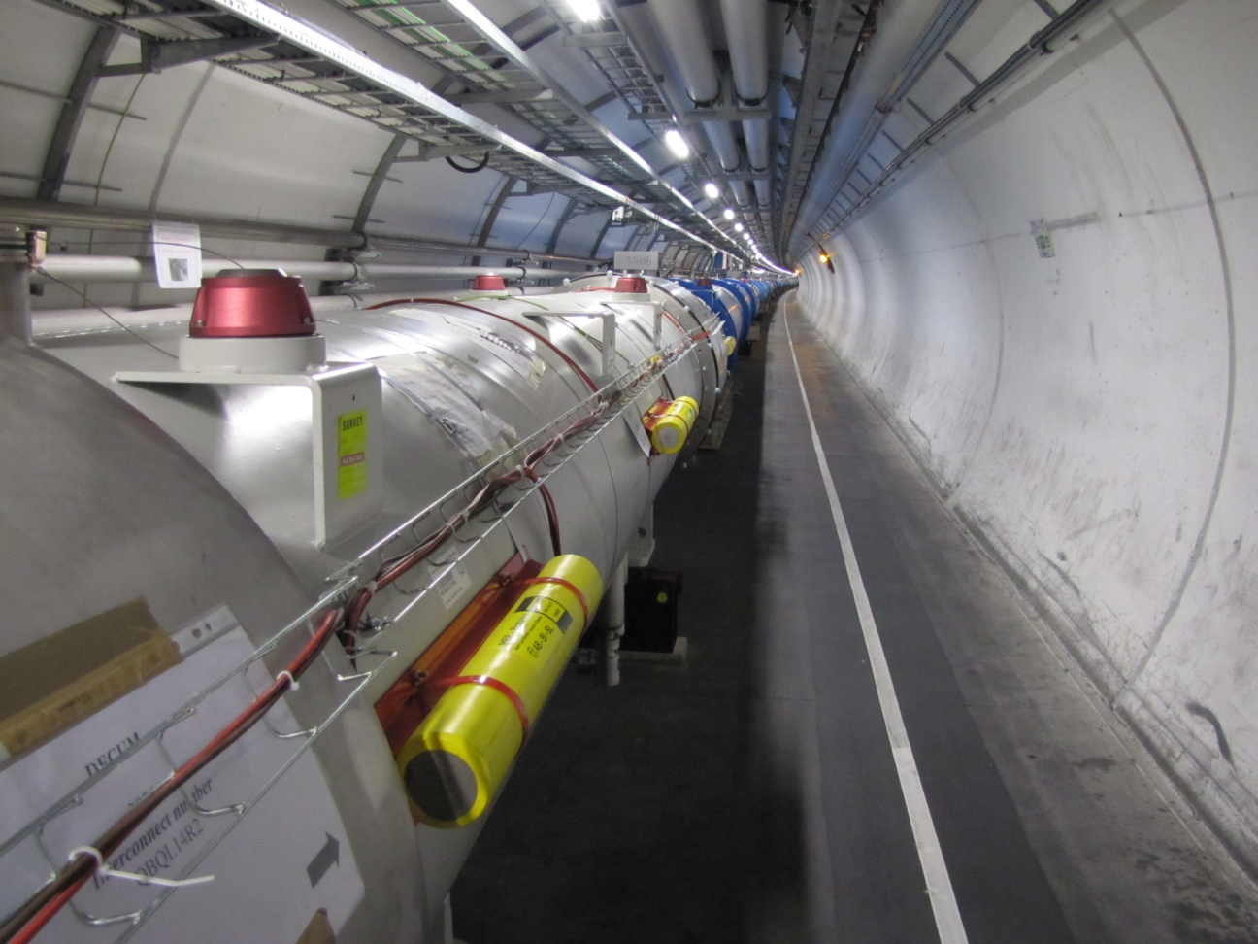
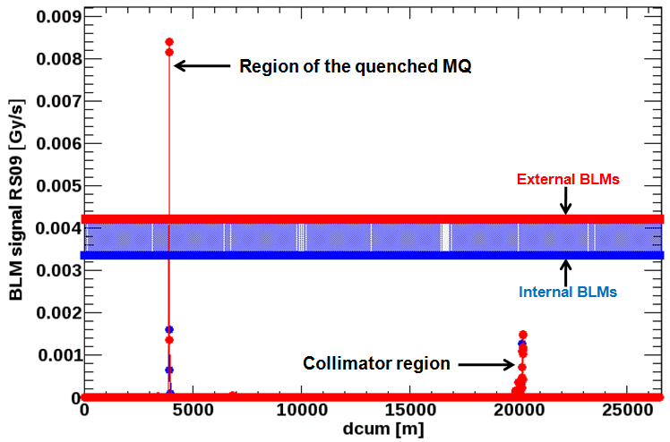
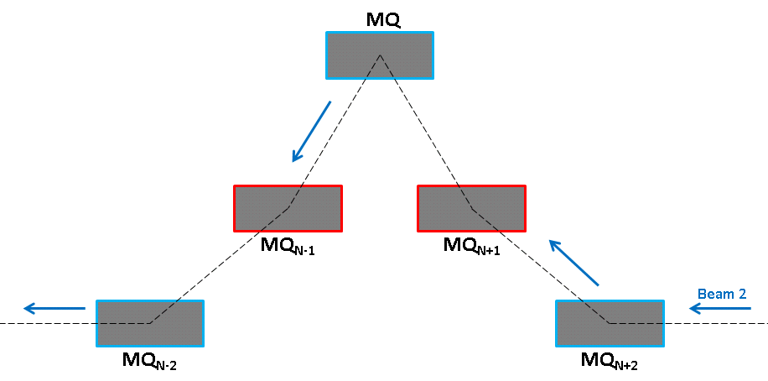
Steady state quench test - experiment
Performed on 17th October 2010
Energy: 3.5 TeV
Beam: 2
Plane: vertical
No of lost protons: 1.1·10¹⁰
Loss duration: 5.6 s
Circulating beam
Cell: 14R2
3-corrector orbital bump
BI Day
Agnieszka Priebe
6th December 2012

Slide 9
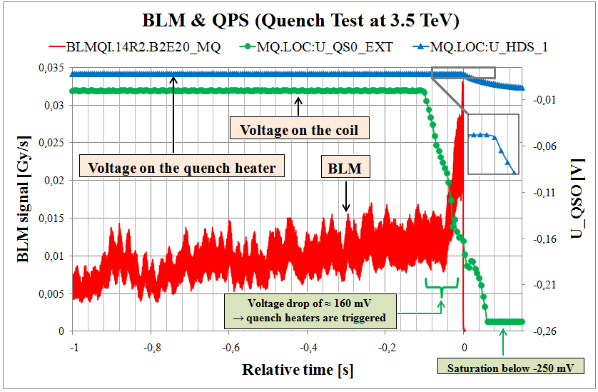
Steady state quench test - experiment
BLM threshold RS01 (40μs) = 4.68 Gy/s
BLM monitor factors increased by a factor of 3 to permit the quench
Real quench: the beam dump triggered by the QPS
BI Day
Agnieszka Priebe
6th December 2012

Slide 10
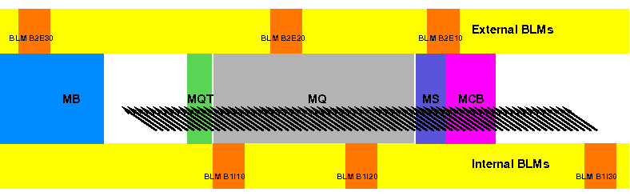
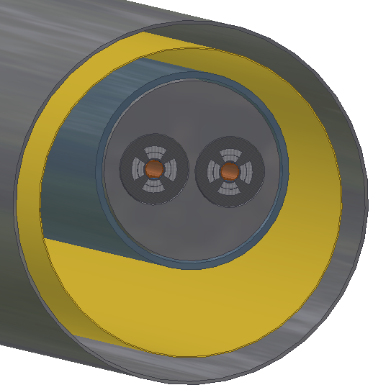
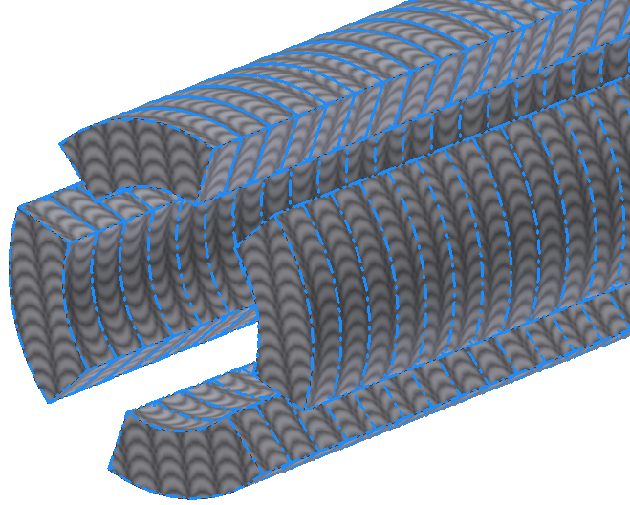
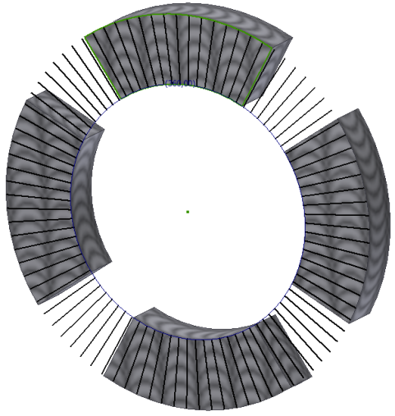
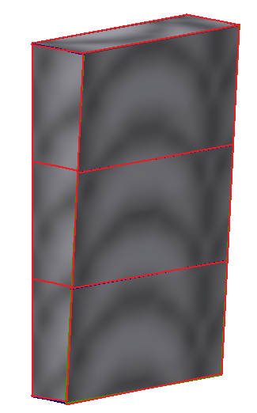
Steady state quench test – simulations
Geant4 simulations
The LHC halfcell: C14R2
Detailed magnet representation
Long pseudo-monitors
Impacting angle: 202 μrad
71 point like losses → flexibility
Correlation: E_{dep} = f(BLM)
OBJECTIVE:
Best fitting loss scenario
r = 2
r = 1
Δz = 9.83 mm
Δφ = 4°
r = 0
BI Day
Agnieszka Priebe
6th December 2012

Slide 11
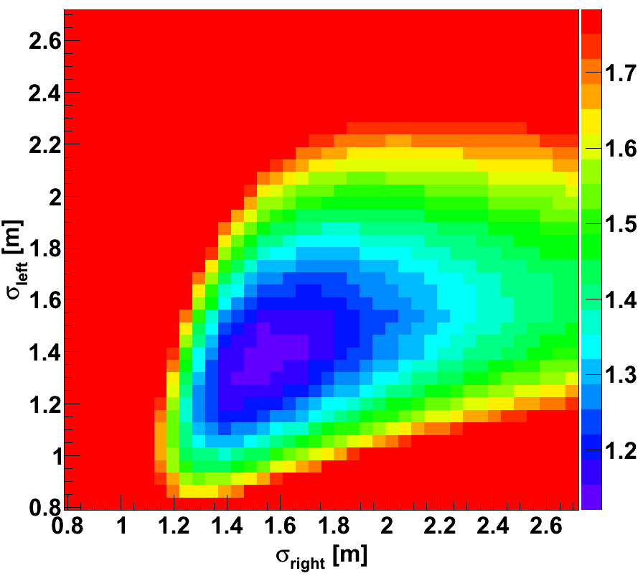
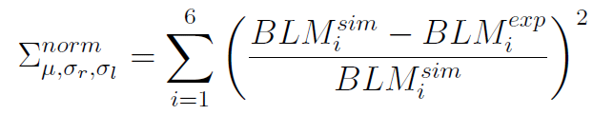


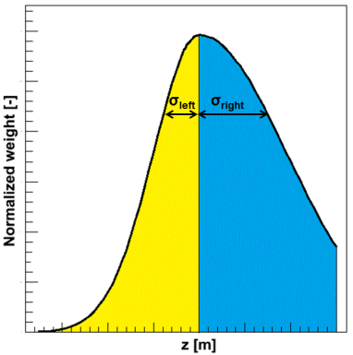
Steady state quench test – simulations
How to find the best agreement between simulations and experimental data?
Simulation-experiment similarity estimator:
Σ_{norm} for optimized μ
Looking for: minimum
- simulated signal of i-th BLM
- measured signal of i-th BLM
Optimized parameters:
Σ_{norm} = 1.12
μ = (0.4±0.1) m
σ_{right} = (1.54±0.15) m
σ_{left} = (1.40±0.14) m
Asymmetrical Gaussian
σ_{right} > σ_{left} (reasonable due to the impact of magnetic field)
≈ 1% (0.05 m²) of the map is characterized by Σ_{norm}≤1.15
BI Day
Agnieszka Priebe
6th December 2012

Slide 12
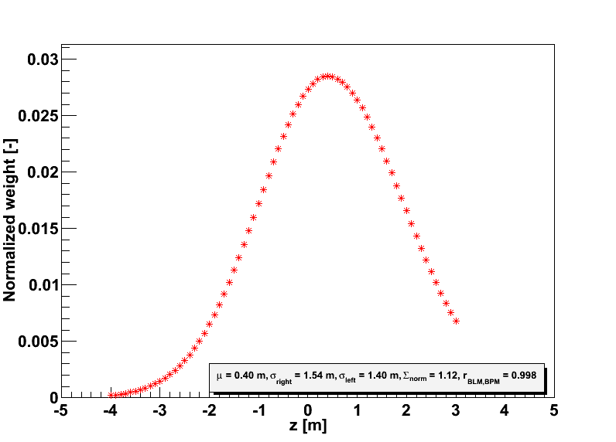
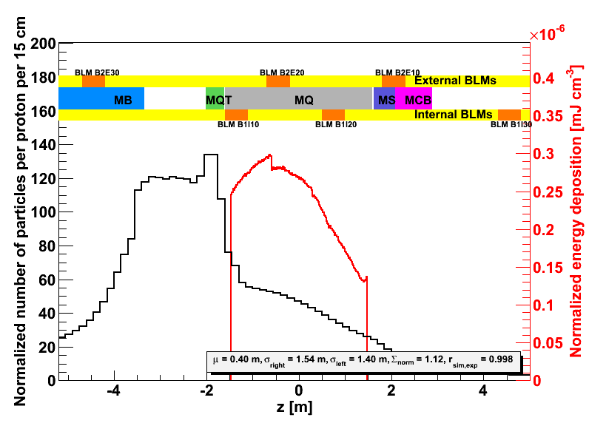
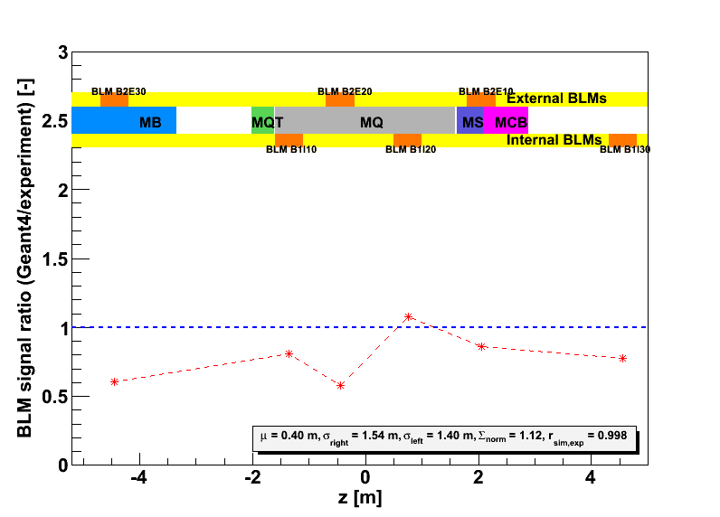
Steady state quench test – simulations
Integrated loss pattern (no time evolution) over 6 s
Beam 2
additional BLMs to be installed before the next QT
Optimized three free parameters:
μ = 0.4 m
σ_{right} = 1.54 m
σ_{left} = 1.40 m
Max of E_{dep} at the end of MQ
The highest number of secondary particles in the interconnection region (MB-SSS)
Σ_{norm} = 1.12
r_{exp,sim} = 0.9978
BI Day
Agnieszka Priebe
6th December 2012

Slide 13
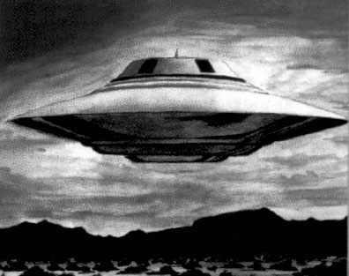

Plans for the future
In the LHC, UFOs are the Undefined Falling Objects
UFOs are expected to be a major luminosity limitation in the future
UFOs rate increases with the beam energy
BLM thresholds should be increased to avoid undesirable beam dumps
UFO’s properties
Temporal loss distribution has Gaussian shape
Loss duration in order of milliseconds
BI Day
Agnieszka Priebe
6th December 2012

Slide 14
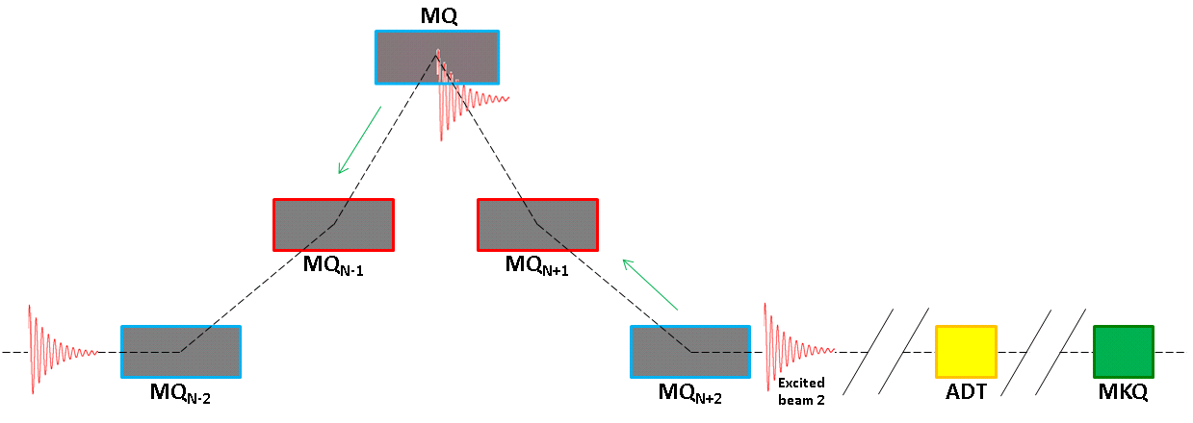
Plans for the future
Fast Losses Quench Test – the end of LHC run 2013
Preparations: 2 MDs – ADT Fast Losses Test and the ADT combined with MKQ Fast Losses Test
Loss duration: ≈ 1 ms
Beam: 2, horizontal (based on MD results, UFO loss orientation, machine protection)
Cell: 12L6
Challenges: beam intensity (below 2·10⁹ protons the beam is not seen by many systems, models predict that quench should occur with ≈10⁸)
BI Day
Agnieszka Priebe
6th December 2012

Slide 15
Summary
Quench Tests
are very
important for
my PhD
… but seriously …
BI Day
Agnieszka Priebe
6th December 2012

Slide 16
Summary
Quench Tests are extremely important to estimate the quench levels and update existing thresholds for fast and steady state losses.
Accurate thresholds are needed to combine a safe machine operation with a reduction of undesired beam dumps.
Fast Losses Quench Test will allow better understanding of UFO-like losses which are expected to be a major luminosity limitation of the LHC after LS1.
Geant4 simulations show good agreement with experimental data. The integrated over time loss pattern was presented. An analysis of loss time evolution is ongoing.
BI Day
Agnieszka Priebe
6th December 2012

Slide 17
Thank you for you attention !
Questions?
Comments?
Remarks?
BI Day
Agnieszka Priebe
6th December 2012

Slide 18
Back-up slides
BI Day
Agnieszka Priebe
6th December 2012

Slide 19
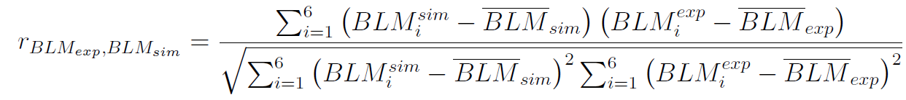
Steady state quench test – simulations
How to find the best correlation between simulations and experimental data?
Simulation-experiment similarity estimator
Looking for: minimum
Correlation coefficient
Looking for: maximum
(value the closest to 1)
BI Day
Agnieszka Priebe
6th December 2012

Slide 20
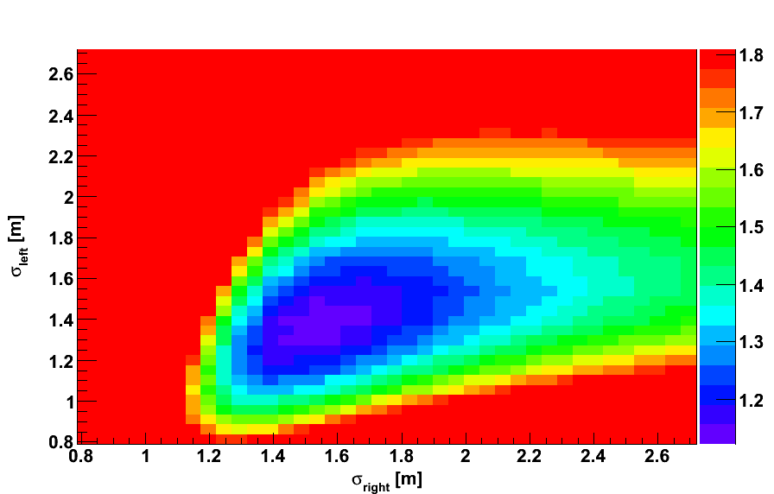
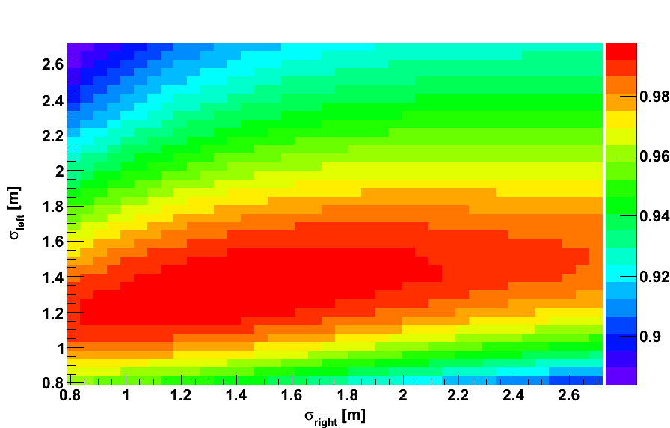
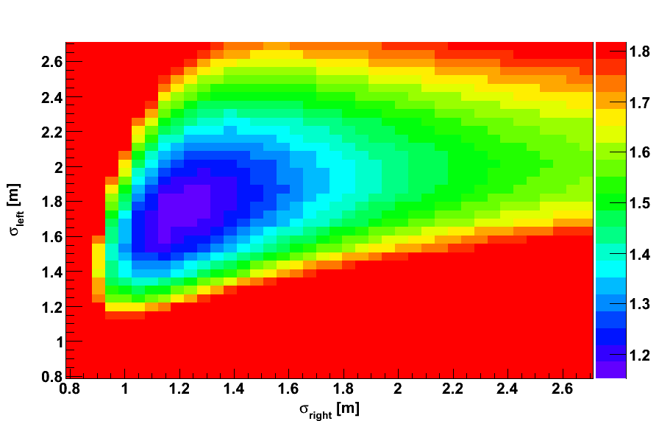
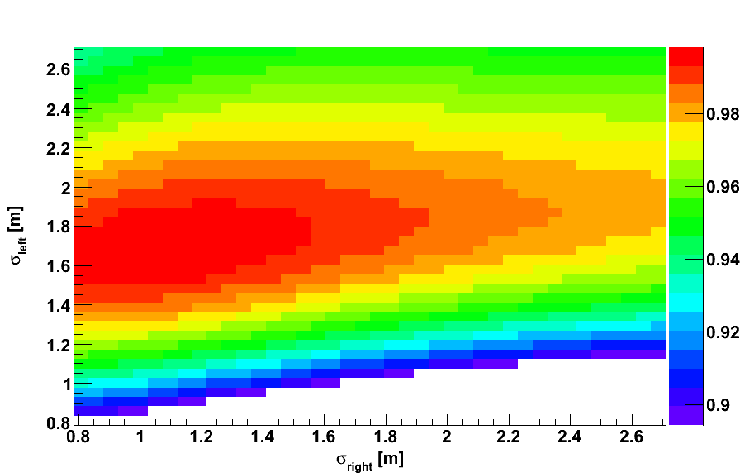
Steady state quench test – simulations
How to find the best correlation between simulations and experimental data?
Results based on Σ_{min} estimation
Σ_{norm} = 1.12
r_{exp,sim} = 0.998
Σ_{norm}
r_{exp,sim}
μ = 0.4 m
σ_{right} = 1.54 m
σ_{left} = 1.4 m
Results based on r_{exp,sim,max} estimation
Σ_{norm} = 1.22
r_{exp,sim} = 0.999
Σ_{norm}
r_{exp,sim}
μ = 0.9 m
σ_{right} = 1.05 m
σ_{left} = 1.68 m
Both factors indicate that the loss occurred inside the MQ with
σ_{right} = (1.3±0.4) m and σ_{left} = (1.5±0.2) m
BI Day
Agnieszka Priebe
6th December 2012

Slide 21
Steady state quench test – simulations
Integrated loss pattern (no time evolution) over 6 s
Beam 2
Optimized three free parameters:
μ = 0.4 m
σ_{right} = 1.54 m
σ_{left} = 1.40 m
Max of E_{dep} at the end of MQ
The highest number of secondary particles in the interconnection region (MB-SSS)
Σ_{norm} = 1.12
r_{exp,sim} = 0.9978
BI Day
Agnieszka Priebe
6th December 2012

Slide 22
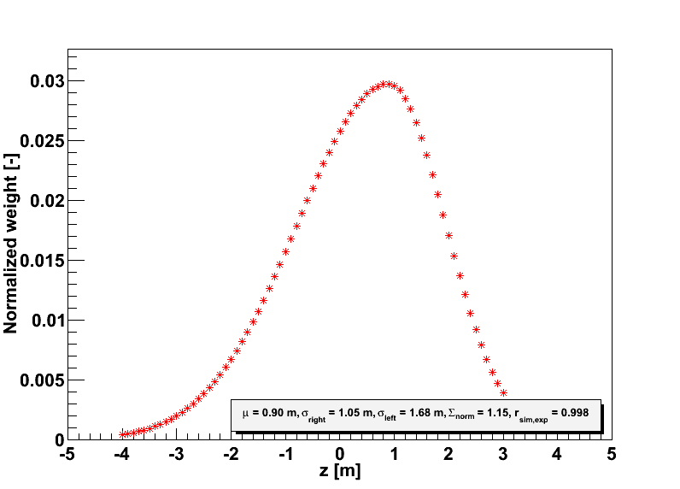
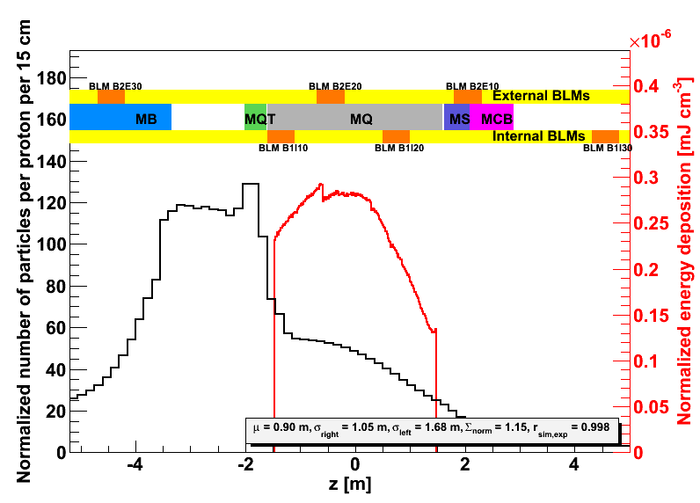

Steady state quench test – simulations
Integrated loss pattern (no time evolution) over 6 s
Beam 2
Optimized three free parameters:
μ = 0.9 m
σ_{right} = 1.05 m
σ_{left} = 1.68 m
Max of E_{dep} at the end of MQ
The highest number of secondary particles in the interconnection region (MB-SSS)
Σ_{norm} = 1.22
r_{exp,sim} = 0.9985
BI Day
Agnieszka Priebe
6th December 2012

Slide 23
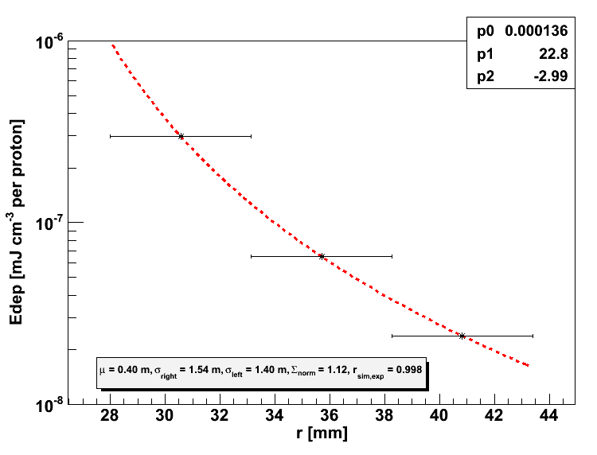


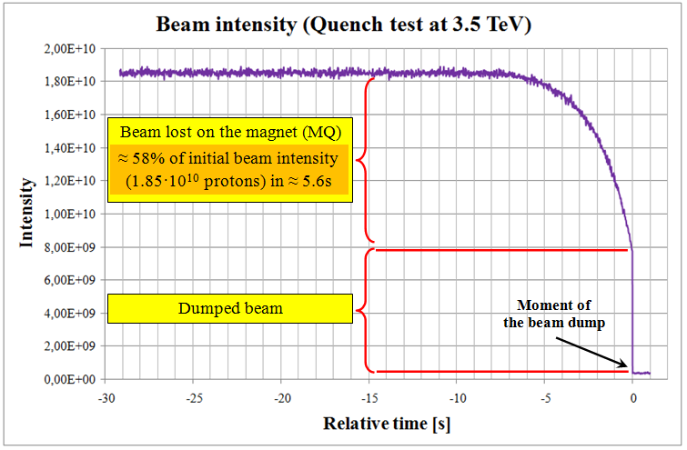
Steady state quench test – Quench level
Radial energy distribution and loss distribution in time are two main inputs to QP3 heat transfer code
Power law function
r – radius of the coil
p₀, p₁, p₂ – fit parameters
The LHC MQ cables consist of two layers, each with 18 strands.
Average energy needed to quench the magnet:
This difference can be partly explained by the different meaning of quench limit for Geant4 and QP3.
E_{avg} [J cm⁻³]
Geant4 | QP3 | Ratio
1.62 | 0.54 | 3
BI Day
Agnieszka Priebe
6th December 2012

Slide 24
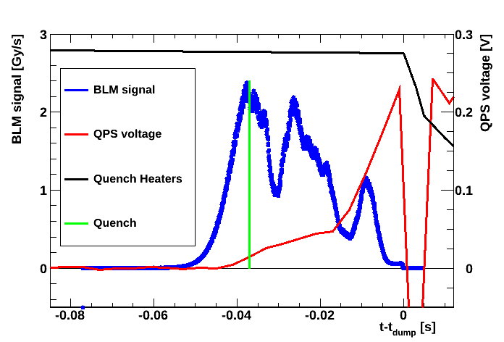
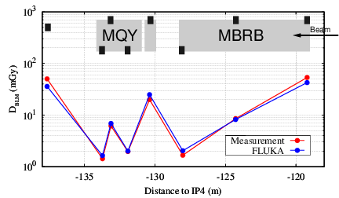
Fast losses quench test preparation
Wire Scanner Quench Test (1.11.2010)
Quench on MBRB magnet after 10 ms
Robust method (3.5 TeV)
Good agreement between FLUKA simulations and experiment
Method suspended
MBRB operates at 4.5 K
No good spare magnet in the case of damage
10 ms
M.Sapinski et al., “Quench Test Strategy WG - Introduction”, QTSWG, 16.03.2012
A new method needed for UFO-timescale losses studies
Courtesy of A.Lechner
BI Day
Agnieszka Priebe
6th December 2012

Slide 25
Fast losses quench test preparation
Wire Scanner Quench Test (1.11.2010)
10 ms
M.Sapinski et al., “Quench Test Strategy WG - Introduction”, QTSWG, 16.03.2012
BI Day
Agnieszka Priebe
6th December 2012

Slide 26
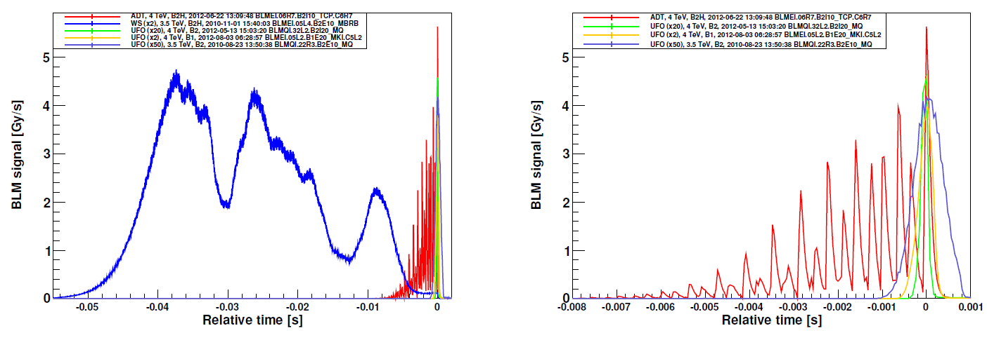
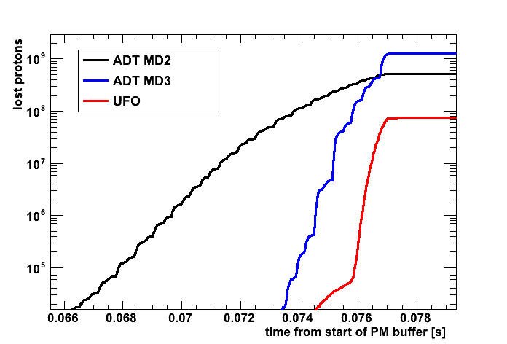
Fast losses quench test preparation
ADT fast losses test (22.06.2012) results compared to Wire Scanner QT and UFOs
UFO induced losses
ADT induced losses
WS induced losses
ADT +MKQ fast losses test (12.10.2012) results compared to ADT fast losses test and UFOs
ADT
Conclusions
The ADT sign flip method provides losses in the order of 7-8 ms
A combination of the ADT with the MKQ (tune kicker) allows 3-ms loss induction
ADT+MKQ
UFO
M.Sapinski et al., “UFO timescale quench test preparation”, LSWG, 26.10.2012
BI Day
Agnieszka Priebe
6th December 2012

