Slide 1
Instrumentation Performance in the Injector Complex in 2012 and Wishes for the Restart after LS1
B. Mikulec
on behalf of the LHC Injector Teams
+ colleagues from connected machines
BI Day, Archamps, 06/12/2012

Slide 2
Outline
2012 Instrumentation Performance/Issues and wishes for the restart after LS1 of the
LHC Proton Injector Chain
  Linac2 – PSB – PS – SPS
ISOLDE + AD + EAST Area + NORTH Area
LHC Ion Injector Chain
  Linac3 – LEIR – PS – SPS
General Remarks
Concluding Remarks
Not covered: Linac4, CTF3/CLIC, HIE-ISOLDE, ELENA,…

Slide 3
Linac2
Main BI-related issue during 2012 operation:
  Problems during startup in the measurement lines (LTE, LTL and LBE) with the SEM-grid controls (hard- and software very old).
Managed to reduce losses by 40% in the LT/LTB lines by applying ‘steering’ with BLMs – would be nice to have the new BLMs better integrated into the controls system!
New Linac4-type pickup installed in August (LTB.UMA20); OP curious to receive data… → presentation Michael Sordet
  Plan to replace all LT/LTB/BI line PUs with this type during LS1.
After LS1: Restart with completely renovated pickup system (hardware + electronics + software) and new readout system based on TRIC cards for transformers → thorough testing and system integration essential
Notes:
SEM-grid controls problems: gain control card and background suppression
Some experience with TRIC cards already (PSB transfer lines) and transformer with TRIC card under test in Linac3.

Slide 4
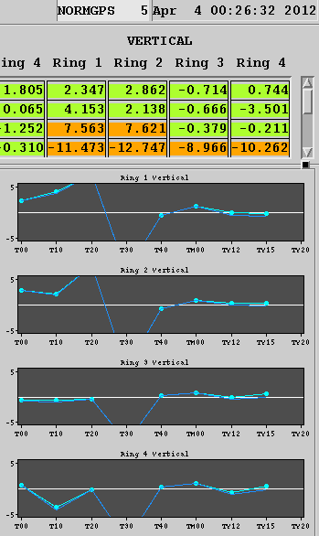
PSB - Pickups
Start of run: different PU issues hampering beam steering
  Vertical alignment wrong for some of the newly installed PUs in BT recombination line + impedance mismatch with amplifier); other signal problems for PSB transfer line PUs still under study
  Injection PUs: old system; droop for injection PUs recalibrated where possible → PU renovation during LS1
New electronics for 3 turn-by-turn ring PUs installed
  First data taken to prepare optics measurements
  Full deployment not during LS1, but solution found to allow commissioning in parallel to standard operation
Bi-weekly meetings to follow up PU system issues assured progress and stable running
Remark: YASP@PSB now one more client relying on correct PU information…

Slide 5
PSB – Continued…
Wire scanner emittance measurements: systematic studies continued throughout the year; quite satisfactory situation, but still some open issues to be solved (calibration/mechanics, 20 m/s, parallel ring measurements…)
Wishlist for after LS1
  Parallel ring measurements for wire scanners
  Consolidation of SEM-grid electronics implemented
  Upgrade of tune kicker system: remote control of tune kickers; ring-by-ring acquisition system synchronised with revolution frequency; chirp excitation with transverse damper; analog diagnostics; spare parts…
  New injection line PUs, new amplifiers for ejection line PUs + alignment correction, commissioning of turn-by-turn PUs (multiplexed per ring), commissioning of new parallel LHC-type BLM system with new electronics → need support from BI for joint evaluation of new BI equipment

Slide 6
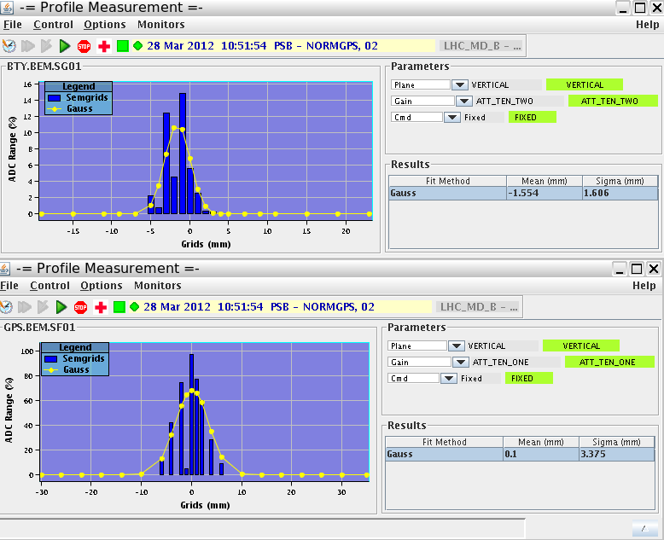
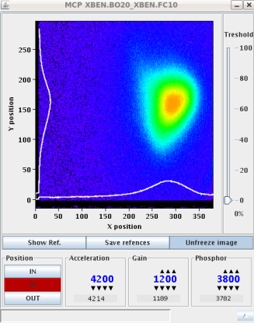
ISOLDE – Open Issues/Ongoing Development
Maintenance of GPS, HRS and target SEM-grid (missing or noisy channels; review status)
Repair of Faraday Cups in HRS/GPS separators
  Due to mechanical issues several critical interventions on FC in the separator area during 2012
  Missing cup in HRS.FC300
  Need to procure ready-to-use spares and equipment to test them offline (fabricate special vacuum chambers)
MCP beam profiler in REX linac
  Started study on linearity and accuracy of MCP beam profilers (offline test bench)
  Beam trigger synchronization implemented
  Scale, image deformation and position calibration -> ongoing work
Notes:
MCP beam profiler:
* this system will remain in the charge breeder and injector part of the linac after HIE, but removed from REX linac
* a study was started by F. Zocca and some modification have already been implemented (synchronisation, new control system)
* More work is needed on the calibration of position and linearity (the beam is deformed due to space charge or optics effect on the electrons)

Slide 7
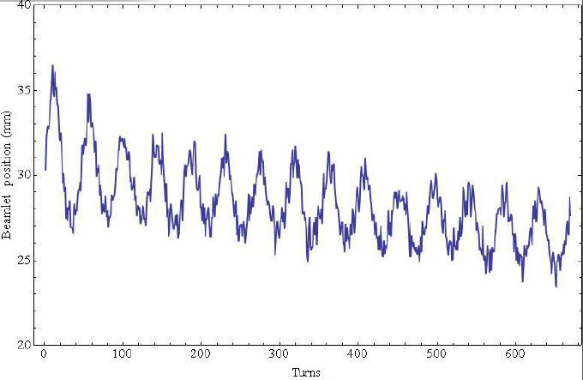
PS – Trajectory and Orbit Measurement
Good and responsive support from BI.
Improvements and new functionalities became available in 2012.
Some issues were identified during (MTE) MD’s where saturation of the pre-amplifiers was at the source of a presumed beam oscillation, but this was a measurement artifact.
These kind of problems are often identified during MD’s as machine and instrument performance is pushed.
However, these issues are also issues for normal beam operation.
Artificial oscillation of beam in one of the MTE MDs
Notes:
Image: beamlet position is shown as a function of number of turns.
Sum signal saturated (difficult gain setting for O(E11)) and oscillation of gate.
Workaround flagging measurements where oscillation present.
Pre-amplifiers won’t be exchanged in the tunnel – search for a good ‘offline’ solution

Slide 8
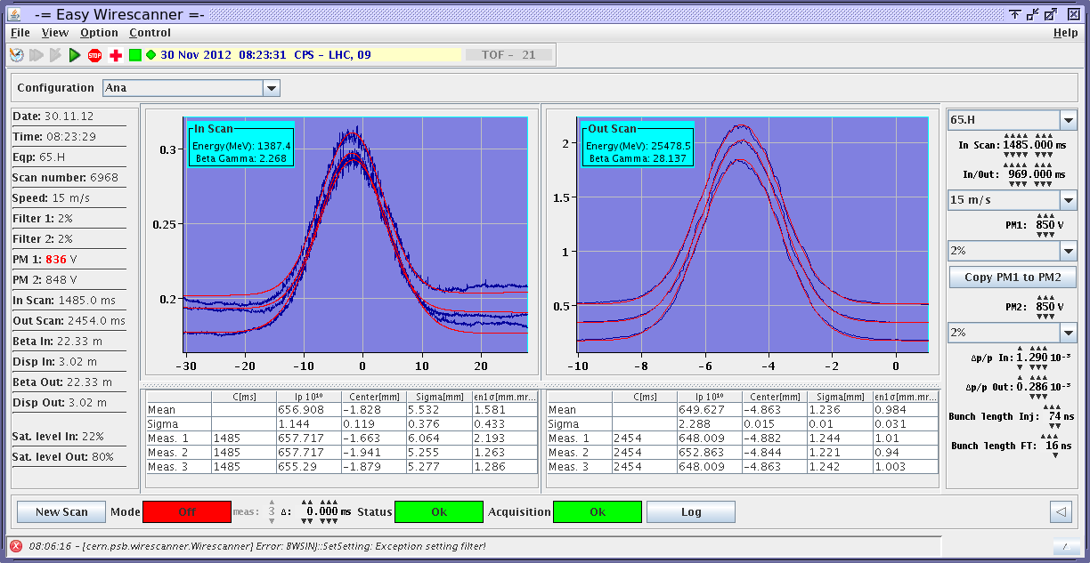
PS – Fast Wire Scanner measurements
Substantial effort (BI, ABP, OP) went into understanding the settings management of the combination of the PM high voltage and the filter settings.
Nevertheless transverse emittance measurements remain tricky, especially with the small emittance beams we have for the LHC.
Since July IN and OUT scans are used on the same cycle to measure beam emittances.
Different wire scanners continue giving different results on the same beam.
One source of errors is also the optics definition (not trivial for the PS with the combined function magnets).
Bunch-by-bunch measurement at fixed revolution frequency after LS1?
In Scan
Out Scan

Slide 9
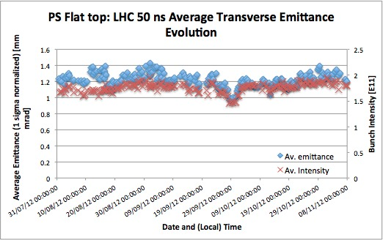
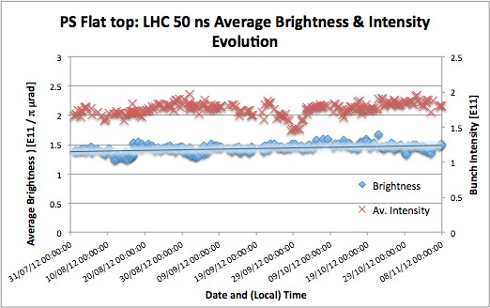
PS – Use of Wire Scanner Measurements
From end July systematic measurements and logging, once every shift in PSB and PS.
Each result per plane is an average of 3 measurements.
Many scans, no bellow problems.

Slide 10
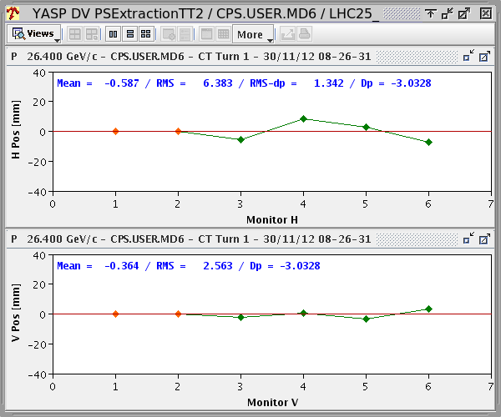
PS – TT2 Trajectory Measurement & Steering (YASP)
TT2 strip line couplers used for TT2 beam steering instead of SEM-grids.
Very good improvement, extending trajectory measurement and steering capabilities.
However, often some are not available and intervention in TT2 is required.
  Can this be improved ? (Rad-hard electronics or shielded electronics?)
Notes:
Directional couplers → provide beam direction

Slide 11
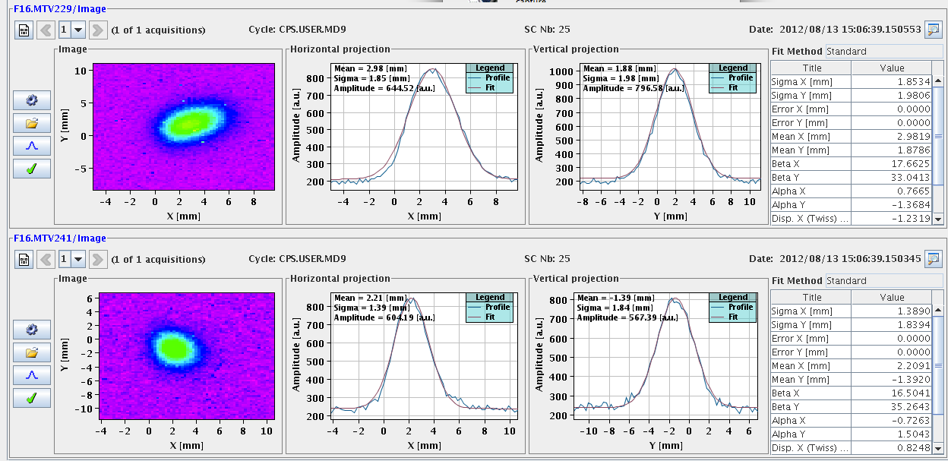
PS – TT2 OTRs
The 4 OTR screens have been made working and will be used to measure and log transverse emittances in the future. Commissioning to be continued with BI (calibration of emittance measurement!).

Slide 12
PS – Various
1000-turn transformer
  Unfortunately not operational due to firmware issue.
  Very important tool to measure and control injection losses (during injection bump decent; see also last year’s request during BI Day).
  Will this be operational after LS1?
Transverse damper PUs: improve reliability.
New PU in TT2 after extraction septum for LS1 restart.
Renovation of East Area primary beam line instrumentation
  Fast BCT revived, enabling cross-calibration of secondary emission chambers, using fast extracted beam.
Logging:
  In 2012 we started logging more acquisitions from BI equipment.
  After LS1 this will be further extended.
Notes:
New PU at start of TT2 will allow to use efficiently the first steerer.

Slide 13
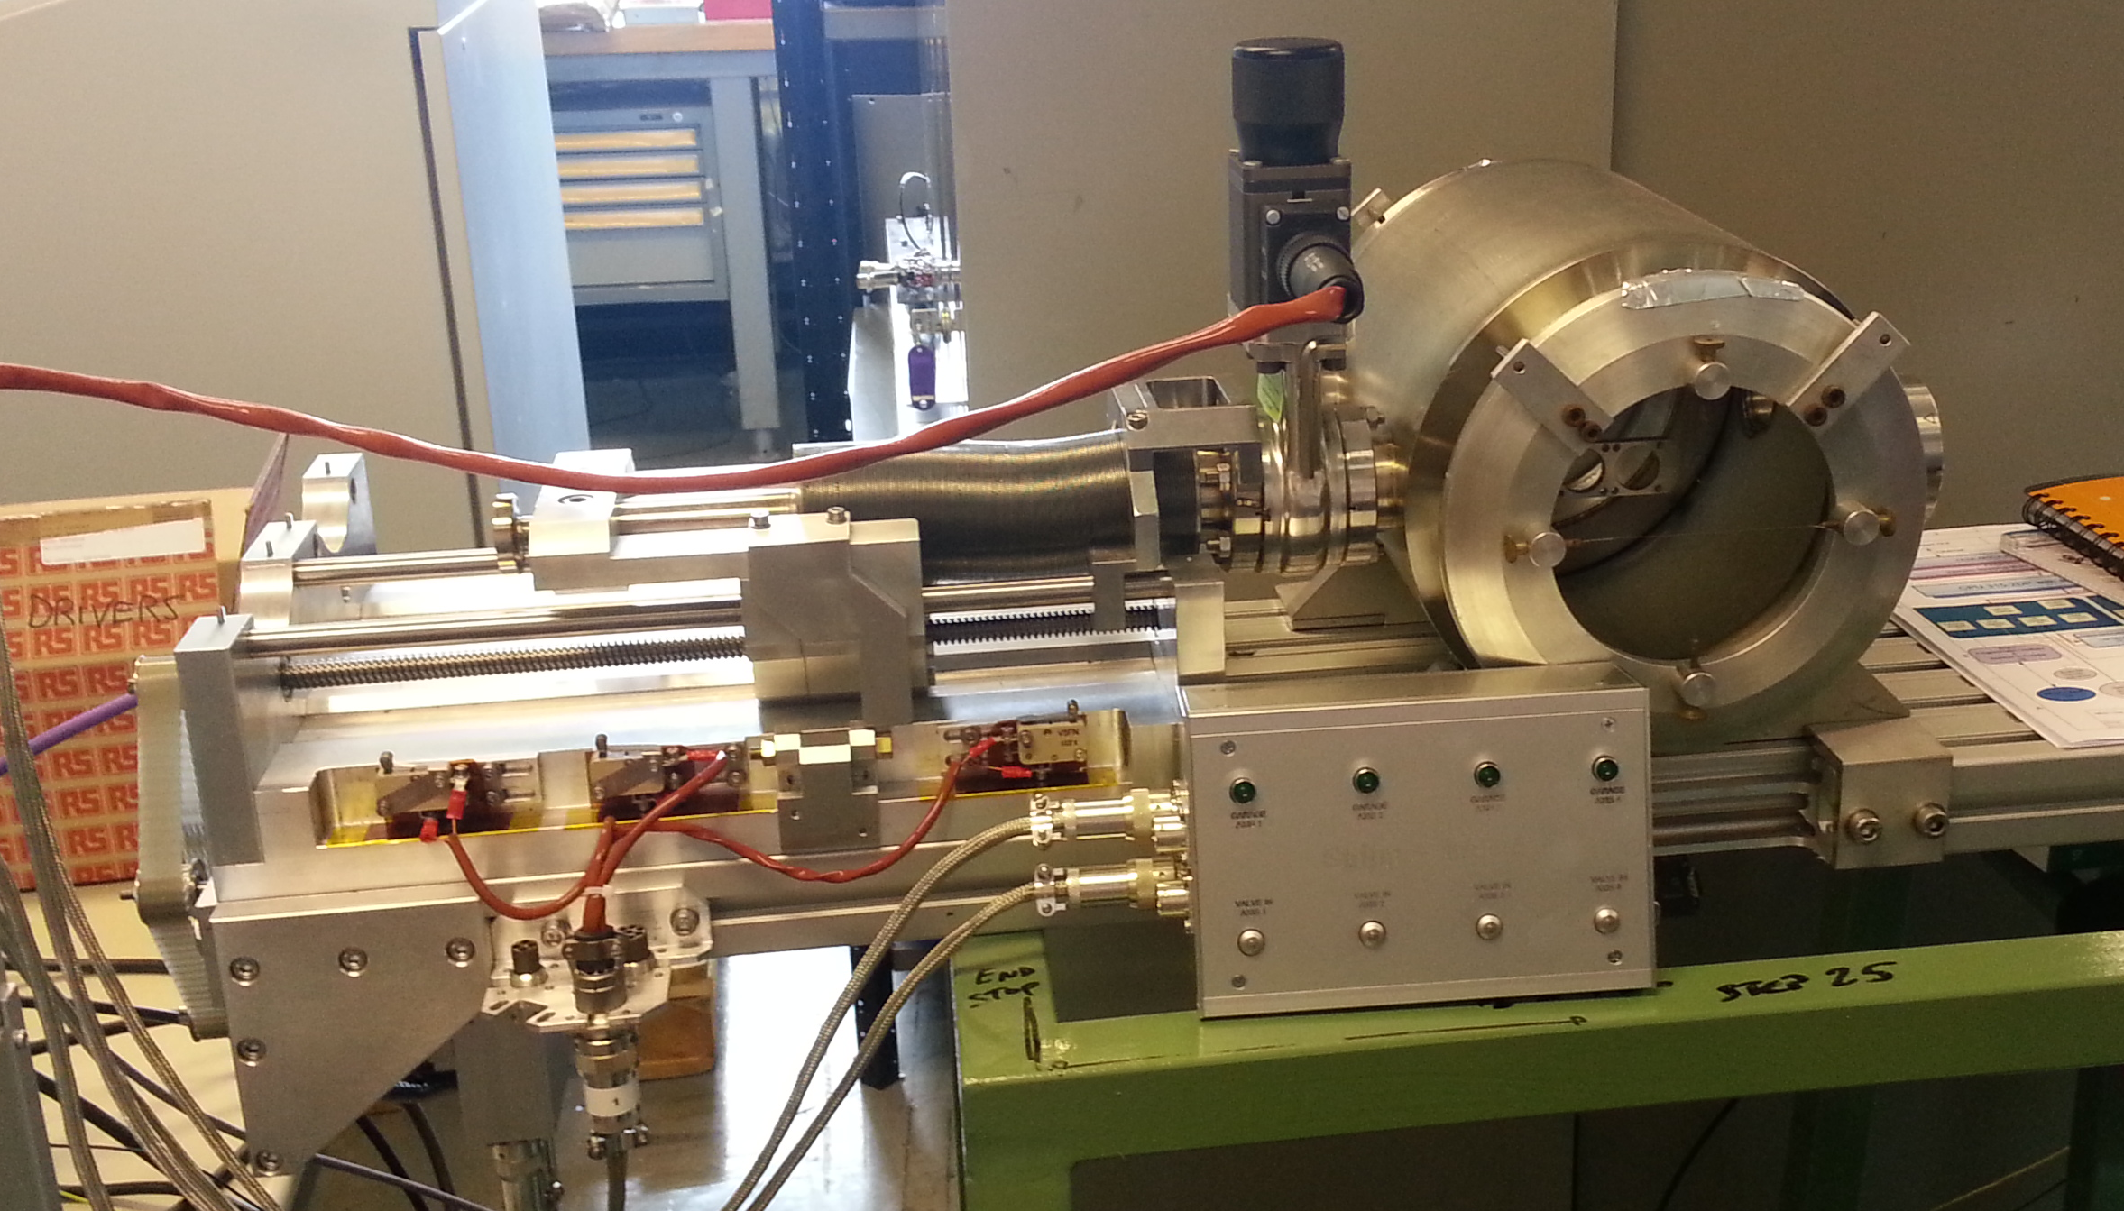
EAST Area
Install BLMs in primary beam lines
  OP request, but will only happen after LS1.
BTV adaptation to new marguerites
  Present marguerites old and fragile, where EITHER target heads OR screen can be used
  New layout (for after LS1) offers combined target AND screen position
Notes:
Also request for FTN (TOF), FTA (AD), TT10, but no cabling…

Slide 14
AD – 2012 Highlights
Intensity measurement during the AD cycle with DSP-based Schottky analysis → the workhorse of AD diagnostics; constantly in use and extremely useful/important. No faults over the year – please keep it up!
All MWPCs in the ejection lines are now replaced with GEM-detectors including new electronics & controls interface: In regular use for all of 2012 → better profile measurements; helped in optics validation and machine improvements; also very reliable!
BTV cameras replaced with CCD-type: now possible to observe the faint and large pbar beams in the injection line downstream of the target.

Slide 15
AD – Post LS1 Wishes
Renewal of orbit and ionisation profile monitor systems in LS1; orbit measurements during ramps highly desirable!
BBQ-tune system: in the pipeline; measurements during ramps highly desirable!
Complete AD controls renovation in LS1 (front-end renewal, FESA, MTG, InCA, HW renewal) → keep posted…!
Notes:
IPM: system will be simpler (all installed in one place)
Orbit: on the plan, but will it be done?

Slide 16
SPS (1)
Cameras
  Some cameras in TT10 and TT20 have ‘blind spot’ in the centre after years of intensive use.
  Ring cameras in LSS2 and LSS6 are only used in case of really big trouble. They have not been used during last years and have an old (or non existing) control. After LS1 we will face a difficult start up, where these cameras might be needed, so they have to be put in an operational state.
SEM (position and profile monitors in TT10 and TT20)
  TT10 SEM-grid spacing too coarse for small beams (LHC beams)
  SEM-grids in splitter region of TT20 have bad channels.
  Motors on mini-scan of T2 (NA) not working.

Slide 17
SPS (2)
BPMs in transfer lines
  Failing BPMs in regions with high losses and radiation: end of TT10, close to CNGS target, close to HiRadMat experiments. Could a more radiation hard version be developed?
MOPOS
  Some bad PUs in LSS1, LSS2 need interventions in the tunnel.
  Still an issue with acquisition on very long cycles (>21 s).
BCT
  New BCT in LSS5 for Fixed Target intensity interlock (primary Pb-beam) expected to be operational after LS1.

Slide 18
SPS (3)
Spill measurement in TT20
  A high bandwidth (10 MHz or higher) intensity acquisition in TT20 in order to check the de-bunching. In the past a PM was used (only for ions). A new system, robust enough to cope with protons, is required.
BLMs
  An renewal and extension of the system is being developed in the framework of LIU, but this is planned on a longer timescale.

Slide 19
SPS (4)
Installation of new wire scanner
prototype during LS1!
WS and Emittance measurements
  Extensive use of wire scanners throughout the year on LHC beams (high intensity, high energy and high brightness).
  Multiple scans gave very good results, but increased the number of scans dramatically.
  High energy, high intensity beams increase the frequency of broken wires – the nominal LHC 25ns and 50ns beam at flat top is BEYOND the wire breakage limit as calculated by BI!
    4 WS (2 per plane) should be operational for LHC beams. At least one WS per plane should be able to measure bunch-by-bunch.
    Define range of valid settings for HV/filter settings.
    Investigate a more robust design for WS with easier and faster repair interventions.
    A robust synchrotron light monitor for emittance measurements at high energy should be (re-)installed as soon as possible.
    Ionisation gas monitor should be operational after LS1 to follow emittance evolution during the cycle.
Notes:
BSRT and BGI perhaps not for after LS1…

Slide 20
NORTH Area – Wishes for LS1 Interventions
TBIU/TBID need consolidation
  Suffered from wrong positions in 2012
  Consolidation foreseen in LS1
    To be coordinated with target renovation
Calibration factor for XION and experimental scalars
  Factor for COMPASS changes between muon and hadron beams
  Should be remotely controllable (CO+BI)
Replace wire chambers installed in secondary beam lines by GEMs
Target Box Instrumentation
TGT
TBIU
TBID
Notes:
Target stations in T2, T4 and T6 (in TCC2 cavern) and T10 target station for NA62 (has no TBID).
XION…ionisation chamber
The replacement of analog wire chambers by GEMs should ideally be a full replacement, but at least partially…

Slide 21
The LHC Ion Chain

Slide 22
Linac3
ITL.MSG02: Lifetime issue solved by installing shielding for parked SEM grid
Long-standing issue: Noisy beam trace of transformers TRA25 and TRA41 – is there a solution in view?
Wished for after LS1 (or at earliest possibility):
  Emittance device (pepper pot) in LEBT
  Dedicated Linac3 emittance and energy/energy spread measurement devices at the end of Linac3 – very difficult to use LBE/LBS!

Slide 23
Slide R. Steerenberg BI Day 2011

Slide 24
LEIR
BI has been very responsive throughout the run!
Some problems during 2012 with
  Tune measurement: New operating system; some cards (unintentionally…) cannibalised
Wishlist for after LS1:
  SEM-grid measurements at injection (sensitivity)
  Make Schottky measurements operational from CCC
  Make ionisation beam profile monitor measurements operational from CCC
  Revive scraper controls
Notes:
New OP: Linux instead of Lynx OS
Scrapers installed in ring – orphan equipment; for independent emittance measurement

Slide 25
PS (Ions)
Tune PU to be installed during LS1.

Slide 26
A Few General Remarks
Cross-calibration of BCTs along the injector chain – where are we??
Satisfactory cross-calibration of emittance measurements along the injector chain and the LHC – point still open…
Functional BI Specification Reviews
  Define wish-list for future machine operation, including LIU
  Reviews held so far: Beam intensity, beam position
  How to go from a ‘wish-list’ to ‘can be provided’ and ‘as measured’?
Introduction of ‘BI issues’ in elogbook
  Very useful - allows fast dispatching of issues and good follow-up for BI and OP
ACCOR renovations need to go ahead during LS1…

Slide 27
Conclusions and Outlook
Good progress and many improvements of beam instrumentation over last years
Steady push for increased beam quality at reduced beam losses translates often to new requests for improvements of our beam instrumentation
Echo throughout the machines: BI very responsive!
We would like to thank all the BI colleagues, also those that work more behind the scenes, for their support and ensuring that beam instrumentation is available and operational.
The BI equipment are the eyes of the operations teams!

Slide 28
Special thanks for having provided information to:
D. Kuechler, R. Scrivens, J-L. Sanchez, K. Hanke, D. Voulot, R. Steerenberg, S. Gilardoni, L. Gatignon, T. Eriksson, K. Cornelis, H. Bartosik, D. Manglunki, B. Goddard.

