Slide 1
Software for Testing the New Injector BLM Electronics
Emmanouil Angelogiannopoulos (BE-BI-SW)
Acknowledgements:
  Maciej Kwiatkowski (BE-BI-BL)
  Stephen Jackson (BE-BI-SW)
  Christos Zamantzas (BE-BI-BL)

Slide 2
Outline
Motivation for this project
Technical details with examples
Results
Conclusions

Slide 3
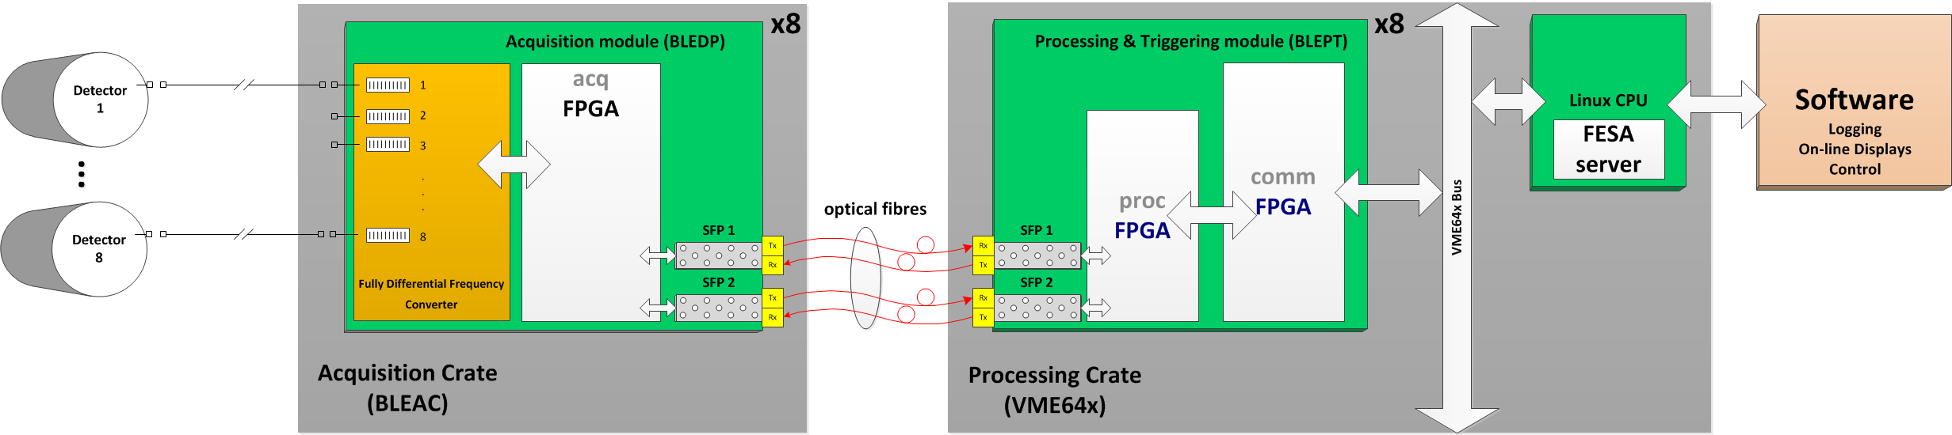
Final System Implementation
Final architecture of the new BLM system:
  Detectors in tunnel
  Acquisition crate (BLEDP)
  VME crate
    Processing electronics (BLEPT)
    FESA server on Linux CPU providing data to clients and dealing with settings and interlocks

Slide 4
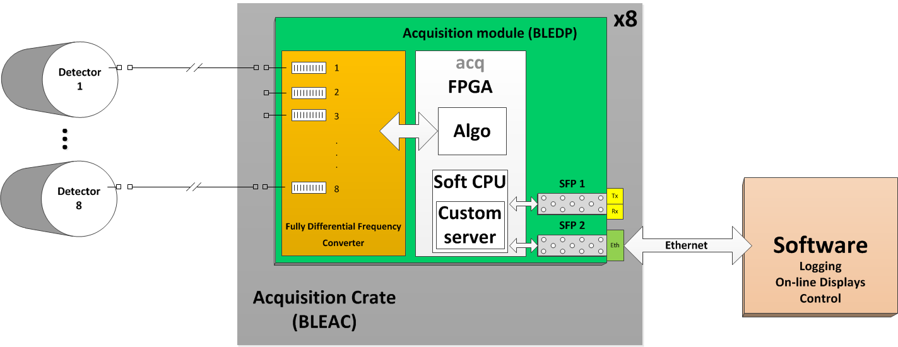
Test System Implementation
Topic of this talk
VME processing electronics not yet available
Replacing fibre module with Ethernet allows standalone implementation
Nios-II software-implemented CPU allows custom server.
Expert BI software communicates directly with the BLEDP module

Slide 5
Objectives for the Expert Software
Debug and verify the hardware
Further develop the analogue circuits and the final firmware
Assist in the development of the FPGA algorithms to merge the acquired data
User-friendly environment
Real-time data-viewing and parallel logging to files

Slide 6
Software, Firmware and Hardware Development Phases
Expert GUI Client
Analogue and PCB Design
Protocol and Software
Specification
Testing & Validation
Nios II firmware development

Slide 7
Two Types of Data Provided
Acquisition data
  8 channels per BLEDP module
  2 measurement methods:
    Low current measurement (in pA)
    High current measurement (in mA)
Status data
  Number of sensors and parameters to be monitored
  Data rate 1s

Slide 8
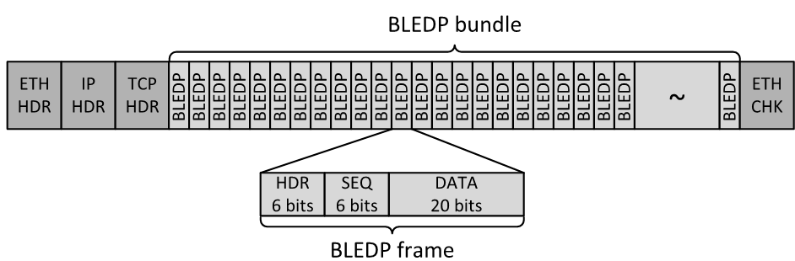
Protocol Specification
The protocol for the client-server architecture:
  Header to identify data source, measurement method, continuity problems.
  Header + payload = 32 bit data frame.
  350 data frames packed into data bundle. Size is selected to avoid IP fragmentation.
  Status data buffers.
  4 byte commands.
  Both TCP and UDP can be used.

Slide 9
Development Phases
Type of acquisition data supported by the module:
Processed data from one channel
16 Mbit/s
TCP protocol
Processed data from all eight channels
128 Mbit/s
UDP protocol
Raw ADC data from one channel
320 Mbit/s
UDP protocol
2. Status Data with 1 Hz frequency interleaving with all the above types.

Slide 10
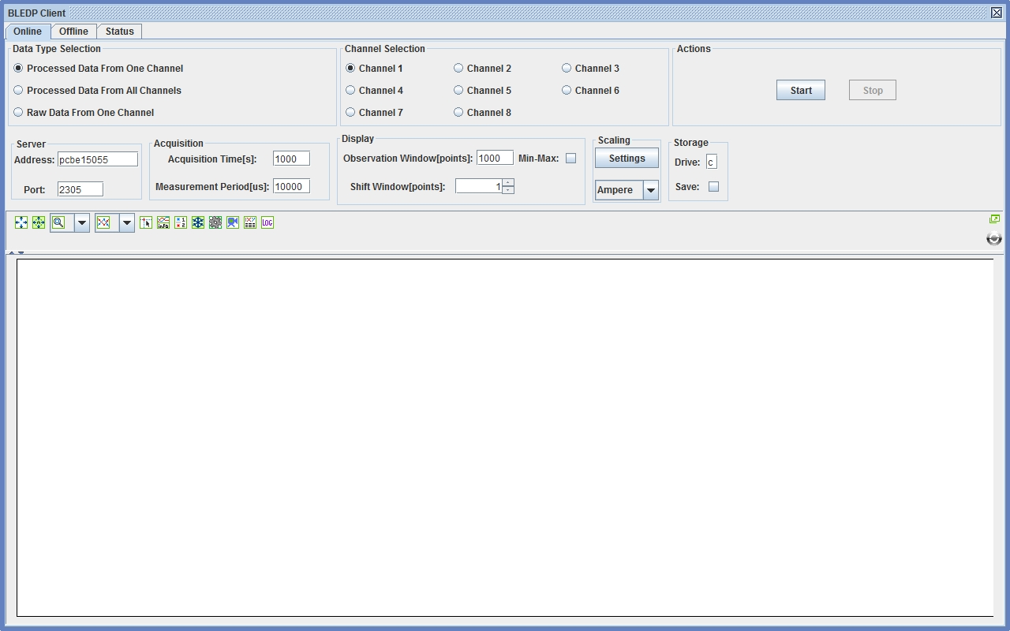
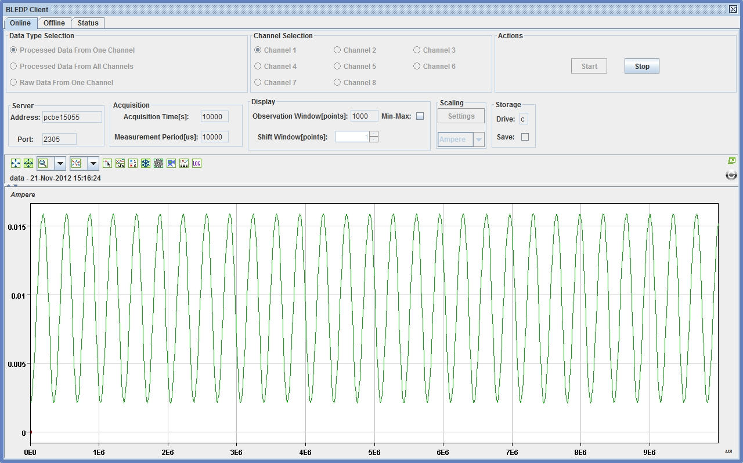
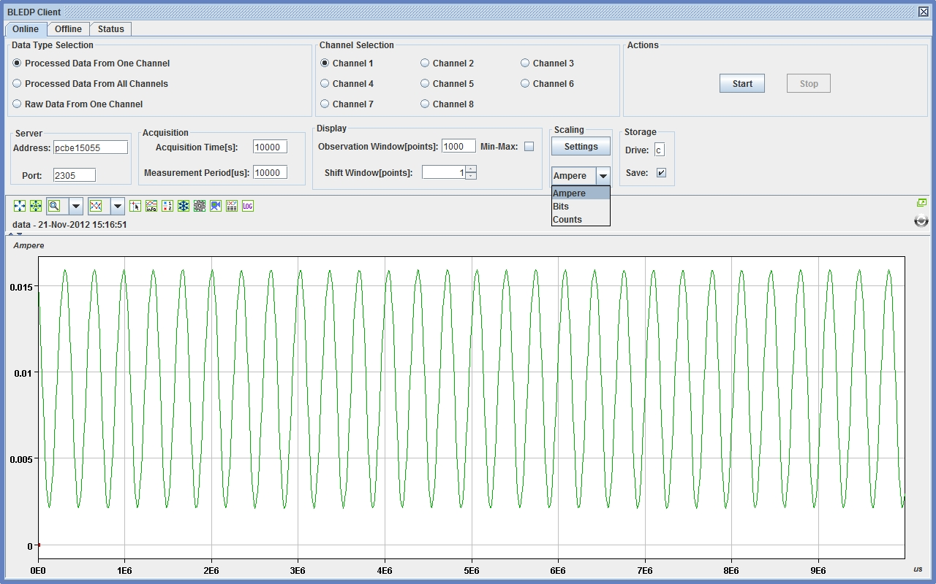
Online Panel
After these steps the acquisition can start and real-time data from the module are plotted in the graph.
The user can also select whether or not to save incoming data to the hard drive. This process is executed in parallel with the real time plotting. It is important for further offline analysis, that will be explained in the next slides.
It is possible to stop the acquisition at any time.
We can see a video example with real time plotting.
The user should set different parameters before starting communication with the module. Most of them are saved from previous sessions on the same computer or have default values.
Acquisition parameters like Data type mode, channel number and acquisition time should always be set manually.
User can also define Units and Scale in the Y Axis.

Slide 11
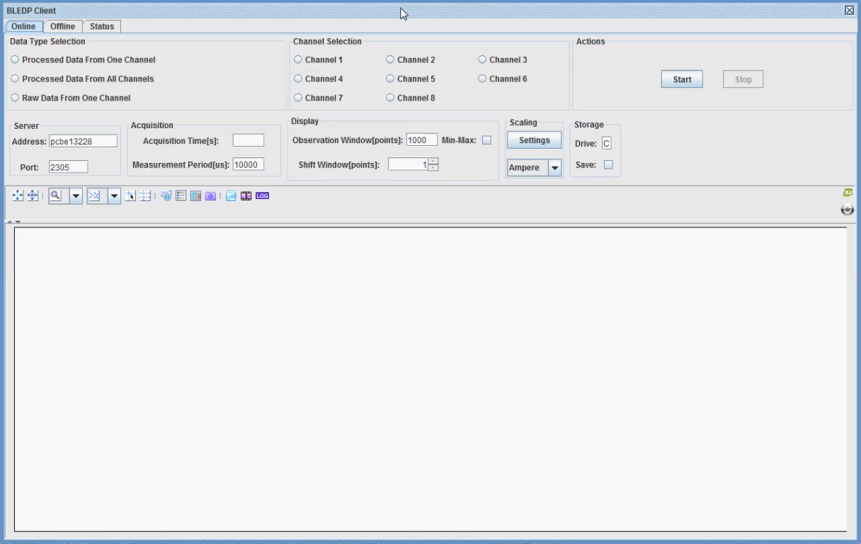
Online Panel Video

Slide 12
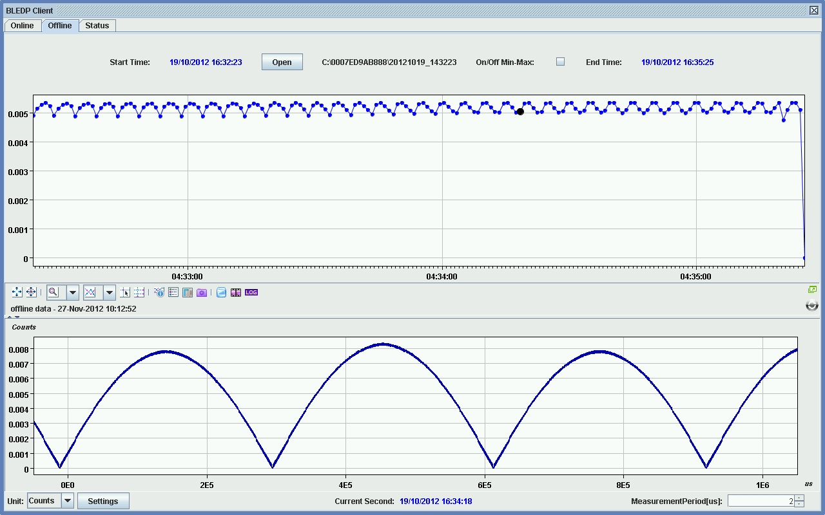
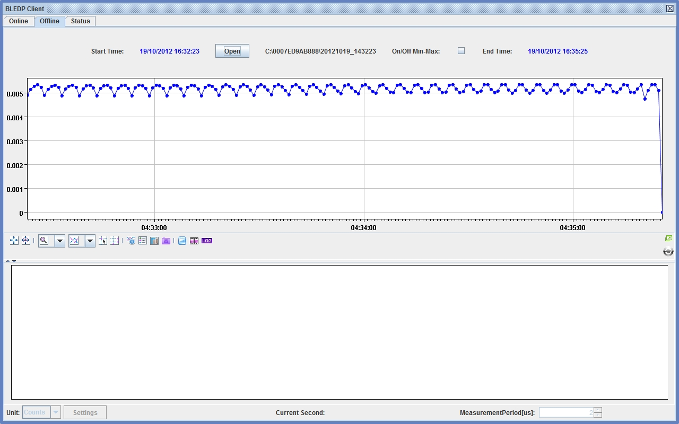
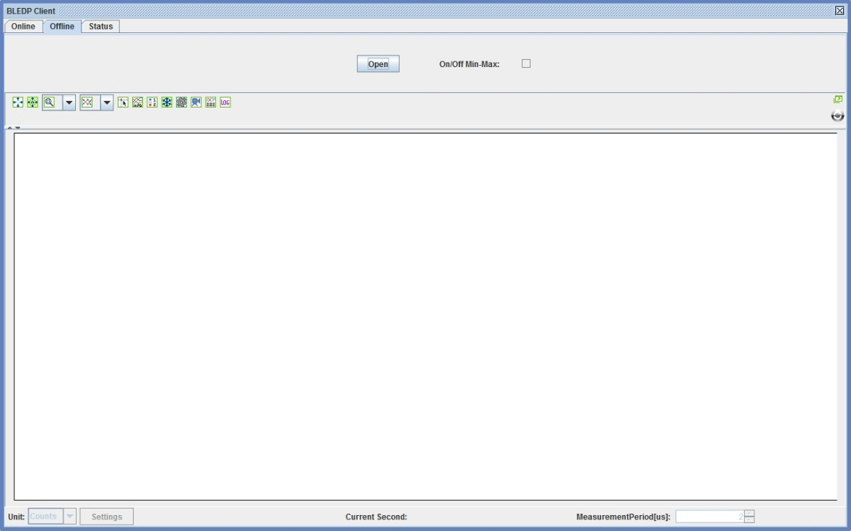
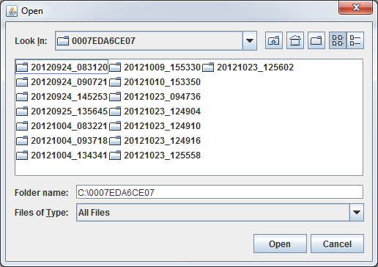
Offline Panel
The picked second is marked in the upper graph and the data are mined from the corresponding file and then plotted with the desired accuracy in the lower graph.
A zooming video example follows.
Mac address of a module.
Open a file search window to select an acquisition folder from a previous online session.
Different acquisition sessions for this module to select.
Upper graph is the picker. It is plotted from statistics files inside the selected session folder and contains minimum, maximum and average values of the data for each second. The user has to pick a second with the mouse.
11/16

Slide 13
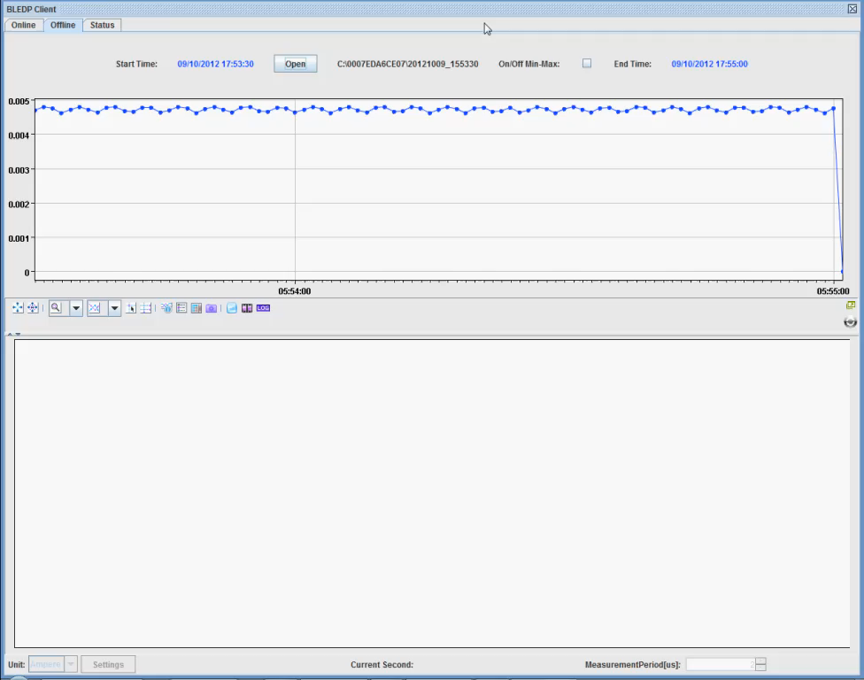
Offline Panel Video

Slide 14
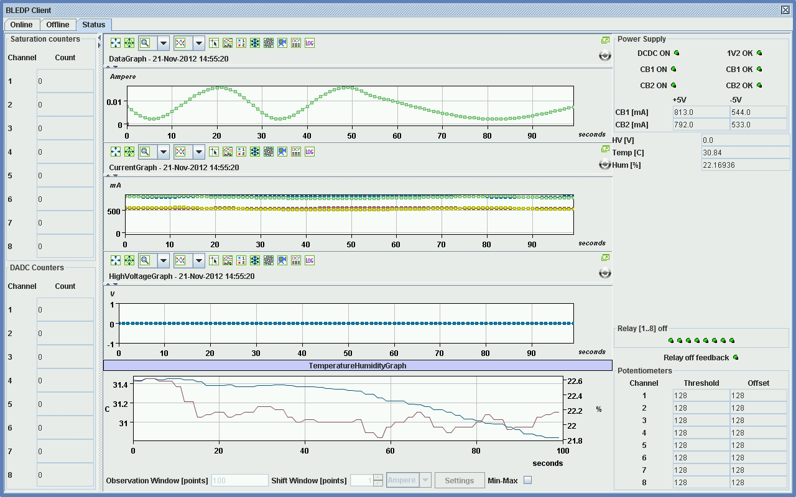
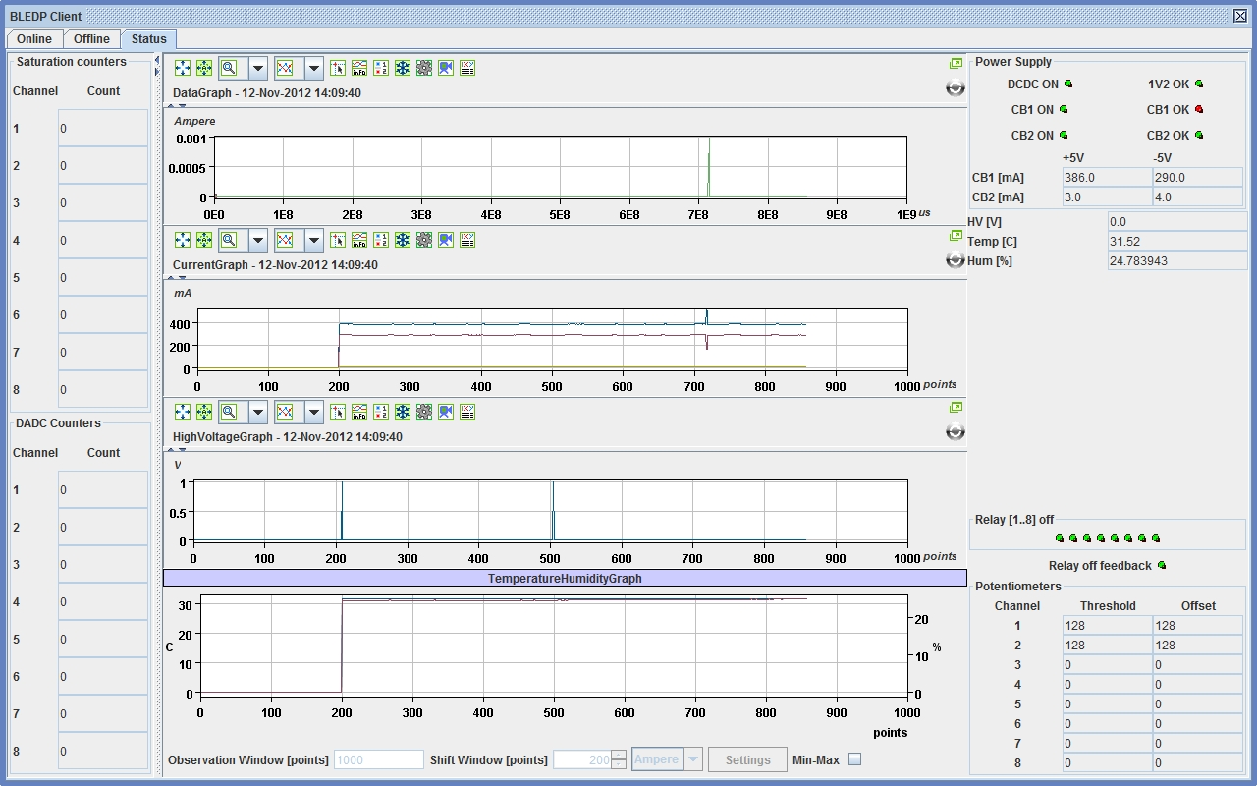
Status Panel
Plot selected status packets in these three graphs with 1 Hz update rate: current consumption, high voltage monitoring, temperature and humidity.
LEDs show status of the power supplies and the calibration relays.
In the first graph are plotted acquisition data from the selected channel with 1 Hz update rate also. The plots of the four graphs are aligned.
Print in textboxes: values which are plotted and additional like digital potentiometers settings and event counters.
E.g. Influence of a power supply problem on the measurements can be seen here.

Slide 15
Conclusion
Direct Ethernet communication allowed a standalone implementation
Collaboration between BL (hardware, firmware) and SW (Expert GUI) sections
Software and the firmware development was split:
  Processed Data from one channel
  Processed data from all 8 channels
  Raw Data from one channel
Expert GUI allowed developing of both firmware and hardware
  Offline data storage allowed detailed analysis of the RT algorithm implemented in the FPGA

Slide 16
Thank you for your attention!
People involved in the Project:
Christos Zamantzas (BE-BI-BL)
Stephen Jackson (BE-BI-SW)
Analog design: William Viganό (BE-BI-BL)
Firmware design: Marcel Alsdorf, Maciej Kwiatkowski (BE-BI-BL)
Software design: Emmanouil Angelogiannopoulos (BE-BI-SW)

