Slide 1
The new BLM System for the Injector Complex
BI Day 2012
Project Team
BI-BL:
M. Alsdorf; M. Kwiatkowski; O. Bitterling; W.Vigano’; C. Zamantzas
BI-SW:
E. Angelogiannopoulos; S. Jackson
Support from BI-BL:
E. Effinger; J.Emery; E. Nebot Del Busto; S. Grishin; G. Venturini

Slide 2
Introduction
The design of the new Beam Loss Monitor System is needed to upgrade the current system on the Injectors.
Project Objectives:
=> Build a generic, highly configurable and high performing BLM system.
=> Design the Acquisition part able to accept several detector types.
=> Use reprogrammable parts to target all injectors’ requirements.

Slide 3
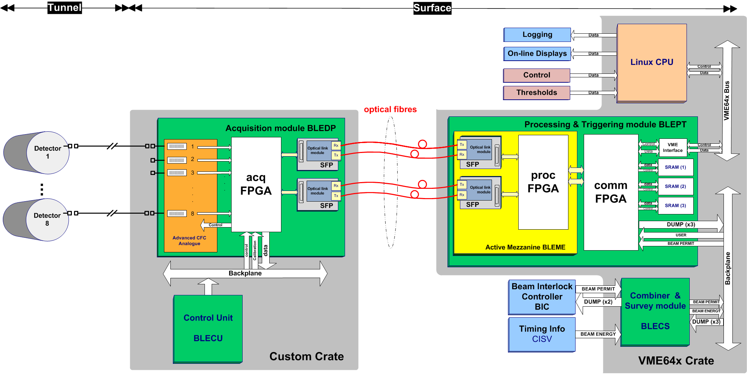
System Architecture

Slide 4
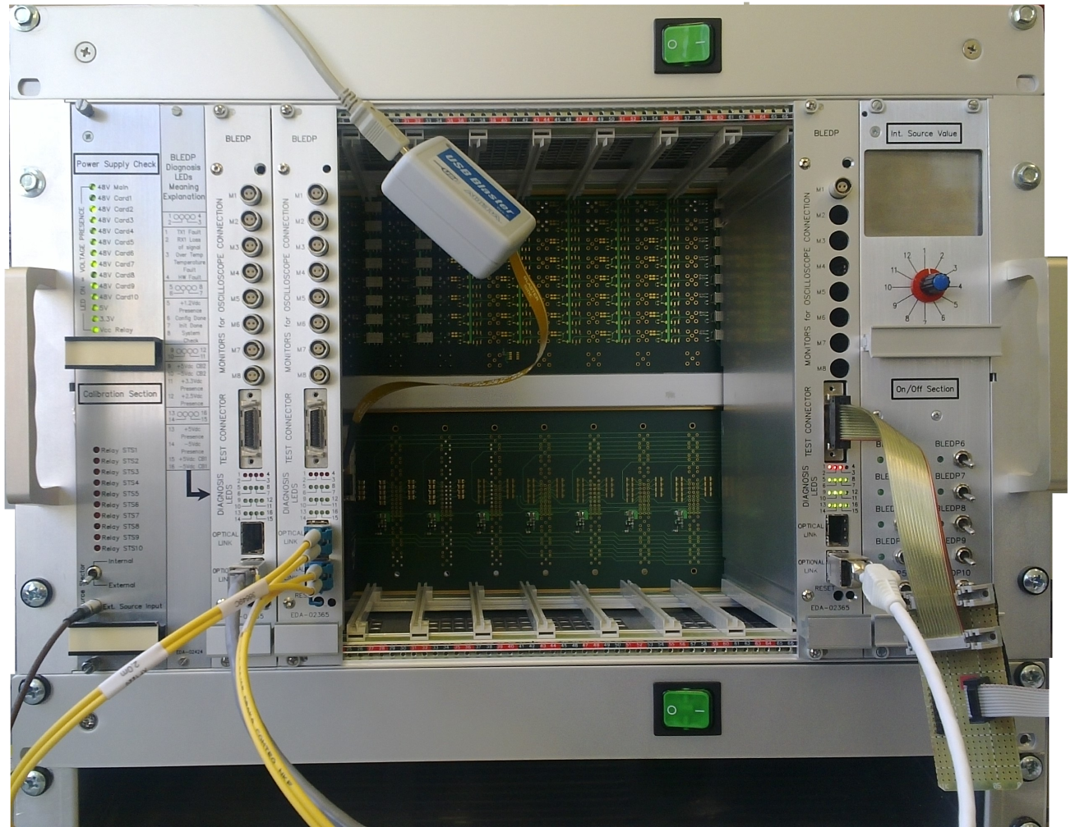
Acquisition Crate
Custom Backplane
See next slide
Control Unit
Later version w/ advanced remote functions
Main panel
Ref. current Input
LEDs
Power switch
Acquisition module (BLEDP)
Up to 8 modules with
8 channel each

Slide 5
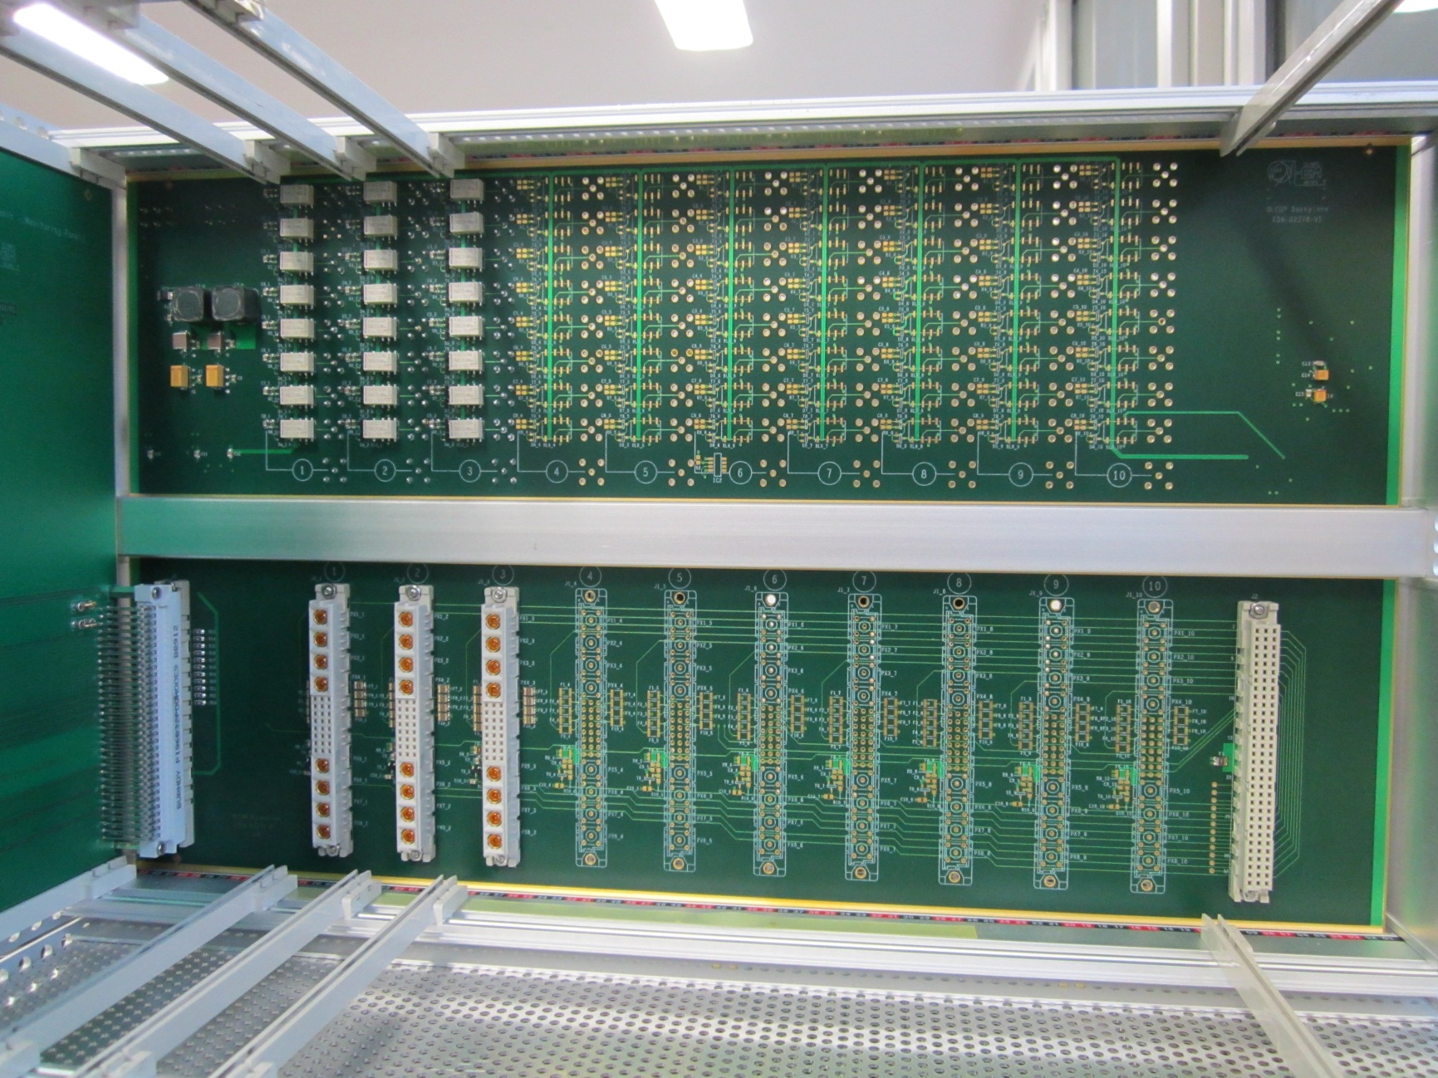
Backplane of the Acquisition Crate
CUSTOM BACKPLANE
Routing of 64 input cables to the 8 BLEDP cards.
48Vdc Power Distribution and protection by Circuit Breakers .
Redundant Power supply single failure tolerant.
Current Supply monitoring.
Internal calibration current Source.
Relays Multiplexer.
Geographical addressing .
Chip ID.
Temperature and Relative Humidity measurement.
Low Leakage design.
Standard Vias and True hole footprint
Modified Vias and True hole footprint
High Insulation Capacitor
Hole

Slide 6
Keeping Down the Power Supply Noise
Acquisition Module
Filter
LDO 2.5V_{DC}
Filter
Backplane
Protections+ Filters
220V_{AC}
Filter
Dc/Dc 1.2V_{DC}
Filter
Ac/Dc Converter
48V_{DC}
3.3V_{DC}
Filter
Filter
Dc/Dc
3.3V_{DC}
Filter
FPGA + Logic
48V_{DC}
LVDS
5V_{DC}
Filter
Dc/Dc
5V_{DC}
Filter
Analog
Several PCB layers are used as ground planes.
The star point connection is done on the Dc/Dc converters’ ground.

Slide 7
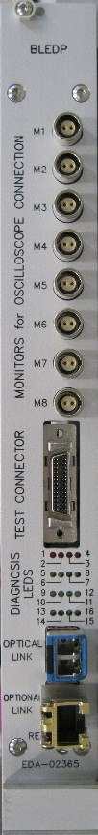
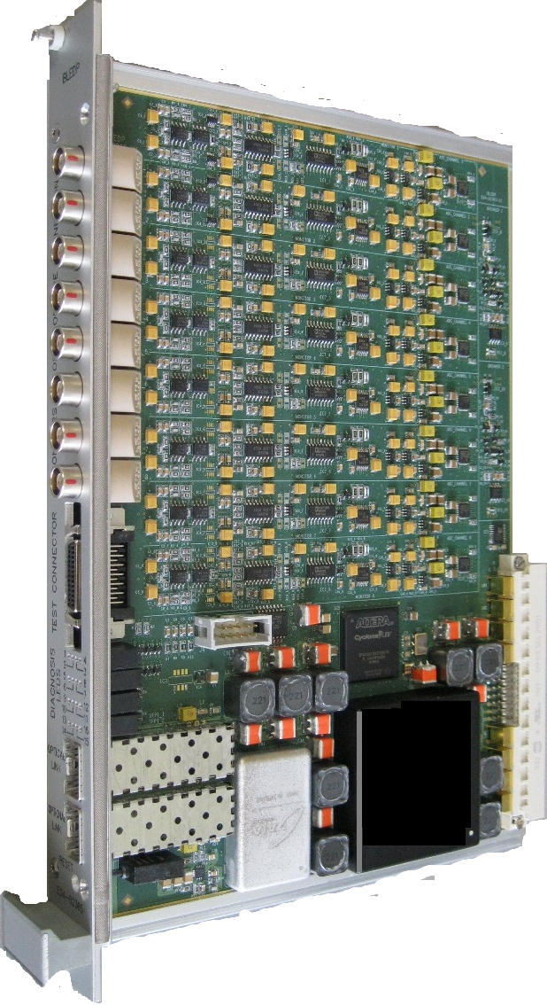
Acquisition module (BLEDP)
Circuit Breakers
Stop the failure propagation
Currently verifying
version 2 of the
printed circuit board
Acquisition
digitisation of 8 channels
FPGA
Altera Cyclone IV
JTAG connection
Local programming
and diagnostics
Backplane connection
Analogue inputs, power and control
SFP connectors
Gigabit optical and/or Ethernet links
Local power supplies
Separated for Digital and Analog

Slide 8
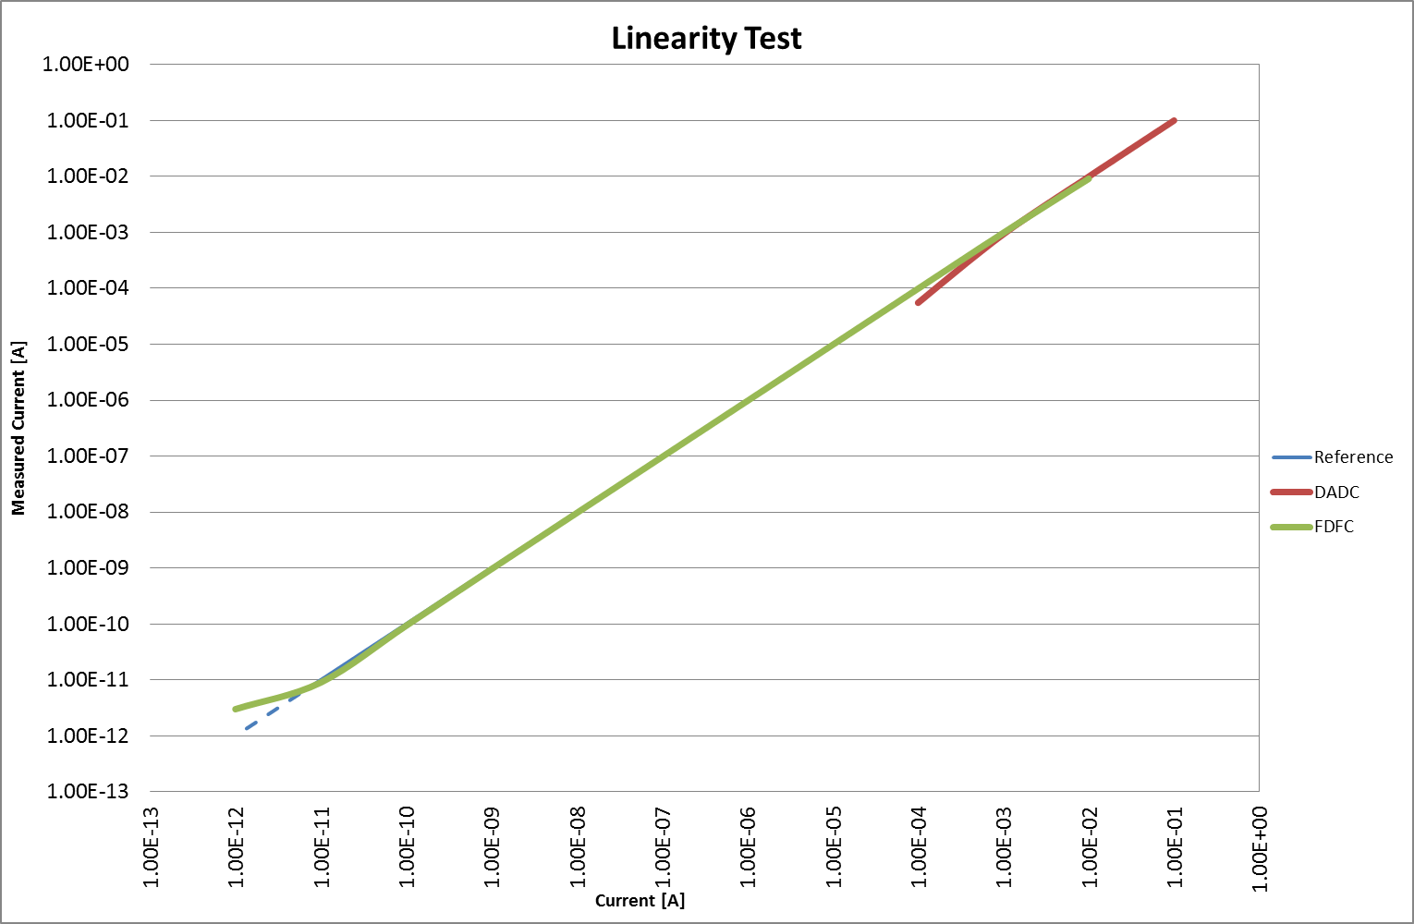
Acquisition principle (FDFC & DADC)
The input channel circuit is able to measure current input from 10pA to 200mA.
The measurement of the current input is performed by two different techniques:
Fully Differential Current to Frequency Converter (FDFC) used in the range 10pA to 30mA
Direct ADC acquisition (DADC) used in the range 80µA to 200mA
No gain change required: The switch between the 2 ranges is managed by the FPGA.

Slide 9
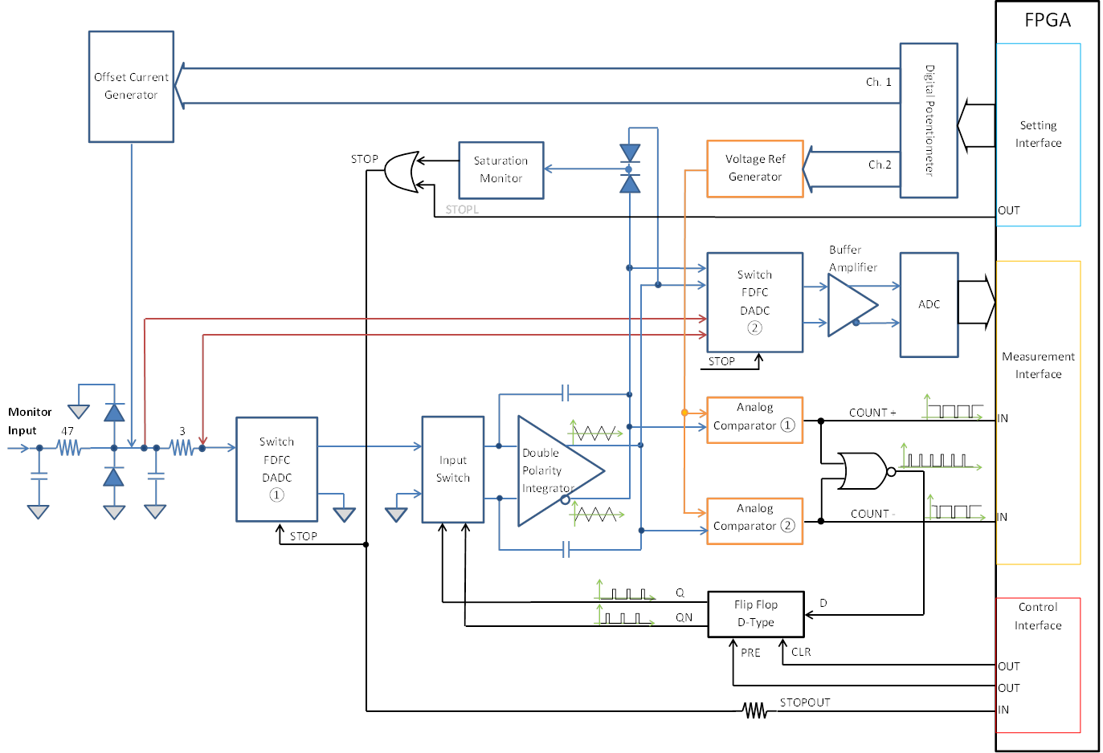
Acquisition Channel Architecture

Slide 10
FDFC data processing
counts
thhigh
ADC values
thLow
0
2 μs
2 μs
2 μs
Time
The number of accumulated counts are combined with the ΔADC values to calculate the integrated loss over a 2 μs period.

Slide 11
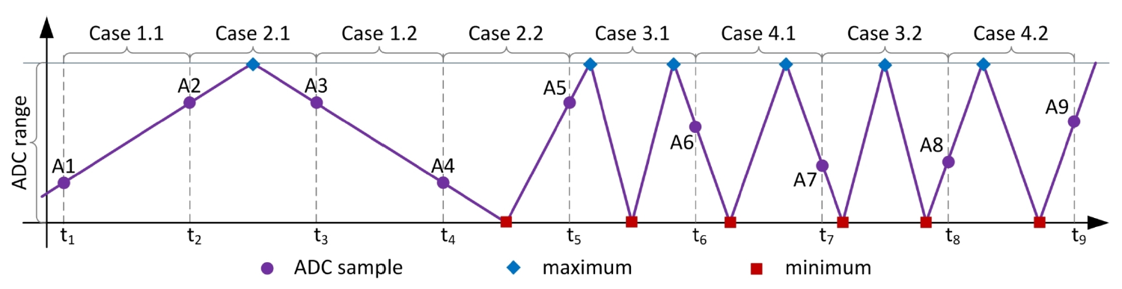
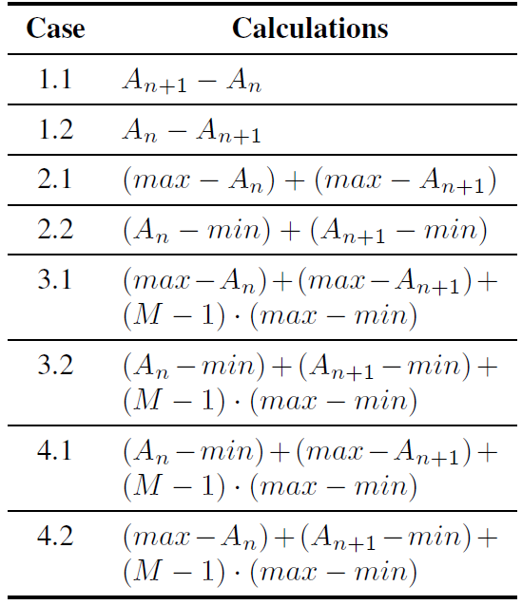
FDFC Data Merger
Algorithms
Two types of data acquired: Counts & ADC values.
Algorithms have been implemented to merge those values for all possible acquisition cases.
Next step currently under testing: implementation of further algorithms to reduce the noise.

Slide 12
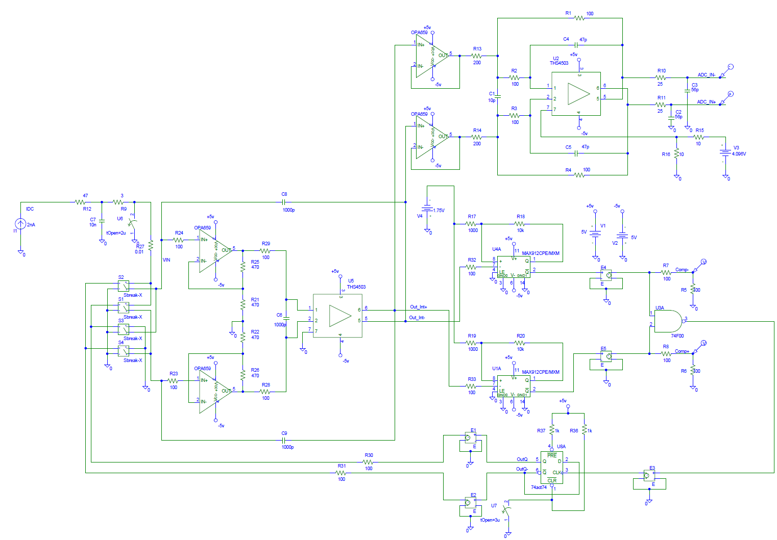
Simulation Model
PSPICE simulation model of the FDFC
Models built using imported files
from component’s supplier

Slide 13
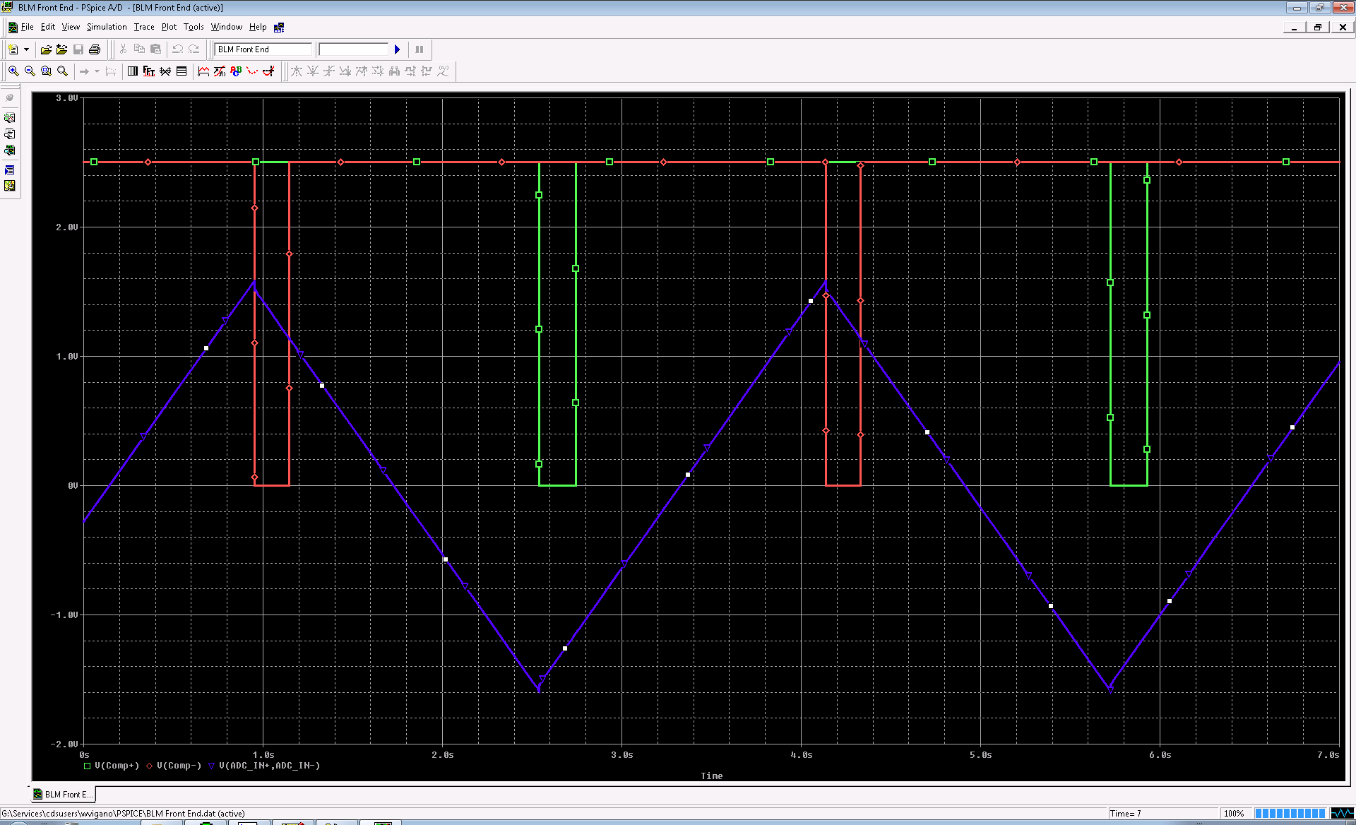
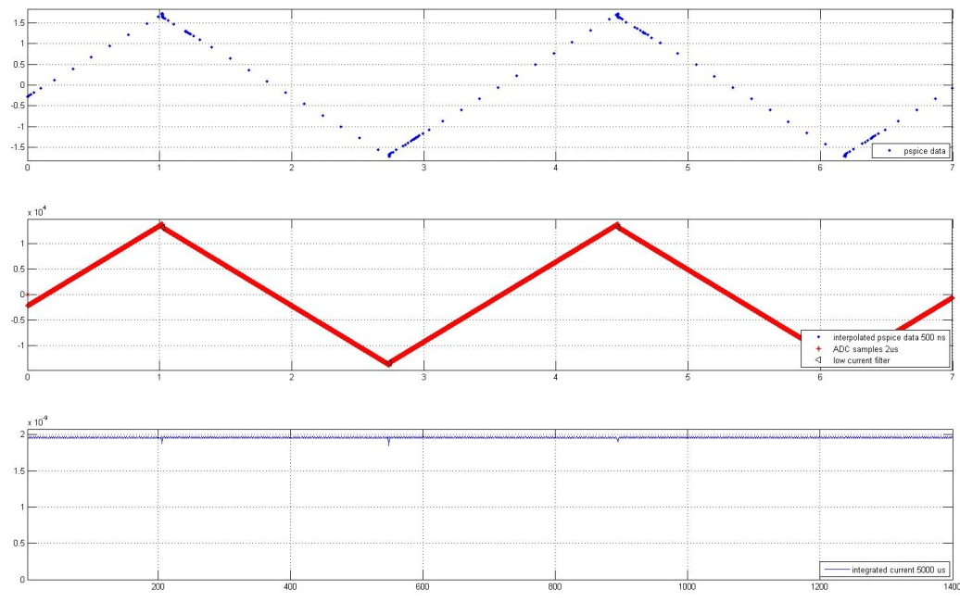
Algorithm Verification with Matlab
PSpice Output
Analog Signal + 2 Comparator Pulses
MODIFICA!!!!
Data created by PSPICE
Data interpolated by MATLAB
FDFC out converted in Ampere (Current value)
Algorithm Verification with Matlab
Full correspondence with reality

Slide 14
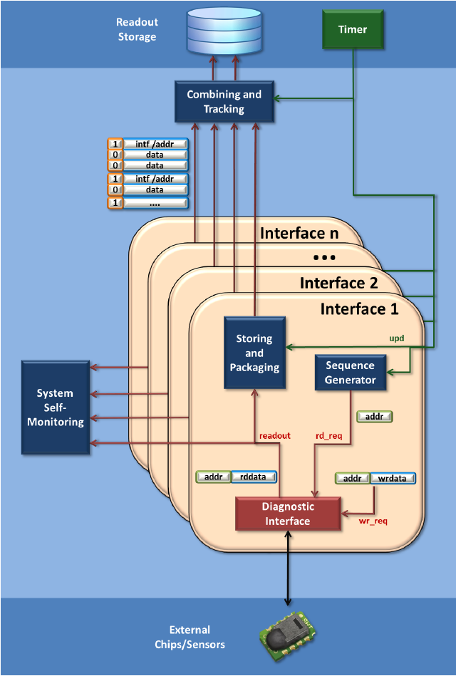
System Survey and Diagnostic Reader
System Survey and Diagnostic Reader
100% of the System Functions have Diagnosis
Read-out status and diagnostic information from connected chips or sensors with every timing event.
All readouts are afterwards pre-stored, packaged and forwarded to logging.
Additional interfaces can be easily added to the reader.
All readouts can be monitored for failsafe actions.

Slide 15
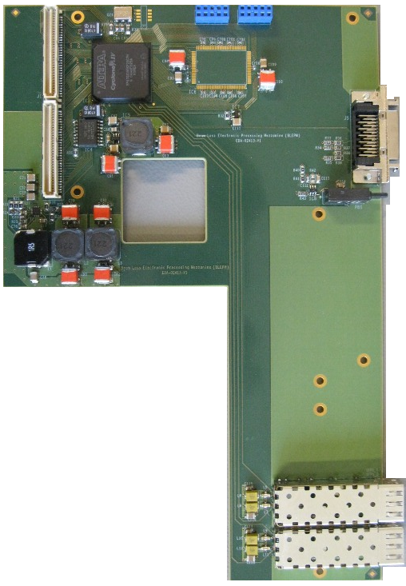
Processing Mezzanine (BLEPM)
SRAM
Connectors
to the mainboard
DAB64x
JTAG connection
Local programming
and diagnostics
FPGA
Cyclone IV 150K logic elements
Dc/Dc converter
And filters
2 SFP modules
gigabit Optical links and Ethernet

Slide 16
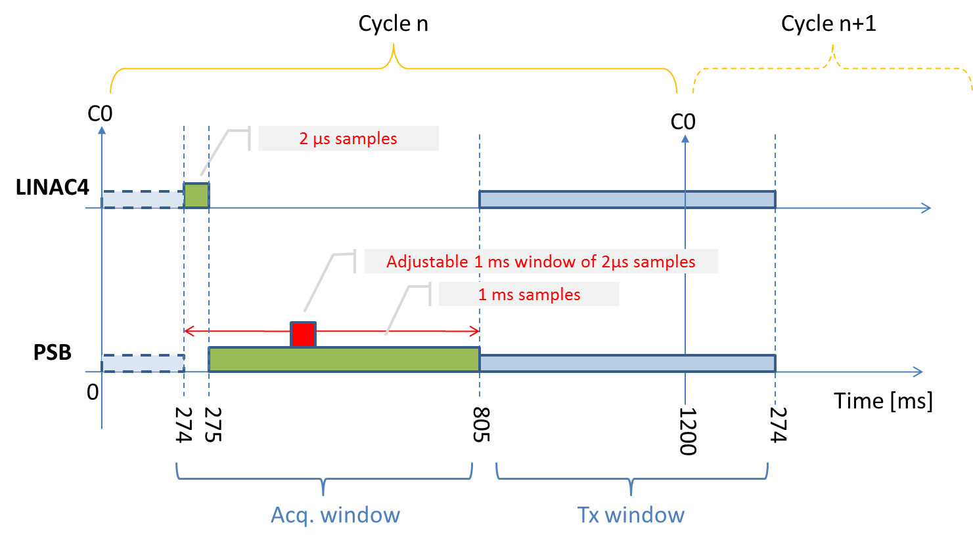
Acquisition & Processing
Different Processing per target.
Selectable integration periods.
E.g. : 2 µs, 400 µs, 1 ms and 1.2 s
Threshold values unique per channel
Integration | Minimum detectable current | Minimum detectable dose [Gy/s]
 |  | Detector: IC | Detector: LIC
2 μs | 31.250 nA | 5.787E-04 | 7.234E-03
1 ms | 62.250 pA | 1.153E-06 | 1.441E-05
400 ms | 0.156 pA | 2.889E-09 | 3.611E-08
1200 ms | 0.052 pA | 9.630E-10 | 1.204E-08

Slide 17
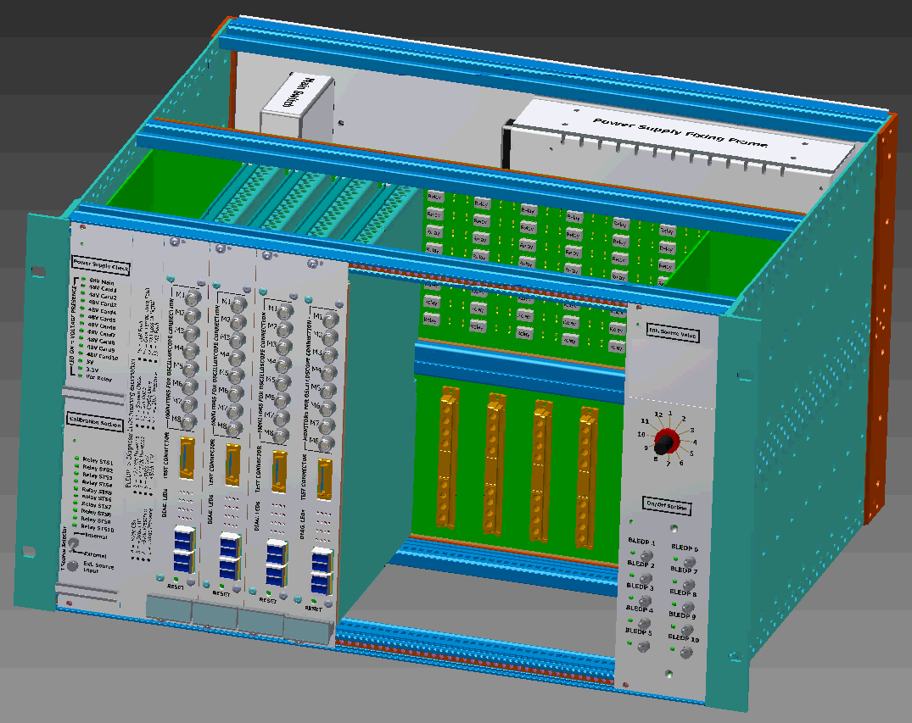
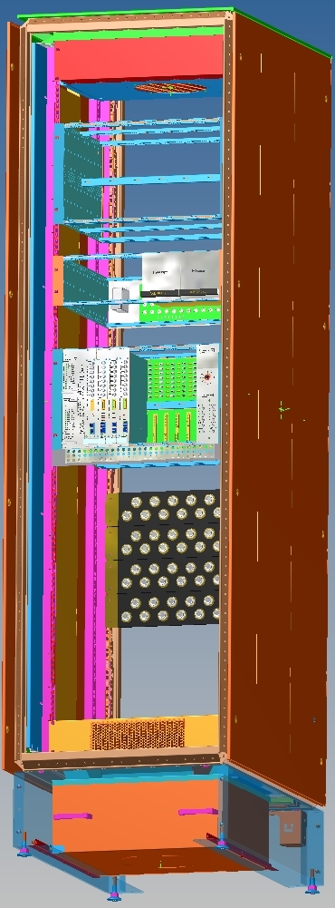
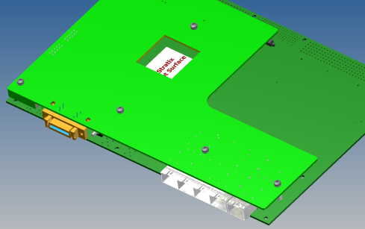
3D Models

Slide 18
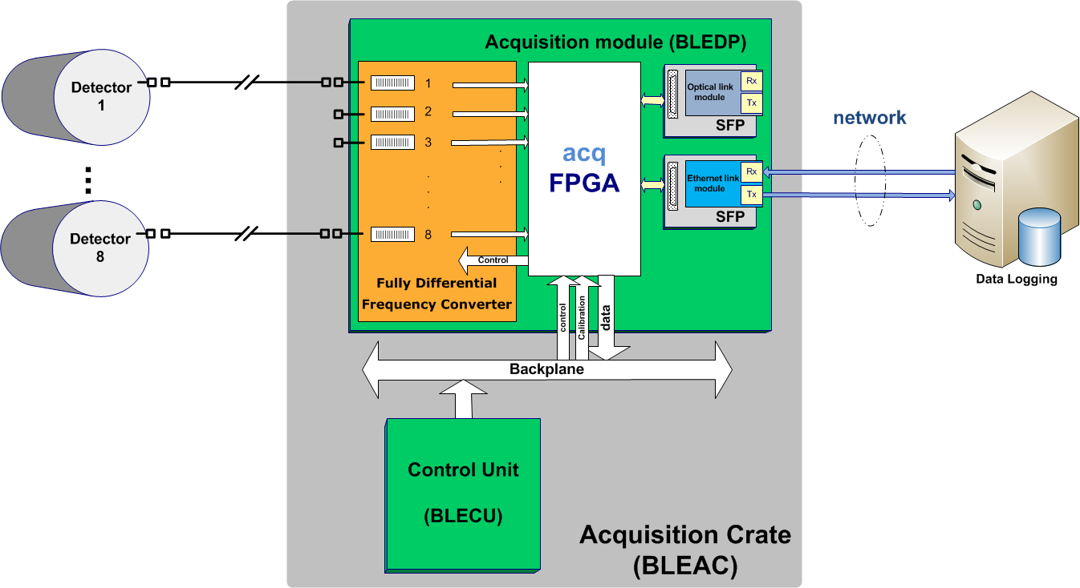
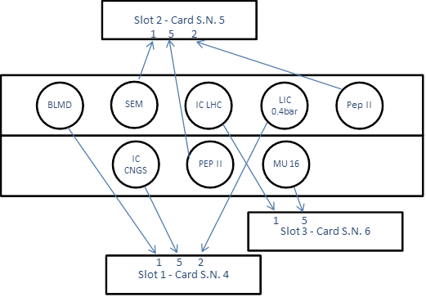
Test Installation in the PS
5 type of detectors
are connected to BLEDP cards
Pre-Series Manufacturing

Slide 19
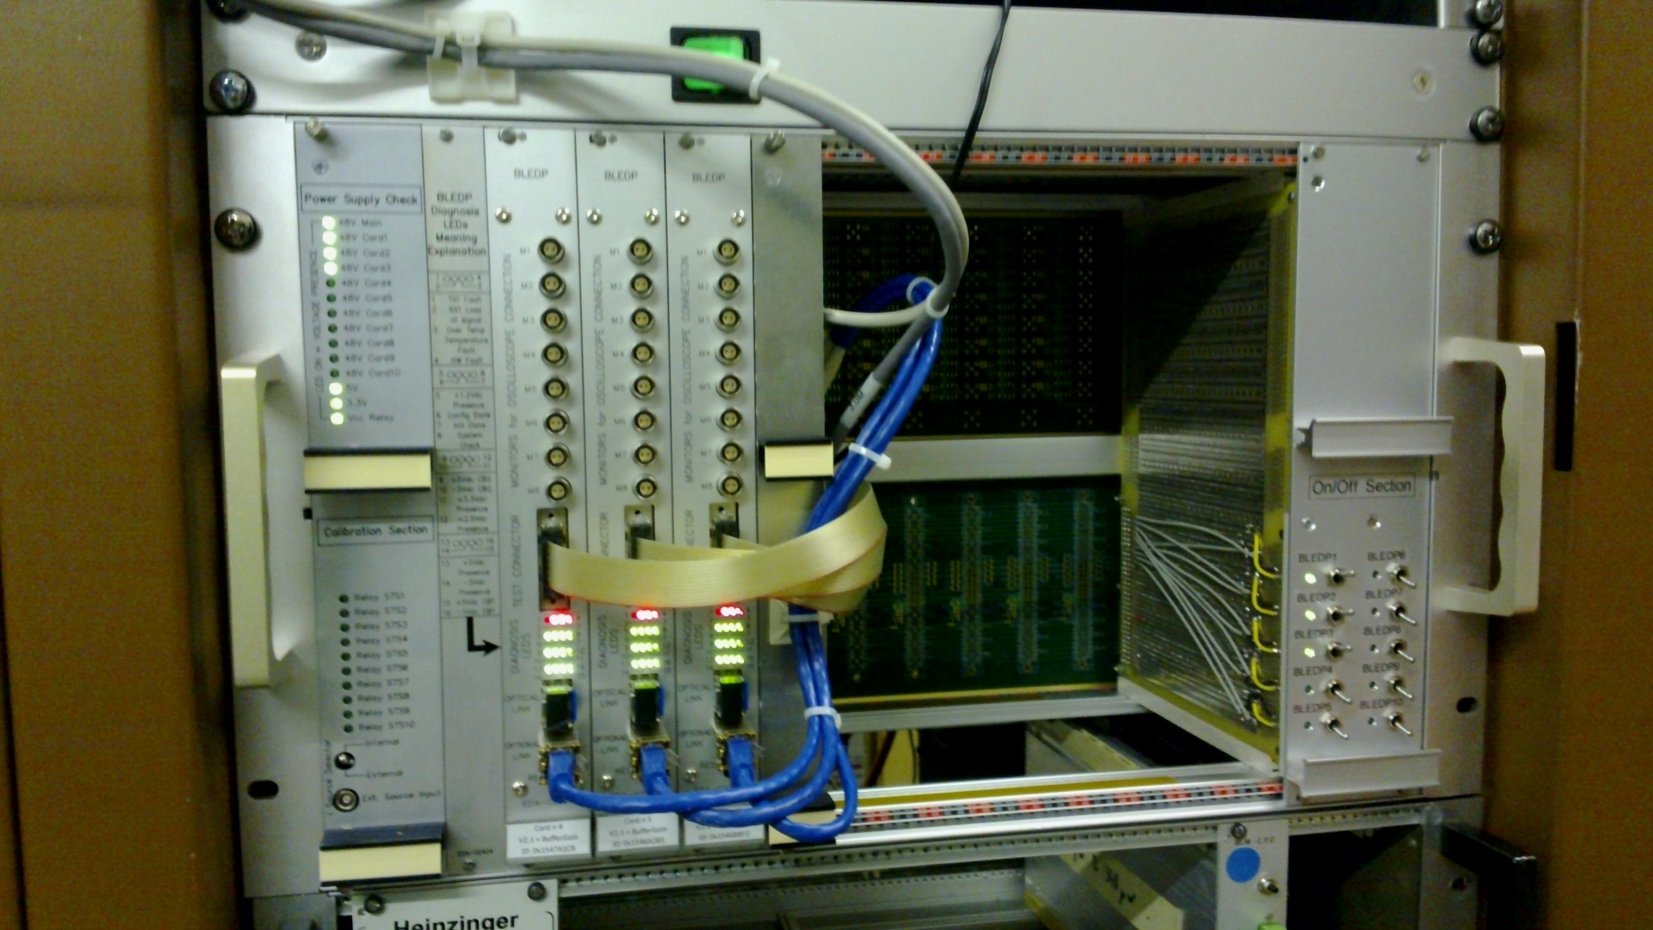
Test Installation in the PS
Ethernet Hub +
JTAG Chain programmer

Slide 20
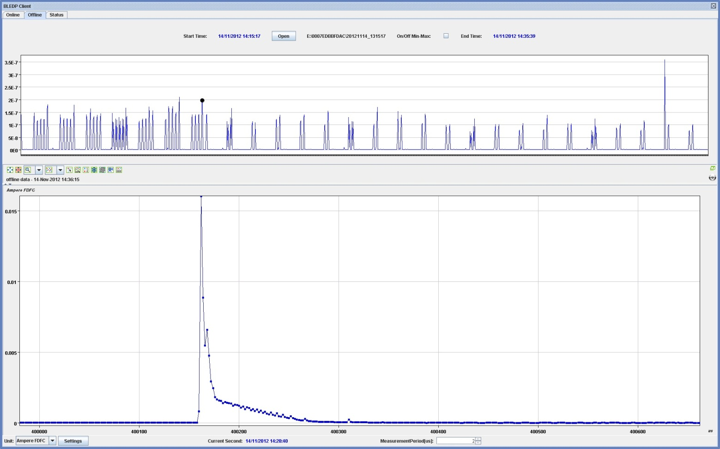
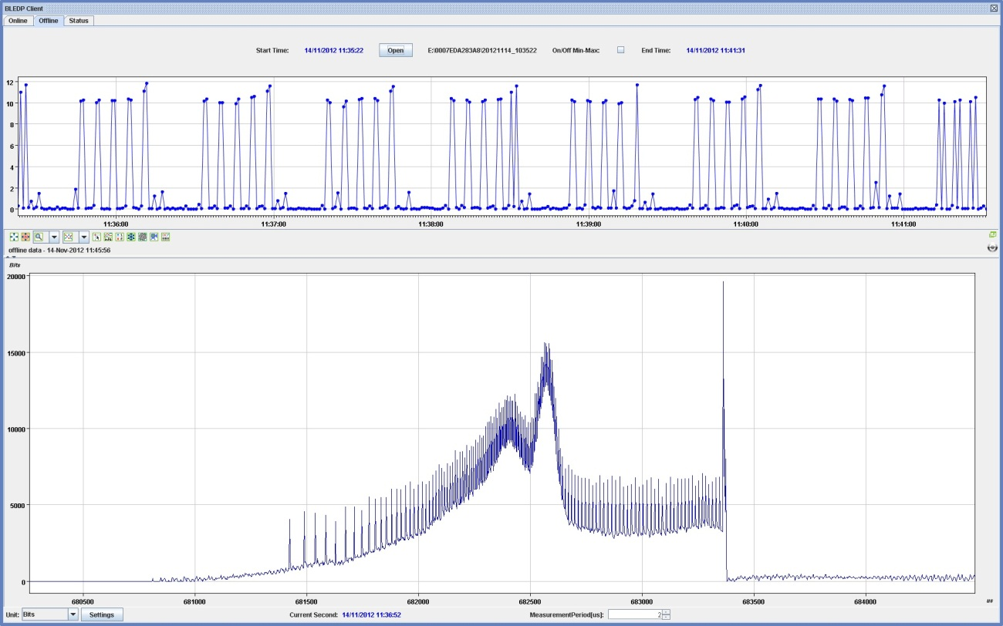
Acquisitions
Ionization Chamber
500.000 acquisition points
PEPII on MU16

Slide 21
Thank you

