Slide 1
Selection and annealing of magnetic materials for transformer cores
Silvia Aguilera – BE/BI/PI
BI Day
6th December 2012

Slide 2
Summary
Introduction
Objectives
Materials
Testing & Production
Results
Outlook & Conclusions

Slide 3
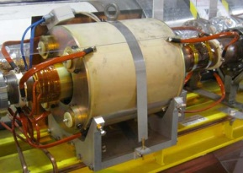
Introduction
Current transformers
Measure the intensity of the beam using magnetic toroids
Types :
DC Current Transformers (DCCTs) → 10 kHz
Fast Beam Current Transformers (FBCTs) → 100 Hz - 1 GHz
In development!
Integrating Current Transformer (ICT) → 100 Hz - 100 MHz
Introduction
Objectives
Materials
Testing
Production
Results
Outlook
Conclusions
Notes:
ICT: new LHC transformer to replace the FBCT in order to solve the beam position dependency issue

Slide 4
Introduction
Big procurement problem
Spare magnetic cores
Building new transformers
Introduction
Objectives
Materials
Testing
Production
Results
Outlook
Conclusions
Problems
Challenges
- Cost
- Specific properties
- Pairing
- Minimum Order Quantities
- Base properties
- Potential properties
Cores
Raw material

Slide 5
Introduction
Solution
Build our own cores!
Things to tackle:
Choice of material
Thermal treatment
Insulation
Introduction
Objectives
Materials
Testing
Production
Results
Outlook
Conclusions

Slide 6
Introduction
Requisites
Different transformers → different B-H curves
Introduction
Objectives
Materials
Testing
Production
Results
Outlook
Conclusions
Magnetization or hysteresis curve
H external magnetizing field
B magnetic induction
Notes:
Also called magnetization curve or hysteresis curve
H: applied external magnetizing field
B: total magnetic field
Magnetic hysteresis
Theoretical model of magnetization m against magnetic field h. Starting at the origin, the upward curve is the initial magnetization curve. The downward curve after saturation, along with the lower return curve, form the main loop. The intercepts h_{c} and m_{rs} are the coercivity and saturation remanence.
When an external magnetic field is applied to a ferromagnet such as iron, the atomic dipoles align themselves with it. Even when the field is removed, part of the alignment will be retained: the material has become magnetized. Once magnetized, the magnet will stay magnetized indefinitely. To demagnetize it requires heat or a magnetic field in the opposite direction. This is the effect that provides the element of memory in a hard disk drive.
The relationship between field strength H and magnetization M is not linear in such materials. If a magnet is demagnetized (H=M=0) and the relationship between H and M is plotted for increasing levels of field strength, M follows the initial magnetization curve. This curve increases rapidly at first and then approaches an asymptote called magnetic saturation. If the magnetic field is now reduced monotonically, M follows a different curve. At zero field strength, the magnetization is offset from the origin by an amount called the remanence. If the H-M relationship is plotted for all strengths of applied magnetic field the result is a hysteresis loop called the main loop. The width of the middle section is twice the coercivity of the material.^{[16]}
A closer look at a magnetization curve generally reveals a series of small, random jumps in magnetization called Barkhausen jumps. This effect is due to crystallographic defects such as dislocations

Slide 7
Introduction
Requisites
Different transformers → different B-H curves
Introduction
Objectives
Materials
Testing
Production
Results
Outlook
Conclusions
B
H
Notes:
Also called magnetization curve or hysteresis curve
H: applied external magnetizing field
B: total magnetic field
Magnetic hysteresis
Theoretical model of magnetization m against magnetic field h. Starting at the origin, the upward curve is the initial magnetization curve. The downward curve after saturation, along with the lower return curve, form the main loop. The intercepts h_{c} and m_{rs} are the coercivity and saturation remanence.
When an external magnetic field is applied to a ferromagnet such as iron, the atomic dipoles align themselves with it. Even when the field is removed, part of the alignment will be retained: the material has become magnetized. Once magnetized, the magnet will stay magnetized indefinitely. To demagnetize it requires heat or a magnetic field in the opposite direction. This is the effect that provides the element of memory in a hard disk drive.
The relationship between field strength H and magnetization M is not linear in such materials. If a magnet is demagnetized (H=M=0) and the relationship between H and M is plotted for increasing levels of field strength, M follows the initial magnetization curve. This curve increases rapidly at first and then approaches an asymptote called magnetic saturation. If the magnetic field is now reduced monotonically, M follows a different curve. At zero field strength, the magnetization is offset from the origin by an amount called the remanence. If the H-M relationship is plotted for all strengths of applied magnetic field the result is a hysteresis loop called the main loop. The width of the middle section is twice the coercivity of the material.^{[16]}
A closer look at a magnetization curve generally reveals a series of small, random jumps in magnetization called Barkhausen jumps. This effect is due to crystallographic defects such as dislocations

Slide 8
Introduction
Requisites
Different transformers → different B-H curves
Introduction
Objectives
Materials
Testing
Production
Results
Outlook
Conclusions
B
Saturation
Remanence: remaining magnetization when driving field is dropped to zero
H
Coercivity: reverse field needed to drive the magnetization to zero after saturation
Permeability

Slide 9
Introduction
Requisites
Different transformers → different B-H curves
FBCTs:
flat curve
not very high permeability
DCCTs:
rounded curve
high permeability
Introduction
Objectives
Materials
Testing
Production
Results
Outlook
Conclusions
B
H
B
H

Slide 10
Introduction
What are we looking for?
Introduction
Objectives
Materials
Testing
Production
Results
Outlook
Conclusions
B
Coercivity: reverse field needed to drive the magnetization to zero after saturation
H
Permeability
 | FBCT | DCCT | ICT
Permeability (@ 10 kHz) | 50 000 - 100 000 | 100 000 | 50 000
Coercivity [A/m] | As low as possible | ∼ 3 | ∼ 3

Slide 11
Introduction
What are we looking for?
Special Co-based or Fe-based alloys…
Normal alloy Amorphous Nanocrystalline
Introduction
Objectives
Materials
Testing
Production
Results
Outlook
Conclusions
Notes:
Zallen

Slide 12
Objectives
Find alloys to suit the desired magnetic properties for transformer cores
Find the parameters for the heat treatment to tailor these properties
Introduction
Objectives
Materials
Testing
Production
Results
Outlook
Conclusions

Slide 13
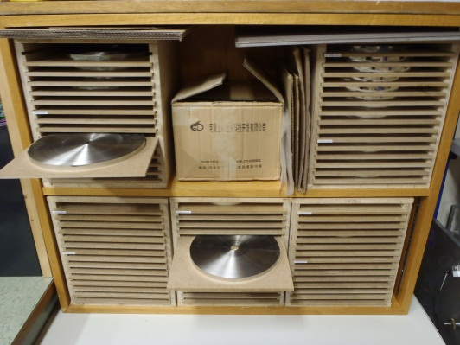
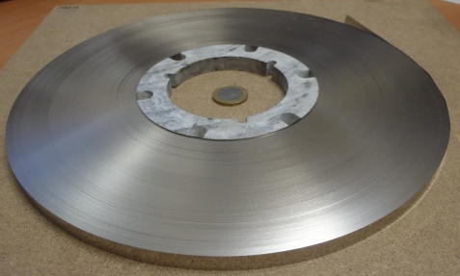
Materials
Ribbons
Metallic Alloys:
Amorphous Cobalt-based x 2
Amorphous Iron-based
Nanocrystalline Iron-based
Thickness ∼ 25 μm
Width = 10 mm
Introduction
Objectives
Materials
Testing
Production
Results
Outlook
Conclusions

Slide 14



Materials
Price comparison
Introduction
Objectives
Materials
Testing
Production
Results
Outlook
Conclusions
Origin | Material | Price [CHF/kg]
China | Fe-based amorphous | 9
 | Fe-based nanocrystalline | 9
 | Nanocrystalline “high quality” | 22
USA | Co-based amorphous | 214
Germany | Co-based amorphous (VAC 6025) | 392
Germany | Co-based amorphous (2714A) | 479

Slide 15
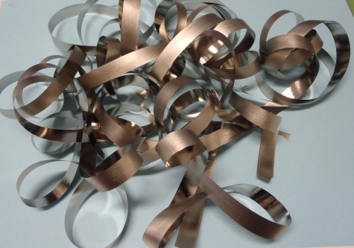
Testing
Materials - manufacturing cores
- Creation of cores to test the material
- Characteristics:
⋅ ∅_{outside} ∼ 45 mm
⋅ □ Section 10 mm x 10 mm
Introduction
Objectives
Materials
Testing
Production
Results
Outlook
Conclusions

Slide 16
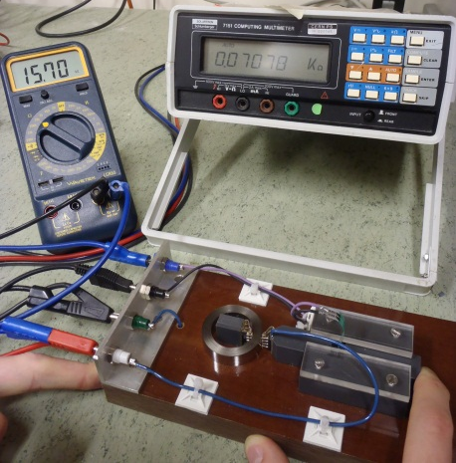
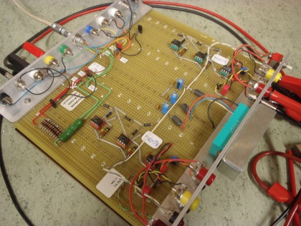
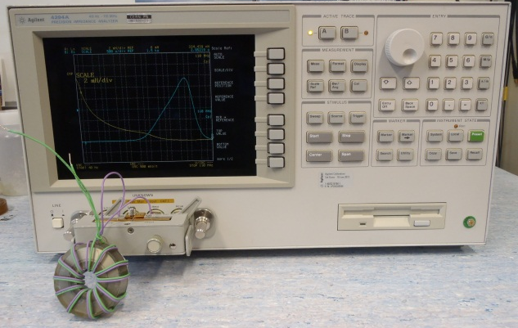
Testing
Measurements
B-H curve
Resistance of section
Impedance
Ferrofluid: magnetic nanostructure
Introduction
Objectives
Materials
Testing
Production
Results
Outlook
Conclusions

Slide 17
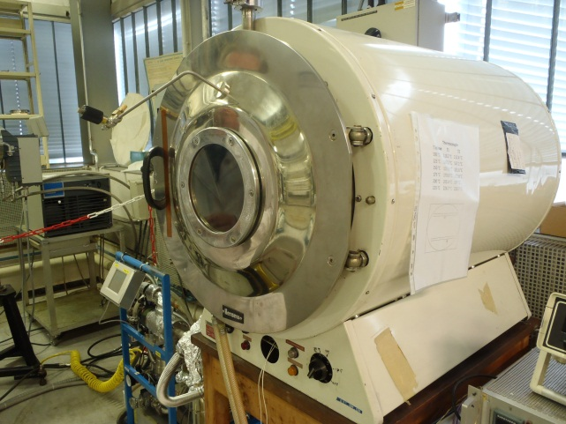
Production
Temperature
Annealing
What for?
Relieve internal stresses
Change B-H curve
Magnetic annealing → change B-H even more
Introduction
Objectives
Materials
Testing
Production
Results
Outlook
Conclusions
Time
Notes:
Definition: heat treatment where a material is altered, causing changes in its properties. It is a process that heats above a critical temperature, maintains it and then cools.

Slide 18
Production
Annealing - Temperature, pressure
Introduction
Objectives
Materials
Testing
Production
Results
Outlook
Conclusions
Notes:
Definition: heat treatment where a material is altered, causing changes in its properties. It is a process that heats above a critical temperature, maintains it and then cools.

Slide 19
Production
Annealing - Temperature
Introduction
Objectives
Materials
Testing
Production
Results
Outlook
Conclusions
1 hour @ 250 °C
Notes:
Definition: heat treatment where a material is altered, causing changes in its properties. It is a process that heats above a critical temperature, maintains it and then cools.

Slide 20
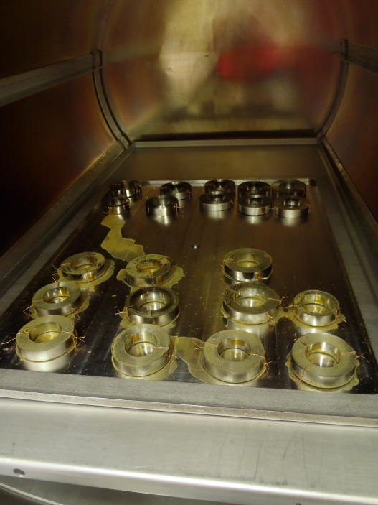
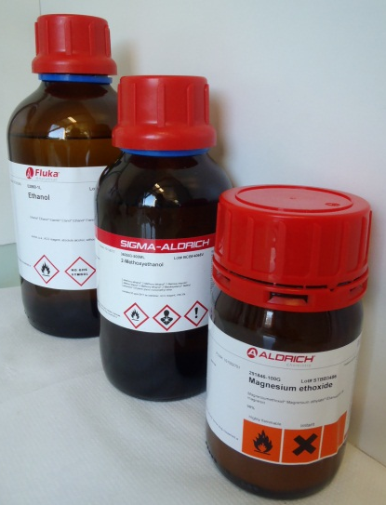
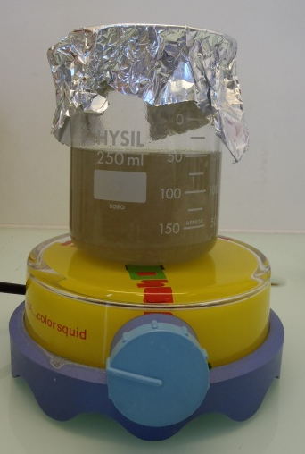
Production
Annealing - Insulation
Sol-gel method → ceramic insulation
Introduction
Objectives
Materials
Testing
Production
Results
Outlook
Conclusions
Notes:
Definition: heat treatment where a material is altered, causing changes in its properties. It is a process that heats above a critical temperature, maintains it and then cools.

Slide 21
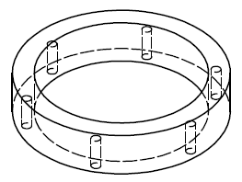
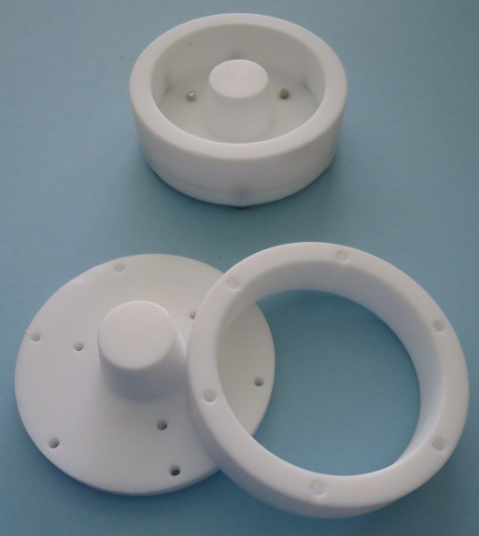
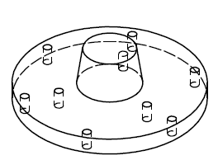
Production
Encapsulation
Moulds: design, fabrication
Introduction
Objectives
Materials
Testing
Production
Results
Outlook
Conclusions

Slide 22
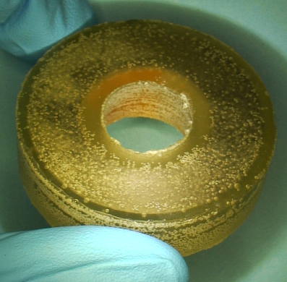
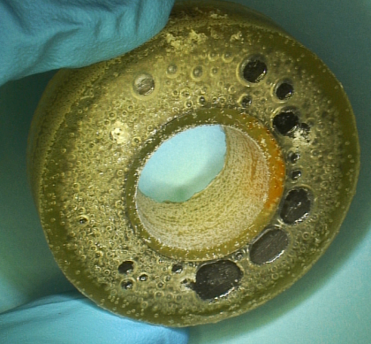
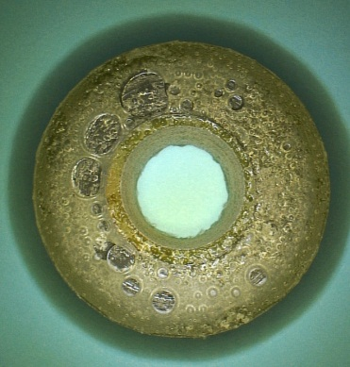
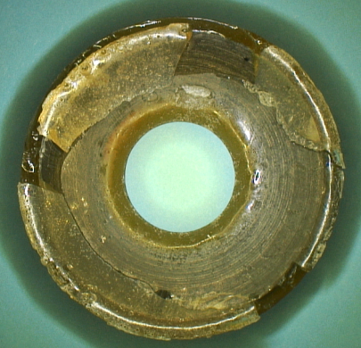
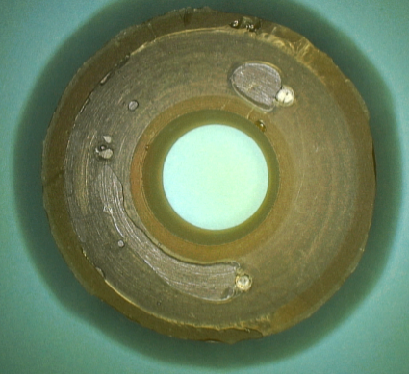
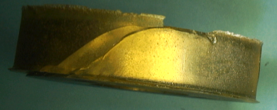
Production
First tests - not very encouraging
Introduction
Objectives
Materials
Testing
Production
Results
Outlook
Conclusions
Polyurethane
(PU)
Epoxy

Slide 23

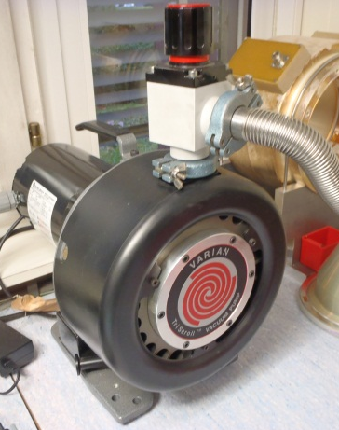
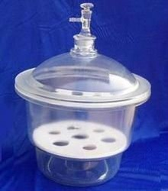
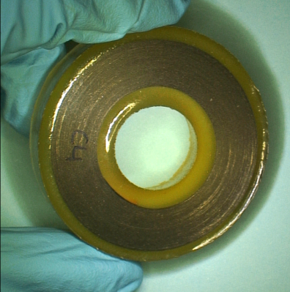
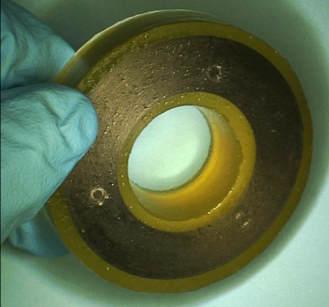
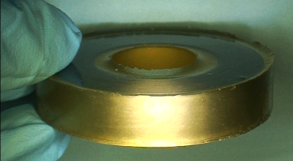
Production
Merci Morad!
Vacuum is our friend!
Introduction
Objectives
Materials
Testing
Production
Results
Outlook
Conclusions
+

Slide 24
Results
Permeability
Introduction
Objectives
Materials
Testing
Production
Results
Outlook
Conclusions
Origin | Material | Max. permeability
China | Fe-based amorphous | 2650
 | Fe-based nanocrystalline | 2610
 | Nanocrystalline “high quality” | 4200
USA | Co-based amorphous | 134 000
Germany | Co-based amorphous (VAC 6025) | 64 000

Slide 25
Results
Co-based amorphous - comparison
Introduction
Objectives
Materials
Testing
Production
Results
Outlook
Conclusions

Slide 26
Results
Co-based amorphous
Introduction
Objectives
Materials
Testing
Production
Results
Outlook
Conclusions

Slide 27
Results
Co-based amorphous
Introduction
Objectives
Materials
Testing
Production
Results
Outlook
Conclusions

Slide 28
Results
Co-based amorphous - insulation
Introduction
Objectives
Materials
Testing
Production
Results
Outlook
Conclusions

Slide 29
Outlook
Exciting future!
New material
New insulation (Kapton)
New annealing tests (Time, Temperature)
New measurements (Ferrofluid)
Introduction
Objectives
Materials
Testing
Production
Results
Outlook
Conclusions

Slide 30
Conclusions
Introduction
Objectives
Materials
Testing
Production
Results
Outlook
Conclusions
Best material candidate: Co-based alloys
Insulation: another approach for sol-gel
Annealing: rounded B-H curves
Encapsulation: Polyurethane

Slide 31




Acknowledgements
Material characterization: S. Sgobba, M. Scheubel, M. Czapski, D. J. Marcinek
Sol-Gel: B. Teissandier, C. Charvet, D. Letant-Delrieux
Annealing: W. Vollenberg
Moulds, encapsulation: L’atelier, F. Camba, M. Hamani
Thanks to today’s organisers!

Slide 32
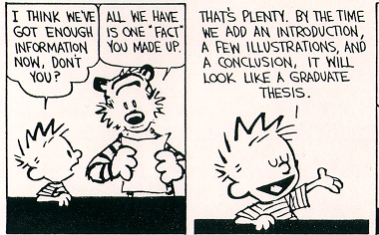

Thank you for your attention
Questions!

