Slide 1



The HIE-ISOLDE Faraday Cup
BI Day
December 6, 2012
Alejandro Garcia Sosa
W. Andreazza, E. Bravin, E. Daniel Cantero, M. Fraser, Y. Kadi, D. Lanaia, D. Voulot, F. Wenander

Slide 2
Contents
Introduction to HIE-ISOLDE
The short diagnostic boxes
Review of Faraday cups
The HIE-ISOLDE Faraday cup
Simulations
Experimental Tests
Conclusions

Slide 3
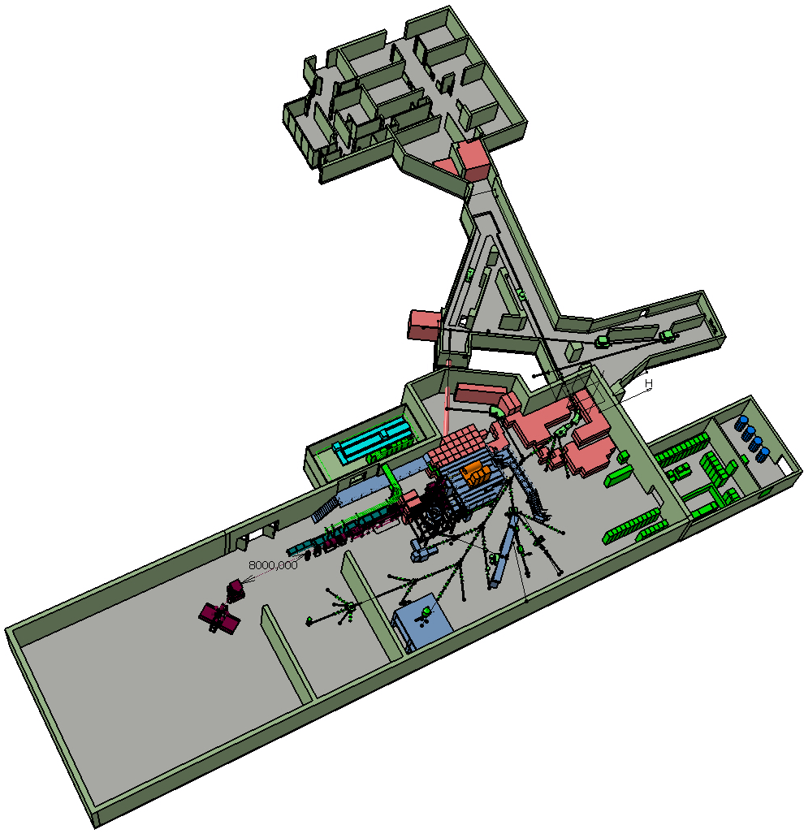
1. Introduction to HIE-ISOLDE
Intensity upgrade
LINAC4+PSB
Design Study of target area, Class-A lab and beam lines
Energy upgrade
10 MeV/u
Construction of SC LINAC
+ service buildings
Beam quality upgrade
RFQ cooler and buncher
Solid state lasers for RILIS
Higher mass resolving
power HRS

Slide 4
1. Introduction to HIE-ISOLDE
Intensity upgrade
LINAC4+PSB
Design Study of target area, Class-A lab and beam lines
Energy upgrade
10 MeV/u
Construction of SC LINAC
+ service buildings
Beam quality upgrade
RFQ cooler and buncher
Solid state lasers for RILIS
Higher mass resolving
power HRS

Slide 5
1. Introduction to HIE-ISOLDE
Intensity upgrade
LINAC4+PSB
Design Study of target area, Class-A lab and beam lines
Energy upgrade
10 MeV/u
Construction of SC LINAC
+ service buildings
Beam quality upgrade
RFQ cooler and buncher
Solid state lasers for RILIS
Higher mass resolving
power HRS

Slide 6
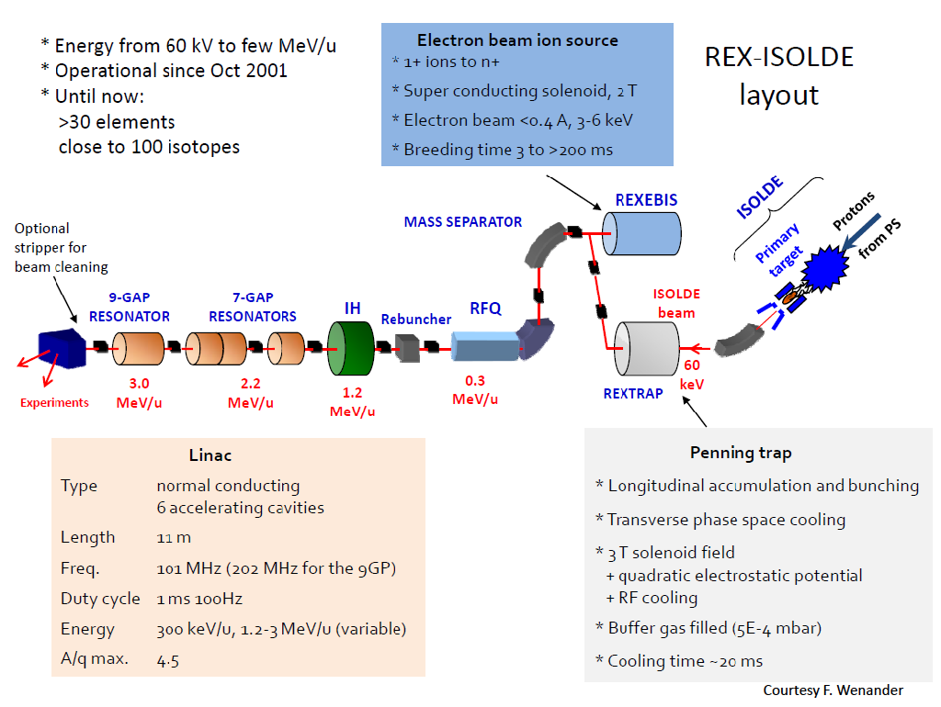

Slide 7
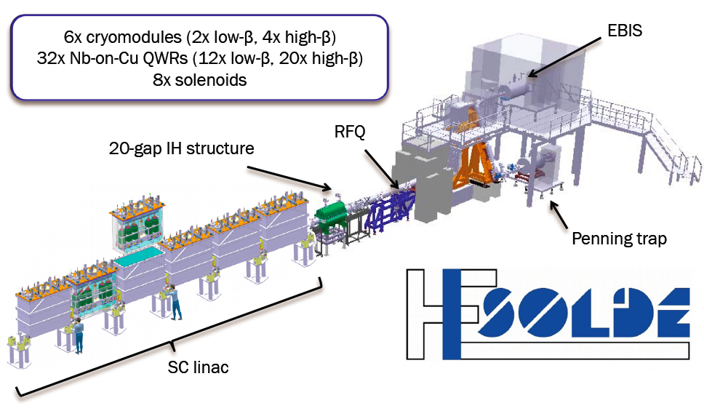
2. The short diagnostic boxes

Slide 8
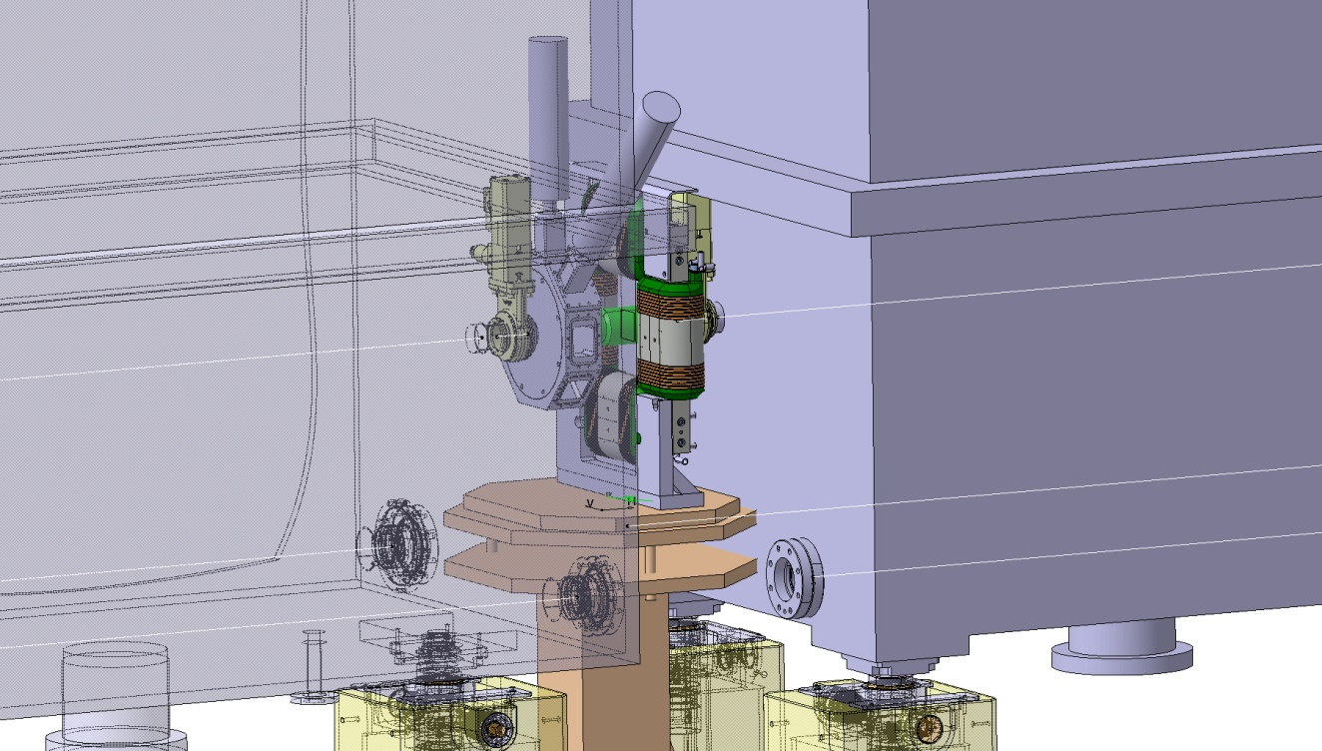
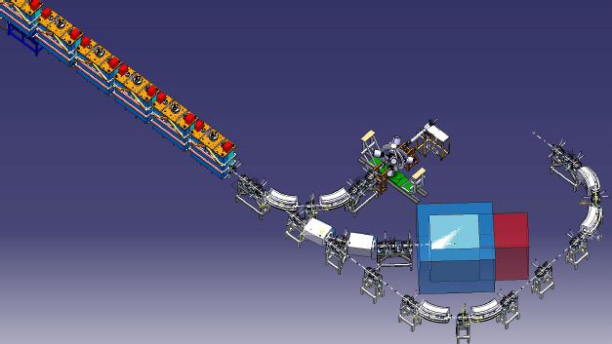
2. The short diagnostic boxes
Vacuum valves
Class 100
ISO 5
Steerer magnet
Short diagnostic box
Notes:
Intertank distance: 320 mm from valve to valve, 420 including the flanges of the tanks.

Slide 9
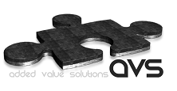
2. The short diagnostic boxes
Currently being developed by CERN and Added Value Solutions (AVS) with the support of the Spanish government (CDTI)
The device fits in the 90 mm long space available and contains
  A 45 degree scanning blade with 2 slits (H, V)
  HIE-ISOLDE Faraday cup
  Solid-state detector (Absolute energy, ToF)
  Collimators blade
  Attenuating and stripping foils

Slide 10
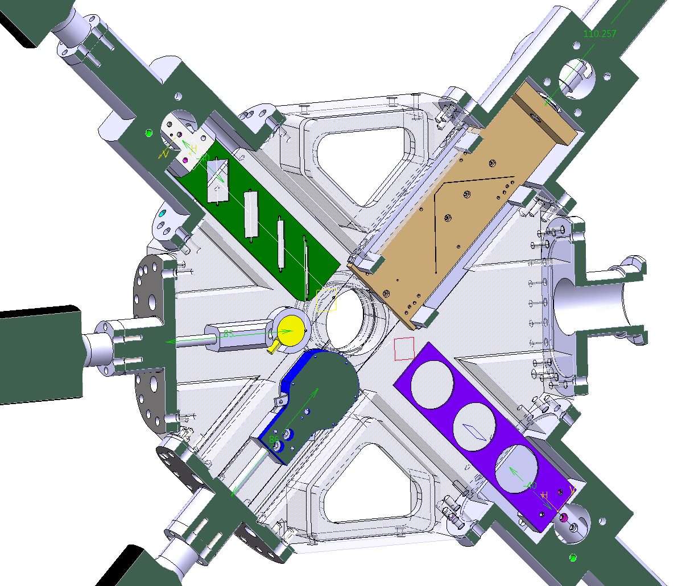
Beam

Slide 11
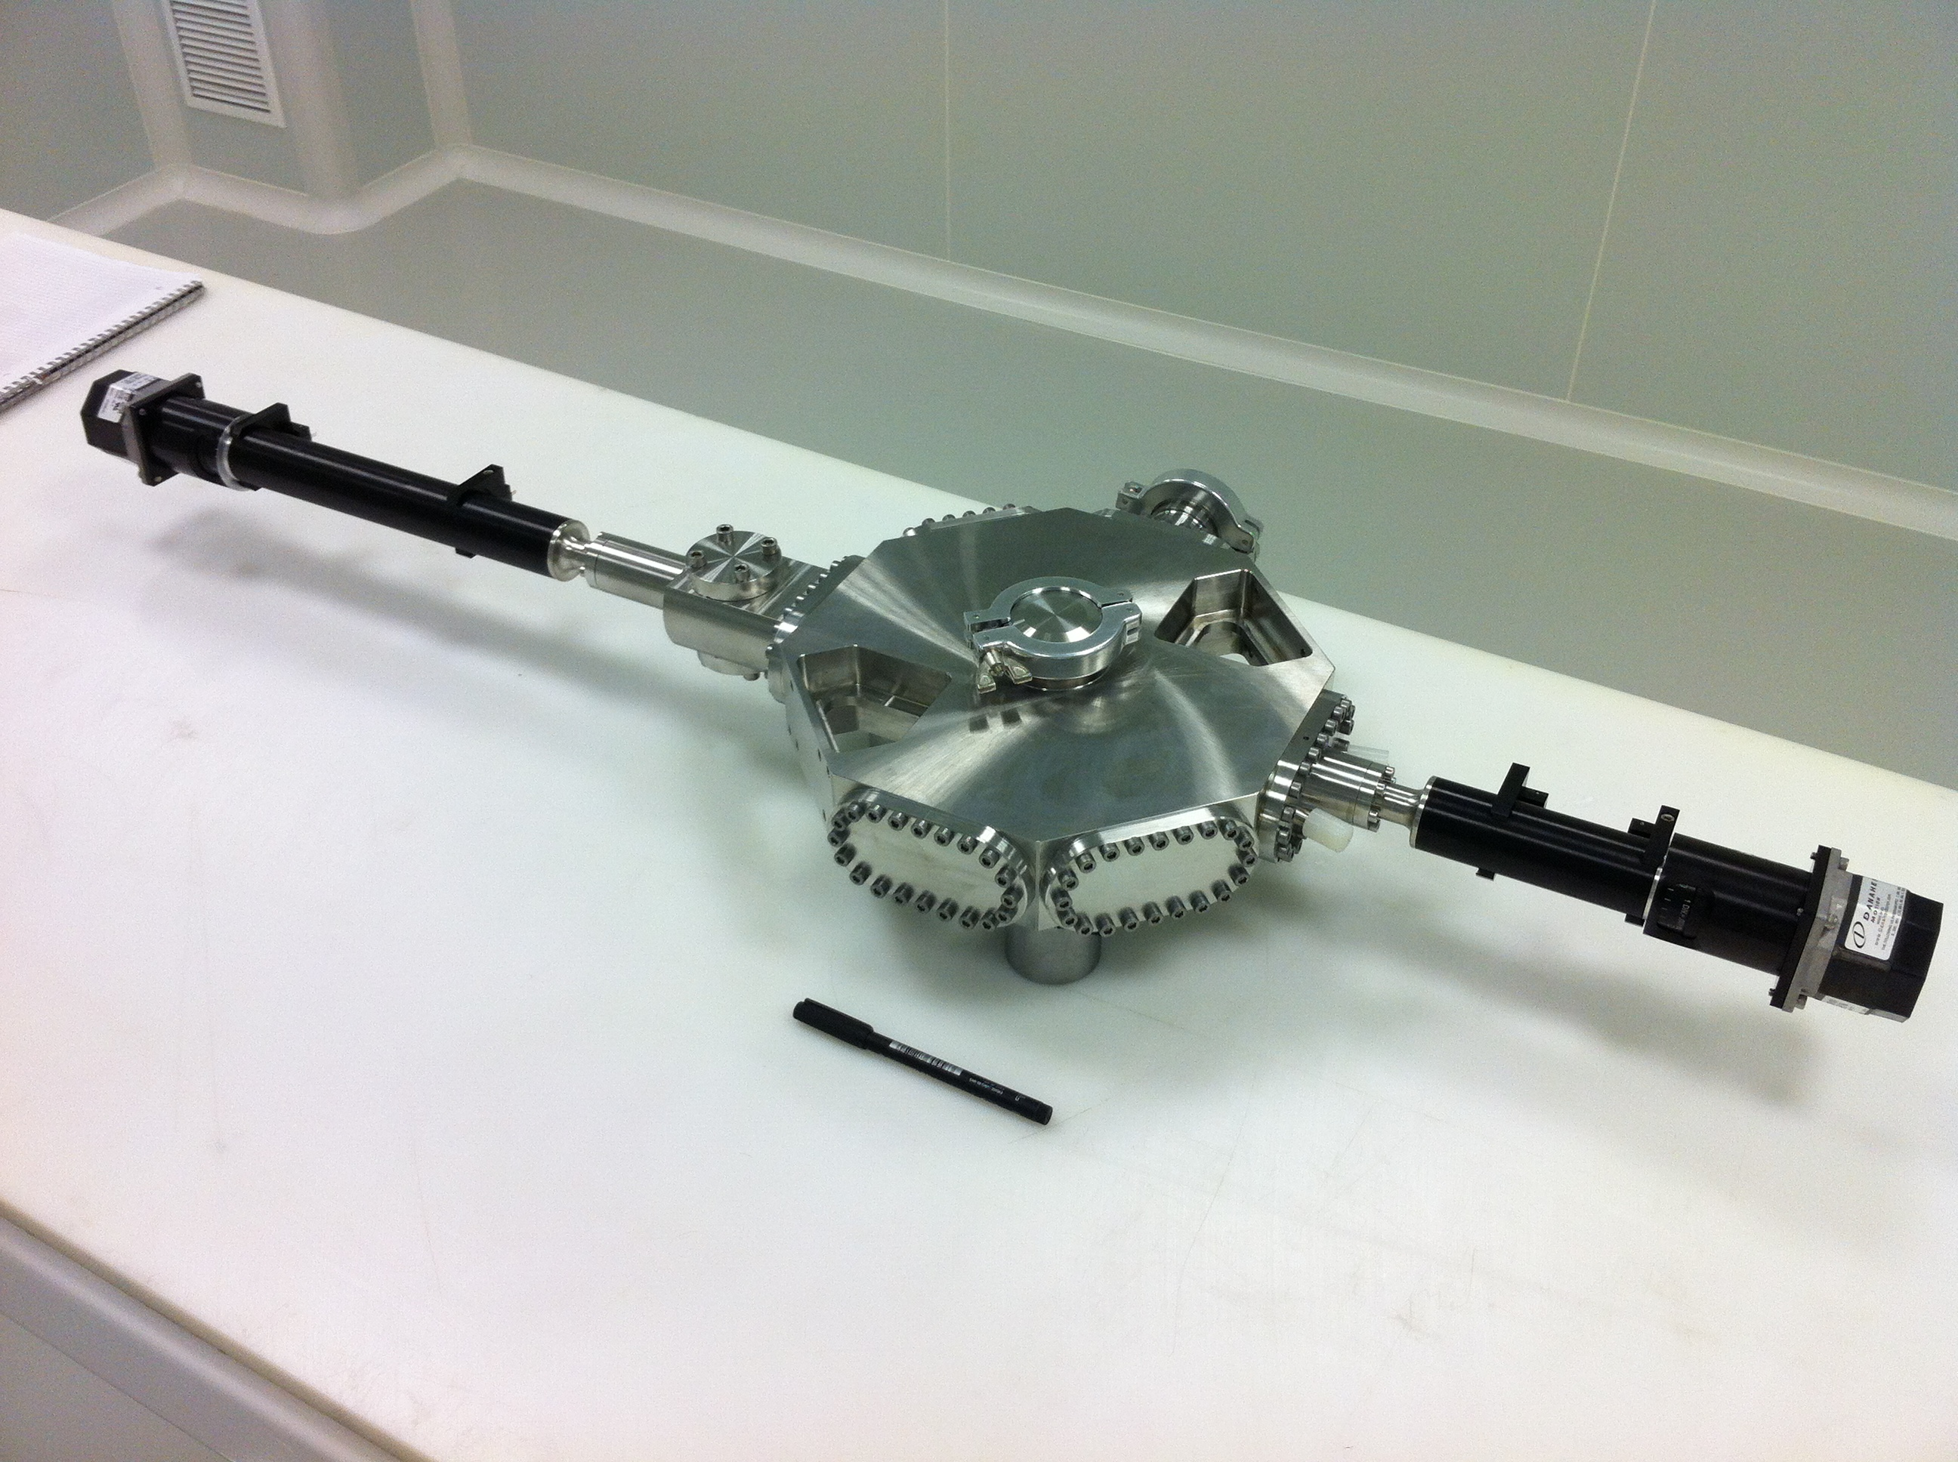

Slide 12
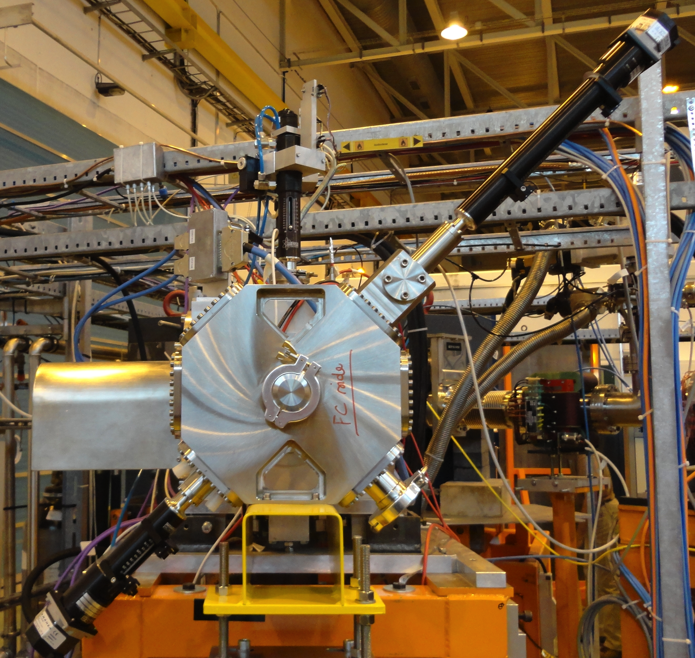

Slide 13
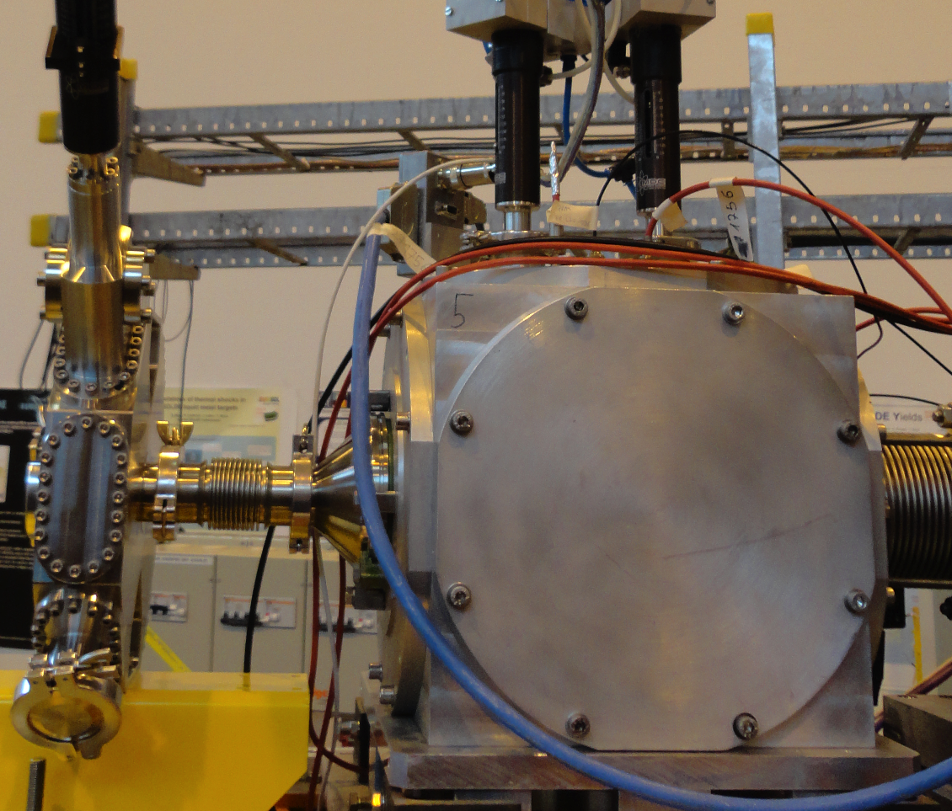

Slide 14
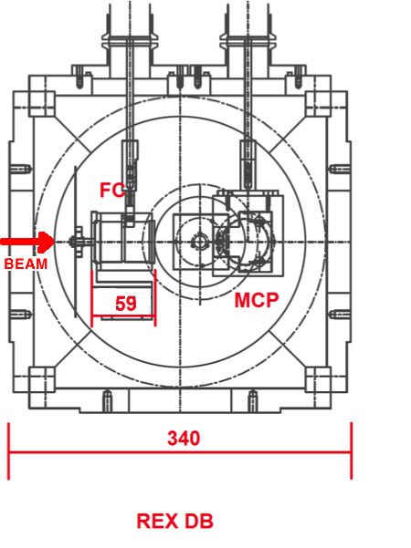
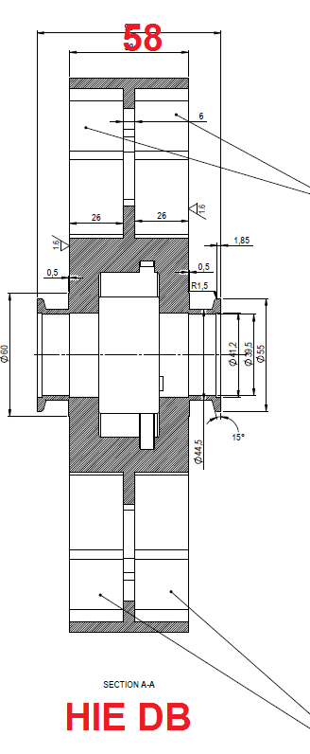
REX vs HIE - DBs
HIE - Faraday cup (14 mm)
Scanning slits (beam profile)
Collimators (optics)
Stripping foils in some cases
Solid-state detector in a few boxes (absolute energy, TOF)
REX - Faraday cup (length: 59 mm)
MCP (beam profile - image) or Si detector (energy and TOF)
Collimators wheel (attenuating and stripping foils as well)
The most important device that needs to be tested is the FC

Slide 15
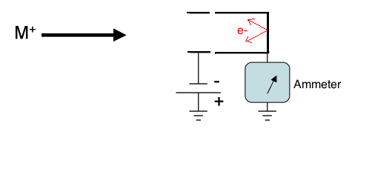
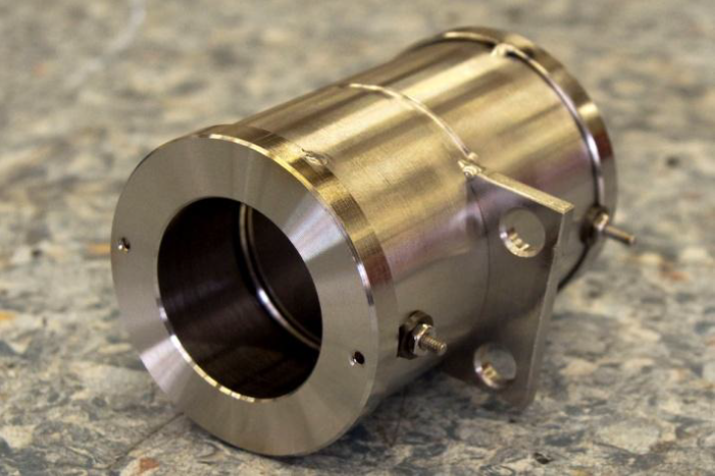
3. Review of Faraday cups
Destructive measurement
Measures absolute beam current
The escape of electrons
increases the value read
in the picoammeter.
Ion-induced electron emission:
  Low energy electrons (E_{e} < 20 eV)
  High energy electrons (E_{e} ~ keV for MeV/u ions)

Slide 16
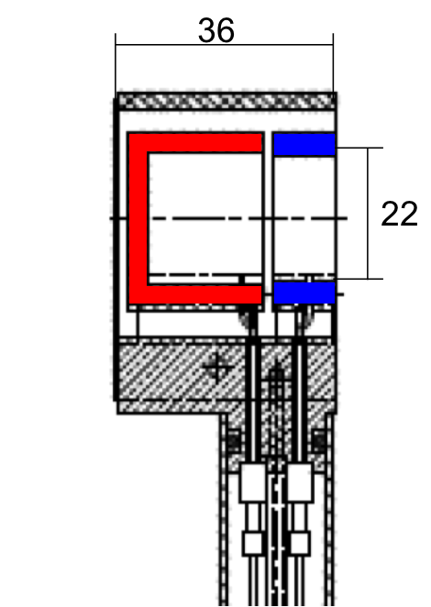
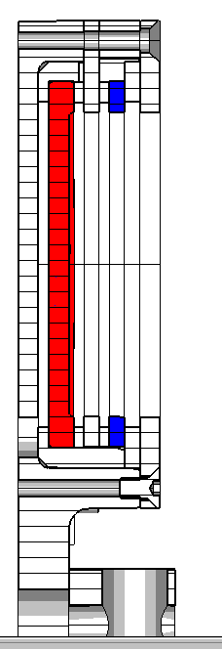
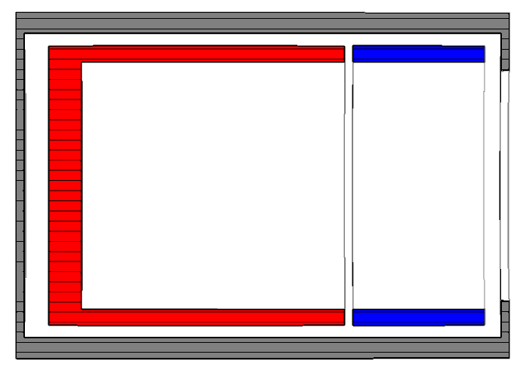
4. The HIE-ISOLDE Faraday cup
HIE-ISOLDE
REX-ISOLDE
ISAC 2
14
59
30
26
(Distances in mm)

Slide 17
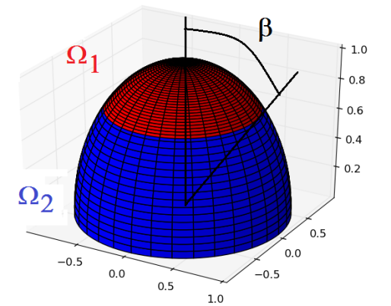
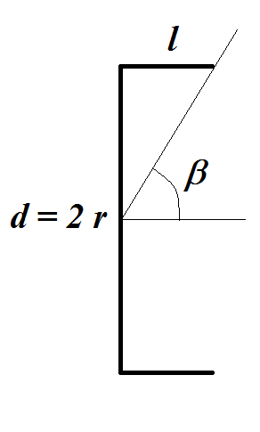
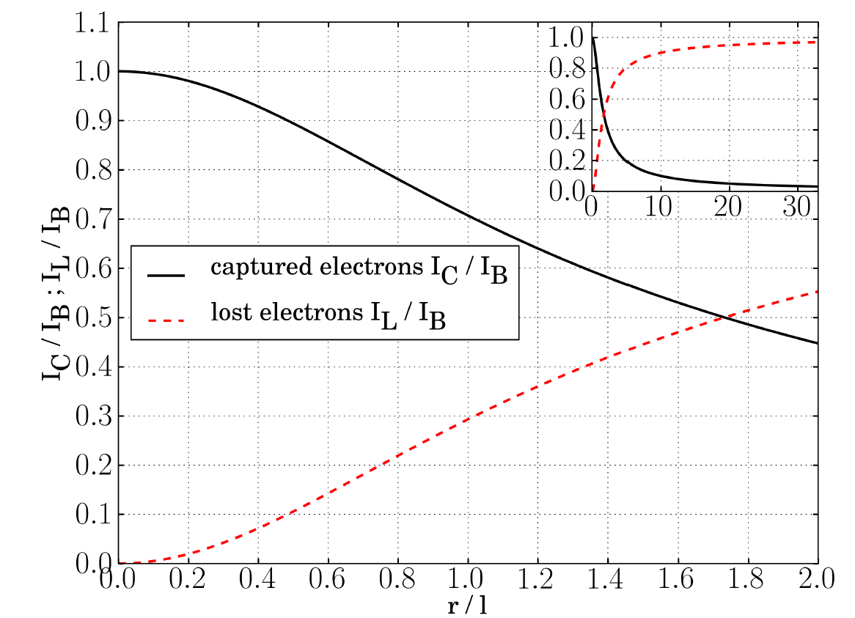
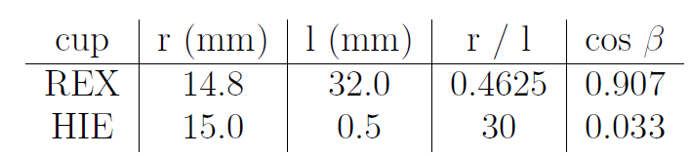
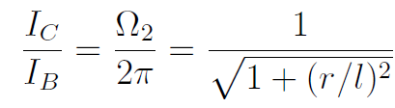
Electrons captured and retained Intensity: solid angle of the signal plate
In a simplified model:
Ω₂ → retained electrons
Ω₁ → lost electrons
Signal plate
geometry

Slide 18
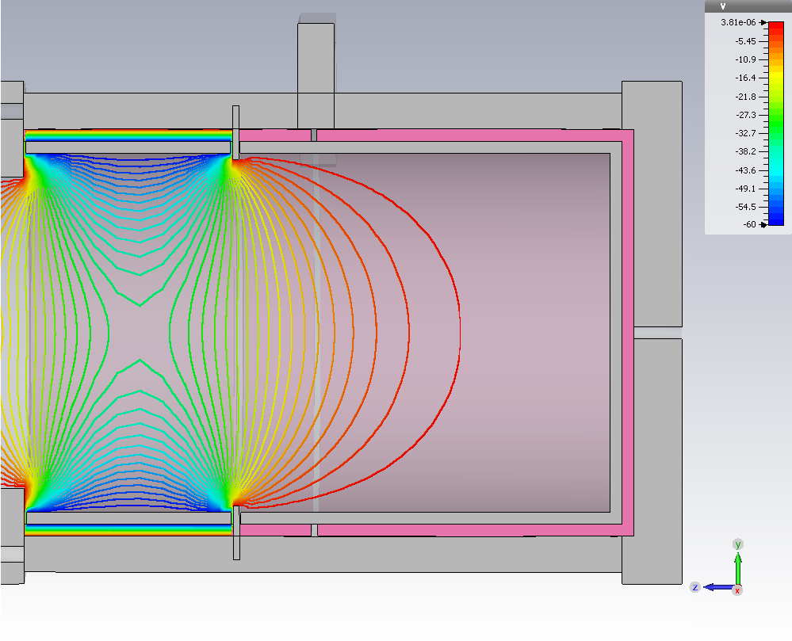

5. Simulations
REX-ISOLDE Faraday cup potential distribution -60 V

Slide 19
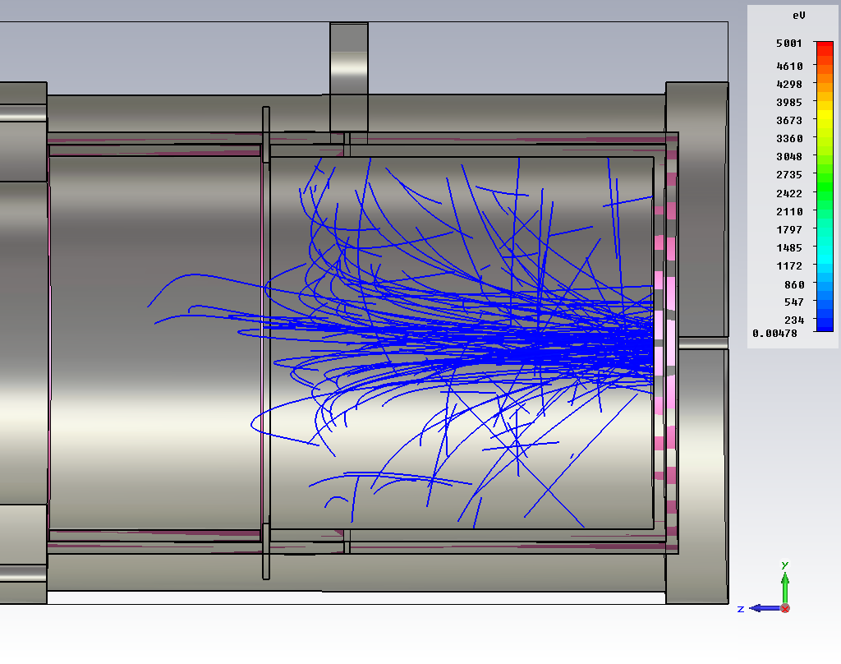
5. Simulations
REX-ISOLDE Faraday cup secondary e- tracking

Slide 20
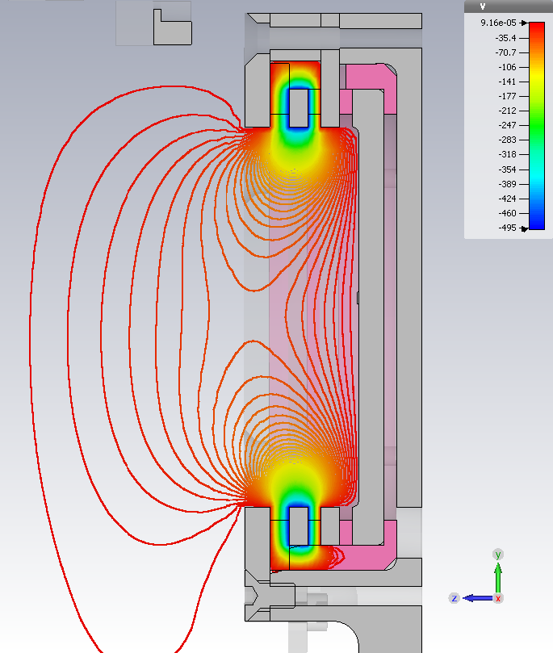
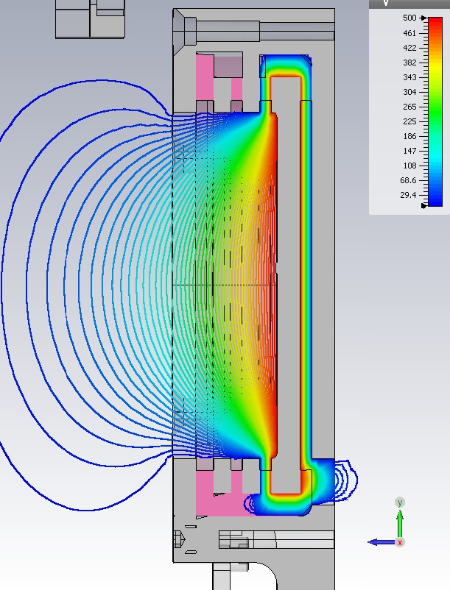
5. Simulations
More uniform potential distribution
Enhanced effectiveness
HIE-ISOLDE Faraday cup: -500V +100V

Slide 21
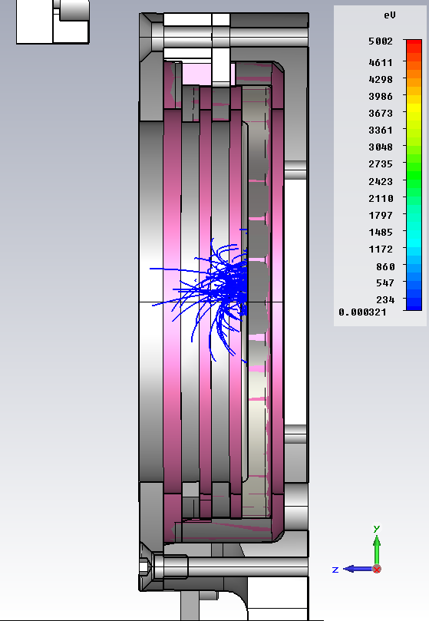
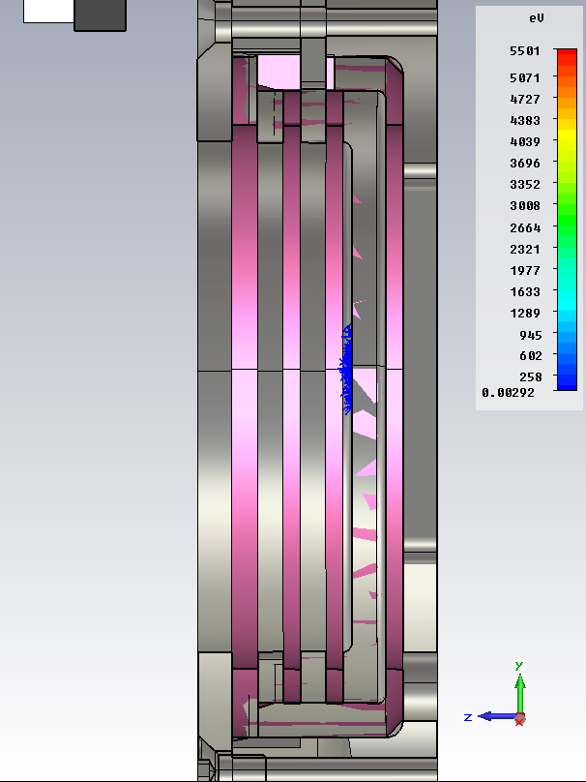
5. Simulations

Slide 22
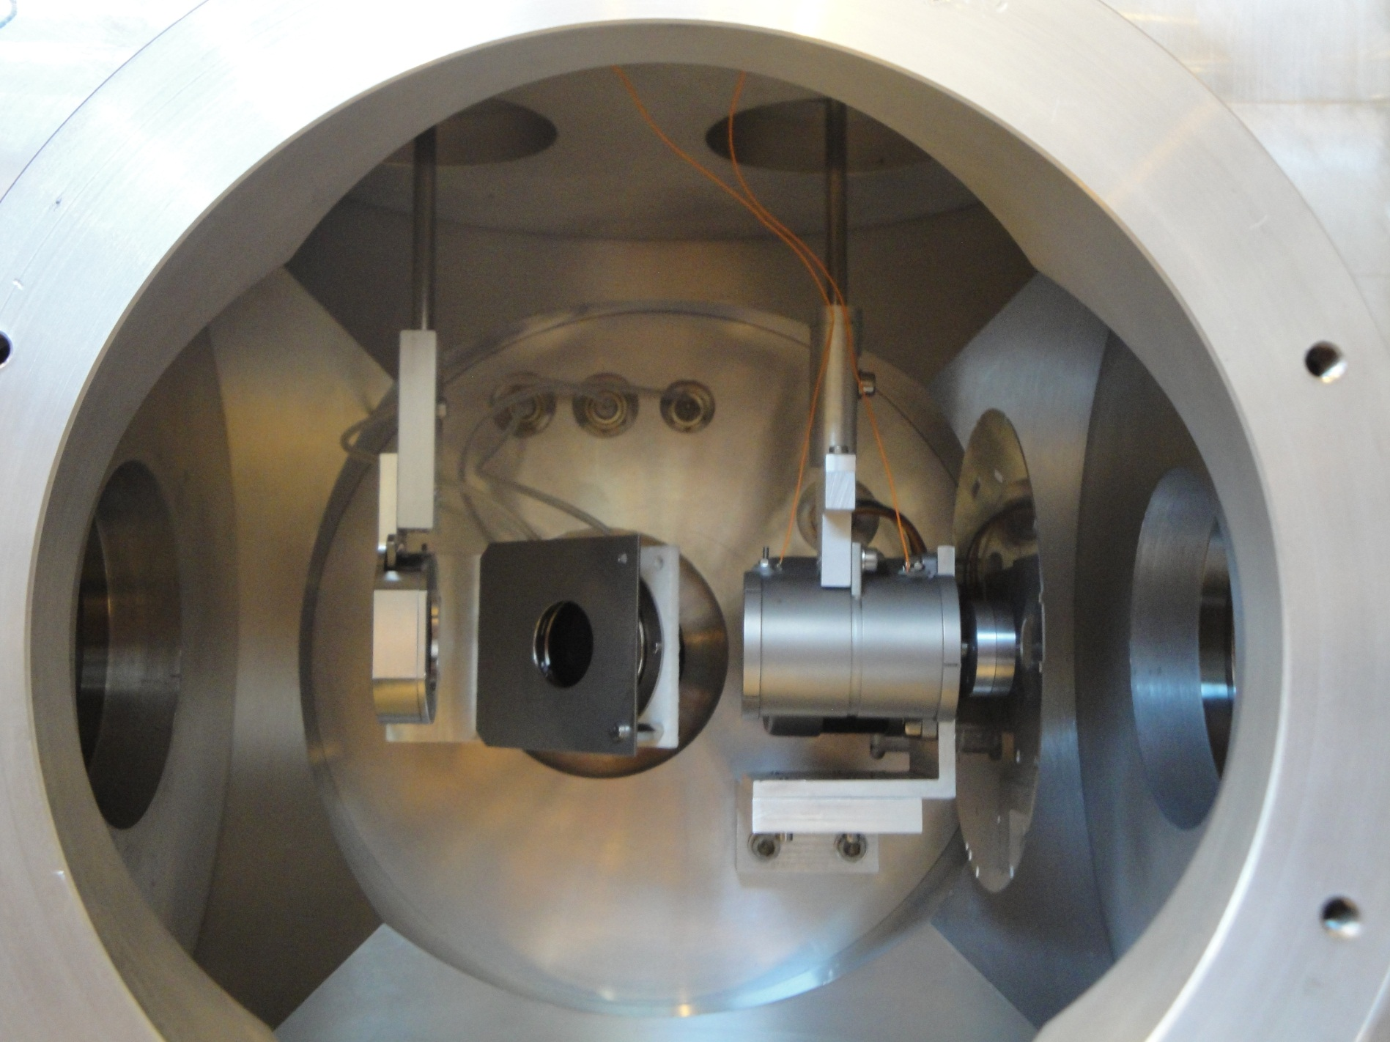
6. Experimental tests

Slide 23
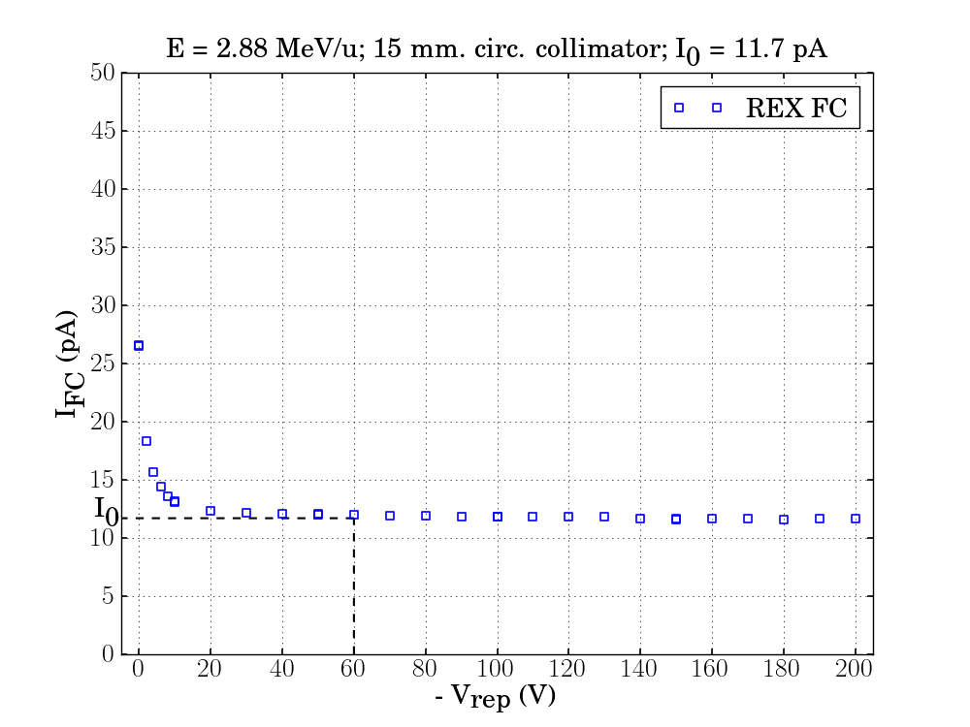
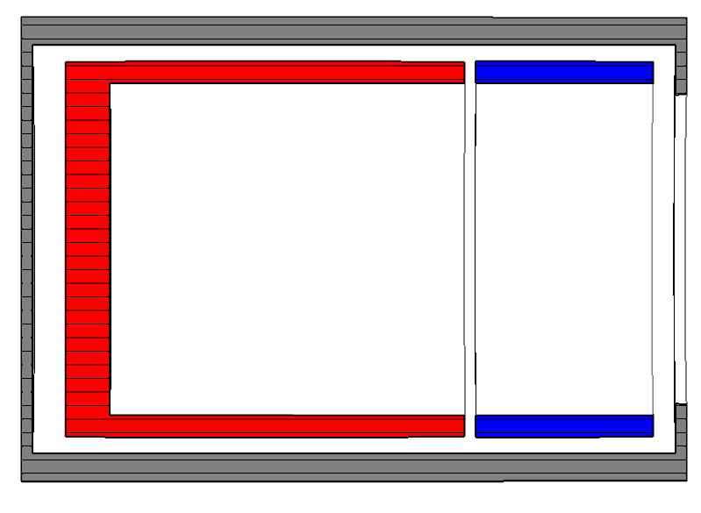
Definition of I0
stable beam
A/Q =4
V_{signal plate} = 0 V
V_{repeller} < 0 V (variable).
Signal
Plate
Repeller

Slide 24
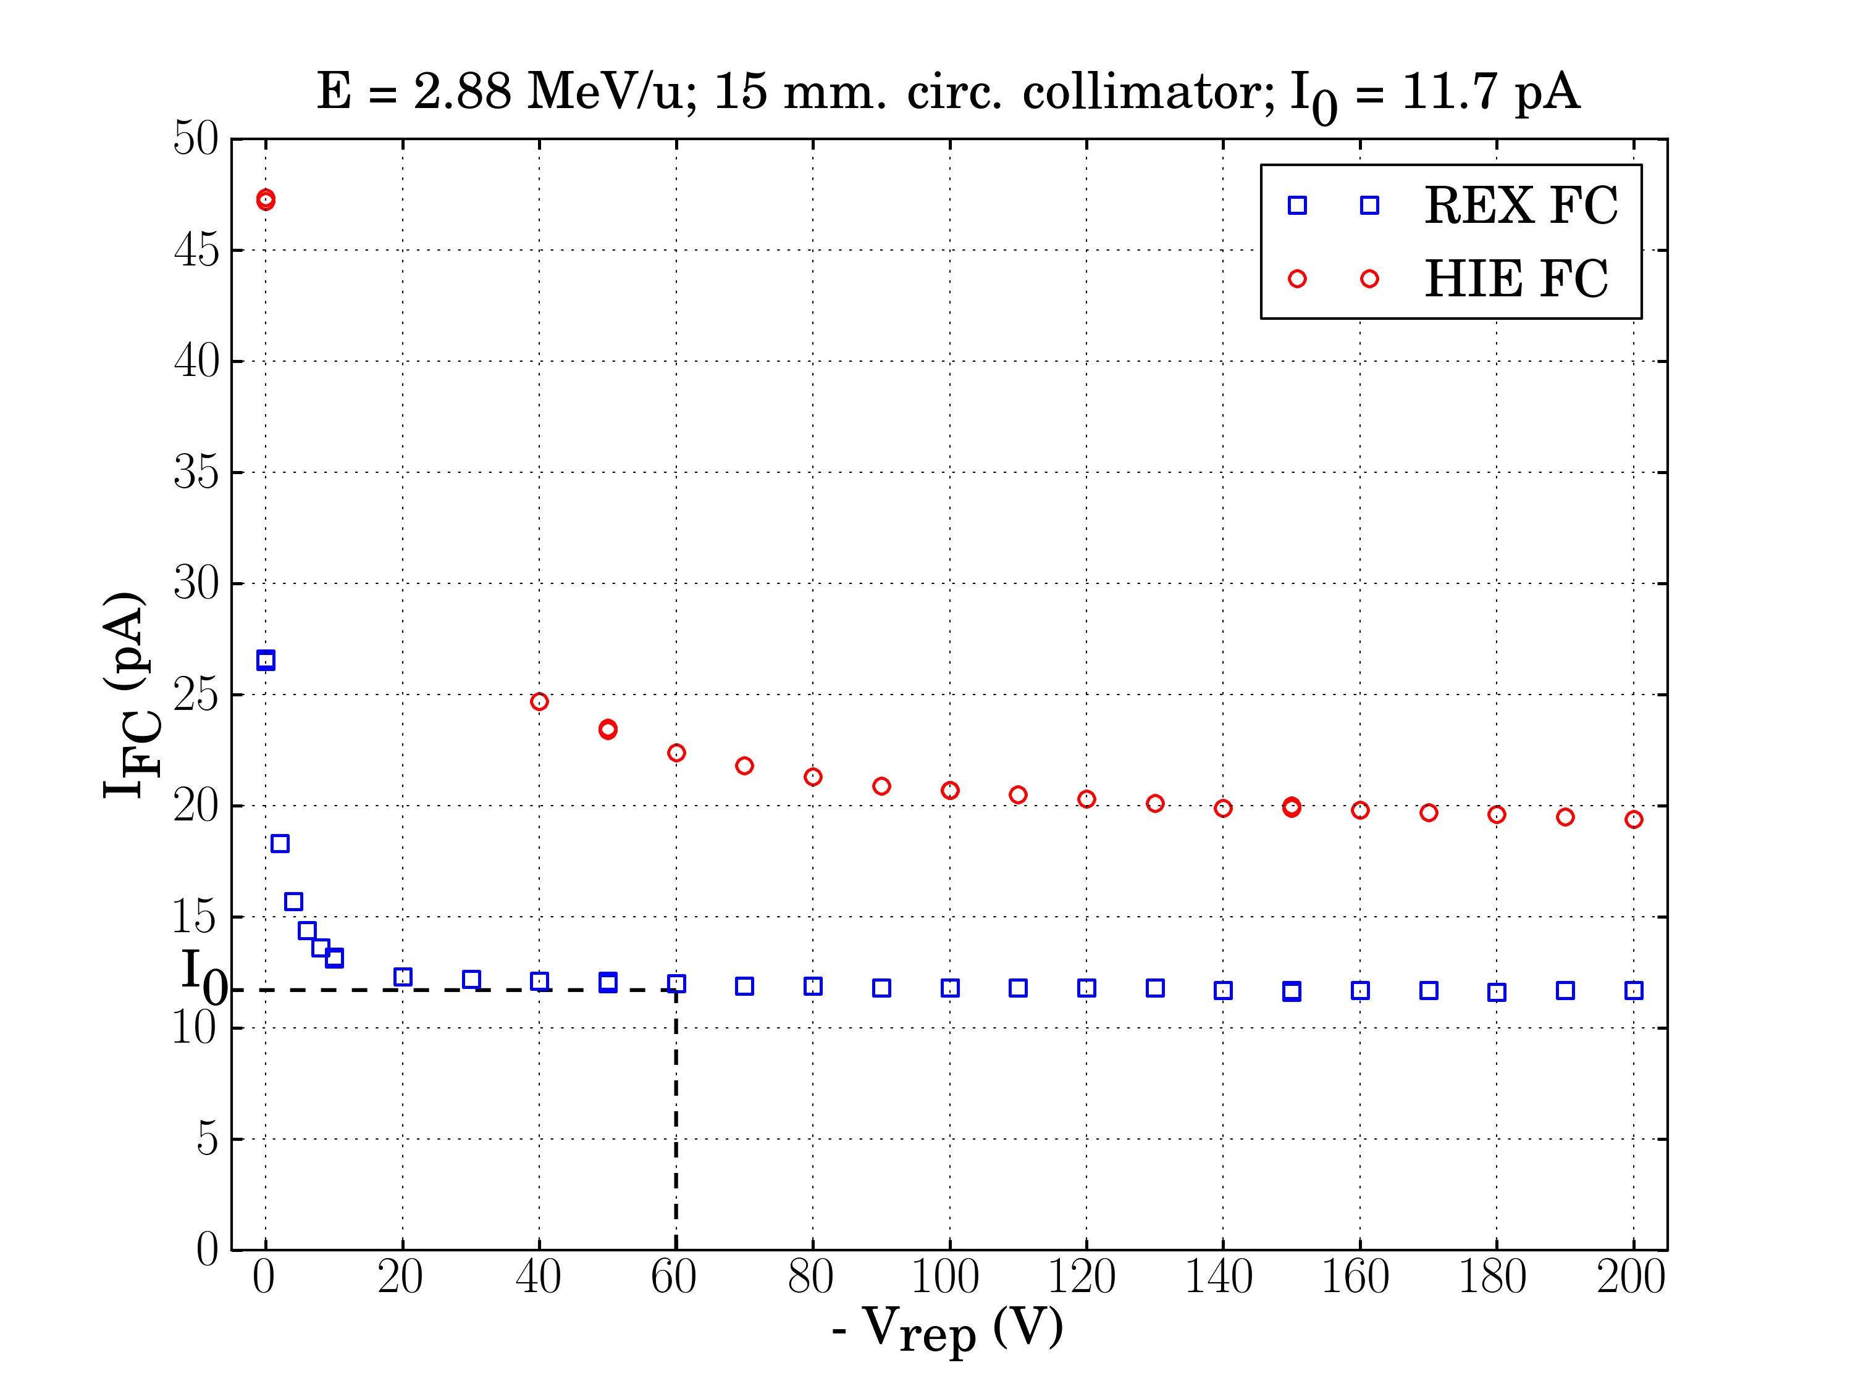
Biasing the repeller ring
stable beam
A/Q =4
V_{signal plate} = 0 V
V_{repeller} < 0 V (variable).
Signal
Plate
Repeller ring
The short cup does not measure the same current value and needs much higher repelling voltage.
Ground ring

Slide 25
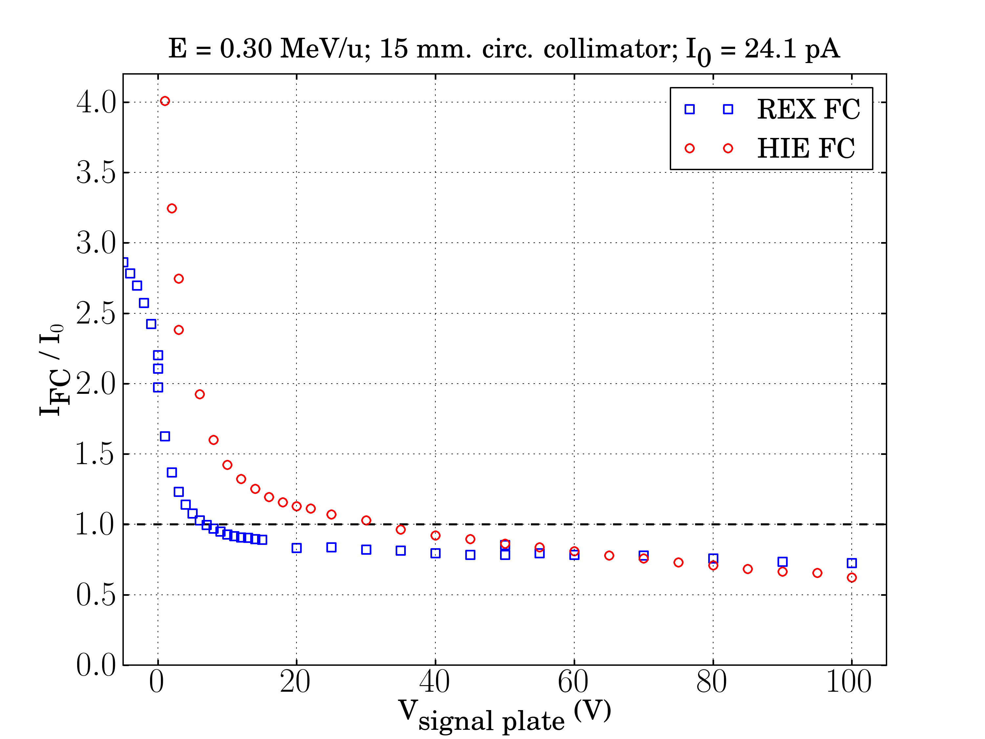
Biasing the signal plate
stable beam
A/Q =4
V_{signal plate} > 0 V (variable).
V_{repeller} = 0 V
Signal
Plate
Repeller ring
High leakage current
Beam current does not reach a current plateau increasing the voltage
Ground ring

Slide 26
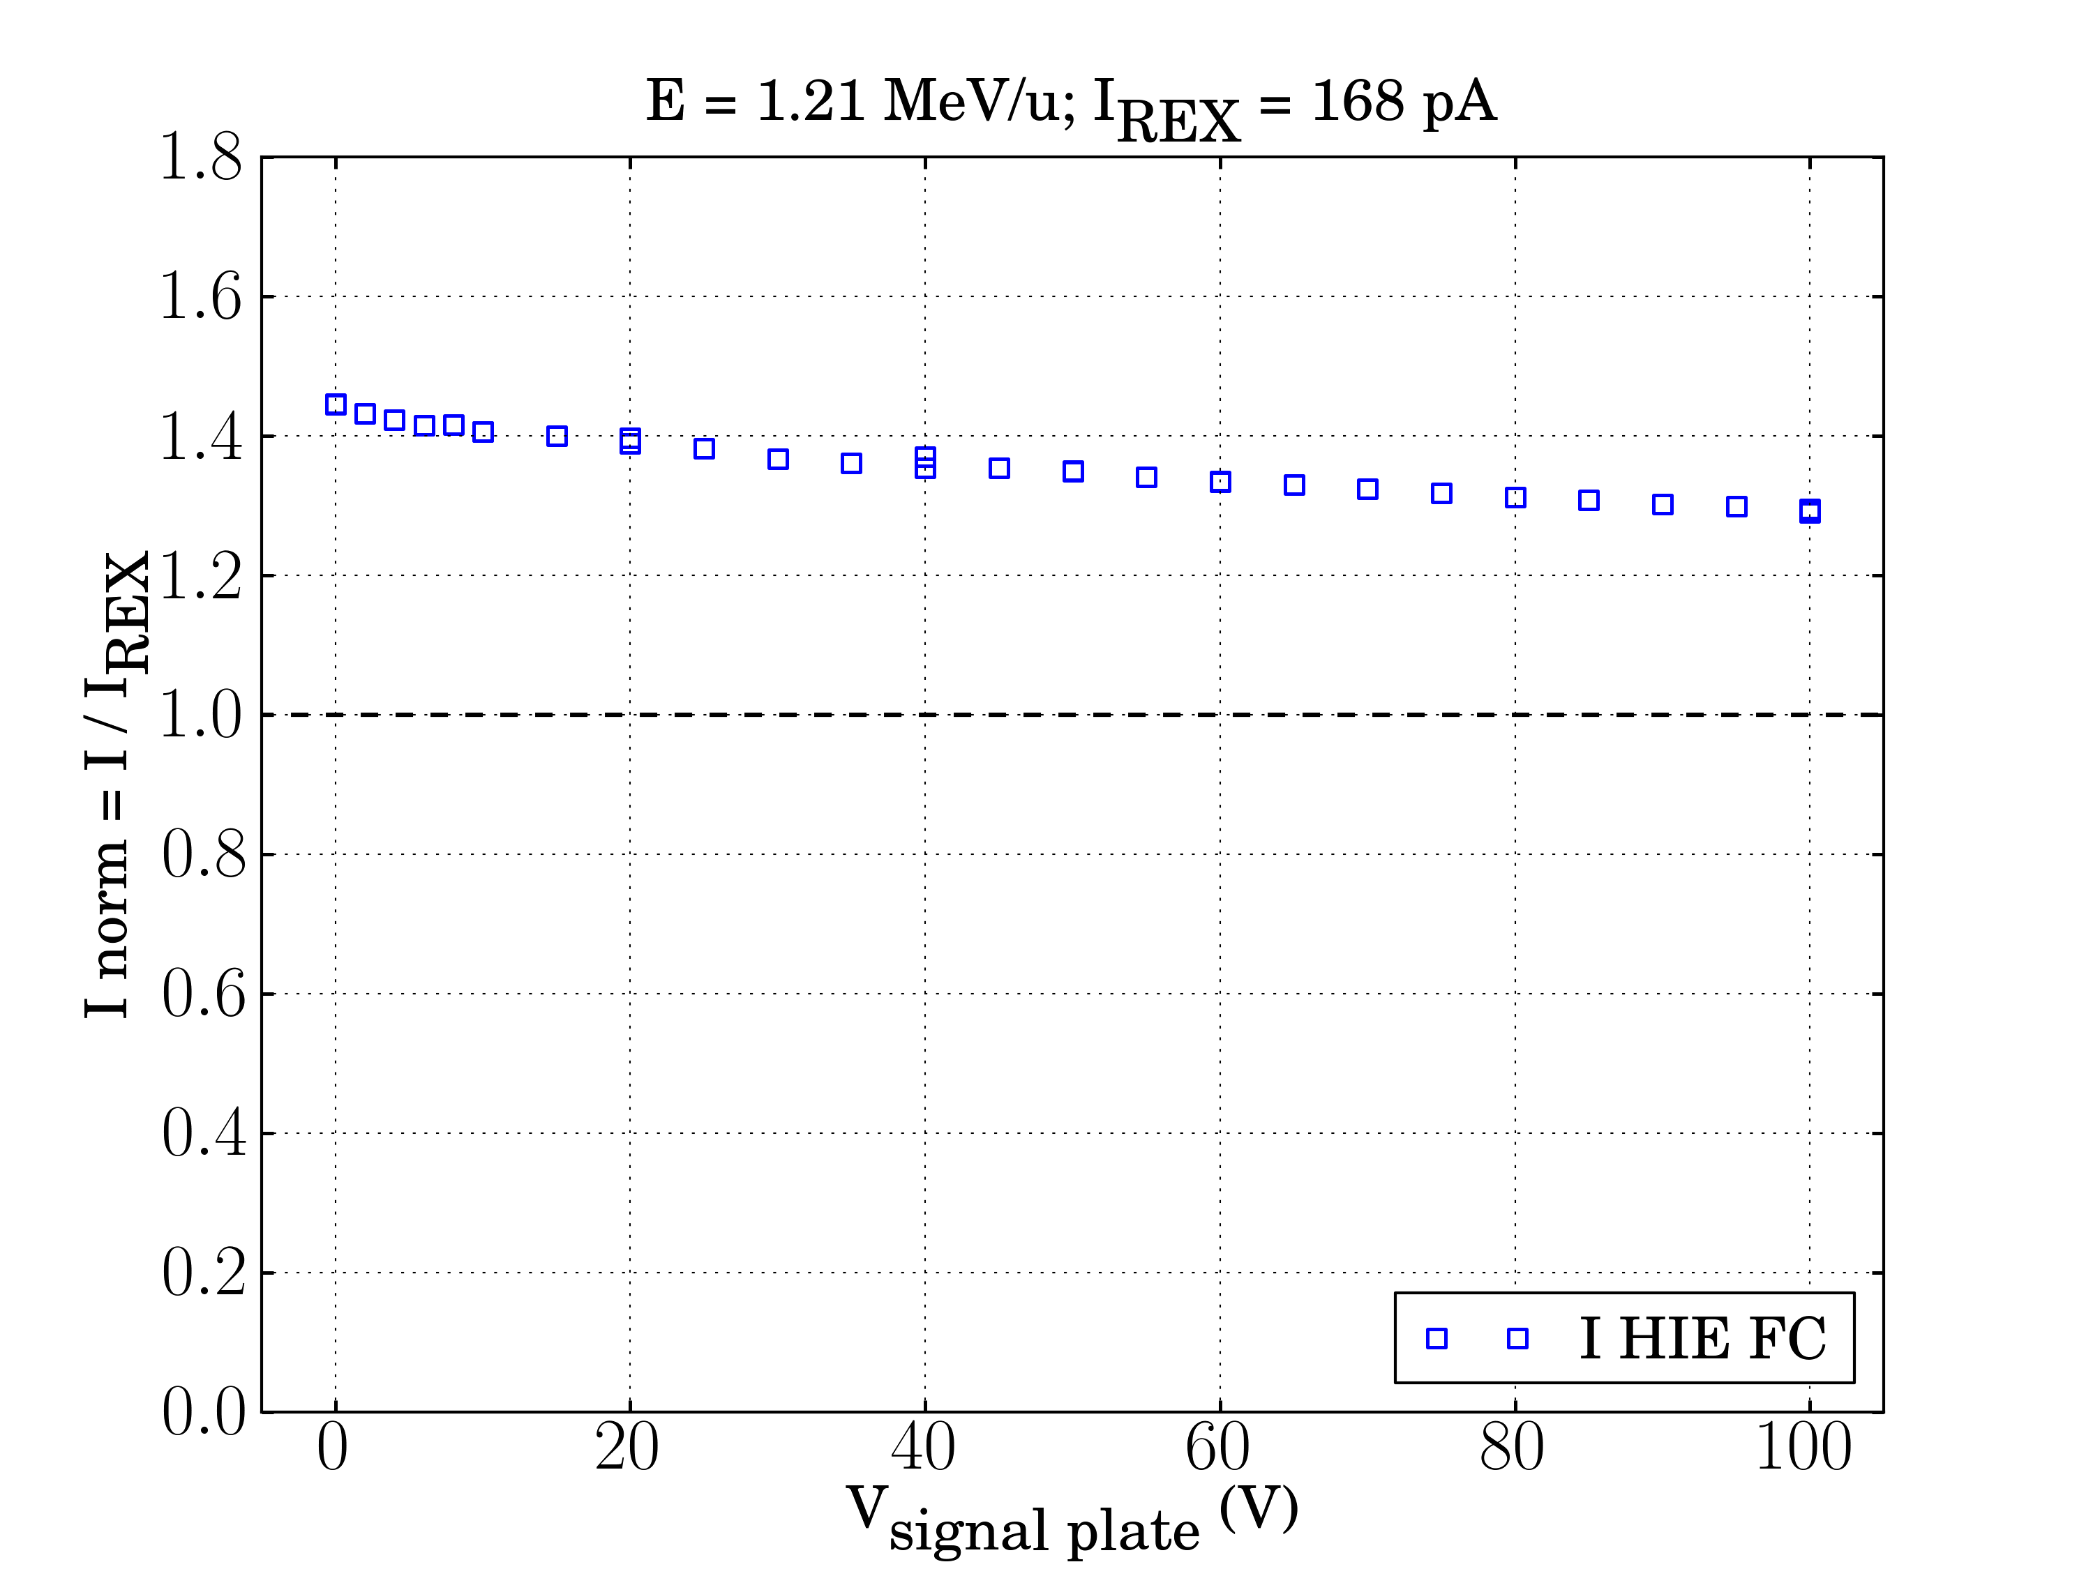
Biasing repeller ring & signal plate
stable beam A/Q =4
V_{signal plate} > 0 V (variable)
V_{repeller} = -500 V
Signal
Plate
Repeller ring
Ground ring

Slide 27
7. Conclusions
Current measurements do not agree with the nominal beam current using the present design
Further improvements in the design are in progress
Beam profile measurements are unaffected in principle by a change in the design.
Notes:
Beam profile measurements are unaffected in principle by a change in the design.

Slide 28
Acknowledgements
The ISOLDE Collaboration
The HIE-ISOLDE Project Team and groups within CERN Accelerator and Technology Sector
The Swedish Knut and Alice Wallenberg Foundation (KAW 2005-0121)
The Belgian Big Science program of the FWO (Research Foundation Flanders) and the Research Council K.U. Leuven
The CATHI Marie Curie Initial Training Network: EU-FP7-PEOPLE-2010-ITN Project number 264330.
The Spanish Programme “Industry for Science” from CDTI

Slide 29
Thank you!
Work supported by the CATHI Marie Curie actions under contract GA-PITN-2010-264330.

