Slide 1
BI Day 2012
The Beam Position System for LINAC4
Michael Sordet BE-BI-PI
Linac4 BPM, 06.12.2012

Slide 2
Presentation index
Linac4 accelerator
BPM on Linac4
Mechanical details
Electronic details
Results
To-do list
Conclusion
Questions
Michael Sordet BE/BI
2
5. décembre 2012

Slide 3
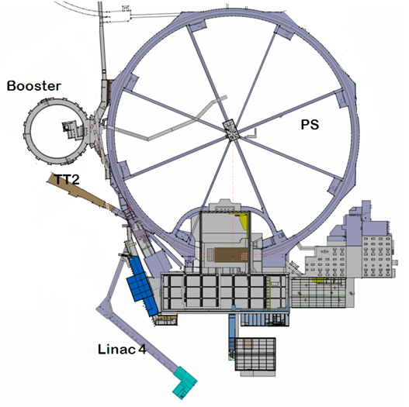
Linac4 accelerator
Ion species H⁻
Output energy 160MeV
Bunch frequency 352.2MHz
Max. repetition rate 2Hz
Beam pulse length 400µs
Mean pulse current 40mA
Number of particles per bunch 1.14 ·10⁹
Michael Sordet BE/BI
3
5. décembre 2012

Slide 4
BPM layout and specs for Linac4
3 MeV
50 MeV
102 MeV
160 MeV
L4L ~ 12 m
L4D ~18 m
L4C ~22 m
L4P ~14 m
L4Z ~10 m
H- source
LEBT
RFQ
MEBT (chopper)
DTL
CCDTL
PIMS
Dump Line
Observable 1: Beam position
Transfer Line to PSB
Observable 2: Beam intensity
L4T- LT- LTB-BI ~178 m
Observable 3: Beam phase in reference to RF
Observable 4: Energy via TOF between two BPMs
Line | # of Monitors | Beam position Resolution | Beam position Accuracy | Rel. Beam Intensity Resolution | Beam phase Resolution | TOF Resolution | Comments
L4D | 2 | 0.1mm | 0.3mm | 1% of peak current | 0.5° | 1 per thousand | Ø34mm
L4C | 7 |  |  |  |  |  | Ø39mm
L4P | 6 |  |  |  |  |  | Ø39mm
L4T to PSB | 10+17 |  |  |  |  |  | Ø100 + 140mm
Michael Sordet BE/BI
4
5. décembre 2012

Slide 5
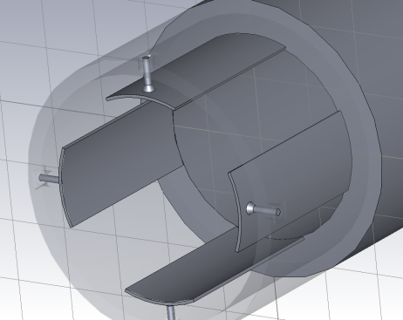
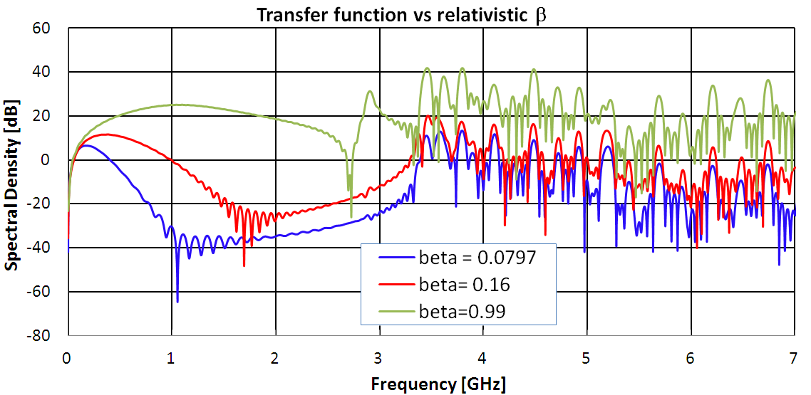
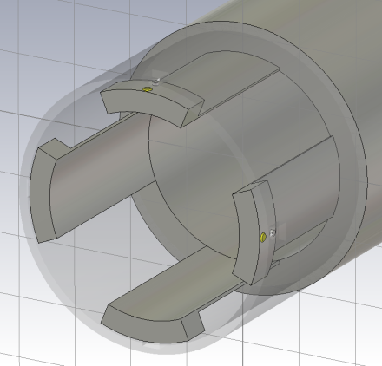
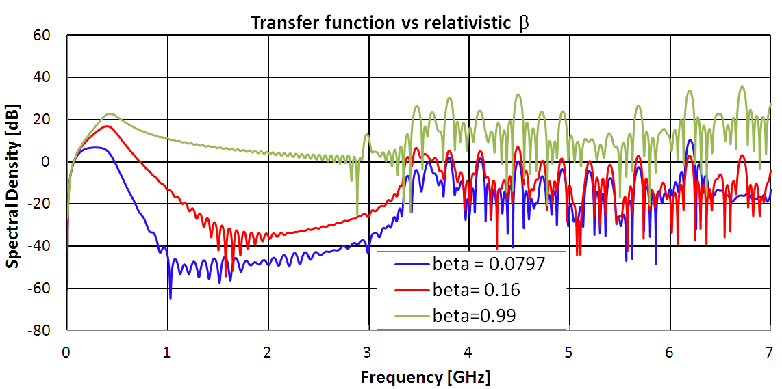
Transfer function of the test stand BPM
Ø67mm
Shorted stripline with added capacitance
Linear on working range
Better for linear phase measurement
β-dependent
Michael Sordet BE/BI
5
5. décembre 2012

Slide 6
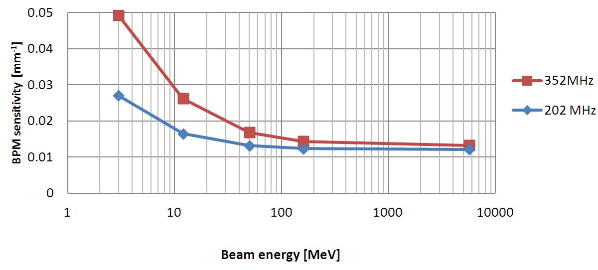
Dealing with low-β beams
PU sensitivity changes with β
These simulations confirm Shafer’s theorem (1994)
The values obtained from the simulations will be implemented in the software
Transfer Line BPM Ø140mm
RFQ
DTL1
DTL3
PIMS12
Β=1
Michael Sordet BE/BI
6
5. décembre 2012

Slide 7
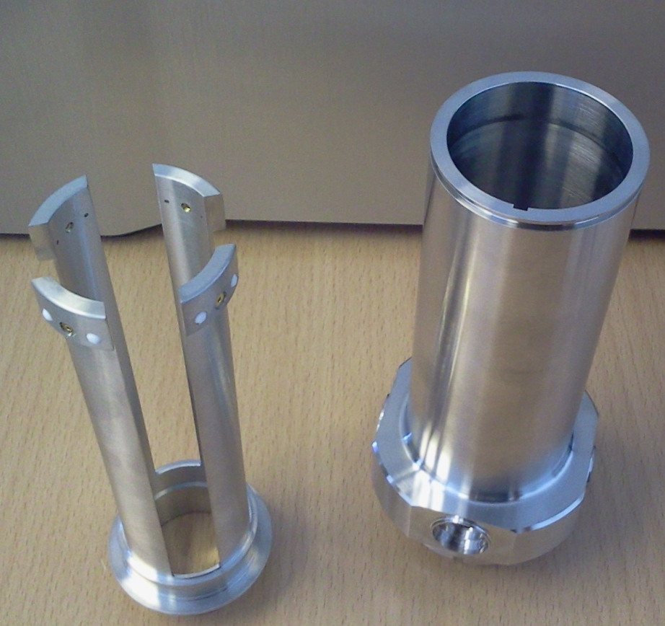
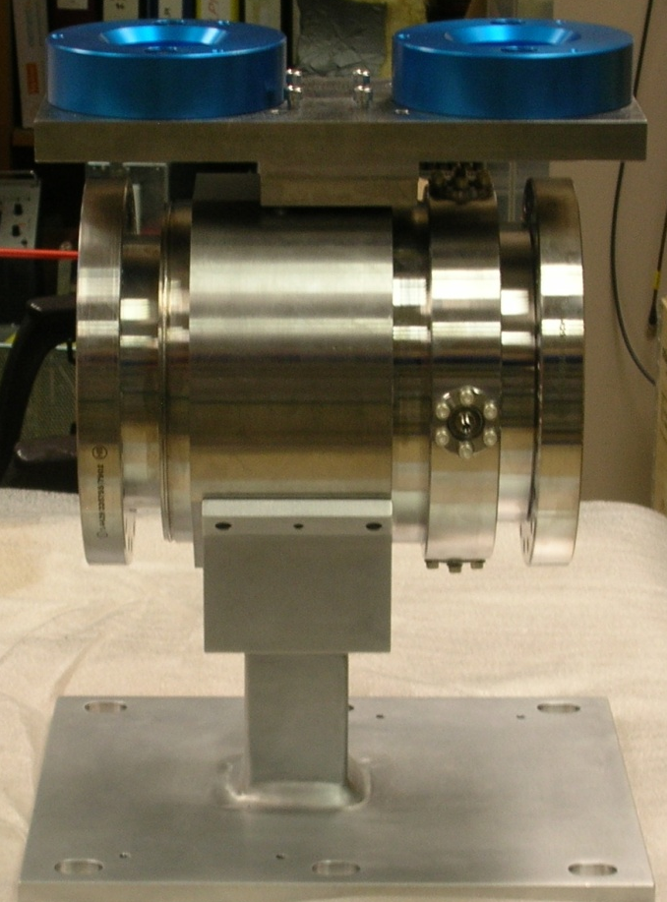
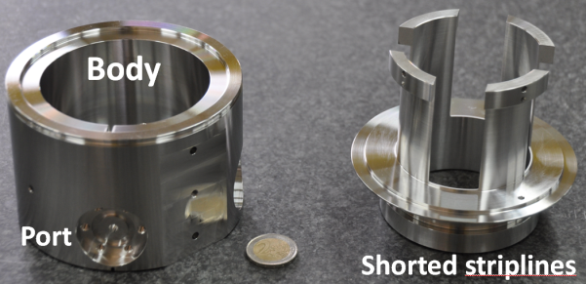
Many different BPM variants
DTL
Beam aperture: 34 mm
Electrode length: 117 mm
TRANSFER LINE
Beam aperture: 100 mm
Electrode length: 140 mm
3MeV
Beam aperture: 60mm
Electrode length: 67mm
Michael Sordet BE/BI
7
5. décembre 2012

Slide 8
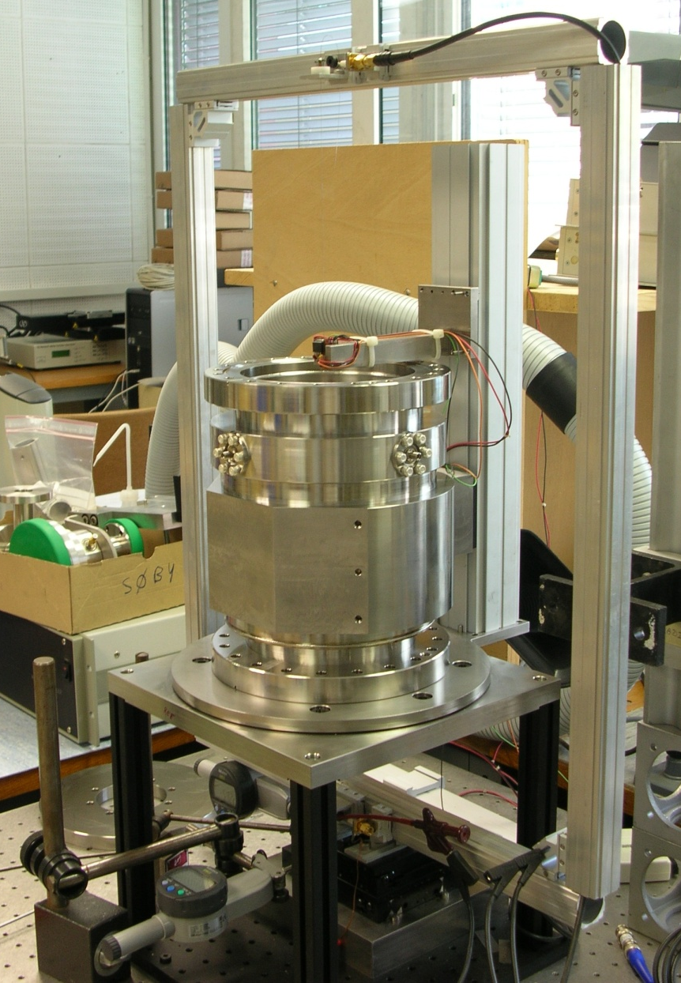
Lab test bench
Wire technique with standing waves
Optical sensor for mechanical centering : ±0.01mm
352MHz sine wave with a N.A.
Data acquisition with steps of 0.1mm
Gives sensitivity and electrical offset
Michael Sordet BE/BI
8
5. décembre 2012

Slide 9
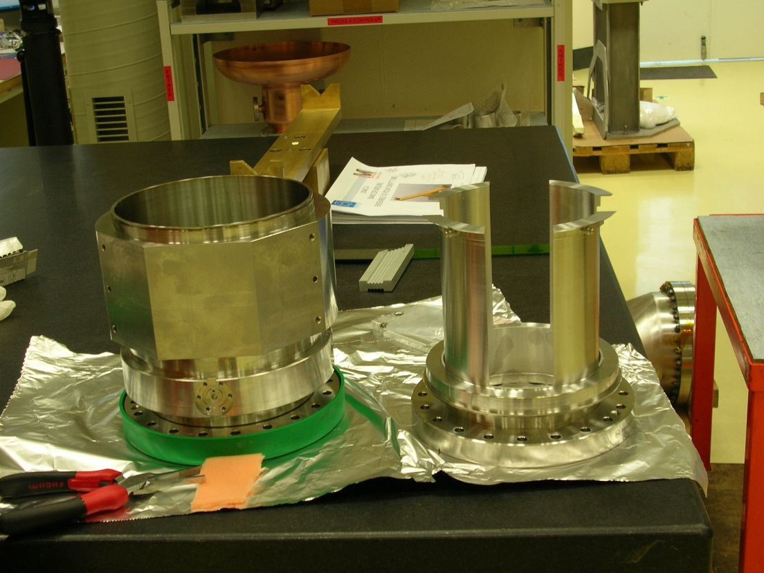
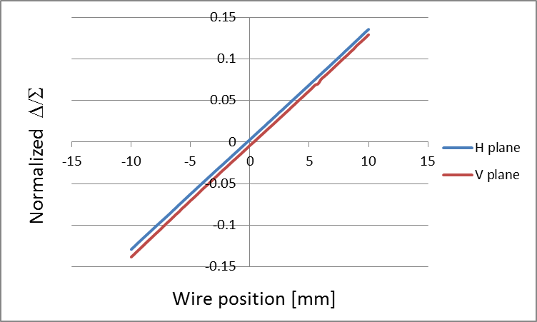
BPM sensitivity at 352MHz
Transfer Line BPM Ø140mm
Body Shorted Striplines
@352MHz | Simulations | H plane | V plane
Sensitivity[mm] | 75.4 | 75.88 | 75.24
Elec. Offset [mm] | - | -0.31 | 0.34
Michael Sordet BE/BI
9
5. décembre 2012

Slide 10
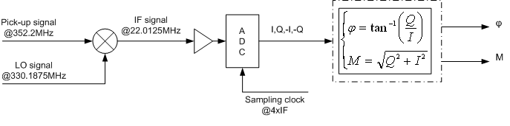
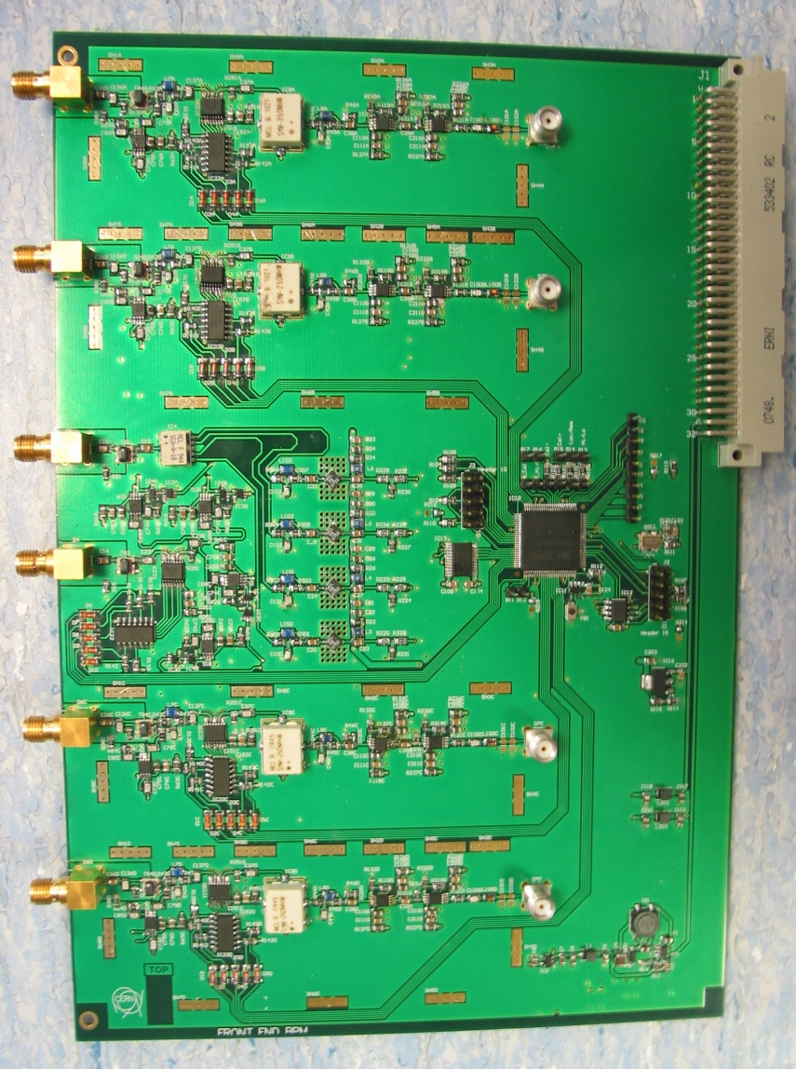
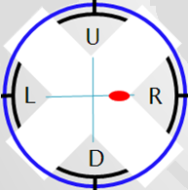
Acquisition chain
FEATURES
Input Low pass filtering @1GHz
Down-mixing with LO
Variable gain selection
Band-pass filtering @22MHz
FPGA for calibration and gain control
Sampling frequency = 4x IF
ENOB ADC 13.4 bits
LSB ADC 76µV
A
D
C
1
6
B
i
t
s
FESA
Class
Michael Sordet BE/BI
10
5. décembre 2012

Slide 11
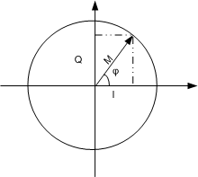
Signal processing
Phase and intensity calculation with I/Q sample per channel
Calculation for each PU
  Position
  Phase
  Intensity
Michael Sordet BE/BI
11
5. décembre 2012

Slide 12
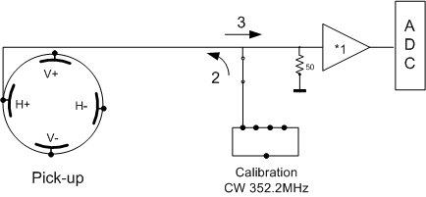
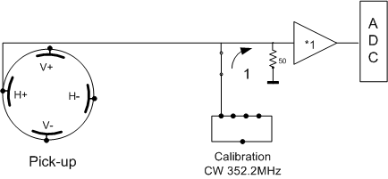
Calibration procedure
Set the phase and the gain per channel
  Inject sine wave into the direct channel(1)
  Numerical gain and phase correction
Set the length of cables per PU
  Inject sine wave into the cable(2)
  Signal back after reflection on the PU(3)
  Numerical gain and phase correction
Michael Sordet BE/BI
12
5. décembre 2012

Slide 13
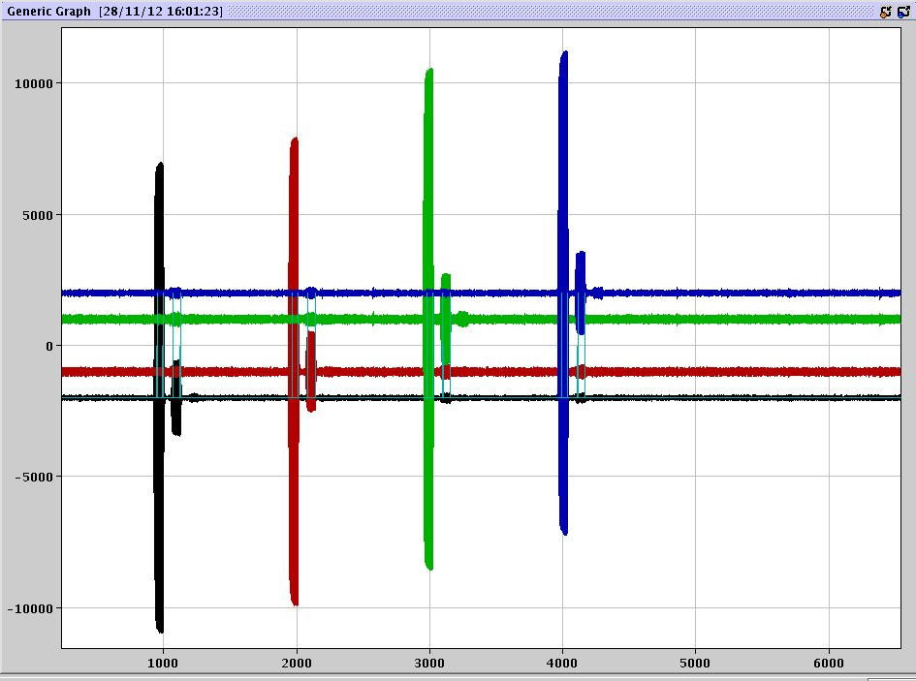
Calibration : raw data
V-
Direct Pulse
4 electrode-calibration
Each channel space with 100µs
Direct and reflected sine wave pulse
I/Q sample series
With artificial offset
V+
H-
Reflected Pulse
H+
100µs
100µs
100µs
Michael Sordet BE/BI
13
5. décembre 2012

Slide 14
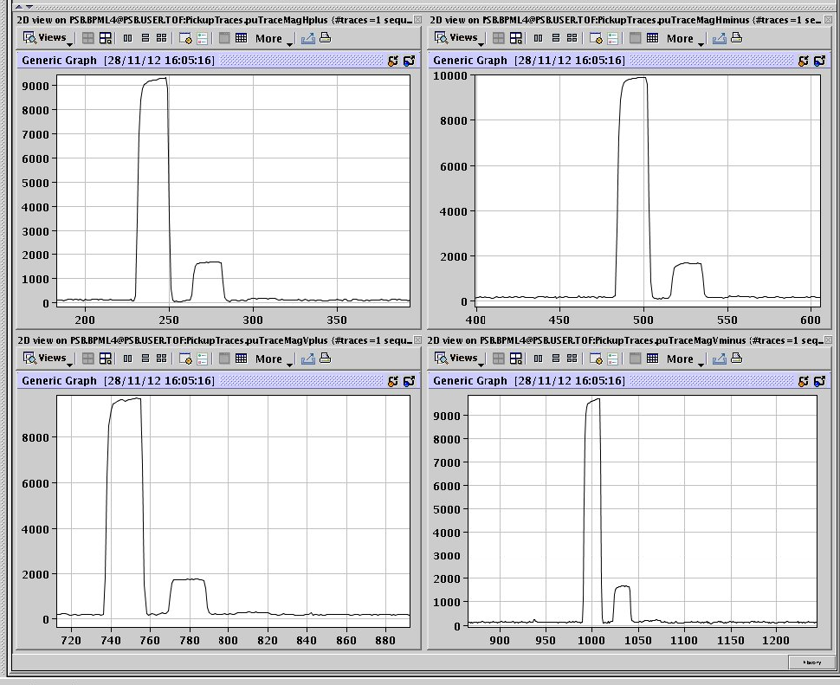
Calibration : processed data
4 electrode-calibration
Direct and reflected sine wave train
One magnitude point for one quadruplet (I,Q,-I,-Q)
Gives a set of scaling factors per electrode:
[Amplitude, Phase]
[A_{1..4}, P _{1..4}]
H+
H-
Direct Pulse
Reflected Pulse
V+
V-
800ns
Michael Sordet BE/BI
14
5. décembre 2012

Slide 15
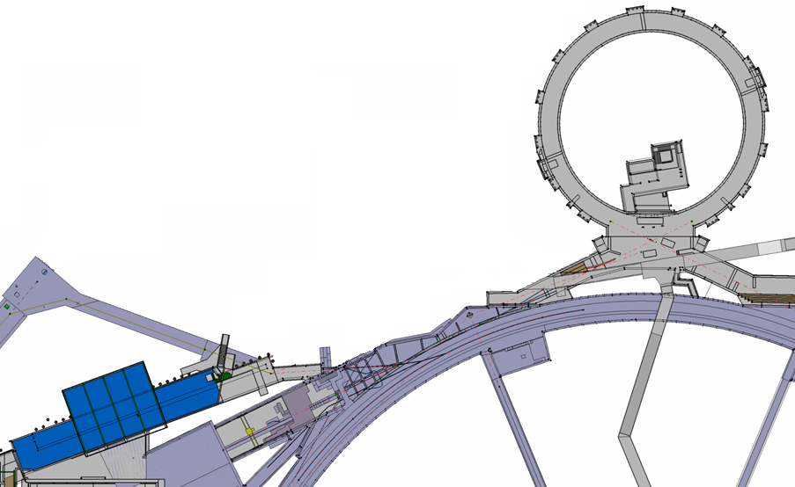
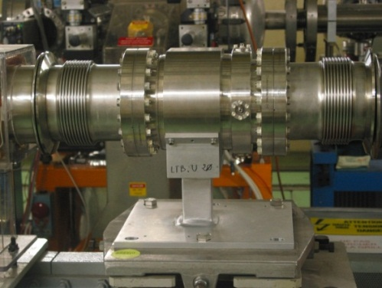
Commissioning with proton beam
Transfer lines from Linac-2 to Booster
Upgrade with Linac4 type BPM : shorted stripline(present BPMs are 40 years old)
Status : commissioning of one monitor with protons since Sept. 2012
Bunching frequency 202MHz
Linac4
Injection
lines
Linac2
LTB.UMA20
Michael Sordet BE/BI
15
5. décembre 2012

Slide 16
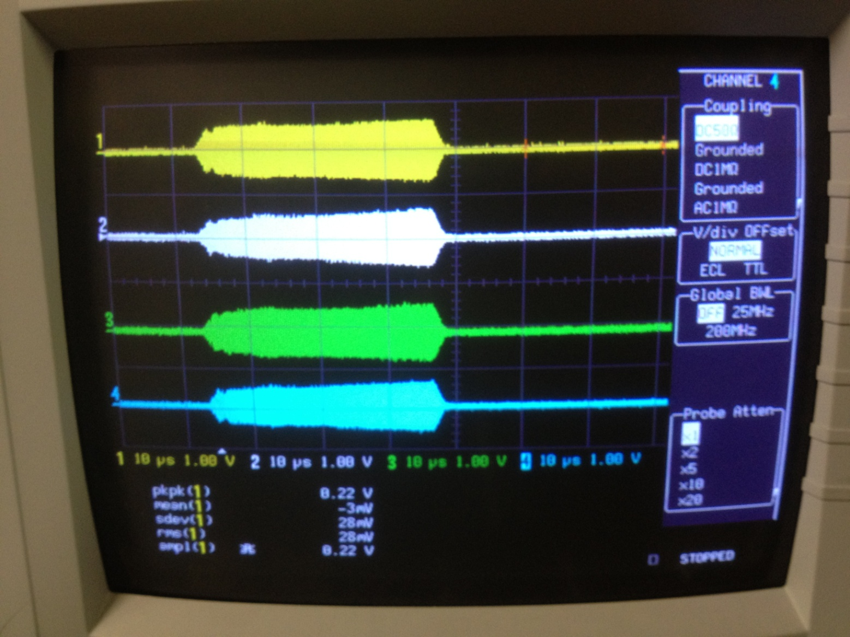
First raw beam data
TOF beam
4 channels
Electronics card output
Difference between simulation and real life : Amplitude is 45% less than expected
Michael Sordet BE/BI
16
5. décembre 2012

Slide 17
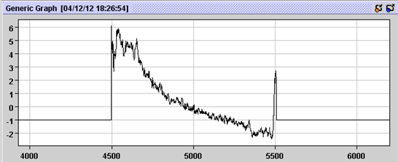
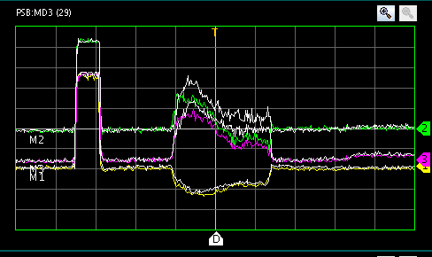
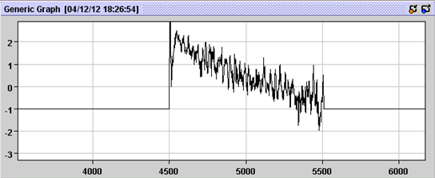
Position measurement
New BPM measurement
Old BPM measurement
TOF beam
20µs Head
Horizontal position
Vertical position
Artifact
40µs
Calibration pulse
Beam
Michael Sordet BE/BI
17
5. décembre 2012

Slide 18
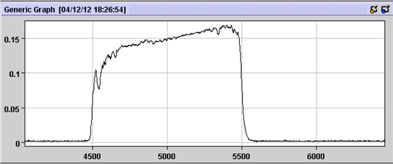
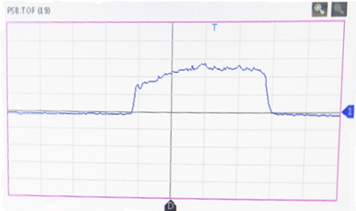
Intensity measurement
150mA average
BPM measurement
40µs
TOF beam
Beam current [A]
Calibrate with BCT
BCT measurement
Michael Sordet BE/BI
18
5. décembre 2012

Slide 19
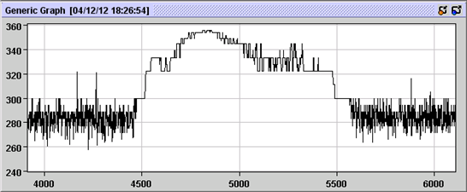
Phase measurement
First phase measurement
5° phase jump
Phase between one BPM and the RF reference
Michael Sordet BE/BI
19
5. décembre 2012

Slide 20
To-do list
Finish commissioning test with the LTB-UMA-20
Be ready for H⁻ beam in the 3MeV test stand in January 2013
LS1change all the old L2 BPM and install new acquisition system
Be ready for H⁻ beam test in L4 tunnel in September 2013
Michael Sordet BE/BI
20
5. décembre 2012

Slide 21
Summary and conclusion
Encouraging first results with beam
Very useful test with Linac2 for the future commissioning of the Linac4
Not expected position measurement excursion, we need to do a MD to test that
Intensity measurement with 45% less signal at the output of the BPM
5° phase jump for phase measurement to be understood and corrected
Michael Sordet BE/BI
21
5. décembre 2012

Slide 22
Acknowledgements
Project leader Jocelyn Tan
Michael Ludwig for the software
Delphine Gerard for the mechanics
RF group
All the BI-PI section
Drawing office EN/MME
Thank you for your attention
QUESTIONS ???
Michael Sordet BE/BI
22
5. décembre 2012

Slide 23
Extra Slide
Michael Sordet BE/BI
23
5. décembre 2012

Slide 24
Sensibility measurement
Constant sum between ±15mm
Linear difference between ±15mm
Linear electrodes between ±15mm
The PU is linear on the desired range
Michael Sordet BE/BI
24
5. décembre 2012

Slide 25
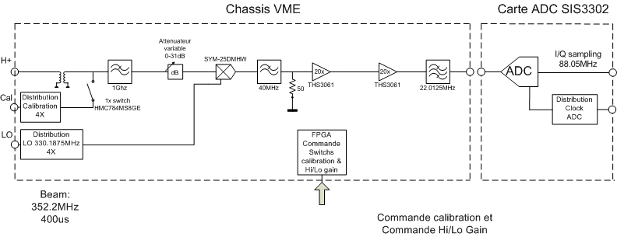
Analog card block diagram
Michael Sordet BE/BI
25
5. décembre 2012

Slide 26
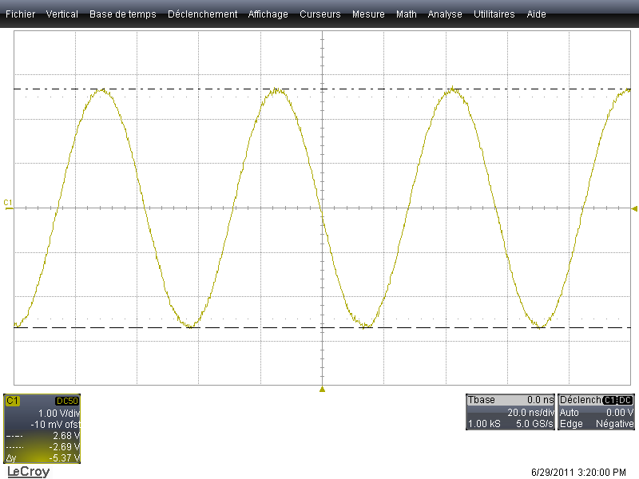
Lab measurement
Dynamic range
Noise measure
Gain & Bandwidth
Michael Sordet BE/BI
26
5. décembre 2012

Slide 27
Analog board characteristics
 | Measure
Gain | 0dB to 30.8 dB
Central frequency | 22.01 MHz
Bandwidth | 10 MHz
Output range | ±2.68 V
Output thermal noise | 700 µV
Crosstalk Signal Cal to IF 22 MHz | -50.4 dBm/0.7mV
Crosstalk LO 330 MHz | -57.2 dBm/0.3mV
Michael Sordet BE/BI
27
5. décembre 2012

Slide 28
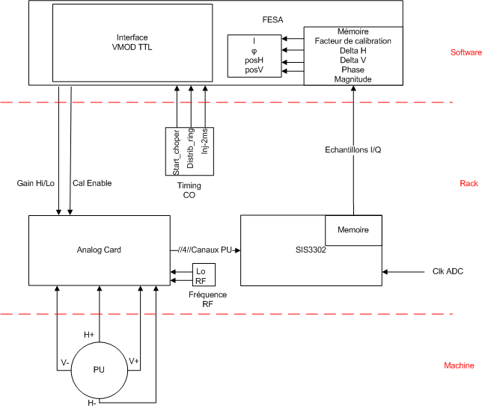
Acquisition chain
Michael Sordet BE/BI
28
5. décembre 2012

Slide 29
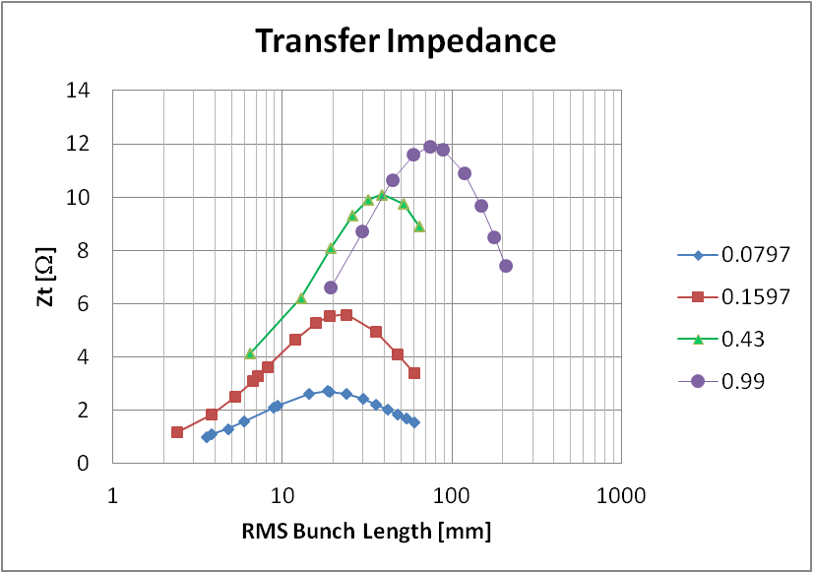
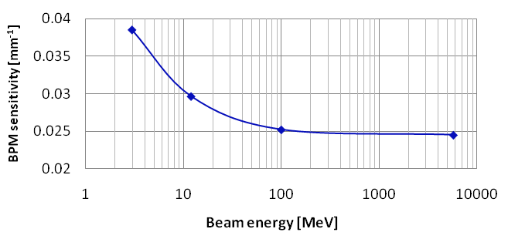
Dealing with low-β beams
Transfer impedance changes with β and bunch length
PU sensitivity changes with β
These simulations confirm Shafer’s theorem (1994)
The values obtained from the simulations will be implemented in the software
β
Sensitivity at 352MHz
Michael Sordet BE/BI
29
5. décembre 2012

Slide 30
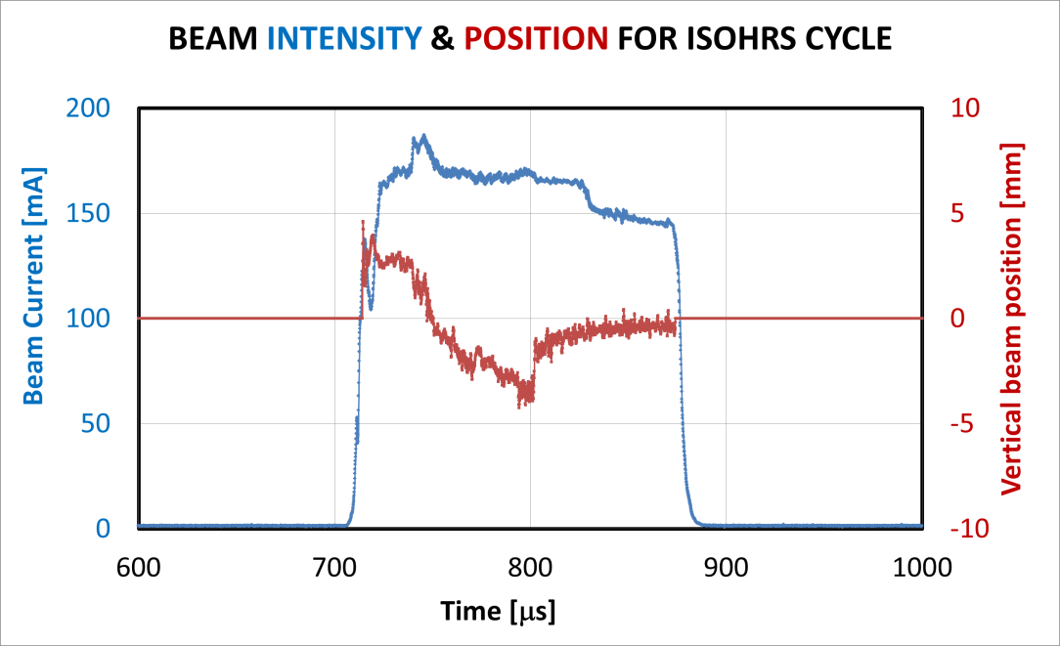
Intensity and position measurement
Michael Sordet BE/BI
30
5. décembre 2012

