Slide 1
Welcome
Bienvenidos
Bienvenue Witamy
WillKommen
Benvenuto

Slide 2
Roadmap
General information:
  who, what, when, where
Drink: as long as you want

Slide 3





Sponsor: discount
http://sites.google.com/site/cernskiclub/Home/membership/shop-discounts
Regular mail for offers, special days, etc.

Slide 4
Organization
Hervé Milcent: president
Serge Reynaud : vice president
Séverine Bergerot: treasurer
Jean-Louis Grenard: secretary
Other tasks
Ghislaine Boureaud: Supplies, logistics
Marco Forte (Marc Tavlet): Bus
Serge Reynaud: sponsoring
Sonia Mallon Amerigo: permanence
Marc Tavlet: meeting secretary
Consuelo Goncalves: secretary support
Sections
Jens Spanggaard : Cross country ski
Niels Madsen: Downhill ski
Nicolas Chritin : Ski touring
Léonard Miffon (Alex Lossent): Snowboard
Ghislaine Boureaud: Ski fitness

Slide 5
Who are we?
Everybody welcome! (CERN and non CERN employees)
Affiliated to FFS (Fédération Française de Ski)
  Carte neige (FFS license + insurance)
GIA and USCA card
  Significant ski pass reductions (photo required for membership card)
To contact us
  Email: ski.club@cern.ch
  Web: http://cern.ch/club-ski
Permanence: every Thursday from 18.00 to 19.00
  @ 1st floor Restaurant 2 (Build. 504)

Slide 6
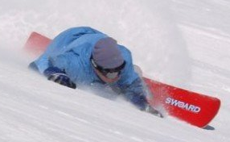
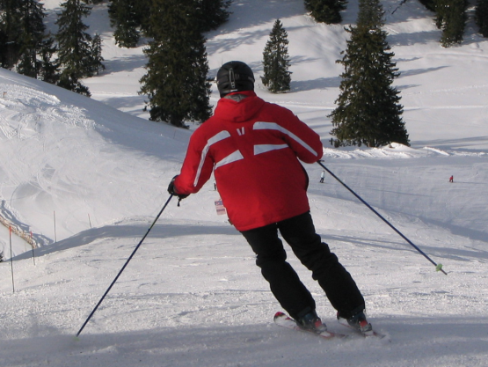
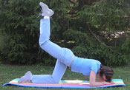
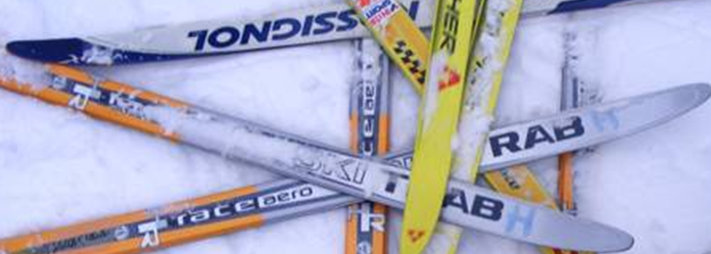
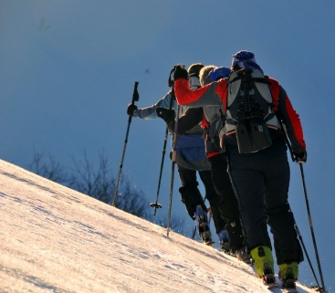
What do we propose?
Downhill ski
Snowboard
Ski fitness
Cross country ski
Ski touring

Slide 7
2011/2012
Around 1000 members
  From 6 to 86 years

Slide 8
2012/2013 special year
50 years anniversary of the ski club
Many activities all along the season:
  Conferences
  Special ski outing
  St Valentin evening organized by the snowboard team
  And many others, stay online…
  http://cern.ch/club-ski

Slide 9
2012/2013 Activities
Type of activities |  | dates | type | remarks
Downhill ski/snowboard 5 lessons Bus and ski pass provided | Child | Saturday or Sunday from 12/01/2013 to 10/02/2013 | Full day lesson in small group with certified instructor | On demand Limited places
 | Adult | Saturday or Sunday from 12/01/2013 to 10/02/2013 |  | Limited places
Downhill ski/snowboard 5 outings Bus and ski pass provided | Child | Saturday or Sunday from 12/01/2013 to 10/02/2013 | Full day Skiing under your own responsibility | Unlimited places
 | Adult
Cross country ski 5 lessons + 1 outing Bus and ski pass provided | Child | Saturday from 12/01/2013 to 23/02/2013 | ½ day lesson in small group with certified instructor | Limited places
 | Adult
Outing after lesson Day or week-end Bus and ski pass provided | Child | Saturday or week-end from 16/02/2012 to 06/04/2013 | Outing with certified instructor if possible | Limited places
 | Adult
Ski touring Day or week-end | Adult | Saturday or Sunday from January 2013 to May 2013 | Full day with certified instructor if possible or under your own responsibility | Limited places
Ski fitness | Adult | September to January 2013 | Ski Fitness | Full
Ski fitness | Adult | February to June 2013 | General Fitness | Limited places

Slide 10
2012/2013 fees €
 |  | Club | Carte Neige ** | Activity | Total
Snowboard 5 lessons Bus and ski pass provided | Child | 5 | 41 | 214 | 260
 | Adult | 10 | 45 | 250 | 305
Downhill ski 5 lessons Bus and ski pass provided | Child | 5 | 41 | 214 | 260
 | Adult | 10 | 45 | 250 | 305
Downhill ski/snowboard 5 outing Bus and ski pass provided | Child | 5 | 41 | 150 | 196
 | Adult | 10 | 45 | 215 | 270
Cross country ski 5 lessons + 1 outing Bus provided | Child | 5 | 25.50* | 64.50 | 95
 | Adult | 10 | 29.50* | 105.50 | 145
 | 5 ski pass | - | - | - | 40/30
Ski touring | Adult | 10 | 45 | 32 | 87
Ski fitness/General fitness | Adult | 10 | 0 | 30 | 40
GIA | Adult | 10 | 0 | 5.50 | 15.50
USCA *** (to be confirmed) | Adult | 10 | 0 | 3.50 | 13.50
« Ticket découverte »: 48h validity, once
* if downhill ski +15 €
** FFS: 30% (13.56 €), Comite Mt Blanc 16.5% (7.44 €),
Optional insurance: 43.5% (19.50+4 €)
Many other possibilities : family card, 1 outing, multi activity, etc.
→ Contact us for more information

Slide 11
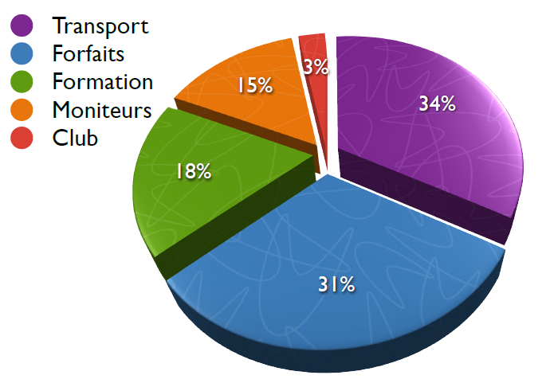
For what do you pay for

Slide 12
Note for new members
To get a carte neige, new members have to provide a medical certificate de “non contre indication à la pratique du ski”
To get one:
  Go to a french / swiss doctor
  Usually re-imbursed by your medical insurance
The medical certificate must
  Be done by a medical doctor (not a dentist)
  Contains the sentence “non contre indication à la pratique du ski”

Slide 13
How to register to 5 lessons, 5 outings downhill ski/snowboard cross country, ski touring
Pre-registration: http://cern.ch/club-ski
  Select you activities, you can select more than one:
    E.g.: downhill ski and USCA
    For downhill, snowboard, ski touring and cross country: carte neige (with optional insurance) automatically added
  For downhill and snowboard lesson → registration for 5 lessons
Payment: pay what you’ve selected
  2012 members: online payment (paypal) until the 20/12/2012
  New members: must come to the permanence with a valid medical certificate from 15/11 to 20/12 every Thursday @ 1st floor Restaurant 2 (Build. 504) from 18h00 to 19h00.
Still possible to cancel or re-register to one lesson before the 20/12/2012
Ski touring payment permanence will start the 15/11/2012
Cross country payment permanence will start the 29/11/2012

Slide 14
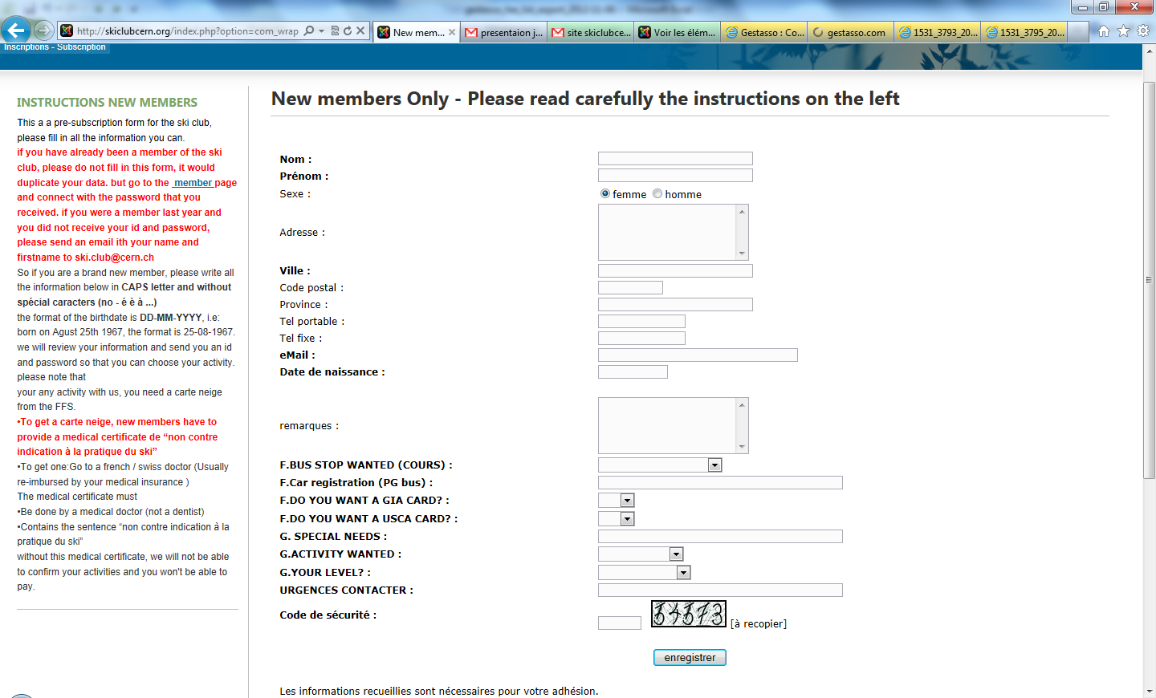
Filling the web form
From: http://cern.ch/club-ski
Fill the form, give a correct email.
Before clicking on “enregistrer” print it!
your credential user id and password will be sent to the email in the following 24 hours.
Mail sent by “delivery@critsend.com [mailto:delivery@critsend.com] On Behalf Of SKI CLUB DU CERN”
If not mail to ski.club@cern.ch

Slide 15
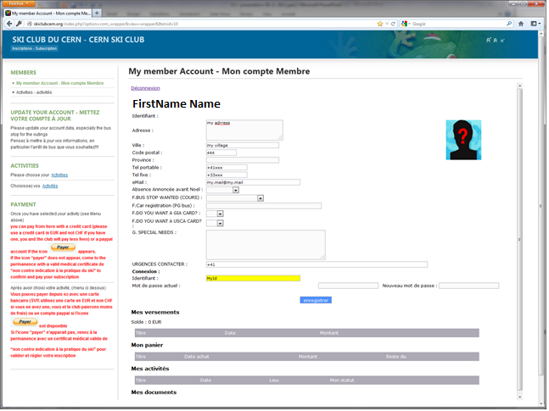
Selecting your activities
From web account
Password, ID lost, mail to ski.club@cern.ch
Select you activities and follow the instructions
If needed come at the permanence to pay with a valid medical certificate to complete the registration and pay.

Slide 16
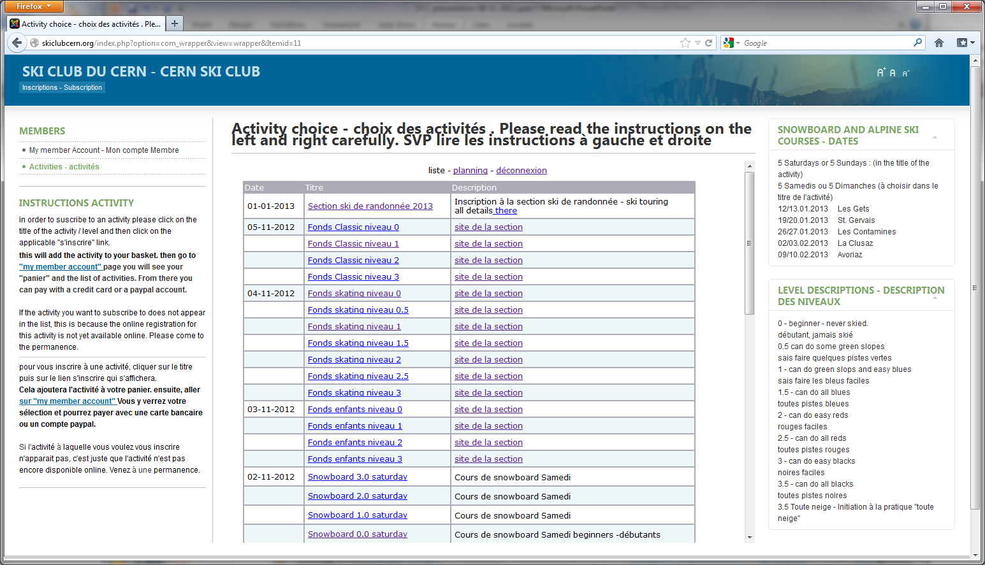
Selecting your activities
From web account
Password, ID lost, mail to ski.club@cern.ch
Select you activities and follow the instructions
If needed come at the permanence to pay with a valid medical certificate to complete the registration and pay.

Slide 17
How to register to a after lessons outing
From your account
Select your outing
Payment before the outing: pay what you’ve selected
  online payment (paypal)
  Thursday @ 1st floor Restaurant 2 (Build. 504) from 18h00 to 19h00.

Slide 18
Downhill ski: more details
5 days lessons with certified instructors (MF1 or MF2 FFS)
  Adult/child > 8: full day
  One ski instructor per group of about 8 students
  Same instructor for the 5 lessons
  All levels: beginner → advanced (0.0 to 3.5)
  “initiation ski toute neige” if possible offered to level 3.5
  Lesson in French and English
  Pedagogical tool: video

Slide 19
Snowboard: more details
5 days lessons with certified instructors (MF1 or MF2 FFS)
  8 students/group maximum where possible
  Change instructor each lesson to see all aspects of snowboarding
  Some instructors are qualified to do “toute neige” (hence all groups may have the opportunity to practice)
Lesson in French and English
All levels: beginner → advanced, Freestyle and Carving
Pedagogical tool: video
Clearly defined group objectives allow the student to constantly improve their skills and/or styles
After lesson outing: no official guided group but everybody welcome to snowboard with the instructors

Slide 20
Downhill ski/Snowboard lessons (provisional)
Sat. 12/01/2013 | Les Gets - France
Sun. 13/01/2013 | Les Gets - France
Sat. 19/01/2013 | St Gervais - France
Sun. 20/01/2013 | St Gervais - France
Sat. 26/01/2013 | Les Contamines - France
Sun. 27/01/2013 | Les Contamines - France
Sat. 02/02/2013 | La Clusaz - France
Sun. 03/02/2013 | La Clusaz - France
Sat. 09/02/2013 | Avoriaz - France
Sun. 10/02/2013 | Avoriaz - France

Slide 21
Downhill ski/Snowboard after lesson outing (provisional)
Sat. 16/02/2013 | sortie concours 50 du ski club CERN
Sat. 23/02/2013 | La Thuile – Italy
Sat. 23/02/2013 | week-end Sestriere – Italy
Sun. 24/02/2013 | week-end Sestriere – Italy
Sat. 02/03/2013 | Grand Massif - France
Sat. 09/03/2013 | Avoriaz- Les Portes du Soleil – France
Sat. 09/03/2013 | week-end Pila & Gressoney – Italy/Switzerland
Sun. 10/03/2013 | week-end Pila & Gressoney – Italy/Switzerland
Sat. 16/03/2013 | Verbier - Switzerland
Sat. 23/03/2013 | Sortie moniteurs
Sun. 24/03/2013 | Sortie moniteurs
Sat. 06/04/2013* | Les Grand Montets - France
*: provisional, may be cancelled

Slide 22
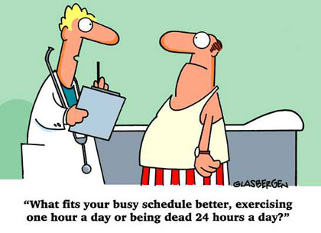
Ski fitness
Why
  Good physical preparation for all snow activities
  Enhanced Performance
  Reduced Risk of Accidents
What
  Building up muscles, Stretching, Cardio exercises
  Groups of ca. 25 persons
  Experienced instructor
When
  Every Tuesday
  2 one-hour lessons: 6-7 pm and 7-8 pm
  From September to February: Ski Fitness classes
  From February to June: General Fitness classes
Where
  Meyrin: Gymnase de la Golette
Subscription
  Price: 40 €/class (ski fitness + membership fee)
  In January for General Fitness at the permanences or via your web interface
  Ski Fitness already full

Slide 23
Cross country ski
Cross country lessons Skating or Classic, from Beginner to Advanced
  Children* and adults lessons with certified instructors
  Five afternoon lessons on Saturdays in La Vattay from 12/01 to 23/02
    Change instructor after 3 lessons
  Transport (from St Genis and Gex) included
  One day family outing
  Several Sunday outings in the region
  One full-moon outing in the night
  One ski-waxing lesson
* Only if the parents take lessons

Slide 24
Cross country ski program 2012
Sat. 12/01 | Lesson 1
Sun. 13/01 | Sunday outing 1
Wed. 16/01 | Introduction to waxing
Sat. 19/01 | Lesson 2
Sun. 20/01 | Sunday outing 2
Thursd. 24/01 | Full moon outing (night)
Sat. 26/01 | Lesson 3
Sun. 27/01 | Sunday outing 3
Sat. 02/02 | Family outing (full day)
Sat. 09/02 | Lesson 4
Sun. 10/02 | Sunday outing 4
Sat. 16/02 | Lesson 5
Sun. 17/02 | Sunday outing 5
Thursd. 21/02 | Full moon outing (night)
Sat. 23/02 | Lesson (if one cancelled)
Pre-registration http://cern.ch/club-ski
Payment: pay what you’ve selected
  2012 members: online payment (paypal) until 20/12/2012
  New members: must come to the permanence with a valid medical certificate from 29/11 to 20/12 every Thursday @ 1st floor Restaurant 2 (Build. 504) from 18h00 to 19h00.
We can accept ~35 kids (8-14 years) and ~80 adults
Contact for more information:
  Ski.club@cern.ch
  http://cern.ch/club-ski-fond

Slide 25
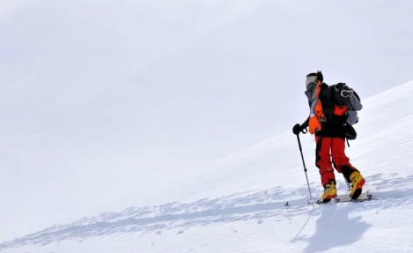
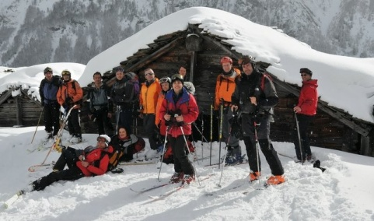
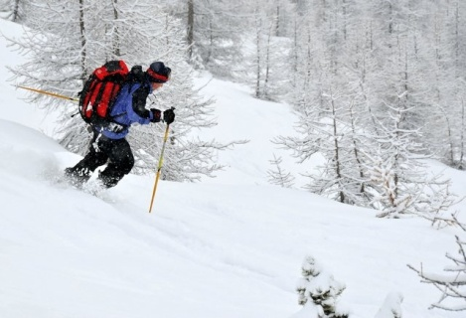
Ski touring – how it works
No lessons
but choice between several tours/week end
from January to April – depending on the snow conditions
One day and week-end tours (later in the season)
  France (Haute-Savoie, Savoie), Switzerland, Italy, Austria, etc.
All levels of difficulties: F, PD, AD ….
  Please go progressively, do not overestimate your capacity!

Slide 26
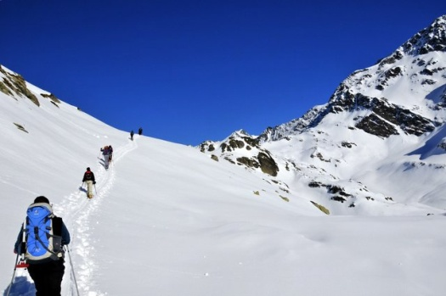
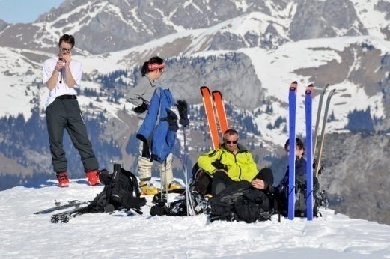
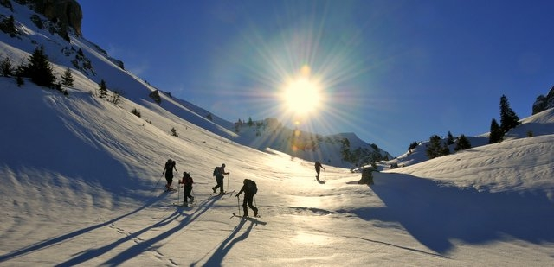
Ski touring – how it works
Pre-registration http://cern.ch/club-ski
  Payment: Pay once → participate as many times as you want
  2012 members: online payment (paypal) until 20/12/2012
  New members: must come to the permanence with a valid medical certificate from 15/11 to 20/12 every Thursday @ 1st floor Restaurant 2 (Build. 504) from 18h00 to 19h00.
Subscription to a tour:
  every Thursday @ 1st floor Restaurant 2 (Build. 504) from 18:00h to 19:00h
  From January to April.
  → you need to register personally,
  no subscription by e-mail or phone!
  Travel costs:
  We use personnel and share expenses.

Slide 27
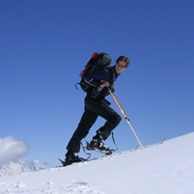
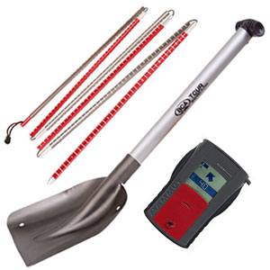
Ski touring – how it works
You need…
…to carry your back pack ! (we can tell you what to put in ☺)
subscribe to a tour on Thursday evening (personally !)
skis, skins, adequate clothing
Lunch bag and beverages
But also:
adequate physical fitness (reach the summit in a good shape to enjoy the descent!)
- good level of skiing (not stylish…but safe in all snow and weather conditions !)
DVA + Shovel + Probe are MANDATORY !

Slide 28


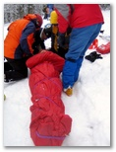
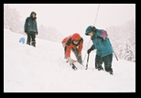
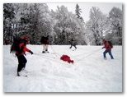
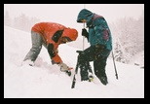
Ski touring – how it works
Members can borrow equipment :
  (for club tours only!)
  DVA, Shovel, Probe
  Maps, books
3 DVA training ½ days will be organized, consult the program.

Slide 29

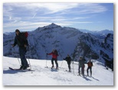
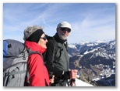
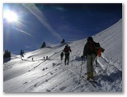
Ski touring – Program
(May change during the season!!)
Scheduled Events in 2013:
3 ½ DVA training days
More than 50 one-day tours:
French and Swiss Alps
Several week-end tours
Section day in the French Alps:
Canadian dinner: in May 2013
Please check frequently for changes:
https://sites.google.com/site/cernskiclub/bienvenue/randomainfr

Slide 30
More information
http://cern.ch/club-ski

Slide 31
Questions?
Preguntas?
Questions? Pytania?
Fragen?
Domande?

Slide 32
Drink

