Slide 1
Future of networks
Avi Cohen , David Moses

Slide 2
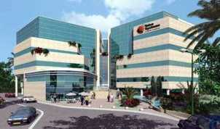








BATM Group
Established in 1992
London Stock Exchange – symbol BVC.l
Turnover of ~150$M
Divisions:
  Telecom & IT
  Medical
Installed over 300,000 systems valued at over $2.5 billion
Over 700 employees:
  most researchers and engineers:
  Software and Technology focus
Headquarters:
  ISRAEL - Hod Hasharon
  USA - Massachusetts
  Europe-Rome
R&D facilities:
  Israel and East Europe
Green initiatives
  Energy efficient products

Slide 3
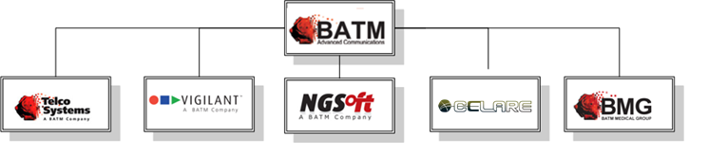
BATM Group
  Telco Systems - Telecom IP products
  CELARE – Cyber Security solutions
  NGSoft - Software and Projects
  Vigilant – Video Surveillance solutions
  BATM Medical group– Medical solutions and diagnostics

Slide 4
BATM Group
Why BATM?
All BATM products are top energy efficient (30-70% less than any comparable equipment)
Highest density in the industry
Production-U.S,Italy, France, Israel,Hungary, Romania, Bulgaria, Germany(Software &Hardware)
Support all over Europe
Successful history of co-development with CERN (ATLAS)

Slide 5
Future of Networks
Enterprise Cyber security :
  Network behavior monitoring
  Network Behavior Anomaly Detection (NBAD)
Network Function Virtualization (NFV):
  Software based Networking
  New carrier edge networks

Slide 6
Network Behavior Monitoring
The Problem:
  Insider threats !!!!
  Assumption: Even heavily secured networks have vulnerabilities and probably are already infected (HUMINT , lack of procedures, targeted attack).
  Networks becomes huge and complex
  New threat are not detected by conventional security technologies ( FW, DLP…)
  How to identify new threats (APT’s) ?

Slide 7
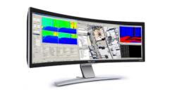
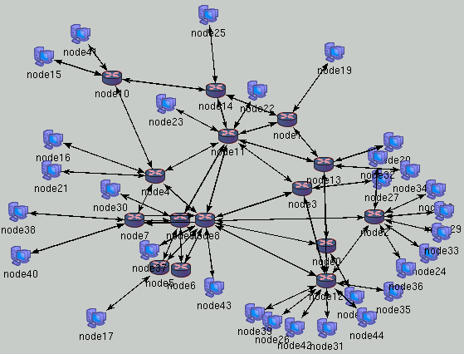


Network Security Monitoring

Slide 8
Network Behavior Monitoring
What we can do:
  Providing IT/Network professionals compressive set of behavioral investigation tools to better understand what is happening in their network !
  Overall view of large networks
  Recording of all Network sessions(Interception)
  Reporting (BI)
  DPI Based Firewall (User side)
  Automation (NBAD/NBID)
    Network Behavior anomaly detection
  Building Correlations and Scalability

Slide 9
Network Behavior Monitoring
The solution :
  Large deployment of Integrated Switch/Probes (collectors)
  Aggregators (UI,DB, ATCA)
  Investigation & Management tools
  Recording of all relevant network data session
  Modular and scalable
  Inline or Tap device
  low cost !!!
  Ultimate platform for Network Cyber protection and investigation

Slide 10
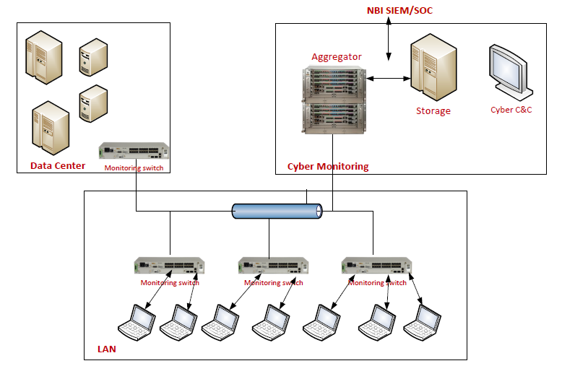
Solution overview

Slide 11
Platform capabilities
DPI (L4-7)
Data Base
DB
Other:
Filtering, DLP, Video
Encryption
AES or Custom
L2-4 Processing
Load Balancing
Network behavior Anomaly Algorithms (NBAD)
Business intelligence (BI)
Interception
DPI Based FW
Interception
Business intelligence (BI)
DPI Based FW
NBAD
API

Slide 12
Technology Building blocks
C &C
Database
DB
NBAD
Algorithms
BI
BiNOX
L2-4 OS
Data Plane SW
DPI SW
Packet Processing
Network Processing
Multicore
Processing
Custom
HW

Slide 13
Recognized protocols and applications by signature/behavior
Mobile
VOIP
Streaming
WEB
Instant Messaging
Mail
File Transfer
Remote Access
Native IP
P2P

Slide 14
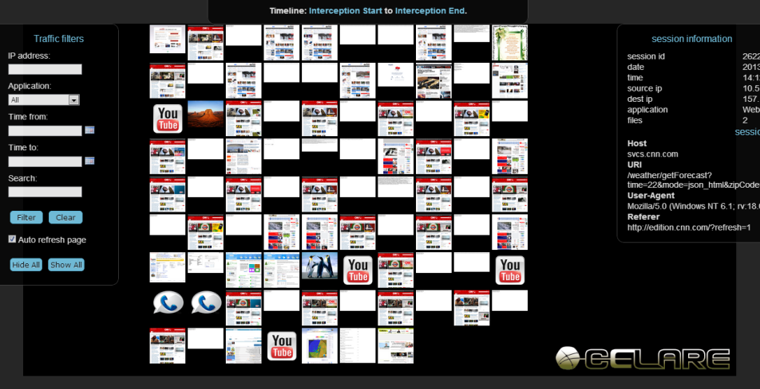
Interception Visualization tool

Slide 15
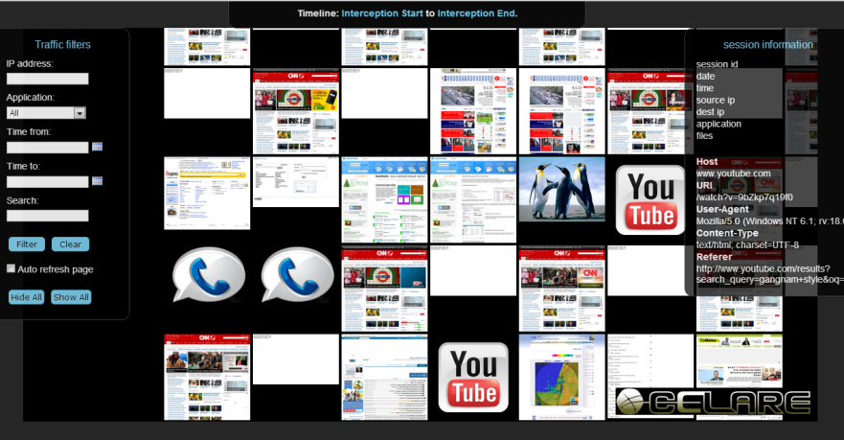
Interception Visualization tool

Slide 16
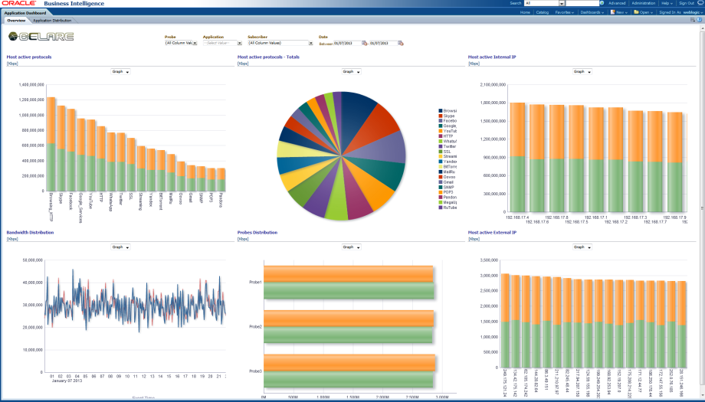
BI Reports

Slide 17
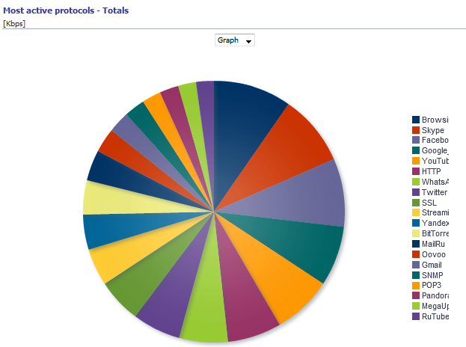
BI Reports

Slide 18
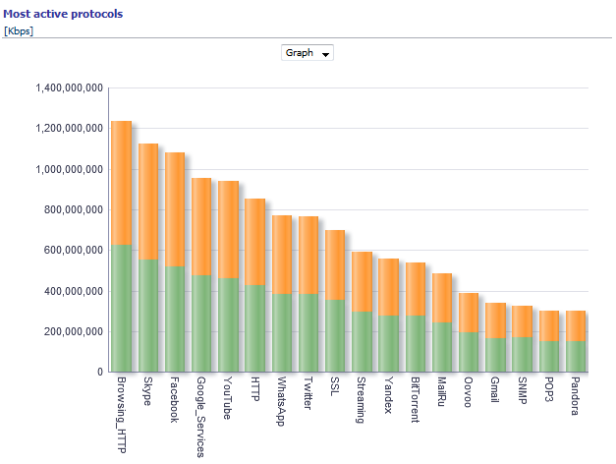
BI Reports

Slide 19
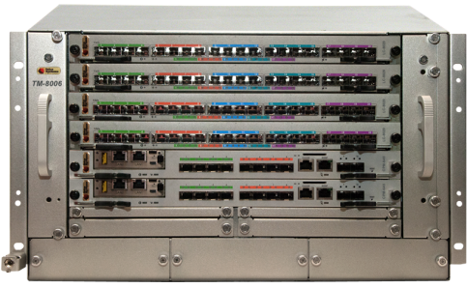

T-Metro 8000 - 1Tbit/s platform
Crypto (Custom)
NBAD (Application CPU)
Database (Application CPU + Storage)
DPI engine (Multicore CPU)
40GE Switch (redundancy)
40GE Switch

Slide 20
Virtual Carrier Infrastructure
Tier1 Carrier motivations:
  It is happening already in the Data Center market
  Cost Reduction
  Vendor-neutrality.
  Radical improvement in service delivery and service operation .
  Introduce new innovations to SW based services (App store)

Slide 21
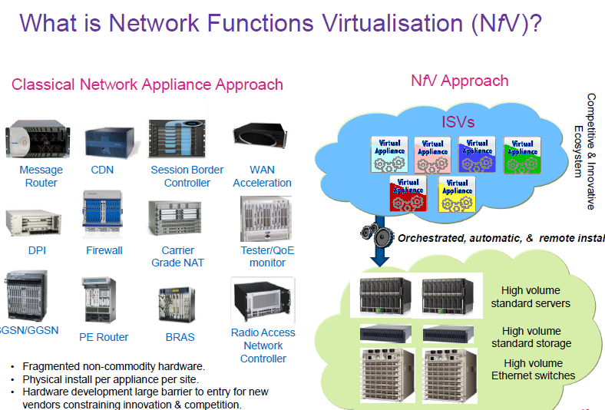

Slide 22
NFV WORKING Groups
Architecture of the Virtualization Infrastructure | Andy Reid | andy.bd.reid@bt.com
Software Architecture for Network Functions | Karl-Heinz Nenner | karl-heinz.nenner@telekom.de
Performance and Portability | Francisco Javier Salguero | fjrs@tid.es
Reliability & Availability | Naseem Khan | naseem.a.khan@verizon.com
Management & Orchestration | Diego Lopez | diego@tid.es

Slide 23
Carrier requirements - the new network
It should be based on general purpose platform. (i.e IA servers)
When network switches will be used they should be simple with open flow or open software control .
The HW must be vendor-neutrality.
Elements like cloud management , images storage from the enterprise cloud (OpenStack ). Make it open for new services .

Slide 24
How the network will look like ?
Network Edge will be intelligent and flexible
  IPV4 , IPV6 , user isolation, policies QOS etc..
  SW based .
The core will be simple
  Fast forwarding , Fabric
  MPLS based .
Edge and Core control will be “SDN “ based .
Separate control plan Edge and Core .

Slide 25
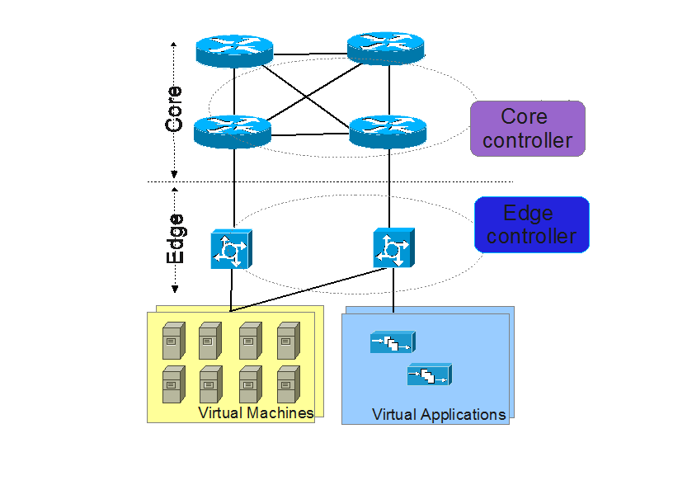
New network - high level concept

Slide 26
New network - high level concept
All Virtual machines will served the Edge application
The Virtual Appliance/Applications will be downloaded to the VM on demand.
Replacing the HW dedicated appliances
Separation of controls (Edge and core) ,gives smooth integration to existing infrastructure

Slide 27
Why it will ADDRESS the carrier need
Most of the innovation is on the network edge
The Edge is the users facing to network and need to be flexible. (ipv4 , ipv6 , QoS , security ,new app ..)
The core is simple and could be less fixable .
Current carrier core infrastructure (MPLS ,PBB, or IP ) can be easily connected to the new network.

Slide 28
Possible Network Architecture #1
Compute Units
Virtual Applications
FW
DPI
Router
NAT
VPN
Cloud
Central Office
Public Network
D.Switch
Simple Switch
Fat pipe
D.Switch

Slide 29
Possible Network Architecture #2
Compute Units
Virtual Application
FW
DPI
Router
NAT
VPN
Central Office
X86 HW
Public Network
User Side
D.Switch
Fat pipe
D.Switch
SDN Controller

Slide 30
Architecture Advantages
It can be scale up by adding more blades and switches as needed .
Pay and Grow as you need .
Energy efficient .
  Shut down blades
  Buy more CPU power .
It can be geographically separated .
Agile .
Vendor independent.
Same HW can run multiple applications:
  DPI ,FW, NAT , Load Balancing per service , etc .

Slide 31

e

