Slide 1
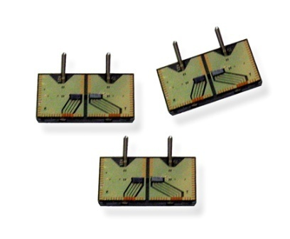
120GB-300Gb Optical Interconnect Solutions for Optical backplane and Optical Routers
TECHNOLOGY
&
MANUFACTURING
March, 2013
Presenting: Avner Badihi
XLoom Proprietary and Confidential

Slide 2

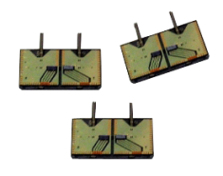
iFlame™ Technology -
Platform for Optical Integration
Optical Cross-Connect
Optical Subsystems
Modules
Transceivers & Cables
- Ethernet
Mux / Demux
- InfiniBand
Optical Router
Integrated
ROSA & TOSA
- Back plane
Subassemblies
iFlame
- Inter-Board connections
ROADM
- Fibre Channel
- Active Optical Cables
AWG
XLoom Proprietary and Confidential

Slide 3

Agenda
Technology Overview
Product Manufacturing and Cost Analysis
Appendix
XLoom Proprietary and Confidential
3

Slide 4

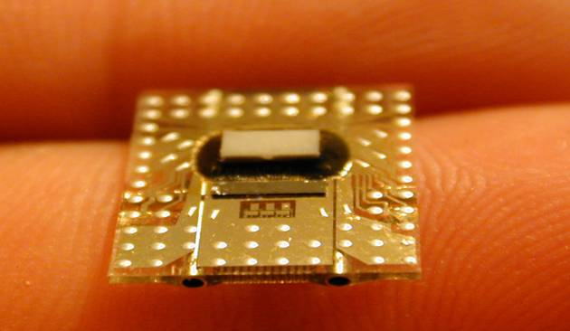
XLoom Micro-Optical Technology
Solves Density, Power and Reach
XLoom Patented Technology
Miniature scale optical-to-electronic conversion
Commercially-available lasers/photodiodes and circuits
Aligned and assembled on the wafer level (6” in process)
Standard semiconductor micromachining processes

Slide 5
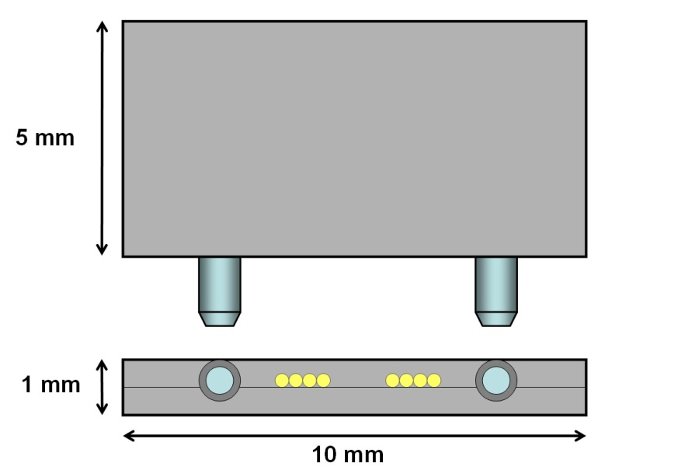
iFlame Technology
Wafer-level assembly – simultaneous alignment of >200 optical chips
Passive Alignment – automation possible
Array Optics – multiple channels assembled simultaneously
Low Profile – multiple environments/applications
XLoom Proprietary and Confidential
5

Slide 6
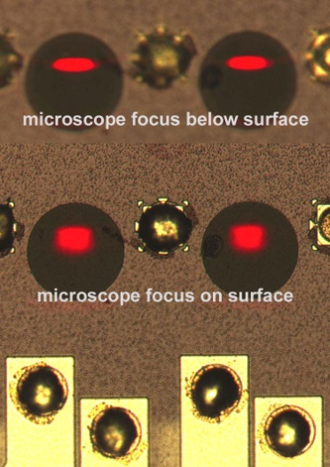
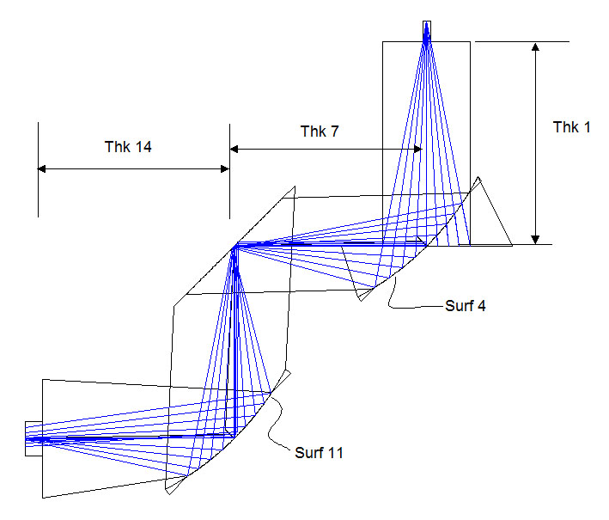
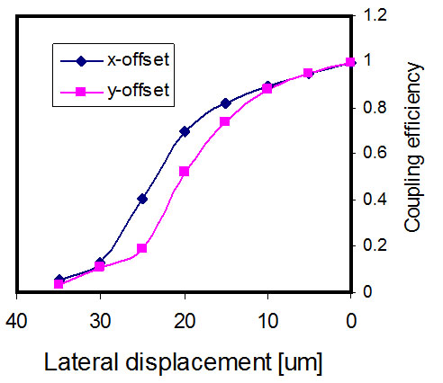
iFlame Optical Design
Ray-tracing optical design
(sequential analysis, using ZEMAX®)
Focus on flat mirror
Near-field pattern at detector
Example of offset z-focus
Imaging 1:1
Acceptance angle > NA of fiber/ VCSELs
XLoom Proprietary and Confidential
6

Slide 7
Light-Coupling Scheme
protective cap
reflectors
reflector bar
epoxy
fiber
substrate
VCSEL/PD
metal traces
XLoom Proprietary and Confidential
7

Slide 8
Agenda
Technology Overview
Product Manufacturing and Process
Appendix

Slide 9


Production Plan Processes
Wafer
Preparation
Fiber Ribbon
Preparation
Lens Strip
Preparation
In process testing
Wafer Level Processing
Chip Assembly
Flip Chip
In process testing
Chip Level Processing
XLoom Proprietary and Confidential
9

Slide 10
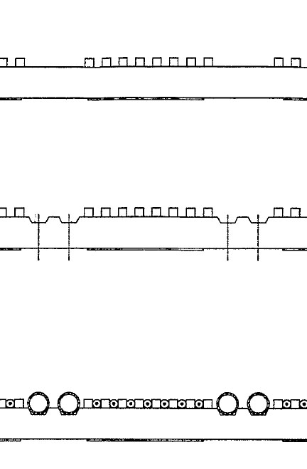
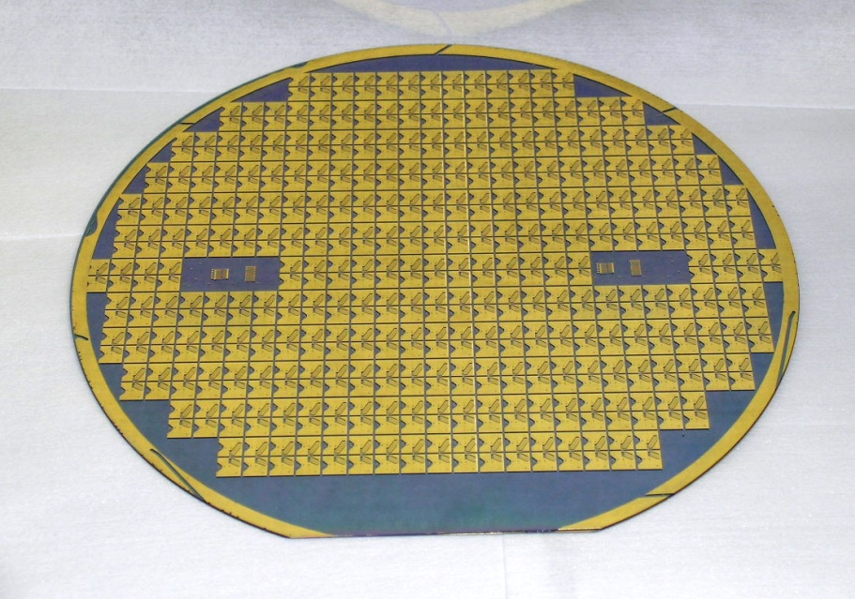
Wafer Level Processes
V-grooves
Structure is repeated in 2D on a 6” or 8” wafer
Grooves created at the same time on all devices
Simultaneous alignment of all devices
Lead free (ROHS) SAC Alloy bumps
silicon/glass
grooves
MT pins
fibers
Patterned device wafer ready for saw

Slide 11
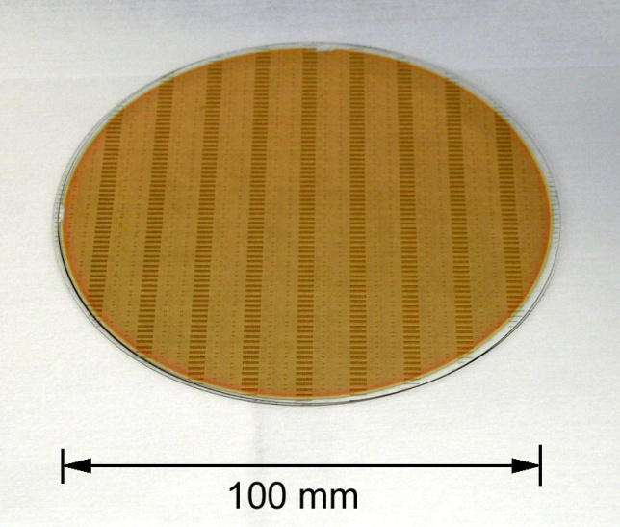
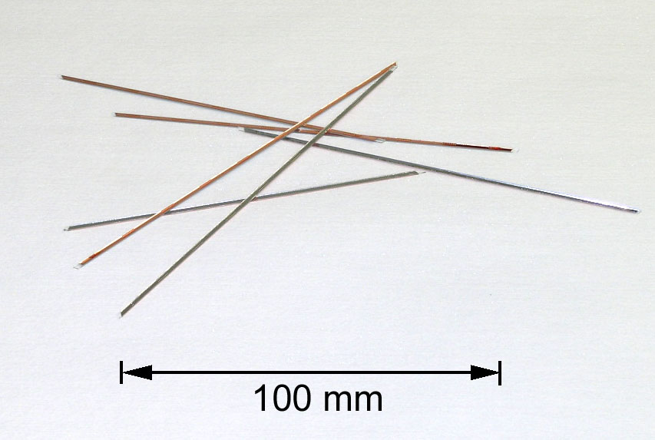
Lens Bars Placement
Lens/Reflectors bars are manufactured separately on in wafer form, cut, and attached to device wafer using an automated machine (passive alignment)

Slide 12
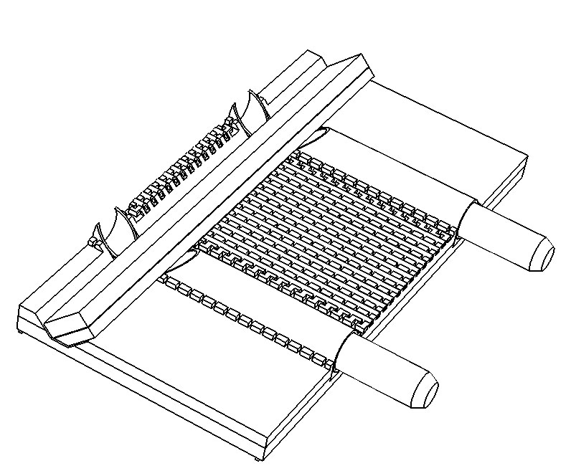
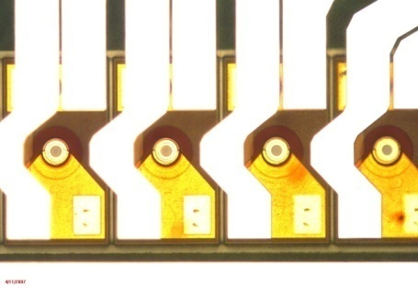
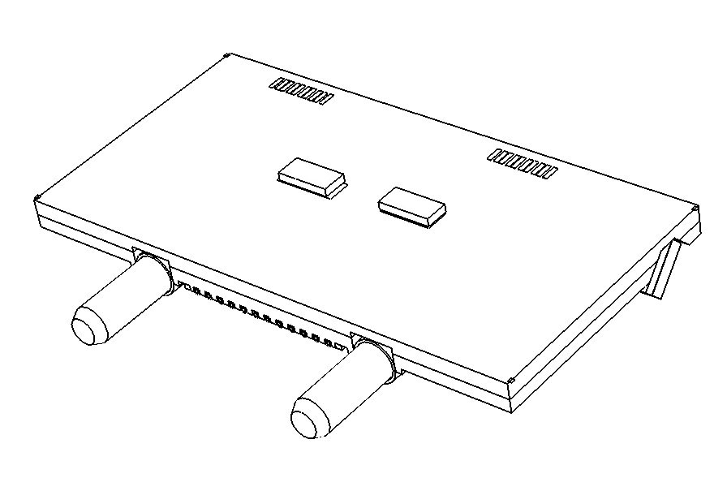
iFlame Optical Chip Structure
reflector bar
Mounted VCSELs
seen from optical side
VCSEL array
PD array
XLoom Proprietary and Confidential
12

Slide 13
iFlame 12X10Gb/s Specs
Compliant with 100GbE specifications 802.3ba (100GBASE-SR10 and nPPI)
High Channel Density: 120Gb/s
Operates at 10.3125 Gb/s per channel with 64b/66b coded data
Links up to 100m using OM3 MM fiber and 150m using OM4 MM fiber
0 to 70ºC case temperature operating range
Two Wire Serial (TWS) interface with maskable interrupts for expanded functionality including:
  Individual channel functions: channel disable, squelch disable, and lane polarity inversion
  A/D read back: module temperature and supply voltages, per channel laser current and laser power, and input receiver power
  Status per channel: Tx fault, electrical (transmitter) or optical (receiver) LOS, and alarm flags
XLoom Proprietary and Confidential
13
XLoom Proprietary and Confidential

Slide 14
iFlame 12X25 / 4X25 Gb/s Specs
FDR & EDR full specifications are not released yet
High Channel Density: up to 300Gb/s
Operates at 25.8 Gb/s per channel .
Links up to 30m using OM3 MM fiber and 100m using OM4 MM fiber
0 to 70ºC case temperature operating range
Bit Error Rate ( BER ) < 10⁻¹⁵
Optical Power 1mW
3 possible configurations
  12x module – Tx, Rx – MPO connector
  QSFP type active cable 4x
  4x module – Tx, Rx – MPO connector
Incircuit flux (optical spot)- <19um
XLoom Proprietary and Confidential
14
XLoom Proprietary and Confidential

Slide 15
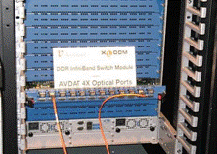
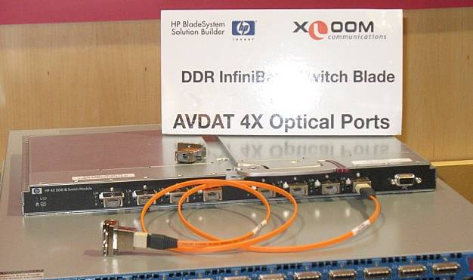
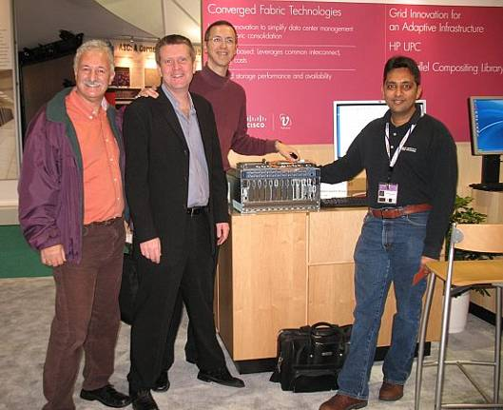

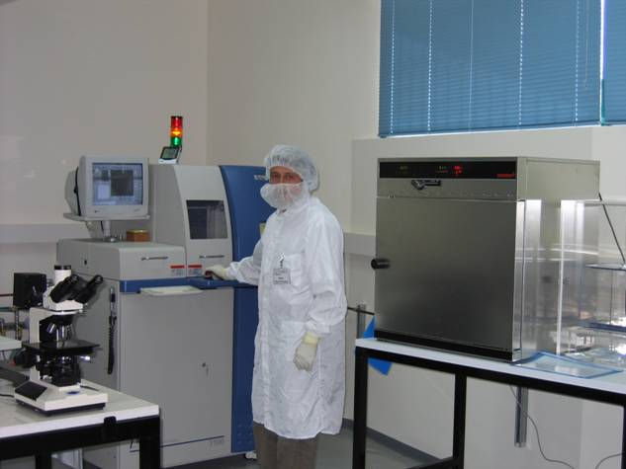
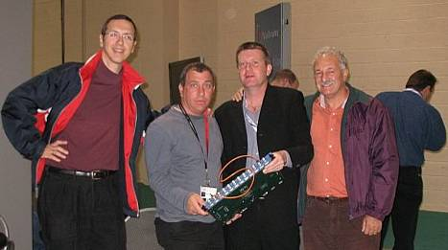
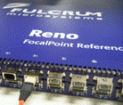



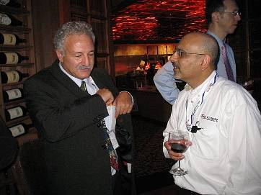

Thank You
XLoom Proprietary and Confidential
15

Slide 16
iFlame Optical Path
Advantages:
Inexpensive (using flexible circuits)
Used widely in the industry
Disadvantages:
Large minimum height is (> 1 cm)
Signal integrity problems at high line rates
iFlame Advantages:
Very high channel density
Potentially very low profiles enabling ultra-small transceivers
Disadvantages:
Difficult technology (in general)
electrical turn
optical turn
XLoom Proprietary and Confidential
16

