Slide 1
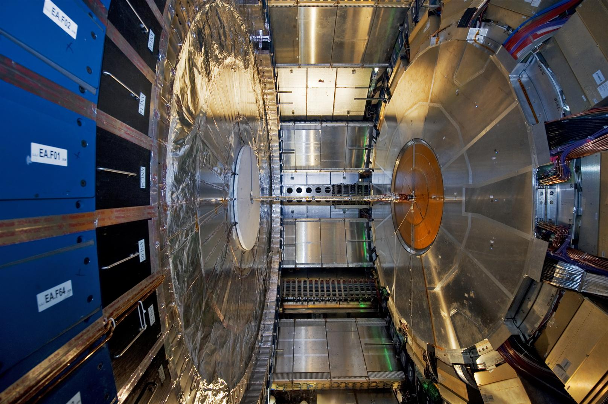
ATLAS Wireless Personal Safety and Supervision System
- EDUSAFE-
O. Beltramello – 04.03.2013

Slide 2
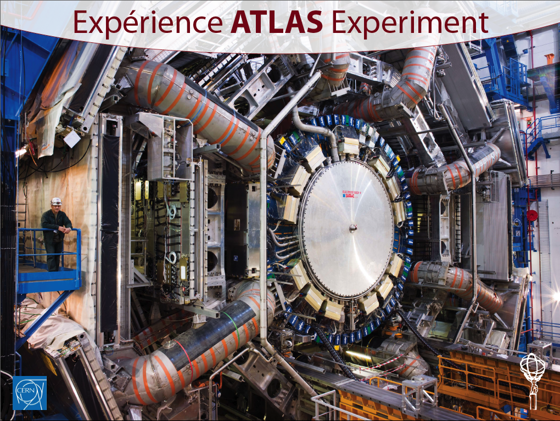
What is our problematic and why we need a supervision and safety system for our personnel ...

Slide 3
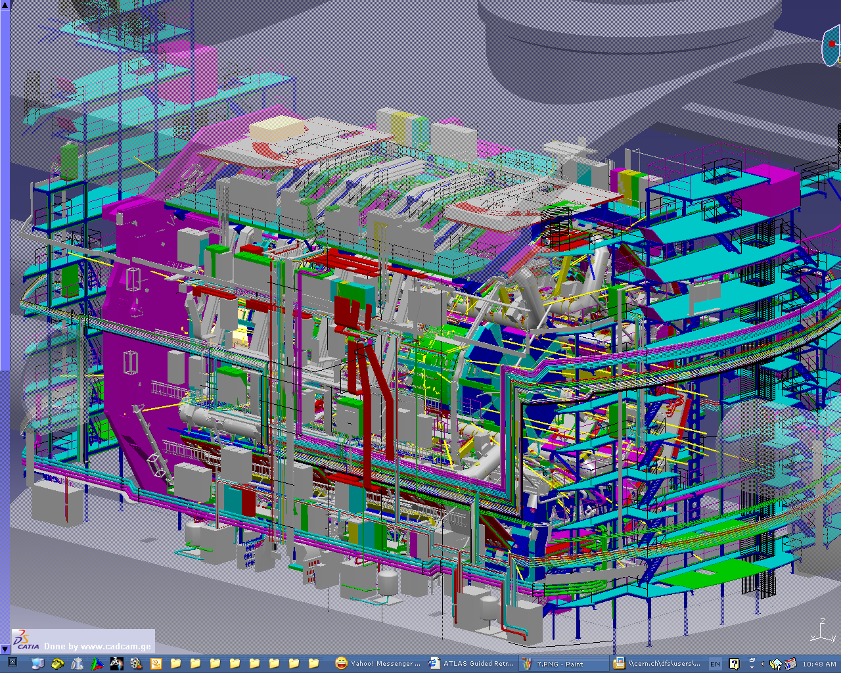
ATLAS is a very complex environment ...
.... 100 meters below ground

Slide 4
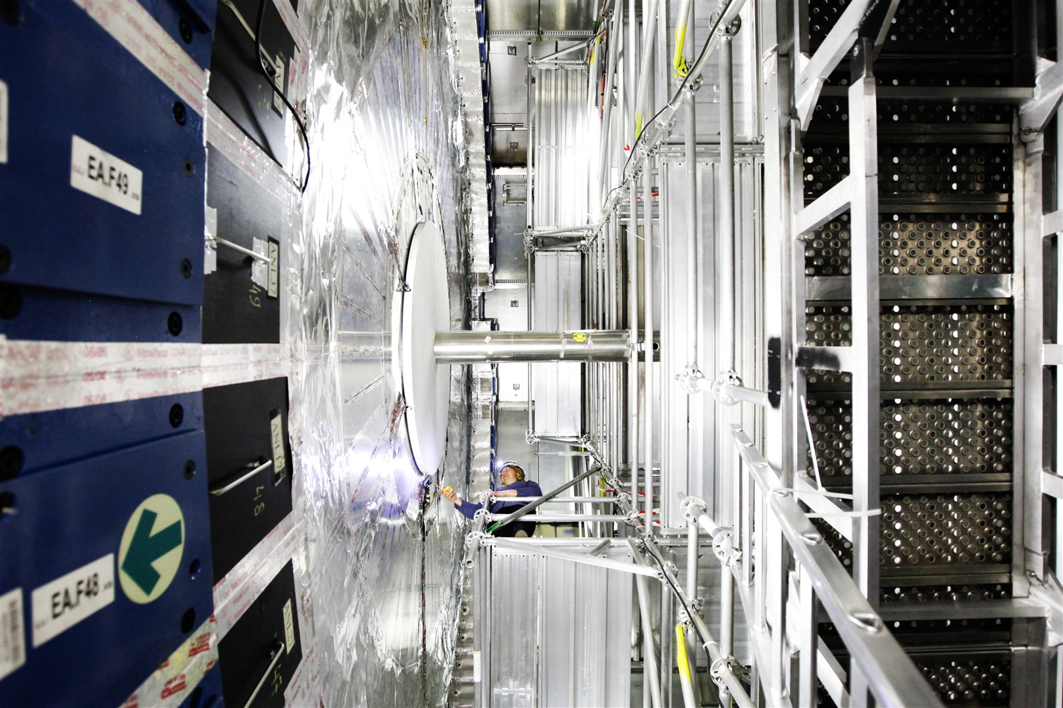
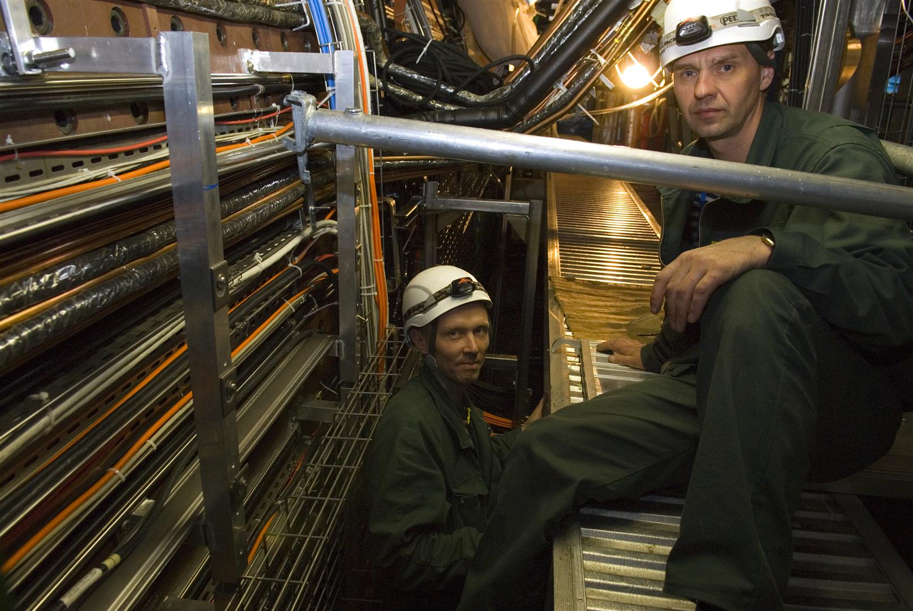
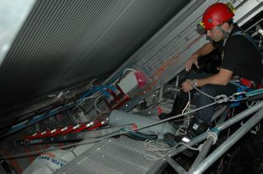
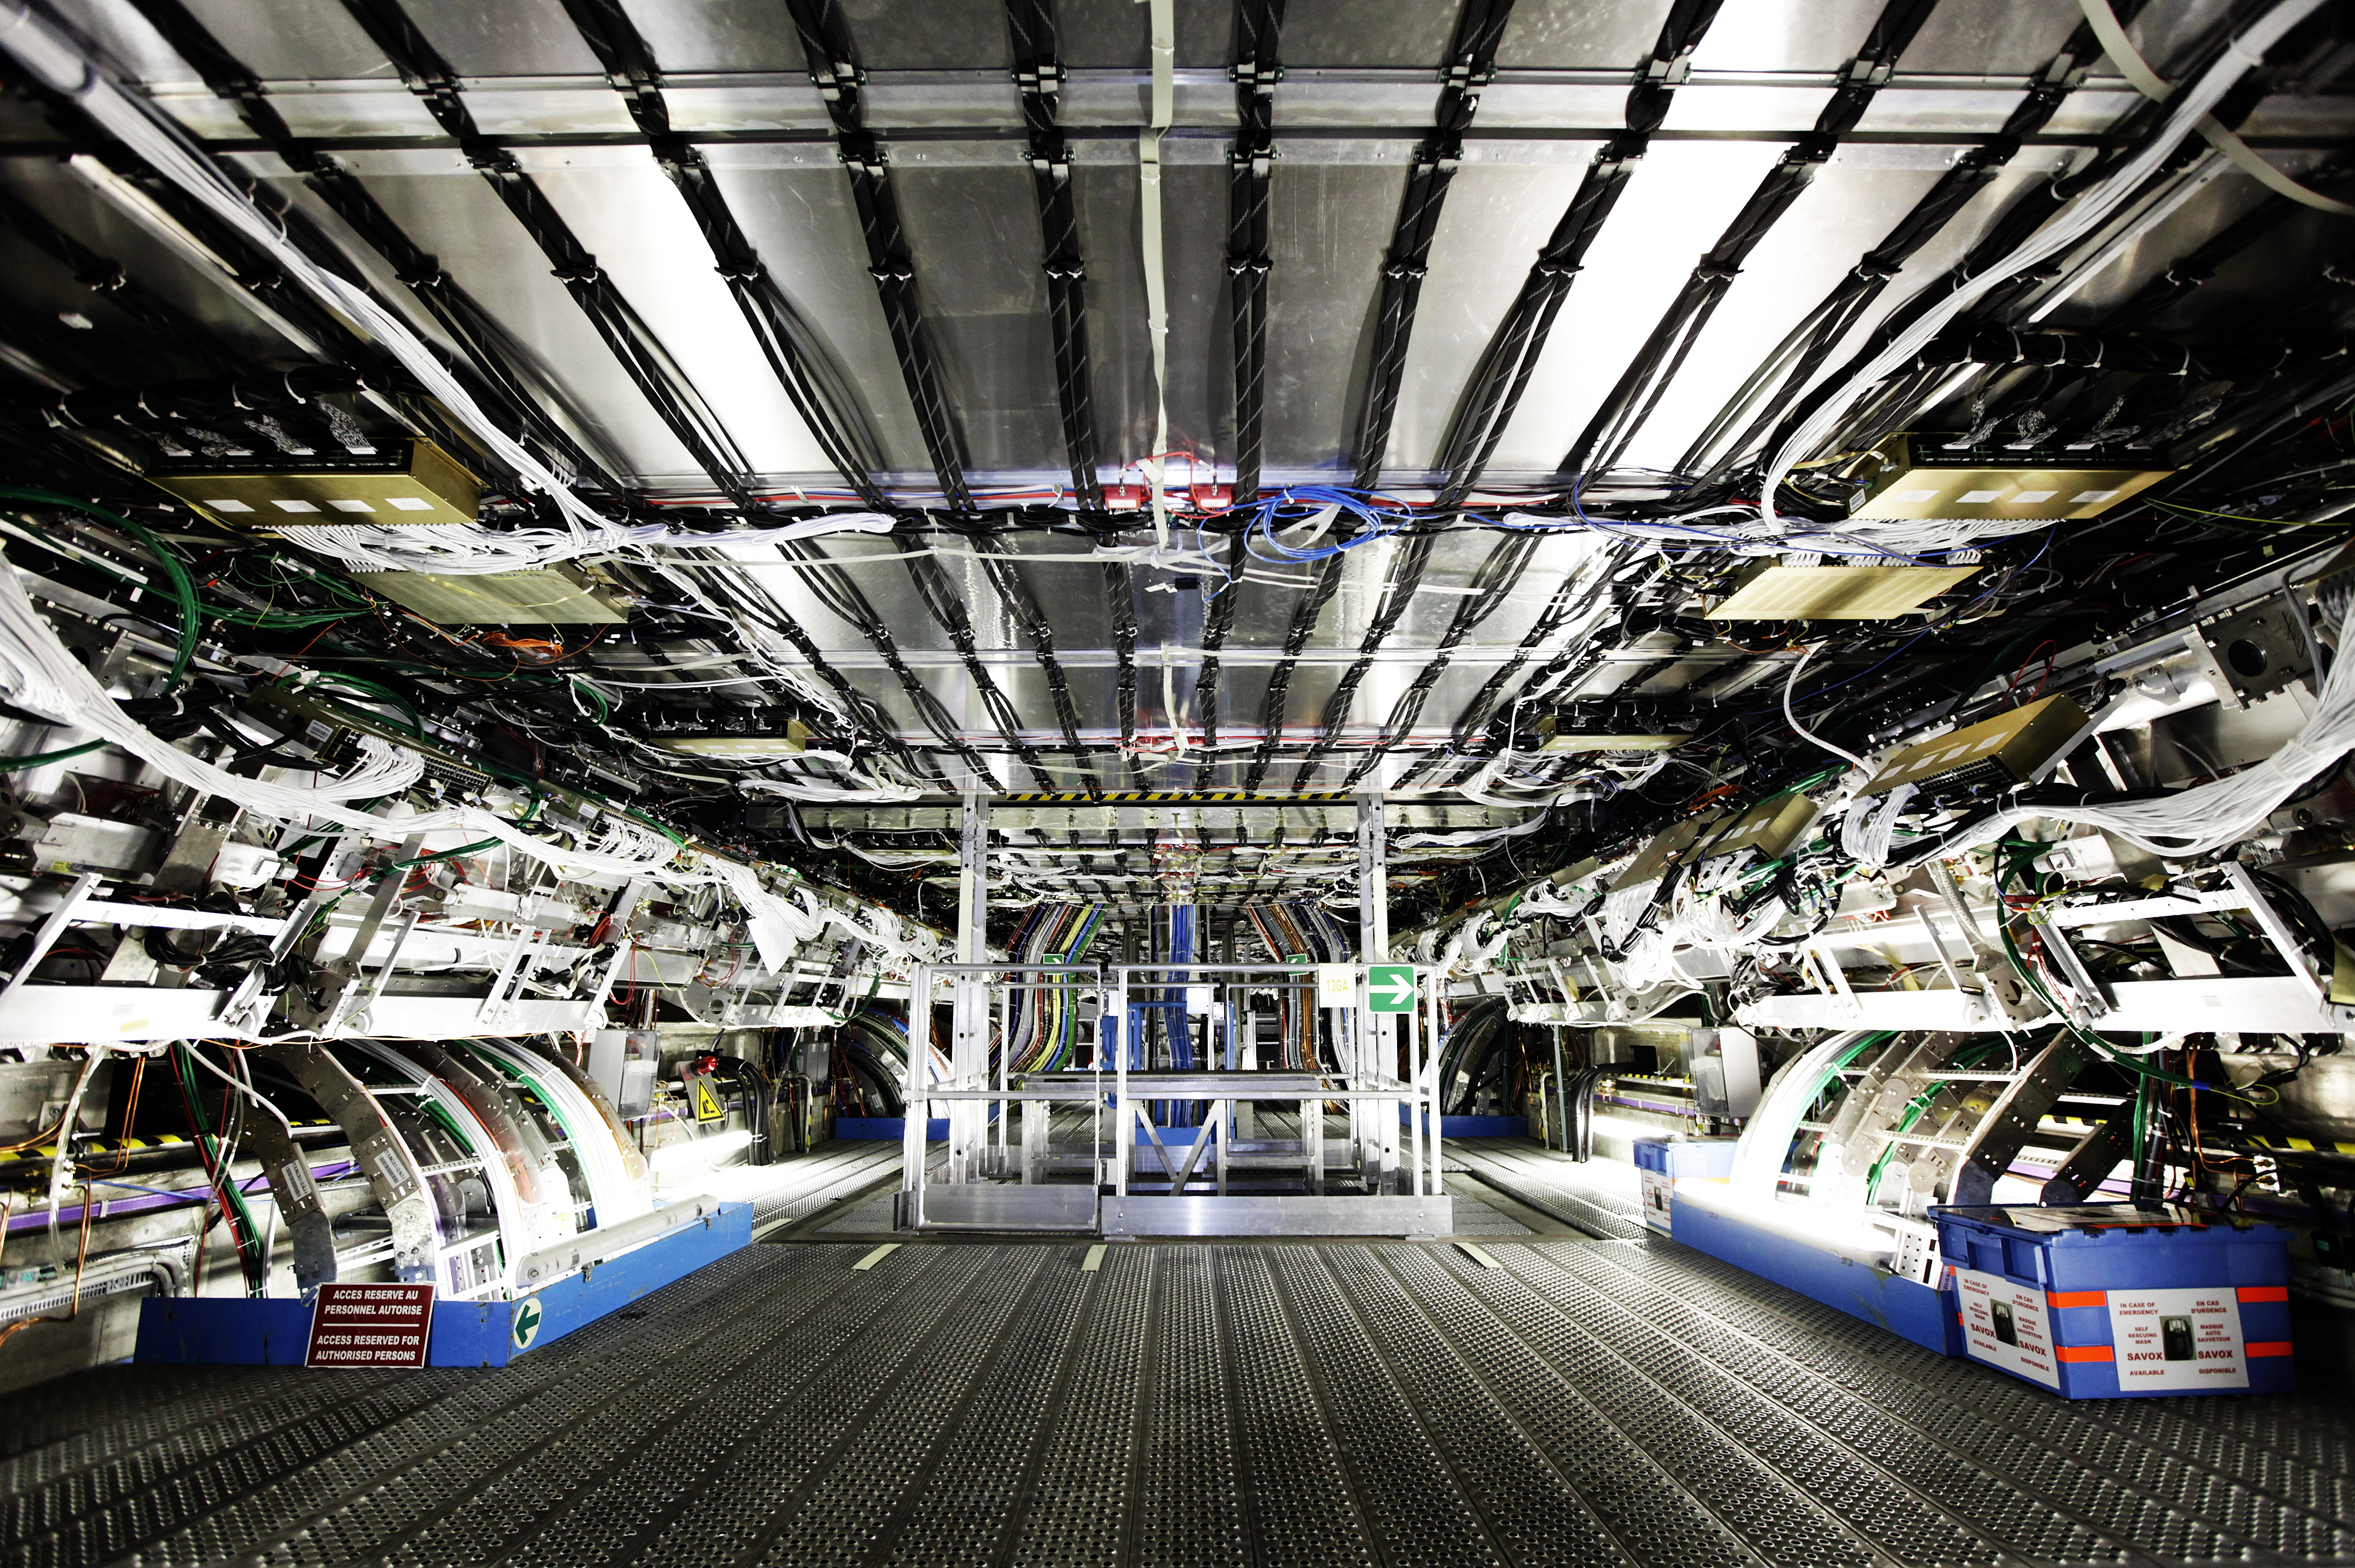
Hundred meters of platforms, ladders, holes,
Scaffoldings...
Confined spaces
Harness is mandatory in some areas.

Slide 5
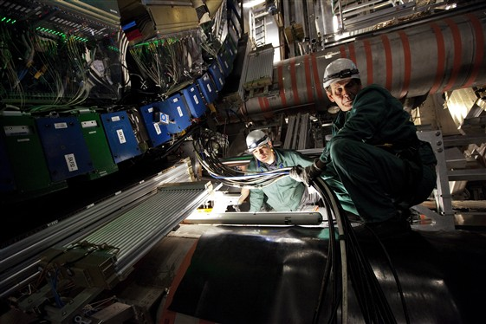
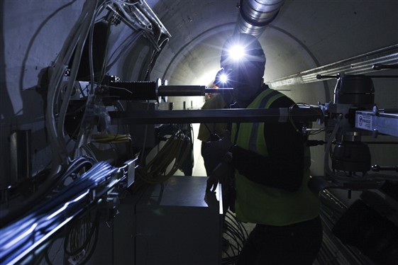
Lightening changing and not always optimum ...

Slide 6
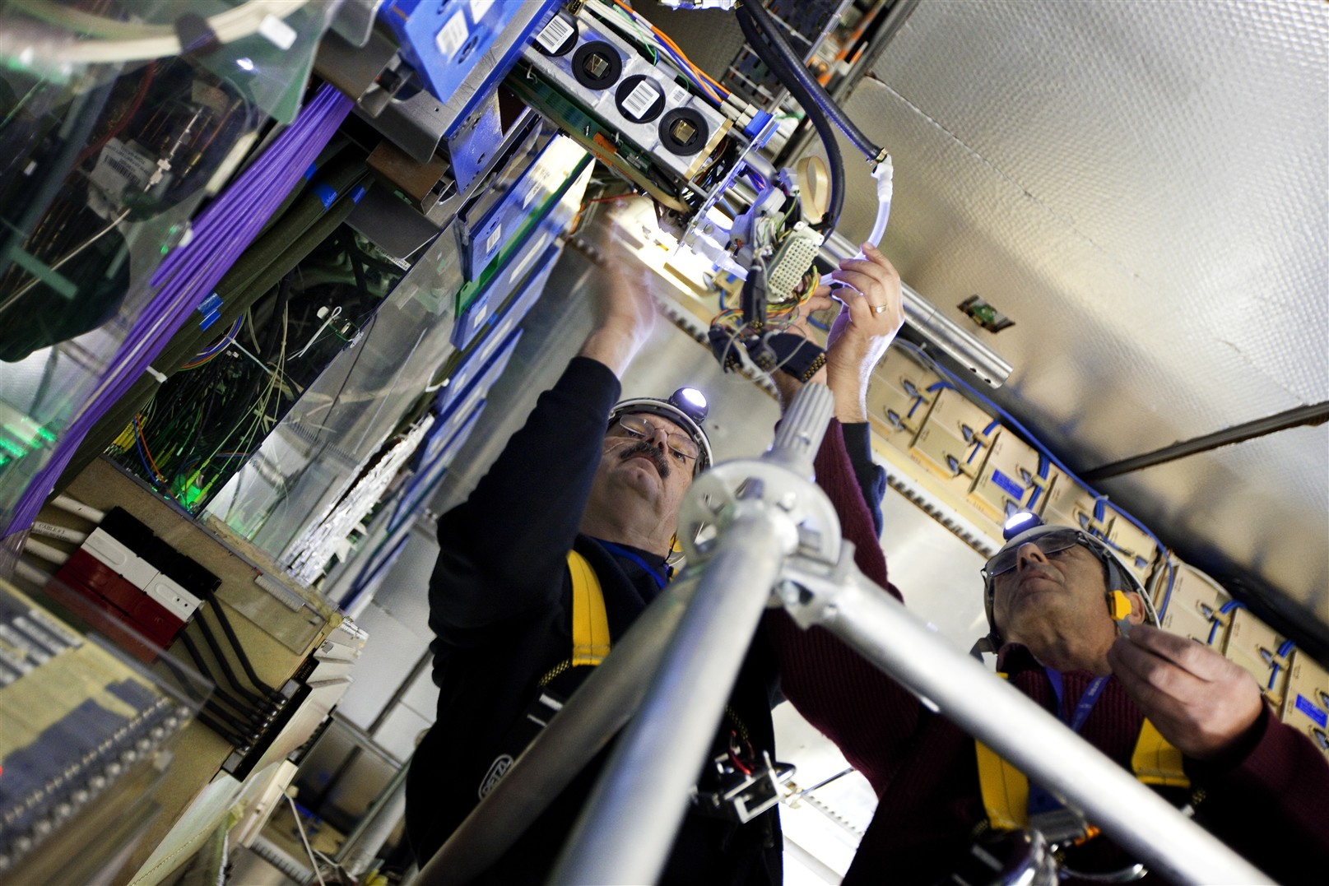
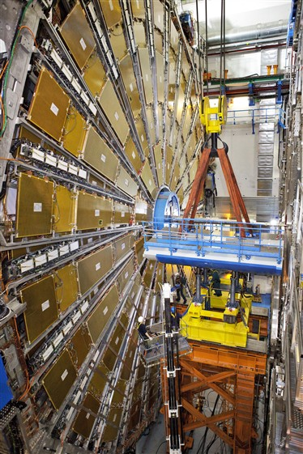
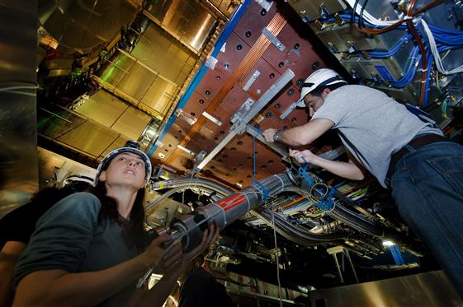
The activities are very different
from very detailed detector expertise work ..
...to heavy loads transport

Slide 7
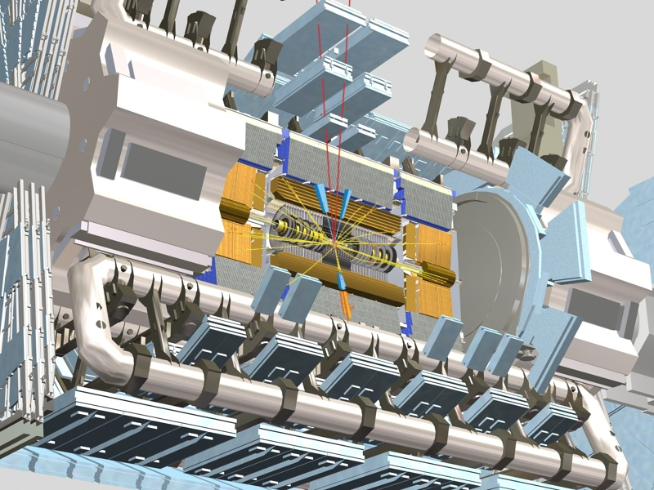
ATLAS is full of potential dangers:
- Magnetic field (1.2 Tesla in the environment)
    - Cryogenics: Liquid Argon (90 m³, –183°C ), Liquid Helium, (11000 l,–268°C), Liquid Nitrogen (15 m³)
- Gases (Argon,...) and flammable gases (n-pentene)
- CO2 in the heart of the detector (from 0.1 % to 2 %)
... and increasing with the beam luminosity: radiations

Slide 8
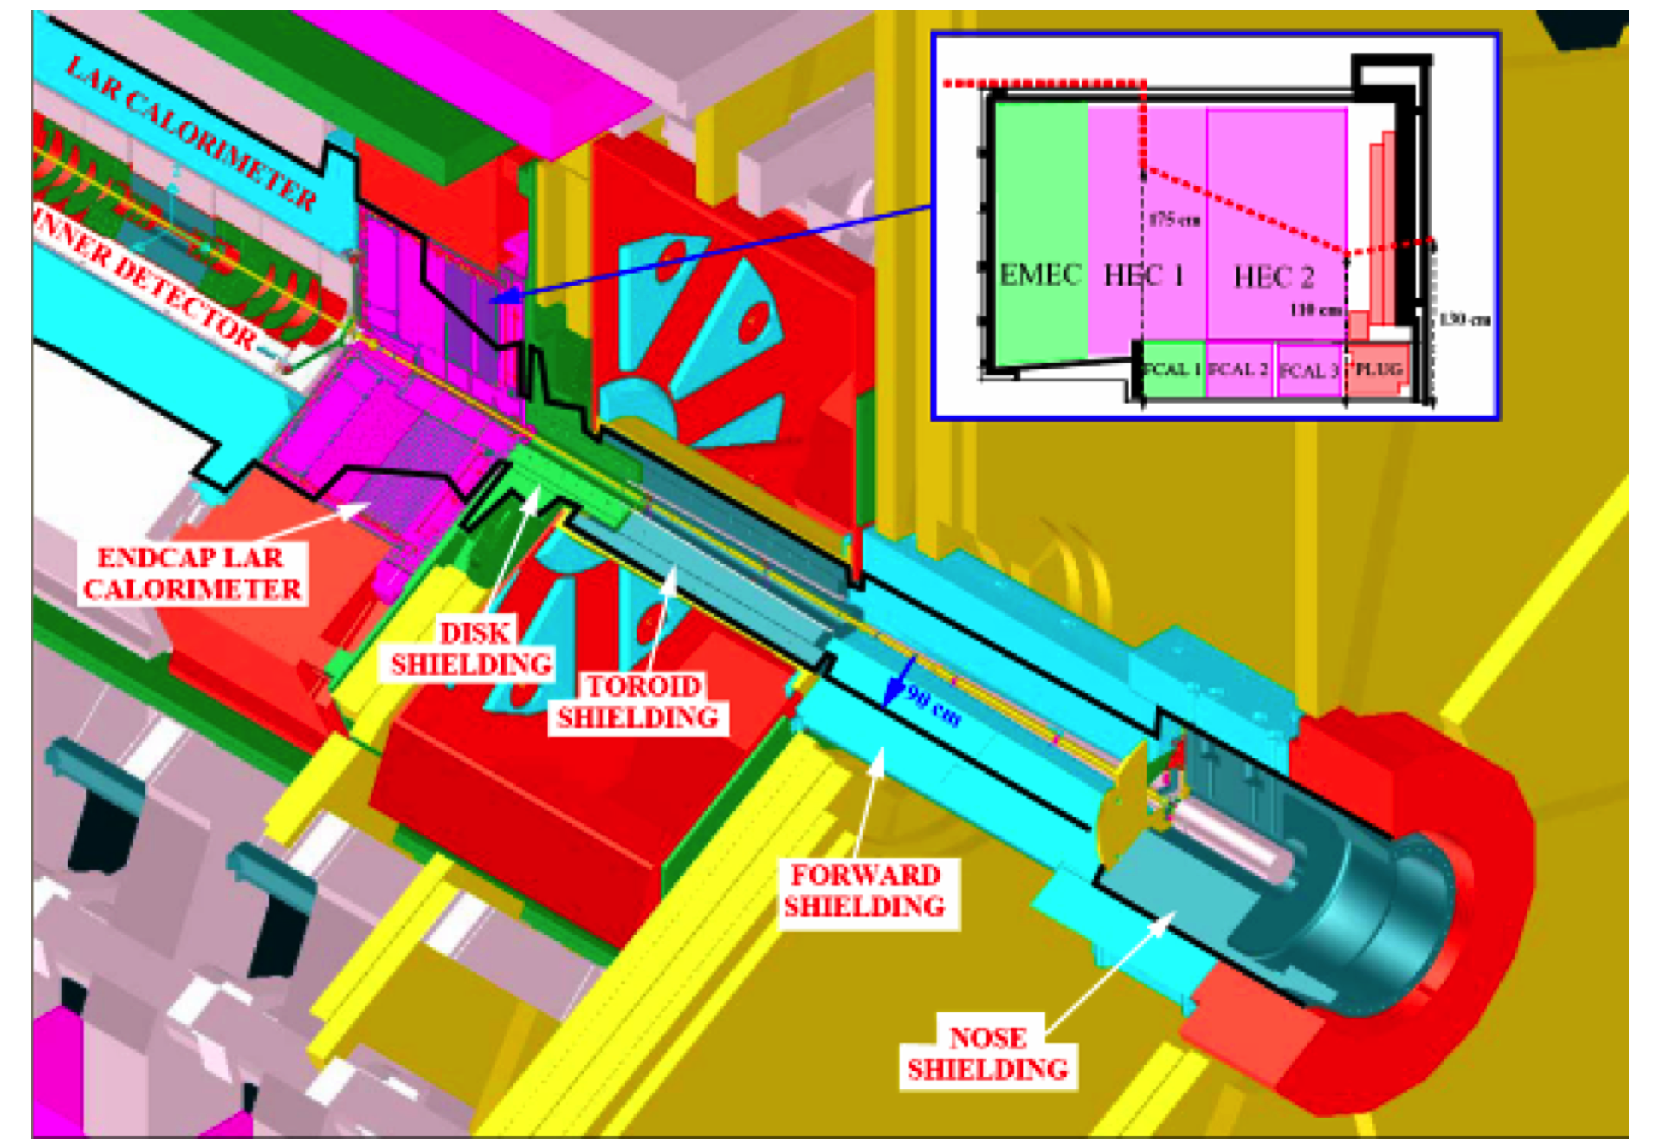
➔ the radiations levels and generally the level of risks faced by our personnel in the coming years will increase by a lot.
We need an ATLAS safety upgrade program aiming to assist them and eventually to replace them to perform these tasks.
It is developed in several stages following the ATLAS Upgrade Program

Slide 9
1. Development of the ATWPSS system, ATLAS Wireless Personal Safety and Supervision system:
the goal is to improve safety of personnel intervening in high radiation areas for planned interventions or in case emergency.
We are supervising them, their environment and their activities :
  audio / video connection
  monitoring of environment parameters: dose rates, gases, T, H
  monitoring of their health data (heart rate, internal T, stress levels, detection of fall, etc..)
We are providing the worker information
  various infrastructure of display systems: IPAds, HMD,..
  from various nature: working procedures, environmental data (especially the dose maps), systems data, etc..
  using virtual and augmented reality technologies
This system increase the safety levels of the personnel, reduce the errors, decrease the time needed during the interventions and reduce the stress linked to these interventions

Slide 10
The ATWPSS system is developed in several stages :
  a pre prototype already designed and manufactured (virtual reality)
  augmented reality technologies should be developed much beyond the current state of the heart, and integrated in the system as well as other cutting edge technologies:
  Currently done within the FP7 Marie Curie EDUSAFE Initial Training Network program.
3.2 ME budget
1st Sept. 2012 – August 2016
10 Early Stage Researchers (ESR)
2 Experienced Researchers (ER)
  R&D initiated within EDUSAFE to developed further via other EU funding.
2. Development of remote handling and robotics technologies towards the ATLAS/CERN needs for the maintenance and upgrade activities with high radiation risks.
The ATWPSS and the especially the Augmented Reality and related technologies will be integrated and adapted to the robotics/ remote handling development program.

Slide 11










This safety upgrade program is run by the ATLAS Safety group within the
ATLAS collaboration.
We want (and we need) to extend our collaboration to partners external to the ATLAS Collaboration.
This is (and must be) done within the ATLAB framework !
We will complement the funding via various EU programs.
Currently the following institutions/industries are collaborating on the project :
Athens University of Economics and Business, Greece
Canberra, France
CERN / ATLAS
EPFL, Switzerland
Novocaptis, Greece
National Technical University Athens, Greece
Prisma Electronics, Greece
Technical University of Munich, Germany
Universita Degli Studi Di Roma Tor Vergata, Italy
Aristotle University of Thessaloniki, Greece
CAEN University, France
Democritus University of Thrace, Greece

Slide 12
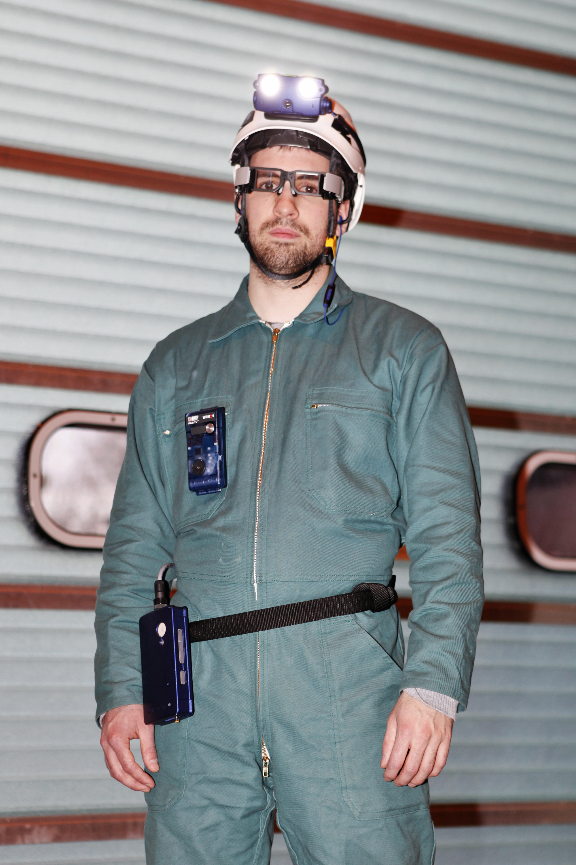
Status of the ATWPSS system development
Several pre–prototypes configurations already
developed and tested in the ATLAS
experimental cavern.
A new version of the system to cope with
the needs of the two years maintenance/upgrade
period of the LHC.
1 Head Mounted Display have been purchased
from LUMUS company and being tested
10 ATWPSS systems are currently in use :
We have already saved radiation doses !

Slide 13
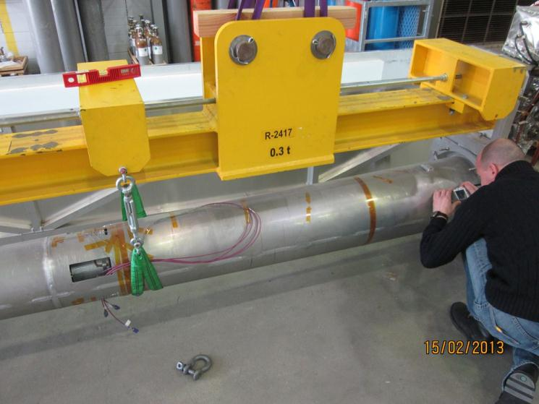
Removal of the VJ beam pipe
Preliminary dose budget ALARA optimization performed
Dry run performed on surface to test and
tune the tooling with vacuum group team
and crane drivers.
Estimated optimized dose rates : 50 μSv per person for the intervention
(*) average dose rate in the area of work
200 μSv /h
(*)
50 μSv /h
(*)

Slide 14
Removal of the VJ beam pipe
We use the ATWPSS prototype for the first time
  some technical issues (related to HW and WIFI coverage)
  we manage nevertheless to use the system during the full intervention.
  we got the vital data : video, audio, dose rates
  we were able to assist / guide the intervention from remotly
We had two serious “incidents”:
  one piece of the BP remained stucked inside the TAS: this unexpected event triggered additional interventions, not planned, made in the hottest areas.
  in some areas, the radiations were much higher than expected
But :
we manage to limit the doses to : 10 μSv per person for the intervention

Slide 15
Further development and EDUSAFE Research challenges
Real time data transmission in difficult wireless environments
Instantaneous data analysis:
- pattern recognition via the WRM technology, weighting resistive matrix (time lag less than human interaction speed)
- pose determination coming from various sources (video, sensors,..)
Real time data visualization methods, VR and AR system architecture optimization, rendering
Integrated control system development adaptable to various environment
Analysis and development of the most appropriate display infrastructure systems, architecture and command methods to visualize data.
Development beyond the state of the art of a light and fast gamma radiation camera and its associated SW with AR features and integrated the system
Portability, wearability, complex interfaces of the personal portable system optimization

