Slide 1
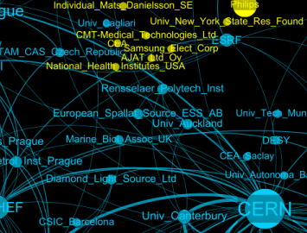
CollSpotting: Big, Beautiful Data
Andrew Grant
STFC
Jean-Marie le Goff
CERN
Notes:
Advanced European Infrastructure for Detectors aida.web.cern.ch

Slide 2
Intro to CollSpotting
How does it work?
What problem does it solve?
Model
What’s next?

Slide 3

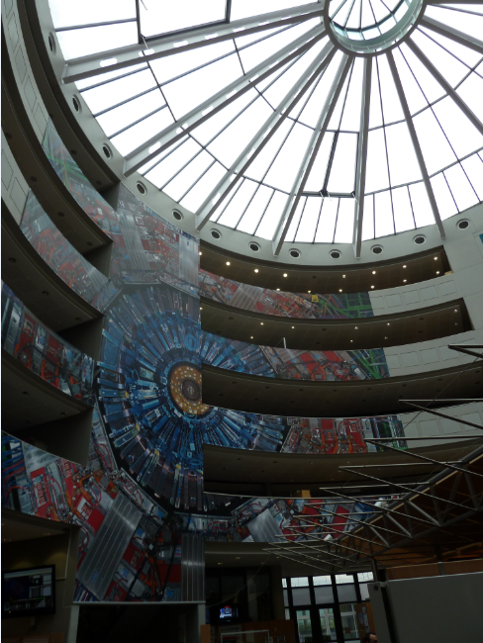

Developed at CERN by Physicists
An FP7 project that
addresses infrastructures required for detector development for future particle physics experiments
We developed the program to help us figure out who the key players at the cutting edge of the 100s of research fields CERN is active in are.
Realised this could be much more widely applicable – which is where you can help!
Notes:
http://collspotting.web.cern.ch/sites/collspotting.web.cern.ch/files/HTML/gexf/index.html#germpub+40cen.gexf
Advanced European Infrastructure for Detectors aida.web.cern.ch

Slide 4
What is CollSpotting?
Software developed at CERN
Identifies relationships between institutions and visualises them
Visualise clusters, who works with whom and who is active in your field of interest
Find closely related topics and hidden connections
Powerful data-mining and visualisation algorithms can be expanded to new areas
Notes:
http://collspotting.web.cern.ch/sites/collspotting.web.cern.ch/files/HTML/gexf/index.html#germpub+40cen.gexf

Slide 5
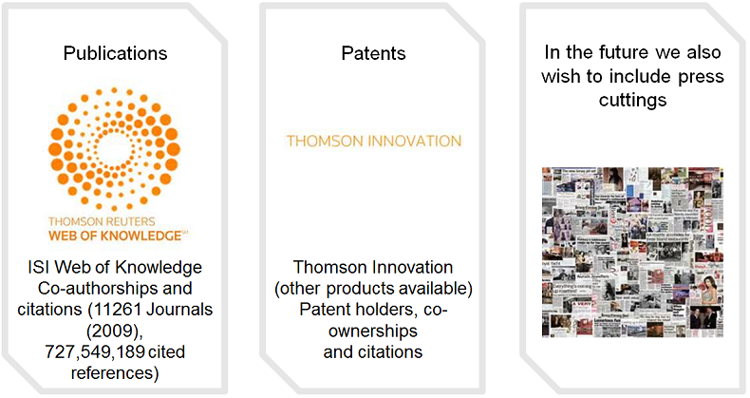
CollSpotting sifts 720m+ Publications: “Who works with Whom?”
In principle, can include any kind of databases where “authorship” can be attributed to different organisations/entities – what else would you like to see here?

Slide 6
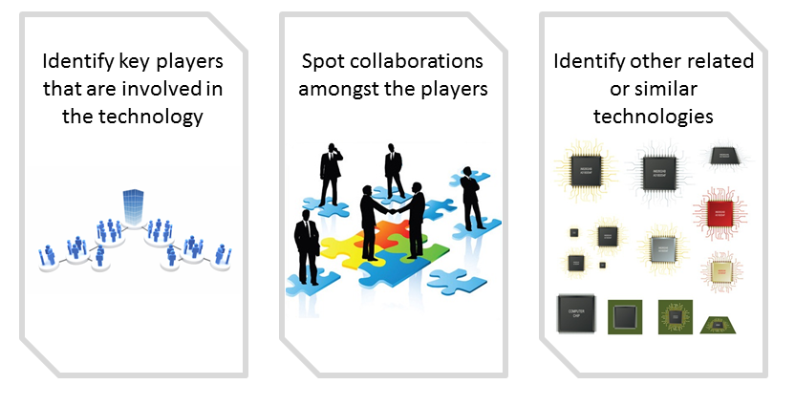
How Collaboration Spotting Works
Data-mining from patent, publication etc. databases (see last slide)
Whose names appear together a lot?
Which keywords appear in the same kinds of clusters?

Slide 7
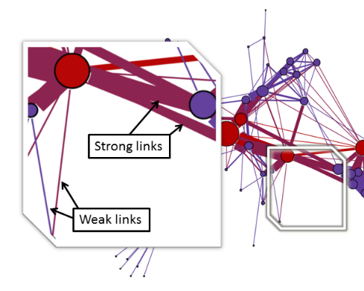
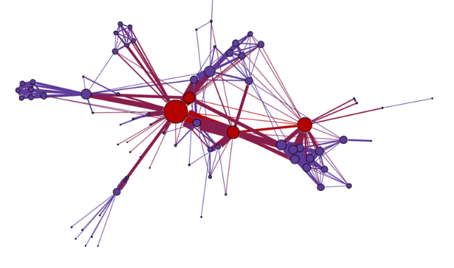
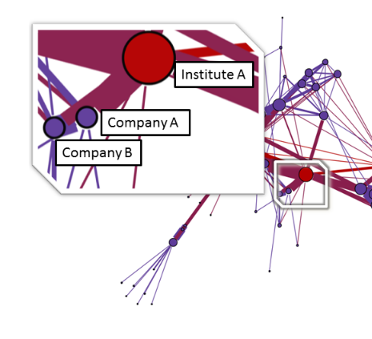
Using Social Network Analysis and Graph Theory to Visualise Complex Relationships Easily
Pretty, huh? ☺
Assign a value to how correlated each two data points (nodes) are, e.g. “how many papers have these two institutes jointly published?”
In a network graph, data points with a large degree of correlation end up clustering together.
Additionally: thicker connections (edges) = stronger correlation, larger dots = more prominent data points.
Can spot key players and relationships at a glance, detect underlying patterns.

Slide 8
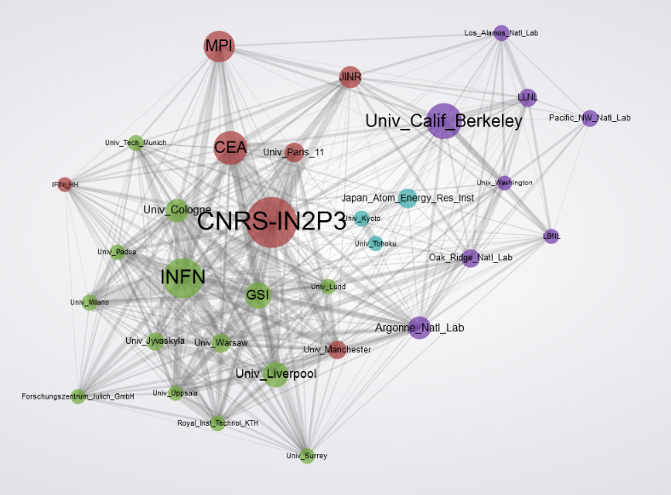
Interactive: Click on a Node to Highlight its Links
Germanium Detectors
(key players)
Germanium
Notes:
http://collspotting.web.cern.ch/sites/collspotting.web.cern.ch/files/HTML/gexf/index.html#germpub+40cen.gexf

Slide 9
What problems can you solve with it?
Identify potential collaborators and competitors.
Identify important economic and research clusters
Who’s patenting in this space? Where is there still room for me to operate?
Assess the strength of your technologies
Look for me-too technologies
Spot technology trends using timeline
What else?

Slide 10
How do people currently spot these connections and trends?
Specialist search engines for patents (Thomson Reuters), publications (ISI WoK), unstructured data (Autonomy)
Attend conferences and workshops
Consultancies to do the leg-work for you
There’s currently no easy way to do this!

Slide 11
Some examples
Researchers: find relevant collaborators
Industry: target less-contested areas for R&D
Lawyers: Patent landscapes
Investors: Spot opportunities and buyers
Basically anyone who wants a rapid, easily digestible summary of who is who in an area of interest and all the hidden links between them.
Notes:
High Tech, e.g. Samsung, IBM carbon nanotubes

Slide 12
Micro Pattern Gaseous detectors: 396 publications
Weizmann Institute

Slide 13
Micro Pattern Gaseous detectors: 111 patents

Slide 14
Micro Pattern Gaseous detectors: 396 publications (Weizmann)

Slide 15
Micro Pattern Gaseous detectors: All publications; Key players (Weizmann in RD-51)
→GEM = Collaboration with IN2P3, CERN; →Micromegas = collaboration with CEA

Slide 16
Micro Pattern Gaseous detectors: All publications; centrality (Weizmann)

Slide 17
Ge detectors 2497 publications → Weizmann

Slide 18
Medipix2 + Timepix (244 pubs)
Partner with NIKHEF, a member of the Medipix (2 & 3) collaborations
Ge detectors Weizmann’s patent

Slide 19
Conclusion
The current incarnation of the software could be used to solve some big problems related to the big data challenge
Possibility to extend the software’s scope to be useful in new settings
And remember, just use it and give feedback in our blog!
http://collspotting.web.cern.ch
Notes:
High Tech, e.g. Samsung, IBM carbon nanotubes

