Slide 1
Developments on power transfer at CERN (DC-DC converters)
Philippe Farthouat
CERN

Slide 2
Typical Power Requirements in ATLAS
A substantial amount of electronics on the detector requiring power
  ATLAS inner tracker 53 kW 16 kA
  ATLAS calorimeters 184 kW 38 kA
  ATLAS muon spectrometer 107 kW 29 kA
Simple direct powering would require too many and too heavy cables
In the experimental cavern we have got
  Radiation Mrads in the inner tracker
  10’s krads in the other places
  Magnetic field 2 Teslas in the inner tracker
  up to 1 kGauss for the rest
→ Requires DC-DC converters and special designs

Slide 3
Generic Power Distribution
Control Room
No radiation
No magnetic field
Experimental Cavern
Radiation
Magnetic field
Voltage
Regulators
DC/DC
6 – 12 V
1.2 – 5 V
AC/DC
DC
48 – 400 V
Main input
220 V 50 Hz
DC
48 – 400 V
POL
DC/DC
DC/DC
6 – 12 V
1.2 – 5 V

Slide 4
R&D Needs and Activities
Control Room
No radiation
No magnetic field
Experimental Cavern
Radiation
Magnetic field
Voltage
Regulators
DC/DC
6 – 12 V
1.2 – 5 V
AC/DC
DC
48 – 400 V
Main input
220 V 50 Hz
DC
48 – 400 V
POL
DC/DC
DC/DC
6 – 12 V
1.2 – 5 V

Slide 5
DC-DC Converters for moderate radiation and magnetic fields
We currently have several types of such devices either from commercial companies or designed and built in some participating institutes
Input voltage is in the range 48 V – 400 V
Output voltage in the range 5 V – 12 V / up to 40 A
Magnetic field up to 1.2 kGauss
Radiation level
  TID: 140 Gy
  NIEL: 10¹² 1MeV neutrons.cm⁻²
  Hadrons capable of causing SEE: 10¹¹ hadrons.cm⁻²

Slide 6
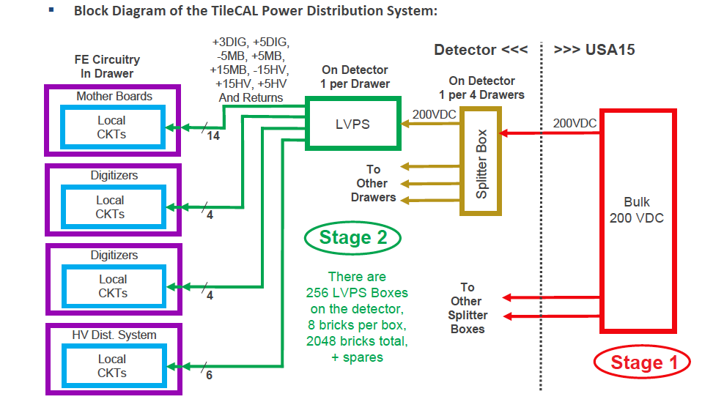
Example of development (1)

Slide 7
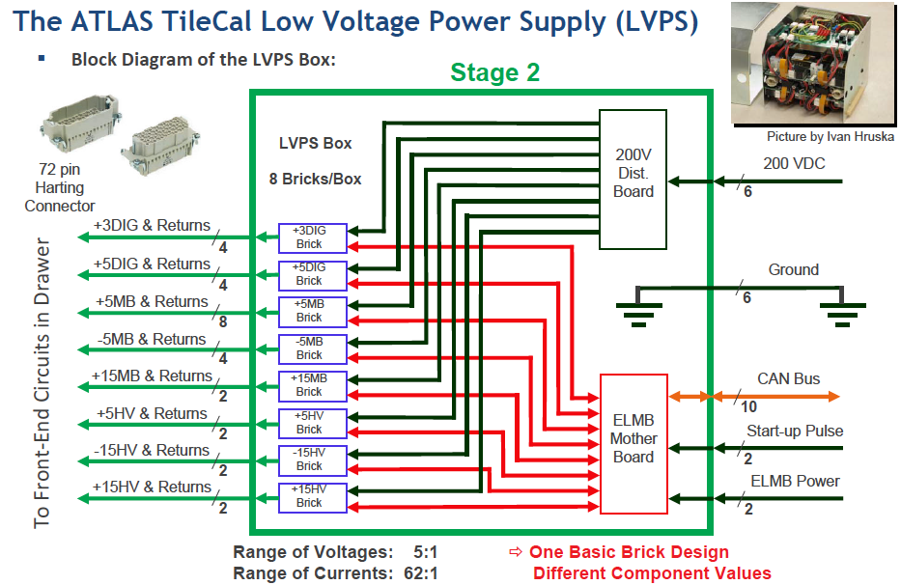
Example of development (2)

Slide 8
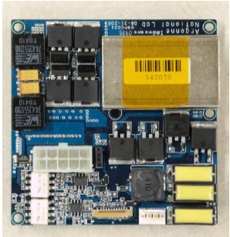
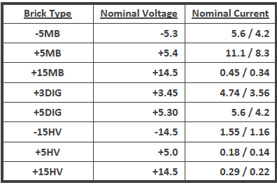
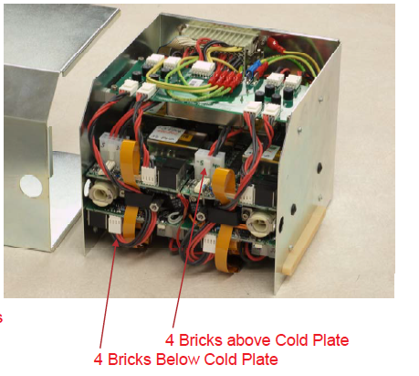
Example of development (3)
~2500 “bricks”
~256 multichannel DC-DC

Slide 9
Future Developments in this Field
For the upgrade of the LHC we plan similar developments to be done
  With higher level of radiation
    TID: 600 Gy
    NIEL: 5 10¹² 1MeV neutrons.cm⁻²
    Hadrons capable of causing SEE: 5 10¹¹ hadrons.cm⁻²
  Probably less different voltages
Our past experience has proven that such a development can be long because of the qualification of components against radiation

Slide 10
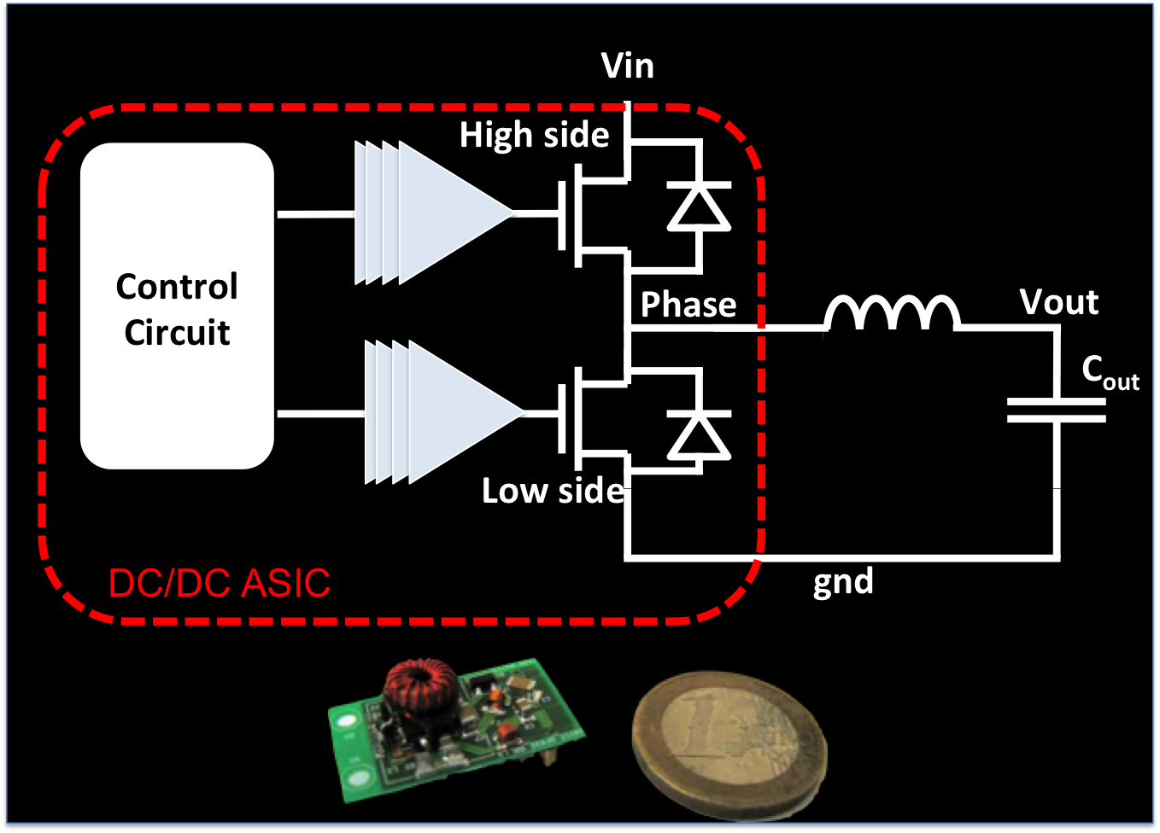
On-going Development: Point Of Load DC-DC
In view of the upgrade of the LHC we are looking for a POL DC-DC converter to be installed in the tracker region
  2 – 4 Tesla magnetic field
  ~1 MGy and 10¹⁵ 1MeV neutrons.cm⁻²
Reduce the input current by a factor ~5 to reduce the material budget
Specifications
  Vin ≤ 10 V
  Vout = 1.2 – 3.3 V
  Iout ≤ 3 A
  Frequency = 1 – 3 MHz
  Air-core inductor
Courtesy
Stefano Michelis

Slide 11
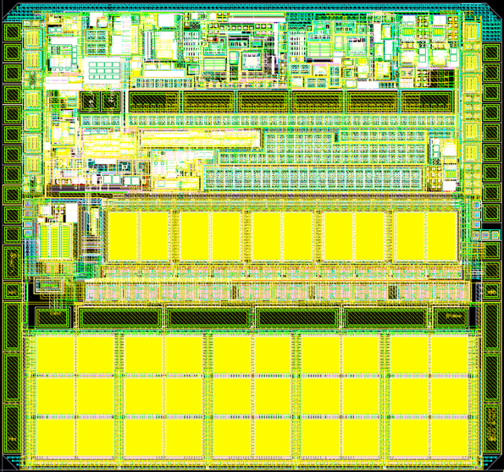
ASIC Development
AMIS5 is designed in a High Voltage 0.35um technology for automotive application.
This technology has been successfully tested for TID, protons and heavy ions.
2.7 mm
Courtesy Stefano Michelis
2.88 mm

Slide 12
AMIS5 Efficiency
Courtesy Stefano Michelis

Slide 13
TID Tests
Courtesy Stefano Michelis

Slide 14
Future Plans
Immediate future (within 2 years)
  Test foreseen for AMIS5
    Single Event and Displacement damage tests (fall 2012)
    Tests on AMIS5 packaged in QFN32
  AMIS5_BB Bump Bonded version
    tests and characterization
  Production of about 10,000 fully assembled converters
Next
  Similar design for higher radiation level
    Requires a change in technology
  Lower overall mass of the converter

Slide 15
Summary
We will have to develop two main types of converters
  Relatively high power to be used in the outer parts of the detector with moderate radiation and magnetic fields
  POL low power to be used also in places with very high radiation and magnetic fields
The first type could be fully industrial
  We could/would help for the radiation hardness qualification
The second type is to be based on a custom radiation hard ASIC and an air-core inductor
  Production of 10,000’s modules needed

Slide 16
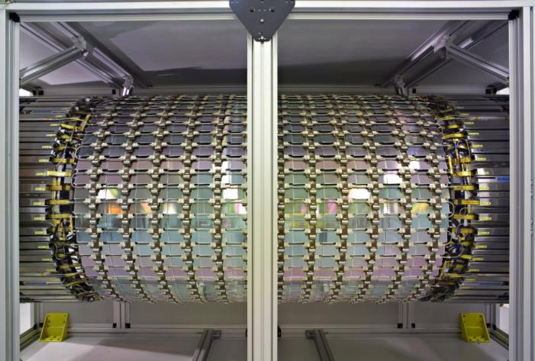
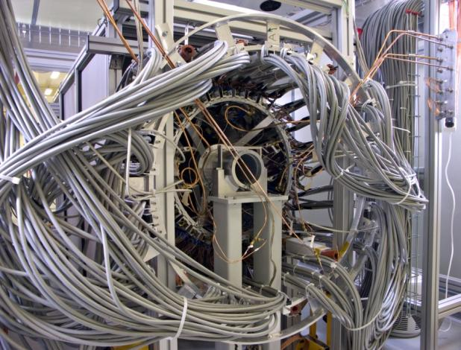
Current ATLAS Silicon Tracker
The beauty
The beast
Courtesy Allan Clark

