Slide 1
General needs at CERN for special PCB’s
Philippe Farthouat
CERN

Slide 2
Outline
High density and low mass PCB’s for tracker front-end
  Rigid, flex and flex rigid
Multilayer PCB’s for high speed applications
Large size rigid and flex PCB’s for Micro-Pattern Gas Detectors (MPGD)

Slide 3
Outline
High density and low mass PCB’s for tracker front-end
  Rigid, flex and flex rigid
Multilayer PCB’s for high speed applications
Large size rigid and flex PCB’s for Micro-Pattern Gas Detectors (MPGD)

Slide 4
High Density PCB’s for tracker front-end
Rigid or flex or flex-rigid
Chip-on-board
  Small pitch
  Wire bonding or flip chip
Low mass
  Aluminum on polyamide for data and power transmission
→ Next slides with examples of existing designs

Slide 5
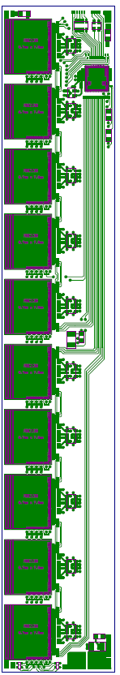
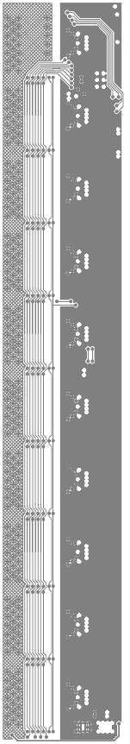

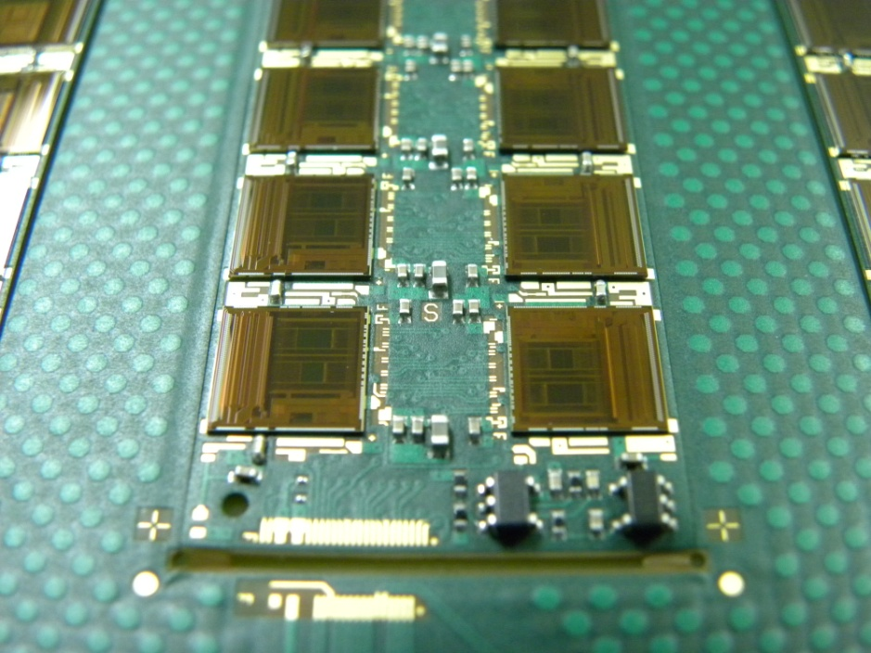
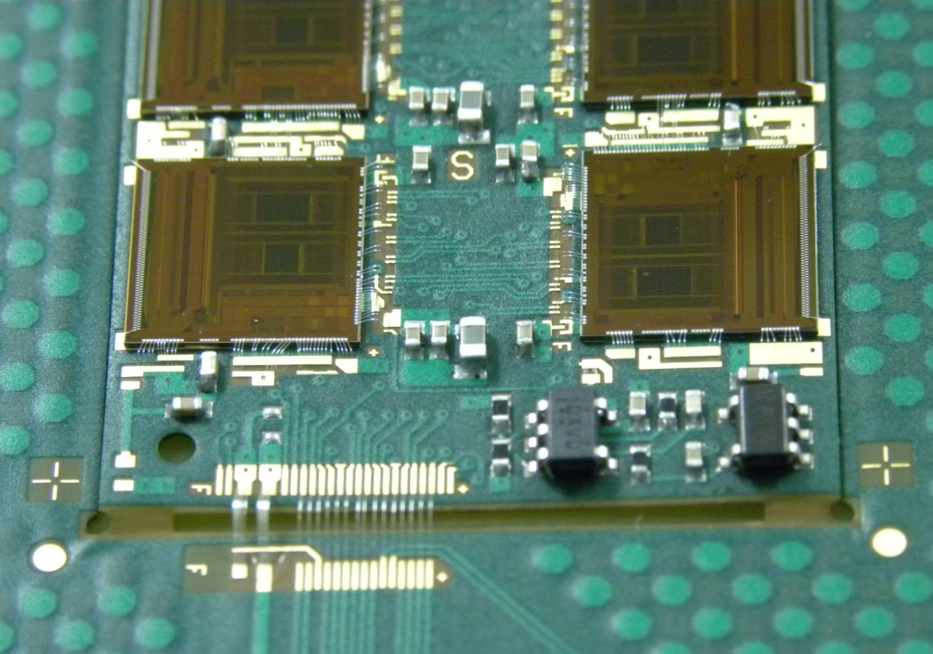
Hybrids for LHC Tracker
ATLAS Upgrade
Layer 1
Layer 2
Layer 3
3 layer Kapton flex
Thin build using 50µm Kapton dielectrics with 18µm Cu
Typically ≥100µm track & gap with 150µm drilled blind vias
~18,000 pieces needed
97.54 mm
VDD
GND
16.5 mm
Existing Prototype
In development
Courtesy Ashley Greenall

Slide 6
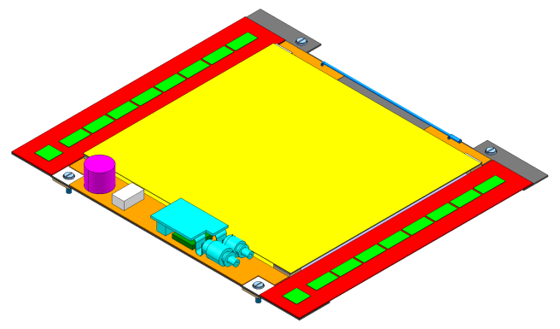
Hybrids for LHC Tracker
CMS Upgrade (1)
Flex foil provides pads only on top layer: can’t bond to the bottom side.
Bond pads reinforcement on the base of the flex, under the bond pads.
Folding the flex in the slot window of the frame.
HYBRID
2x1016 STRIPS
CBC
HYBRID
CBC
COOLING & SUPPORTING STRUCTURE
2x1016 STRIPS
Flex substrate implementation
Courtesy François Vasey

Slide 7
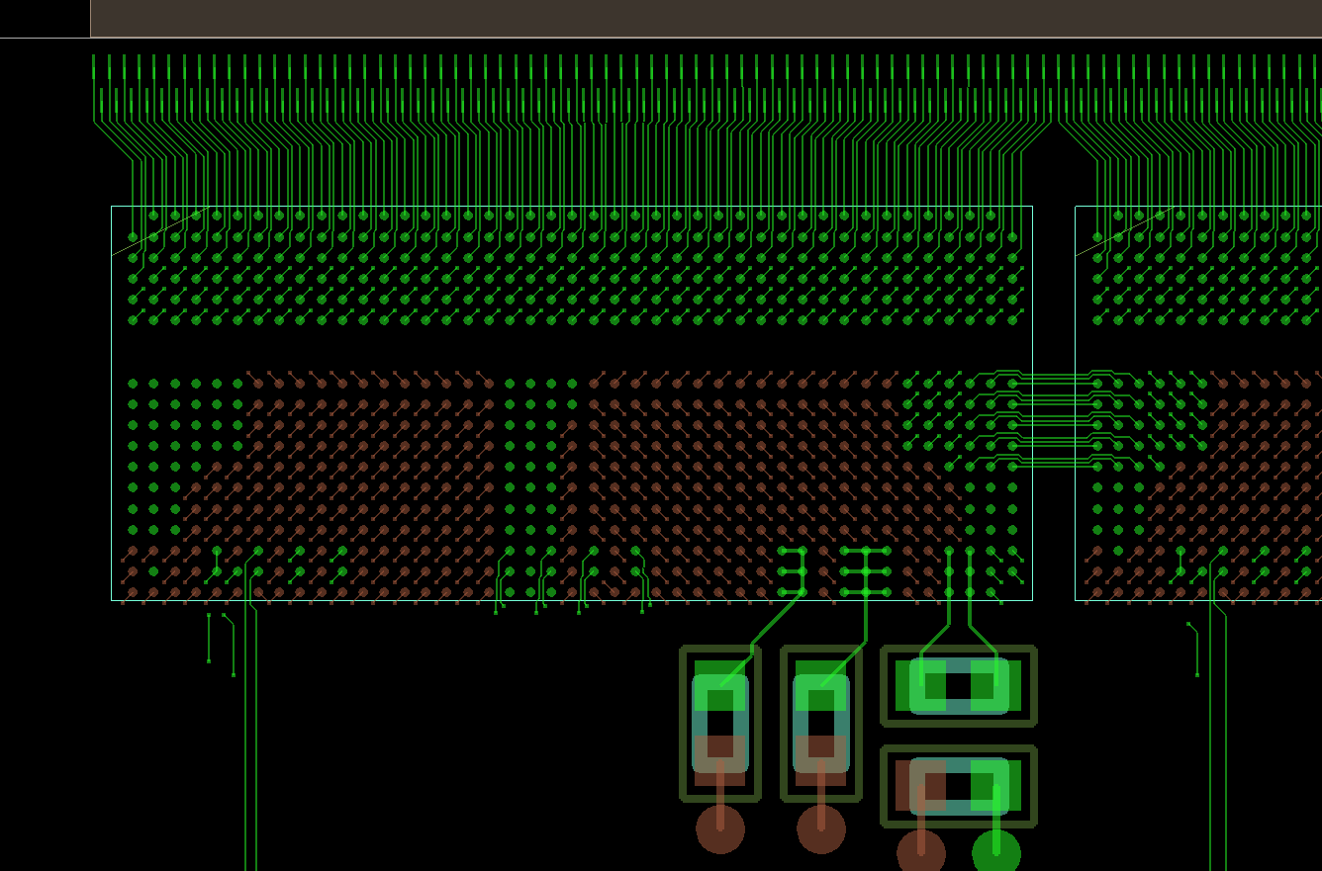
Hybrids for LHC Tracker
CMS Upgrade (2)
Flip chip
  Pitch 250 µm
  Bump size 146 µm
25 µm width/spacing
50 µm microvias
~20,000 needed
Top Sensor Inputs
Constrained Area:
Baseline = 25 um width/spacing.
on TOP and BOT build up layers. Constrained track length < 20 mm.
Microvias = 50 um drill on 100 um pad.
Courtesy François Vasey

Slide 8
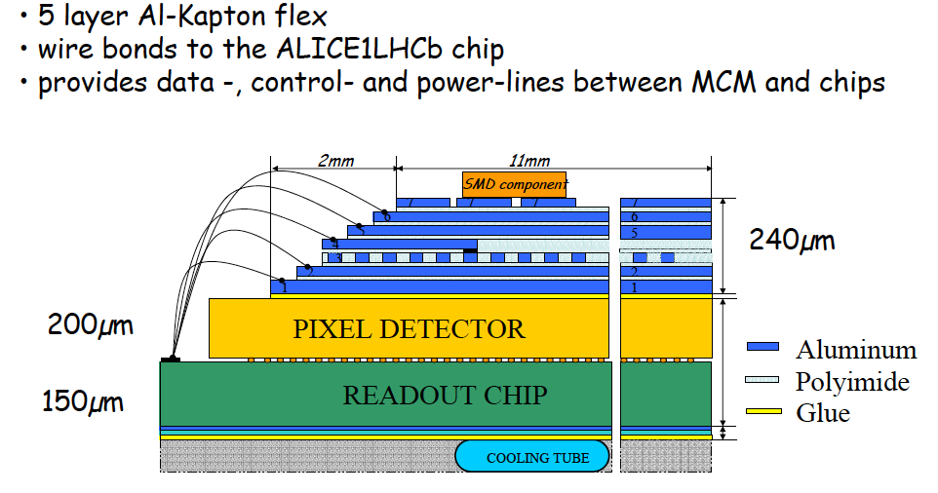
Low Mass Circuits
ALICE Pixel Bus (1)
Courtesy Petra Riedler

Slide 9
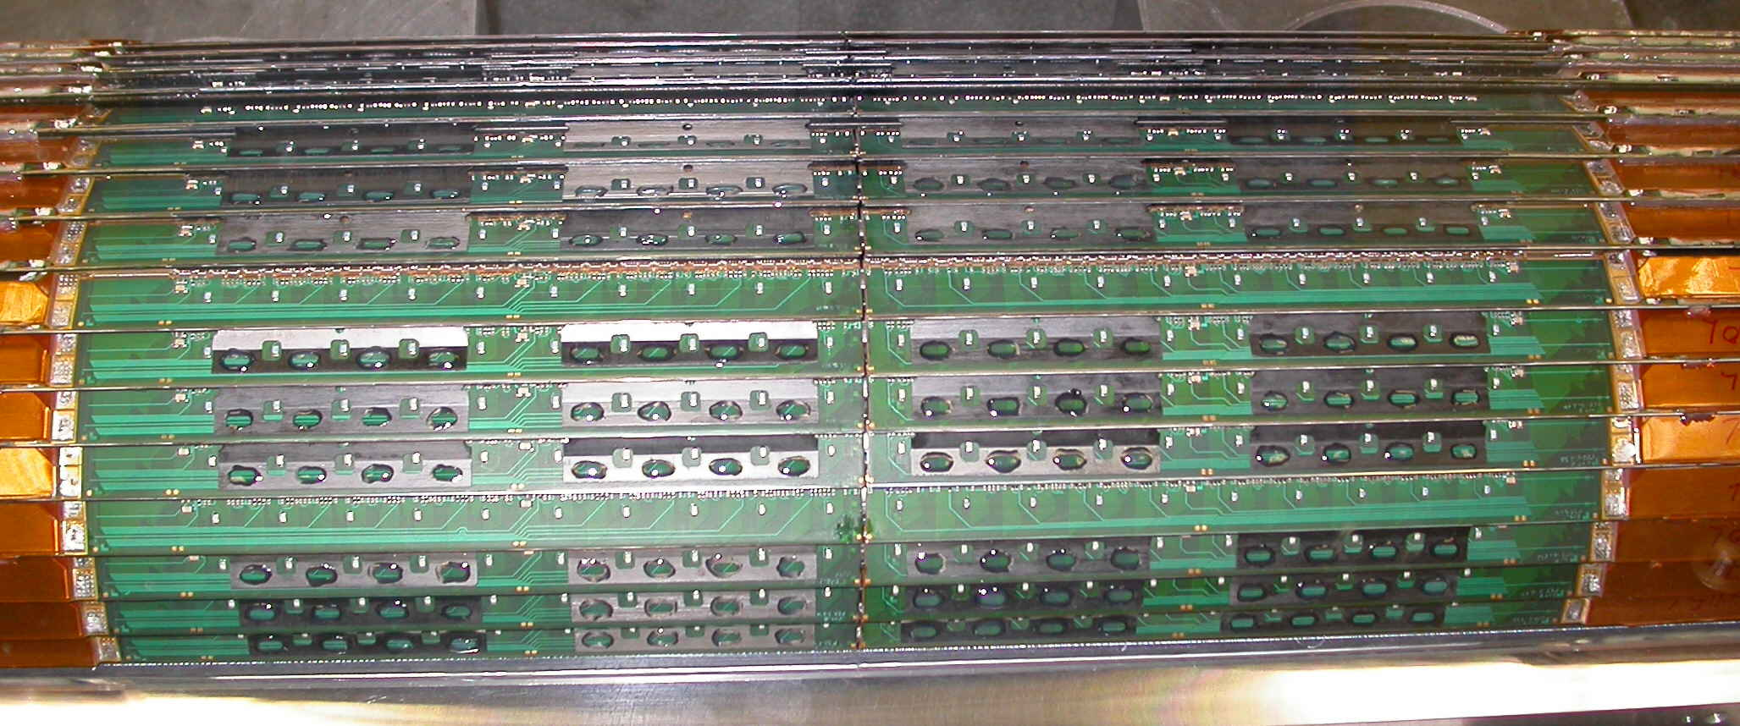
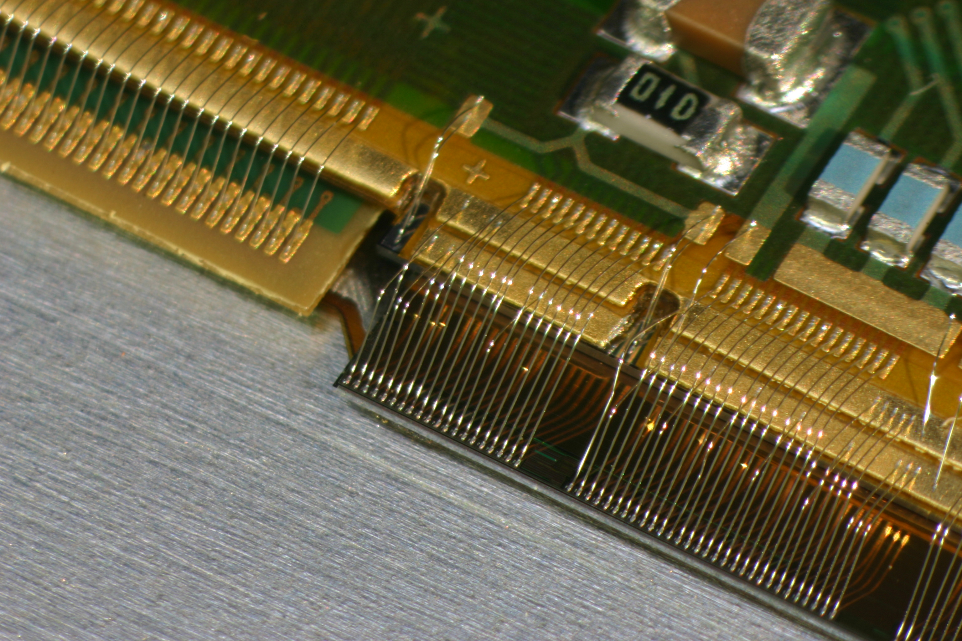
Low Mass Circuits
ALICE Pixel Bus (2)
Courtesy Michel Morel
About 20 cm long (1/2 stave)
120 pieces built
Similar circuits to be designed and built for the ALICE upgrade
  To be installed in 2018

Slide 10
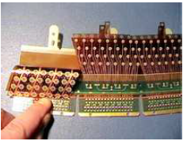
Special Flex-Rigid PCB’s
High voltage distribution and signal capture
  Contact done by the petals
Chemical etching of the Kapton
Blind vias for HV
Installed in ATLAS
  2500 pieces produced

Slide 11
Outline
High density and low mass PCB’s for tracker front-end
  Rigid, flex and flex rigid
Multilayer PCB’s for high speed applications
Large size rigid and flex PCB’s for Micro-Pattern Gas Detectors (MPGD)

Slide 12
Multilayer PCB’s for High Speed Applications
Much more standard PCB
Size from 10 * 10 to 400 * 400 mm²
Up to 20 layers
More and more high speed links (several Gbps)
  Controlled impedances needed
Low loss material very desirable
No statistic about number of PCB ordered/produced per year
  300 – 350 layout jobs done per year

Slide 13
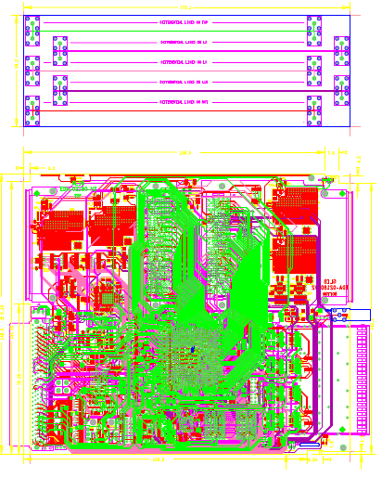
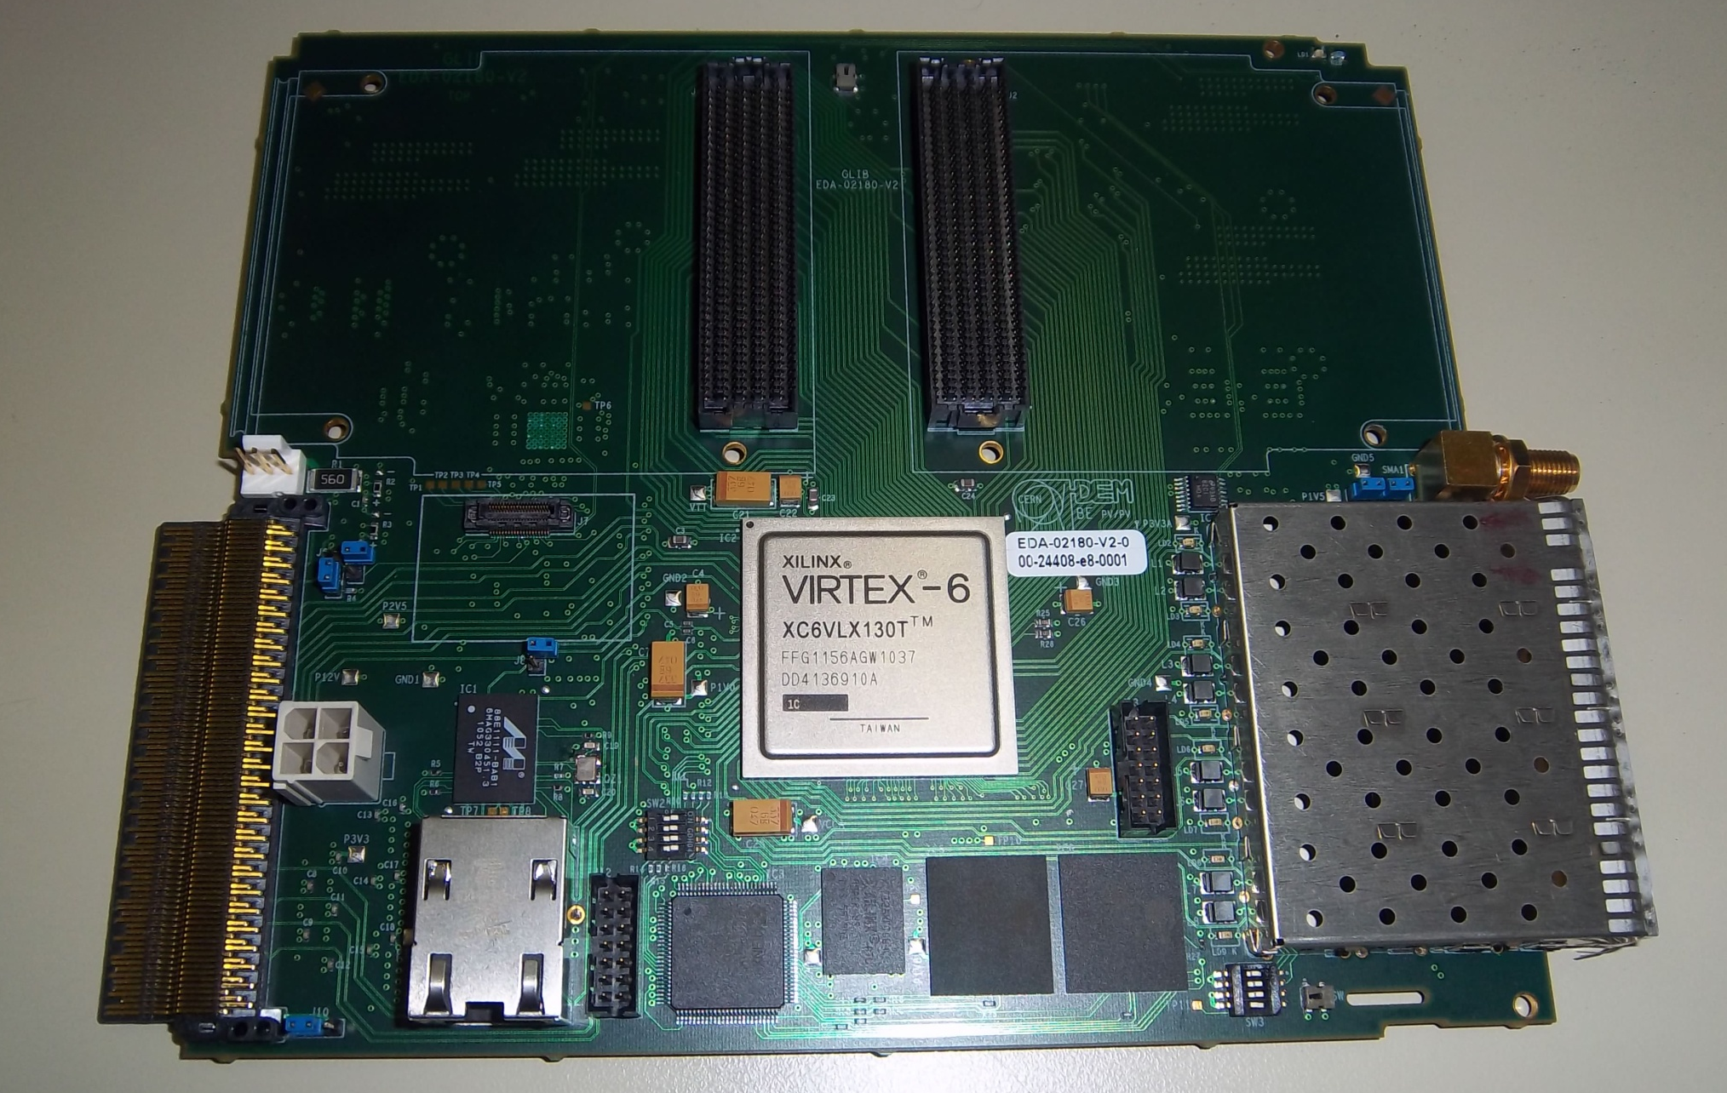
Multilayer PCB’s for High Speed Applications
Courtesy Paschalis Vichoudis
Quad 5 Gbps bidirectional links
PCI-e links

Slide 14
Outline
High density and low mass PCB’s for tracker front-end
  Rigid, flex and flex rigid
Multilayer PCB’s for high speed applications
Large size rigid and flex PCB’s for Micro-Pattern Gas Detectors (MPGD)

Slide 15
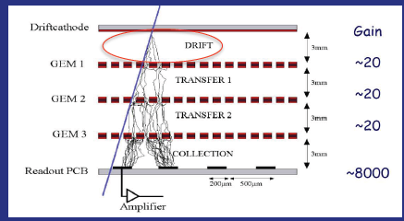
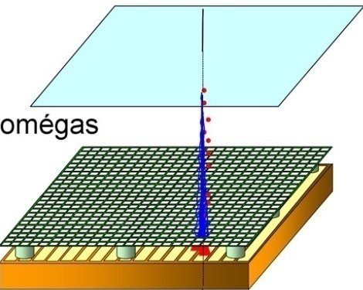
Micro-Pattern Gas Detectors
Two types of detectors
Both use PCB manufacturing techniques
For both types we are interested in large sizes
  1 * 2 m² or more
-800 V
Conversion & drift space
-550 V
(few mm)
Mesh
Amplification
Gap 128 µm
GEM
µMEGAS

Slide 16
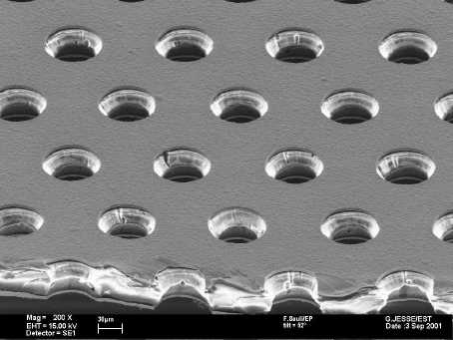
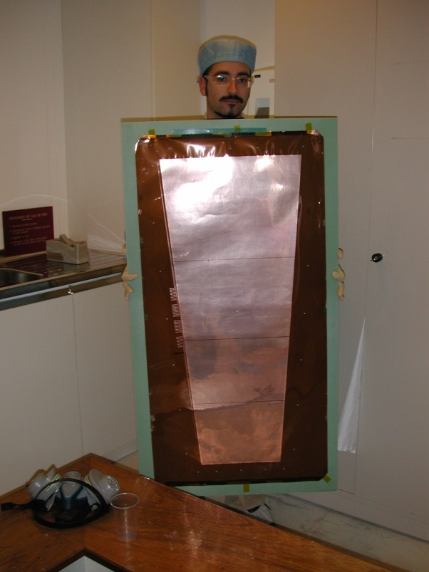
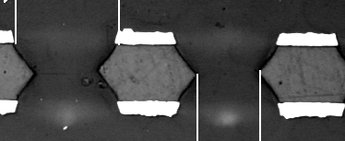
GEM Foils
Size
  Currently 1.2 * 0.6 m²
  Wishing 2 * 0.6 m²
Thickness
  50 µm
Holes
  70 µm diameter
  140 µm pitch

Slide 17
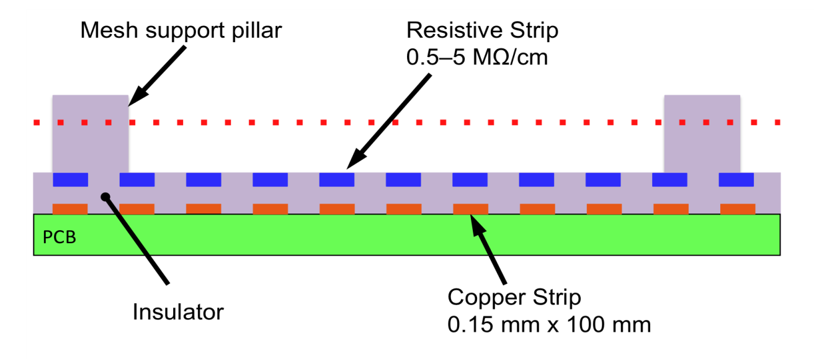
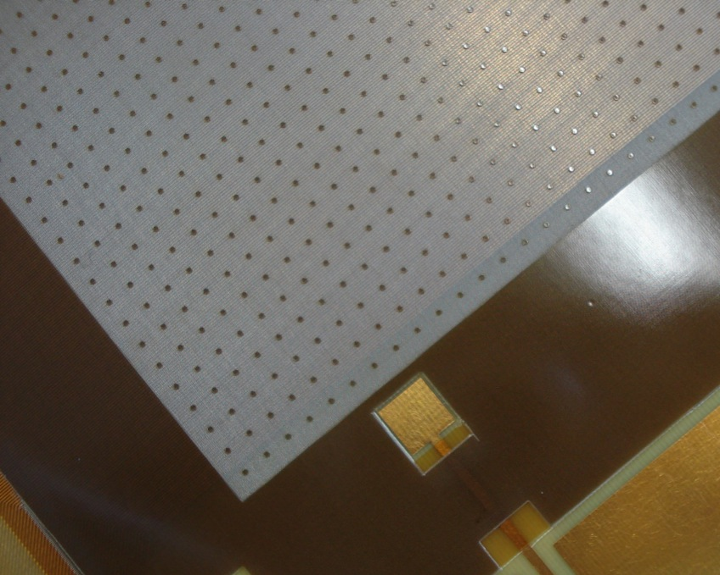
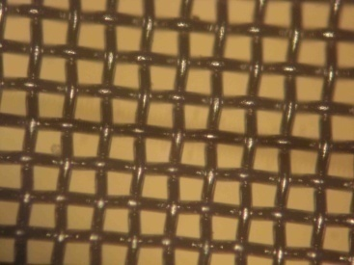
µMEGAS (1)
Standard configuration
Pillars every 5 (or 10) mm
Pillar diameter ≈350 µm
Mesh: 325 lines/inch
Pillar distance on photo: 2.5 mm

Slide 18
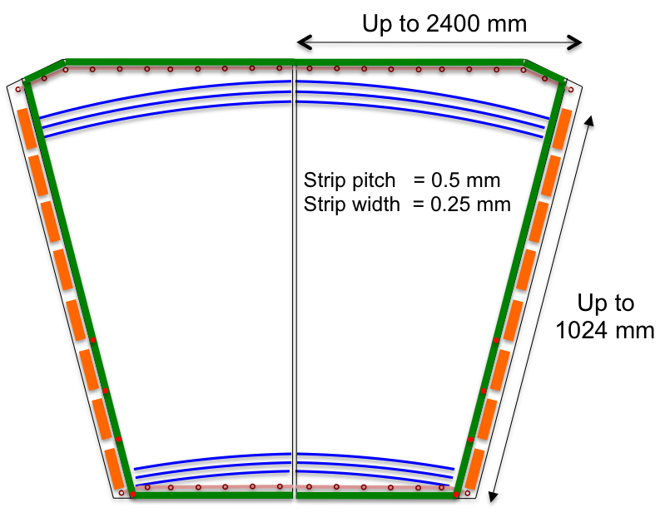
µMEGAS (2)
Single sided PCB with strips
2 * 1 m²
Position of the strips
  Absolute precision of 30 µm

Slide 19
Summary
Low mass, fine pitch PCB for tracker
  Flex and rigid
  Aluminum
“Standard” PCB for high speed application
  Controlled impedances
  Low loss material welcome
Large size PCB and flex for the MPGC

