Slide 1



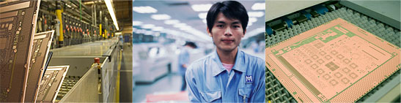
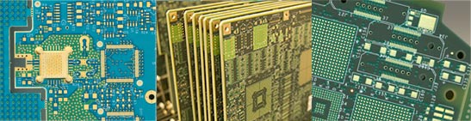
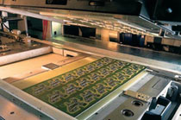
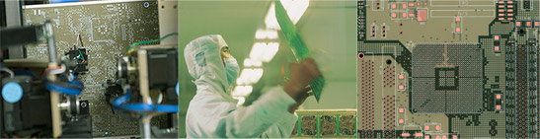

Your PCB partner

Slide 2
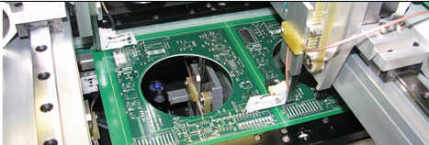
Established year : 1982
Employees: approximately 100 people
Production area : 3000 Sqr meter
Company Type : Private owned

Slide 3




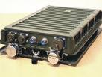

Products by sector
Telecommunication
Automotive
Medical
Information Technologies
Science
Security products
Consumer products
Industrial Automation
Military & Defense

Slide 4




Our Standards
ISO 9001-2008
UL 94V-0
IPC 600H,6011,6012.6013
ROHS-Compliant

Slide 5
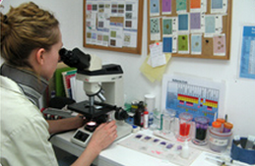
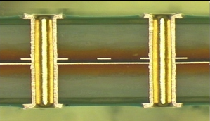
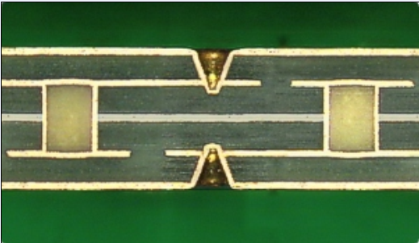
Quality
Print Electronics quality system is based on and conforms to the Requirements of ISO 9001. Regular audits are performed
by the Israeli Institute of standards.
Production is according to IPC-A-600 Acceptability of Printed Boards with class 2-3
Company policy:
customers are welcome to consult with our quality assurance staff both at the design review stage and after production.

Slide 6
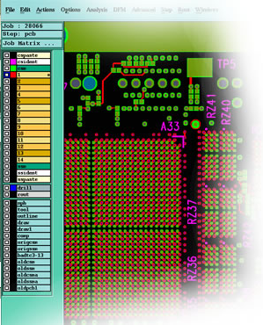
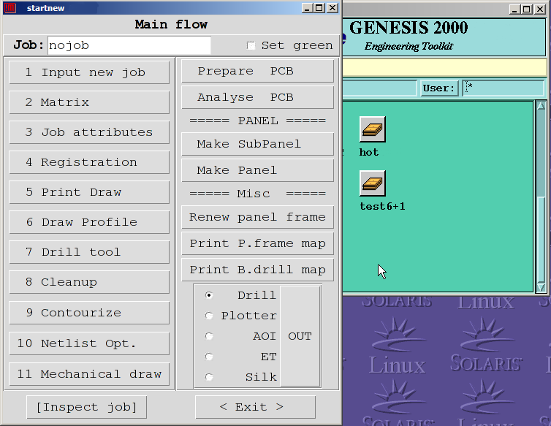

Engineering
Print electronics has computerized engineering system, enabling data processing, design-criteria evaluation and fabrication of manufacturing tools
Net list is checked against Gerber files using IPC-356.

Slide 7
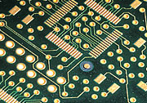
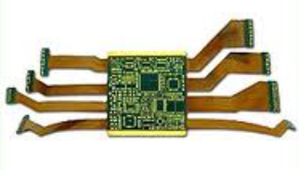
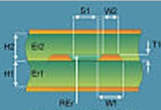
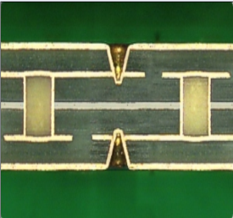
Products
Standard rigid boards
Double-sided boards & Multilayer up to 20 layers.
Flexible and rigid-flex boards.
Controlled impedance circuits.
Blind and buried via hole
HDI including Blind and buried VIAS
Heat sink- nickel plated copper
or aluminum (3D heat sink)
Other products

Slide 8

Base Material:
FR-4 High TG
ROHS/ Lead-Free compatible FR-4
Polyimide Glass
Teflon ™
High speed materials : Rogers, Arlon, Taconic
Kapton - Polyimide
Other

Slide 9
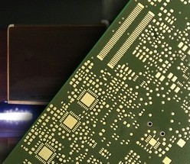
Surface Finish
Electroless nickel/immersion gold (ENIG)
Electrolytic Ni / Hard Au
Immersion Silver
HASL
HASL for Lead free application
Immersion Tin
OSP - Entek-106 +
Electrolytic Ni / Soft Au
Carbon Printing
Via holes- capping

Slide 10
Design Feature STANDARD
BOARD THICKNESS: 8~126 mil (0.2~6.0mm)
Copper foil :0.5oz, 1oz, 2oz, 3oz
working panel size: 500X600mm(STD), 1200x2300mm.
Line width/space : 4/4 mil for internal and external layers. (3/3 mil)
Minimum Drill size (Finish): 0.15 mm. (0.1 mm)
Hole location tolerance : 15 µ.
Routing tolerance: +/- 0.2mm. (+/- 0.1mm)
Final thickness tolerance: +/- 5%
Aspect ratio (hole-to-thickness) up to 1:12

Slide 11
ELECTRICAL TESTING
Net list electrical testing is performed as standard test
The testing is performed using:
Emma- Test double sided flying probe tester- 4 Machines.
Test voltage up to 250v.

Slide 12
Final Inspection
Full visual check
  Full dimension check
  Electrical test
  Solder-ability test
  Micro section

Slide 13
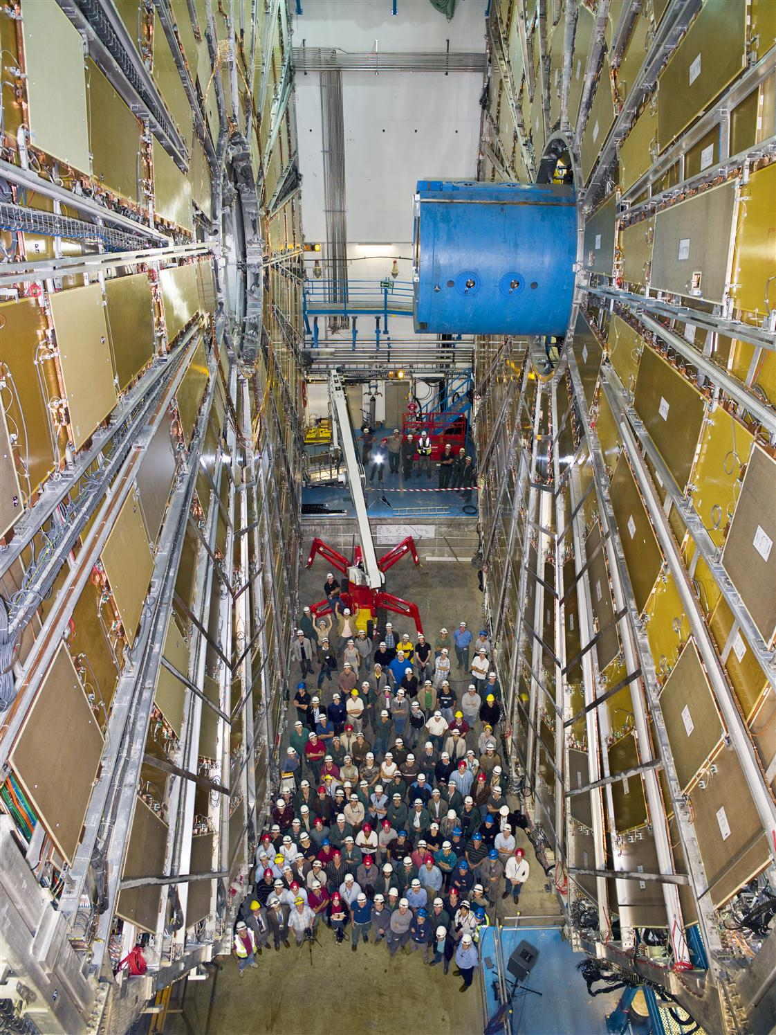
Products: Science
CERN-ATLAS 2009
Thin-Gap Wire Chambers (TGC) of Weizmann Inst.
PCB-cathodes made by Print electronics

Slide 14
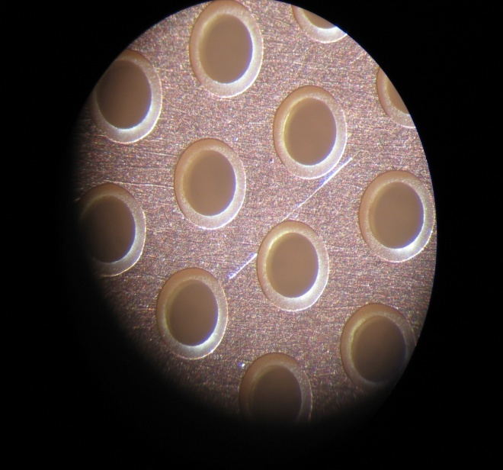


THGEM!
Producer:
Print Electronics

Slide 15
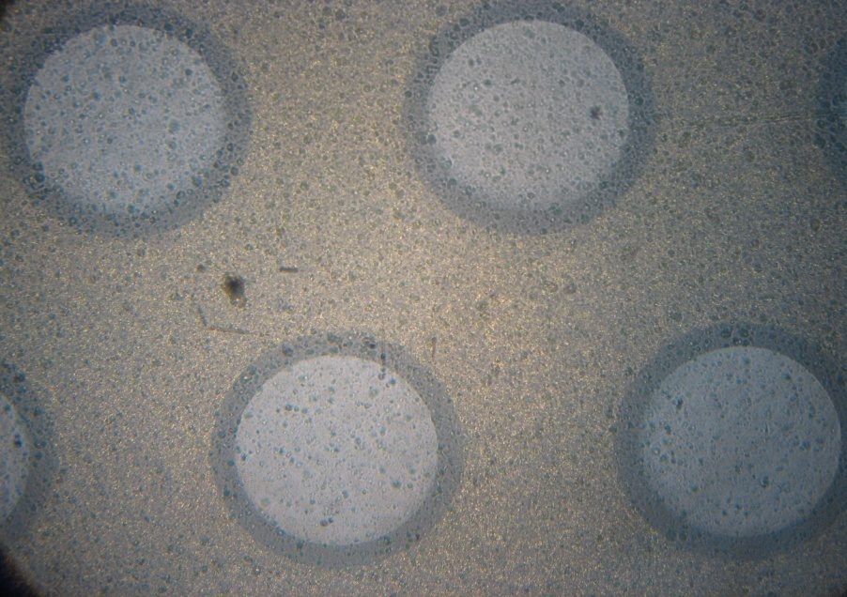
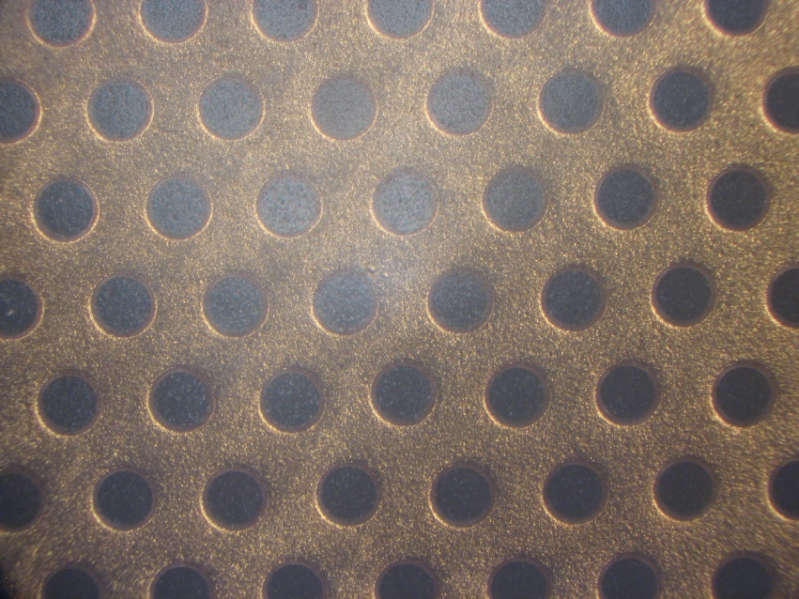
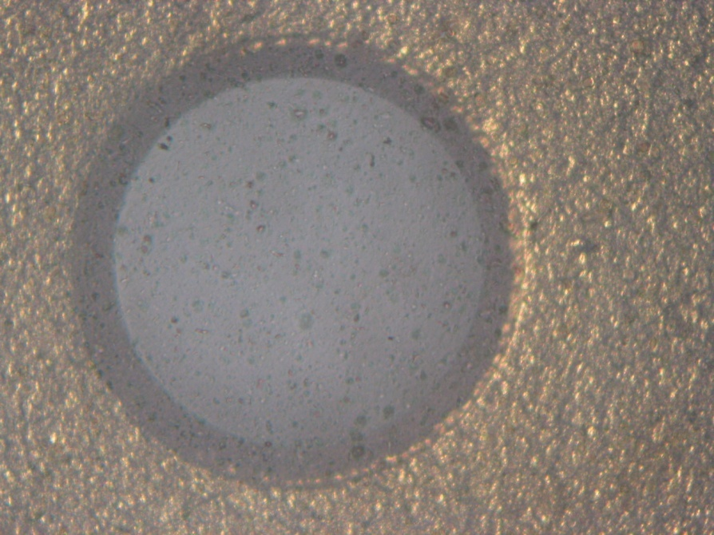
300x300 THGEM
THGEM geometry:
Hole dia.: 0.5 mm
Pitch: 1 mm
Thickness: 0.4 mm
Rim: 0.05 mm
Ni/Au plating
Producer:
Print Electronics www.print-e.co.il

Slide 16
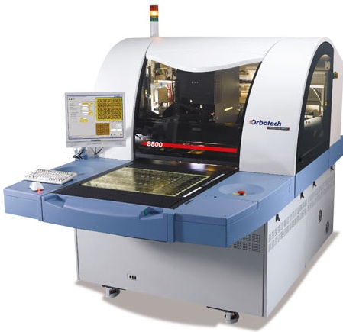
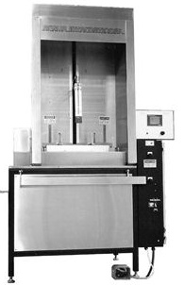
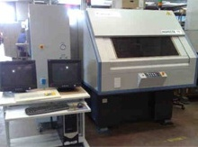
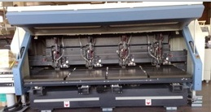
Some of our machines & equipment
AOI
Hot air leveling
CNC ROUTING
Inspecta

Slide 17
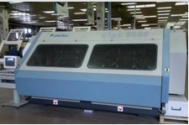
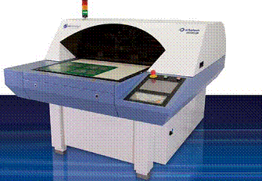
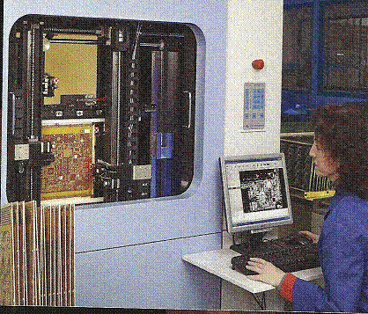
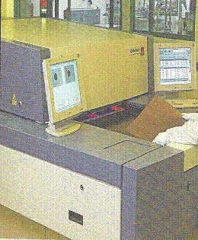
Some of our machines & equipment
CNC Drilling
Silk Printer
E-T
DI

Slide 18
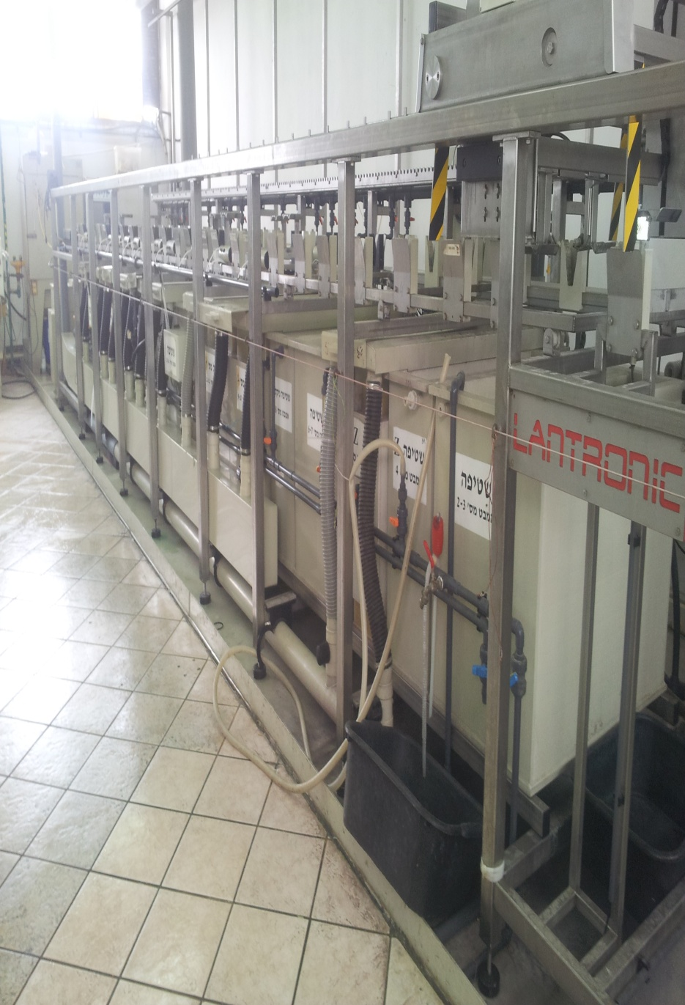
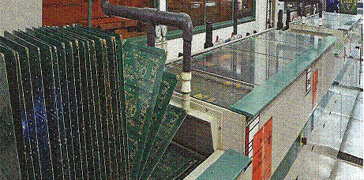

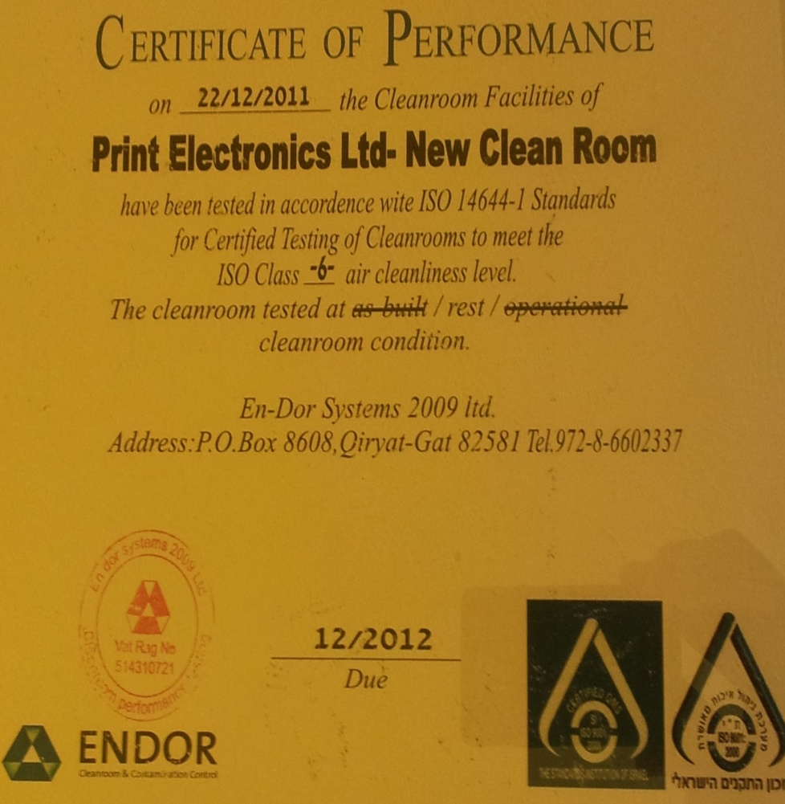
Some of our machines & equipment
Immersion Silver
Enig
Polar stack up & Impedance

Slide 19
Product By layer Count
Products by no’ of layers

Slide 20
Sales by Region
Sales Region

Slide 21


















Some of our Main Customers
Notes:
21

Slide 22

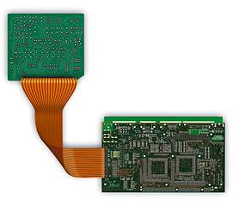
Address:
3 Eitan St. New Ind zone, Rishon Le-Zion 75650
ISRAEL
Tel: +972-3-9611168
Fax: 972-3-9612232
www.print-e.co.il
info@print-e.co.il

